Slide 1
Computer and Robot Vision I
Chapter 8
The Facet Model
Presented by: 蕭延儒
luis862013@gmail.com
指導教授: 傅楸善 博士
Notes:
facet: 小平面 -> 小面模型
如同在講傅立葉轉換(或線性代數、jpeg 壓縮等)的時候應該會提到的 wavelet 小波轉換
(fast)

Slide 2
Final exam
About Final exam, please review 8.2 and 8.3.
Wish you a happy new year ☺.
Notes:
8.1 用local給的資訊推一個最逼近原圖的數學model(算式 函數 之類的東西)出來
8.2 介紹小平面模型定義一維觀測序列相對極大值的原理應用
8.3 複習對斜的小平面參數預估
8.4 對傾斜的小平面模型雜訊的移除處理
8.5 介紹小平面模型可以用來將亮度灰階影像表面分區域
8.6 介紹使用古典梯度邊界偵測應用
8.7 討論使用貝式法去決定觀測的梯度強度統計
8.8討論zero crossing 在二階導數的邊界偵測
8.9討論集成方向導數梯度
8.10 討論小平面方法去做corner detection
8.11討論了使用小平面的方法來計算高階各向同性微分大小
8.12討論山脊和溝壑
8.13提出了每個像素的各種地形類別的標籤轉化

Slide 3
8.0 Outline
8.1 Introduction
8.2 Relative Maxima
8.3 Sloped Facet Parameter and Error Estimation
8.4 Facet-Based Peak Noise Removal
8.5 Iterated Facet Model
8.6 Gradient-Based Facet Edge Detection
8.7 Bayesian Approach to Gradient Edge Detection
8.8 Zero-Crossing Edge Detector
8.9 Integrated Directional Derivative Gradient Operator
8.10 Corner Detection
8.11 Isotropic Derivative Magnitudes
8.12 Ridges and Ravines on Digital Images
8.13 Topographic Primal Sketch
Notes:
8.1 用local給的資訊推一個最逼近原圖的數學model(算式 函數 之類的東西)出來
8.2 介紹小平面模型定義一維觀測序列相對極大值的原理應用
8.3 複習對斜的小平面參數預估
8.4 對傾斜的小平面模型雜訊的移除處理
8.5 介紹小平面模型可以用來將亮度灰階影像表面分區域
8.6 介紹使用古典梯度邊界偵測應用
8.7 討論使用貝式法去決定觀測的梯度強度統計
8.8討論zero crossing 在二階導數的邊界偵測
8.9討論集成方向導數梯度
8.10 討論小平面方法去做corner detection
8.11討論了使用小平面的方法來計算高階各向同性微分大小
8.12討論山脊和溝壑
8.13提出了每個像素的各種地形類別的標籤轉化

Slide 4
Outline
8.1 Introduction
8.2 Relative Maxima
8.3 Sloped Facet Parameter and Error Estimation
8.4 Facet-Based Peak Noise Removal
8.5 Iterated Facet Model
8.6 Gradient-Based Facet Edge Detection
8.7 Bayesian Approach to Gradient Edge Detection
8.8 Zero-Crossing Edge Detector
8.9 Integrated Directional Derivative Gradient Operator
8.10 Corner Detection
8.11 Isotropic Derivative Magnitudes
8.12 Ridges and Ravines on Digital Images
8.13 Topographic Primal Sketch

Slide 5
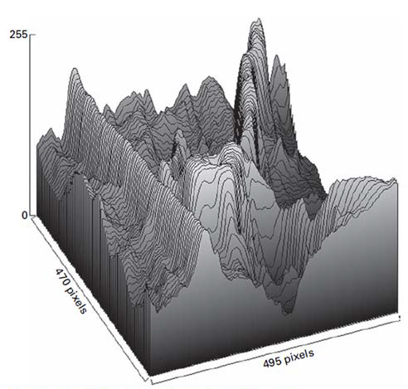
8.1 Introduction
The facet model principle states that the image can be thought of as an underlying continuum or piecewise continuous gray level intensity surface.
observed digital image: noisy discretized sampling of distorted version of this surface

Slide 6
8.1 Introduction
To actually carry out the processing with the observed digital image requires a model describes what the general form of the surface would be in the neighborhood of any pixel.
https://all3dp.com/what-is-stl-file-format-extension-3d-printing/
Notes:
引用: https://all3dp.com/what-is-stl-file-format-extension-3d-printing/

Slide 7
8.1 Introduction
Example: Imagine an image (size=1*N)
https://all3dp.com/what-is-stl-file-format-extension-3d-printing/
Notes:
以一維數列作為舉例。(可以把它想像成一張數位影像中的一個row。)

Slide 8
8.1 Introduction
Example:
https://all3dp.com/what-is-stl-file-format-extension-3d-printing/
Notes:
鎖定一個pixel和周邊。

Slide 9
8.1 Introduction
Example:
https://all3dp.com/what-is-stl-file-format-extension-3d-printing/
Notes:
模擬出一條曲線。

Slide 10
8.1 Introduction
Example:
https://all3dp.com/what-is-stl-file-format-extension-3d-printing/
Notes:
鎖定不同pixel會產生不同的曲線。

Slide 11
8.1 Introduction
There are many kinds of facet model 1. piecewise constant (flat facet model)
2. piecewise linear (sloped facet model)
3. piecewise quadratic
4. piecewise cubic
Notes:
一般式：一些數學方程式
分段常數（平的小平面模型）理想區間：常數灰階值
分段線性（斜的小平面模型）理想區間：斜的平面灰階值
分段二次方程式（灰階表面）理想區間：二元二次方程式 (圓形等)
分段三次方程式，灰階表面 理想區間：立方表面

Slide 12
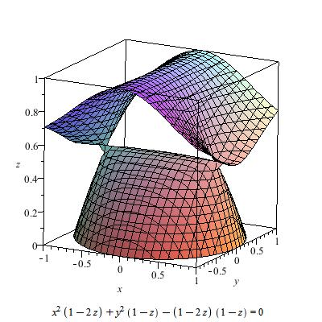
8.1 Introduction
Cubic surfaces
https://en.wikipedia.org/wiki/Cubic_surface
Notes:
https://en.wikipedia.org/wiki/Cubic_surface

Slide 13
Outline
8.1 Introduction
8.2 Relative Maxima
8.3 Sloped Facet Parameter and Error Estimation
8.4 Facet-Based Peak Noise Removal
8.5 Iterated Facet Model
8.6 Gradient-Based Facet Edge Detection
8.7 Bayesian Approach to Gradient Edge Detection
8.8 Zero-Crossing Edge Detector
8.9 Integrated Directional Derivative Gradient Operator
8.10 Corner Detection
8.11 Isotropic Derivative Magnitudes
8.12 Ridges and Ravines on Digital Images
8.13 Topographic Primal Sketch
Notes:
8.2 介紹小平面模型定義一維觀測序列相對極大值的原理應用

Slide 14
8.2 Relative Maxima
a simple labeling application
Detect and locate all relative maxima
relative maxima:
first derivative zero
second derivative negative
Notes:
來看一個找出相對極大值的例子
複習一下求相對極大值的方法
要滿足兩點 1 一階導數為零 2 二階導數是負的

Slide 15
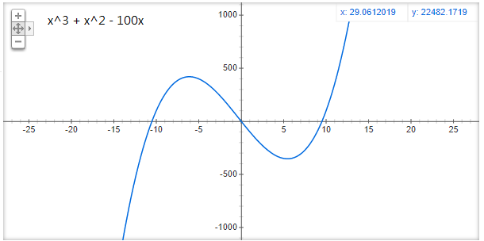
8.2 Relative Maxima
Notes:
來看一個找出相對極大值的例子
上慢點 多些舉例，知道到時候投票TA 該支持誰了吧

Slide 16
8.2 Relative Maxima
Notes:
一階導數為零 2 二階導數是負的

Slide 17
8.2 Relative Maxima
One-dimensional observation sequence
$f_{1 },f_{2 },f_{3 }$,……$f_{N }$
To find the relative maxima, we can least-squares fit a quadratic function
$\hat{c}m^{2}+\hat{b}m+\hat{a}$ ,
where $−k≤m≤k$ , to each group of 2k+1 successive observations
Notes:
給予數列f1~fn，可想像成長=1、寬=n的數位影像。
每次取2k+1個連續的fi，並以最中間作為$f_{0}$，因此最左邊為$f_{−k}$, 最右邊為$f_{k}$。
根據這些點，用最小平方法來擬合(fit)它們。

Slide 18
8.2 Relative Maxima
$f_{1},f_{2}$, $f_{3}$, $f_{4}$, $f_{5}$, $f_{6}$ = (3, 4, 5, 2, 7, 8), $k=1$
Notes:
舉例

Slide 19
8.2 Relative Maxima
$f_{1},f_{2}$, $f_{3}$, $f_{4}$, $f_{5}$, $f_{6}$ = (3, 4, 5, 2, 7, 8), $k=1$
(-1, 3), (0, 4), (1, 5)
$\hat{c_{1}}m^{2}+\hat{b_{1}}m+\hat{a_{1}}$
Notes:
舉例

Slide 20
8.2 Relative Maxima
$f_{1},f_{2}$, $f_{3}$, $f_{4}$, $f_{5}$, $f_{6}$ = (3, 4, 5, 2, 7, 8), $k=1$
(-1, 3), (0, 4), (1, 5)
(-1, 4), (0, 5), (1, 2)
$\hat{c_{1}}m^{2}+\hat{b_{1}}m+\hat{a_{1}}$
$\hat{c_{2}}m^{2}+\hat{b_{2}}m+\hat{a_{2}}$
Notes:
以此類推

Slide 21
8.2 Relative Maxima
$f_{1},f_{2}$, $f_{3}$, $f_{4}$, $f_{5}$, $f_{6}$ = (3, 4, 5, 2, 7, 8), $k=1$
(-1, 3), (0, 4), (1, 5)
(-1, 5), (0, 2), (1, 7)
(-1, 4), (0, 5), (1, 2)
(-1, 2), (0, 7), (1, 8)
$\hat{c_{1}}m^{2}+\hat{b_{1}}m+\hat{a_{1}}$
$\hat{c_{3}}m^{2}+\hat{b_{3}}m+\hat{a_{3}}$
$\hat{c_{2}}m^{2}+\hat{b_{2}}m+\hat{a_{2}}$
$\hat{c_{4}}m^{2}+\hat{b_{4}}m+\hat{a_{4}}$
Notes:
以此類推

Slide 22
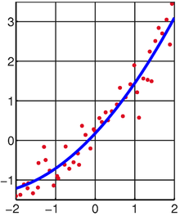
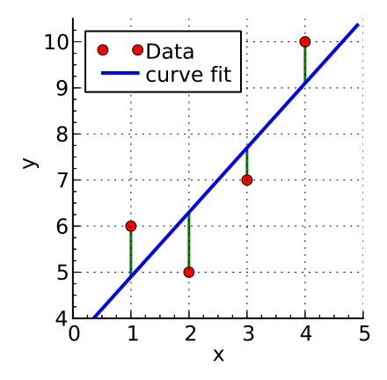
8.2 Relative Maxima
The squared fitting error $ε_{n}^{2}$ for the $n_{th}$ group of 2k+1 can be expressed by
$$ε_{n}^{2}= \sum_{m=−k}^{k}{{(\hat{c}m^{2}+\hat{b}m+\hat{a} −f_{n+m})}^{2}}$$
https://en.wikipedia.org/wiki/Least_squares
Notes:
＃計算誤差最小的平方和的算式
一般式可以表示為 $ε_{n}^{2}= \sum_{m=−k}^{k}{{(\hat{c}m^{2}+\hat{b}m+\hat{a} −f_{n+m})}^{2}}$
$\hat{c}m^{2}+\hat{b}m+\hat{a}$為預測式子，會使
最小平方法求得的數據與實際數據之間誤差的平方和為最小
我們擬合出來的數學式和觀測值的誤差的平方和就是這個式子
我們的觀測值一共有大N個，每次取2k+1個點，假設可以取小n組
最小平方法要求我們求出來的chat bhat ahat 使得這個誤差的平方和最小

Slide 23
8.2 Relative Maxima
Ex. $f$ = (3, 4, 5, 2, 7, 8), $k$ = 1
When n=2, we get (-1, 3), (0, 4), (1, 5)
$ε_{2}^{2}=$ ${(\hat{c}∗{\left(−1\right)}^{2}+\hat{b}∗(−1)+\hat{a} −3)}^{2}$
+ ${(\hat{c}∗{\left(0\right)}^{2}+\hat{b}∗(0)+\hat{a} −4)}^{2}$ + ${(\hat{c}∗{\left(1\right)}^{2}+\hat{b}∗(1)+\hat{a} −5)}^{2}$
= …
When n=3, we get (-1, 4), (0, 5), (1, 2)
$ε_{3}^{2}=$ ${(\hat{c}∗{\left(−1\right)}^{2}+\hat{b}∗(−1)+\hat{a} −4)}^{2}$
+ ${(\hat{c}∗{\left(0\right)}^{2}+\hat{b}∗(0)+\hat{a} −5)}^{2}$ + ${(\hat{c}∗{\left(1\right)}^{2}+\hat{b}∗(1)+\hat{a} −2)}^{2}$
= …
https://en.wikipedia.org/wiki/Least_squares
Notes:
＃計算誤差最小的平方和的算式
對2K+1 組其中的第 n 組的平方fitting$ε_{n}^{2}$誤差，一般式可以表示為 $ε_{n}^{2}= \sum_{m=−k}^{k}{{(\hat{c}m^{2}+\hat{b}m+\hat{a} −f_{n+m})}^{2}}$
最小平方法求得的數據與實際數據之間誤差的平方和為最小
我們擬合出來的數學式和觀測值的誤差的平方和就是這個式子
我們的觀測值一共有大N個，每次取2k+1個點，假設可以取小n組
最小平方法要求我們求出來的chat bhat ahat 使得這個誤差的平方和最小

Slide 24
8.2 Relative Maxima
Taking partial derivatives of $ε_{n}^{2}$ with respect to the free parameter $\hat{a}$ , $\hat{b}$, $\hat{c}$ results in the following
Notes:
用$ε_{n}^{2}$的相對於自由參數$\hat{a}$ , $\hat{b}$, $\hat{c}$偏導數如下矩陣表示
偏導數為 0 的時候，誤差會最小
我們對ahat bhat chat 求偏導數(偏微分)
(連鎖律: 微分一次 * 本身微分)

Slide 25
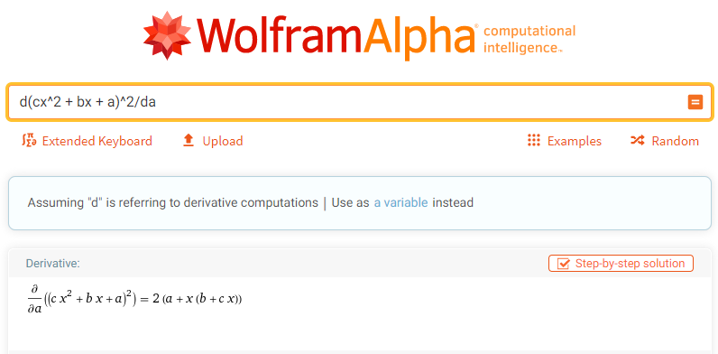
8.2 Relative Maxima
Partial Derivatives
https://www.wolframalpha.com/
Notes:
微積分都快忘光也不用怕
分享這個我不太確定有沒有問題
私心推薦大家一個好用的網站
這也是台大數學系的朋友推薦的
更精準的來說是我問煩他了
https://www.wolframalpha.com/
當初修微積分作業沒有解答也不怕了

Slide 26
8.2 Relative Maxima
Assume k = 1, setting these partial derivatives to zero and simplifying yields the matrix equation from
Notes:
回到式子，觀察這一條。

Slide 27
8.2 Relative Maxima
Assume k = 1, setting these partial derivatives to zero and simplifying yields the matrix equation from
m = -1: $\hat{c}$ – $\hat{b}$ + $\hat{a}$ –$f_{n−1}$= 0 $\hat{c}$ - $\hat{b}$ + $\hat{a}$ = $f_{n−1}$
m = 0: $\hat{a}$ – $f_{n}$ = 0 $\hat{a}$ = $f_{n}$
m = 1: $\hat{c}$ + $\hat{b}$ + $\hat{a}$ – $f_{n+1}$ = 0 $\hat{c}$ + $\hat{b}$ + $\hat{a}$ = $f_{n+1}$
Notes:
假設k=1，(只取三個點)
M = -1, M = 0, M = 1 代入解聯立

Slide 28
8.2 Relative Maxima
$$\hat{a}=f_{n}$$
$$\hat{b}=\frac{1}{2}{ (f}_{n+1}−f_{n−1})$$
$$\hat{c}=\frac{1}{2}(f_{n−1}−2f_{n}+f_{n+1})$$
Notes:
解聯立得到答案

Slide 29
8.2 Relative Maxima
$\hat{a}=f_{n}, \hat{b}=\frac{1}{2}{ (f}_{n+1}−f_{n−1}), \hat{c}=\frac{1}{2}(f_{n−1}−2f_{n}+f_{n+1})$
$f$ = (3, 4, 5, 2, 7, 8), $k$ = 1
When n=2, we get (-1, 3), (0, 4), (1, 5)
$$\hat{a}=4$$
$$\hat{b}=1$$
$$\hat{c}=0$$
$$y=x+4$$
$f_{2}=4$is not a maximum.
https://en.wikipedia.org/wiki/Least_squares
Notes:
回到主題relative maixma，以剛剛舉例的數列來實作

Slide 30
8.2 Relative Maxima
$\hat{a}=f_{n}, \hat{b}=\frac{1}{2}{ (f}_{n+1}−f_{n−1}), \hat{c}=\frac{1}{2}(f_{n−1}−2f_{n}+f_{n+1})$
$f$ = (3, 4, 5, 2, 7, 8), $k$ = 1
When n=3, we get (-1, 4), (0, 5), (1, 2)
(-0.25, 5.125)
$$\hat{a}=5$$
$$\hat{b}=−1$$
$$\hat{c}=−2$$
$$y=−2x^{2}−x+5$$
$f_{3}=5$is a maximum?
https://en.wikipedia.org/wiki/Least_squares
Notes:
(Continue.)

Slide 31
8.2 Relative Maxima
To test if $f_{n}$ is a relative Maximum:
The quadratic $y= \hat{c}m^{2}+\hat{b}m+\hat{a}$ has relative extrema at $x_{0}=−\frac{\hat{b}}{2\hat{c}}$
$\hat{c}<0$.
$\left|x_{0}\right|<1/2$.
Notes:
$\hat{c}<0$ 才會有相對極大值
$\left|x_{0}\right|<1/2$ 代表$x_{0}$距離原點夠近。

Slide 32
8.2 Relative Maxima
$\hat{a}=f_{n}, \hat{b}=\frac{1}{2}{ (f}_{n+1}−f_{n−1}), \hat{c}=\frac{1}{2}(f_{n−1}−2f_{n}+f_{n+1})$
$f$ = (3, 4, 5, 2, 7, 8), $k$ = 1
When n=3, we get (-1, 4), (0, 5), (1, 2)
(-0.25, 5.125)
$$\hat{a}=5$$
$$\hat{b}=−1$$
$$\hat{c}=−2$$
$$y=−2x^{2}−x+5$$
$f_{3}=5$is a maximum.
https://en.wikipedia.org/wiki/Least_squares
Notes:
$f_{3}=5 為$相對極大值。

Slide 33
8.2 Relative Maxima
$\hat{a}=f_{n}, \hat{b}=\frac{1}{2}{ (f}_{n+1}−f_{n−1}), \hat{c}=\frac{1}{2}(f_{n−1}−2f_{n}+f_{n+1})$
$f$ = (3, 4, 5, 2, 7, 8), $k$ = 1
When n=4, we get (-1, 5), (0, 2), (1, 7)
$$\hat{a}=2$$
$$\hat{b}=1$$
$$\hat{c}=4$$
$$y=4x^{2}+x+2$$
$f_{4}=2$is not a maximum.
https://en.wikipedia.org/wiki/Least_squares
Notes:
$\hat{c}>$0，因此$f_{4}=2$並非相對極大值。

Slide 34
8.2 Relative Maxima
$\hat{a}=f_{n}, \hat{b}=\frac{1}{2}{ (f}_{n+1}−f_{n−1}), \hat{c}=\frac{1}{2}(f_{n−1}−2f_{n}+f_{n+1})$
$f$ = (3, 4, 5, 2, 7, 8), $k$ = 1
When n=5, we get (-1, 2), (0, 7), (1, 8)
$$\hat{a}=7$$
$$\hat{b}=3$$
$$\hat{c}=−2$$
$$y=−2x^{2}+3x+7$$
$$(−\frac{\hat{b}}{2\hat{c}}=0.75)$$
$f_{5}=7$is not a maximum.
https://en.wikipedia.org/wiki/Least_squares
Notes:
$|−\frac{\hat{b}}{2\hat{c}}|=0.75>0$.5，因此$f_{5}=7$並非相對極大值。

Slide 35
Outline
8.1 Introduction
8.2 Relative Maxima
8.3 Sloped Facet Parameter and Error Estimation
8.4 Facet-Based Peak Noise Removal
8.5 Iterated Facet Model
8.6 Gradient-Based Facet Edge Detection
8.7 Bayesian Approach to Gradient Edge Detection
8.8 Zero-Crossing Edge Detector
8.9 Integrated Directional Derivative Gradient Operator
8.10 Corner Detection
8.11 Isotropic Derivative Magnitudes
8.12 Ridges and Ravines on Digital Images
8.13 Topographic Primal Sketch
Notes:
8.3 斜的小平面參數預估

Slide 36
8.3 Sloped Facet Parameter and Error Estimation
Similar to 8.2, we employ a least-squares procedure both to estimate the parameters of the sloped facet model.
Given two-dimensional rectangular neighborhood, the row index set is R and the column index set is C
Notes:
剛才是一元二次，現在看二元一次的小平面模型。
我們用R作為row的索引值，C作為column的索引值

Slide 37
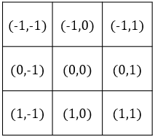
8.3 Sloped Facet Parameter and Error Estimation
Assume the coordinate of the given pixel are (0,0) in its central neighborhood, and assume each (r,c) ∈ R X C
Image function g is modeled by
Where $η$ is a random variable indexed on $R×C$ , which represents noise.
We assume that $η\sim N(0,σ^{2})$ is noise having mean 0 and variance $σ^{2}$ and that the noise for any two pixels is independent.
$$g\left(r,c\right)=αr+βc+γ+η(r,c)$$
observed
truth
noise
Notes:
二維的斜面小平面模型的方程式如上
數位影像=真實影像+noise。
Noise為隨機分布，且擁有常態分布的特性，平均值=0、變異數=$σ^{2}$ 。這個特性與這章節的結果有關。
但因為牽涉到較艱深的統計學，我們只會講結果(畢竟我也不完全透徹)，有興趣的同學可以去翻原文書。

Slide 38
8.3 Sloped Facet Parameter and Error Estimation
The least-squares procedure determine parameters $\hat{a}$ , $\hat{b}$, $\hat{c}$ that minimize the sum of the squared differences between the fitted surface and the observed one
Taking the partial derivatives of $ε_{n}^{2}$ and setting them to zero
$$ε^{2}=\sum_{r∈R}{\sum_{c∈C}{{[\hat{α}r+\hat{β}c+\hat{γ}−g(r,c)]}^{2}}}$$
estimated
observed
Notes:
最小平方法要求參數αhat βhat γhat使得誤差的平方和最小
還是求最小值的操作
一階偏微分等於0

Slide 39
8.3 Sloped Facet Parameter and Error Estimation
We choose our coordinate RxC so that the center of the neighborhood RxC has coordinates (0, 0)
The symmetry in the chosen coordinate system leads to
Hence
$$\sum_{r∈R}{r}=0$$
$$\sum_{c∈C}{c}=0$$
and
$$\sum_{r∈R}{\sum_{c∈C}{rc}}=\sum_{r∈R}{r\sum_{c∈C}{c}}=0$$
Notes:
＠不失一般性(證明不是特例，而是普遍情況)，我們選擇中心點ＲＸＣ做為座標的原點
奇數 r, c -> 中心 (0,0) 偶數r, c 則中心點就沒有 pixel
＠選擇的座標系統具有對稱性使得 加總r = 0 加總c =0

Slide 40
8.3 Sloped Facet Parameter and Error Estimation
$$\frac{∂ε^{2}}{∂\hat{a}}$$
$$r$$
$$c$$
$$1$$
$$= 2\sum_{r∈R}{\sum_{c∈C}{\left[\hat{α}r+\hat{β}c+\hat{γ} −g\left(r, c\right)\right] =0}}$$
$$\frac{∂ε^{2}}{∂\hat{b}}$$
$$\frac{∂ε^{2}}{∂\hat{c}}$$
$$\sum_{r∈R}{r}=0 ，\sum_{c∈C}{c}=0 ，\sum_{r∈R}{\sum_{c∈C}{rc}}=0$$

Slide 41
8.3 Sloped Facet Parameter and Error Estimation
$$2\sum_{r∈R}{\sum_{c∈C}{\left[\hat{α}r+\hat{β}c+\hat{γ} −g\left(r, c\right)\right]r=0}}$$
$$\sum_{r∈R}{\sum_{c∈C}{\left[\hat{α}r+\hat{β}c+\hat{γ} −g\left(r, c\right)\right]r=0}}$$
$$\sum_{r∈R}{\sum_{c∈C}{\left[\hat{α}r^{2}+\hat{β}cr+\hat{γ}r −rg\left(r, c\right)\right]=0}}$$
Notes:
以偏微分 α hat 做舉例

Slide 42
8.3 Sloped Facet Parameter and Error Estimation
$$\sum_{r∈R}{\sum_{c∈C}{\hat{α}r^{2}}}+\sum_{r∈R}{\sum_{c∈C}{\hat{β}cr }}+\sum_{r∈R}{\sum_{c∈C}{\hat{γ}r }}−\sum_{r∈R}{\sum_{c∈C}{rg\left(r, c\right) }}=0$$
0
0
$$\sum_{r∈R}{\sum_{c∈C}{\hat{α}r^{2}}}−\sum_{r∈R}{\sum_{c∈C}{rg\left(r, c\right) }}=0$$
$$\hat{α}\sum_{r∈R}{\sum_{c∈C}{r^{2}}}=\sum_{r∈R}{\sum_{c∈C}{rg\left(r, c\right) }}$$
Notes:
以偏微分 α hat 做舉例

Slide 43
8.3 Sloped Facet Parameter and Error Estimation
$$\sum_{r∈R}{\sum_{c∈C}{\hat{α}r^{2}}}+\sum_{r∈R}{\sum_{c∈C}{\hat{β}cr }}+\sum_{r∈R}{\sum_{c∈C}{\hat{γ}r }}−\sum_{r∈R}{\sum_{c∈C}{rg\left(r, c\right) }}=0$$
0
0
$$\sum_{r∈R}{\sum_{c∈C}{\hat{α}r^{2}}}−\sum_{r∈R}{\sum_{c∈C}{rg\left(r, c\right) }}=0$$
$$\hat{α}\sum_{r∈R}{\sum_{c∈C}{r^{2}}}=\sum_{r∈R}{\sum_{c∈C}{rg\left(r, c\right) }}$$
Notes:
以偏微分 α hat 做舉例

Slide 44
8.3 Sloped Facet Parameter and Error Estimation
$$\sum_{r∈R}{\sum_{c∈C}{\hat{α}r^{2}}}+\sum_{r∈R}{\sum_{c∈C}{\hat{β}cr }}+\sum_{r∈R}{\sum_{c∈C}{\hat{γ}r }}−\sum_{r∈R}{\sum_{c∈C}{rg\left(r, c\right) }}=0$$
0
0
$$\sum_{r∈R}{\sum_{c∈C}{\hat{α}r^{2}}}−\sum_{r∈R}{\sum_{c∈C}{rg\left(r, c\right) }}=0$$
$$\hat{α}\sum_{r∈R}{\sum_{c∈C}{r^{2}}}=\sum_{r∈R}{\sum_{c∈C}{rg\left(r, c\right) }}$$
Notes:
以偏微分 α hat 做舉例

Slide 45
8.3 Sloped Facet Parameter and Error Estimation
$$\sum_{r∈R}{\sum_{c∈C}{\hat{α}r^{2}}}+\sum_{r∈R}{\sum_{c∈C}{\hat{β}cr }}+\sum_{r∈R}{\sum_{c∈C}{\hat{γ}r }}−\sum_{r∈R}{\sum_{c∈C}{rg\left(r, c\right) }}=0$$
0
0
$$\sum_{r∈R}{\sum_{c∈C}{\hat{α}r^{2}}}−\sum_{r∈R}{\sum_{c∈C}{rg\left(r, c\right) }}=0$$
$$\hat{α}\sum_{r∈R}{\sum_{c∈C}{r^{2}}}=\sum_{r∈R}{\sum_{c∈C}{rg\left(r, c\right) }}$$
$$\hat{α}=\frac{\sum_{r∈R}{\sum_{c∈C}{rg\left(r, c\right) }}}{\sum_{r∈R}{\sum_{c∈C}{r^{2}}}}$$
Notes:
以偏微分 α hat 做舉例

Slide 46
8.3 Sloped Facet Parameter and Error Estimation
Solving for $\hat{α}$, $\hat{β}$, and $\hat{γ}$ , we obtain
$$\hat{α}=\frac{\sum_{r∈R}{\sum_{c∈C}{rg\left(r, c\right) }}}{\sum_{r∈R}{\sum_{c∈C}{r^{2}}}}$$
$$\hat{β}=\frac{\sum_{r∈R}{\sum_{c∈C}{cg\left(r, c\right) }}}{\sum_{r∈R}{\sum_{c∈C}{c^{2}}}}$$
$$\hat{γ}=\frac{\sum_{r∈R}{\sum_{c∈C}{g\left(r, c\right) }}}{\sum_{r∈R}{\sum_{c∈C}{1}}}$$
Notes:
然後我們就可以求得估計值α β γ bar 了
估計值α 的分母 是小r平方連加的和 分子是小r和觀測值g(r,c)的乘積的加和
就是簡單的移項

Slide 47
8.3 Sloped Facet Parameter and Error Estimation
Example: consider the following 3*3 region
3 | 5 | 9
4 | 7 | 7
0 | 3 | 7
Notes:
來看個例子

Slide 48
8.3 Sloped Facet Parameter and Error Estimation
Example:
3 | 5 | 9
4 | 7 | 7
0 | 3 | 7
$$\hat{α}=\frac{\sum_{r∈R}{\sum_{c∈C}{rg\left(r, c\right) }}}{\sum_{r∈R}{\sum_{c∈C}{r^{2}}}}$$
$$\hat{α}=\frac{−1×\left(3+5+9\right)+0∗\left(4+7+7\right)+1∗(0+3+7)}{{(−1)}^{2}∗3+{(0)}^{2}∗3+1^{2}∗3}=−1.17$$
Notes:
來看個例子
(-17 + 10) / 6

Slide 49
8.3 Sloped Facet Parameter and Error Estimation
Example:
3 | 5 | 9
4 | 7 | 7
0 | 3 | 7
$$\hat{β}=\frac{\sum_{r∈R}{\sum_{c∈C}{cg\left(r, c\right) }}}{\sum_{r∈R}{\sum_{c∈C}{c^{2}}}}$$
$$\hat{β}=\frac{−1×\left(3+4+0\right)+0∗\left(5+7+3\right)+1∗(9+7+7)}{1∗3+0∗3+1∗3}=2.67$$
Notes:
來看個例子鞏固一下

Slide 50
8.3 Sloped Facet Parameter and Error Estimation
Example:
3 | 5 | 9
4 | 7 | 7
0 | 3 | 7
$$\hat{γ}=\frac{\sum_{r∈R}{\sum_{c∈C}{g\left(r, c\right) }}}{\sum_{r∈R}{\sum_{c∈C}{1}}}$$
$$\hat{γ}=\frac{\left(3+5+9\right)+\left(4+7+7\right)+(0+3+7)}{9}=5$$
Notes:
來看個例子鞏固一下

Slide 51
8.3 Sloped Facet Parameter and Error Estimation
Example:
$$\hat{α}r+\hat{β}c+\hat{γ}=\text{−1.17 }r+2.67 c \text{+5}$$
c
-1
0
1
r
-1
0
1
estimated
Notes:
我們知道了統計值abr之後，就可以利用這個擬合的方程式求出這個區域的擬合灰度值

Slide 52
8.3 Sloped Facet Parameter and Error Estimation
Example:
$$\hat{α}r+\hat{β}c+\hat{γ}=\text{−1.17 }r+2.67 c \text{+5}$$
3.5
(-1) $×$-1.17 + (-1) $×$2.67 $+$5 = 3.5
estimated
Notes:
我們知道了統計值abr之後，就可以利用這個擬合的方程式求出這個區域的擬合灰度值

Slide 53
8.3 Sloped Facet Parameter and Error Estimation
Example:
$$\hat{α}r+\hat{β}c+\hat{γ}=\text{−1.17 }r+2.67 c \text{+5}$$
3.5 | 6.17
(-1) $×$-1.17 + (0) $×$2.67 $+$5 = 6.17
estimated
Notes:
我們知道了統計值abr之後，就可以利用這個擬合的方程式求出這個區域的擬合灰度值

Slide 54
8.3 Sloped Facet Parameter and Error Estimation
Example:
$$\hat{α}r+\hat{β}c+\hat{γ}=\text{−1.17 }r+2.67 c \text{+5}$$
3.5 | 6.17 | 8.84
(-1) $×$-1.17 + (1) $×$2.67 $+$5 = 8.84
estimated
Notes:
我們知道了統計值abr之後，就可以利用這個擬合的方程式求出這個區域的擬合灰度值

Slide 55
8.3 Sloped Facet Parameter and Error Estimation
Example:
$$\hat{α}r+\hat{β}c+\hat{γ}=\text{−1.17 }r+2.67 c \text{+5}$$
3.5 | 6.17 | 8.84
2.33 | 5 | 7.67
1.17 | 3.83 | 6.5
estimated
Notes:
我們知道了統計值abr之後，就可以利用這個擬合的方程式求出這個區域的擬合灰度值

Slide 56
Notes:
圖例

Slide 57
8.3 Sloped Facet Parameter and Error Estimation
Example:
Calculate the error:
3.5 | 6.17 | 8.84
2.33 | 5 | 7.67
1.17 | 3.83 | 6.5
3 | 5 | 9
4 | 7 | 7
0 | 3 | 7
0.5 | 1.17 | -0.17
-1.67 | -2 | 0.67
1.17 | 0.83 | -0.5
- =
estimated
observed
error
Notes:
求出擬合矩陣之後，我們就可以算出誤差的平方和

Slide 58
8.3 Sloped Facet Parameter and Error Estimation
Example:
$$ε^{2}=\sum_{r∈R}{\sum_{c∈C}{{(ε\left(r,c\right))}^{2}}}=$$
$$0.25 +1.3689+0.0289+$$
$$2.7889+ 4+0.4489+$$
$$1.3689+0.6889+ 0.25$$
$$=11.1934$$
c
-1
0
1
r
0.5 | 1.17 | -0.17
-1.67 | -2 | 0.67
1.17 | 0.83 | -0.5
-1
0
1
$$ε^{2}≅11.19$$
Notes:
求出擬合矩陣之後，我們就可以算出誤差的平方和

Slide 59
8.3 Sloped Facet Parameter and Error Estimation
According to the theory of Chi-square Distribution, the variance of the noise $η$ can be estimated as:
$$σ^{2}= \frac{ε^{2}}{\sum_{r}{\sum_{c}{1}}−3}$$
Notes:
前面的前提下(noise 為常態分佈、blahblahblah)
所得到的結果。

Slide 60
8.3 Sloped Facet Parameter and Error Estimation
Example:
Calculating the variance of $η$:
3 | 5 | 9
4 | 7 | 7
0 | 3 | 7
$$ε^{2}≅11.19$$
$$σ^{2}= \frac{ε^{2}}{\sum_{r}{\sum_{c}{1}}−3}$$
$σ^{2}= \frac{{(11.19)}^{2}}{9−3}≅20.87$
observed
Notes:
求出擬合矩陣之後，我們就可以算出誤差的平方和
是我可能就附上公式考這個
是我可能很懶就不改數字了
公式只要取到小數點第一位(4捨5入
或分數的形式

Slide 61
Outline
8.1 Introduction
8.2 Relative Maxima
8.3 Sloped Facet Parameter and Error Estimation
8.4 Facet-Based Peak Noise Removal
8.5 Iterated Facet Model
8.6 Gradient-Based Facet Edge Detection
8.7 Bayesian Approach to Gradient Edge Detection
8.8 Zero-Crossing Edge Detector
8.9 Integrated Directional Derivative Gradient Operator
8.10 Corner Detection
8.11 Isotropic Derivative Magnitudes
8.12 Ridges and Ravines on Digital Images
8.13 Topographic Primal Sketch
Notes:
8.4 用小平面模型來做尖端雜訊的移除

Slide 62
8.4 Facet-Based Peak Noise Removal
Peak noise pixel: a pixel whose gray level intensity significantly differs from neighborhood pixels.
It is difficult to judge that the center pixel in part (b) is peak noise, whereas it is easier in part (a)
Notes:
尖端雜訊像素，灰階值意義上和鄰居不一樣(略顯突兀的感覺)
圖a明顯有雜訊，那個尖端值十分突兀，
然而b就難判斷許多(可能原本就是尖端
可看出，我們需要一套基準來判斷。

Slide 63
8.4 Facet-Based Peak Noise Removal
Let N be a set of neighborhood pixels that does not contain the center pixel
(-1,-1) | (-1,0) | (-1,1)
(0,-1) | (0,0) | (0,1)
(1,-1) | (1,0) | (1,1)
$$N=R ×C −\{(0, 0)\}$$
observed
truth
noise
$$g\left(r, c\right)= N=αr+ βc+ γ+η\left(r, c\right) for (r,c)∈N$$
Where $η(r,c)$ is assumed to be independent additive Gaussian noise having mean 0 and variance $σ^{2}$
Notes:
和上一章節一樣的做法，只是去除掉center pixel
=> 先排除掉中間那個點來看，看模型預估的值應該是多少

Slide 64
8.4 Facet-Based Peak Noise Removal
The least-squares procedure determines $\hat{α}$, $\hat{β}$, and $\hat{γ}$ which minimize the sum of the squared difference between the fitted surface are given by the observed one:
The minimizing $\hat{α}$, $\hat{β}$, and $\hat{γ}$ are given by
$$ε^{2}=\sum_{(r, c)∈N}{{[\hat{α}r+\hat{β}c+\hat{γ}−g(r,c)]}^{2}}$$
$$\hat{α}=\frac{\sum_{(r, c)∈N}{rg(r,c)}}{\sum_{(r, c)∈N}{r^{2}}}$$
$$\hat{β}=\frac{\sum_{(r, c)∈N}{cg(r,c)}}{\sum_{(r, c)∈N}{c^{2}}}$$
$$\hat{γ}=\frac{\sum_{(r, c)∈N}{g(r,c)}}{\#N}$$
Notes:
公式不贅述，和前面章節類似。
得到alpha_hat、b_hat、r_hat

Slide 65
8.4 Facet-Based Peak Noise Removal
According to the theories of Chi-square Distribution and t-distribution,
we let $t= \frac{g\left(0,0\right)−\hat{γ}}{\sqrt{(1+\frac{1}{\#N})ε^{2}}}$ ,
and let $T_{\#N−3, p}$ be the threshold.
(Value for p is usually .05~.01)
Notes:
根據神奇的統計學，得到神奇的結果。

Slide 66
8.4 Facet-Based Peak Noise Removal
t-distribution table:
p
degree
of
freedom
Notes:
T值須做查表動作

Slide 67
8.4 Facet-Based Peak Noise Removal
If $t>T_{\#N−3, p}$, we assume that center pixel is a noise pixel, the output value of the center pixel will be $\hat{γ}$ .
If $t≤T_{\#N−3, p}$, we assume that center pixel is not a noise pixel, the output value of the center pixel will be $g\left(0,0\right)$.
Output of center pixel = $(t>T_{\#N−3, p}) ? \hat{γ} : g\left(0,0\right)$
Notes:
若t>threshold T，則判斷為peak noise，用model的預測值來取代。
反之，則不是peak noise，我們什麼都不做。
最下面為精美的判斷式

Slide 68
8.4 Facet-Based Peak Noise Removal
Example: consider the following 3*3 region
3 | 5 | 3
4 | 9 | 3
0 | 3 | 3
Set p = 0.05, $T_{\#N−3, p}=2.015$
Notes:
舉例

Slide 69
8.4 Facet-Based Peak Noise Removal
Example:
3 | 5 | 3
4 | 9 | 3
0 | 3 | 3
$$\hat{α}=−0.83$$
$$\hat{β}=0.33$$
$$\hat{γ}=3.0$$
Set p = 0.05, $T_{\#N−3, p}=2.015$
Notes:
算出三個參數值

Slide 70
8.4 Facet-Based Peak Noise Removal
Example:
$$−0.83r+0.33c+3.0$$
3 | 5 | 3
4 | 9 | 3
0 | 3 | 3
0.25 | 1.36 | 1.36
1.78 |  | 0.11
3.36 | 0.69 | 0.25
error
Set p = 0.05, $T_{\#N−3, p}=2.015$
$$ε^{2}=9.16$$
Notes:
帶回九宮格並算出error

Slide 71
8.4 Facet-Based Peak Noise Removal
Example:
3 | 5 | 3
4 | 9 | 3
0 | 3 | 3
$$t=\frac{g\left(0, 0\right)−\hat{γ}}{\sqrt{\left(1+1/{\#N}\right)∗ε^{2}}}$$
$= \frac{9−3}{\sqrt{{(9}/{8)∗}9.16}}$
$=1.86$
Set p = 0.05, $T_{\#N−3, p}=2.015$
Notes:
計算小t

Slide 72
8.4 Facet-Based Peak Noise Removal
Example:
3 | 5 | 3
4 | 9 | 3
0 | 3 | 3
Since $t=1.86<2.015$,
the center pixel 9 is not considered to be a peak noise.
Set p = 0.05, $T_{\#N−3, p}=1.943$

Slide 73
8.4 Facet-Based Peak Noise Removal
Example:
3 | 5 | 3
4 | 9.5 | 3
0 | 3 | 3
Change the center pixel to 9.5:
then $t=2.02>2.015$,
the center pixel is considered to be a peak noise.
Set p = 0.05, $T_{\#N−3, p}=2.015$

Slide 74
8.4 Facet-Based Peak Noise Removal
Example:
3 | 5 | 3
4 | 3 | 3
0 | 3 | 3
$$Thus, center pixel= \hat{γ}=3.0$$
Set p = 0.05, $T_{\#N−3, p}=2.015$
Notes:
誤差公式和估計值公式都應該很熟悉了
但是之前有兩個加和號，現在只有一個
因為之前考慮的鄰域可以是長方形，但這邊考慮的是正方形，所以r和c的總數相同，可以寫在一起

Slide 75
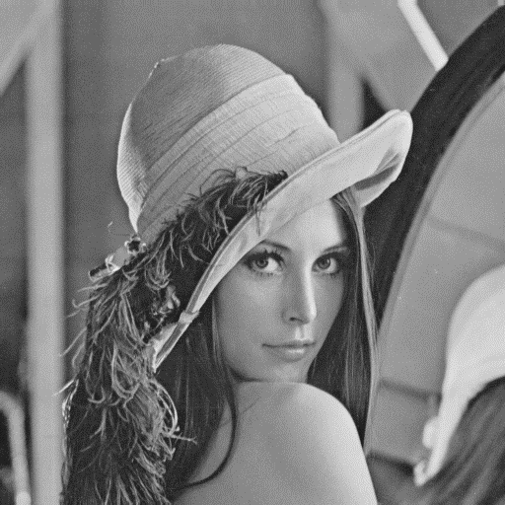
8.4 Facet-Based Peak Noise Removal
Ex: Lena.bmp

Slide 76
8.4 Facet-Based Peak Noise Removal
Ex: Lena.bmp

Slide 77
8.4 Facet-Based Peak Noise Removal
Ex: Lena.bmp
Neighborhood = 5*5, threshold = 0.5
Notes:
Neighborhood = 5*5, threshold = 0.5

Slide 78
8.4 Facet-Based Peak Noise Removal
Ex: Lena.bmp
Neighborhood = 5*5, threshold = 0.25
Notes:
Neighborhood = 5*5, threshold = 0.25

Slide 79
8.4 Facet-Based Peak Noise Removal
Ex: shiba.png

Slide 80
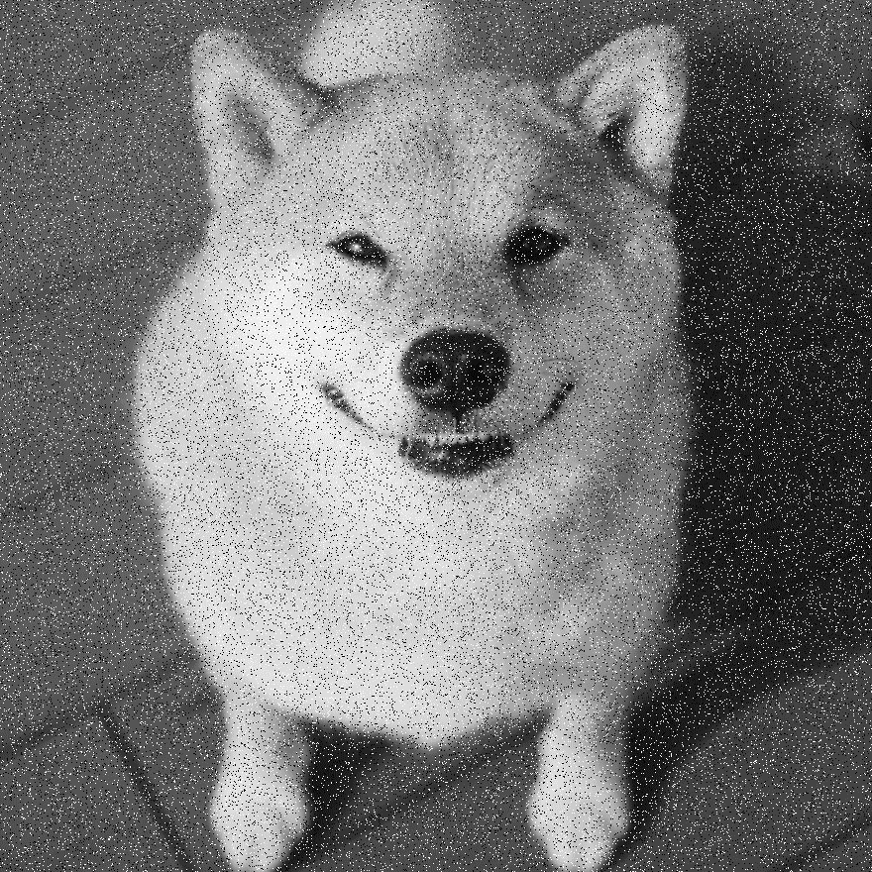
8.4 Facet-Based Peak Noise Removal
Ex: shiba.png

Slide 81
8.4 Facet-Based Peak Noise Removal
Ex: shiba.png
Neighborhood = 5*5, threshold = 0.25
Notes:
Neighborhood = 5*5, threshold = 0.25

Slide 82
Outline
8.1 Introduction
8.2 Relative Maxima
8.3 Sloped Facet Parameter and Error Estimation
8.4 Facet-Based Peak Noise Removal
8.5 Iterated Facet Model
8.6 Gradient-Based Facet Edge Detection
8.7 Bayesian Approach to Gradient Edge Detection
8.8 Zero-Crossing Edge Detector
8.9 Integrated Directional Derivative Gradient Operator
8.10 Corner Detection
8.11 Isotropic Derivative Magnitudes
8.12 Ridges and Ravines on Digital Images
8.13 Topographic Primal Sketch
Notes:
8.5 重複模型
facet model -> partition image to regions

Slide 83
8.5 Iterated Facet Model
The iterated model for ideal image
The spatial of the image can be partitioned into connected regions called facets.
Each of which satisfies certain gray level and shape constraints.
Notes:
重複模型對理想影像的假設:
1. 可以被分割成許多相連區域
2. 每一個都符合特定的灰階和形狀限制

Slide 84
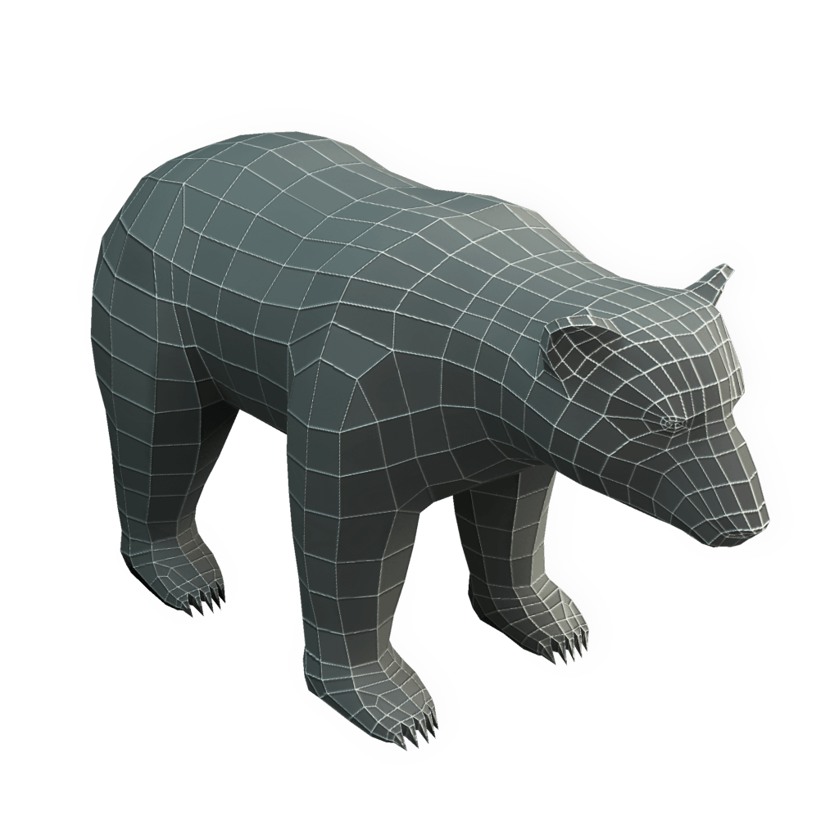
8.5 Iterated Facet Model
The iterated model for ideal image
https://www.pinterest.com/pin/296674694187240243/
Notes:
Ex: 這個3D熊由多個不同的四面體構成

Slide 85
8.5 Iterated Facet Model
Shape region constraint:
Each facet must be sufficiently smooth in shape.
To be precise, each region can be represented as the union of $K×K$ blocks of pixels.
Region gray level constraint:
Gray levels in each facet must be a polynomial function of row-column coordinates.
Replace the pixel value with the output of the model, which has the smallest residual error.
Notes:
形狀限制
--每一個小平面必須滿足平滑的形狀
灰階限制
--每一個小平面的座標（Ｒ, C）必須是多項式方程式(facet model)
每個 region 由 k*k 個 piexls 構成
Output 會是最小 variance

Slide 86
8.5 Iterated Facet Model
Example:

Slide 87
8.5 Iterated Facet Model
Example:

Slide 88
8.5 Iterated Facet Model
Example:

Slide 89
8.5 Iterated Facet Model
Example:

Slide 90
8.5 Iterated Facet Model
Example:

Slide 91
Outline
8.1 Introduction
8.2 Relative Maxima
8.3 Sloped Facet Parameter and Error Estimation
8.4 Facet-Based Peak Noise Removal
8.5 Iterated Facet Model
8.6 Gradient-Based Facet Edge Detection
8.7 Bayesian Approach to Gradient Edge Detection
8.8 Zero-Crossing Edge Detector
8.9 Integrated Directional Derivative Gradient Operator
8.10 Corner Detection
8.11 Isotropic Derivative
8.12 Ridges and Ravines on Digital Images
8.13 Topographic Primal Sketch
Notes:
8.6 介紹使用梯度來做邊界偵測的應用
gradient edge detector

Slide 92
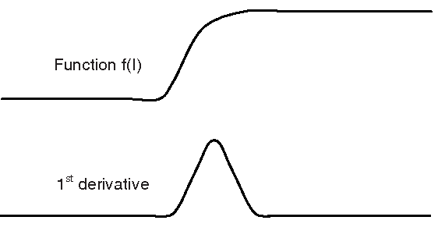
8.6 Gradient-Based Facet Edge Detection
gradient-based edge detection: high values in first partial derivative (sharp discontinuities)
https://www.semanticscholar.org/paper/Gradient-Based-Edge-Detection-of-Songket-Motifs-Jamil-Sembok/eea31d166c062a3dddccb212474a6b8
565ae6eee/figure/2
Notes:
邊界就是它的一邊暗，另一邊亮
所以梯度邊界偵測就是找一階偏微分的值很大的地方（明顯的不連續）

Slide 93
8.6 Gradient-Based Facet Edge Detection
When a neighborhood is fitted with the sloped facet model , $\hat{α}r+\hat{β}c+\hat{γ}$, a gradient magnitude of $\sqrt{{\hat{α}}^{2}+{\hat{β}}^{2}}$ will result.
Use ${\hat{α}}^{2}+{\hat{β}}^{2}$ as the basis for edge detection.
Notes:
以斜面的小平面模型為例
${\hat{α}}^{2}+{\hat{β}}^{2}$ 就會是一個判斷基準

Slide 94
8.6 Gradient-Based Facet Edge Detection
For example:
$$\hat{α}r+\hat{β}c+\hat{γ}$$
$$\text{−1.17 }r+2.67 c \text{+5}$$
3.5 | 6.17 | 8.84
2.33 | 5 | 7.67
1.17 | 3.83 | 6.5
$$\sqrt{{\hat{α}}^{2}+{\hat{β}}^{2}}$$
$$\sqrt{{(−1.17)}^{2}+{2.67}^{2}}$$
Notes:
拿之前 8.3 的九宮格舉例

Slide 95
8.6 Gradient-Based Facet Edge Detection
Review: According to the theory of Chi-square Distribution, the variance of the noise $η$ can be estimated as:
$$σ^{2}= \frac{ε^{2}}{\sum_{r}{\sum_{c}{1}}−3}$$
Notes:
複習，8.3最後的結論

Slide 96
8.6 Gradient-Based Facet Edge Detection
If $ε_{n}^{2}$ represents the squared residual fitting error from the n-th neighborhood and the images has N neighborhoods, then we may use $\hat{σ^{2}}= \frac{ε^{2}}{\sum_{r}{\sum_{c}{1}}−3}=\frac{\frac{1}{N}\sum_{n=1}^{N}{ε_{n}^{2}}}{\sum_{r}{\sum_{c}{1}}−3}$ in place of $σ^{2}$.
Notes:
一張image會根據自己的neighborhood而算出不同的model，總計有n個model。
每個model有自己的error，全部加總就會是整張圖的error。
把變異數轉換一下。

Slide 97
8.6 Gradient-Based Facet Edge Detection
According to the theories of Chi-square Distribution, t-distribution and F-distribution, we let $G=\frac{{\hat{α}}^{2}\sum_{r}{\sum_{c}{r^{2}}}+{\hat{β}}^{2}\sum_{r}{\sum_{c}{c^{2}}}}{\hat{σ^{2}}}$
Notes:
根據統計學blahblahblah
G為以上公式

Slide 98
8.6 Gradient-Based Facet Edge Detection
Since we usually choose our neighborhood to be a square (Ex: 3*3, 5*5), we get: $\sum_{r}{\sum_{c}{r^{2}}}=\sum_{r}{\sum_{c}{c^{2}}}$
Then, $G=\frac{\sum_{r}{\sum_{c}{r^{2}}}}{\hat{σ^{2}}}({\hat{α}}^{2}+{\hat{β}}^{2})$
Notes:
通常neighborhood會找長方形，所以$\sum_{r}{\sum_{c}{r^{2}}} \sum_{r}{\sum_{c}{c^{2}}}$這兩項會相等。
因此可以把G轉成下面那個形式。

Slide 99
8.6 Gradient-Based Facet Edge Detection
We set a threshold t such that if $G≥t$, we assume that the center pixel is an edge pixel.
$$IsEdge=\left(G≥t\right) ?True :False$$
Notes:
設一個threshold來做比較，和前面peak noise removal 類似。

Slide 100
8.6 Gradient-Based Facet Edge Detection
$$backgroung pixel=0$$
$$disk pixel=200$$
$$σ^{2}=40$$
$$σ^{2}=50$$
$$σ^{2}=75$$
Notes:
課本 PDF的圖例，但解析度乾那賽

Slide 101
8.6 Gradient-Based Facet Edge Detection
$$t=120$$
$$t=4$$
$$t=8$$
$$t=11$$
upper right
Notes:
課本的圖例

Slide 102
8.6 Gradient-Based Facet Edge Detection
Example: lena.bmp

Slide 103
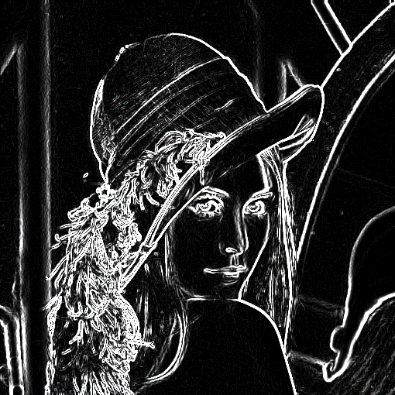
8.6 Gradient-Based Facet Edge Detection
Example:
Set neighborhood size to 3*3
Original
Slope image

Slide 104
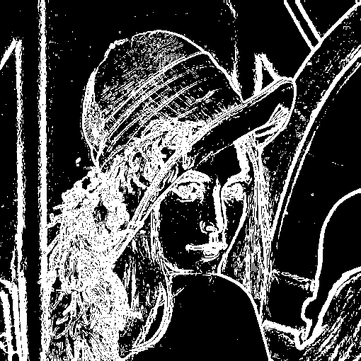
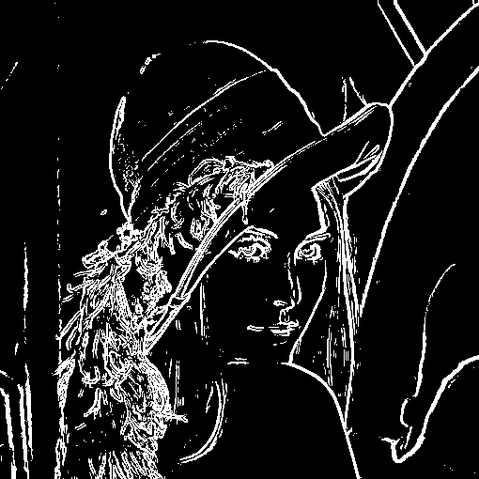
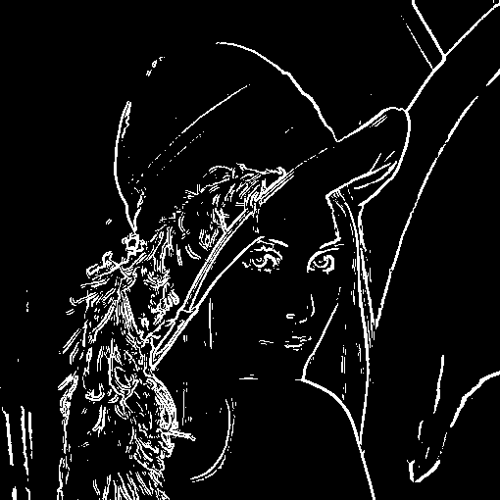
8.6 Gradient-Based Facet Edge Detection
Example:
Set neighborhood size to 3*3, threshold to 10, 60, 120, respectively.

Slide 105
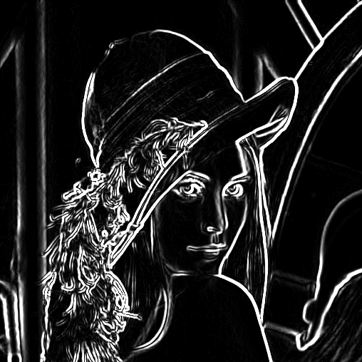
8.6 Gradient-Based Facet Edge Detection
Example:
Set neighborhood size to 5*5
Original
Slope image

Slide 106
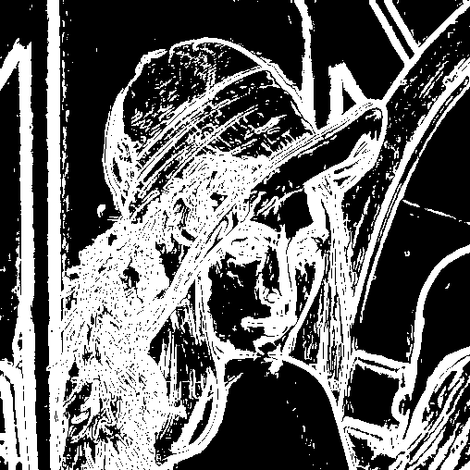
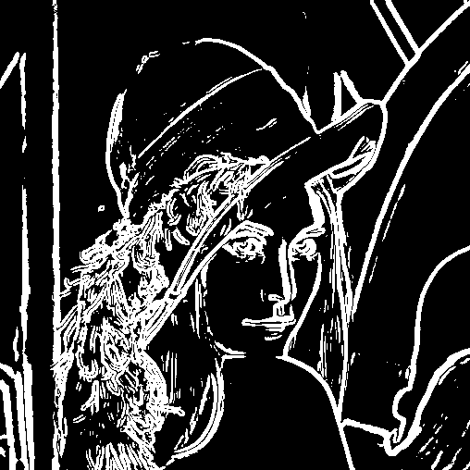
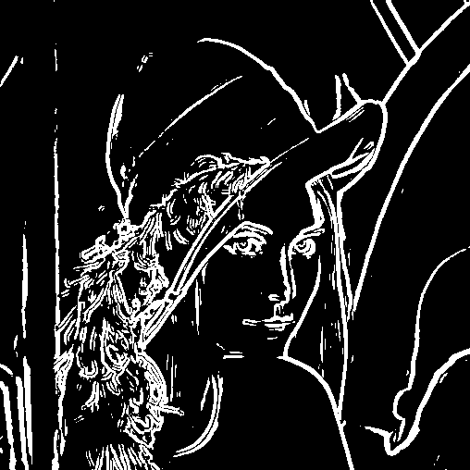
8.6 Gradient-Based Facet Edge Detection
Example:
Set neighborhood size to 5*5, threshold to 10, 60, 120, respectively.

Slide 107
8.6 Gradient-Based Facet Edge Detection
Example:
Set neighborhood size to 3*3, threshold to 10, 60, 120, respectively.

Slide 108
8.6 Gradient-Based Facet Edge Detection
Example:
Set neighborhood size to 3*3, threshold to 10, 60, 120, respectively.

Slide 109
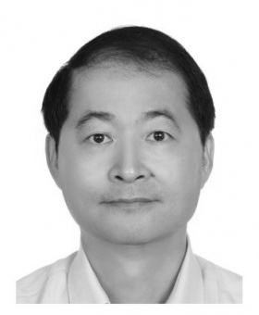
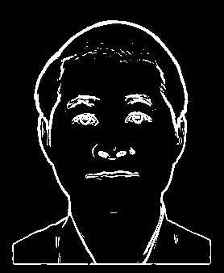
8.6 Gradient-Based Facet Edge Detection
Example:
Handsome young man
Notes:
Neighborhood = 3*3, threshold = 120

Slide 110
Outline
8.1 Introduction
8.2 Relative Maxima
8.3 Sloped Facet Parameter and Error Estimation
8.4 Facet-Based Peak Noise Removal
8.5 Iterated Facet Model
8.6 Gradient-Based Facet Edge Detection
8.7 Bayesian Approach to Gradient Edge Detection
8.8 Zero-Crossing Edge Detector
8.9 Integrated Directional Derivative Gradient Operator
8.10 Corner Detection
8.11 Isotropic Derivative Magnitudes
8.12 Ridges and Ravines on Digital Images
8.13 Topographic Primal Sketch
Notes:
8.7 使用貝式定理去決定觀測的梯度強度是否為Edge

Slide 111
8.7 Bayesian Approach to Gradient Edge Detection
The Bayesian approach is to decide there is an edge (statistically significant gradient) when,
$$P\left(edge | G\right)>P\left(nonedge|G\right)$$
$P\left(edge | G\right) :$ given gradient magnitude conditional probability of edge.
$P\left(nonedge|G\right) :$ given gradient magnitude conditional probability of nonedge.

Slide 112
8.7 Bayesian Approach to Gradient Edge Detection
$$P\left(edge | G\right)=\frac{P\left(G | edge\right)P\left(edge\right)}{P\left(G\right)}$$
$$P\left(nonedge | G\right)=\frac{P\left(G | nonedge\right)P\left(nonedge\right)}{P\left(G\right)}$$
$$P\left(edge | G\right)>P\left(nonedge|G\right)$$
Hence, a decision for edge is made whenever
$$P\left(G | edge\right)P\left(edge\right)>P\left(G | nonedge\right)P\left(nonedge\right)$$

Slide 113
8.7 Bayesian Approach to Gradient Edge Detection
$$P\left(G | edge\right)P\left(edge\right)>P\left(G | nonedge\right)P\left(nonedge\right)$$
$P(G|nonedge)$ can be known according to the theory of chi-square distribution,
$P\left(nonedge\right)$ is a user-specified prior probability of non-edge, 0.9 to 0.95 are reasonable.
$P\left(edge\right)$ = 1 - $P\left(nonedge\right)$

Slide 114
8.7 Bayesian Approach to Gradient Edge Detection
Infer $P\left(G | edge\right)$ from $P(G)$
$P\left(G\right)=P\left(G | edge\right)P\left(edge\right)+P\left(G | nonedge\right)P\left(nonedge\right)$
$P\left(G | edge\right)=\frac{P\left(G\right)−P\left(G | nonedge\right)P\left(nonedge\right)}{P\left(edge\right)}$
$=\frac{P\left(G\right)−P\left(G | nonedge\right)P\left(nonedge\right)}{1−P\left(nonedge\right)}$
Notes:
P(G) density function of the histogram of observed gradient magnitude
從 P(G) 可推出 P(給定是邊 ，G的機率)

Slide 115
8.7 Bayesian Approach to Gradient Edge Detection
The threshold t for G is determined as that value t for which
$$P\left(t | edge\right)P\left(edge\right)=P\left(t | nonedge\right)P\left(nonedge\right)$$
Implies that the threshold t must satisfy that
$P\left(t\right)=2P\left(t | nonedge\right)P\left(nonedge\right)$
Notes:
G 的門檻值 t
因$為P\left(t\right)=P\left(t | edge\right)P\left(edge\right)+P\left(t | nonedge\right)P\left(nonedge\right)$,
而且$P\left(t | edge\right)P\left(edge\right)=P\left(t | nonedge\right)P\left(nonedge\right)$,
所以$P\left(t\right)=2P\left(t | nonedge\right)P\left(nonedge\right)$

Slide 116
Outline
8.1 Introduction
8.2 Relative Maxima
8.3 Sloped Facet Parameter and Error Estimation
8.4 Facet-Based Peak Noise Removal
8.5 Iterated Facet Model
8.6 Gradient-Based Facet Edge Detection
8.7 Bayesian Approach to Gradient Edge Detection
8.8 Zero-Crossing Edge Detector
8.9 Integrated Directional Derivative Gradient Operator
8.10 Corner Detection
8.11 Isotropic Derivative Magnitudes
8.12 Ridges and Ravines on Digital Images
8.13 Topographic Primal Sketch
Notes:
8.8討論zero crossing 在二階導數的邊界偵測
二階微分 zero crossing detectors(檢測器)

Slide 117
8.8 Zero-Crossing Edge Detector
compare
gradient edge detector: looks for high values of first derivatives
zero-crossing edge detector: looks for relative maxima in first derivative
In what follows we assume that in each neighborhood of the images, the underlying gray-level intensity function f takes the form
Notes:
Zero-crossing edge detector : 會在一階導數相對極大值
接下來，我們假設在圖像的每個鄰域中，底層灰度強度函數f的形式為

Slide 118
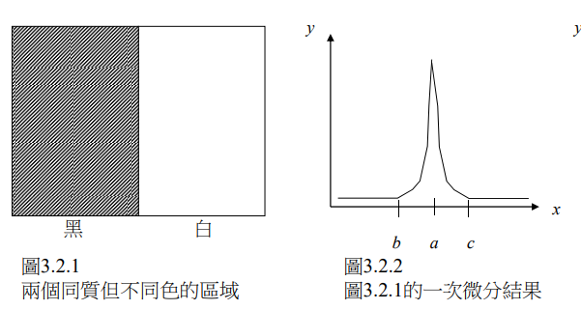
8.8 Zero-Crossing Edge Detector
http://140.117.156.238/course/CSSV/2011/%E7%9B%A3%E6%8E%A7%E8%A6%96%E8%A8%8A_ch3.pdf
Notes:
圖例
引用
http://140.117.156.238/course/CSSV/2011/%E7%9B%A3%E6%8E%A7%E8%A6%96%E8%A8%8A_ch3.pdf

Slide 119
8.8.1 Discrete Orthogonal Polynomials
A discrete orthogonal polynomial consists of Index Set R and Polynomial Set P.
A discrete orthogonal polynomial of size N has polynomials from degree 0~N-1.
The index set R must be symmetric. If $r∈R, then −r∈R.$
Ex.
Index Set
Discrete Orthogonal Polynomial Set
$$\{1, r, r^{2}−\frac{2}{3}\}$$
$$\{−1, 0, 1\}$$

Slide 120
8.8.1 Discrete Orthogonal Polynomials
Suppose $P=\{P_{0}\left(r\right), …,P_{n−1}\left(r\right)\}$, $P_{i}\left(r\right)$ must be orthogonal to $P_{j}\left(r\right)$, where $0≤i,j≤n−1, i≠j$.
Hence, we must have the equations, $\sum_{r∈R}{P_{i}\left(r\right)P_{j}\left(r\right)=0,} 0≤i<j≤n−1.$
Ex. Let $R=\left\{−1, 0, 1\right\},$ $P=\{1, r, r^{2}−\frac{2}{3}\}$

Slide 121
8.8.1 Discrete Orthogonal Polynomials
Ex. Let $R=\left\{−1, 0, 1\right\},$ $P=\{1, r, r^{2}−\frac{2}{3}\}$
$$\sum_{r∈R}{P_{0}\left(r\right)P_{1}\left(r\right)=}\sum_{r∈R}{r=}\left(−1+0 +1\right)=0$$
$$\sum_{r∈R}{P_{0}\left(r\right)P_{2}\left(r\right)=}\sum_{r∈R}{(r^{2}−\frac{2}{3})=}\left(\frac{1}{3}+\left(−\frac{2}{3}\right)+\frac{1}{3}\right)=0$$
$$\sum_{r∈R}{P_{1}\left(r\right)P_{2}\left(r\right)=}\sum_{r∈R}{(r^{3}−\frac{2}{3}r)=}\left((−\frac{1}{3})+0+\frac{1}{3}\right)=0$$

Slide 122
8.8.1 Discrete Orthogonal Polynomials
Ex. Let $R=\left\{−1, 0, 1\right\},$ $P=\{1, r, r^{2}−\frac{2}{3}\}$
$$\sum_{r∈R}{P_{0}\left(r\right)P_{1}\left(r\right)=}\sum_{r∈R}{r=}\left(−1+0 +1\right)=0$$
$$\sum_{r∈R}{P_{0}\left(r\right)P_{2}\left(r\right)=}\sum_{r∈R}{(r^{2}−\frac{2}{3})=}\left(\frac{1}{3}+\left(−\frac{2}{3}\right)+\frac{1}{3}\right)=0$$
$$\sum_{r∈R}{P_{1}\left(r\right)P_{2}\left(r\right)=}\sum_{r∈R}{(r^{3}−\frac{2}{3}r)=}\left((−\frac{1}{3})+0+\frac{1}{3}\right)=0$$

Slide 123
8.8.1 Discrete Orthogonal Polynomials
Ex. Let $R=\left\{−1, 0, 1\right\},$ $P=\{1, r, r^{2}−\frac{2}{3}\}$
$$\sum_{r∈R}{P_{0}\left(r\right)P_{1}\left(r\right)=}\sum_{r∈R}{r=}\left(−1+0 +1\right)=0$$
$$\sum_{r∈R}{P_{0}\left(r\right)P_{2}\left(r\right)=}\sum_{r∈R}{(r^{2}−\frac{2}{3})=}\left(\frac{1}{3}+\left(−\frac{2}{3}\right)+\frac{1}{3}\right)=0$$
$$\sum_{r∈R}{P_{1}\left(r\right)P_{2}\left(r\right)=}\sum_{r∈R}{(r^{3}−\frac{2}{3}r)=}\left((−\frac{1}{3})+0+\frac{1}{3}\right)=0$$

Slide 124
8.8.1 Discrete Orthogonal Polynomials
discrete orthogonal polynomials can be recursively generated:
$P_{i+1}\left(r\right)=rP_{i}(r)－β_{i}P_{i−1}\left(r\right)$
$$P_{0 }\left(r\right)=1,P_{1 }\left(r\right)=r$$
$β_{i}=\frac{\sum_{r∈R}{rP_{i}\left(r\right)P_{i−1}\left(r\right)}}{\sum_{r∈R}{P_{i−1}^{2}\left(r\right)}}$

Slide 125
8.8.1 Discrete Orthogonal Polynomials
The first 4 polynomial function formulas are:
$$P_{0}\left(r\right)=1$$
$P_{1}\left(r\right)=r$
$${ P}_{2}\left(r\right)=r^{2}−\frac{μ_{2}}{μ_{0}}$$
$${ P}_{3}\left(r\right)=r^{3}−\frac{μ_{4}}{μ_{2}}r$$
$$, where μ_{k}=\sum_{s∈R}{s^{k}}$$

Slide 126
8.8.1 Discrete Orthogonal Polynomials
Ex.
Index Set
Discrete Orthogonal Polynomial Set
$$\{1, r, r^{2}−\frac{2}{3}\}$$
$$\{−1, 0, 1\}$$
$${ P}_{2}\left(r\right)=r^{2}−\frac{μ_{2}}{μ_{0}}, μ_{k}=\sum_{s∈R}{s^{k}}$$
${ P}_{2}\left(r\right)= r^{2}−\frac{μ_{2}}{μ_{0}} = r^{2}−\frac{\sum_{s∈R}{s^{2}}}{\sum_{s∈R}{s^{0}}} =$ $r^{2}−\frac{1+0+1}{1+1+1} = r^{2}−\frac{2}{3}$

Slide 127
8.8.1 Discrete Orthogonal Polynomials
The polynomial function can be expressed as:
$$f\left(r\right)=\sum_{n=0}^{N−1}{{a_{n}P}_{n}\left(r\right)}, where a_{i} are the coefficents.$$

Slide 128
8.8.2 Two-Dimensional Discrete Orthogonal Polynomials
2-D discrete orthogonal polynomials creatable from tensor products of 1D from above equations
Index Set
{-1,0,1}$×${-1,0,1}
Discrete Orthogonal Polynomial Set
$$\{1,r,r^{2}−\frac{2}{3}\}×\left\{1,c,c^{2}−\frac{2}{3}\right\}$$
$$=\{1,r,r^{2}−\frac{2}{3},c,{rc, c\left(r^{2}−\frac{2}{3}\right),c}^{2}−\frac{2}{3}, r\left(c^{2}−\frac{2}{3}\right),(r^{2}−\frac{2}{3})(c^{2}−\frac{2}{3})\}$$
Notes:
二維離散正交多項式從上面的從一維公式張量積 可創建
直接乘開

Slide 129
8.8.2 Two-Dimensional Discrete Orthogonal Polynomials
2-D discrete orthogonal polynomials creatable from tensor products of 1D from above equations
Index Set
{-1,0,1}$×${-1,0,1}
Discrete Orthogonal Polynomial Set
$$\{1,r,r^{2}−\frac{2}{3}\}×\left\{1,c,c^{2}−\frac{2}{3}\right\}$$
$$=\{1,r,r^{2}−\frac{2}{3},c,{rc, c\left(r^{2}−\frac{2}{3}\right),c}^{2}−\frac{2}{3}, r\left(c^{2}−\frac{2}{3}\right),(r^{2}−\frac{2}{3})(c^{2}−\frac{2}{3})\}$$
Notes:
二維離散正交多項式從上面的從一維公式張量積 可創建
直接乘開

Slide 130
8.8.2 Two-Dimensional Discrete Orthogonal Polynomials
2-D discrete orthogonal polynomials creatable from tensor products of 1D from above equations
Index Set
{-1,0,1}$×${-1,0,1}
Discrete Orthogonal Polynomial Set
$$\{1,r,r^{2}−\frac{2}{3}\}×\left\{1,c,c^{2}−\frac{2}{3}\right\}$$
$$=\{1,r,r^{2}−\frac{2}{3},c,{rc, c\left(r^{2}−\frac{2}{3}\right),c}^{2}−\frac{2}{3}, r\left(c^{2}−\frac{2}{3}\right),(r^{2}−\frac{2}{3})(c^{2}−\frac{2}{3})\}$$
Notes:
二維離散正交多項式從上面的從一維公式張量積 可創建
直接乘開

Slide 131
8.8.2 Two-Dimensional Discrete Orthogonal Polynomials
2-D discrete orthogonal polynomials creatable from tensor products of 1D from above equations
Index Set
{-1,0,1}$×${-1,0,1}
Discrete Orthogonal Polynomial Set
$$\{1,r,r^{2}−\frac{2}{3}\}×\left\{1,c,c^{2}−\frac{2}{3}\right\}$$
$$=\{1,r,r^{2}−\frac{2}{3},c,{rc, c\left(r^{2}−\frac{2}{3}\right),c}^{2}−\frac{2}{3}, r\left(c^{2}−\frac{2}{3}\right),(r^{2}−\frac{2}{3})(c^{2}−\frac{2}{3})\}$$
Notes:
二維離散正交多項式從上面的從一維公式張量積 可創建
直接乘開

Slide 132
8.8.2 Two-Dimensional Discrete Orthogonal Polynomials
The polynomial function can be expressed as:
$$f\left(r, c\right)=\sum_{n=0}^{R∗C−1}{{a_{n}P}_{n}\left(r, c\right)}, where a_{i} are the coefficents.$$
Notes:
二維離散正交多項式從上面的從一維公式張量積 可創建
直接乘開

Slide 133
8.8.3 Equal-Weighted Least-Squares Fitting Problem
The approximate fitting problem is to determine coefficients a₀,…,a_{K}, $K≤N−1$, such that
$$e^{2}=\sum_{r∈R}{{\left[d\left(r\right)−\sum_{n=0}^{K}{a_{n}P_{n}\left(r\right)}\right]}^{2}is minimized.}$$
$$the result is a_{m}=\frac{\sum_{r∈R}{P_{m}\left(r\right)d(r)}}{\sum_{s∈R}{P_{m}^{2}\left(s\right)}}.$$
Notes:
d(r) 觀測值，同樣的 least-square error fitting
a_m means that each fitting coefficients can be computed as a linear combination of the data values
(am 代表可將每一項係數，直接由 data values 的線性組合產生)

Slide 134
8.8.3 Equal-Weighted Least-Squares Fitting Problem
$Let f\left(r, c\right)=a_{0}+a_{1}r+a_{2}c+a_{3}\left(r^{2}−2\right)+a_{4}rc+$
$$a_{5}\left(c^{2}−2\right)+a_{6}\left(r^{3}−3.4r\right)+a_{7}\left(r^{2}−2\right)c+a_{8}r\left(c^{2}−2\right)+$$
$$a_{9}\left(c^{3}−3.4c\right)$$
$Let d=$
1 | 1 | 1 | 1 | 5
1 | 1 | 1 | 5 | 6
1 | 1 | 5 | 6 | 6
1 | 5 | 6 | 6 | 6
1 | 5 | 6 | 6 | 6
Notes:
推倒 am
偏微分 -> 移項

Slide 135
8.8.3 Equal-Weighted Least-Squares Fitting Problem
$Let f\left(r, c\right)=a_{0}+a_{1}r+a_{2}c+a_{3}\left(r^{2}−2\right)+a_{4}rc+$
$$a_{5}\left(c^{2}−2\right)+a_{6}\left(r^{3}−3.4r\right)+a_{7}\left(r^{2}−2\right)c+a_{8}r\left(c^{2}−2\right)+$$
$$a_{9}\left(c^{3}−3.4c\right)$$
$Let d=$
c
r
-2
-1
0
1
2
1 | 1 | 1 | 1 | 5
1 | 1 | 1 | 5 | 6
1 | 1 | 5 | 6 | 6
1 | 5 | 6 | 6 | 6
1 | 5 | 6 | 6 | 6
-2
-2 | -2 | -2 | -2 | -2
-1 | -1 | -1 | -1 | -1
0 | 0 | 0 | 0 | 0
1 | 1 | 1 | 1 | 1
2 | 2 | 2 | 2 | 2
-1
0
1
2
$$r$$
Notes:
推倒 am
偏微分 -> 移項

Slide 136
8.8.3 Equal-Weighted Least-Squares Fitting Problem
$a_{1}=\frac{\sum_{(r,c)∈R×C}{P_{1}\left(r, c\right)d(r,c)}}{\sum_{(r,c)∈R×C}{P_{1}^{2}\left(r,c\right)}}$
1*(-2) | 1*(-2) | 1*(-2) | 1*(-2) | 5*(-2)
1*(-1) | 1*(-1) | 1*(-1) | 5*(-1) | 6*(-1)
1*0 | 1*0 | 5*0 | 6*0 | 6*0
1*1 | 5*1 | 6*1 | 6*1 | 6*1
1*2 | 5*2 | 6*2 | 6*2 | 6*2
sum up
$$40$$
Notes:
推倒 am
偏微分 -> 移項

Slide 137
8.8.3 Equal-Weighted Least-Squares Fitting Problem
$a_{1}=\frac{\sum_{(r,c)∈R×C}{P_{1}\left(r, c\right)d(r,c)}}{\sum_{(r,c)∈R×C}{P_{1}^{2}\left(r,c\right)}}$
-2 | -2 | -2 | -2 | -2
-1 | -1 | -1 | -1 | -1
0 | 0 | 0 | 0 | 0
1 | 1 | 1 | 1 | 1
2 | 2 | 2 | 2 | 2
4 | 4 | 4 | 4 | 4
1 | 1 | 1 | 1 | 1
0 | 0 | 0 | 0 | 0
1 | 1 | 1 | 1 | 1
4 | 4 | 4 | 4 | 4
square
sum up
$$50$$
$$r$$
Notes:
推倒 am
偏微分 -> 移項

Slide 138
8.8.3 Equal-Weighted Least-Squares Fitting Problem
$Let f\left(r, c\right)=a_{0}+a_{1}r+a_{2}c+a_{3}\left(r^{2}−2\right)+a_{4}rc+$
$$a_{5}\left(c^{2}−2\right)+a_{6}\left(r^{3}−3.4r\right)+a_{7}\left(r^{2}−2\right)c+a_{8}r\left(c^{2}−2\right)+$$
$$a_{9}\left(c^{3}−3.4c\right)$$
$Let d=$
$$a_{1}=\frac{\sum_{(r,c)∈R×C}{P_{1}\left(r, c\right)d(r,c)}}{\sum_{(r,c)∈R×C}{P_{1}^{2}\left(r,c\right)}}$$
$$=\frac{40}{50}$$
$$=0.8$$
1 | 1 | 1 | 1 | 5
1 | 1 | 1 | 5 | 6
1 | 1 | 5 | 6 | 6
1 | 5 | 6 | 6 | 6
1 | 5 | 6 | 6 | 6
Notes:
推倒 am
偏微分 -> 移項

Slide 139
8.8.3 Equal-Weighted Least-Squares Fitting Problem
$Let f\left(r, c\right)=a_{0}+a_{1}r+a_{2}c+a_{3}\left(r^{2}−2\right)+a_{4}rc+$
$$a_{5}\left(c^{2}−2\right)+a_{6}\left(r^{3}−3.4r\right)+a_{7}\left(r^{2}−2\right)c+a_{8}r\left(c^{2}−2\right)+$$
$$a_{9}\left(c^{3}−3.4c\right)$$
$Let d=$
1 | 1 | 1 | 1 | 5
1 | 1 | 1 | 5 | 6
1 | 1 | 5 | 6 | 6
1 | 5 | 6 | 6 | 6
1 | 5 | 6 | 6 | 6
4 | 2 | 0 | -2 | -4
2 | 1 | 0 | -1 | -2
0 | 0 | 0 | 0 | 0
-2 | -1 | 0 | 1 | 2
-4 | -2 | 0 | 2 | 4
$$rc$$
Notes:
推倒 am
偏微分 -> 移項

Slide 140
8.8.3 Equal-Weighted Least-Squares Fitting Problem
$a_{4}=\frac{\sum_{(r,c)∈R×C}{P_{4}\left(r, c\right)d(r,c)}}{\sum_{(r,c)∈R×C}{P_{4}^{2}\left(r,c\right)}}$
1*4 | 1*2 | 1*0 | 1*(-2) | 5*(-4)
1*2 | 1*1 | 1*0 | 5*(-1) | 6*(-2)
1*0 | 1*0 | 5*0 | 6*0 | 6*0
1*(-2) | 5*(-1) | 6*0 | 6*1 | 6*2
1*(-4) | 5*(-2) | 6*0 | 6*2 | 6*4
sum up
$$3$$
Notes:
推倒 am
偏微分 -> 移項

Slide 141
8.8.3 Equal-Weighted Least-Squares Fitting Problem
$a_{4}=\frac{\sum_{(r,c)∈R×C}{P_{4}\left(r, c\right)d(r,c)}}{\sum_{(r,c)∈R×C}{P_{4}^{2}\left(r,c\right)}}$
4 | 2 | 0 | -2 | 4
2 | 1 | 0 | -1 | 2
0 | 0 | 0 | 0 | 0
-2 | -1 | 0 | 1 | 2
-4 | -2 | 0 | 2 | 4
16 | 4 | 0 | 4 | 16
4 | 1 | 0 | 1 | 4
0 | 0 | 0 | 0 | 0
4 | 1 | 0 | 1 | 4
16 | 4 | 0 | 4 | 16
square
sum up
$$100$$
$$r$$
Notes:
推倒 am
偏微分 -> 移項

Slide 142
8.8.3 Equal-Weighted Least-Squares Fitting Problem
$Let f\left(r, c\right)=a_{0}+a_{1}r+a_{2}c+a_{3}\left(r^{2}−2\right)+a_{4}rc+$
$$a_{5}\left(c^{2}−2\right)+a_{6}\left(r^{3}−3.4r\right)+a_{7}\left(r^{2}−2\right)c+a_{8}r\left(c^{2}−2\right)+$$
$$a_{9}\left(c^{3}−3.4c\right)$$
$Let d=$
$$a_{4}=\frac{\sum_{(r,c)∈R×C}{P_{4}\left(r, c\right)d(r,c)}}{\sum_{(r,c)∈R×C}{P_{4}^{2}\left(r,c\right)}}$$
$$=\frac{3}{100}$$
$$=0.03$$
1 | 1 | 1 | 1 | 5
1 | 1 | 1 | 5 | 6
1 | 1 | 5 | 6 | 6
1 | 5 | 6 | 6 | 6
1 | 5 | 6 | 6 | 6
Notes:
推倒 am
偏微分 -> 移項

Slide 143
8.8.4 Directional Derivative Edge Finder
Review: z$\text{ero}\text{−}\text{crossing} \text{edge} \text{detector}\text{: }\text{looks} \text{for} \text{relative} \text{maxima} \text{in} \text{first} \text{derivative}$
Notes:
我們定義方向導數邊界尋檢器視為一運算。
一個邊的所有pixel 的二階方向導數在具有方向梯度上有負斜率過零點
ρ(rho), alpha

Slide 144
8.8.4 Directional Derivative Edge Finder
We transfer the $f\left(r, c\right)$ into polar coordinating system.
$$f\left(r, c\right)→ f_{α}(ρ)$$
$r$: row
$c$: column
$ρ$: radius in polar coordinate
$α$ : angle in polar coordinate, clockwise from column axis
Notes:
我們定義方向導數邊界尋檢器視為一運算。
一個邊的所有pixel 的二階方向導數在具有方向梯度上有負斜率過零點
ρ(rho), alpha

Slide 145
8.8.4 Directional Derivative Edge Finder
We can easily replace $r, c$ with $ρsinα, ρcosα,$ respectively.
$$r=ρsinα, c=ρcosα$$
We define $α$ with
$$sinα=\frac{k_{2}}{\sqrt{k_{2}^{2}+k_{3}^{2}}}, cosα=\frac{k_{3}}{\sqrt{k_{2}^{2}+k_{3}^{2}}}$$
where $k_{2}$represents the sum of weight that involves $r$,
and $k_{3}$represents the sum of weight that involves $c$.
Notes:
我們定義方向導數邊界尋檢器視為一運算。
一個邊的所有pixel 的二階方向導數在具有方向梯度上有負斜率過零點
ρ(rho), alpha

Slide 146
8.8.4 Directional Derivative Edge Finder
Relative Maximum
For some $\left|ρ\right|<ρ_{0},$where $ρ_{0}$is slightly smaller than the length of the side of a pixel. (Ex. $ρ_{0}=1.0$)
$f_{α}^{′′′}\left(ρ\right)<0$
$f_{α}^{′′}\left(ρ\right)=0$
$f_{α}^{′}\left(ρ\right)≠0$
The pixel is marked as edge candidate
Notes:
所以 edge pixel
往下看範例

Slide 147
8.8.4 Directional Derivative Edge Finder
Analyzing
Transfer $f_{α}(ρ)$ to $g_{α}(ρ)$ so that the inflection point is at the origin, and the essence hasn’t change.
$f_{α}\left(ρ\right)= c_{0}+c_{1}ρ+c_{2}ρ^{2}+c_{3}ρ^{3}$
$g_{α}\left(ρ\right)=C(Sρ−S^{3}ρ^{3})$
$where, C=\frac{{(c_{2}^{2}−3c_{1}c_{3})}^{1.5}}{3^{1.5}c_{3}^{2}}, S=\sqrt{\frac{3c_{3}^{2}}{(c_{2}^{2}−3c_{1}c_{3})}}$
Notes:
所以 edge pixel
往下看範例

Slide 148
8.8.4 Directional Derivative Edge Finder
Analyzing (Continue.)
$g_{α}\left(ρ\right)=C\left(Sρ−S^{3}ρ^{3}\right)$
$g_{α}^{′}\left(ρ\right)=C\left(S−{3S}^{3}ρ^{2}\right)$
$g_{α}^{′′}\left(ρ\right)=−6CS^{3}ρ$
The locations of the relative maximum depend only on$S.$
They are located at $±1/S\sqrt{3}$. (Obtained by solving $g_{α}^{′}\left(ρ\right)$=0)
Notes:
所以 edge pixel
往下看範例

Slide 149
8.8.4 Directional Derivative Edge Finder
Analyzing (Continue.)
$g_{α}\left(ρ\right)=C\left(Sρ−S^{3}ρ^{3}\right)$
$g_{α}^{′}\left(ρ\right)=C\left(S−{3S}^{3}ρ^{2}\right)$
$g_{α}^{′′}\left(ρ\right)=−6CS^{3}ρ$
The height of the relative maximum depends only on$C.$
Their heights are $±2C/\sqrt{3}$. (Obtained by computing $g_{α}\left(±1/S\sqrt{3}\right)$)
Notes:
所以 edge pixel
往下看範例

Slide 150
8.8.4 Directional Derivative Edge Finder
Use the ideal step edge as experiments, we obtain: ($N$ = size of neighborhood)
-1 | -1 | 0 | 1 | 1
-1 | -1 | 0 | 1 | 1
-1 | -1 | 0 | 1 | 1
-1 | -1 | 0 | 1 | 1
-1 | -1 | 0 | 1 | 1
$$C=3.16257$$
$$S=\frac{1.793157}{N}$$
ideal step edge
Notes:
所以 edge pixel
往下看範例

Slide 151
8.8.4 Directional Derivative Edge Finder
We use this as our standard for edge detection, we let:
$$Edge contrast=\frac{2C}{3.16257}, Edge scale=\frac{S×N}{1.793157}$$
For an edge, $Edge contrast$ is bigger than $p$ times the image’s dynamic range (Highest pixel value – lowest pixel value).
Also, $Edge scale$ is restricted between $lb$~$ub$
(Usually, $p=0.05, lb=0.4, ub=1.1$)
Notes:
所以 edge pixel
往下看範例

Slide 152
8.8.4 Directional Derivative Edge Finder
Ex: Lena.bmp
Notes:
所以 edge pixel
往下看範例

Slide 153
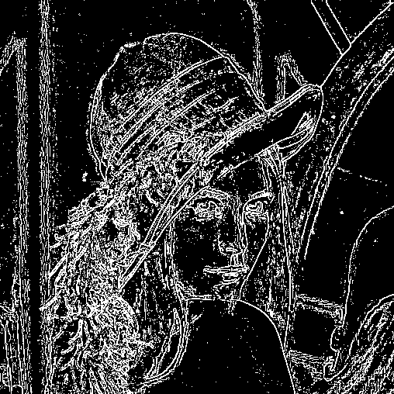
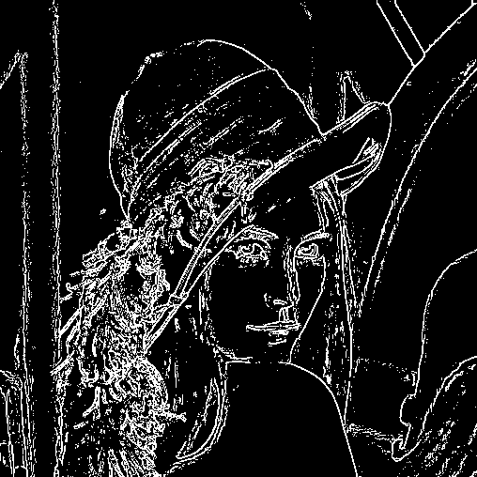
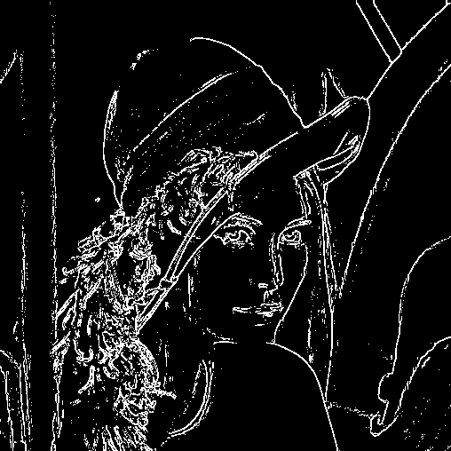
8.8.4 Directional Derivative Edge Finder
Ex:
$$p=0.05, lb=0.4, ub=1.1$$
$$p=0.1, lb=0.4, ub=1.1$$
$$p=0.15, lb=0.4, ub=1.1$$
Notes:
所以 edge pixel
往下看範例

Slide 154
8.8.4 Directional Derivative Edge Finder
(Gradient-based)
Notes:
所以 edge pixel
往下看範例

Slide 155
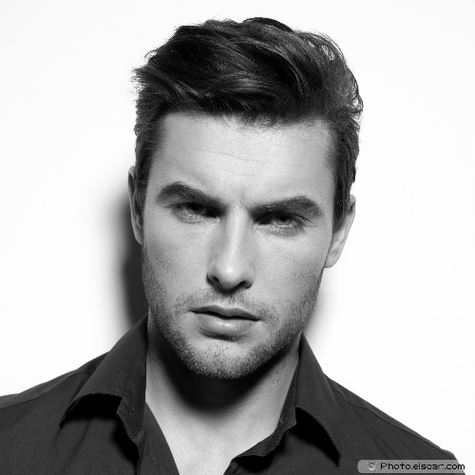
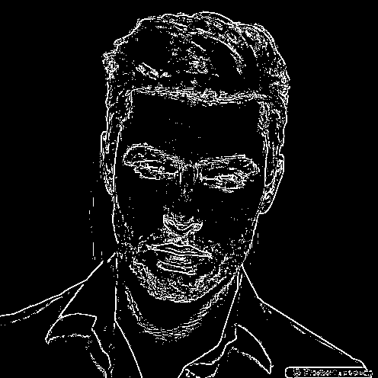
8.8.4 Directional Derivative Edge Finder
Ex:
Handsome young man
$$p=0.1, lb=0.4, ub=1.1$$
Notes:
所以 edge pixel
往下看範例

Slide 156
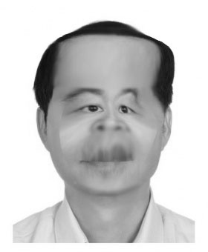
8.8.4 Directional Derivative Edge Finder
Ex:
Ugly old man.jpg
$$p=0.1, lb=0.4, ub=1.1$$
Notes:
所以 edge pixel
往下看範例

Slide 157
Outline
8.1 Introduction
8.2 Relative Maxima
8.3 Sloped Facet Parameter and Error Estimation
8.4 Facet-Based Peak Noise Removal
8.5 Iterated Facet Model
8.6 Gradient-Based Facet Edge Detection
8.7 Bayesian Approach to Gradient Edge Detection
8.8 Zero-Crossing Edge Detector
8.9 Integrated Directional Derivative Gradient Operator
8.10 Corner Detection
8.11 Isotropic Derivative Magnitudes
8.12 Ridges and Ravines on Digital Images
8.13 Topographic Primal Sketch
Notes:
8.9討論集成方向導數梯度

Slide 158
8.9 Integrated Directional Derivative Gradient Operator
integrated directional derivative gradient operator
an operator that measures the integrated directional derivative strength as the integral of first directional derivative taken over a square area
more accurate step edge direction
Journals
Notes:
積分 方向導數梯度，一個平面。而不是之前只看一個點
更為精準
更詳細可以看課本 8.9.1 、 8.9.2 有 demo
或是我有附上作者發在 IEEE journals 的連結

Slide 159
Outline
8.1 Introduction
8.2 Relative Maxima
8.3 Sloped Facet Parameter and Error Estimation
8.4 Facet-Based Peak Noise Removal
8.5 Iterated Facet Model
8.6 Gradient-Based Facet Edge Detection
8.7 Bayesian Approach to Gradient Edge Detection
8.8 Zero-Crossing Edge Detector
8.9 Integrated Directional Derivative Gradient Operator
8.10 Corner Detection
8.11 Isotropic Derivative Magnitudes
8.12 Ridges and Ravines on Digital Images
8.13 Topographic Primal Sketch
Notes:
8.10 討論小平面方法去做corner detection

Slide 160
8.10 Corner Detection
purpose
corners: to detect buildings in aerial images
corner points: to determine displacement vectors from image pair
corners with two conditions
the occurrence of an edge
significant changes in edge direction
Notes:
目的
偵測空照圖中的建築
角落點:求出一對圖片的位移向量
角落的2條件
有邊出現
明顯邊方向的變化

Slide 161
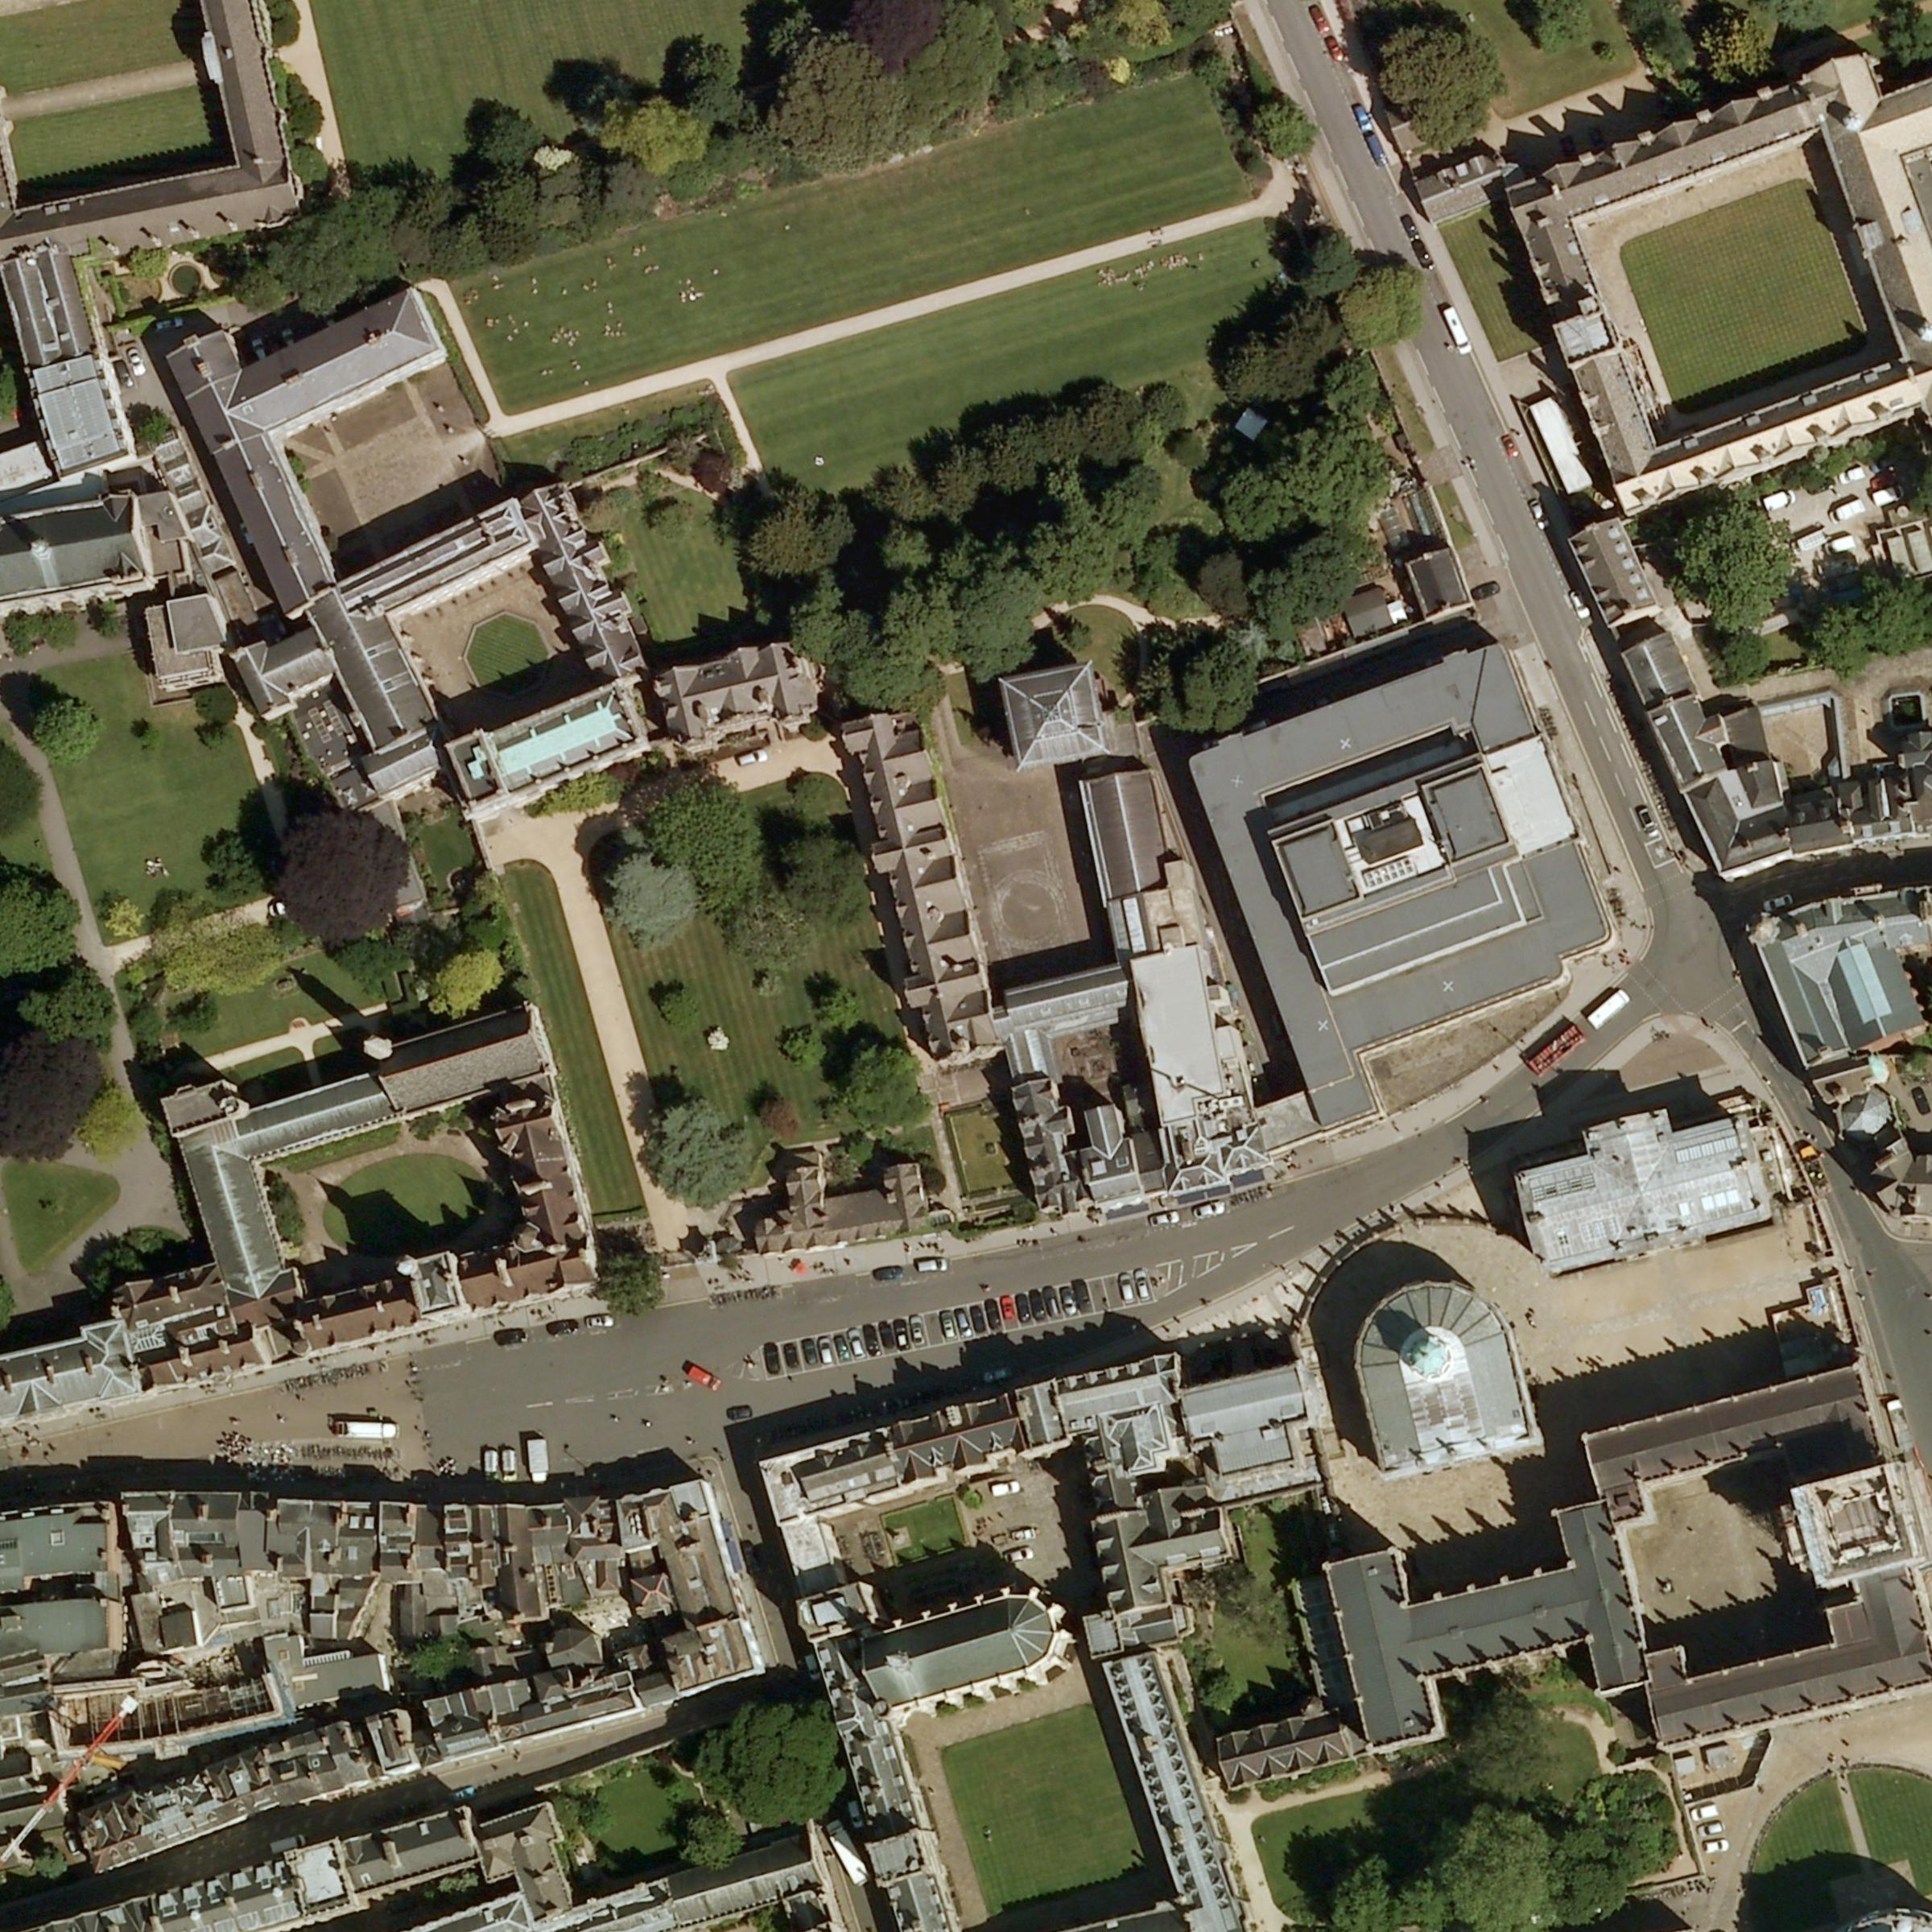
Aerial Images
Blackwell’s |
Book store‎
Notes:
空拍圖

Slide 162
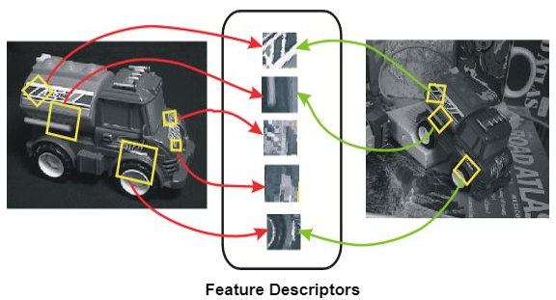
8.10 Corner Detection
corner points: to determine displacement vectors from image pair
Digital Image Processing, 4/e
Notes:
圖像匹配 (同個物件 不同角度)

Slide 163
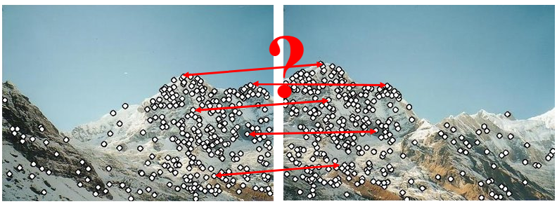
8.10 Corner Detection
corner points: to determine displacement vectors from image pair
Digital Image Processing, 4/e
Notes:
圖像結合

Slide 164
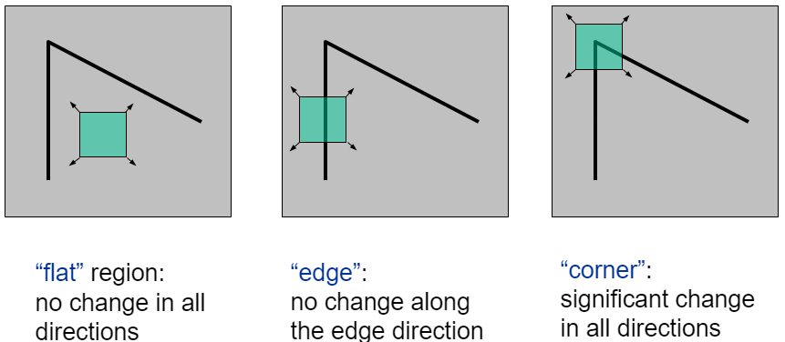
8.10 Corner Detection
corners with two conditions
the occurrence of an edge
significant changes in edge direction
Digital Image Processing, 4/e
Notes:
左: 移動一點不改變
中: 只有上下移動不改變
右: 怎動都改變

Slide 165
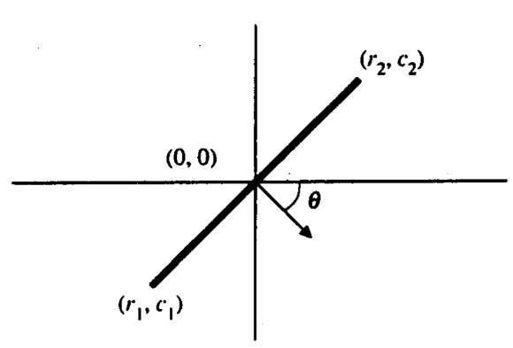
8.10 Corner Detection
Detection Method:
Given 3 points, $\left(0 ,0\right), \left(r_{1}, c_{1}\right), \left(r_{2}, c_{2}\right)$
Given a threshold $Ω$.
$|θ\left(r_{1}, c_{1}\right)−θ\left(r_{2}, c_{2}\right)|>Ω$.
$IsCorner= \left|θ\left(r_{1}, c_{1}\right)−θ\left(r_{2}, c_{2}\right)\right|>Ω ?True:False$
Notes:
課本這邊判斷是不是 Corner 採用以下方式

Slide 166
Outline
8.1 Introduction
8.2 Relative Maxima
8.3 Sloped Facet Parameter and Error Estimation
8.4 Facet-Based Peak Noise Removal
8.5 Iterated Facet Model
8.6 Gradient-Based Facet Edge Detection
8.7 Bayesian Approach to Gradient Edge Detection
8.8 Zero-Crossing Edge Detector
8.9 Integrated Directional Derivative Gradient Operator
8.10 Corner Detection
8.11 Isotropic Derivative Magnitudes
8.12 Ridges and Ravines on Digital Images
8.13 Topographic Primal Sketch
Notes:
8.11使用小平面的方法來說明各方向同性微分大小
Isotropic:等向的、各向同性。不同角度所測得的數值是相同的

Slide 167
8.11 Isotropic Derivative Magnitudes
A gradient edge can be understood as arising from a first-order isotropic derivative magnitude
Consider the two dimensional function.
$$f(r,c)=k_{1}+k_{2}r+k_{3}c$$
rotate the coordinate system by$θ$and call the resulting function g in the new (r’,c’) coordinate
Notes:
@梯度邊緣可以被理解為從第一階各向同性 導數 量值而產生
@判定二維函數的“二維函數的平方偏導”的線性組合在定義域下的旋轉下不變
＠選轉$θ角後的座標在 g 的表示如下頁$

Slide 168
8.11 Isotropic Derivative Magnitudes
(Continue. ) rotate the coordinate system by$θ$and call the resulting function g in the new (r’,c’) coordinate
$$r^{′}=rcosθ+csinθ, c^{′}=−rsinθ+ccosθ$$
$$g\left(r^{′},c^{′}\right)=k_{1}+k_{2}r^{′}+k_{3}c^{′}$$
=$k_{1}+\left(k_{2}cosθ−k_{3}sinθ\right)r+\left(k_{2}sinθ+k_{3}cosθ\right)c$
Notes:
移項一下可以用 r, c 表示 r’, c’

Slide 169
8.11 Isotropic Derivative Magnitudes
(Continue. ) rotate the coordinate system by$θ$and call the resulting function g in the new (r’,c’) coordinate
$$r^{′}=rcosθ+csinθ, c^{′}=−rsinθ+ccosθ$$
$$g\left(r^{′},c^{′}\right)=k_{1}+k_{2}r^{′}+k_{3}c^{′}$$
=$k_{1}+\left(k_{2}cosθ−k_{3}sinθ\right)r+\left(k_{2}sinθ+k_{3}cosθ\right)c$
Notes:
移項一下可以用 r, c 表示 r’, c’

Slide 170
8.11 Isotropic Derivative Magnitudes
$g\left(r^{′},c^{′}\right) = k_{1}+\left(k_{2}cosθ−k_{3}sinθ\right)r+\left(k_{2}sinθ+k_{3}cosθ\right)c$
${[\frac{∂g\left(r^{′}, c^{′}\right)}{∂r}]}^{2}+{[\frac{∂g\left(r^{′}, c^{′}\right)}{∂c}]}^{2}$
=(k₂cos$θ$-k₃sin$θ$)² + (k₂sin$θ$+ k₃cos$θ$)²
=$k_{2}^{2}+k_{3}^{2}={[\frac{∂f\left(r, c\right)}{∂r}]}^{2}+{[\frac{∂f\left(r, c\right)}{∂c}]}^{2}$
The sum of the squares of the first partials is the same constant $k_{2}^{2}+k_{3}^{2}$, the squared gradient magnitude, for the original function or for the rotated function.
$$f(r,c)=k_{1}+k_{2}r+k_{3}c$$
Notes:
偏微 r 與 c 的平方加總會是
看到與原本的 magnitude 平方相同
不因為旋轉改變

Slide 171
Outline
8.1 Introduction
8.2 Relative Maxima
8.3 Sloped Facet Parameter and Error Estimation
8.4 Facet-Based Peak Noise Removal
8.5 Iterated Facet Model
8.6 Gradient-Based Facet Edge Detection
8.7 Bayesian Approach to Gradient Edge Detection
8.8 Zero-Crossing Edge Detector
8.9 Integrated Directional Derivative Gradient Operator
8.10 Corner Detection
8.11 Isotropic Derivative
8.12 Ridges and Ravines on Digital Images
8.13 Topographic Primal Sketch
Notes:
8.12討論山脊和溝壑

Slide 172
8.12 Ridges and Ravines on Digital Images
Notes:
在數位影像上的山脊(Ridges)和深谷(Ravines)

Slide 173
8.12 Ridges and Ravines on Digital Images
A digital ridge (ravine) occurs on a digital image when there is a simply connected sequence of pixels with gray level intensity values that are significantly higher (lower) in the sequence than those neighboring the sequence.
The facet model can be used to help accomplish ridge and ravine identification.
Notes:
在數位影像上山脊或深谷，是灰階值簡單的相連，且與相鄰區域有著顯著的高(低)序列
山脊發生在灰階值比鄰居高
深谷發生在灰階值比鄰居低
Facet model 可用來鑑定
細節可以參考課本 8.12.2

Slide 174
Outline
8.1 Introduction
8.2 Relative Maxima
8.3 Sloped Facet Parameter and Error Estimation
8.4 Facet-Based Peak Noise Removal
8.5 Iterated Facet Model
8.6 Gradient-Based Facet Edge Detection
8.7 Bayesian Approach to Gradient Edge Detection
8.8 Zero-Crossing Edge Detector
8.9 Integrated Directional Derivative Gradient Operator
8.10 Corner Detection
8.11 Isotropic Derivative Magnitudes
8.12 Ridges and Ravines on Digital Images
8.13 Topographic Primal Sketch
Notes:
8.13提出了每個像素的各種地形類別的標籤轉化

Slide 175
8.13 Topographic Primal Sketch 8.13.1 Introduction
We can categorize topography using functions.
Categories:
These categories have required invariance
Peak
Pit
Ridge
Ravine
Saddle
Flat
Hillside
Notes:
根據單調函數、灰度函數和不變函數定義的類別，
我們能將地形分成幾類，並進行標記和分類，就構成了地形原始草圖(地形基本素描)
Peak:山峰 pit:凹坑 ridge:山脊 ravine:深谷 saddle:鞍狀 flat:平面 hillside:山坡

Slide 176
8.13.2 Mathematical Classification of Topographic Structure
We will use the following notation to describe the mathematical properties of our topographic categories for continuous surfaces
Notes:
@ f 的梯度向量(vector)
＠梯度強度
＠ω1: 二階方向導數具有最大強度的單位方向向量(vector)
＠ω2: 正交於ω1 的向量(vector)
＠二階方向導數在w¹方向的值

Slide 177
8.13.2 Peak
Peak (knob): occurs where there is a local maximum in all directions
curvature downward in all directions
gradient zero & second directional derivative negative in all directions
point classified as peak if
$λ_{1}$ is second directional derivative in $ω^{\left(1\right)}$ direction.
$λ_{2}$ is second directional derivative in $ω^{\left(2\right)}$ direction.
: gradient magnitude
Notes:
@發生在所有方向的局部最大值
＠所有方下的曲率皆向下
＠在峰點：梯度為0
@所有方向的二階方向導數皆為負

Slide 178
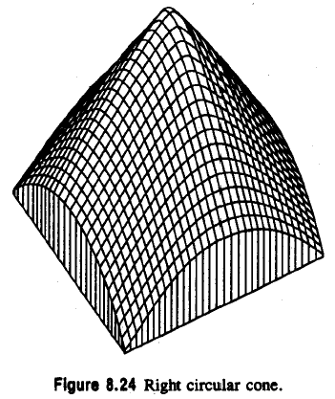
8.13.2 Peak
: second directional derivative in direction
: second directional derivative in direction
Notes:
梯度各方項都是負的

Slide 179
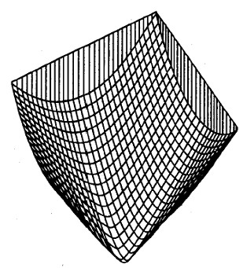
8.13.2 Pit
pit (sink: bowl): local minimum in all directions
pit: gradient zero, second directional derivative positive
Notes:
＠跟peak 相反，所有方向皆為正的
(只是把 Peak 翻轉，實際上課本沒有圖，不知道誰想到的方法)

Slide 180
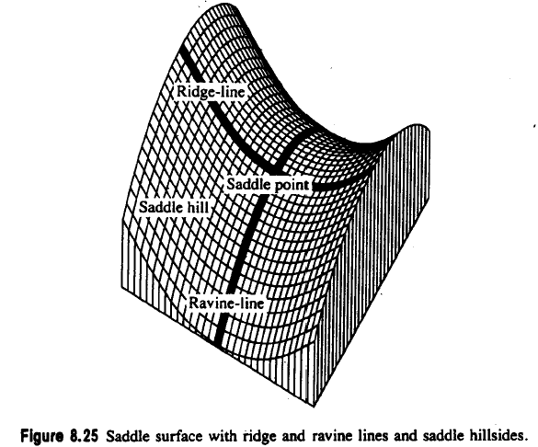
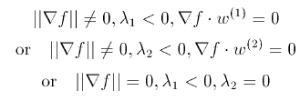
8.13.2 Ridge
A ridge occurs on ridge line, a curve consisting of a series of ridge points and along ridge line, the points to the right and left are lower
ridge line: may be flat, sloped upward, sloped downward, curved upward…
ridge: local maximum in one direction
Notes:
Ridge (山脊、山脈)
@發生在稜線
＠包含了一系列的脊點

Slide 181
8.13.2 Ravine
A ravine (valley): is identical to a ridge except that it is a local minimum in one direction
walk along ravine line: points to the right and left are higher
Notes:
Ravine(峽谷): 兩側都比他高

Slide 182
8.13.2 Saddle
local maximum in one direction, local minimum in perpendicular dir.
positive curvature in one direction, negative in perpendicular dir.
gradient magnitude zero
extrema of second
directional derivative
have opposite signs
Notes:
Saddle (鞍)
＠在一方向有局部最大值，另一方向則有局部最小值
＠一方向正曲率，另一垂直方向為負
＠梯度為0
＠兩個不同方向的極值也正負相反

Slide 183
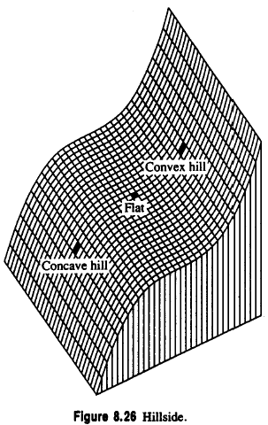
8.13.2 Flat
A flat (plain) is a simple, horizontal surface, must have zero gradient and no curvature.
It satisfies the following conditions
Notes:
Flat (平的)
＠平面、簡單、水平表面
＠梯度0,沒有曲率
＠
＠foot : 平開始轉成小山往上
＠shoulder：平結束變且開始轉成斜坡往下的地方
Hill(小山、斜坡)

Slide 184
8.13.2 Hillside
A hillside point is anything not covered by previous categories.
hillside: nonzero gradient, no strict extrema
Slope: tilted flat (constant gradient)
convex hill: curvature positive (upward)
concave hill: curvature negative
(downward)
Notes:
Hillside(山腰、山坡)
＠非零梯度、沒有嚴格的極值
＠山坡：非零梯度，無嚴格極大值
＠斜率：傾斜的平面（常數梯度）
＠凸的山坡:曲率為正（向上）
往外凸
不是 convex hull(凸包)

Slide 185
8.13.2 Hillside
saddle hill: up in one direction, down in perpendicular direction
inflection point: zero
crossing of second
directional derivative
Notes:
＠凹的坡：曲率為負（向下）(往內凹)
＠鞍狀坡：一方向向上，另一垂直方向向下
＠拐點、反區點：第二個方向導數的過零點

Slide 186
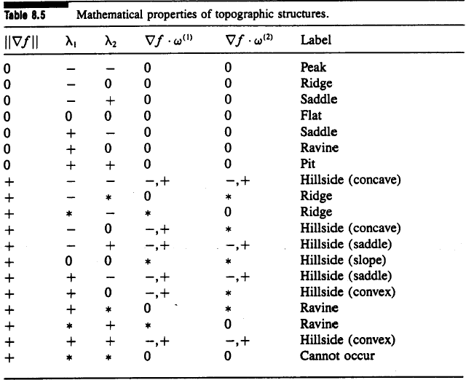
8.13.2 Summary of the Topographic Categories
Mathematical properties of topographic structures on continuous surfaces
Notes:
總結的表格

Slide 187
8.13.3 Topographic Classification Algorithm
peak, pit, ridge, ravine, saddle: likely not to occur precisely at a pixel’s center
peak, pit, ridge, ravine, saddle: if within pixel area, carry the label
We search zero crossing of the first directional derivative, then decide the label of the pixel.
Notes:
不會高好出現在 pixel 的正中間
可能夾在四個 pixel 中間 -> 範圍內的 pixel 要 label

Slide 188
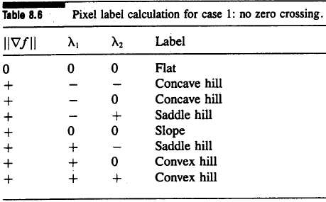
8.13.3 Case One: No Zero Crossing
No zero crossing along either of two directions: flat or hillside
If gradient zero, then flat
If gradient nonzero, then hillside
Hillside: possibly inflection point, slope, convex hill, concave hill,…
Notes:
如果在兩隔一階方向導數沒有 zero crossing 則有可能是 flat or hillside
可以看表

Slide 189
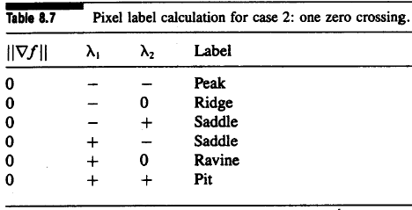
8.13.3 Case Two: One Zero Crossing
one zero crossing: peak, pit, ridge, ravine, or saddle
Notes:
如果在一階方向導數有zero crossing 則必定給訂的標籤是(peak, pit, ridge, ravine, or saddle)

Slide 190
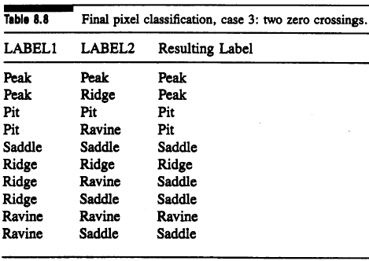
8.13.3 Case Three: Two Zero Crossings
LABEL1, LABEL2: assign label to each zero crossing

Slide 191
8.13.3 Case Four: More Than Two Zero Crossings
More than two zero crossings:
Choose the one closest to pixel center
After ignoring the other, same as case 3

Slide 192
8.13.4 Summary of Topographic Classification Scheme
One pass through the image, at each pixel
Calculate fitting coefficients, $k_{1}$ through $k_{10}$ of cubic polynomial
Use above coefficients to find gradient, gradient magnitude, and the eigenvalues and eigenvector of Hessian
Search in eigenvector direction for zero crossing of first derivative
Recompute gradient, gradient magnitude, second derivative at each zero crossing of the first directional derivative, then classify
Notes:
該方案是對每個像素進行地形分類的並行過程，可以一次通過圖像來完成。

Slide 193
END

