Slide 1
Computer and Robot Vision I
Chapter 8
The Facet Model
Presented by: 湯竣淋
r08922185@ntu.edu.tw
指導教授: 傅楸善 博士
Notes:
facet: 小平面 -> 小面模型
如同在講傅立葉轉換(或線性代數、jpeg 壓縮等)的時候應該會提到的 wavelet 小波轉換
(fast)

Slide 2
8.0 Outline
8.1 Introduction
8.2 Relative Maxima
8.3 Sloped Facet Parameter and Error Estimation
8.4 Facet-Based Peak Noise Removal
8.5 Iterated Facet Model
8.6 Gradient-Based Facet Edge Detection
8.7 Bayesian Approach to Gradient Edge Detection
8.8 Zero-Crossing Edge Detector
8.9 Integrated Directional Derivative Gradient Operator
8.10 Corner Detection
8.11 Isotropic Derivative
8.12 Ridges and Ravines on Digital Images
8.13 Topographic Primal Sketch
Notes:
8.1 用local給的資訊推一個最逼近原圖的數學model(算式 函數 之類的東西)出來
8.2 介紹小平面模型定義一維觀測序列相對極大值的原理應用
8.3 複習對斜的小平面參數預估
8.4 對傾斜的小平面模型雜訊的移除處理
8.5 介紹小平面模型可以用來將亮度灰階影像表面分區域
8.6 介紹使用古典梯度邊界偵測應用
8.7 討論使用貝式法去決定觀測的梯度強度統計
8.8討論zero crossing 在二階導數的邊界偵測
8.9討論集成方向導數梯度
8.10 討論小平面方法去做corner detection
8.11討論了使用小平面的方法來計算高階各向同性微分大小
8.12討論山脊和溝壑
8.13提出了每個像素的各種地形類別的標籤轉化

Slide 3
Outline
8.1 Introduction
8.2 Relative Maxima
8.3 Sloped Facet Parameter and Error Estimation
8.4 Facet-Based Peak Noise Removal
8.5 Iterated Facet Model
8.6 Gradient-Based Facet Edge Detection
8.7 Bayesian Approach to Gradient Edge Detection
8.8 Zero-Crossing Edge Detector
8.9 Integrated Directional Derivative Gradient Operator
8.10 Corner Detection
8.11 Isotropic Derivative
8.12 Ridges and Ravines on Digital Images
8.13 Topographic Primal Sketch
Notes:
8.1 用local給的資訊推一個最逼近原圖的數學model(算式 函數 之類的東西)出來
改進
1.上慢點 多些舉例
2.PDF版本
3.加入頁碼
4.講解定義

Slide 4
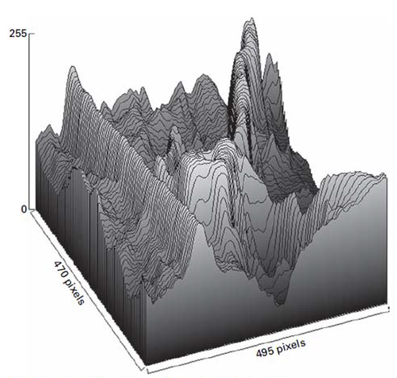
8.1 Introduction
The facet model principle states that the image can be thought of as an underlying continuum or piecewise continuous gray level intensity surface.
observed digital image: noisy discretized sampling of distorted version of this surface
Notes:
一張灰階影像實際上就是一個矩陣，前幾次作業應該能感受到，一個圖片的[長][寬]以及他的灰階值，
如果我們把灰階值當做是高度而非亮度，那麼一塊區域的灰度值越亮，這塊區域就越高，就是這幅圖上我們看到的
實際的形狀應該是連續的(或分段連續的)，但對於數位影像來說，它是對於連續影像的離散採樣(一般8個bit就是0~255)(作業沒有轉換型態可能會溢位)，是會有雜訊存在的
所以我們觀察到的數位影像是真實影像的雜訊或扭曲版本

Slide 5
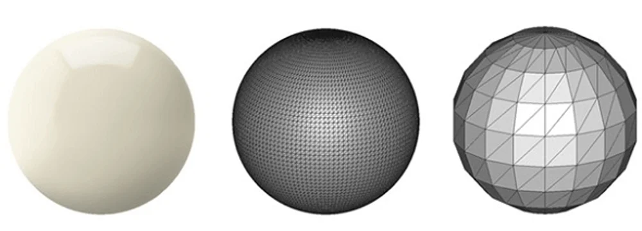
8.1 Introduction
To actually carry out the processing with the observed digital image requires a model describes what the general form of the surface would be in the neighborhood of any pixel
https://all3dp.com/what-is-stl-file-format-extension-3d-printing/
Notes:
所以我們對於影像進行處裡的時候，需要一個模型來描述在沒有雜訊情況下，該表面在任何像素附近的一般形式
就是用局部的鄰域裡的資訊推一個最逼近原始灰度值的數學式出來，然後用這個數學式來表示鄰域內的灰度值
=> 更簡單來說，用一個數學模型來表示沒雜訊的真實影像
左邊真實的球 最右邊可能離散採樣
引用: https://all3dp.com/what-is-stl-file-format-extension-3d-printing/

Slide 6
8.1 Introduction
general forms: some mathematical formulas
1. piecewise constant (flat facet model),
Ideal region: constant gray level
2. piecewise linear (sloped facet model), ideal region: sloped plane gray level
3. piecewise quadratic, gray level surface: bivariate quadratic
4. piecewise cubic, gray level surface: cubic surfaces
Notes:
一般式：一些數學方程式
分段常數（平的小平面模型）理想區間：常數灰階值
分段線性（斜的小平面模型）理想區間：斜的平面灰階值
分段二次方程式（灰階表面）理想區間：二元二次方程式 (圓形等)
分段三次方程式，灰階表面 理想區間：立方表面

Slide 7
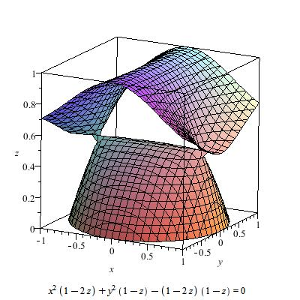
8.1 Introduction
Cubic surfaces
https://en.wikipedia.org/wiki/Cubic_surface
Notes:
https://en.wikipedia.org/wiki/Cubic_surface

Slide 8
Outline
8.1 Introduction
8.2 Relative Maxima
8.3 Sloped Facet Parameter and Error Estimation
8.4 Facet-Based Peak Noise Removal
8.5 Iterated Facet Model
8.6 Gradient-Based Facet Edge Detection
8.7 Bayesian Approach to Gradient Edge Detection
8.8 Zero-Crossing Edge Detector
8.9 Integrated Directional Derivative Gradient Operator
8.10 Corner Detection
8.11 Isotropic Derivative
8.12 Ridges and Ravines on Digital Images
8.13 Topographic Primal Sketch
Notes:
8.2 介紹小平面模型定義一維觀測序列相對極大值的原理應用

Slide 9
8.2 Relative Maxima
a simple labeling application
Detect and locate all relative maxima
relative maxima:
first derivative zero
second derivative negative
Notes:
來看一個找出相對極大值的例子
複習一下求相對極大值的方法
要滿足兩點 1 一階導數為零 2 二階導數是負的
李宏毅老師的 Warning of Math

Slide 10
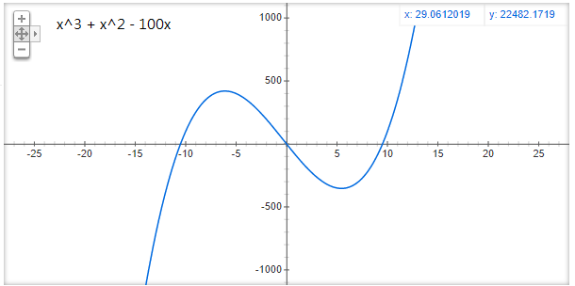
8.2 Relative Maxima
Notes:
來看一個找出相對極大值的例子
上慢點 多些舉例，知道到時候投票TA 該支持誰了吧

Slide 11
8.2 Relative Maxima
Notes:
一階導數為零 2 二階導數是負的

Slide 12
8.2 Relative Maxima
One-dimensional observation sequence
$f_{1 },f_{2 },f_{3 }$,……$f_{N }$
To find the relative maxima, we can least-squares fit a quadratic function
$\hat{c}m^{2}+\hat{b}m+\hat{a}$ ,
where $−k≤m≤k$ , to each group of 2k+1 successive observations
Notes:
的觀測序列f1到fN
我們現在先取這個序列的前2k+1個點，用一個二次方程式用最小平方法去擬合(fit)它（擬合了之後我們才能用數學的方法找出這個序列的極大值）
我們把原點定在2k+1個點的中間那個點，所以m是從-k到k
有hat說明是估計值
=> 一個線段取部分出來
(下一張 ML 常用的 MSE 但沒 M)

Slide 13
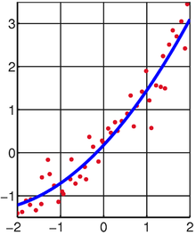
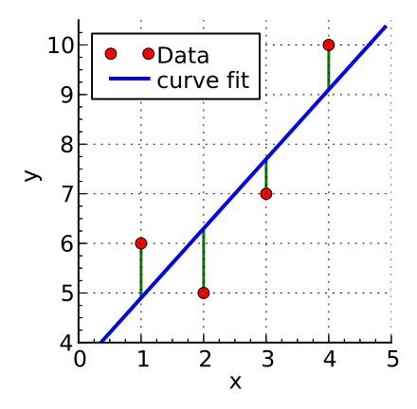
8.2 Relative Maxima
The squared fitting error $ε_{n}^{2}$ for the $n_{th}$ group of 2k+1 can be expressed by
$$ε_{n}^{2}= \sum_{m=−k}^{k}{{(\hat{c}m^{2}+\hat{b}m+\hat{a} −f_{n+m})}^{2}}$$
https://en.wikipedia.org/wiki/Least_squares
Notes:
＃計算誤差最小的平方和的算式
對2K+1 組其中的第 n 組的平方fitting$ε_{n}^{2}$誤差，一般式可以表示為 $ε_{n}^{2}= \sum_{m=−k}^{k}{{(\hat{c}m^{2}+\hat{b}m+\hat{a} −f_{n+m})}^{2}}$
最小平方法求得的數據與實際數據之間誤差的平方和為最小
我們擬合出來的數學式和觀測值的誤差的平方和就是這個式子
我們的觀測值一共有大N個，每次取2k+1個點，假設可以取小n組
最小平方法要求我們求出來的chat bhat ahat 使得這個誤差的平方和最小

Slide 14
8.2 Relative Maxima
Taking partial derivatives of $ε_{n}^{2}$ with respect to the free parameter $\hat{a}$ , $\hat{b}$, $\hat{c}$ results in the following
$ε_{n}^{2}=\sum_{m=−k}^{k}{{(\hat{c}m^{2}+\hat{b}m+\hat{a} −f_{n+m})}^{2}}$
Notes:
用$ε_{n}^{2}$的相對於自由參數$\hat{a}$ , $\hat{b}$, $\hat{c}$偏導數如下矩陣表示
什麼時候這個誤差最小呢
偏導數為 0 的時候
我們對ahat bhat chat 求偏導數(偏微分)
連鎖律: 微分一次 * 本身微分

Slide 15
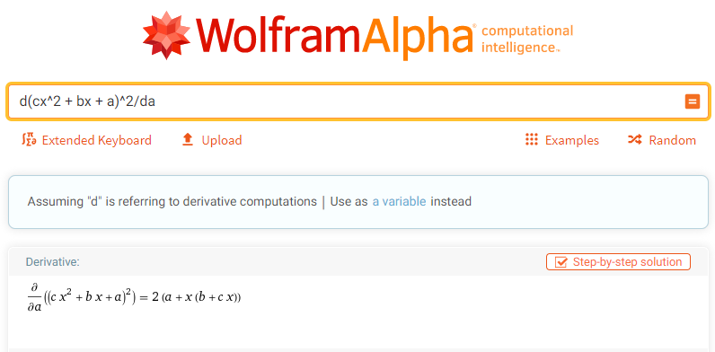
8.2 Relative Maxima
Partial Derivatives
https://www.wolframalpha.com/
Notes:
微積分都快忘光也不用怕
分享這個我不太確定有沒有問題
私心推薦大家一個好用的網站
這也是台大數學系的朋友推薦的
更精準的來說是我問煩他了
https://www.wolframalpha.com/
當初修微積分作業沒有解答也不怕了

Slide 16
8.2 Relative Maxima
Assume k = 1, setting these partial derivatives to zero and simplifying yields the matrix equation from
M = -1:
{c – b + a – f(n-1)} = -{c – b + a – f(n-1)}
= {c – b + a – f(n-1)} = 0
=> c - b + a = f(n-1)
=0
Notes:
現在考慮一個簡單情況，假設k=1，那麼就是每次只取三個點
求得$\hat{a}$ , $\hat{b}$, $\hat{c}$ 我們就得到了擬合的方程式
M = -1
{c – b + a – f(n-1)} = -{c – b + a – f(n-1)} = {c – b + a – f(n-1)} = 0
=> c - b + a = f(n-1)
M = 0
a – f(n)
=> a = f(n)
M = 1
c + b + a – f(n+1) = 0
=> c + b + a = f(n+1)
2c + 2a = f(n-1) + f(n+1)
2c = f(n-1) + f(n+1) + f(n)
-2b = f(n-1) – f(n+1)
=> 2b = f(n+1) - f(n-1)

Slide 17
8.2 Relative Maxima
M = 0:
a – f(n) => a = f(n)
M = 1:
c + b + a – f(n+1) = 0
=> c + b + a = f(n+1)
=0
Notes:
M = 0 代入
a – f(n)
=> a = f(n)
M = 1 代入
c + b + a – f(n+1) = 0
=> c + b + a = f(n+1)
2c + 2a = f(n-1) + f(n+1)
2c = f(n-1) + f(n+1) + f(n)
-2b = f(n-1) – f(n+1)
=> 2b = f(n+1) - f(n-1)

Slide 18
8.2 Relative Maxima
M = -1:
c - b + a = f(n-1)
M = 0:
a = f(n)
M = 1:
c + b + a = f(n+1)
2c + 2a = f(n-1) + f(n+1)
2c = f(n-1) + f(n+1) - 2*f(n)
2b = f(n+1) - f(n-1)
Notes:
有 M = -1, 0, 1 得出的結論 -> 解聯立

Slide 19
8.2 Relative Maxima
Assume $k=1$, setting these partial derivatives to zero
$$\left(\begin{aligned}\begin{aligned}0 \\ 0\end{aligned} \\ 0\end{aligned}\right)=\frac{1}{2}\left(\begin{aligned}\begin{aligned}\frac{∂ε_{n}^{2}}{∂\hat{a}} \\ \frac{∂ε_{n}^{2}}{∂\hat{b}}\end{aligned} \\ \frac{∂ε_{n}^{2}}{∂\hat{c}}\end{aligned}\right)=\left(\begin{aligned}\hat{c}+\hat{b}+\hat{a}−f_{n+1} \\ \hat{c}+\hat{b}+\hat{a}−f_{n+1} \\ \hat{c}+\hat{b}+\hat{a}−f_{n+1}\end{aligned}\right)+\left(\begin{aligned}\hat{a}−f_{n} \\ 0 \\ 0\end{aligned}\right)+\left(\begin{aligned}\hat{c}−\hat{b}+\hat{a}−f_{n−1} \\ −\hat{c}+\hat{b}−\hat{a}+f_{n−1} \\ \hat{c}−\hat{b}+\hat{a}−f_{n−1}\end{aligned}\right)$$
$$=\left(\begin{aligned}2\hat{c}+3\hat{a}−f_{n−1}−f_{n}−f_{n+1} \\ 2\hat{b}−f_{n−1}+f_{n−1} \\ 2\hat{c}+2\hat{a}−f_{n−1}−f_{n+1}\end{aligned}\right)$$
Notes:
From CV1_CH8_2016@14
1, 0, -1

Slide 20
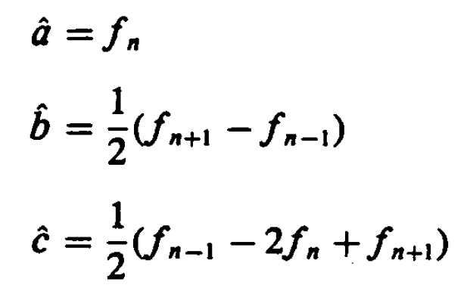
8.2 Relative Maxima
Assume k = 1, setting these partial derivatives to zero and simplifying yields the matrix equation from
$\left[\begin{matrix}2\hat{c}+3\hat{a} \\ 2\hat{b} \\ 2\hat{c}+2\hat{a}\end{matrix}\right]=\left[\begin{matrix}f_{n+1}+f_{n}+f_{n−1} \\ f_{n+1}−f_{n−1} \\ f_{n+1}+f_{n−1}\end{matrix}\right]$
=0
Notes:
現在考慮一個簡單情況，假設k=1，那麼就是每次只取三個點
求得$\hat{a}$ , $\hat{b}$, $\hat{c}$ 我們就得到了擬合的方程式

Slide 21
8.2 Relative Maxima
The quadratic $y= \hat{c}m^{2}+\hat{b}m+\hat{a}$ has relative extrema at $x_{0}=−\hat{b}/2\hat{c}$
The extremum is a relative maximum when $\hat{c}<0$
The algorithm then amounts to the following
Notes:
二次式 y 在 $x_{0}=−\hat{b}/2\hat{c}$和Ｃ<0 時具有極大值 (C > 0 開口向上拋物線，只有最小值)
其實也就是通過一階導數等於零 二階導數小於零來算的
2cm + b = 0
M = -b/2c
然後我們就可以設計一個演算法來找出這個觀測序列的相對極大值點
3我們剛才是用2k+1點最中間的那個點來當做原點，x0絕對值小於二分之一，說明這個相對極大值最靠近原點，
我們就把這組2k+1個點的原點標記為相對極大值點
-k ~ k (k k+1) 避免邊界問題
課本上有這種演算法在 加獨立 Gaussian noise 的範例與運算過程，有興趣的可以去看一下

Slide 22
Outline
8.1 Introduction
8.2 Relative Maxima
8.3 Sloped Facet Parameter and Error Estimation
8.4 Facet-Based Peak Noise Removal
8.5 Iterated Facet Model
8.6 Gradient-Based Facet Edge Detection
8.7 Bayesian Approach to Gradient Edge Detection
8.8 Zero-Crossing Edge Detector
8.9 Integrated Directional Derivative Gradient Operator
8.10 Corner Detection
8.11 Isotropic Derivative
8.12 Ridges and Ravines on Digital Images
8.13 Topographic Primal Sketch
Notes:
8.3 斜的小平面參數預估

Slide 23
8.3 Sloped Facet Parameter and Error Estimation
We employ a least-squares procedure both to estimate the parameters of the sloped facet model for a given two-dimensional rectangular neighborhood whose row index set is R and whose column index set is C and to estimate the noise variance
Notes:
8.3 對斜的小平面參數預估
剛才看了一維的，現在來看二維的斜面小平面模型。
對於一個二維長方形鄰域，我們用大R作為row的索引值，大C作為column的索引值

Slide 24
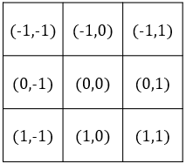
8.3 Sloped Facet Parameter and Error Estimation
Assume the coordinate of the given pixel are (0,0) in its central neighborhood, and assume each (r,c) ∈ R X C
Image function g is modeled by
Where $η$ is a random variable indexed on $R×C$ , which represents noise.
We assume that $η\sim N(0,σ^{2})$ is noise having mean 0 and variance $σ^{2}$ and that the noise for any two pixels is independent.
$$g\left(r,c\right)=αr+βc+γ+η(r,c)$$
Notes:
二維的斜面小平面模型的方程式就是這個
g(r,c)是二維的觀測值，之後會一再看到
r,c是行和列的索引值，我們把區域的中心看做是原點
Eta (發音 eita) 是雜訊(給每個 pixel 一個雜訊) 假設足期望為0，變異數為固定某個 sigma平方 的常態分佈
陣列類似線代的表示方式(帶進去舉例)

Slide 25
8.3 Sloped Facet Parameter and Error Estimation
The least-squares procedure determine parameters $\hat{a}$ , $\hat{b}$, $\hat{c}$ that minimize the sum of the squared differences between the fitted surface and the observed one
Taking the partial derivatives of $ε_{n}^{2}$ and setting them to zero
$$ε^{2}=\sum_{r∈R}{\sum_{c∈C}{{[\hat{α}r+\hat{β}c+\hat{γ}−g(r,c)]}^{2}}}$$
Notes:
最小平方法要求參數αhat βhat γhat使得誤差的平方和最小
還是求最小值的操作
一階偏微分等於0

Slide 26
8.3 Sloped Facet Parameter and Error Estimation
Without loss of generality, we choose our coordinate RxC so that the center of the neighborhood RxC has coordinates (0, 0)
The symmetry in the chosen coordinate system leads to
Hence
$$\sum_{r∈R}{\sum_{c∈C}{rc}}=\sum_{r∈R}{r\sum_{c∈C}{c}}=0$$
Notes:
＠不失一般性(證明不是特例，而是普遍情況)，我們選擇中心點ＲＸＣ做為座標的原點
奇數 r, c -> 中心 (0,0) 偶數r, c 則中心點就沒有 pixel
＠選擇的座標系統具有對稱性使得 加總r = 0 加總c =0

Slide 27
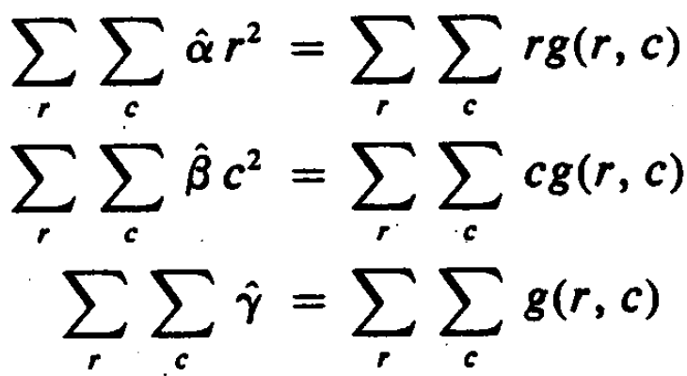
8.3 Sloped Facet Parameter and Error Estimation
$$\sum_{r∈R}{\sum_{c∈C}{rc}}=0$$
Hence
Notes:
這邊直接看一下子可能有點難看出來，下一張
2ΣΣ [αr + βc + γ – g(r, c)] r = 0
ΣΣ [αr + βc + γ – g(r, c)] r = 0
ΣΣ [αr^2 + βcr + γr – rg(r, c)] = 0
ΣΣ αr^2 + ΣΣ βcr + ΣΣγr - ΣΣrg(r, c) = 0
ΣΣ αr^2 = ΣΣrg(r, c)

Slide 28
8.3 Sloped Facet Parameter and Error Estimation
2ΣΣ [αr + βc + γ – g(r, c)] r = 0
ΣΣ [αr + βc + γ – g(r, c)] r = 0
ΣΣ [αr^2 + βcr + γr – rg(r, c)] = 0
ΣΣ αr^2 + ΣΣ βcr + ΣΣγr - ΣΣ rg(r, c) = 0
ΣΣ αr^2 = ΣΣ rg(r, c)
Notes:
以偏微分 α hat 做舉例

Slide 29
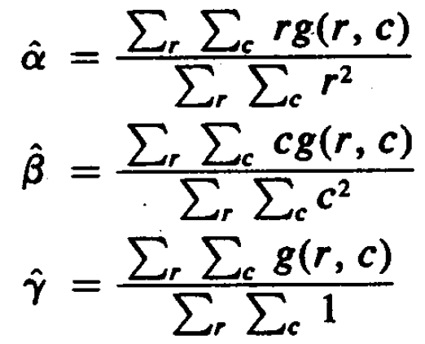
8.3 Sloped Facet Parameter and Error Estimation
Solving for $\hat{α}$, $\hat{β}$, and $\hat{γ}$ , we obtain
Notes:
然後我們就可以求得估計值α β γ bar 了
估計值α 的分母 是小r平方連加的和 分子是小r和觀測值g(r,c)的乘積的加和
就是簡單的移項

Slide 30
8.3 Sloped Facet Parameter and Error Estimation
Example 8.1 : consider the following 3*3 region
3 | 5 | 9
4 | 7 | 7
0 | 3 | 7
$$\hat{α}=\frac{−1×\left(3+5+9\right)+0∗\left(4+7+7\right)+1∗(0+3+7)}{{−1}^{2}+{−1}^{2}+{−1}^{2}+0^{2}+0^{2}{+0}^{2}{+1}^{2}{+1}^{2}{+1}^{2}}$$
$$\hat{α}=−1.17$$
$$\hat{β}=\frac{−1×\left(3+4+0\right)+0∗\left(5+7+3\right)+1∗(9+7+7)}{{−1}^{2}+{−1}^{2}+{−1}^{2}+0^{2}+0^{2}{+0}^{2}{+1}^{2}{+1}^{2}{+1}^{2}}$$
$$\hat{β}=2.67$$
$$\hat{γ}=\frac{3+5+9+4+7+7+0+3+7}{9}$$
$$\hat{γ}=5$$
Notes:
來看個例子鞏固一下

Slide 31
8.3 Sloped Facet Parameter and Error Estimation
The estimated gray level surface is given by
$$\hat{α}r+\hat{β}c+\hat{γ}$$
$$\text{−1.17 }r+2.67 c \text{+5}$$
(-1,-1) | (-1,0) | (-1,1)
(0,-1) | (0,0) | (0,1)
(1,-1) | (1,0) | (1,1)
3.5 | 6.17 | 8.84
2.33 | 5 | 7.67
1.16 | 3.83 | 6.5
(-1) $×$-1.17 + (-1) $×$2.67 $+$5
0 $×$ -1.17 + 0 $×$2.67 $+$5
1 $×$ -1.17 + 1 $×$2.67 $+$5
Notes:
我們知道了統計值abr之後，就可以利用這個擬合的方程式求出這個區域的擬合灰度值 就是右邊這個矩陣

Slide 32
8.3 Sloped Facet Parameter and Error Estimation
The estimated gray level surface is given by
$$\hat{α}r+\hat{β}c+\hat{γ}$$
$$\text{−1.17 }r+2.67 c \text{+5}$$
3.5 | 6.17 | 8.84
2.33 | 5 | 7.67
1.17 | 3.83 | 6.5
3 | 5 | 9
4 | 7 | 7
0 | 3 | 7
0.5 | 1.17 | -0.17
-1.67 | -2 | 0.67
1.17 | 0.83 | -0.5
$$ε^{2}=11.19$$
Notes:
求出擬合矩陣之後，我們就可以算出誤差的平方和
是我可能就附上公式考這個
是我可能很懶就不改數字了
公式只要取到小數點第一位(4捨5入
或分數的形式

Slide 33
Notes:
圖例

Slide 34
8.3 Sloped Facet Parameter and Error Estimation
Solving for $\hat{α}$, $\hat{β}$, and $\hat{γ}$ , we obtain
Notes:
再來複習一下剛才算估計值的公式

Slide 35
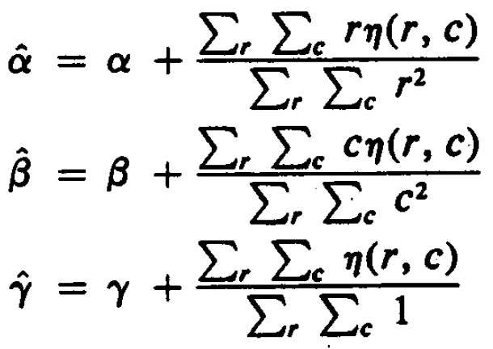
8.3 Sloped Facet Parameter and Error Estimation
Replacing $g(r, c)$by $αr+βc+γ+η(r, c)$ and simplifying the equations will allow us to see explicitly the dependence of $\hat{α}$, $\hat{β}$, and $\hat{γ}$ on the noise
Notes:
前面的前提，觀測值g(r,c) = …..
為何可以替換 -> 看下一張投影片
將 alpha hat ..., 中的 g(r, c)也就是觀測值 替換成前面所謂的斜面模型 + 雜訊

Slide 36
8.3 Sloped Facet Parameter and Error Estimation
Assume the coordinate of the given pixel are (0,0) in its central neighborhood, and assume each (r,c) ∈ R X C
Image function g is modeled by
Where $η$ is a random variable indexed on $R×C$ , which represents noise.
We assume that $η\sim N(0,σ^{2})$ is noise having mean 0 and variance $σ^{2}$ and that the noise for any two pixels is independent.
$$g\left(r,c\right)=αr+βc+γ+η(r,c)$$
Notes:
前面的前提

Slide 37
8.3 Sloped Facet Parameter and Error Estimation
Replacing $g(r, c)$by $αr+βc+γ+η(r, c)$ and simplifying the equations will allow us to see explicitly the dependence of $\hat{α}$, $\hat{β}$, and $\hat{γ}$ on the noise
Notes:
前面的前提，觀測值g(r,c) = …..
為何可以替換 -> 看下一張投影片
將 alpha hat ..., 中的 g(r, c)也就是觀測值 替換成前面所謂的斜面模型 + 雜訊

Slide 38
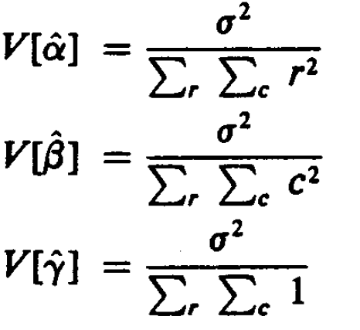
8.3 Sloped Facet Parameter and Error Estimation
$η$ is noise having mean 0 and variance $σ^{2}$
$E\left[\hat{α}\right]=α$ $E\left[\hat{β}\right]=β E[\hat{γ}]=γ$
Notes:
利用這個新式子 我們可以算出估計值α-hat β-hat γ-hat的數學期望值和變異數
因為eita是均值為 0(期望值為 0) 變異數為 sigma 平方的常態分佈
α-hat β-hat γ-hat 會是常態分布，數學期望值同為 alpha, beta, gamma 和變異數為 V[alpha hat]
所以統計上 unbiased estimator: sample mean = 整體 mean

Slide 39
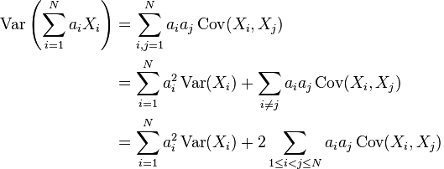
8.3 Sloped Facet Parameter and Error Estimation
review
Notes:
加一個常數 變異數不變
乘以係數a ​​變異數會乘以係數a方
XY獨立共變異數為0 (Covariance)

Slide 40
8.3 Sloped Facet Parameter and Error Estimation
$$V\left[\hat{α}\right]=V\left[\frac{\sum_{r}{\sum_{c}{rη(r,c)}}}{\sum_{r}{\sum_{c}{r^{2}}}}\right]=\frac{\sum_{r}{\sum_{c}{r^{2}V[η\left(r,c\right)]}}}{{(\sum_{r}{\sum_{c}{r^{2}}})}^{2}}=\frac{σ^{2}}{\sum_{r}{\sum_{c}{r^{2}}}}$$
Notes:
Variance 推倒過程，這邊只放 alpha 的
因為雜訊是 常態分布(Mean = 0, variance = sigma^2) -> 所以 alpha hat, beta hat, gamma hat 也會是常態分佈

Slide 41
8.3 Sloped Facet Parameter and Error Estimation
Examining the squared error residual $ε^{2}$
Notes:
重新檢視一下誤差平方和，這次直接爆開並移向
用擬合函數減去觀測值 整個的平方

Slide 42
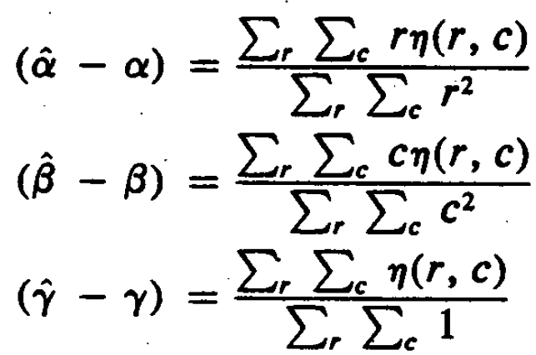
8.3 Sloped Facet Parameter and Error Estimation
Using the fact that
We obtain
Notes:
使用前面推出來的 (alpha hat - alpha )代入並替換得到 以下式子
ΣΣ eta(r, c) = (gamma hat - gamma) * ΣΣ1

Slide 43
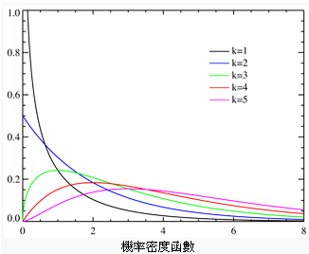
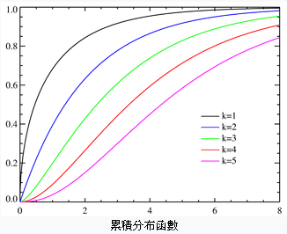
8.3 Sloped Facet Parameter and Error Estimation
Chi-square distribution
https://zh.wikipedia.org/wiki/%E5%8D%A1%E6%96%B9%E5%88%86%E4%BD%88
Notes:
在一些前提的情況下(這邊是常態分布)，一些數值的加總，可轉成統計上與機率的關係
並藉此，依靠統計來當做判斷標準 (ex: 希望機率多少等)

Slide 44
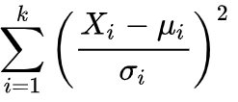
8.3 Sloped Facet Parameter and Error Estimation
Chi-square distribution
Assume $Z_{1}$, $Z_{2}$, …… , $Z_{n}$ are independent variable , where $Z_{i}\sim N\left(0,1\right).$
$Y=Z_{1}^{2}+Z_{2}^{2}+…+Z_{n}^{2}$ is distributed according to the chi-squared distribution with n degrees of freedom.
This is usually denoted as $Y\sim χ_{n}^{2}$
For example, a + b = 6 degrees of freedom is 1 because a is freely chosen and b is finite.
Notes:
接下來就要提到統計學裡的卡方分佈，是統計學中常用的一種機率分布。
定義如下：
@假設 N 個隨機變量 Z1, Z2, …Zn 是互相獨立符合標準常態分佈的隨機變量（平均值期望為0 變異數為 1）
@則隨機變量Ｚ的平方和被稱為符合自由度為 Ｎ 的卡方分佈 記作$Y\sim X_{n}^{2}$
在統計學中，自由度（英語：degree of freedom, df）是指當以樣本的統計量來估計母體的參數時，樣本中獨立或能自由變化的數據的個數，稱為該統計量的自由度
Ex: a + b= 6 自由度為 1，因為 a 自由選擇後 b 就被限制了。
統計上變異數除以 (n-1) 因為分子使用的是樣本平均數(不是母體)，貝索校正(Bessel’s correction)
https://pansci.asia/archives/115065

Slide 45
8.3 Sloped Facet Parameter and Error Estimation
Chi-square distribution
https://zh.wikipedia.org/wiki/%E5%8D%A1%E6%96%B9%E5%88%86%E4%BD%88
Notes:
機率密度函數
參考自由度
機率與數值的關係

Slide 46
8.3 Sloped Facet Parameter and Error Estimation
Chi-square distribution
https://zh.wikipedia.org/wiki/%E5%8D%A1%E6%96%B9%E5%88%86%E4%BD%88
Notes:
查表用圖表
之後還會看到

Slide 47
8.3 Sloped Facet Parameter and Error Estimation
$$η\sim N(0, σ^{2})$$
$\frac{\sum_{r}{\sum_{c}{η^{2}(r, c)}}}{σ^{2}}$ is a chi-squared distribution with $\sum_{r}{\sum_{c}{1}}$ degrees of freedom.
Notes:
接續剛剛說的 error
已經說過 eita 是常態分布 -> 卡方分布就是常態分布的一項平方加總，除以 sigma^2 -> 正規化回N(0, 1)
@自由度為 r*c 的卡方分佈
Σ( (Xi-ui)/σ )^2 -> Σ(Xi-ui)^2 * (1/σ )^2

Slide 48
8.3 Sloped Facet Parameter and Error Estimation
$\hat{α}\sim N\left(α,\frac{σ^{2}}{\sum_{r∈R}{\sum_{c∈C}{r^{2}}}}\right)$
$\frac{(\hat{α}−α)\sqrt{\sum_{r∈R}{\sum_{c∈C}{r^{2}}}}}{σ}\sim N(0,1)$
is a chi-squared distribution with 3 degrees of freedom.
Notes:
alpha hat 為常態分布 N(平均, 變異數)
轉為 N(0, 1)
加總(…) 是自由度為三的法方分布
@因為$\hat{α}$, $\hat{β}$, and $\hat{γ}$ 為獨立的常態分佈，所以 「 方程式」 為自由度為3的卡方分佈
Σ( (Xi-ui)/σ )^2

Slide 49
8.3 Sloped Facet Parameter and Error Estimation
$ε^{2}/σ^{2}$ is distributed as a chi-squared variate with $\sum_{r}{\sum_{c}{1}}−3$ degrees of freedom.
This means that $ε^{2}/(\sum_{r}{\sum_{c}{1}}−3)$ can be used as an unbiased estimator for $σ^{2}$
Notes:
＠$ε^{2}/σ^{2}$ 的分佈為自由度為$\sum_{r}{\sum_{c}{1}}−3$ 的卡方變量 (ε: epsilon)
＠代表 可以為$ε^{2}/(\sum_{r}{\sum_{c}{1}}−3)$使用來當作 $σ^{2}$的無偏差估計
原本的 error – 調剛剛算的那幾項
統計上 unbiased estimator: sample mean = 整體 mean

Slide 50
Outline
8.1 Introduction
8.2 Relative Maxima
8.3 Sloped Facet Parameter and Error Estimation
8.4 Facet-Based Peak Noise Removal
8.5 Iterated Facet Model
8.6 Gradient-Based Facet Edge Detection
8.7 Bayesian Approach to Gradient Edge Detection
8.8 Zero-Crossing Edge Detector
8.9 Integrated Directional Derivative Gradient Operator
8.10 Corner Detection
8.11 Isotropic Derivative
8.12 Ridges and Ravines on Digital Images
8.13 Topographic Primal Sketch
Notes:
8.4 對傾斜的小平面模型尖端雜訊的移除處理

Slide 51
8.4 Facet-Based Peak Noise Removal
Peak noise pixel: a pixel whose gray level intensity significantly differs from neighborhood pixels.
It is difficult to judge that the center pixel in part (b) is peak noise, whereas it is easier in part (a)
This indicates that the gray level spatial statistic are important
Notes:
8.4 小平面基底的尖端雜訊移除
尖端雜訊像素 灰階值意義上和鄰居不一樣
在這裡並不能說 b 就沒有雜訊，他比a 要難以斷定。這個例子指出空間灰階值的統計就相當重要

Slide 52
8.4 Facet-Based Peak Noise Removal
Let N be a set of neighborhood pixels that does not contain the center pixel
Where $η(r,c)$ is assumed to be independent additive Gaussian noise having mean 0 and variance $σ^{2}$
(-1,-1) | (-1,0) | (-1,1)
(0,-1) | (0,0) | (0,1)
(1,-1) | (1,0) | (1,1)
Notes:
我們現在還是用斜面小平面模型的這個方程式
考慮一個鄰域大N 大N是個正方形，但是不包括區域中心的那個像素
=> 先排除掉中間那個點來看，看模型預估的值應該是多少

Slide 53
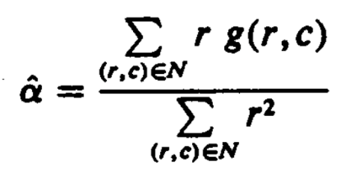
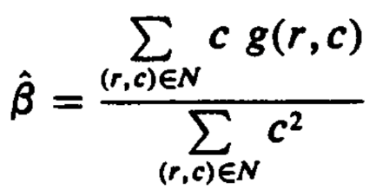
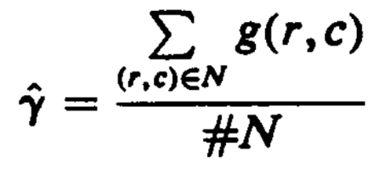
8.4 Facet-Based Peak Noise Removal
The least-squares procedure determines $\hat{α}$, $\hat{β}$, and $\hat{γ}$ which minimize the sum of the squared difference between the fitted surface are given by the observed one:
The minimizing $\hat{α}$, $\hat{β}$, and $\hat{γ}$ are given by
$$ε^{2}=\sum_{r∈R}{\sum_{c∈C}{{[\hat{α}r+\hat{β}c+\hat{γ}−g(r,c)]}^{2}}}$$
Notes:
誤差公式和估計值公式都應該很熟悉了
但是之前有兩個加和號，現在只有一個
因為之前考慮的鄰域可以是長方形，但這邊考慮的是正方形，所以r和c的總數相同，可以寫在一起

Slide 54
8.4 Facet-Based Peak Noise Removal
Under the hypothesis that $g\left(0,0\right)$ is not peak noise, $g\left(0,0\right)−\hat{γ}$ has a Gaussian distribution with mean 0 and variance $σ^{2}(1+\frac{1}{\#N})$
$g\left(0,0\right)−\hat{γ}$
= $(α×0+β×0+γ+η(0,0)$) – ($\hat{α}×0 \text{+}\hat{ β}×0\text{ +} \hat{γ})$
= $γ+η\left(0,0\right)− γ − \frac{\sum_{(r,c)εN}{η(r,c)}}{\#N}$
= $η\left(0,0\right)− \frac{\sum_{(r,c)εN}{η(r,c)}}{\#N}$
Notes:
我們現在要利用剛才的那些資訊來移除峰值雜訊了
現在我們有g(0,0) 是在原點的觀測值 觀測值是可能有雜訊的
還有rhat 是擬合函數在原點的估計值 因為a, b=0
Rhat 應該和鄰居像素的值比較相近
如果 g(0,0)小於等於rhat的話，我們就認為g(0,0)不是雜訊
所以我們就要用到統計學裡的假設檢驗
$g\left(0,0\right)−\hat{γ}$ 有高斯分佈平均值為0 ,變異數$σ^{2}(1+\frac{1}{\#N})$
下面要推倒證明這件事情

Slide 55
8.4 Facet-Based Peak Noise Removal
Under the hypothesis that $g\left(0,0\right)$ is not peak noise, $g\left(0,0\right)−\hat{γ}$ has a Gaussian distribution with mean 0 and variance $σ^{2}(1+\frac{1}{\#N})$
$V\left[g\left(0,0\right)−\hat{γ}\right]=V[η\left(0,0\right)− \frac{\sum_{(r,c)εN}{η(r,c)}}{\#N}]$
= $σ^{2}+ \frac{\#N}{{(\#N)}^{2}}σ^{2}=σ^{2}(1+\frac{1}{\#N})$
Notes:
基於 $g\left(0,0\right)$不是一個峰值雜訊的假設
$g\left(0,0\right)−\hat{γ}$ 有高斯分佈平均值為0 ,變異數$σ^{2}(1+\frac{1}{\#N})$
σ^2 + Σ V[η(r,c)] / (#N)^2 (#N 個 σ^2 ) = $σ^{2}+ \frac{\#N}{{(\#N)}^{2}}σ^{2}$ = $σ^{2}(1+\frac{1}{\#N})$

Slide 56
8.4 Facet-Based Peak Noise Removal
Under the hypothesis that $g\left(0,0\right)$ is not peak noise, $g\left(0,0\right)−\hat{γ}$ has a Gaussian distribution with mean 0 and variance $σ^{2}(1+\frac{1}{\#N})$
Hence $\frac{g\left(0,0\right)−\hat{γ}}{σ\sqrt{1+\frac{1}{\#N}}}$ has mean 0 and variance 1
Notes:
基於 $g\left(0,0\right)$不是一個峰值雜訊的假設
$g\left(0,0\right)−\hat{γ}$ 有高斯分佈平均值為0 ,變異數$σ^{2}(1+\frac{1}{\#N})$
V[1/x * a] -> (1/x)^2 V[a]

Slide 57
8.4 Facet-Based Peak Noise Removal
Student's t-distribution: estimating the mean of a normally distributed population in situations where the sample size is small and the population standard deviation is unknown.
$Z\sim N$(0,1), $Y\sim χ_{n}^{2}$ , $Z$ and $Y$ are independent.
$T=\frac{Z}{\sqrt{Y/n}}$ is a t-distribution with n degrees of freedom, denoted as $T\sim t_{n}$
Notes:
從常態分配的母體中所抽樣的樣本數夠多，那麼這些樣本的表現就足夠代表母體的性質。但萬一樣本數不多的話還能適用嗎？為了解決這樣的問題
https://zh.wikipedia.org/wiki/學生t-分布:
根據小樣本來估計呈 常態分布 且 變異數未知 的 總體的 平均值
$Y\sim X_{n}^{2 }$: 符合自由度為 Ｎ 的卡方分佈
同卡方分布在一些前提的情況下(這邊是常態分布)，一些數值的加總，可轉成統計上與機率的關係
並藉此，依靠統計來當做判斷標準 (ex: 希望機率多少等)
下面那個 T 就是哪來查表看機率的

Slide 58
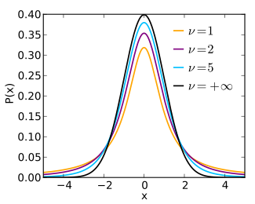
8.4 Facet-Based Peak Noise Removal
t-distribution
https://en.wikipedia.org/wiki/Student%27s_t-distribution
Notes:
＠如果假設 hypothesis $g\left(0,0\right)=\hat{γ}$ 被 reject 則 中心像素被判定為峰值雜訊
當樣本數越多越接近母體(最上面 N(0, 1))
參數是自由度

Slide 59
8.4 Facet-Based Peak Noise Removal
We have already obtained that $ε^{2}/σ^{2}$ has a chi-squared distribution with $\#N−3$ degrees of freedom.
$Y={ε^{2}}/{σ^{2}} \sim χ_{\#N−3}^{2}$
$Z=\frac{g\left(0,0\right)−\hat{γ}}{σ\sqrt{1+\frac{1}{\#N}}}\sim N(0,1)$
Hence $t=\frac{Z}{\sqrt{Y/(\#N−3)}}=\frac{(g\left(0,0\right)−\hat{γ})\sqrt{\#N−3}}{\sqrt{(1+\frac{1}{\#N})ε^{2}}}$ has a t-distribution with $\#N−3$ degrees of freedom
Notes:
＠所以我們已經得到 Y = $ε^{2}/σ^{2}$ 自由度為 #N-3 的卡方分佈
Z 前面提到 中心點
＠故 $t=\frac{(g\left(0,0\right)−\hat{γ})\sqrt{\#N−3}}{\sqrt{(1+\frac{1}{\#N})ε^{2}}}$ 具有自由度為 #N-3 的t-分佈
(epsilon, sigma)
t 就是這樣計算

Slide 60
8.4 Facet-Based Peak Noise Removal
The center pixel is judged to be a peak noise pixel if a test of the hypothesis $g\left(0,0\right)=\hat{γ}$ rejects the hypothesis
Let $T_{\#N−3, p}$ be the number satisfying
$$P\left(t≤T_{\#N−3, p}\right)=1−p$$
The reasonable value for p is 0.05 to 0.01
$T_{\#N−3, p}$ is a threshold.
Notes:
＠如果假設 hypothesis $g\left(0,0\right)=\hat{γ}$ 被 reject 則 中心像素被判定為峰值雜訊 $≤$.
t 估計呈常態分布且變異數未知的總體的平均值
因為前面假設$g\left(0,0\right) 不是peak noies, g\left(0,0\right)−\hat{γ}$ has a Gaussian distribution with mean 0 and variance $σ^{2}(1+\frac{1}{\#N})$
P = 0.05 -> 95%的可信度
<= 就接受

Slide 61
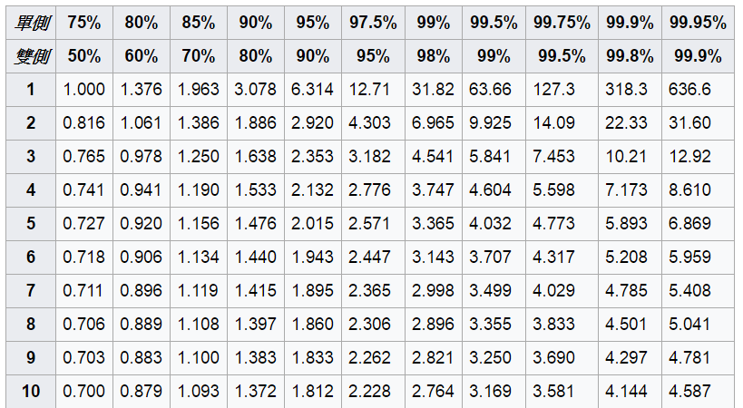
8.4 Facet-Based Peak Noise Removal
t-distribution
1-p
#N-3
Notes:
＠如果假設 hypothesis $g\left(0,0\right)=\hat{γ}$ 被 reject 則 中心像素被判定為峰值雜訊

Slide 62
8.4 Facet-Based Peak Noise Removal
If $t>T_{\#N−3, p}$
the hypothesis of the equality of $g\left(0,0\right)$ and $\hat{γ}$ is rejected, and the output value for the center pixel is given by $\hat{γ}$.
If $t≤T_{\#N−3, p}$
the hypothesis of the equality of $g\left(0,0\right)$ and $\hat{γ}$ is not rejected, and the output value for the center pixel is given by $g\left(0,0\right)$.
Notes:
If $t>T_{\#N−3, p}$
＠ hypothesis $g\left(0,0\right)=$ r 被 reject 則 中心像素輸出值為給定的$\hat{γ}$.
If $t≤T_{\#N−3, p}$
＠ hypothesis $g\left(0,0\right)=$r沒有被 reject 則 中心像素輸出值為給定的$g\left(0,0\right)$
注意: 強者我統計高手朋友強調統計上只是沒拒絕，不代表接受

Slide 63
Outline
8.1 Introduction
8.2 Relative Maxima
8.3 Sloped Facet Parameter and Error Estimation
8.4 Facet-Based Peak Noise Removal
8.5 Iterated Facet Model
8.6 Gradient-Based Facet Edge Detection
8.7 Bayesian Approach to Gradient Edge Detection
8.8 Zero-Crossing Edge Detector
8.9 Integrated Directional Derivative Gradient Operator
8.10 Corner Detection
8.11 Isotropic Derivative
8.12 Ridges and Ravines on Digital Images
8.13 Topographic Primal Sketch
Notes:
8.5 重複模型 介紹小平面模型可以用來將亮度灰階影像表面分區域
facet model -> partition image to regions

Slide 64
8.5 Iterated Facet Model
The iterated model for ideal image
The spatial of the image can be partitioned into connected regions called facets.
Each of which satisfies certain gray level and shape constraints.
Notes:
重複模型對理想影像假設影像的空間域可以被分割成許多相連區域 每一個都符合特定的灰階和形狀限制

Slide 65
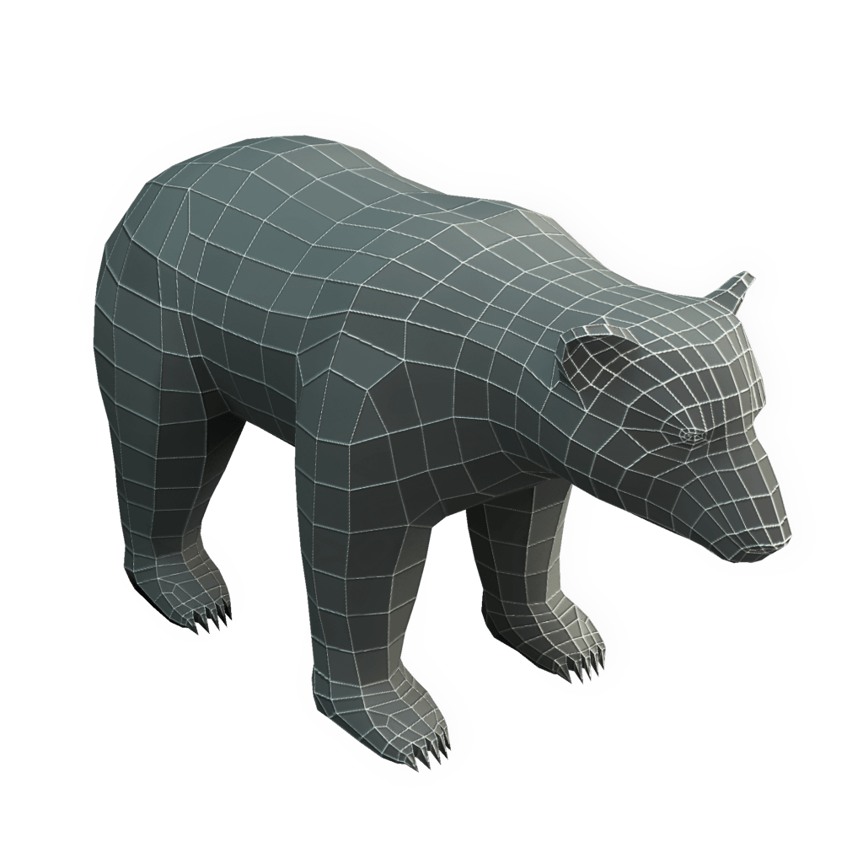
8.5 Iterated Facet Model
The iterated model for ideal image
https://www.pinterest.com/pin/296674694187240243/
Notes:
有點類似 maya 或 autoCAD 建模->基於不同四面體或三角形
Ex: 熊由多個不同的四面體構成

Slide 66
8.5 Iterated Facet Model
Shape region constraint:
each facet must be sufficiently smooth in shape
Region gray level constraint:
gray levels in each facet must be a polynomial function of row-column coordinates
Each region can be represented as the union of $K×K$ blocks of pixels.
Set the output gray value to be that gray value fitted by the block with smallest error variance.
Notes:
形狀限制
--每一個小平面必須滿足平滑的形狀
灰階限制
--每一個小平面的座標（Ｒ, C）必須是多項式方程式
每個 region 由 k*k 個 piexls 構成
Output 會是最小 variance

Slide 67
Outline
8.1 Introduction
8.2 Relative Maxima
8.3 Sloped Facet Parameter and Error Estimation
8.4 Facet-Based Peak Noise Removal
8.5 Iterated Facet Model
8.6 Gradient-Based Facet Edge Detection
8.7 Bayesian Approach to Gradient Edge Detection
8.8 Zero-Crossing Edge Detector
8.9 Integrated Directional Derivative Gradient Operator
8.10 Corner Detection
8.11 Isotropic Derivative
8.12 Ridges and Ravines on Digital Images
8.13 Topographic Primal Sketch
Notes:
8.6 介紹使用梯度邊界偵測應用
gradient edge detector

Slide 68
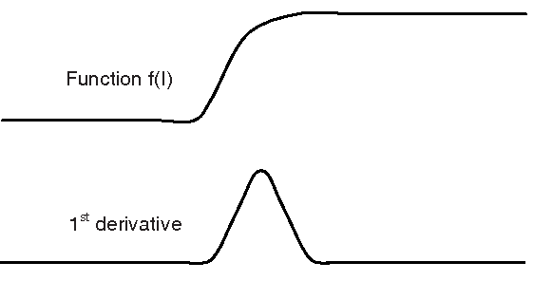
8.6 Gradient-Based Facet Edge Detection
gradient-based facet edge detection: high values in first partial derivative (sharp discontinuities)
https://www.semanticscholar.org/paper/Gradient-Based-Edge-Detection-of-Songket-Motifs-Jamil-Sembok/eea31d166c062a3dddccb212474a6b8
565ae6eee/figure/2
Notes:
8.6 基於梯度的平面邊界偵測 (可參考 7.4 Edge Detection)
邊界就是它的一邊暗，另一邊暗
所以梯度邊界偵測就是找一階偏微分的值很大的地方（明顯的不連續）

Slide 69
8.6 Gradient-Based Facet Edge Detection
When a neighborhood is fitted with the sloped facet model , $\hat{α}r+\hat{β}c+\hat{γ}$, a gradient magnitude of $\sqrt{{\hat{α}}^{2}+{\hat{β}}^{2}}$ will result.
Use the estimated gradient $\sqrt{{\hat{α}}^{2}+{\hat{β}}^{2}}$ as the basis for edge detection.
Notes:
以斜面的小平面模型為例
是可以直接用梯度的大小做邊界檢測就可以 (同 7.4.1 提到的)，這種方式就是 gradient-based edge detectors
對於 row, col 個別偏微分 -> 得到個別 row, col 梯度 -> 畢氏定理
(怕大家一時之間比較難想起來，下一頁有說明)

Slide 70
8.6 Gradient-Based Facet Edge Detection
The estimated gray level surface is given by
$$\hat{α}r+\hat{β}c+\hat{γ}$$
$$\text{−1.17 }r+2.67 c \text{+5}$$
3.5 | 6.17 | 8.84
2.33 | 5 | 7.67
1.17 | 3.83 | 6.5
$$\sqrt{{\hat{α}}^{2}+{\hat{β}}^{2}}$$
$$\sqrt{{−1.17}^{2}+{2.67}^{2}}$$
Notes:
之前 8.3 的舉例，我們已知中心點為 g(r, c) = alpha * r + beta * c + gamma
對 row 偏微: -1.17。對 col 偏微: 2.67
有兩個方向的 gradient -> 求大小
https://docs.opencv.org/2.4/doc/tutorials/imgproc/imgtrans/sobel_derivatives/sobel_derivatives.html
Opencv 等一般使用 Sobel 的 kernal 來近似一階微分 (chap 7.4.1 與 HW 有講到)
但問題是這個梯度的大小的門檻值要設為多少，才能判斷出有邊界呢
所以我們又要用統計值了

Slide 71
8.6 Gradient-Based Facet Edge Detection
$\hat{α}\sim N(α, \frac{σ^{2}}{\sum_{r}{\sum_{c}{r^{2}}}})$
$\hat{β}\sim N(β, \frac{σ^{2}}{\sum_{r}{\sum_{c}{c^{2}}}})$
$\hat{α}$ , $\hat{β}$ are independent
$\frac{{(\hat{α}−α)}^{2}\sum_{r}{\sum_{c}{r^{2}}}+{(\hat{β}−β)}^{2}\sum_{r}{\sum_{c}{c^{2}}}}{σ^{2}}\sim χ_{2}^{2}$
Notes:
N 是指常態分佈
符合自由度為 2 的卡方分佈 記作$Y\sim X_{n}^{2}$

Slide 72
8.6 Gradient-Based Facet Edge Detection
It follows that to test the hypothesis of no edge under the assumption that $α=β=0$, we use the statistic G:
If the statistic G has high enough value, then we reject that there is no edge.
$G=\frac{{\hat{α}}^{2}\sum_{r}{\sum_{c}{r^{2}}}+{\hat{β}}^{2}\sum_{r}{\sum_{c}{c^{2}}}}{σ^{2}}\sim χ_{2}^{2}$
Notes:
如果取的一個鄰域內沒有邊界，說明這個鄰域內灰度值很相近，ahat bhat接近為0
所以梯度的大小也接近0
找邊界的時候，接近0說明不是邊界
他依照假設去測試沒有邊界在 alpha = beta = 0, 我們使用
統計值 Ｇ
如果 G 具有足夠高的值，則我們拒絕認為沒有邊界(reject 沒有邊界)。

Slide 73
8.6 Gradient-Based Facet Edge Detection
If $ε_{n}^{2}$ represents the squared residual fitting error from the n-th neighborhood and the images has N neighborhoods, then we may use $\hat{σ^{2}}=\frac{\frac{1}{N}\sum_{n=1}^{N}{ε_{n}^{2}}}{\sum_{r}{\sum_{c}{1}}−3}$ in replace of $σ^{2}$.
$G=\frac{{\hat{α}}^{2}\sum_{r}{\sum_{c}{r^{2}}}+{\hat{β}}^{2}\sum_{r}{\sum_{c}{c^{2}}}}{\hat{σ^{2}}}$
Notes:
如果 E 表示平方餘數符合n-個鄰居誤差 且 影像有 n 個鄰居。則我們可以使用 ~A^2 取代 a^2
G是兩個卡方分佈相除，應該是F分佈
但因為sigma方hat的自由度太大，
所以G可以看做是一個自由度為2的卡方分佈

Slide 74
8.6 Gradient-Based Facet Edge Detection
The false-alarm rate
the conditional probability that the edge detector classifies a pixel as an edge given that the pixel is not a edge.
Suppose the false-alarm rate is to be held to 1%. Then since $P\left(χ_{2}^{2}>9.21\right)=0.01$, the threshold we used must be at least 9.21
Notes:
假警報: 說是 edge 但其實不是

Slide 75
8.6 Gradient-Based Facet Edge Detection
查表
Notes:
方分佈 記作$Y\sim X_{n}^{2}$
左邊自由度，自由度為 2
上面機率，目標是找到 0.01

Slide 76
8.6 Gradient-Based Facet Edge Detection
Notes:
課本 PDF p.386 的圖例，但解析度你知道的

Slide 77
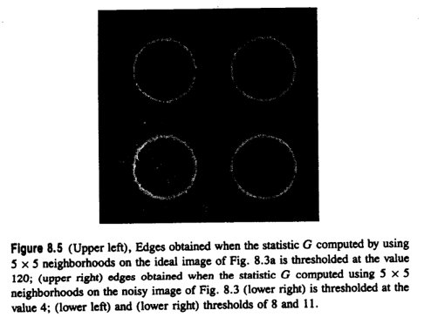
8.6 Gradient-Based Facet Edge Detection
Notes:
課本的圖例

Slide 78
Outline
8.1 Introduction
8.2 Relative Maxima
8.3 Sloped Facet Parameter and Error Estimation
8.4 Facet-Based Peak Noise Removal
8.5 Iterated Facet Model
8.6 Gradient-Based Facet Edge Detection
8.7 Bayesian Approach to Gradient Edge Detection
8.8 Zero-Crossing Edge Detector
8.9 Integrated Directional Derivative Gradient Operator
8.10 Corner Detection
8.11 Isotropic Derivative
8.12 Ridges and Ravines on Digital Images
8.13 Topographic Primal Sketch
Notes:
8.7 使用貝式法去決定觀測的梯度強度統計
bayesian approach 判斷觀測到的 gradient 大小是否統計上顯著不同於 0
*magnitude: 大小

Slide 79
8.7 Bayesian Approach to Gradient Edge Detection
The Bayesian approach to the decision of whether or not an observed gradient magnitude G is statistically significant and therefore participates in some edge is to decide there is an edge (statistically significant gradient) when,
: given gradient magnitude conditional probability of edge.
: given gradient magnitude conditional probability of nonedged.
$$P\left(edge | G\right)>P\left(nonedge|G\right)$$
$$P\left(edge | G\right)$$
$$P\left(nonedge|G\right)$$
Notes:
貝式方法去決定觀察梯度Ｇ是否顯著統計且參與決定某些邊是否為邊界當

Slide 80
8.7 Bayesian Approach to Gradient Edge Detection
$$P\left(edge | G\right)=\frac{P\left(G | edge\right)P\left(edge\right)}{P\left(G\right)}$$
Hence a decision for edge is made whenever
$P(G|nonedge)$ is known to be the density function of a $χ_{2}^{2}$ variate.
$$P\left(nonedge | G\right)=\frac{P\left(G | nonedge\right)P\left(nonedge\right)}{P\left(G\right)}$$
$$P\left(edge | G\right)>P\left(nonedge|G\right)$$
$$P\left(G | edge\right)P\left(edge\right)>P\left(G | nonedge\right)P\left(nonedge\right)$$
Notes:
已知 P(edge|G) …
P(nonedge|G)
加上上一頁的前提 P(edge|G) > P(nonedge|G)
把P(G) 約分掉
另外從上一個章節可以看出，G 是 自由度為2的卡方分部 變量的密度函數(ppt.71)

Slide 81
8.7 Bayesian Approach to Gradient Edge Detection
Infer $P\left(G | edge\right)$ from $P(G)$
$$P\left(G\right)=P\left(G | edge\right)P\left(edge\right)+P\left(G | nonedge\right)P\left(nonedge\right)$$
$$P\left(G | edge\right)=\frac{P\left(G\right)−P\left(G | nonedge\right)P\left(nonedge\right)}{P\left(edge\right)}$$
$$P\left(G | edge\right)=\frac{P\left(G\right)−P\left(G | nonedge\right)P\left(nonedge\right)}{1−P\left(nonedge\right)}$$
$P\left(nonedge\right)$ is a user-specified prior probability of nonedge, 0.9 to 0.95 are reasonable.
Notes:
P(G) density function of the histogram of observed gradient magnitude
從 P(G) 可推出 P(給定是邊 ，G的機率)

Slide 82
8.7 Bayesian Approach to Gradient Edge Detection
The threshold t for G is determined as that value t for which
$$P\left(t | edge\right)P\left(edge\right)=P\left(t | nonedge\right)P\left(nonedge\right)$$
Implies that the threshold t must satisfy that
$P\left(t\right)=2P\left(t | nonedge\right)P\left(nonedge\right)$
Notes:
G 的門檻值 t

Slide 83
Outline
8.1 Introduction
8.2 Relative Maxima
8.3 Sloped Facet Parameter and Error Estimation
8.4 Facet-Based Peak Noise Removal
8.5 Iterated Facet Model
8.6 Gradient-Based Facet Edge Detection
8.7 Bayesian Approach to Gradient Edge Detection
8.8 Zero-Crossing Edge Detector
8.9 Integrated Directional Derivative Gradient Operator
8.10 Corner Detection
8.11 Isotropic Derivative
8.12 Ridges and Ravines on Digital Images
8.13 Topographic Primal Sketch
Notes:
8.8討論zero crossing 在二階導數的邊界偵測
二階微分 zero crossing detectors(檢測器)

Slide 84
8.8 Zero-Crossing Edge Detector
compare
gradient edge detector: looks for high values of first derivatives
zero-crossing edge detector: looks for relative maxima in first derivative
In what follows we assume that in each neighborhood of the images, the underlying gray-level intensity function f takes the form
Notes:
把在二階微分通過零的pixel當作edge
Zero-crossing edge detector : 會在一階導數相對極大值
接下來，我們假設在圖像的每個鄰域中，底層灰度強度函數f的形式為

Slide 85
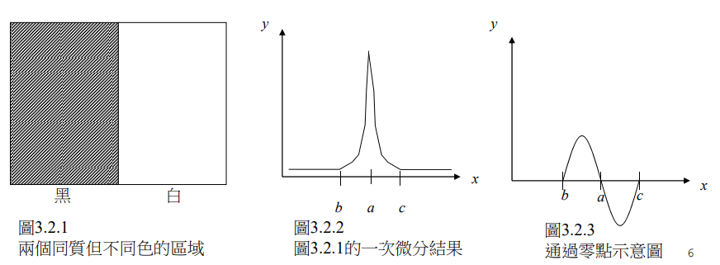
8.8 Zero-Crossing Edge Detector
http://140.117.156.238/course/CSSV/2011/%E7%9B%A3%E6%8E%A7%E8%A6%96%E8%A8%8A_ch3.pdf
Notes:
圖例
引用
http://140.117.156.238/course/CSSV/2011/%E7%9B%A3%E6%8E%A7%E8%A6%96%E8%A8%8A_ch3.pdf

Slide 86
8.8.1 Discrete Orthogonal Polynomials
The underlying functions from which the directional derivative are computed are easy to represent as linear combinations of the polynomials in any polynomial basis set.
basis set:
The discrete orthogonal polynomials
Notes:
以多項式的線性組合來表達被隱含的圖像函數
＠底層函數從方向導數容易用來表示在已多項式為基底集合的線系組合多項式
計算梯度(做 zero crossing)所需要的 functions 可以很容易的用 basis set(基底函數組 or 基組) 的線性組合表示，
允許獨立估計每個係數的多項式 basis set 將最易於使用。 這樣的 basis 稱為離散正交多項式

Slide 87
8.8.1 Discrete Orthogonal Polynomials
discrete orthogonal polynomial basis set of size N
polynomials deg. 0..N - 1
discrete Chebyshev polynomials:
Initial:$P_{0}\left(r\right)=1, P_{1}\left(r\right)=r$
General: $P_{n}\left(r\right)=r^{n}+a_{n−1}r^{n−1}+…+a_{1}r+a_{0}$
Constraint: $P_{n}\left(r\right)$ is orthogonal to $P_{0}\left(r\right), P_{1}\left(r\right),…,P_{n−1}\left(r\right)$
$$\sum_{r∈R}{P_{k}\left(r\right)\left(r^{n}+a_{n−1}r^{n−1}+…+a_{1}r+a_{0}\right)}=0, k=0,…,n−1$$
Notes:
Size N 的離散正交多項式 其最高系數是0~n-1
課本這邊這邊使用切比雪夫
Discrete Orthogonal Polynomials 還有 Charlier polynomials, Krawtchouk polynomials (克拉夫楚克,克勞喬克).. 等
可用來近似 limited area function (有限區域的 function)，ex: functon -1~1 之間

Slide 88
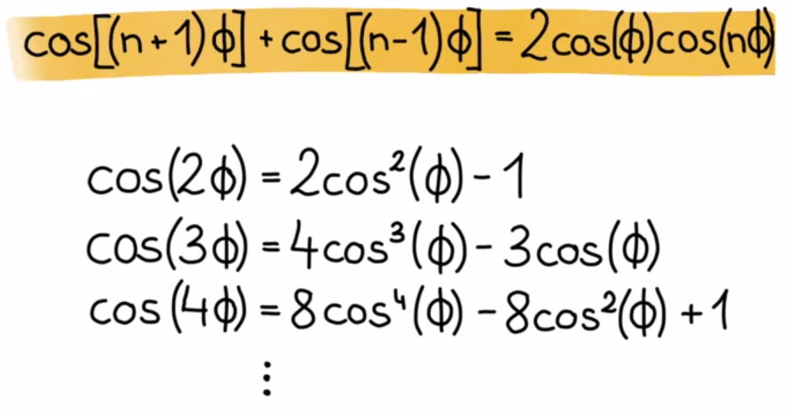
8.8.1 Discrete Orthogonal Polynomials (cont’)
Chebyshev polynomials
Computers, Waves, Simulations: A Practical Introduction
to Numerical Methods using Python
Notes:
高中數學 cos(2 theta) = cos^2(theta) – sin^2(theta)
又 sin^2(theta) = 1 – cos^2(theta)

Slide 89
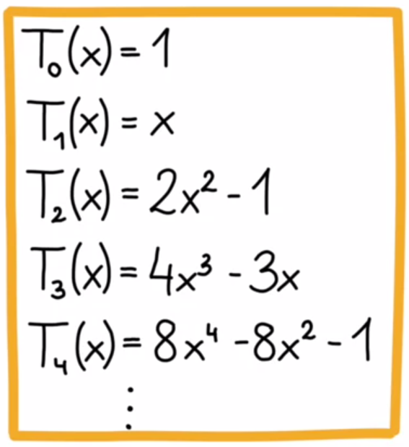
8.8.1 Discrete Orthogonal Polynomials (cont’)
Chebyshev polynomials
$T_{n+1}\left(x\right)=2xT_{n}\left(x\right)−T_{n−1}\left(X\right)$
Computers, Waves, Simulations: A Practical Introduction
to Numerical Methods using Python
Notes:
其實大家就可以看出來，這邊就是把 cos(phi) = x 替換
遞迴定義

Slide 90
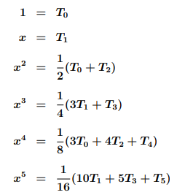
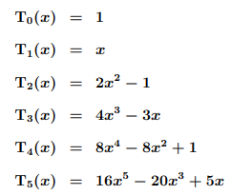
8.8.1 Discrete Orthogonal Polynomials (cont’)
Chebyshev polynomials
http://www.mhtl.uwaterloo.ca/courses/me755/web_chap6.pdf
Notes:
basis 的部分 -> linear combination
可線性組合出任一項

Slide 91
8.8.1 Discrete Orthogonal Polynomials (cont’)
discrete orthogonal polynomials can be recursively generated
$P_{i+1}\left(r\right)=rP_{i}(r)－β_{i}P_{i−1}\left(r\right)$
$β_{i}=\frac{\sum_{r∈R}{rP_{i}\left(r\right)P_{i−1}\left(r\right)}}{\sum_{r∈R}{P_{i−1}^{2}\left(r\right)}}$
$μ_{k}=\sum_{r∈R}{s^{k}}$
Notes:
因為是離散的關係，可能積分 -> sigma，微分變成相減等方式
所以離散的 Chebyshev polynomials 如上述所定義
線性代數的一些資訊可以參考課本 appendix(附錄) B
二維離散正交多項式可以遞回產生
http://www.mymathlib.com/functions/orthogonal_polynomials/discrete_chebyshev.html

Slide 92
8.8.1 Discrete Orthogonal Polynomials (cont’)
discrete orthogonal polynomials can be recursively generated
$$β_{i}=\frac{\sum_{r∈R}{rP_{i}\left(r\right)P_{i−1}\left(r\right)}}{\sum_{r∈R}{P_{i−1}^{2}\left(r\right)}}$$
Example: Find $P_{2}\left(r\right)$
$P_{2}\left(r\right)=rP_{1}\left(r\right)−β_{1}P_{0}\left(r\right)$
$=r×r−\frac{\sum_{r∈R}{rP_{1}\left(r\right)P_{0}\left(r\right)}}{\sum_{r∈R}{P_{0}^{2}\left(r\right)}}×1$
$=r^{2}−\frac{\sum_{r∈R}{r^{2}}}{\sum_{r∈R}{1}}=r^{2}−\frac{μ_{2}}{μ_{0}}$
Notes:
二維離散正交多項式可以遞回產生

Slide 93
8.8.1 Discrete Orthogonal Polynomials (cont’)
discrete orthogonal polynomials can be recursively generated
,
Notes:
二維離散正交多項式可以遞回產生
一些項

Slide 94
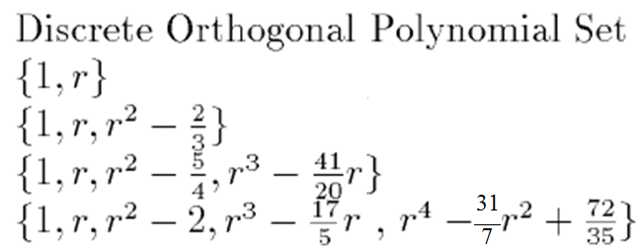
8.8.2 Two-Dimensional Discrete Orthogonal Polynomials
2-D discrete orthogonal polynomials creatable from tensor products of 1D from above equations
$$P_{2}(r)=r^{2}−\frac{μ_{2}}{μ_{0}}=r^{2}−\frac{2}{3}$$
{-1,0,1}
$$μ_{2}={(−1)}^{2}+0^{2}+1^{2}=2 μ_{0}={−1}^{0}+0^{0}+1^{0}=3$$
Notes:
這邊課本有錯，提醒大家可以去課程首頁 Handouts(Past Materials) 最後有個課本勘誤
41/20 r
31/7 r^2
Index set 對原點佔有平均的空間，且間隔 = 1

Slide 95
8.8.2 Two-Dimensional Discrete Orthogonal Polynomials
Index Set
$\left\{−\frac{1}{2},\frac{1}{2}\right\}$
$\left\{−1, 0, 1\right\}$
$\left\{−\frac{3}{2}, −\frac{1}{2},\frac{1}{2},\frac{3}{2}\right\}$
Discrete Orthogonal Polynomial Set
$\left\{1, r\right\}$
$\left\{1, r, r^{2}−\frac{2}{3}\right\}$
$\left\{1, r, r^{2}−\frac{5}{4}, r^{3}−\frac{41}{20}r\right\}$
$$P_{3}\left(r\right)=r^{3}−\frac{μ_{4}}{μ_{2}}r$$
$$=r^{3}−\frac{41}{20}r$$
$$μ_{4}={(−\frac{3}{2})}^{4}+{(−\frac{1}{2})}^{4}+{(\frac{1}{2})}^{4}+{(\frac{3}{2})}^{4}=\frac{41}{4}$$
$$μ_{2}={(−\frac{3}{2})}^{2}+{(−\frac{1}{2})}^{2}+{(\frac{1}{2})}^{2}+{(\frac{3}{2})}^{2}=5$$
Notes:
這邊課本有錯，提醒大家可以去課程首頁 Handouts(Past Materials) 最後有個課本勘誤

Slide 96
8.8.2 Two-Dimensional Discrete Orthogonal Polynomials
2-D discrete orthogonal polynomials creatable from tensor products of 1D from above equations
Index Set
{-1,0,1}$×${-1,0,1}
Discrete Orthogonal Polynomial Set
$$\{1,r,r^{2}−\frac{2}{3}\}×\left\{1,c,c^{2}−\frac{2}{3}\right\}$$
$$=\{1,r,r^{2}−\frac{2}{3},c,c^{2}−\frac{2}{3},rc,c\left(r^{2}−\frac{2}{3}\right),r\left(c^{2}−\frac{2}{3}\right),(r^{2}−\frac{2}{3})(c^{2}−\frac{2}{3})\}$$
Notes:
二維離散正交多項式從上面的從一維公式張量積 可創建
直接乘開

Slide 97
8.8.3 Equal-Weighted Least-Squares Fitting Problem
The exact fitting problem is to determine the coefficients $a_{0}, …, a_{N−1}$ such that
The approximate fitting problem is to determine coefficients a₀,…,a_{K}, $K≤N−1$, such that
Is minimized. the result is
For each index r, the data value d(r) is multiplied by the weight $\frac{P_{m}\left(r\right)}{\sum_{s∈R}{P_{m}^{2}\left(s\right)}}$
$$e^{2}=\sum_{r∈R}{{\left[d\left(r\right)−\sum_{n=0}^{K}{a_{n}P_{n}\left(r\right)}\right]}^{2}}$$
Notes:
d(r) 觀測值，同樣的 least-square error fitting
a_m means that each fitting coefficients can be computed as a linear combination of the data values
(am 代表可將每一項係數，直接由 data values 的線性組合產生)

Slide 98
8.8.3 Equal-Weighted Least-Squares Fitting Problem
$$e^{2}=\sum_{r∈R}{{\left[d\left(r\right)−\sum_{n=0}^{K}{a_{n}P_{n}\left(r\right)}\right]}^{2}}$$
$$\frac{∂e^{2}}{∂a_{m}}=0=2\sum_{r∈R}{\left[P_{m}\left(r\right)d\left(r\right)−\sum_{n=0}^{K}{a_{n}P_{m}\left(r\right)P_{n}\left(r\right)}\right]}$$
$$\sum_{r∈R}{P_{m}\left(r\right)d\left(r\right)}=\sum_{r∈R}{a_{m}P_{m}^{2}\left(r\right)}$$
$$a_{m}=\frac{\sum_{r∈R}{P_{m}\left(r\right)d\left(r\right)}}{\sum_{s∈R}{P_{m}^{2}\left(s\right)}}$$
Proof
Notes:
推倒 am
偏微分 -> 移項

Slide 99
8.8.3 Equal-Weighted Least-Squares Fitting Problem
Weight $\frac{P_{m}\left(r\right)}{\sum_{s∈R}{P_{m}^{2}\left(s\right)}}$
Notes:
Numerator (分子) denominator (分母)
[1/25] 是說整個要除正規化回來
Σg(r,c)^2

Slide 100
8.8.3 Equal-Weighted Least-Squares Fitting Problem (cont’)
Notes:
5x5 矩陣 以中心 代表 r=0, c =0 。左上代表r =-2, c =-2。右下代表 r =2, c =2。代入式子即可得出矩陣 ex K10: c³-3.4c

Slide 101
Break time
Notes:
Residentsleeper: 想睡
不怪你 這次我自己先講 :D

Slide 102
8.8.4 Directional Derivative Edge Finder
We define the directional derivative edge finder as the operator that places an edge in all pixels having a negatively sloped zero crossing of the second directional derivative taken in the direction of the gradient
r: row
c: column
ρ: radius in polar coordinate
α: angle in polar coordinate, clockwise from column axis
Notes:
我們定義方向導數邊界尋檢器視為一運算。
一個邊的所有pixel 的二階方向導數在具有方向梯度上有負斜率過零點
ρ(rho), alpha

Slide 103
8.8.4 Directional Derivative Edge Finder (cont’)
$$r=ρsinα, c=ρcosα$$
Directional derivative of f at point (r, c) in direction $α$:
$$f_{α}^{′}\left(r, c\right)=\lim_{h→0}{\frac{f\left(r+hsinα, c+hcosα\right)−f\left(r,c\right)}{h}}$$
$$f_{α}^{′}\left(r, c\right)=\frac{∂f}{∂r}\left(r, c\right)sinα+\frac{∂f}{∂c}\left(r, c\right)cosα$$
Notes:
http://blog.ncue.edu.tw/sys/lib/read_attach.php?id=13236
http://blog.ncue.edu.tw/sys/lib/read_attach.php?id=13237
(前一頁)α: angle in polar coordinate, clockwise from column axis
連鎖律
下一頁有推倒過程

Slide 104
8.8.4 Directional Derivative Edge Finder (cont’)
$$f_{α}^{′}\left(r, c\right)=\lim_{h→0}{\frac{f\left(r+hsinα, c+hcosα\right)−f\left(r,c\right)}{h}}$$
$$=\lim_{h→0}{\frac{f\left(r+hsinα, c+hcosα\right)−f\left(r,c+hcosα\right)}{h}}$$
$$+\lim_{h→0}{\frac{f\left(r, c+hcosα\right)−f\left(r,c\right)}{h}}$$
$$=\lim_{h→0}{\frac{f\left(r+hsinα, c+hcosα\right)−f\left(r,c+hcosα\right)}{hsinα}sinα}$$
$$+\lim_{h→0}{\frac{f\left(r, c+hcosα\right)−f\left(r,c\right)}{hcosα}cosα}$$
$$=\frac{∂f}{∂r}\left(r, c\right)sinα+\frac{∂f}{∂c}\left(r, c\right)cosα$$

Slide 105
8.8.4 Directional Derivative Edge Finder (cont’)
second directional derivative of f at point (r, c) in direction $α$:
$$f_{α}^{′}\left(r, c\right)=\frac{∂f}{∂r}\left(r, c\right)sinα+\frac{∂f}{∂c}\left(r, c\right)cosα$$
$$f_{α}^{′′}\left(r,c\right)=\frac{∂^{2}f}{∂r^{2}}\left(r,c\right)\sin^{2}{α}+2\frac{∂^{2}f}{∂r∂c}\left(r,c\right)sinαcosα+\frac{∂^{2}f}{∂c^{2}}\left(r,c\right)\cos^{2}{α}$$
$$f_{α}^{′′′}\left(r,c\right)=\frac{∂^{3}f}{∂r^{3}}\left(r,c\right)\sin^{3}{α}+3\frac{∂^{3}f}{∂r^{2}∂c}\left(r,c\right)\sin^{2}{α}cosα+$$
$$3\frac{∂^{3}f}{∂r∂c^{2}}\left(r,c\right)sinα\cos^{2}{α}+\frac{∂^{3}f}{∂c^{3}}\left(r,c\right)\cos^{3}{α}$$
Notes:
f’ 代入 f
f’ = df/dr (r, c)sina + df/dr (r, c)cosa
f‘’ = df’/dr (r, c)sina + df’/dr (r, c)cosa
= d( df/dr (r, c)sina + df/dr (r, c)cosa )/dr (r, c)sina + d( df/dr (r, c)sina + df/dr (r, c)cosa )/dc (r, c)cosa
= {d^2f/dr^2 (r, c) sin a + d^2f/drc (r, c) cosa}sina + {d^2f/drc (r, c) sin a + d^2f/dc^2 (r, c) cosa} cosa
= {d^2f/dr^2 (r, c) sin^2 a} + {2 d^2f/drc (r, c) sin a cos a} + {d^2f/dc^2 (r, c) cos^2 a}

Slide 106
8.8.4 Directional Derivative Edge Finder (cont’)
An edge pixel
$f_{α}^{′′′}\left(ρ\right)<0$
$f_{α}^{′′}\left(ρ\right)=0$
$f_{α}^{′}(ρ)≠0$
Notes:
所以 edge pixel
往下看範例

Slide 107
8.8.4 Directional Derivative Edge Finder (cont’)
4.6 Directional Derivatives and the Gradient
Notes:
上慢點 多些舉例，這個票..可以考慮一下

Slide 108
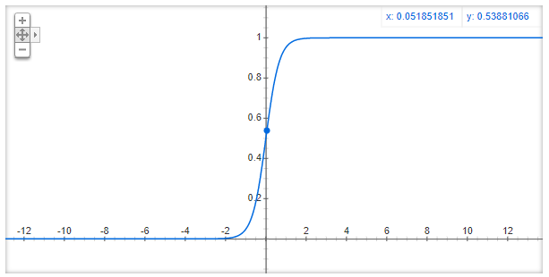
8.8.4 Directional Derivative Edge Finder (cont’)
f
Notes:
我們沿著其中一角度切下去的剖面圖
這個就是大家在 DL 上一定也不陌生的 sigmoid
所以一般認為的邊應該是正中間這個位置
手動微分太麻煩 -> 之前提過的網站 (想不到吧 前後呼應 我也沒想到)

Slide 109
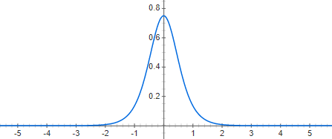
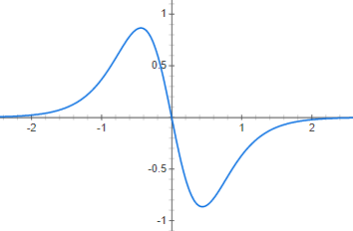
8.8.4 Directional Derivative Edge Finder (cont’)
f’
f’’
Notes:
剛剛提到的
f’ != 0 (= 0的部分是平坦的)
f‘’ = 0
有點像把 f’ 當 f 的 zero crossing

Slide 110
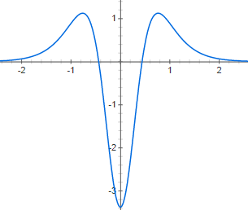
8.8.4 Directional Derivative Edge Finder (cont’)
An edge pixel f’’’
$f_{α}^{′′′}\left(ρ\right)<0$
$f_{α}^{′′}\left(ρ\right)=0$
$f_{α}^{′}(ρ)≠0$
Notes:
所以 edge pixel

Slide 111
Outline
8.1 Introduction
8.2 Relative Maxima
8.3 Sloped Facet Parameter and Error Estimation
8.4 Facet-Based Peak Noise Removal
8.5 Iterated Facet Model
8.6 Gradient-Based Facet Edge Detection
8.7 Bayesian Approach to Gradient Edge Detection
8.8 Zero-Crossing Edge Detector
8.9 Integrated Directional Derivative Gradient Operator
8.10 Corner Detection
8.11 Isotropic Derivative
8.12 Ridges and Ravines on Digital Images
8.13 Topographic Primal Sketch
Notes:
8.9討論集成方向導數梯度

Slide 112
8.9 Integrated Directional Derivative Gradient Operator
integrated directional derivative gradient operator
an operator that measures the integrated directional derivative strength as the integral of first directional derivative taken over a square area
more accurate step edge direction
Journals
Notes:
積分 方向導數梯度，一個平面。而不是之前只看一個點
更為精準
如下圖
更詳細可以看課本 8.9.1 、 8.9.2 有 demo
或是我有附上作者發在 IEEE journals 的連結

Slide 113
Outline
8.1 Introduction
8.2 Relative Maxima
8.3 Sloped Facet Parameter and Error Estimation
8.4 Facet-Based Peak Noise Removal
8.5 Iterated Facet Model
8.6 Gradient-Based Facet Edge Detection
8.7 Bayesian Approach to Gradient Edge Detection
8.8 Zero-Crossing Edge Detector
8.9 Integrated Directional Derivative Gradient Operator
8.10 Corner Detection
8.11 Isotropic Derivative
8.12 Ridges and Ravines on Digital Images
8.13 Topographic Primal Sketch
Notes:
8.10 討論小平面方法去做corner detection

Slide 114
8.10 Corner Detection
purpose
corners: to detect buildings in aerial images
corner points: to determine displacement vectors from image pair
corners with two conditions
the occurrence of an edge
significant changes in edge direction
Gray scale corner detectors:
detect corners directly by gray scale image
Notes:
目的
偵測空照圖中的建築
角落點:求出一對圖片的位移向量
角落的2條件
有邊出現
明顯邊方向的變化

Slide 115
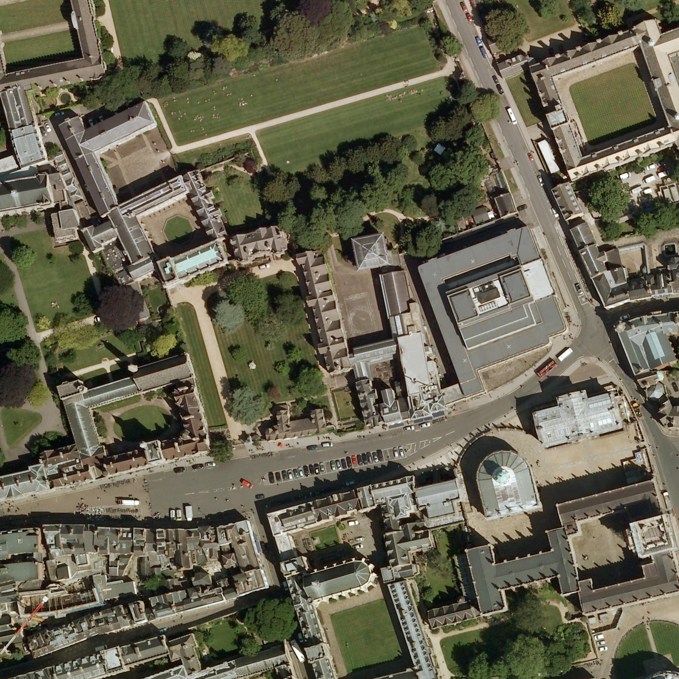
Aerial Images
Blackwell’s |
Book store‎
Notes:
空拍圖

Slide 116
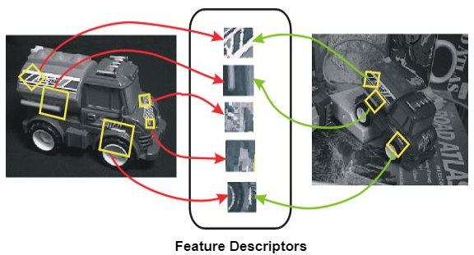
8.10 Corner Detection
corner points: to determine displacement vectors from image pair
Digital Image Processing, 4/e
Notes:
圖像匹配 (同個物件 不同角度)

Slide 117
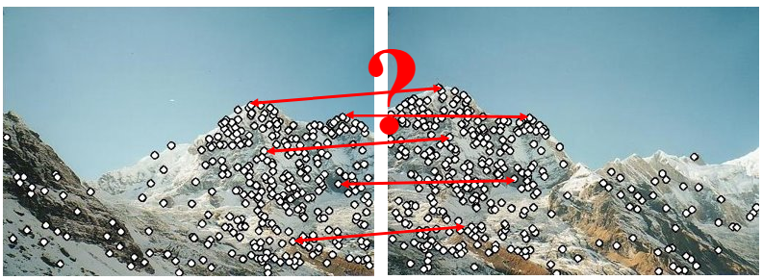
8.10 Corner Detection
corner points: to determine displacement vectors from image pair
Digital Image Processing, 4/e
Notes:
圖像結合

Slide 118
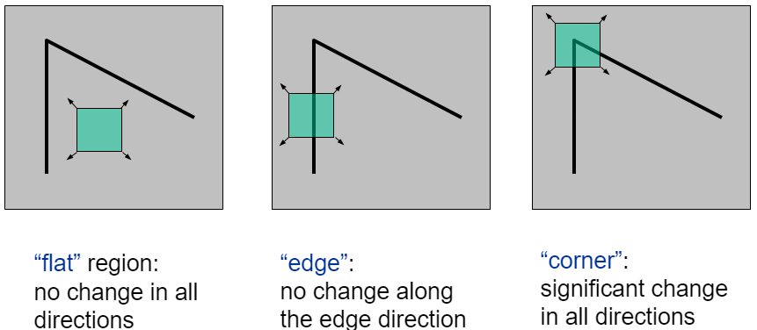
8.10 Corner Detection
corners with two conditions
the occurrence of an edge
significant changes in edge direction
Digital Image Processing, 4/e
Notes:
左: 移動一點不改變
中: 只有上下移動不改變
右: 怎動都改變

Slide 119
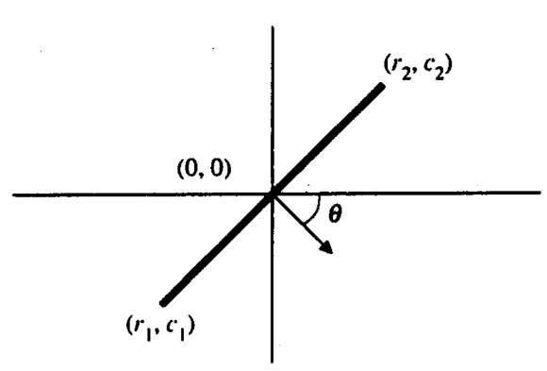
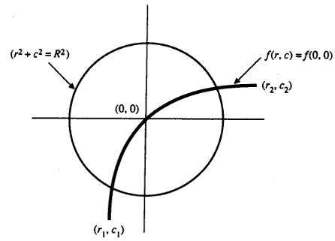
8.10 Corner Detection
Let $θ\left(r,c\right)$ be the gradient direction at coordinate $(r,c)$, and let$θ$₀ =$θ$(0,0)
(sin$θ$₀,cos$θ$₀) is a unit vector in the
direction of the gradient at the origin
The origin(0,0) is a corner point
involves meeting the following
two conditions:
Notes:
課本這邊判斷是不是 Corner 採用以下方式

Slide 120
Outline
8.1 Introduction
8.2 Relative Maxima
8.3 Sloped Facet Parameter and Error Estimation
8.4 Facet-Based Peak Noise Removal
8.5 Iterated Facet Model
8.6 Gradient-Based Facet Edge Detection
8.7 Bayesian Approach to Gradient Edge Detection
8.8 Zero-Crossing Edge Detector
8.9 Integrated Directional Derivative Gradient Operator
8.10 Corner Detection
8.11 Isotropic Derivative
8.12 Ridges and Ravines on Digital Images
8.13 Topographic Primal Sketch
Notes:
8.11使用小平面的方法來說明各方向同性微分大小
Isotropic:等向的、各向同性。不同角度所測得的數值是相同的

Slide 121
8.11 Isotropic Derivative Magnitudes
A gradient edge can be understood as arising from a first-order isotropic derivative magnitude
determine those linear combinations of squared partial derivative of the two-dimensional functions that are invariant under rotation of the domain of the two dimensional function.
rotate the coordinate system by$θ$and call the resulting function g in the new (r’,c’) coordinate
$$f(r,c)=k_{1}+k_{2}r+k_{3}c$$
$$r=r′\cos{θ}−c′\sin{θ},c=r′\sin{θ}+c′\cos{θ}$$
$$g(r′,c′)=f(r,c)$$
Notes:
@梯度邊緣可以被理解為從第一階各向同性 導數 量值而產生
@判定二維函數的“二維函數的平方偏導”的線性組合在定義域下的旋轉下不變
＠選轉$θ角後的座標在 g 的表示如下$

Slide 122
8.11 Isotropic Derivative Magnitudes
A gradient edge can be understood as arising from a first-order isotropic derivative magnitude
determine those linear combinations of squared partial derivative of the two-dimensional functions that are invariant under rotation of the domain of the two dimensional function.
rotate the coordinate system by$θ$and call the resulting function g in the new (r’,c’) coordinate
$$f(r,c)=k_{1}+k_{2}r+k_{3}c$$
$$r^{′}=rcosθ+csinθ, c^{′}=−rsinθ+ccosθ$$
Notes:
移項一下可以用 r, c 表示 r’, c’

Slide 123
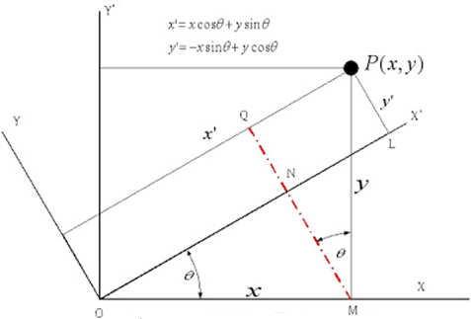
8.11 Isotropic Derivative Magnitudes
$$r^{′}=rcosθ+csinθ, c^{′}=−rsinθ+ccosθ$$
$$g\left(r^{′},c^{′}\right)=k_{1}+k_{2}r^{′}+k_{3}c^{′}$$
=$k_{1}+\left(k_{2}cosθ−k_{3}sinθ\right)r+\left(k_{2}sinθ+k_{3}cosθ\right)c$
Notes:
C s
S c
逆上 順下(負號在 sin)
把 r’, c’ 代入

Slide 124
8.11 Isotropic Derivative Magnitudes
$g\left(r^{′},c^{′}\right) = k_{1}+\left(k_{2}cosθ−k_{3}sinθ\right)r+\left(k_{2}sinθ+k_{3}cosθ\right)c$
${[\frac{∂g\left(r^{′}, c^{′}\right)}{∂r}]}^{2}+{[\frac{∂g\left(r^{′}, c^{′}\right)}{∂c}]}^{2}$
=(k₂cos$θ$-k₃sin$θ$)² + (k₂sin$θ$+ k₃cos$θ$)²
=$k_{2}^{2}+k_{3}^{2}={[\frac{∂f\left(r, c\right)}{∂r}]}^{2}+{[\frac{∂f\left(r, c\right)}{∂c}]}^{2}$
The sum of the squares of the first partials is the same constant $k_{2}^{2}+k_{3}^{2}$, the squared gradient magnitude, for the original function or for the rotated function.
$$f(r,c)=k_{1}+k_{2}r+k_{3}c$$
Notes:
偏微 r 與 c 的平方加總會是
看到與原本的 magnitude 平方相同
不因為旋轉改變

Slide 125
Outline
8.1 Introduction
8.2 Relative Maxima
8.3 Sloped Facet Parameter and Error Estimation
8.4 Facet-Based Peak Noise Removal
8.5 Iterated Facet Model
8.6 Gradient-Based Facet Edge Detection
8.7 Bayesian Approach to Gradient Edge Detection
8.8 Zero-Crossing Edge Detector
8.9 Integrated Directional Derivative Gradient Operator
8.10 Corner Detection
8.11 Isotropic Derivative
8.12 Ridges and Ravines on Digital Images
8.13 Topographic Primal Sketch
Notes:
8.12討論山脊和溝壑

Slide 126
8.12 Ridges and Ravines on Digital Images
Notes:
在數位影像上的山脊(Ridges)和深谷(Ravines)(惹 vins)

Slide 127
8.12 Ridges and Ravines on Digital Images
A digital ridge (ravine) occurs on a digital image when there is a simply connected sequence of pixels with gray level intensity values that are significantly higher (lower) in the sequence than those neighboring the sequence.
The facet model can be used to help accomplish ridge and ravine identification.
Notes:
在數位影像上山脊或深谷，是灰階值簡單的相連，且與相鄰區域有著顯著的高(低)序列
山脊發生在灰階值比鄰居高
深谷發生在灰階值比鄰居低
Facet model 可用來鑑定
細節可以參考課本 8.12.2

Slide 128
Outline
8.1 Introduction
8.2 Relative Maxima
8.3 Sloped Facet Parameter and Error Estimation
8.4 Facet-Based Peak Noise Removal
8.5 Iterated Facet Model
8.6 Gradient-Based Facet Edge Detection
8.7 Bayesian Approach to Gradient Edge Detection
8.8 Zero-Crossing Edge Detector
8.9 Integrated Directional Derivative Gradient Operator
8.10 Corner Detection
8.11 Isotropic Derivative
8.12 Ridges and Ravines on Digital Images
8.13 Topographic Primal Sketch
Notes:
8.13提出了每個像素的各種地形類別的標籤轉化

Slide 129
8.13 Topographic Primal Sketch 8.13.1 Introduction
The basis of the topographic primal sketch consists of the labeling and grouping of the underlying Image-intensity surface patches according to the categories defined by monotonic, gray level, and invariant functions of directional derivatives
categories:
Peak
Pit
Ridge
Ravine
Saddle
Flat
Hillside
Notes:
根據單調函數、灰度函數和不變函數定義的類別，對基礎圖像表面進行標記和分類，就構成了地形原始草圖(地形基本素描)
Peak:山峰 pit:凹坑 ridge:山脊 ravine:深谷 saddle:鞍狀 flat:平面 hillside:山坡

Slide 130
8.13.1 Introduction (cont’) Invariance Requirement
histogram normalization, equal probability quantization: nonlinear enhancing
For example, edges based on zero crossings of second derivatives will change in position as the monotonic gray level transformation changes
Convexity of a gray level intensity surface is not preserved under such transformation.
peak, pit, ridge, valley, saddle, flat, hillside: have required invariance
Notes:
基於二階導數過零的邊界會隨著單調灰度變換的變化而變化
不變性(Invariance) 的需求
相對的就不會因為灰階的數值變動而變動

Slide 131
8.13.2 Mathematical Classification of Topographic Structure
We will use the following notation to describe the mathematical properties of our topographic categories for continuous surfaces
Notes:
@ f 的梯度向量(vector)
＠梯度強度
＠ω1: 二階方向導數具有最大強度的單位方向向量(vector)
＠ω2: 正交於ω1 的向量(vector)
＠二階方向導數在w¹方向的值

Slide 132
8.13.2 Mathematical Classification of Topographic Structure
$H=\left[\begin{matrix}\frac{∂^{2}f}{∂r^{2}} & \frac{∂^{2}f}{∂r∂c} \\ \frac{∂^{2}f}{∂c∂r} & \frac{∂^{2}f}{∂c^{2}}\end{matrix}\right]$
The eigenvalues of the Hessian are the values of the extrema of the second directional derivative, and their associated eigenvectors are the directions in which the second directional derivative is extremized.
Notes:
＠一階方向導數在w¹方向的值
不失一般性，假設|入1| >= |入2|
@二階方向打數可以被計算表示成 Hessian 2x2 matrix
＠Hessian矩陣的特徵值是所述二階方向導數的極值的值，和它們的相關特徵向量，其中二階方向導數偏移的方向。

Slide 133
8.13.2 Peak
Peak (knob): occurs where there is a local maximum in all directions
curvature downward in all directions
gradient zero & second directional derivative negative in all directions
point classified as peak if
$λ_{1}$ is second directional derivative in $ω^{\left(1\right)}$ direction.
$λ_{2}$ is second directional derivative in $ω^{\left(2\right)}$ direction.
: gradient magnitude
Notes:
@發生在所有方向的局部最大值
＠所有方下的曲率皆向下
＠在峰點：梯度為0
@所有方向的二階方向導數皆為負

Slide 134
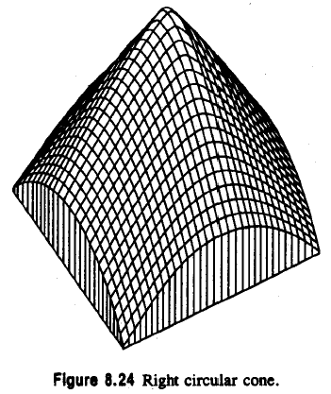
8.13.2 Peak
: second directional derivative in direction
: second directional derivative in direction
Notes:
梯度各方項都是負的

Slide 135
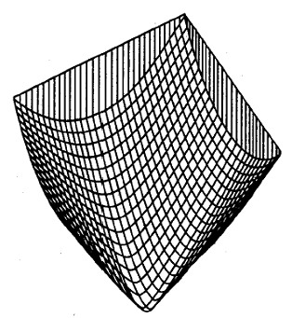
8.13.2 Pit
pit (sink: bowl): local minimum in all directions
pit: gradient zero, second directional derivative positive
Notes:
＠跟peak 相反，所有方向皆為正的
(只是把 Peak 翻轉，實際上課本沒有圖，不知道誰想到的方法)

Slide 136
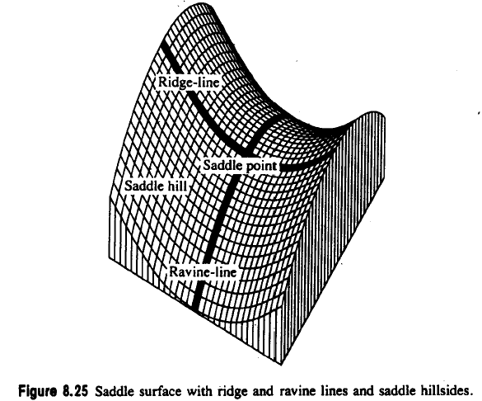
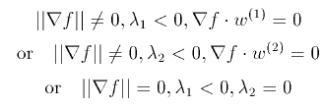
8.13.2 Ridge
A ridge occurs on ridge line, a curve consisting of a series of ridge points and along ridge line, the points to the right and left are lower
ridge line: may be flat, sloped upward, sloped downward, curved upward…
ridge: local maximum in one direction
Notes:
Ridge (山脊、山脈)
@發生在稜線
＠包含了一系列的脊點

Slide 137
8.13.2 Ravine
A ravine (valley): is identical to a ridge except that it is a local minimum in one direction
walk along ravine line: points to the right and left are higher
Notes:
Ravine(峽谷): 兩側都比他高

Slide 138
8.13.2 Saddle
local maximum in one direction, local minimum in perpendicular dir.
positive curvature in one direction, negative in perpendicular dir.
gradient magnitude zero
extrema of second
directional derivative
have opposite signs
Notes:
Saddle (鞍)
＠在一方向有局部最大值，另一方向則有局部最小值
＠一方向正曲率，另一垂直方向為負
＠梯度為0
＠兩個不同方向的極值也正負相反

Slide 139
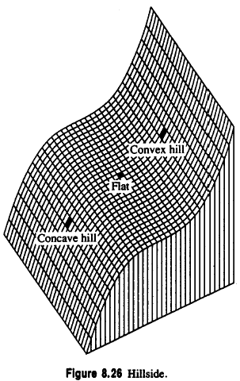
8.13.2 Flat
A flat (plain) is a simple, horizontal surface, must have zero gradient and no curvature.
It satisfies the following conditions
If the conditions are true, we may further classify a foot or a shoulder
foot: flat begins to turn up into a hill
shoulder: flat ending and turning down into a hill
Notes:
Flat (平的)
＠平面、簡單、水平表面
＠梯度0,沒有曲率
＠
＠foot : 平開始轉成小山往上
＠shoulder：平結束變且開始轉成斜坡往下的地方
Hill(小山、斜坡)

Slide 140
8.13.2 Hillside
A hillside point is anything not covered by previous categories.
hillside: nonzero gradient, no strict extrema
Slope: tilted flat (constant gradient)
convex hill: curvature positive (upward)
concave hill: curvature negative
(downward)
Notes:
Hillside(山腰、山坡)
＠非零梯度、沒有嚴格的極值
＠山坡：非零梯度，無嚴格極大值
＠斜率：傾斜的平面（常數梯度）
＠凸的山坡:曲率為正（向上）
往外凸
不是 convex hull(凸包)

Slide 141
8.13.2 Hillside
saddle hill: up in one direction, down in perpendicular direction
inflection point: zero
crossing of second
directional derivative
Notes:
＠凹的坡：曲率為負（向下）(往內凹)
＠鞍狀坡：一方向向上，另一垂直方向向下
＠拐點、反區點：第二個方向導數的過零點

Slide 142
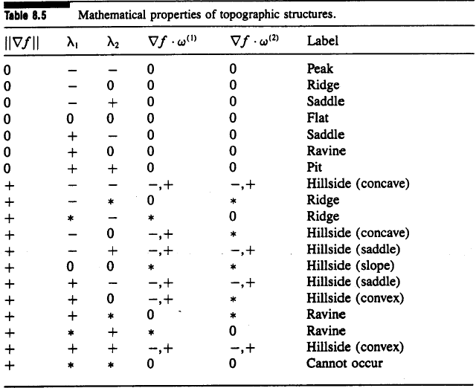
8.13.2 Summary of the Topographic Categories
Mathematical properties of topographic structures on continuous surfaces
Notes:
總結的表格

Slide 143
8.13.2 Invariance of the Topographic Categories
Invariant under monotonically increasing gray level transformations
Topographic labels (peak, pit, ridge, ravine, saddle, flat, and hillside)
Gradient direction
Directions of second directional derivative extrema
Monotonically increasing:
positive derivative everywhere
Notes:
@的特性不隨著單調增灰階值的轉換而改變(ex:histogram equalization)
@地形標籤
＠梯度方向
＠二階方向導數極值的方向

Slide 144
8.13.3 Topographic Classification Algorithm
peak, pit, ridge, ravine, saddle: likely not to occur precisely at a pixel’s center
peak, pit, ridge, ravine, saddle: if within pixel area, carry the label
We search zero crossing of the first directional derivative, then decide the label of the pixel.
Notes:
不會高好出現在 pixel 的正中間
可能夾在四個 pixel 中間 -> 範圍內的 pixel 要 label

Slide 145
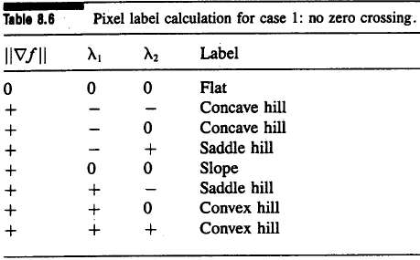
8.13.3 Case One: No Zero Crossing
No zero crossing along either of two directions: flat or hillside
If gradient zero, then flat
If gradient nonzero, then hillside
Hillside: possibly inflection point, slope, convex hill, concave hill,…
Notes:
如果在兩隔一階方向導數沒有 zero crossing 則有可能是 flat or hillside
可以看表

Slide 146
8.13.3 Case Two: One Zero Crossing
one zero crossing: peak, pit, ridge, ravine, or saddle
Notes:
如果在一階方向導數有zero crossing 則必定給訂的標籤是(peak, pit, ridge, ravine, or saddle)

Slide 147
8.13.3 Case Three: Two Zero Crossings
LABEL1, LABEL2: assign label to each zero crossing

Slide 148
8.13.3 Case Four: More Then Two Zero Crossings
More than two zero crossings:
Choose the one closest to pixel center
After ignoring the other, same as case 3

Slide 149
8.13.4 Summary of Topographic Classification Scheme
One pass through the image, at each pixel
Calculate fitting coefficients, $k_{1}$ through $k_{10}$ of cubic polynomial
Use above coefficients to find gradient, gradient magnitude, and the eigenvalues and eigenvector of Hessian
Search in eigenvector direction for zero crossing of first derivative
Recompute gradient, gradient magnitude, second derivative at each zero crossing of the first directional derivative, then classify
Notes:
該方案是對每個像素進行地形分類的並行過程，可以一次通過圖像來完成。

Slide 150
END

