Slide 1
Computer and Robot Vision I
Chapter 8
The Facet Model
Presented by: 梁益銓
D04922003@ntu.edu.tw
指導教授: 傅楸善 博士
Notes:
用local給的資訊推一個最逼近原圖的數學model(算式 函數 之類的東西)出來
8.2 介紹小平面模型定義一維觀測序列相對極大值的原理應用
8.3 複習對斜的小平面參數預估
8.4 對傾斜的小平面模型雜訊的移除處理
8.5介紹小平面模型可以用來將亮度灰階影像表面分區域
8.6 介紹使用古典梯度邊界偵測應用
8.7 討論使用貝式法去決定觀測的梯度強度統計
8.8討論zero crossing 在二階導數的邊界偵測
8.9討論整合方向導數梯度操作
8.10 討論小平面方法去做corner detection
8.11討論了使用小平面的方法來計算高階各向同性微分幅度
8.12討論線的定義，是地形隆起和溝壑
8.13提出了每個像素的各種地形類別的標籤轉化

Slide 2
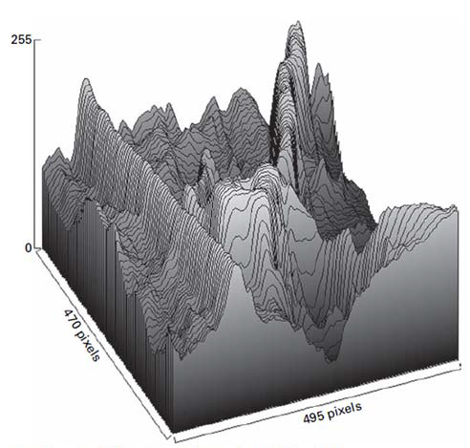
8.1 Introduction
The facet model principle states that the image can be thought of as an underlying continuum or piecewise continuous gray level intensity surface.
observed digital image: noisy discretized sampling of distorted version of this surface
Notes:
Conditioning: background normalization
--小平面模型原則指出，影像可以視為連續或片段連續的灰階表面
--觀察數位影像：在表面扭曲的離散雜訊樣本
觀察到的數字圖像是這個表面的扭曲的版本，嘈雜的，離散採樣

Slide 3
8.1 Introduction
To actually carry out the processing with the observed digital image requires a model describes what the general form of the surface would be in the neighborhood of any pixel
Notes:
實際執行處理觀察的數位影像需要相鄰的像素點來描述一個模型表面的一般式
那有哪些一般式呢 ？以下我們提到

Slide 4
8.1 Introduction
general forms:
some mathematical formulas
1. piecewise constant (flat facet model),
Ideal region: constant gray level
2. piecewise linear (sloped facet model), ideal region: sloped plane gray level
3. piecewise quadratic, gray level surface: bivariate quadratic
4. piecewise cubic, gray level surface: cubic surfaces
Notes:
一般式：一些數學方程式
分段常數（平的小平面模型）理想區間：常數灰階值
分段線性（斜的小平面模型）理想區間：斜的平面灰階值
分段二次方程式（灰階表面）理想區間：二元二次方程式
分段三維空間，灰階表面 理想區間：立方表面
接下來介紹小平面模型定義一維觀測序列相對極大值的原理應用

Slide 5
Break time

Slide 6
8.2 Relative Maxima
To illustrate the facet model principle, we consider a simple labeling application, which is to detect and locate all relative maxima, to subpixel accuracy, from a one-dimensional observation sequence f₁,f₂,…f_{n} taken on successive equally spaced points a unit distance apart
relative maxima:
first derivative zero
second derivative negative
Notes:
＃＃為了解釋小平面模型的概念，我們考慮一個簡單的labeling應用。從連續等間隔點索取的單元間隔距離的一維觀測序列，偵測和定位相對極大值到subpixel 的精確度
＠一簡單標籤應用
偵測和定位相對極大值（relative maxima）
這裏複習一下微積分，一多項式什麼時候會有相對極大值
相對極大值
一次微分為0
二次微分為負值

Slide 7
8.2 Relative Maxima
One-dimensional observation sequence
$f_{1 },f_{2 },f_{3 }$,……$f_{N }$
To find the relative maxima, we can least-squares fit a quadratic function
$\hat{c}m^{2}+\hat{b}m+\hat{a}$ ,
where $−k≤m≤k$ , to each group of 2k+1 successive observations
Notes:
＠採取連續等距離單位的一維觀測序列,
＠我們可以用最小平方去fit 二次函數, 其中 m 介於 –k 到 k , 對2K+1 組的連續觀測
##然後我們解析確定擬合二次具有足夠靠近原點的相對最大值

Slide 8
8.2 Relative Maxima
The squared fitting error $ε_{n}^{2}$ for the $n_{th}$ group of 2k+1 can be expressed by
$$ε_{n}^{2}= \sum_{m=−k}^{k}{{(\hat{c}m^{2}+\hat{b}m+\hat{a} −f_{n+m})}^{2}}$$
Notes:
＃計算誤差最小的平方和的算式
對2K+1 組其中的第 n 組的平方fitting$ε_{n}^{2}$誤差，一般式可以表示為 $ε_{n}^{2}= \sum_{m=−k}^{k}{{(\hat{c}m^{2}+\hat{b}m+\hat{a} −f_{n+m})}^{2}}$

Slide 9
8.2 Relative Maxima
Taking partial derivatives of $ε_{n}^{2}$ with respect to the free parameter $\hat{a}$ , $\hat{b}$, $\hat{c}$ results in the following
$ε_{n}^{2}=\sum_{m=−k}^{k}{{(\hat{c}m^{2}+\hat{b}m+\hat{a} −f_{n+m})}^{2}}$
Notes:
用$ε_{n}^{2}$的相對於自由參數$\hat{a}$ , $\hat{b}$, $\hat{c}$偏導數如下矩陣表示

Slide 10
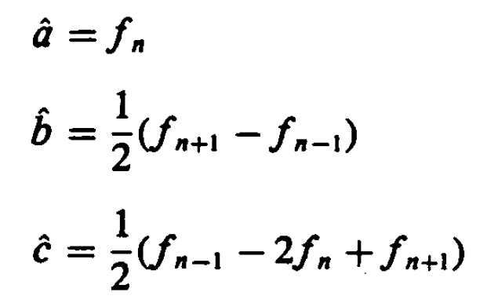
8.2 Relative Maxima
Assume k = 1, setting these partial derivatives to zero and simplifying yields the matrix equation from
$\left[\begin{matrix}3 & 0 & 2 \\ 0 & 2 & 0 \\ 2 & 0 & 2\end{matrix}\right]\left[\begin{matrix}\hat{a} \\ \hat{b} \\ \hat{c}\end{matrix}\right]=\sum_{m=−1}^{1}{\left[\begin{matrix}f_{n+m} \\ mf_{n+m} \\ m^{2}f_{n+m}\end{matrix}\right]}=\left[\begin{matrix}f_{n+1}+f_{n}+f_{n−1} \\ f_{n+1}−f_{n−1} \\ f_{n+1}+f_{n−1}\end{matrix}\right]$
Notes:
假設K = 1，這些偏導數設置為零假設K = 1，並簡化收率矩陣方程。求得$\hat{a}$ , $\hat{b}$, $\hat{c}$

Slide 11
8.2 Relative Maxima
The quadratic $y= \hat{c}m^{2}+\hat{b}m+\hat{a}$ has relative extrema at $x_{0}=−\hat{b}/2\hat{c}$
The extremum is a relative maximum when $\hat{c}<0$
The algorithm then amounts to the following
Notes:
可以求得 a, b, c
@二次式 y 在 $x_{0}=−\hat{b}/2\hat{c}$ 具有極大值
＠當Ｃ<0 時的極值為極大值
-------------------------------------------- 該演算法的算法如下

Slide 12
Break time

Slide 13
8.3 Sloped Facet Parameter and Error Estimation
We employ a least-squares procedure both to estimate the parameters of the sloped facet model for a given two-dimensional rectangular neighborhood whose row index set is R and whose column index set is C and to estimate the noise variance
Notes:
8.3 對斜的小平面參數預估
採用最小平方法來估計，對於給定的兩維矩形附近的行索引集合為R，列索引集是C的”傾斜小平面模型的參數”和”雜訊變異數”

Slide 14
8.3 Sloped Facet Parameter and Error Estimation
Assume the coordinate of the given pixel are (0,0) in its central neighborhood, and assume each (r,c) ∈ R X C
Image function g is modeled by
Where $η$ is a random variable indexed on $R×C$ , which represents noise.
We assume that $η\sim N(0,σ^{2})$ is noise having mean 0 and variance $σ^{2}$ and that the noise for any two pixels is independent.
Notes:
＃＃＃j我們假設給定的（0,0）為相鄰區域的中心，假設每一個點(r,c) 屬於（ＲＸＣ），其影像函式可表示為 ＠使用最小平方法估計斜面參數 雜訊變異數
＠影像函式
＠當$η$ 是隨機變數索引在 ＲＸＣ表示為雜訊
＠$η\sim N(0,σ^{2})$雜訊對任兩點像素為獨立 。Ｎ（）統計裡的表示方式 前面為平均值,後面為變異數
Grc 是最後算出來的結果，eta 代表要加上誤差

Slide 15
8.3 Sloped Facet Parameter and Error Estimation
The least-squares procedure determine parameters $\hat{a}$ , $\hat{b}$, $\hat{c}$ that minimize the sum of the squared differences between the fitted surface and the observed one
Taking the partial derivatives of $ε_{n}^{2}$ and setting them to zero
Notes:
@定義參數使平方差加總和最小
最小平方法產生參數$\hat{a}$ , $\hat{b}$, $\hat{c}$最小化，介於Fitted surface 和觀測間的平方差加總
@對$ε_{n}^{2}$偏微分並設為0

Slide 16
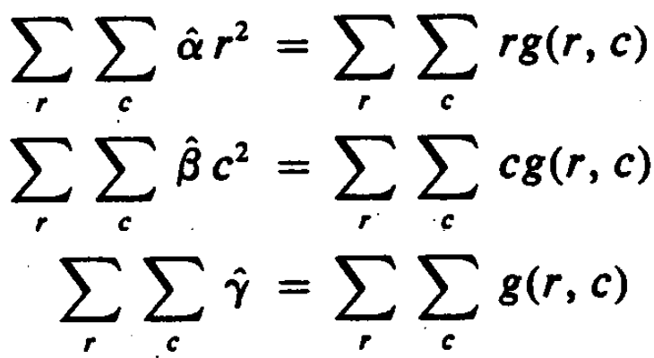
8.3 Sloped Facet Parameter and Error Estimation
Without loss of generality, we choose our coordinate RxC so that the center of the neighborhood RxC has coordinates (0, 0)
The symmetry in the chosen coordinate system leads to
Hence
Notes:
＠不失一般性，我們選擇中心點ＲＸＣ做為座標的原點
＠選擇的座標系統具有對稱性使得 加總r = 0 加總c =0

Slide 17
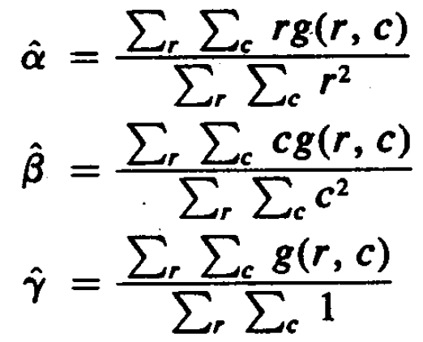
8.3 Sloped Facet Parameter and Error Estimation
Solving for $\hat{α}$, $\hat{β}$, and $\hat{γ}$ , we obtain

Slide 18
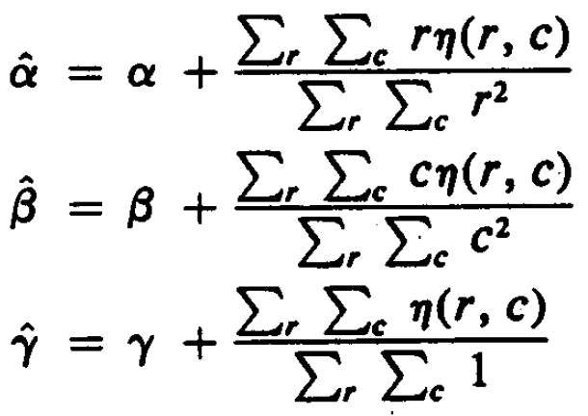
8.3 Sloped Facet Parameter and Error Estimation
Replacing $g(r, c)$by $αr+βc+γ+η(r, c)$ and simplifying the equations will allow us to see explicitly the dependence of $\hat{α}$, $\hat{β}$, and $\hat{γ}$ on the noise
Notes:
透過簡化的過程，我們可以明顯的看到$\hat{α}$, $\hat{β}$, and $\hat{γ}$ 在雜訊上的相依

Slide 19
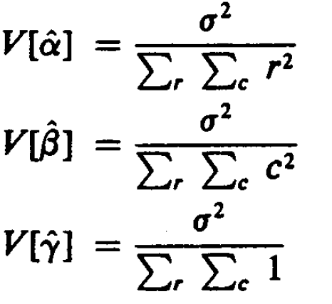
8.3 Sloped Facet Parameter and Error Estimation
$η$ is noise having mean 0 and variance $σ^{2}$
Notes:
http://en.wikipedia.org/wiki/Variance 變異數（Variance），應用數學裡的專有名詞。在機率論和統計學中，一個隨機變量的變異量數描述的是它的離散程度，也就是該變量離其期望值的距離。一個實隨機變量的變異量數也稱為它的二階矩或二階中心動差，恰巧也是它的二階累積量。變異量數的算術平方根稱為該隨機變量的標準差。

Slide 20
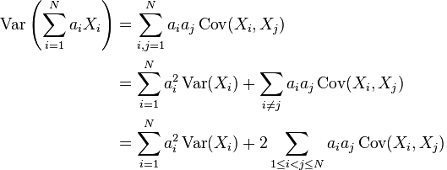
8.3 Sloped Facet Parameter and Error Estimation
review
Notes:
公式複習

Slide 21
8.3 Sloped Facet Parameter and Error Estimation
Examining the squared error residual $ε^{2}$
Notes:
檢查平方差餘數

Slide 22
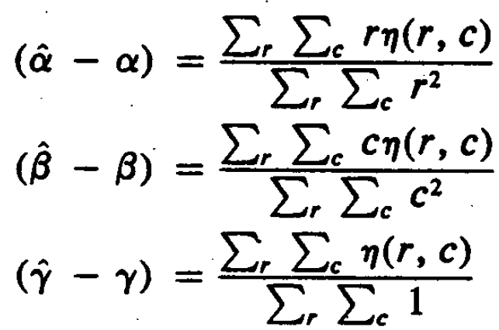
8.3 Sloped Facet Parameter and Error Estimation
Using the fact that
We obtain
Notes:
使用 （a^-a）代入得到 以下式子

Slide 23
8.3 Sloped Facet Parameter and Error Estimation
Review chi-distribution
Assume $Z_{1}$, $Z_{2}$, …… , $Z_{n}$ are independent variable , where $Z_{i}\sim N\left(0,1\right).$
$Y=Z_{1}^{2}+Z_{2}^{2}+…+Z_{n}^{2}$ is distributed according to the chi-squared distribution with n degrees of freedom.
$Y\sim X_{n}^{2}$
Notes:
Chi-distribution https://zh.wikipedia.org/wiki/卡方分佈
定義如下：
@假設Ｋ個隨機變量 Z1, Z2, …Zn 是互相獨立符合標準常態分佈的隨機變量（平均值期望為0 變異數為 1）
@則隨機變量Ｚ的平方和被稱為符合自由度為Ｎ的卡方分佈 記作$Y\sim X_{n}^{2}$

Slide 24
8.3 Sloped Facet Parameter and Error Estimation
$η\sim N(0, σ^{2})$
$\frac{\sum_{r}{\sum_{c}{η^{2}(r, c)}}}{σ^{2}}$ is a chi-squared distribution with $\sum_{r}{\sum_{c}{1}}$ degrees of freedom.
Notes:
$η$ //eta $σ^{}$// sigma 假定eta 的隨機常態分佈是 （平均值為0,變異數是 sigma ^2)
@自由度為1的卡方分佈

Slide 25
8.3 Sloped Facet Parameter and Error Estimation
Because $\hat{α}$, $\hat{β}$, and $\hat{γ}$ are independent normal distributions
is a chi-squared distribution with 3 degrees of freedom.
Notes:
chi-squared distribution ：卡方分佈
@因為$\hat{α}$, $\hat{β}$, and $\hat{γ}$ 為獨立的常態分佈，所以 「 方程式」 為自由度為3的卡方分佈

Slide 26
8.3 Sloped Facet Parameter and Error Estimation
$ε^{2}/σ^{2}$ is distributed as a chi-squared variate with $\sum_{r}{\sum_{c}{1}}−3$ degrees of freedom.
This means that $ε^{2}/(\sum_{r}{\sum_{c}{1}}−3)$ can be used as an unbiased estimator for $σ^{2}$
Notes:
＠$ε^{2}/σ^{2}$ 的分佈為自由度為$\sum_{r}{\sum_{c}{1}}−3$ 的卡方變量
＠代表 可以為$ε^{2}/(\sum_{r}{\sum_{c}{1}}−3)$使用來當作 $σ^{2}$的無偏差估計

Slide 27
Break time

Slide 28
8.4 Facet-Based Peak Noise Removal
Peak noise pixel: a pixel whose gray level intensity significantly differs from neighborhood pixels.
It is difficult to judge that the center pixel in part (b) is peak noise, whereas it is easier in part (a)
This indicates that the gray level spatial statistic are important
Notes:
8.4 小平面基底的尖端雜訊移除
尖端雜訊像素 灰階值意義上和鄰居不一樣
在這裡並不能說 b 就沒有雜訊，他比a 要難以斷定。這個例子指出空間灰階值的統計就相當重要

Slide 29
8.4 Facet-Based Peak Noise Removal
Let N be a set of neighborhood pixels that does not contain the center pixel
Where $η(r,c)$ is assumed to be independent additive Gaussian noise having mean 0 and variance $σ^{2}$
Notes:
設N為一組鄰近像素不包含中心像素的集合。記作 Ｎ＝ＲＸＣ-{(0,0)}
Gaussian noise 高斯雜訊
有平均值0
其中，η（R，C）被假定為具有平均值為0，變異數$σ^{2}$的獨立添加的高斯雜訊

Slide 30
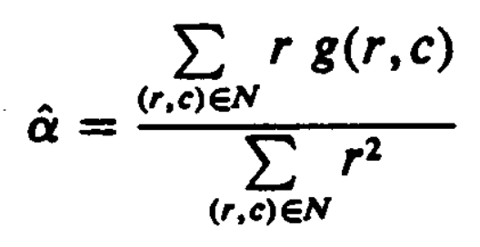
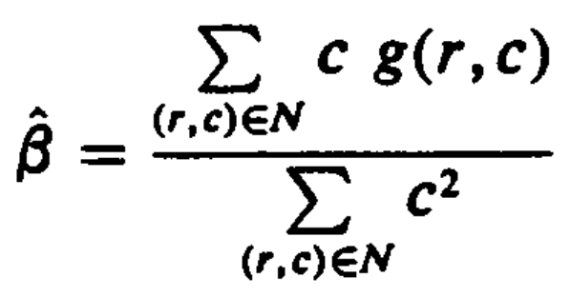
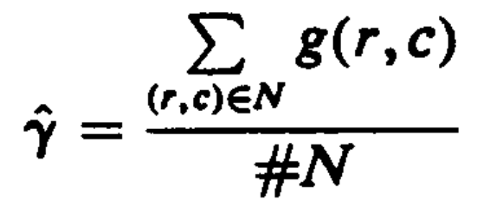
8.4 Facet-Based Peak Noise Removal
The least-squares procedure determines $\hat{α}$, $\hat{β}$, and $\hat{γ}$ which minimize the sum of the squared difference between the fitted surface are given by the observed one:
The minimizing $\hat{α}$, $\hat{β}$, and $\hat{γ}$ are given by
Notes:
最小平方法產生參數$\hat{a}$ , $\hat{b}$, $\hat{c}$最小化，介於Fitted surface 和觀測間的平方差加總
藉由底下的式子給出$\hat{α}$, $\hat{β}$, and $\hat{γ}$ 的最小值
$\hat{α}$ // hat//有 hat 皆代表有誤差要最小化。是個量測估計值

Slide 31
8.4 Facet-Based Peak Noise Removal
Under the hypothesis that $g\left(0,0\right)$ is not peak noise, $g\left(0,0\right)−\hat{γ}$ has a Gaussian distribution with mean 0 and variance $σ^{2}(1+\frac{1}{\#N})$
Hence $\frac{g\left(0,0\right)−\hat{γ}}{σ\sqrt{1+\frac{1}{\#N}}}$ has mean 0 and variance 1
Notes:
基於 $g\left(0,0\right)$不是一個峰值雜訊的假設
$g\left(0,0\right)−\hat{γ}$ 有高斯分佈平均值為0 ,變異數$σ^{2}(1+\frac{1}{\#N})$

Slide 32
8.4 Facet-Based Peak Noise Removal
統計定義
t-distribution
$Z\sim N$(0,1), $Y\sim χ_{n}^{2}$ , $Z$ and $Y$ are independent.
$T=\frac{Z}{\sqrt{Y/n}}$ is a t-distribution with n degrees of freedom, denoted as $T\sim t_{n}$
Notes:
複習 https://en.wikipedia.org/wiki/Student%27s_t-distribution
https://zh.wikipedia.org/wiki/卡方分佈

Slide 33
8.4 Facet-Based Peak Noise Removal
We have already obtained that $ε^{2}/σ^{2}$ has a chi-squared distribution with $\#N−3$ degrees of freedom.
Hence $t=\frac{(g\left(0,0\right)−\hat{γ})\sqrt{\#N−3}}{\sqrt{(1+\frac{1}{\#N})ε^{2}}}$ has a t-distribution with $\#N−3$ degrees of freedom
Notes:
＠所以我們已經得到 $ε^{2}/σ^{2}$ 自由度為 #N-3 的卡方分佈
＠故 $t=\frac{(g\left(0,0\right)−\hat{γ})\sqrt{\#N−3}}{\sqrt{(1+\frac{1}{\#N})ε^{2}}}$ 具有自由度為 #N-3 的t-分佈

Slide 34
8.4 Facet-Based Peak Noise Removal
The center pixel is judged to be a peak noise pixel if a test of the hypothesis $g\left(0,0\right)=\hat{γ}$ rejects the hypothesis
Let $T_{\#N−3, p}$ be the number satisfying
$$P\left(t≤T_{\#N−3, p}\right)=1−p$$
$T_{\#N−3, p}$ is a threshold.
Notes:
＠如果假設 hypothesis $g\left(0,0\right)=\hat{γ}$ 被 reject 則 中心像素被判定為峰值雜訊

Slide 35
8.4 Facet-Based Peak Noise Removal
If $t>T_{\#N−3, p}$
the hypothesis of the equality of $g\left(0,0\right)$ and $\hat{γ}$ is rejected, and the output value for the center pixel is given by $\hat{γ}$.
If $t≤T_{\#N−3, p}$
the hypothesis of the equality of $g\left(0,0\right)$ and $\hat{γ}$ is not rejected, and the output value for the center pixel is given by $g\left(0,0\right)$.
Notes:
If $t>T_{\#N−3, p}$
＠ hypothesis $g\left(0,0\right)=$ r 被 reject 則 中心像素輸出值為給定的$\hat{γ}$.
If $t≤T_{\#N−3, p}$
＠ hypothesis $g\left(0,0\right)=$r沒有被 reject 則 中心像素輸出值為給定的$g\left(0,0\right)$

Slide 36
8.4 Facet-Based Peak Noise Removal
$P\left(t≤T_{\#N−3, p}\right)=1−p$
The reasonable value for p is 0.05 to 0.01
Notes:
合理的p 的機率為 0.05 ~ 0.01

Slide 37
Break time

Slide 38
8.5 Iterated Facet Model
The iterated model for ideal image assume that the spatial of the image can be partitioned into connected regions called facets, each of which satisfies certain gray level and shape constraints.
Notes:
重複模型對理想影像假設影像可以被分割成許多相連區域 每一個都符合特定的灰階和形狀限制

Slide 39
8.5 Iterated Facet Model
gray level constraint:
gray levels in each facet must be a polynomial function of row-column coordinates
shape constraint:
each facet must be sufficiently smooth in shape
Notes:
灰階限制
--每一個小平面的座標（Ｒ, C）必須是多項式方程式
形狀限制
--每一個小平面必須滿足平滑的形狀

Slide 40
8.5 Iterated Facet Model
Each pixel in image is contained in $K^{2}$ different $K×K$ blocks.
Each $K×K$ block fits a polynomial model.
Set the output gray value to be that gray value fitted by the block with smallest error variance.
Notes:
--在影像中每一個像素包含在Ｋ^2 個不同的block 內
--每一個ＫxK block 適合一多項式模型
--設定輸出灰階值滿足block 最小變異數

Slide 41
8.6 Gradient-Based Facet Edge Detection
gradient-based facet edge detection: high values in first partial derivative (sharp discontinuities)
Notes:
8.6 基於梯度的平面邊界偵測 小平面梯度邊界偵測：一階偏微分的高值（明顯的不連續）

Slide 42
8.6 Gradient-Based Facet Edge Detection
When a neighborhood is fitted with the sloped facet model , $\hat{α}r+\hat{β}c+\hat{γ}$, a gradient magnitude of $\sqrt{{\hat{α}}^{2}+{\hat{β}}^{2}}$ will result.
Use the estimated gradient $\sqrt{{\hat{α}}^{2}+{\hat{β}}^{2}}$ as the basis for edge detection.
Notes:
--當鄰居符合 小平面模型 ar +bc + r時 將會產生 (a^2+b^2)^1/2 的梯度結果
--使用估計梯度(a^2+b^2)^1/2當作基底做邊界偵測

Slide 43
8.6 Gradient-Based Facet Edge Detection
$\hat{α}\sim N(α, \frac{σ^{2}}{\sum_{r}{\sum_{c}{r^{2}}}})$
$\hat{β}\sim N(β, \frac{σ^{2}}{\sum_{r}{\sum_{c}{c^{2}}}})$
$\hat{α}$ , $\hat{β}$ are independent
$\frac{{(\hat{α}−α)}^{2}\sum_{r}{\sum_{c}{r^{2}}}+{(\hat{β}−β)}^{2}\sum_{r}{\sum_{c}{c^{2}}}}{σ^{2}}\sim χ_{2}^{2}$

Slide 44
8.6 Gradient-Based Facet Edge Detection
It follows that to test the hypothesis of no edge under the assumption that $α=β=0$, we use the statistic G:
$G=\frac{{\hat{α}}^{2}\sum_{r}{\sum_{c}{r^{2}}}+{\hat{β}}^{2}\sum_{r}{\sum_{c}{c^{2}}}}{σ^{2}}\sim χ_{2}^{2}$
Notes:
他依照假設去測試沒有邊界在 a = B = 0, 我們使用
統計值 Ｇ

Slide 45
8.6 Gradient-Based Facet Edge Detection
If $ε_{n}^{2}$ represents the squared residual fitting error from the n-th neighborhood and the images has N neighborhoods, then we may use $\hat{σ^{2}}=\frac{\frac{1}{N}\sum_{n=1}^{N}{ε_{n}^{2}}}{\sum_{r}{\sum_{c}{1}}−3}$ in replace of $σ^{2}$.
$G=\frac{{\hat{α}}^{2}\sum_{r}{\sum_{c}{r^{2}}}+{\hat{β}}^{2}\sum_{r}{\sum_{c}{c^{2}}}}{\hat{σ^{2}}}$
Notes:
如果 E 表示平方餘數符合n-個鄰居誤差 且 影像有 n 個鄰居。則我們可以使用 ~A^2 取代 a^2

Slide 46
8.6 Gradient-Based Facet Edge Detection
The false-alarm rate is the conditional probability that the edge detector classifies a pixel as an edge given that the pixel is not a edge.
Suppose the false-alarm rate is to be held to 1%. Then since $P\left(χ_{2}^{2}>9.21\right)=0.01$, the threshold we used must be at least 9.21
Notes:
假警報率是邊界偵測分類一個pixel 誤判是邊界的機率

Slide 47
8.7 Bayesian Approach to Gradient Edge Detection
The Bayesian approach to the decision of whether or not an observed gradient magnitude G is statistically significant and therefore participates in some edge is to decide there is an edge (statistically significant gradient) when,
: given gradient magnitude conditional probability of edge
: given gradient magnitude conditional probability of nonedge
Notes:
貝式方法去決定觀察梯度Ｇ是否顯著統計且參與決定某些邊是否為邊界當

Slide 48
8.7 Bayesian Approach to Gradient Edge Detection
Hence a decision for edge is made whenever
$P(G|nonedge)$ is known to be the density function of a $χ_{2}^{2}$ variate.

Slide 49
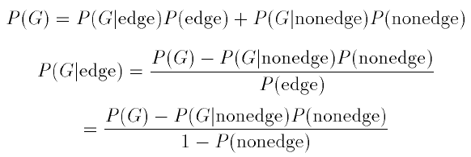
8.7 Bayesian Approach to Gradient Edge Detection
Infer $P\left(G | edge\right)$ from $P(G)$

Slide 50
8.7 Bayesian Approach to Gradient Edge Detection
The threshold t for G is determined as that value t for which
$P\left(t | edge\right)P\left(edge\right)=P\left(t | nonedge\right)P\left(nonedge\right)$
Implies that the threshold t must satisfy that $P\left(t\right)=2P\left(t | nonedge\right)P\left(nonedge\right)$
$P\left(nonedge\right)$ is a user-specified prior probability of nonedge, 0.9 to 0.95 are reasonable.

Slide 51
8.8 Zero-Crossing Edge Detector
compare
gradient edge detector: looks for high values of first derivatives
zero-crossing edge detector: looks for relative maxima in first derivative
zero-crossing: pixel as edge if zero crossing of second directional derivative underlying gray level intensity function f takes the form
Notes:
把在二階微分通過零的pixel當作edge
Zero-crossing edge detector : 會在一階導數相對極大值
零點：像素的邊緣，如果第二個方向導數底層的灰度級強度函數f的零點採用以下形式

Slide 52
8.8.1 Discrete Orthogonal Polynomials
The underlying functions from which the directional derivative are computed are easy to represent as linear combinations of the polynomials in any polynomial basis set.
basis set: the discrete orthogonal polynomials
Notes:
以多項式的線性組合來表達被隱含的圖像函數
＠底層函數從方向導數容易用來表示在已多項式為基底集合的線系組合多項式

Slide 53
8.8.1 Discrete Orthogonal Polynomials
discrete orthogonal polynomial basis set of size N: polynomials deg. 0..N - 1
discrete Chebyshev polynomials: these unique polynomials
Notes:
Size N 的離散正交多項式 其最高系數是0~n-1
下面表示如何產生 正交離散多項式

Slide 54
8.8.1 Discrete Orthogonal Polynomials (cont’)
discrete orthogonal polynomials can be recursively generated
,
Notes:
二維離散正交多項式可以遞回產生

Slide 55
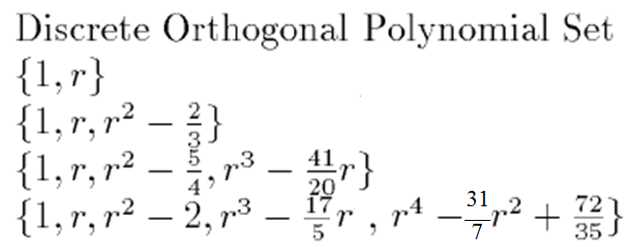
8.8.2 Two-Dimensional Discrete Orthogonal Polynomials
2-D discrete orthogonal polynomials creatable from tensor products of 1D from above equations
Notes:
r^3-(17/5)r
2011-12-20
二維離散正交多項式從上面的從一維公式張量積 可創建

Slide 56
8.8.3 Equal-Weighted Least-Squares Fitting Problem
the exact fitting problem is to determine the coefficients such that
The approximate fitting problem is to determine coefficients a₀,…,a_{K}, K ≦ N-1, such that
Is minimized. the result is
for each index r, the data value d(r) is multiplied by the weight

Slide 57
8.8.3 Equal-Weighted Least-Squares Fitting Problem
weight
Notes:
Numerator (分子) denominator (分母)

Slide 58
8.8.3 Equal-Weighted Least-Squares Fitting Problem (cont’)
Notes:
5x5 矩陣 以中心 代表 r=0, c =0 。左上代表r =-2, c =-2。右下代表 r =2, c =2。代入式子即可得出矩陣 ex K10: c³-3.4c

Slide 59
Suppose the model is $g\left(x\right)=\sum_{n=1}^{N}{α_{n}f_{n}\left(x\right)+η(x)}$, where $g$ is the observed surface at discretized values of $x$, the $f_{n}$ are the orthonormal basis functions and $η$ is an independent additive noise having mean 0 and variance $σ^{2}$ for each x. The squared difference is $ε^{2}=\sum_{x}{{\left[\sum_{n=1}^{N}{\hat{α_{n}}}f_{n}\left(x\right)−g(x)\right]}^{2}}$. Please use least-squares to estimate $\hat{α_{m}}$.
(Hint: $f_{n}$ are the orthonormal basis. $\sum_{x}{f_{n}(x)f_{m}(x)}=1$, if n=m. $\sum_{x}{f_{n}(x)f_{m}(x)}=0$, otherwise.)

Slide 60
8.8.4 Directional Derivative Edge Finder
We define the directional derivative edge finder as the operator that places an edge in all pixels having a negatively sloped zero crossing of the second directional derivative taken in the direction of the gradient
r: row
c: column
radius in polar coordinate
angle in polar coordinate, clockwise from column axis
Notes:
我們定義方向導數邊界尋檢器視為一運算。
一個邊的所有pixel 的二階方向導數在具有方向梯度上有負斜率過零點

Slide 61
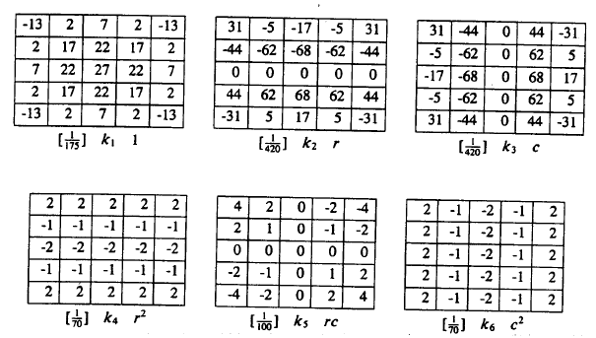
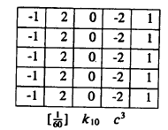

Slide 62
8.8.4 Directional Derivative Edge Finder (cont’)

Slide 63
8.8.4 Directional Derivative Edge Finder (cont’)
directional derivative of f at point (r, c) in direction :
Notes:
http://blog.ncue.edu.tw/sys/lib/read_attach.php?id=13236
http://blog.ncue.edu.tw/sys/lib/read_attach.php?id=13237

Slide 64
$w=f\left(x,y\right)$
$x=g\left(t\right), y=h(t)$
$\frac{dw}{dt}=\frac{∂w}{∂x}\frac{dx}{dt}+\frac{∂w}{∂y}\frac{dy}{dt}$
Assume $g\left(h\right)=f\left(r,c\right)$ $=f(r_{0}+h cosα,c_{0}+h sinα)$
$\frac{dg}{dh}=\frac{∂g}{∂r}\frac{dr}{dh}+\frac{∂g}{∂c}\frac{dc}{dt}=\frac{∂g}{∂r}cosα+\frac{∂g}{∂c}sinα$

Slide 65
8.8.4 Directional Derivative Edge Finder (cont’)
second directional derivative of f at point (r, c) in direction :

Slide 66
8.8.4 Directional Derivative Edge Finder (cont’)

Slide 67
8.8.4 Directional Derivative Edge Finder (cont’)
$f_{α}^{′′′}\left(ρ\right)<0, f_{α}^{′′}\left(ρ\right)=0, and f_{α}^{′}(ρ)≠0$
An edge pixel

Slide 68
8.9 Integrated Directional Derivative Gradient Operator
integrated directional derivative gradient operator
an operator that measures the integrated directional derivative strength as the integral of first directional derivative taken over a square area
more accurate step edge direction

Slide 69
8.10 Corner Detection
purpose
corners: to detect buildings in aerial images
corner points: to determine displacement vectors from image pair
corners with two conditions
the occurrence of an edge
significant changes in edge direction
gray scale corner detectors: detect corners directly by gray scale image
Notes:
目的
偵測空照圖中的建築
角落點:求出一對圖片的位移向量
角落的2條件
有邊出現
明顯邊方向的變化

Slide 70
Aerial Images

Slide 71
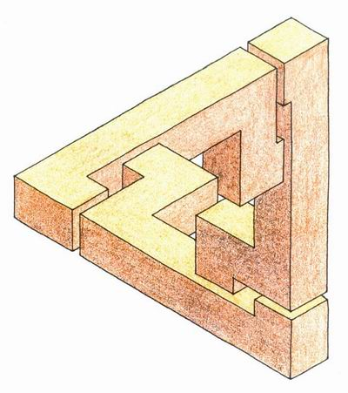
立體視覺圖

Slide 72
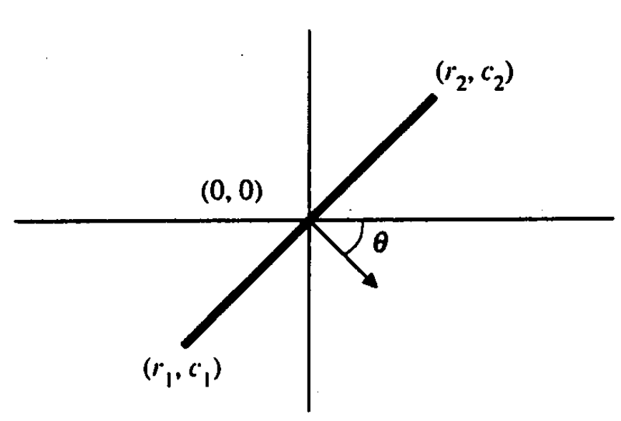
8.10.1 Corner Detection
Let $θ\left(r,c\right)$ be the gradient direction at coordinate $(r,c)$, and let$θ$₀ =$θ$(0,0)
(sin$θ$₀,cos$θ$₀) is a unit vector in the direction of the gradient at the origin
The origin(0,0) is a corner point involves meeting the following two conditions:

Slide 73
8.11 Isotropic Derivative Magnitudes
A gradient edge can be understood as arising from a first-order isotropic derivative magnitude
determine those linear combinations of squared partial derivative of the two-dimensional functions that are invariant under rotation of the domain of the two dimensional function.
rotate the coordinate system by$θ$and call the resulting function g in the new (r’,c’) coordinate
Notes:
@梯度邊緣可以被理解為從第一階各向同性衍生物量值而產生
@判定二維函數的“二維函數的平方偏導”的線性組合在定義域下的旋轉下不變
＠選轉$θ角後的座標在 g 的表示如下$

Slide 74
8.11 Isotropic Derivative Magnitudes
${[\frac{∂g\left(r^{′}, c^{′}\right)}{∂r}]}^{2}+{[\frac{∂g\left(r^{′}, c^{′}\right)}{∂c}]}^{2}$
=(k₂cos$θ$-k₃sin$θ$)² + (k₂sin$θ$+ k₃cos$θ$)²
=$k_{2}^{2}+k_{3}^{2}={[\frac{∂f\left(r, c\right)}{∂r}]}^{2}+{[\frac{∂f\left(r, c\right)}{∂c}]}^{2}$
The sum of the squares of the first partials is the same constant $k_{2}^{2}+k_{3}^{2}$, the squared gradient magnitude, for the original function or for the rotated function.

Slide 75
8.12 Ridges and Ravines on Digital Images
Notes:
在數位影像上的山脊(Ridges)和深谷(Ravines)

Slide 76
8.12 Ridges and Ravines on Digital Images
A digital ridge (ravine) occurs on a digital image when there is a simply connected sequence of pixels with gray level intensity values that are significantly higher (lower) in the sequence than those neighboring the sequence.
The facet model can be used to help accomplish ridge and ravine identification.
Notes:
在數位影像上山脊或深谷，的灰階值簡單的相連，且與相鄰區域有著顯著的高(低)序列
山脊發生在灰階值比鄰居高
深谷發生在灰階值比鄰居低

Slide 77
8.13 Topographic Primal Sketch 8.13.1 Introduction
The basis of the topographic primal sketch consists of the labeling and grouping of the underlying Image-intensity surface patches according to the categories defined by monotonic, gray level, and invariant functions of directional derivatives
categories:
Notes:
地形最初草圖的基礎由標籤和底層圖像，藉由單純灰階值和不變函數的方向導數根據定義分類
Peak:山峰 pit:凹坑 ridge:山脊 ravine:深谷 saddle:鞍狀 flat:平面 hillside:山坡

Slide 78
8.13.1 Introduction (cont’) Invariance Requirement
histogram normalization, equal probability quantization: nonlinear enhancing
For example, edges based on zero crossings of second derivatives will change in position as the monotonic gray level transformation changes
Convexity of a gray level intensity surface is not preserved under such transformation.
peak, pit, ridge, valley, saddle, flat, hillside: have required invariance

Slide 79
8.13.2 Mathematical Classification of Topographic Structure
We will use the following notation to describe the mathematical properties of our topographic categories for continuous surfaces
Notes:
@ f 梯度向量
＠梯度力度
＠二階方向導數具有最大力度的單位方向向量
＠正交於w1 的向量
＠二階方向導數在w¹方向的值

Slide 80
8.13.2 Mathematical Classification of Topographic Structure
$H=\left[\begin{matrix}\frac{∂^{2}f}{∂r^{2}} & \frac{∂^{2}f}{∂r∂c} \\ \frac{∂^{2}f}{∂c∂r} & \frac{∂^{2}f}{∂c^{2}}\end{matrix}\right]$
The eigenvalues of the Hessian are the values of the extrema of the second directional derivative, and their associated eigenvectors are the directions in which the second directional derivative is extremized.
Notes:
＠一階方向導數在w¹方向的值
不失一般性，假設|入1| >= |入2|
@二階方向打數可以被計算表示成 Hessian 2x2 matrix
＠Hessian矩陣的特徵值是所述二階方向導數的極值的值，和它們的相關特徵向量，其中二階方向導數偏移的方向。

Slide 81
8.13.2 Peak
Peak (knob): occurs where there is a local maximum in all directions
peak: curvature downward in all directions
at peak: gradient zero & second directional derivative negative in all directions
point classified as peak if
: gradient magnitude
Notes:
@發生在所有方向的局部最大值
＠所有方下的曲率皆向下
＠在峰點：梯度為0
@所有方向的二階方向導數皆為負

Slide 82
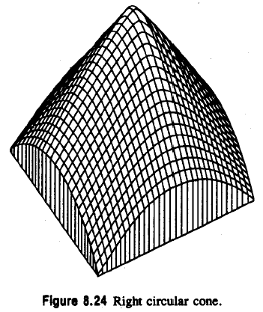
8.13.2 Peak
: second directional derivative in direction
: second directional derivative in direction

Slide 83
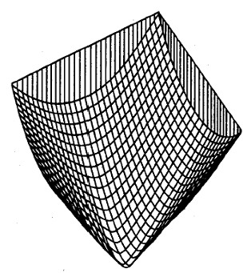
8.13.2 Pit
pit (sink: bowl): local minimum in all directions
pit: gradient zero, second directional derivative positive
Notes:
＠跟peak 相反，所有方向皆為局部最小值

Slide 84
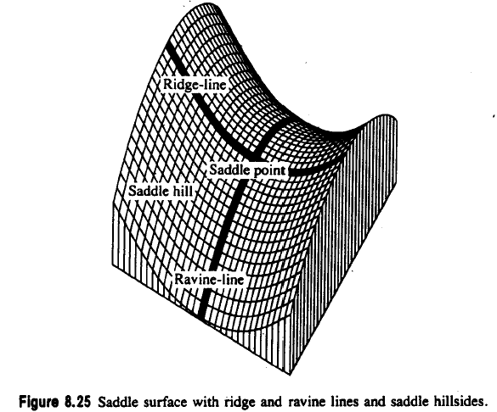
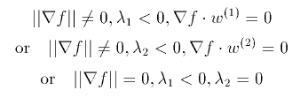
8.13.2 Ridge
A ridge occurs on ridge line, a curve consisting of a series of ridge points and along ridge line, the points to the right and left are lower
ridge line: may be flat, sloped upward, sloped downward, curved upward…
ridge: local maximum in one direction
Notes:
Ridge (鞍部/嶺)
@發生在稜線
＠包含了一系列的脊點

Slide 85
8.13.2 Ravine
A ravine (valley): is identical to a ridge except that it is a local minimum in one direction
walk along ravine line: points to the right and left are higher
Notes:
Ravine(峽谷)

Slide 86
8.13.2 Saddle
saddle: local maximum in one direction, local minimum in perpendicular dir.
saddle: positive curvature in one direction, negative in perpendicular dir.
saddle: gradient magnitude zero
saddle: extrema of second directional derivative have opposite signs
Notes:
Saddle (鞍)
＠在一方向有局部最大值，另一方向則有局部最小值
＠一方向正曲率，另一垂直方向為負
＠梯度為0
＠兩個不同方向的極值也正負相反

Slide 87
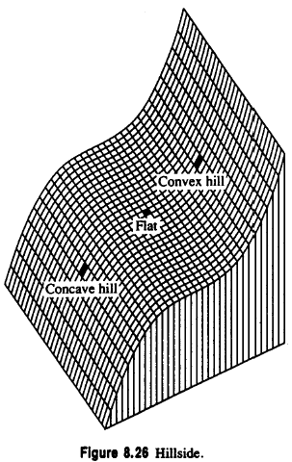
8.13.2 Flat
A flat (plain) is a simple, horizontal surface, must have zero gradient and no curvature.
It satisfies the following conditions
If the conditions are true, classify a foot or a shoulder
foot: flat begins to turn up into a hill
shoulder: flat ending and turning down into a hill
Notes:
Flat (平的)
＠平面、簡單、水平表面
＠梯度0,沒有曲率
＠
＠foot : 平開始轉成小山
＠shoulder：平結束變且開始轉成小山的地方

Slide 88
8.13.2 Hillside
A hillside point is anything not covered by previous categories.
hillside: nonzero gradient, no strict extrema
Slope: tilted flat (constant gradient)
convex hill: curvature positive (upward)
Notes:
Hillside(山腰、山坡)
＠非零梯度、沒有嚴格的極值
＠山坡：非零梯度，無嚴格極大值
＠斜率：傾斜的平面（常數梯度）
＠凸的山坡:曲率為正（向上）

Slide 89
8.13.2 Hillside
concave hill: curvature negative (downward)
saddle hill: up in one direction, down in perpendicular direction
inflection point: zero crossing of second directional derivative
Notes:
＠凸的坡：曲率為負（向下）
＠鞍狀坡：一方向向上，另一垂直方向向下
＠曲折點：第二個方向導數的過零點

Slide 90
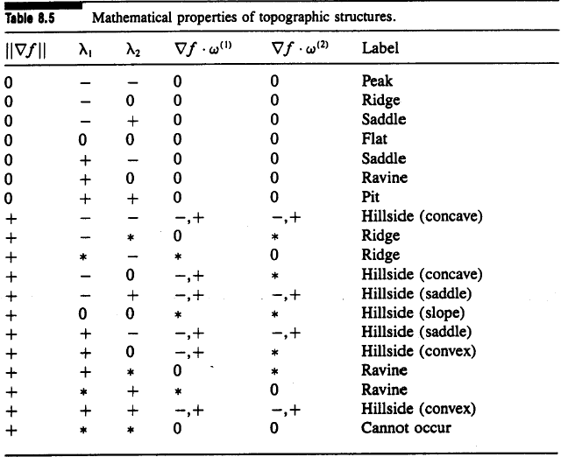
8.13.2 Summary of the Topographic Categories
Mathematical properties of topographic structures on continuous surfaces

Slide 91
8.13.2 Invariance of the Topographic Categories
Topographic labels (peak, pit, ridge, ravine, saddle, flat, and hillside)
Gradient direction
Directions of second directional derivative extrema for peak, pit, ridge, ravine, and saddle
1.2.3. are all invariant under monotonically increasing gray level transformations
monotonically increasing: positive derivative everywhere
Notes:
@地形標籤
＠梯度方向
＠二階方向導數極值的方向
@123 的特性不隨著灰階值的轉換而改變

Slide 92
8.13.2 Invariance of the Topographic Categories
Let original underlying gray level surface be $f\left(r,c\right)$,
Let w be a monotonically increasing gray level transformation
Let $g(r,c)$ denote the transformed image : $g\left(r,c\right)=w[f(r,c)]$
It is directly derivable that
Which we obtain that

Slide 93
8.13.2 Invariance of the Topographic Categories
The direction $β$ that maximizes $g_{β}^{′}$ also maximizes $f_{β}^{′}$, thereby showing that the gradient directions are the same.

Slide 94
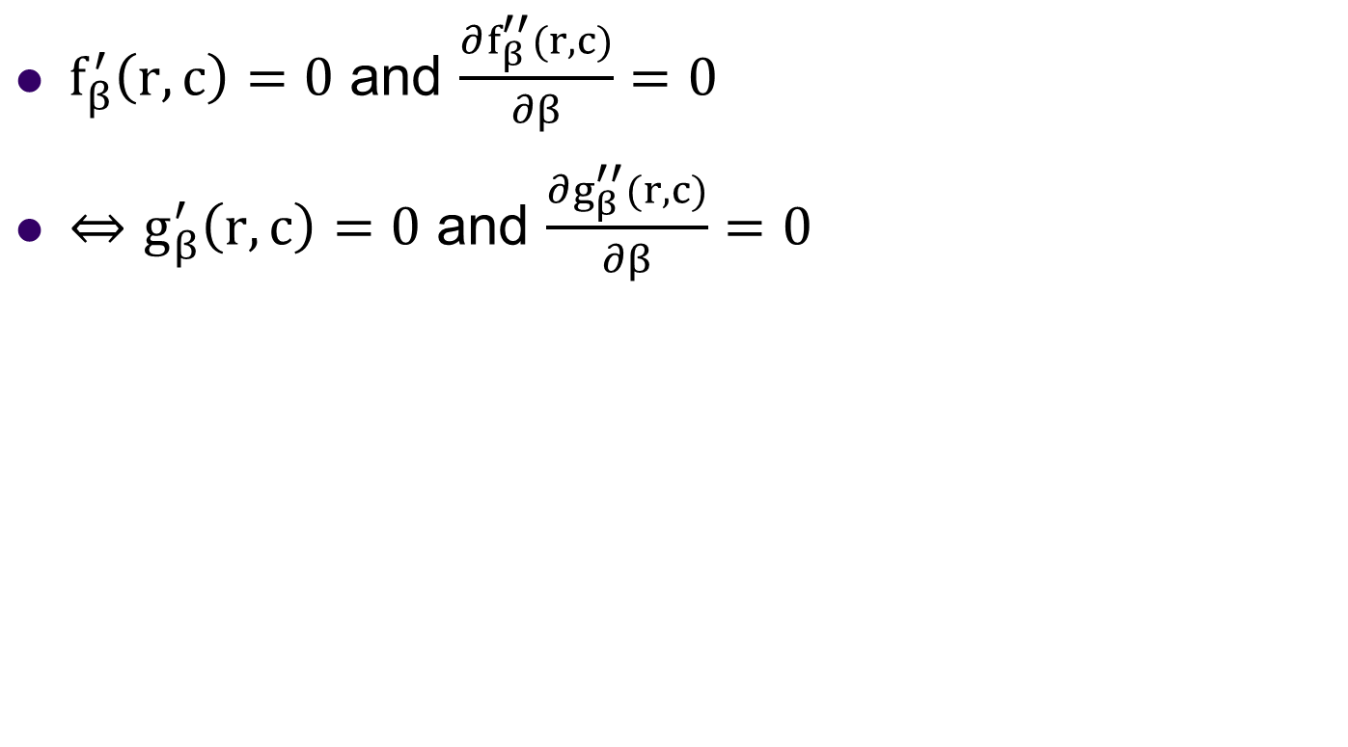
8.13.2 Invariance of the Topographic Categories
$f_{β}^{′}\left(r,c\right)=0$ and $\frac{∂f_{β}^{′′}(r,c)}{∂β}=0$
$⇔g_{β}^{′}\left(r,c\right)=0$ and $\frac{∂g_{β}^{′′}(r,c)}{∂β}=0$
Notes:
F(r,c) = (r²+c²)^{(1/2)}

Slide 95
8.13.2 Ridge and Ravine Continua
entire areas of surface: may be classified as all ridge or all ravine
Notes:
F(r,c) = (r^2+c^2)^(1/2)

Slide 96
8.13.3 Topographic Classification Algorithm
peak, pit, ridge, ravine, saddle: likely not to occur at pixel center
peak, pit, ridge, ravine, saddle: if within pixel area, carry the label

Slide 97
8.13.3 Topographic Classification Algorithm
We search zero crossing of the first directional derivative in the directions of extreme second directional derivative, $ω^{(1)}$ and $ω^{(2)}$.

Slide 98
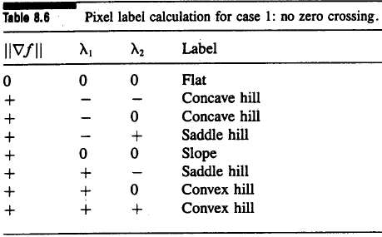
8.13.3 Case One: No Zero Crossing
no zero crossing along either of two directions: flat or hillside
if gradient zero, then flat
if gradient nonzero, then hillside
Hillside: possibly inflection point, slope, convex hill, concave hill,…
Notes:
如果在兩隔一階方向導數沒有 zero crossing 則有可能是 flat or hillside

Slide 99
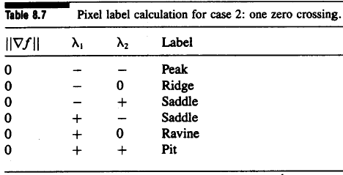
8.13.3 Case Two: One Zero Crossing
one zero crossing: peak, pit, ridge, ravine, or saddle
Notes:
如果在一階方向導數有zero crossing 則必定給訂的標籤是(peak, pit, ridge, ravine, or saddle)

Slide 100
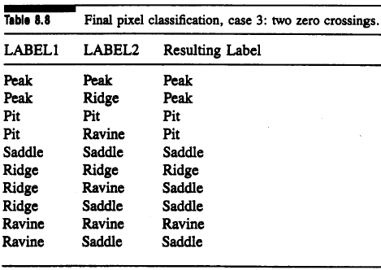
8.13.3 Case Three: Two Zero Crossings
LABEL1, LABEL2: assign label to each zero crossing

Slide 101
8.13.3 Case Four: More Then Two Zero Crossings
more than two zero crossings: choose the one closest to pixel center
more than two zero crossings: after ignoring the other, same as case 3

Slide 102
8.13.4 Summary of Topographic Classification Scheme
one pass through the image, at each pixel
calculate fitting coefficients, $k_{1}$ through $k_{10}$ of cubic polynomial
use above coefficients to find gradient, gradient magnitude, and the eigenvalues and eigenvector of Hessian
search in eigenvector direction for zero crossing of first derivative
recompute gradient, gradient magnitude, second derivative at each zero crossing of the first directional derivative, then classify

Slide 103
END

