Slide 1
Computer and Robot Vision I
Chapter 7
Conditioning and Labeling
Presented by: 蕭雅云
E-mail:amy@shihtech.com.tw
d03921006@ntu.edu.tw
LINEID:amyqq12
開課教授: 傅楸善 博士

Slide 2
Recognition Methodology
Conditioning
Labeling
Grouping
Extracting
Matching
HW
1
Notes:
調節、潤飾：去除無用的資訊，白話的說，就是去除雜訊
下標籤：針對有意義的pattern 做標記
群組化：把標籤值相同或相近的區塊圈選出來
解析：算出一些能代表群組特性的數值，像是 標準差 或是 平均值
比對：和已知的物品進行分析 比對

Slide 3
7-1 Introduction
Conditioning:
Noise Cleaning (Sec. 7-2)
Background Normalization
Sharpening (Sec. 7-3)
光線不足或室內情況下拍攝，出來的相片會有一點點顆粒，術語稱之為「噪點」(Noise)
若果相機預設的ISO感光值是「自動模式」，在光線不足的情況下相機會自動提高ISO值以增加感光來維持適當的快門值，高ISO值自然會令相片產生雜訊。
最簡單的做法就是把ISO值調整為比較低的值如ISO50、100或200，噪點問題便能大大降低，但因為感光值低，在相同光圈下快門值會相應變慢，此時便需要使用三腳架來固定相機或開啟閃燈了。
2
Notes:
Conditioning : 雜訊移除，背景正規化
固定輸出銳化（Fixed Output Sharpening）
Labeling : 門檻值處理，邊緣偵
測，角落偵測

Slide 4
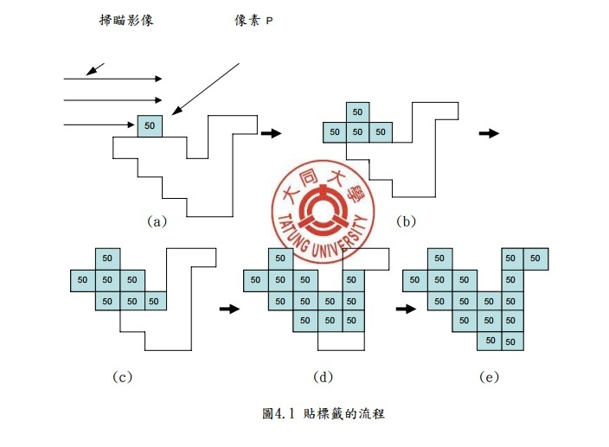
Labeling:
Threshold operation
Edge Detection (Sec. 7-4)
Line Detection (Sec. 7-5)
Corner Detection
Ref:
數位紅眼缺陷的全自動化檢測及校正研究
大同大學
研究生：林起字(Chi-Tzu Lin)
指導教授：鄭嘉慶 博士(Ｄr. Jia-Ching Cheng)
3
Notes:
將相連的像素加上同一個編號 叫做
標籤化

Slide 5
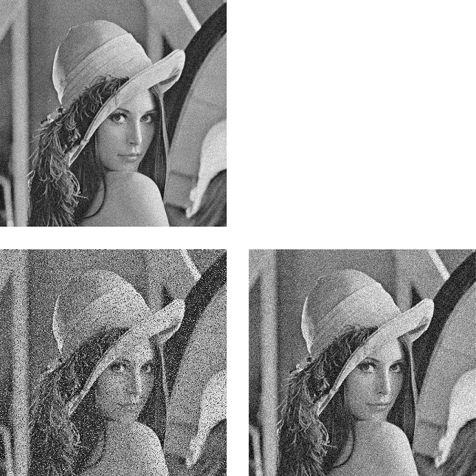
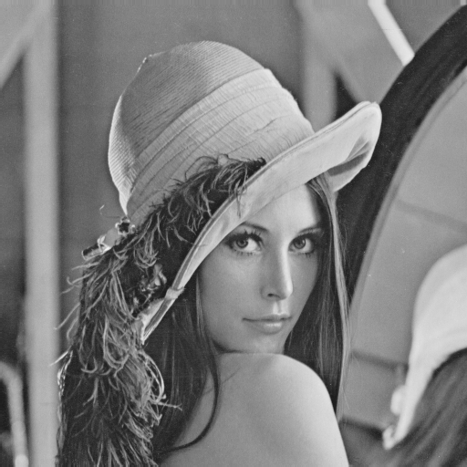
Conditioning: Noise removal
產生照片噪點的成因主要有兩種︰一）長時間曝光而導致的「電流噪點」；二）提高ISO感光值後的「高感噪點」，兩者均使相片細節受損。
Uniform
Original
S & P
Gaussian
4

Slide 6
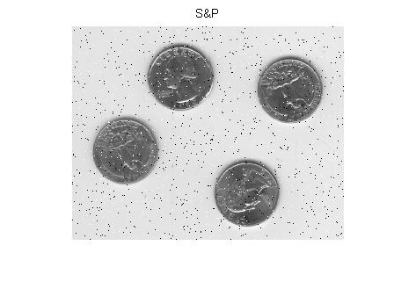
Conditioning: Noise removal
5

Slide 7
7-2 Noise Cleaning
Noise cleaning:
Uses neighborhood spatial coherence
Uses neighborhood pixel value homogeneity
1 | 1 | 1
1 | 1 | 1
1 | 1 | 1
0 | 3 | 4 | 3 | 0
3 | 6 | 7 | 6 | 3
4 | 7 | 8 | 7 | 4
3 | 6 | 7 | 6 | 3
0 | 3 | 4 | 3 | 0
3*3 mask
5*5 mask
空間域(spatial domain) ：直接對影像上的 pixel value 做處理
6
Notes:
Coherence: 連慣性，一致性
Homogeneity: 同質性
利用相同局部區域內的pixel 空間連貫性 和 同質性來去除雜詢
之所以稱為雜訊，就是他的 pixel value 和別人顯著的不同
空間域(spatial domain) ：直接對影像上的 pixel value 做處理

Slide 8
7-2 Filter
 | f(x-1,y-1) | f(x,y-1) | f(x+1,y-1)
 | f(x-1,y) | f(x,y) | f(x+1,y)
 | f(x-1,y+1) | f(x,y+1) | f(x+1,y+1)
Y axis
image
Filter
X axis
W(-1,-1) | W(0,-1) | W(1,-1)
W(-1,0) | W(0,0) | W(1,0)
W(-1,1) | W(0,1) | W(1,1)
7

Slide 9
TAKE A BREAK 0
全球最易令人想歪的10個廣告
8

Slide 10
7.2.1 Statistical Framework For Noise Removal – Mask Template (Cont.)
$$\left[\begin{matrix}x_{1} & x_{2} & x_{3} \\ x_{4} & x_{5} & x_{6} \\ x_{7} & x_{8} & x_{9}\end{matrix}\right]$$
(a)
$$\left[\begin{matrix}βσ^{2} & ασ^{2} & βσ^{2} \\ ασ^{2} & σ^{2} & ασ^{2} \\ βσ^{2} & ασ^{2} & βσ^{2}\end{matrix}\right]$$
(b)
$$\left[\begin{matrix}β^{−1} & α^{−1} & β^{−1} \\ α^{−1} & 1 & α^{−1} \\ β^{−1} & α^{−1} & β^{−1}\end{matrix}\right]$$
(c)
gure explanation:
(a) Correspondences between the components of the vector $x$ = ($x_{1}$, $x_{2}$,..., $x_{9}$) and their spatial position in a 3 x 3 neighborhood.
(b) Variances associated with each spatial position; in a typical circumstance, $α$ < $β$.
(c) Un-normalized minimum variance weight mask. The normalization constant divides each entry by 1 + 4$α^{−1}$ + 4$β^{−1}.$

Slide 11
7.2 Noise Cleaning
box filter: computes equally weighted average
box filter: separable
box filter: recursive implementation with “two+”, “two-”, “one/”
per pixel
Notes:
Explain what is box filter and why 2+ 2- 1/
Box filter : 定義：鄰域內的pixel 權重相等
Box filter : 可分離，mask矩陣可以分拆成 一個列向量*行向量
Box filter : 可以遞迴實作，只需要兩個加法、兩個減法，一個除法

Slide 12
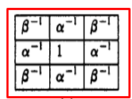
Minimum Variance Weight Mask Template
$$α=2 β=2$$
$$\left[\begin{matrix}\frac{1}{2} & \frac{1}{2} & \frac{1}{2} \\ \frac{1}{2} & 1 & \frac{1}{2} \\ \frac{1}{2} & \frac{1}{2} & \frac{1}{2}\end{matrix}\right]∗\frac{1}{(1+4∗\frac{1}{2}+4∗\frac{1}{2}) }$$
=$\left[\begin{matrix}\frac{1}{2} & \frac{1}{2} & \frac{1}{2} \\ \frac{1}{2} & 1 & \frac{1}{2} \\ \frac{1}{2} & \frac{1}{2} & \frac{1}{2}\end{matrix}\right]$* $\frac{1}{\begin{aligned}5 \\ \end{aligned}}$ = $\left[\begin{matrix}1 & 1 & 1 \\ 1 & 2 & 1 \\ 1 & 1 & 1\end{matrix}\right]$* $\frac{1}{10}$

Slide 13
7.2.1 Statistical Framework for Noise Removal (Cont.)
Minimum Variance Weight Mask Template
$$α=2 β=4$$
$$\left[\begin{matrix}\frac{1}{4} & \frac{1}{2} & \frac{1}{4} \\ \frac{1}{2} & 1 & \frac{1}{2} \\ \frac{1}{4} & \frac{1}{2} & \frac{1}{4}\end{matrix}\right]∗\frac{1}{(1+4∗\frac{1}{2}+4∗\frac{1}{4}) }$$
=$\left[\begin{matrix}\frac{1}{4} & \frac{1}{2} & \frac{1}{4} \\ \frac{1}{2} & 1 & \frac{1}{2} \\ \frac{1}{4} & \frac{1}{2} & \frac{1}{4}\end{matrix}\right]$* $\frac{1}{\begin{aligned}4 \\ \end{aligned}}$ = $\left[\begin{matrix}1 & 2 & 1 \\ 2 & 4 & 2 \\ 1 & 2 & 1\end{matrix}\right]$* $\frac{1}{16}$

Slide 14
3倍和3倍加起來六倍
1/4 | 2/4 | 1/4
1/3 | 1/3 | 1/3
¼
2/4
1/4
1/16 | 2/16 | 1/16
2/16 | 4/16 | 2/16
1/16 | 2/16 | 1/16
1/3
1/3
1/3
1/9 | 1/9 | 1/9
1/9 | 1/9 | 1/9
1/9 | 1/9 | 1/9
沒separable=>9倍
Separable :
原本一個二維的濾波器係數矩陣
可以拆成兩個唯一的Column Vector 乘上 Row Vector

Slide 15
Box filter 的 separable例子
$\left[\begin{matrix}1 & 1 & 1 \\ 1 & 1 & 1 \\ 1 & 1 & 1\end{matrix}\right]$* $\frac{1}{9}$= $\frac{1}{3}\left[\begin{matrix}1 \\ 1 \\ 1\end{matrix}\right]$* $\frac{1}{3} \left[\begin{matrix}1 & 1 & 1\end{matrix}\right]$
9 multiplications
3 multiplications
3 multiplications
非Box filter 的 separable例子
$\left[\begin{matrix}1 & 2 & 1 \\ 2 & 4 & 2 \\ 1 & 2 & 1\end{matrix}\right]$* $\frac{1}{16}$= $\frac{1}{4}\left[\begin{matrix}1 \\ 2 \\ 1\end{matrix}\right]$* $\frac{1}{4} \left[\begin{matrix}1 & 2 & 1\end{matrix}\right]$
3 multiplications
3 multiplications
9 multiplications

Slide 16
filter: separable
原始影像的一個小區塊(patch)
類似 Matlab 的點乘 .* 運算子operator
濾波器係數 $\overset{⃑}{c}$
box filter: recursive implementation with “two+”, “two-”, “one/”
per pixel

Slide 17
Filter: Separable implementation
一個二維濾波器分離成column vector 和 row vector 的乘積
濾波$器係數\overset{⃑}{c} ≡\left[\begin{matrix}1 & 2 & 1 \\ 2 & 4 & 2 \\ 1 & 2 & 1\end{matrix}\right]$=

Slide 18
Row direction 先做濾波
Column direction 再做濾波

Slide 19
box filter: recursive implementation
原始形式：
雙層Loop 一個pixel 一個 pixel
累加每個像素值。
最後除以總像素個數(2K+1)*(2L+1)。
原始形式
Notes:
觀察：重複計算的數值可以存起來，給下一個pixel 使用
所有在一個列的pixel 屬於同一個window ABCD
以 3*3 的MASK 為例，IBUF 的大小是一個 3 * 1 的陣列，包含同一個column位置上的三個pixel value 的和
IBUF( j-1) = ( pxl(i-1, j-1) , pxl(i, j-1), pxl(i+1, j-1))
IBUF( j) = ( pxl(i-1, j) , pxl(i, j), pxl(i+1, j))
IBUF( j+1) = ( pxl(i-1, j+1) , pxl(i, j+1), pxl(i+1, j+1))
一個 Window 內 maintain N 個 IBUF,
假設現在要計算原始影像f(i,j)的輸出值，只要加上 IBUF(j-1) + IBUF(j) + IBUF( j + 1) 的值 再 除以 mask 的 長 * 寬 即可
當某一列的pixel 都計算完之後，下一個Window 的 IBUF 值 只要減去上一列的pixel value, 再加上下一列的 pixel value 即可完成更新
原本的計算量： I^2 * N^2 乘法 和 加法
透過

Slide 20
Filter: Separable Form
Recursive形式：
避免內部Nested loop。
對每個pixel而言，
直接拿 IBUF (小Column )。
一次拿三個 IBUF。
ISUM = IBUF(j-1) + IBUF(j) + IBUF(j+1)
輪到下一個(右邊)的pixel時，
新的ISUM =
舊的 ISUM + 新的 IBUF – 舊的 IBUF
輪到下一行時，update IBUF。
Recursive 形式

Slide 21
Take a break 1
超爆笑！！！客服電話

Slide 22
7.2 Noise Cleaning
Gaussian filter: linear smoother
weight matrix:
for all where
size of W: two or three from center
linear noise-cleaning filters: defocusing images, edges blurred
Notes:
可以將 w ( r , c ) 分開成2項相成 w1( r ) w2( c )
Mask大小的取法 => 離中心2~3倍sigma，也就是取4~6作為mask 的size
這種線性的去除雜訊filter會使影像失去焦點，邊緣會變得模糊

Slide 23
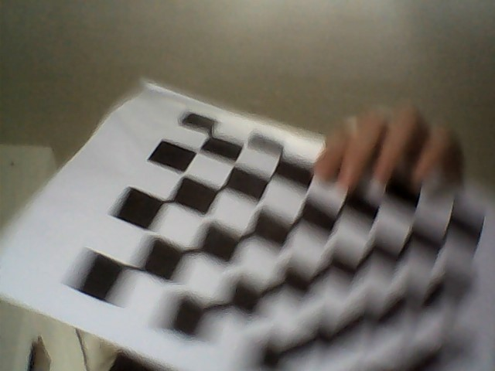
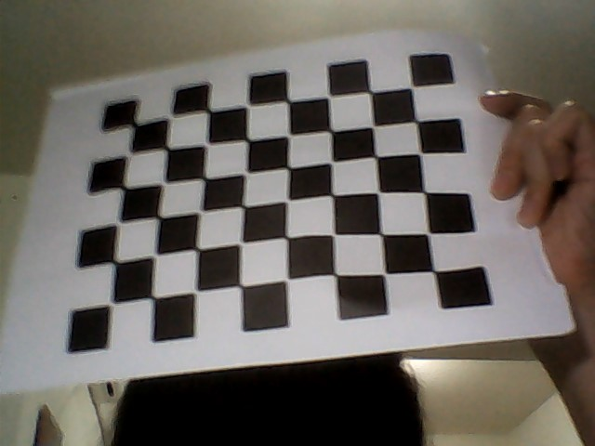
Defocusing images & edges blurred
Defocusing
edges blurred

Slide 24
A Statistical Framework for Noise Removal
Idealization assumption:
if there were no noise,
the pixel values in each image neighborhood would be the same constant
Notes:
理想化的假設
假如都沒有雜訊的話，鄰域內的pixel 應該擁有相同的pixel value

Slide 25
x : neighborhood 重新組合成為一個 N x 1 的向量
N : N = M x M = neighborhood 的寬 x neighborhood 的高
$μ$ : 完美影像的鄰域平均值
$\hat{μ}$ : 復原影像(=真實影像經過濾波器濾波之後的影像)的鄰域平均值
c : 濾波器係數。
1 : 1 = [ 1 1 1 … 1]^Transpose= 一個 N x 1 的向量，且每個元素皆為1。
E[ variable ] : 機率統計中的期望值算子。具有線性性質。

Slide 26
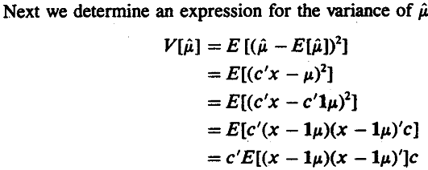

Slide 27
Objective function
希望$c′Σc$ 最小化
Constraint
C 必須滿足 c’1 = 1

Slide 28
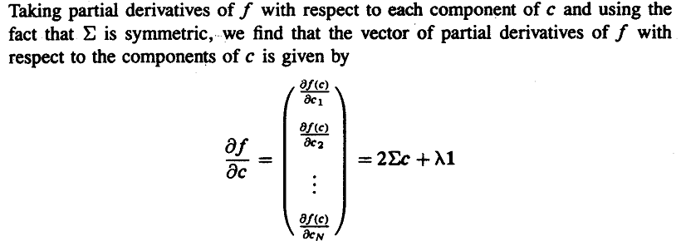
移項整理係數得到 濾波器係數c

Slide 31
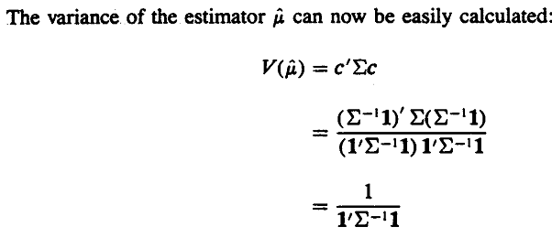

Slide 32
Take a break 2
日本上班族~超快速5分鐘出門!!

Slide 33
7.2.3 Outlier Or Peak Noise
Outlier also known as peak noise: pixel value replaced by random noise value
Neighborhood size: larger than noise, smaller than preserved detail
Center-deleted: neighborhood pixel values in neighborhood except center
Notes:
主要是將一個預測值與實際值做比較，若是差異太大，則判斷此點為peak noise or outlier
鄰域的size的選擇：要比noise 還大，但是要比想要保留的細節還要小。
一種neighborhood的定義方式: 除了中心的之外的剩餘mask中值的集合。
Center-deleted neighborhood : 相鄰區域內的pixel, 但是去除中心點。

Slide 34
Outlier or Peak Noise
outlier: peak noise: pixel value replaced by random noise value
This can be happen when there is a transmission error, when there is a bad spot on a vidicon(攝像機) or CCD array, when external noise affect the analog-to-digital-conversion process, or when something small and irrelevant occludes the object of interest.
neighborhood size: larger than noise, smaller
than preserved detail
center-deleted: neighborhood pixel values in
neighborhood except center
Notes:
主要是將一個預測值與實際值做比較，若是差異太大，則判斷此點為peak noise or outlier
鄰域的size的選擇：要比noise 還大，但是要比想要保留的細節還要小。
一種neighborhood的定義方式: 除了中心的之外的剩餘mask中值的集合。
Center-deleted neighborhood : 相鄰區域內的pixel, 但是去除中心點。

Slide 35
Outlier or Peak Noise
Decide whether y is an outlier or not
X₁ | X₂ | X₃
X₄ | y | X₅
X₆ | X₇ | X₈
center-deleted neighborhood
center pixel value
mean estimator of center-deleted neighborhood
Notes:
Center-deleted neighborhood
中心像素不列入林裕

Slide 36
Outlier or Peak Noise
center-deleted neighborhood
center pixel value
mean of center-deleted neighborhood
minimizes
Notes:
為什麼取mean？
主要是為了最小化 sum of squared difference
使誤差的平方和為最小
Outlier 異常值偵測
類比數位轉換器或位元傳輸錯誤

Slide 37
Outlier or Peak Noise
output value of neighborhood outlier removal
not an outlier value if reasonably close to
use mean value when outlier
threshold for outlier value
too small: edges blurred
too large: noise cleaning will not be good
Notes:
Theta 門檻值
Y 為 center-value
Z 算子的輸出值：
假如 y – u hat < 門檻值，則輸出 y, 保持中心值值不變
假如 y - u hat >= 門檻值，表示 y 是 outlier, 用 u hat 取代之
Theta 取的小，表示條件嚴格，連一點小小的變化都當成 outlier, 那麼像是 邊線上的 pixel 就會被平均值取代，影像變得模糊
Theta 取太大，表示條件很寬鬆，大道雜訊都沒有被過濾到，沒有得到太大的去除雜訊效果

Slide 38
Outlier or Peak Noise
center-deleted neighborhood variance
use neighborhood mean if pixel value significantly far from mean
Notes:
對比相依的 偏差值(離群值)移除 的方法
統計上的Z值計算，轉換到圖型領域上，就是計算一個pixel 離平均值u hat 相差多少個標準差。
當某個pixel 減去 u hat 再除以 sigma hat相差 theta 個標準差以上時，我們把它視為顯著差異，也就是偏差值。

Slide 39
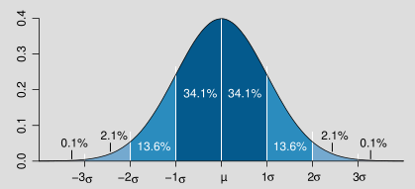
7-2-3 Outlier or Peak Noise
Notes:
若我們取 theta = 1;
相當於我們只保留與 平均值距離1 個sigma以內的 pixel, 超過一個 sigma的 pixel 都會被視為是outlier, 被 u hat 取代。
保留深藍色部分，取代淺藍色部分的pixel

Slide 40
7-2-3 Outlier or Peak Noise
smooth replacement:
instead of complete replacement or not at all
convex combination of input and mean
use neighborhood mean
weighting parameter
use input pixel value
Notes:
除了使用二分法的小於門檻值就保留，大於門肯直就取代之外，我們也可以用一個平滑的 convex combination來當作輸出結果.
何謂 convex combination, 凸組合，簡單講就是一種有條件的線性內插：
X = a1 * x1+ a2 * x2 + a3 * x3 + ak * xk
所有的係數 ai >= 0 , where i = 1 , 2 , … , k
所有的係數和 = 1 , i.e. , a1 + a2 + a3 + … + ak = 1

Slide 41
$Z_{smooth replacement | K= 0 }= \frac{\left|\frac{y−\hat{μ}}{\hat{σ}}\right|}{\left|\frac{y−\hat{μ}}{\hat{σ}}\right|+K}\hat{μ}$ + $\frac{K}{\left|\frac{y−\hat{μ}}{\hat{σ}}\right|+K}$ y
= $\frac{\left|\frac{y−\hat{μ}}{\hat{σ}}\right|}{\left|\frac{y−\hat{μ}}{\hat{σ}}\right|+0}\hat{μ}= \hat{μ}$
$Z_{smooth replacement | K= ∞ }= \frac{\left|\frac{y−\hat{μ}}{\hat{σ}}\right|}{\left|\frac{y−\hat{μ}}{\hat{σ}}\right|+K}\hat{μ}$ + $\frac{K}{\left|\frac{y−\hat{μ}}{\hat{σ}}\right|+K}$ y
= $\frac{∞}{\left|\frac{y−\hat{μ}}{\hat{σ}}\right|+∞}y≅$ y
Two special cases

Slide 42
7-2-4 K-Nearest Neighbor
K-nearest neighbor:
average equally weighted average of k-nearest neighbors.
Notes:
在鄰居中找K個跟center-value接近的，然後作平均。
和中心點相近權重相同
課本的建議，
取鄰域中前6個靠近的pixel,K=6,
重複3~4次比只做一次好。
會得到比較好的結果

Slide 43
Take a break 3
《娱乐百分百》罗志祥聽證會 罗志祥饰演三个老爸，，好搞笑！！ - YouTube (360p)

Slide 44
7-2-5 Gradient Inverse weighted
gradient inverse weighted:
reduces sum-of-squares error within regions
Notes:
與K-nearest不同，他是將neighbor距離參考點的灰階值倒數來當作weight
和中心點的像素差距越小，權重越大。
相反的，和中心點的像素差距越大，權重越小。
K為何要在前面補上1/2

Slide 45
7-2-6 Order Statistic Neighborhood Operators
order statistic:
linear combination of neighborhood sorted values
neighborhood pixel values
sorted neighborhood values from smallest to
largest
Notes:
排序統計輛
排序後的數值的線性組合
X1, … , Xn : 鄰域的pixel value
X(1), … , Xn : 排序後的pixel value

Slide 46
7-2-6 Order Statistic Neighborhood Operators
(Before sorting)
x1 | x2 | x3 | x4 | x5 | x6 | x7 | x8 | x9
16 | 128 | 109 | 66 | 4 | 6 | 96 | 84 | 53
(After sorting)
x(1) | x(2) | x(3) | x(4) | x(5) | x(6) | x(7) | x(8) | x(9)
4 | 6 | 16 | 53 | 66 | 84 | 96 | 109 | 128
Notes:
一個隨便排
一個是從最小到最大

Slide 47
7-2-6 Order Statistic Neighborhood Operators
Median Operator
median: most common order statistic operator
median root: fixed-point result of a median filter
median roots: comprise only constant-valued neighborhoods,
sloped edges
Notes:
最常見的統計排序運算子
一直重複做median filter會得到一個最後不會再改變的結果稱為 median root
Median roots : 只有常數值的鄰域pixel(一片平坦的區域) 和 斜邊

Slide 48
Original Image
Median Root Image

Slide 49
7-2-6 Order Statistic Neighborhood Operators
median: effective for impulsive noise (salt and pepper)
The Median filter is used to remove noise from an image by replacing pixels with the middle pixel value selected from a certain window size.
median: distorts or loses fine detail such as
thin lines
Notes:
專門針對 脈衝式的雜訊(像是椒鹽雜訊)
缺點：使影像失真，損失細節，像是影像中細微的線條
Quartile: 4分位數
inter-
prep.
1. 表示"互相"
2. 表示"在...中間","在...之間","在...內

Slide 50
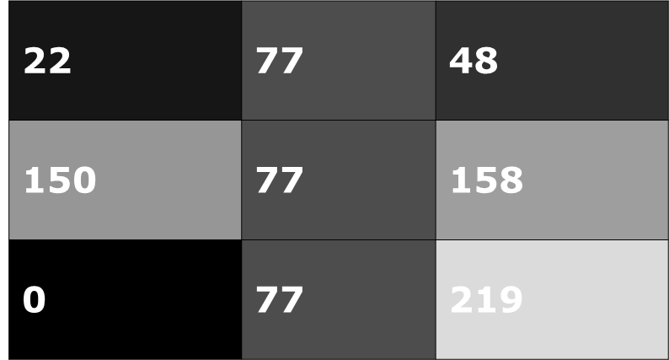
Median Filter
Original
y
(x,y)
Image f(x,y)
x
(x,y)
Original
y
(x,y)
Image g(x,y)
0, 22, 48, 77, [ 77 ], 77, 150, 158, 219
x
Notes:
還有一種mean filter 但此處median filter指的是中位數濾波器

Slide 51
Median filter
(a) 加入點雜訊的方形影像； (b) 點雜訊方形影像的輪廓圖； (c) 經中間值濾波後的影像； (d) 中間值濾波後的輪廓圖。

Slide 52
Mean filter & Median filter
Mean filter
Median filter

Slide 53
7-2-6 Order Statistic Neighborhood Operators
Running-median Operator
inter-quartile distance
Notes:
Inter-quartile distance 四分位差距(3rd四分位數 – 1st四分位數), 和 變異數 和 標準差一樣，都代表資料的分散程度
Contrast-dependent outlier removal 做比較
前面是 y - u
可以和
無條件捨去
Theta太大 => 原圖
Theta太小 => median filter

Slide 54
7-2-6 Order Statistic Neighborhood Operators
Trimmed-Mean Operator
trimmed-mean: first k and last k order statistics not used
trimmed-mean: equal weighted average of central N-2k order
statistics
Notes:
When alpha = kN called alpha trimmed mean
去掉前N個最大的和後N個最小的pixel

Slide 55
7-2-6 Order Statistic Neighborhood Operators
Midrange operator
midrange: noise distribution with light and smooth tails
最亮加上最暗的去除以二
Notes:
取排序後數值最小的pixel 和 數值最大的pixel 相加取平均

Slide 56
7-2-7 Hysteresis Smoothing
hysteresis smoothing:
removes minor fluctuations, preserves major transients
hysteresis smoothing:
finite state machine with two states: UP, DOWN
applied row-by-row and then column-by-column
Notes:
滯後作用 平滑
移除影像中的，保留主要變化ˋtrænʃənt
有兩個狀態的有現狀態機
定義兩個thresholds, Thigh and Tlow，像素(x; y) 如果 MNMS (x; y) > Thigh，該像素就稱為strong，像素(x; y) 如果 MNMS (x; y) ≦ Tlow，該像素就稱為weak，所有其他的像素稱為 candidate  如果像素(x; y) 是weak，則略去；如果是strong，則輸出 為edge像素；如果像素(x; y) 是candidate，而且 MNMS > Tlow，則判斷是否沿著local maxima相連的edge方向有穿 過(x,y)，若是，則輸出為edge  如果candidate像素(x; y)與一strong像素，則輸出該 candidate 為edge 。

Slide 57
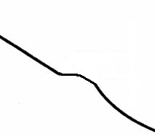
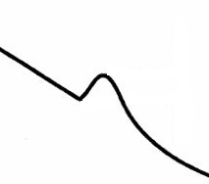
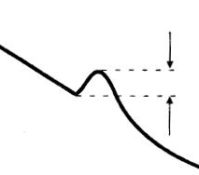
7-2-7 Hysteresis Smoothing
if state DOWN and next one larger, if next local maximum does not exceed threshold then stays current value i.e. small peak cuts flat
otherwise state changes from DOWN to UP and preserves major transients
Notes:
消除小突出部
保留巨大變動
假如現在狀態是DOWN，也就是”向下”
若相對最高值 < 門檻值 h, 則視為小波動，以紅色虛線的地方砍平
若相對最高值 > 門檻值 h, 則視為方向改變，保留原有的數值，切換到 UP(向上)

Slide 58
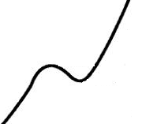
7-2-7 Hysteresis Smoothing
if state UP and next one smaller, if next local minimum does not exceed threshold then stays current value i.e. small valley filled flat
otherwise state changes from UP to DOWN and preserves major transients
Notes:
消除小突出部
保留巨大變動
假如現在狀態是UP，也就是”向上”
若相對最小值 < 門檻值 h, 則視為小波動，以紅色虛線的地方填滿
若相對最小值 > 門檻值 h, 則視為方向改變，保留原有的數值，切換到 DOWN(向下)

Slide 59
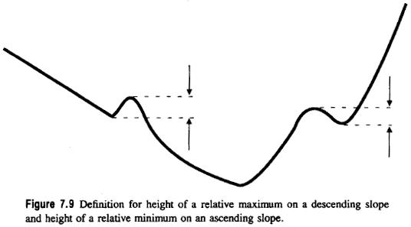
7-2-7 Hysteresis Smoothing
Notes:
在一個row中，本來pixel value 越變越小，遇到轉折點的pixel時候，的時候偵測變化頂點的相對最大值，假如相對最大值超過門檻，則視為
在上坡的時候偵測相對最大值

Slide 60
Take a break 4
什麼功能都有的iphone 笑死我了

Slide 61
Sigma Filter
sigma filter: average only with values within
two-sigma interval
Notes:
How sigma be counted? 是否為此mask中的值的sigma
Trick:當#M太小，則直接取neighbors的平均

Slide 62
Selected-Neighborhood Averaging
selected-neighborhood averaging:
assumes pixel a part of homogeneous region
(not required to be squared, others can be diagonal, rectangle, three pixels vertical and horizontal neighborhood)
noise-filtered value:
mean value from lowest variance neighborhood
Notes:
觀點不同，先前都以參考點為中心，這個則以包含參考點的數個鄰域為參考區域候選人
取 variance 最小的鄰域為參考區域，算出mean value當作 filter的輸出。
Advantage: 包含邊的鄰域variance會很大，所以不會被選為參考區域 也就是說，此方法不會cross edge boundary，可以保持邊的性質

Slide 63
Minimum Mean Square Noise Smoothing
minimum mean square noise smoothing:
additive or multiplicative noise
each pixel in true image:
regarded as a random variable
Notes:
將每個pixel視為random variable : Y
再假定noise亦為random variable : e
則每個點 Z = Y + e;
我們的目摽則是由Z去預測Y’ => Y’ = aZ + b;
為了使a , b 最小，則利用 E[ (Y-Y’)^2 ]
其中 Y’ = aZ + b;

Slide 64
Minimum Mean Square Noise Smoothing
Notes:
Z : 觀察到的像素值
Y : 原始影像應該擁有的像素值
Ksi : 雜訊
Y : 估計的像素值, 我們透過數學方法還原所得到的值，可以用 Y hat = a Z + b 來表達
目標是 選擇適當的 alpha 和 beta 使得 均方差為最小，也就是我們透過數學方法還原所得到的值和原始影像的像素值越近越好

Slide 65
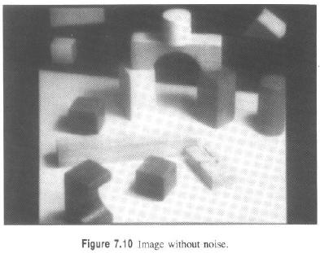
Noise-Removal Techniques-Experiments

Slide 66
Noise-Removal Techniques-Experiments
types of noise
uniform
Gaussian
salt and pepper
varying noise
(the noise energy varies across the image)
Notes:
Uniform : 雜訊值分布遵守均勻分布,每個gray level都有可能出現,且機率相等 , 又稱為 Quantization noise
Gaussian :雜訊值分布遵守高斯分布的雜訊,會聚集在常態分布的兩端
Salt and pepper : 雜訊根據特定的比率參數出現在影像中,雜訊值只有兩種白雜點(Salt)pixel value 為 0 或 黑雜點(Pepper) pixel value 為255
Varying noise : 沒有固定分布模式, 整張影像的雜訊分布沒有固定的 pattern

Slide 67
Noise-Removal Techniques-Experiments
salt and pepper
minimum/ maximum gray value for noise pixels
fraction of image to be corrupted with noise
uniform random variable in [0,1]
gray value at given pixel in input image
gray value at given pixel in output image
Notes:
如果 random variable u大於 p, 就維持不變
如果 random variable u小於等於 p, 就輸出 ( Imin + I max – I min )* u
P : 是要參雜雜訊的比例參數
U : 均勻分布的隨機變數，大小在 0 , 1 區間之間

Slide 68
Noise-Removal Techniques-Experiments
Generate salt-and-pepper noise
I(nim, i , j) = 0 if uniform(0,1) < 0.05
I(nim, i , j) = 255 if uniform(0,1) > 1- 0.05
I(nim, i , j) = I(im, i ,j) otherwise
uniform(0,1) : random variable uniformly distributed over [0,1]

Slide 69
Noise-Removal Techniques-Experiments
S/N ratio (signal to noise ratio):
VS: image gray level variance
VN: noise variance
$$SNR=20∗ \log_{10} \frac{\sqrt{VS}}{\sqrt{VN}}$$
Notes:
VN: 結果 – 帶有雜訊的圖 = 雜訊

Slide 70
Noise-Removal Techniques-Experiments
$$μ_{s}= \frac{\sum_{\text{∀}n}{I\left( i, j\right)}}{\left\|n\right\|}$$
$$VS= \frac{{\sum_{\text{∀}n}{\left( \left(I\left( i, j\right) − μ_{s} \right)\right)}}^{2}}{\left\|n\right\|}$$
$$μ_{Noise}= \frac{\sum_{\text{∀}n}{I_{Noise}\left( i, j\right) −I( i,j)}}{\left\|n\right\|}$$
$$VN= \frac{{\sum_{\text{∀}n}{\left( \left(I_{Noise}\left( i, j\right) −I( i,j)− μ_{Noise} \right)\right)}}^{2}}{\left\|n\right\|}$$
$$SNR=20∗ \log_{10} \frac{\sqrt{VS}}{\sqrt{VN}}$$

Slide 71
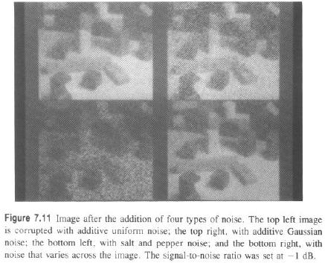
Noise-Removal Techniques-Experiments
uniform noise
Gaussian noise
salt and pepper noise
varies

Slide 72
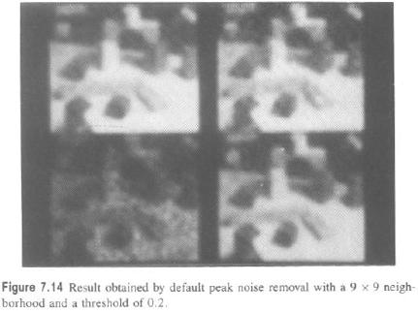
default peak noise removal

Slide 73
Uniform
Uniform
outlier removal
Gaussian
S & P
Gaussian
S & P
Notes:
效果並不好，影像失去焦點，邊緣模糊

Slide 74
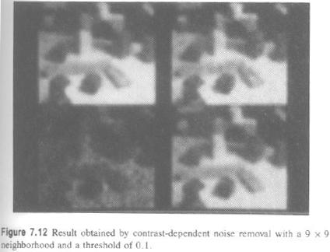
contrast-dependent noise removal

Slide 75
Uniform
Uniform
contrast-dependent outlier removal
Gaussian
S & P
Gaussian
S & P

Slide 76
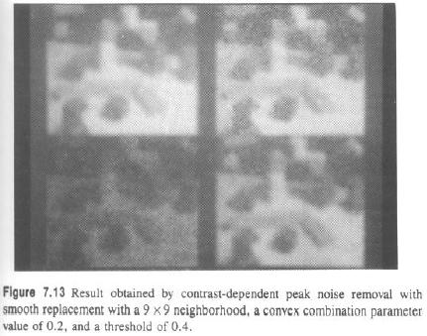
smooth replacement
Notes:
Why need theta

Slide 77
Uniform
Uniform
contrast-dependent outlier removal with smooth replacement
Gaussian
S & P
Gaussian
S & P

Slide 78
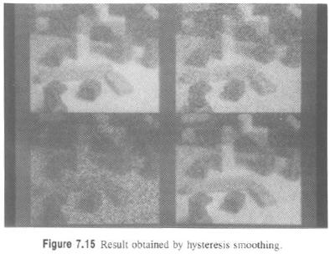
hysteresis smoothing

Slide 79
Uniform
Uniform
hysteresis smoothing
Gaussian
S & P
Gaussian
S & P
Notes:
對於 pepper and salt 的雜訊影像並不適用，因為 黑點 和 白點 和中心pixel 差距太大，會被當成主要波動

Slide 80
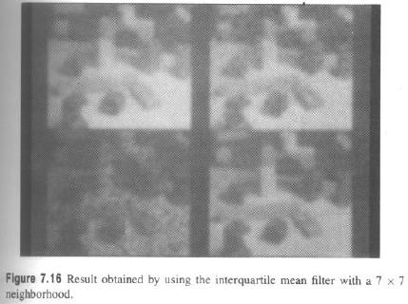
inter-quartile mean filter

Slide 81
Uniform
Uniform
inter-quartile mean filter
Gaussian
S & P
Gaussian
S & P

Slide 82
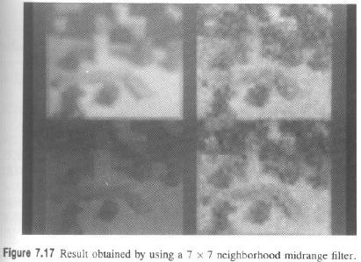
neighborhood midrange filter

Slide 83
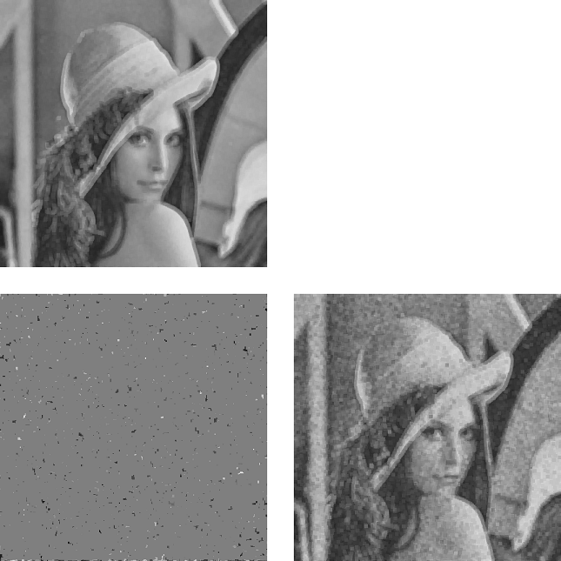
Uniform
Uniform
neighborhood midrange filter
Gaussian
S & P
Gaussian
S & P

Slide 84
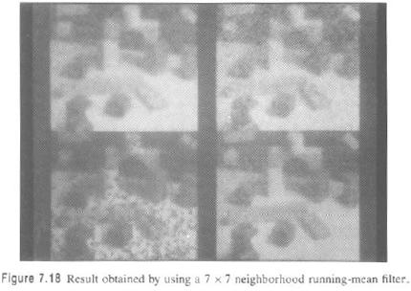
neighborhood running-mean filter

Slide 85
Uniform
Uniform
neighborhood running-mean filter
Gaussian
S & P
Gaussian
S & P

Slide 86
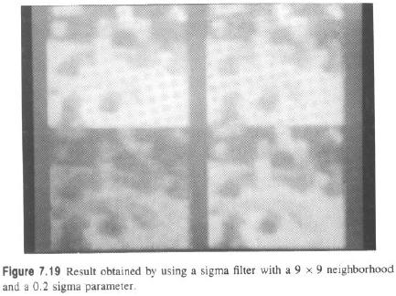
sigma filter

Slide 87
Uniform
Uniform
sigma filter
Gaussian
S & P
Gaussian
S & P

Slide 88
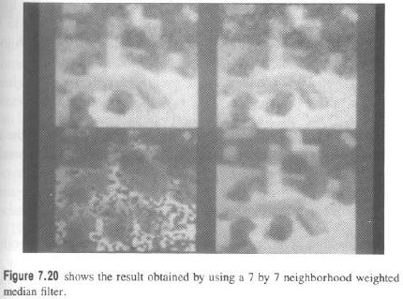
neighborhood weighted median filter
(7X7)

Slide 89
Uniform
Uniform
neighborhood weighted median filter
Gaussian
S & P
Gaussian
S & P

Slide 90
Noise-Removal Techniques-Experiments with Lena
SNR | Uniform | Gaussian_30 | S & P 0.1
Contrast-dependent outlier removal | 26.408 | 25.758 | 20.477
Smooth replacement | 29.344 | 26.821 | 26.792
Outlier removal | 26.407 | 25.768 | 20.406
Hysteresis | 18.278 | 13.804 | 1.9040
Interquartile mean filter | 29.193 | 24.517 | 35.720
Midrange filter | 22.171 | 19.629 | -0.1658
Running-mean filter | 29.522 | 28.278 | 21.194
Sigma filter | 34.717 | 18.831 | -2.9151
Weighted-median filter | 33.964 | 30.720 | 36.033

Slide 91
7.3 Sharpening
unsharp masking: subtract fraction of
neighborhood mean and scale result
possible to replace neighborhood mean with neighborhood median
Notes:
K越大 => 越 sharp

Slide 92
Extremum Sharpening
extremum-sharpening: output closer of
neighborhood maximum or minimum
Notes:
看離極大值或極小值這兩種極值，哪個極值較近。選比較靠近中心pixel 的 極值當作輸出
讓intensity強的pixel 更強
讓intensity弱的pixel 更弱
Z = Zmin，假如中心項訴離鄰域中的 最小值比較近, 就輸出Zmin
Z = Zmax，假如中心項訴離鄰域中的 最大值比較近, 就輸出Zmax

Slide 93
7.4 Edge Detection
Edge in a digital image: Boundary where brightness values are significantly different
要找出灰階有劇烈變化的邊界。
Edge: Brightness value appears to jump
Jump: In brightness value are associated with bright of first derivative and are the kinds of edges that Roberts (1965) originally detected.
邊緣檢測中我們選擇了 MATLAB 中提供的幾種演算法，就是 Sobel、Prewitt、Canny 三種邊緣檢測的方法，另外 再使用 MATLAB 中沒有提供的 Frei-Chen 的演算法
Notes:
Digital edge : 一條影像上的邊界，左右兩側的pixel value 明顯不同
Edge : 明亮度有突然的抬升或下降，

Slide 94
Gradient
First mask
p1 | p2 | p3
p4 | p5 | p6
p7 | p8 | p9
G_{X}=p6-p5
G_{y}=p6-p3

Slide 95
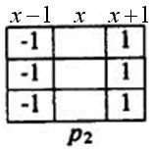
Gradient Edge Detectors
second mask
Notes:
Prewitt邊緣運算子可以想成是連續兩個點的差分運算子之和

Slide 96
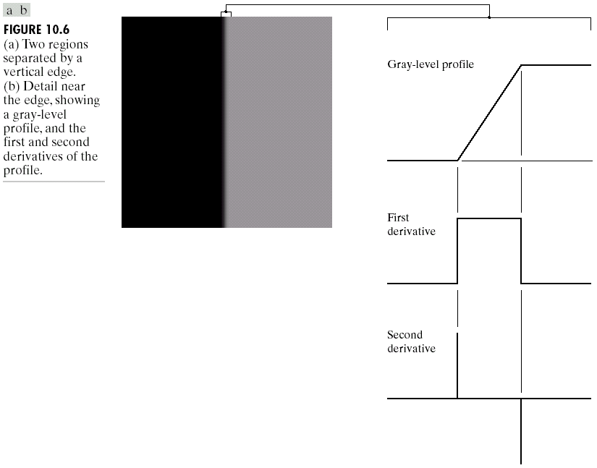

Slide 97
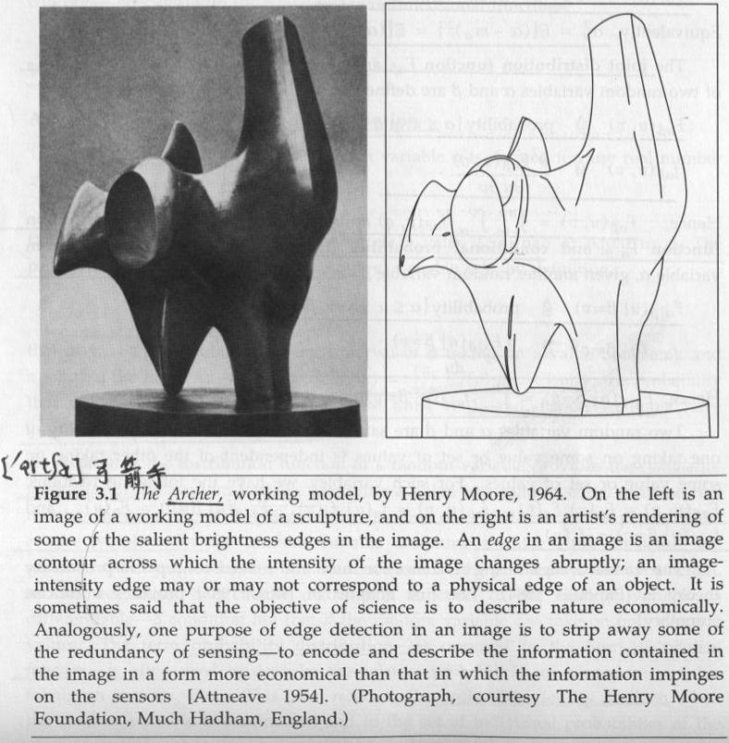
(1965
Notes:
Sculpture: 雕刻品
Salient:顯著的
Abruptly: 突然地
一般影像所謂的邊其實不見得會對應到實際物體的邊會因為打光 使我們在套mask找邊的時候 也會找到

Slide 98
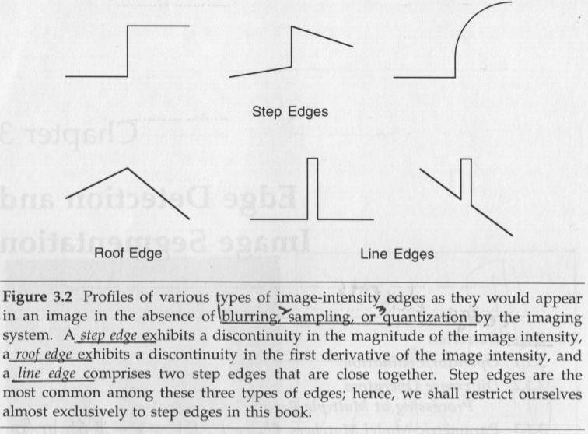
Notes:
Roof Edge : 紋理或邊緣的漸層變化
Step Edge :紋理或邊緣的強烈變化，影像強度不連續的地方
Line Edge : 可以想成是兩個Step Edge 的組合，圖型中一條明顯的線段

Slide 99
step :這是假設的人工訊號(不存在於一般圖形)，因為 image scanner 通常在前級處理會利用 LPF 濾除會有產生 alias 的高頻部分，好比利用 Gaussian mask 去做 convolution 結果。

Slide 100
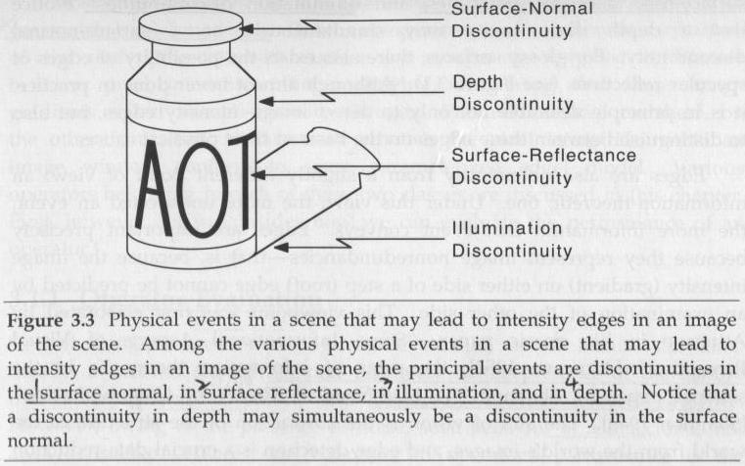
Notes:
場景中的物理屬性的變化會產生”邊緣”
Surface-normal: 法向量 => 對瓶蓋而言，由於法向量不連續，所以會造成邊(原本往上 突然變成向自己)
Depth: 後半部顯示不出來，造成不連續
Illumination:光照射不連續，由於光照不到影子覆蓋的地方，造成有邊
Surface reflectance:表面反射不連續,紙上面有黑色塗料,這兩個東西反射係數不同

Slide 101
Gradient Edge Detectors
Roberts operators: two 2X2 masks to calculate gradient
gradient magnitude:
where are values from first, second masks respectively
Notes:
由於做first-order微分可以凸顯高頻的地方，而邊正好是高頻的地方
考慮一個點的差分
此兩mask微分得來 => f’(x) = f(x+1) – f(x)
f’(x)=f(x+△x)/△x , △x趨近於0但電腦上單位為pixel 所以△x會是1則 f’(x) = f(x+1) – f(x)

Slide 102
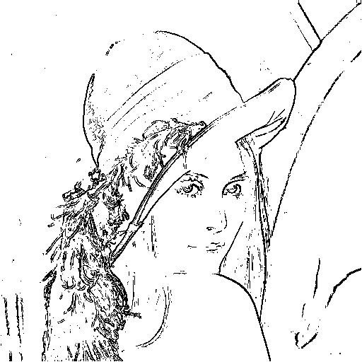
Roberts operators with threshold = 30

Slide 103
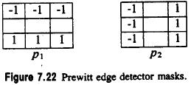
Gradient Edge Detectors
Prewitt edge detector: two 3X3 masks in row column direction
P1
P2
gradient magnitude:
gradient direction: clockwise w.r.t. column axis
Notes:
考慮兩個點？
f’(x) = f(x+1) – f(x)
f’(x-1) = f(x) – f(x-1)
=> f’(x) + f’(x-1) = f(x+1) – f(x-1)

Slide 104
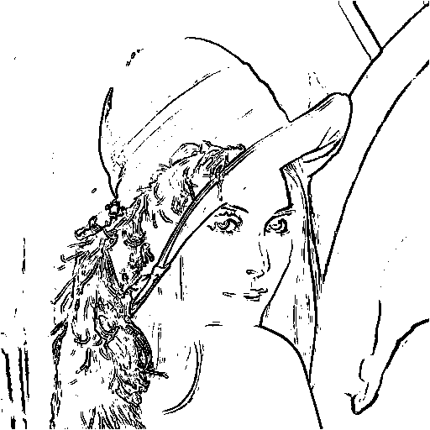
Prewitt edge detector with threshold = 30

Slide 105
Take a break
親愛的我這麼嚴格我都是為你好

Slide 106
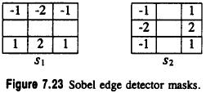
Gradient Edge Detectors
Sobel edge detector: two 3X3 masks in row column direction
gradient magnitude:
gradient direction: w.r.t. column axis (counter-clockwise )

Slide 107
Gradient Edge Detectors
[ ]
-1
1
-1
1
=
-1
-1
+1
-1
1
+1
-1
1
-1
-1
+1
1

Slide 108
Gradient Edge Detectors
Sobel edge detector: 2X2 smoothing followed by 2X2 gradient
Notes:
兩mask做convolution即可得到

Slide 109
Sobel edge detector with threshold = 30

Slide 110
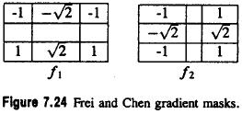
Gradient Edge Detectors
Frei and Chen edge detector: two in a set of nine orthogonal
masks (3X3)
gradient magnitude:
gradient direction: clockwise w.r.t. column axis
where are values from first, second masks respectively
中間沒東西的地方其實是零
Notes:
W^T * W = O =>稱之為orthogonal
總共有9個 orthogonal mask, 其中2個用來做 edge detection

Slide 111
Gradient Edge Detectors orthogonal
把兩個矩陣分別轉為列向量和行向量，兩向量內積 = 0，稱為 Orthogonal
Notes:
把兩個矩陣分別轉為列向量和行向量，兩向量內積 = 0，稱為 Orthogonal

Slide 112
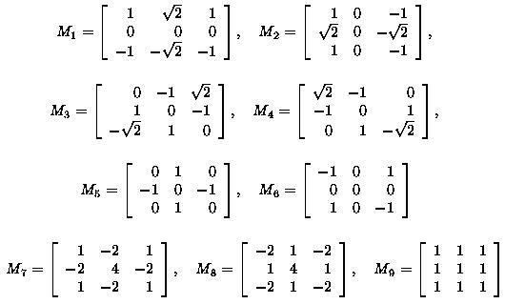
Gradient Edge Detectors
Frei and Chen edge detector: nine orthogonal masks (3X3)
邊緣
線
平均畫直線空間

Slide 113
Comparion between Frei-Chen and Sobel
而在使用 Frei-Chen 的演算法時發現他比 Sobel 跟Prewitt 的遮罩在做邊
緣檢測的時候有以下幾個優點：
(1) 有更多的邊緣的子區域被偵測出來。
(2) 較粗的邊緣會被當成細瘦的邊緣線條被檢測出來。
(3) 在黑暗中的邊緣此法比其他的方法更容易可以檢測出來。
(4) 但是此法對於影像的雜訊太過於靈敏。

Slide 114
Take a break
搞笑幽默 讓人笑噴的日本澡堂遇見黑社會老大

Slide 115
Frei and Chen edge detector with threshold = 30

Slide 116
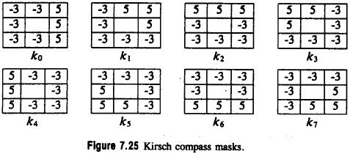
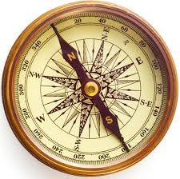
Gradient Edge Detectors
Kirsch: set of eight compass template edge masks
gradient magnitude:
gradient direction:
compass
Notes:
會是45*n?

Slide 117
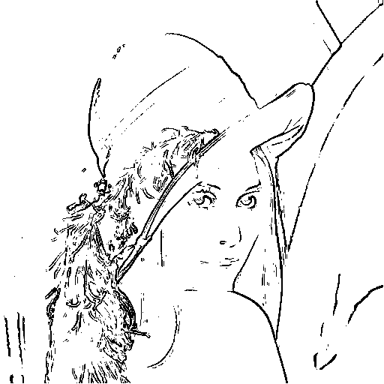
Kirsch edge detector with threshold = 30

Slide 118
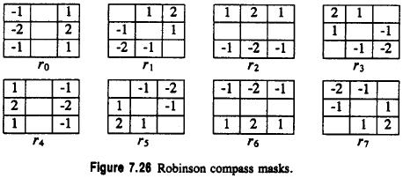
Gradient Edge Detectors
Robinson: compass template mask set with only
Simplify mask coefficients
(Kirsch)
done by only four masks since negation of each mask is also a mask
gradient magnitude and direction same as Kirsch operator

Slide 119
Robinson edge detector with threshold = 30

Slide 120
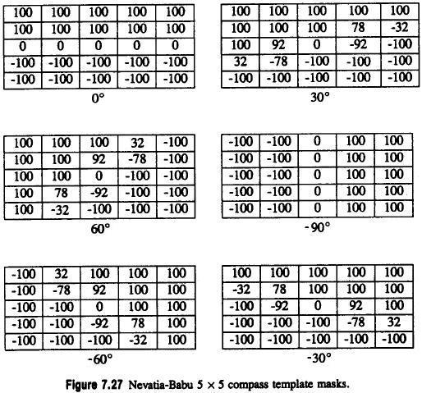
Gradient Edge Detectors
參考軸：y 軸
Nevatia and Babu: set of six 5X5 compass template masks

Slide 121
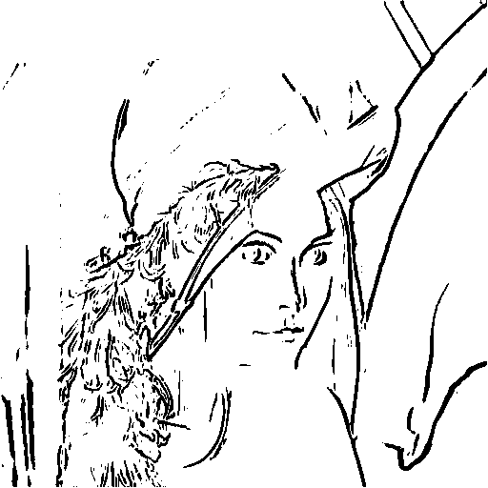
Nevatia and Babu with threshold = 30

Slide 122
Gradient Edge Detectors
edge contour direction:
along edge, right side bright, left side dark
edge contour direction:
more than gradient direction
gradient direction
contour direction

Slide 123
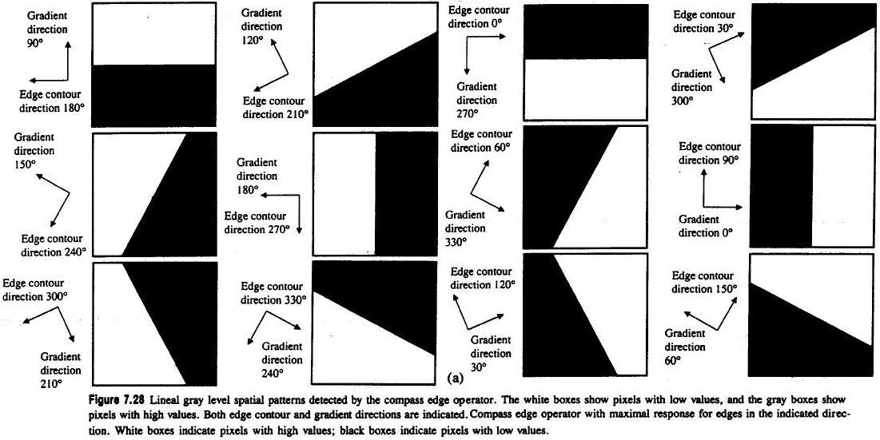
Robinson and Kirsch compass operator: detect lineal edges
Notes:
梯度 的 方向角 + 90 度 = Edge 的方向角

Slide 124
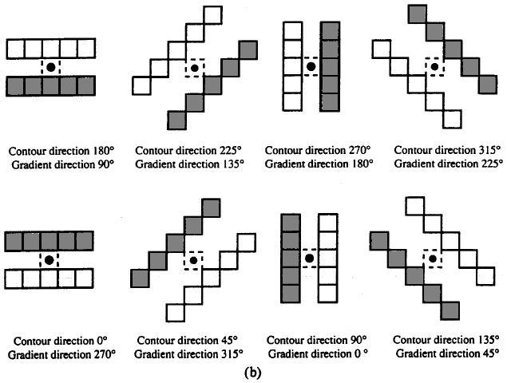

Slide 125
Gradient Edge Detectors
four important properties an edge operator might have
accuracy in estimating gradient magnitude
accuracy in estimating gradient direction
accuracy in estimating step edge contrast
accuracy in estimating step edge direction
gradient direction: used for edge organization, selection, linking
Notes:
Edge operator 要有的性質
準確估計 梯度的強度
準確估計 梯度的方向
準確估計 step edge 的對比性
準確估計 step edge 的方向性
Gradient direction : 用來做邊的組織，選擇，和連結。

Slide 126
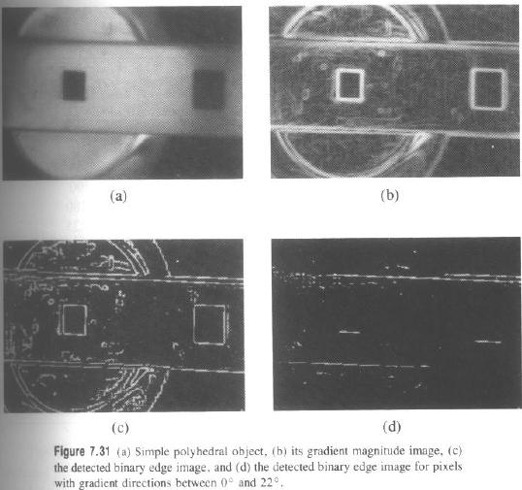
7.4.1 Gradient Edge Detectors
參考軸：X軸, 順時針方向
contour
Notes:
Polyhedral: 多面體
左上角：多面體物體
右上角：梯度強度影像
左下角：梯度強度二值化影像(門檻值為12)
右下角：右邊白左邊黑，選theta值在0~22度之間的。

Slide 127
Take a break
美女与猛男的浴室之战

Slide 128
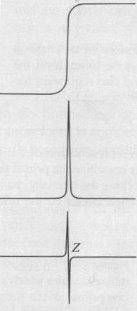
Zero-Crossing Edge Detectors
first derivative maximum: exactly where second derivative zero crossing
first derivative maximum: exactly where second derivative zero crossing
Notes:
圖a) 影像橫剖面pixel亮度變化
圖b) 影像橫剖面pixel 一階導數變化
圖c) 影像橫剖面pixel 二階導數變化
跟課本上的比較

Slide 129
Zero-Crossing Edge Detectors
Laplacian of a function

Slide 130
Zero-Crossing Edge Detectors
two common 3X3 masks to calculate digital Laplacian
First type
Second type
Notes:
Rotate
How to generate first one

Slide 131
Zero-Crossing Edge Detectors
the 3X3 neighborhood values of an image function
Notes:
子影像可以用雙變數函數 image function I(r,c)來表達

Slide 132
Zero-Crossing Edge Detectors
I(r,c) = k1+k2r+k3c+k4r²+k5rc+k6c²
( r, c)
(-1,-1) | (-1, 0) | (-1, 1)
( 0,-1) | ( 0, 0) | ( 0, 1)
( 1,-1) | ( 1, 0) | ( 1, 1)
(-1,-1) | (-1, 0) | (-1, 1)
( 0,-1) | ( 0, 0) | ( 0, 1)
( 1,-1) | ( 1, 0) | ( 1, 1)
(-1,-1) | (-1, 0) | (-1, 1)
( 0,-1) | ( 0, 0) | ( 0, 1)
( 1,-1) | ( 1, 0) | ( 1, 1)
(-1,-1) | (-1, 0) | (-1, 1)
( 0,-1) | ( 0, 0) | ( 0, 1)
( 1,-1) | ( 1, 0) | ( 1, 1)
(-1,-1) | (-1, 0) | (-1, 1)
( 0,-1) | ( 0, 0) | ( 0, 1)
( 1,-1) | ( 1, 0) | ( 1, 1)
(-1,-1) | (-1, 0) | (-1, 1)
( 0,-1) | ( 0, 0) | ( 0, 1)
( 1,-1) | ( 1, 0) | ( 1, 1)
(-1,-1) | (-1, 0) | (-1, 1)
( 0,-1) | ( 0, 0) | ( 0, 1)
( 1,-1) | ( 1, 0) | ( 1, 1)
(-1,-1) | (-1, 0) | (-1, 1)
( 0,-1) | ( 0, 0) | ( 0, 1)
( 1,-1) | ( 1, 0) | ( 1, 1)
(-1,-1) | (-1, 0) | (-1, 1)
( 0,-1) | ( 0, 0) | ( 0, 1)
( 1,-1) | ( 1, 0) | ( 1, 1)
(-1,-1) | (-1, 0) | (-1, 1)
( 0,-1) | ( 0, 0) | ( 0, 1)
( 1,-1) | ( 1, 0) | ( 1, 1)

Slide 133
I(r,c) = k1+k2r+k3c+k4r²+k5rc+k6c²

Slide 134
Zero-Crossing Edge Detectors
Notes:
Laplacian operator 算子對影像I的結果

Slide 135
Zero-Crossing Edge Detectors
Notes:
子影像帶入兩個常見的Laplacian operator去計算

Slide 136
Zero-Crossing Edge Detectors
3X3 mask computing
a digital Laplacian
Notes:
Laplacian 運算子的general pattern 必須滿足的兩個條件

Slide 137
Zero-Crossing Edge Detectors
Notes:
推導 e = -(4a+4b) 條件怎麼來的
推導 2a+b = 1 條件怎麼來的

Slide 138
Zero-Crossing Edge Detectors
3X3 mask for computing minimum-variance digital Laplacian
First type
Notes:
-first+2first_rotate

Slide 139
Take a break
與哥兒們喝酒作罷篇

Slide 142
Laplacian of the Gaussian kernel
-2 -9 -23 -1 103 178 103 -1 -23 -9 -2
Notes:
圖形像墨西哥帽

Slide 143
Zero-Crossing Edge Detectors

Slide 144
Notes:
黑白區域的邊界就是 Zero-crossing 發生的地方

Slide 147
Zero-Crossing Edge Detectors

Slide 148
Zero-Crossing Edge Detectors
A pixel is declared to have a zero crossing if it is less than –t and one of its eight neighbors is greater than t or if it is greater than t and one of its eight neighbors is less than –t for some fixed threshold t
t
-t

Slide 149
Zero-Crossing Edge Detectors

Slide 150
Take a Break
爆笑空姐

Slide 151
Edge Operator Performance
edge detector performance characteristics:
misdetection/false-alarm rate
Notes:
False-alarm rate: 將非邊的pixel當做邊的機率。
Misdetection rate: 1 – 找到邊的比例
用來評估 edge detector 的兩個特徵
False-alarm rate : 假警報 把不是邊的pixel判定程是邊的pixel
Misdetection rate : 誤檢率 明明是邊上的pixel確判定程不在邊上

Slide 152
Notes:
這種找邊的方法她會先用gaussian 對原圖做smooth
齒輪的邊緣還有字體的清晰程度是最主要的不同
Sigma小的時候，小細節比較清楚；sigma逐漸增大的時候，粗略輪廓就逐漸顯現出來，但是細節就會逐漸消失。

Slide 153
Notes:
抹布的影像
Scale 代表 解析度，換句話說，就是細節的呈現程度。放大或縮小的尺度。
Sigma小的時候，小細節比較清楚；sigma逐漸增大的時候，粗略輪廓就逐漸顯現出來，但是細節就會逐漸消失。

Slide 154
7.5 Line Detection
A line segment on an image can be characterized as an elongated rectangular region having a homogeneous gray level bounded on both its longer sides by homogeneous regions of a different gray level
Notes:
Line segment 可以被描述成一個拉長的矩形，期內部有一致的灰階值，被另一個擁有不同灰階值區域區隔開來，

Slide 155
7.5 Line Detection
one-pixel-wide lines can be detected by compass line detectors

Slide 156
detecting lines of one to three pixels in width

Slide 157
semilinear line detector
by step edge on
either side of the line
$$s=\max\left\{ a_{i}+b_{i}\right|a_{i}>t and b_{i}>t\}$$
$θ= 45° ∗i, where$ $a_{i}+b_{i}$ $=$ $s$

Slide 158
Take a break
如果每個人都老老實實地搭飛機的話，到底會有多爆笑？

Slide 159
Project due Dec. 8
Write the following programs
Generate additive white Gaussian noise (2張圖)
Gaussian noise with amplitude = 10
Gaussian noise with amplitude = 30
Generate salt-and-pepper noise (2‘張圖)
threshold = 0.05
threshold = 0.1
3. Run box filter (3X3, 5X5) on all noisy images (8張圖)
4. Run median filter (3X3, 5X5) on all noisy images (8張圖)
5. Run opening followed by closing or closing followed by opening
(8張) Octagon grayscale 每一個值都是零
Notes:
高斯雜訊（Gaussian noise）是白雜訊（white noise）的理想形態，是由訊號中隨機的擾動而造成。
疊加雜訊：I+N
像素值加上亂數數值
乘積雜訊：I(1+N)
像素值乘上亂數數值，則會產生斑點（speckle）雜訊（或簡稱斑點），因此又稱為乘積雜訊（multiplicative noise）。

Slide 160
Project due Dec. 8
Generate additive white Gaussian noise
Gaussian random variable with zero mean and st. dev. 1
amplitude determines signal-to-noise ratio, try 10, 30
Notes:
產生一個高斯分布在亂數產生器，對應參數為 平均值為0，標準差為1
震幅 amplitude 為 10 和 30 兩種case

Slide 161
RandNum Generator (Gaussian) C++ Implementation
#include <random> //Standard C++ Header
…
// function prototype and implementation
double randomNumGaussian( double mean, double stddev)
{
static default_random_engine generator;
static normal_distribution<double> distribution( mean, stddev);
return distribution(generator);
}//end of randomNumGaussian

Slide 163
Project due Dec. 8
Generate salt-and-pepper noise
I( noiseImage,i ,j) =$\left\{ \begin{aligned} 0 \\ 255 \\ I\left( srcImage,i,j\right) \end{aligned} \right.$
$$, if uniform\left(0,1\right)<0.05$$
$$, if uniform\left(0,1\right)>1−0.05$$
$$, otherwise$$
Notes:
產生一個均勻分布在0~1之間的亂數產生器

Slide 164
Project due Dec. 8
box filter on white Gaussian noise with amplitude = 10
Gaussian noise
After 5x5 box filter

Slide 165
Project due Dec. 8
box filter on salt-and-pepper noise with threshold = 0.05
salt-and-pepper noise
After 5x5 box filter
After 3x3 box filter

Slide 166
Project due Dec.8
median filter on white Gaussian noise with amplitude = 10
Gaussian noise
After 5x5 median filter
After 3x3 median filter

Slide 167
Project due Dec. 8
median filter on salt-and-pepper noise with threshold = 0.05
salt-and-pepper noise
After 5x5 median filter
After 3x3 median filter

Slide 168
Project due Dec. 8
Generate additive white Gaussian noise
with amplitude = 10

Slide 169
Project due Dec. 8
Generate additive white Gaussian noise
with amplitude = 30

Slide 170
Project due Nov. 26
Generate salt-and-pepper noise
with threshold = 0.05

Slide 171
Project due Dec.8
Generate salt-and-pepper noise
with threshold = 0.1

Slide 172
Project due Dec. 12
Write programs to generate the following gradient magnitude images and choose proper thresholds to get the binary edge images:
Roberts operator
Prewitt edge detector
Sobel edge detector
Frei and Chen gradient operator
Kirsch compass operator
Robinson compass operator
Nevatia-Babu 5X5 operator

Slide 173
Project due Dec. 15
Roberts operator with threshold = 30

Slide 174
Project due Dec. 15
Prewitt edge detector with threshold = 30

Slide 175
Project due Dec. 15
Sobel edge detector with threshold = 30

Slide 176
Project due Dec. 15
Frei and Chen gradient operator with threshold = 30

Slide 177
Project due Dec. 15
Kirsch compass operator with threshold = 30

Slide 178
Project due Dec. 15
Robinson compass operator with threshold = 30

Slide 179
Project due Dec. 15
Nevatia-Babu 5X5 operator threshold = 30

Slide 180
Project due Dec. 22
Write the following programs to detect edge:
Zero-crossing on the following four types of
images to get edge images (choose proper
thresholds), p. 349
Laplacian
minimum-variance Laplacian
Laplacian of Gaussian
Difference of Gaussian, (use tk to generate D.O.G.)
dog (inhibitory , excitatory ,
kernel size=11)

Slide 181
Difference of Gaussian

Slide 182
Difference of Gaussian

Slide 183
Project due Dec. 22
Zero-crossing on the following four types of
images to get edge images (choose proper
thresholds t=1)

Slide 184
Laplacian

Slide 185
minimum-variance Laplacian

Slide 186
Laplacian of Gaussian

Slide 187
Difference of Gaussian
(inhibitory , excitatory , kernel size=11)

