Slide 1
Computer Vision
Chapter6
Neighborhood Operators
曾子家
r05945052@ntu.edu.tw

Slide 2
Chapter 6
Neighborhood Operators
6.1 Introduction
6.2 Symbolic Neighborhood Operators
6.3 Extremum-Related Neighborhood Operators
6.4 Linear Shift-invariant Neighborhood Operators

Slide 3


6.1 Introduction
6.2 Symbolic Neighborhood Operators
  6.2.1 Region-Growing Operator
  6.2.2 Nearest Neighbor Sets and Influence Zones
  6.2.3 Region-Shrinking Operator
  6.2.4 Mark-Interior/Border-Pixel Operator
  6.2.5 Connectivity Number Operator
    Yokoi Connectivity Number
    Rutovitz Connectivity Number
  6.2.6 Connected Shrink Operator
  6.2.7 Pair Relationship Operator
  6.2.8 Thinning Opertator
  6.2.9 Distance Transformation Operator
  6.2.10 Radius od Fusion
  6.2.11 Number of Shortest Paths
6.3 Extremum-Related Neighborhood Operators
  6.3.1 Non-Minima-Maxima Operator
  6.3.2 Relative Extrema Operator
  6.3.3 Reachability Operator
6.4 Linear Shift-invariant Neighborhood Operators
  6.4.1 Convolution and Correlation
  6.4.2 Saperability

Slide 4
6.1 Introduction
6.2 Symbolic Neighborhood Operators
  6.2.1 Region-Growing Operator
  6.2.2 Nearest Neighbor Sets and Influence Zones
  6.2.3 Region-Shrinking Operator
  6.2.4 Mark-Interior/Border-Pixel Operator
  6.2.5 Connectivity Number Operator
    Yokoi Connectivity Number
    Rutovitz Connectivity Number
  6.2.6 Connected Shrink Operator
  6.2.7 Pair Relationship Operator
  6.2.8 Thinning Opertator
  6.2.9 Distance Transformation Operator
  6.2.10 Radius od Fusion
  6.2.11 Number of Shortest Paths
6.3 Extremum-Related Neighborhood Operators
  6.3.1 Non-Minima-Maxima Operator
  6.3.2 Relative Extrema Operator
  6.3.3 Reachability Operator
6.4 Linear Shift-invariant Neighborhood Operators
  6.4.1 Convolution and Correlation
  6.4.2 Saperability

Slide 5
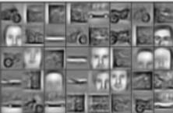
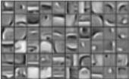


6.1.1 Introduction
1. The workhorse of low-level vision
  What are levels of vision?
input
Low-Level
-----------------------
grouping
Color
Spatial freq.
Local Motion
Mid-Level
-----------------------
Textures
Surfaces
Global motion
Depth
High-Level
-----------------------
Objects
Characters
Actions
intentions
https://goo.gl/ynA9VN
https://goo.gl/o5Q3Qy
Notes:
Workhorse 主力
F ( x ) = y

Slide 6
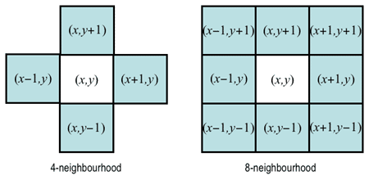
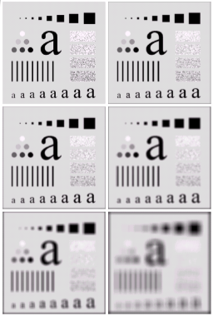
6.1.1 Introduction
2. Definitions and Classifications
  domain type: numeric / symbolic
    numeric: +, -, min, max
    Symbolic: AND, OR, NOT, table-look-up
  Neighborhood type: 4-connected / 8-connected
  Recursive type: Rec.(sequential) / Non-Rec.(parallel)
    whether output depends on previously generated output
    in the view of “memory”: sequential vs parallel
A1
A2
A3
B1
A2
A3
C1
A2
A3
C1
B2
A3
C1
C2
A3
A1
A2
A3
D1
D2
D3
Notes:
Symbolic: 與數值無關
Neighborhood type還有其他的，mask越大，效果就越像散光

Slide 7
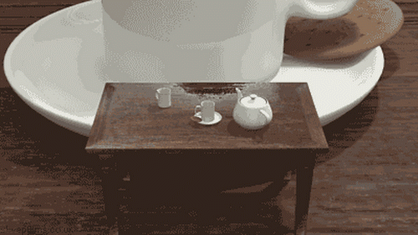
When I debug recursive code...

Slide 8
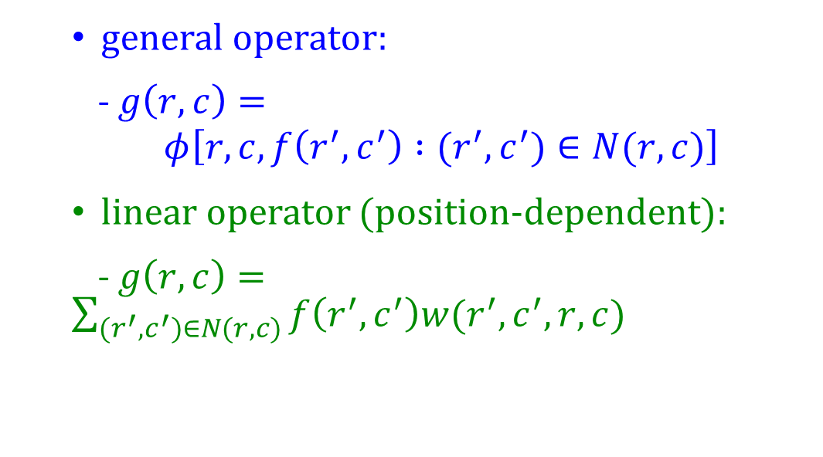

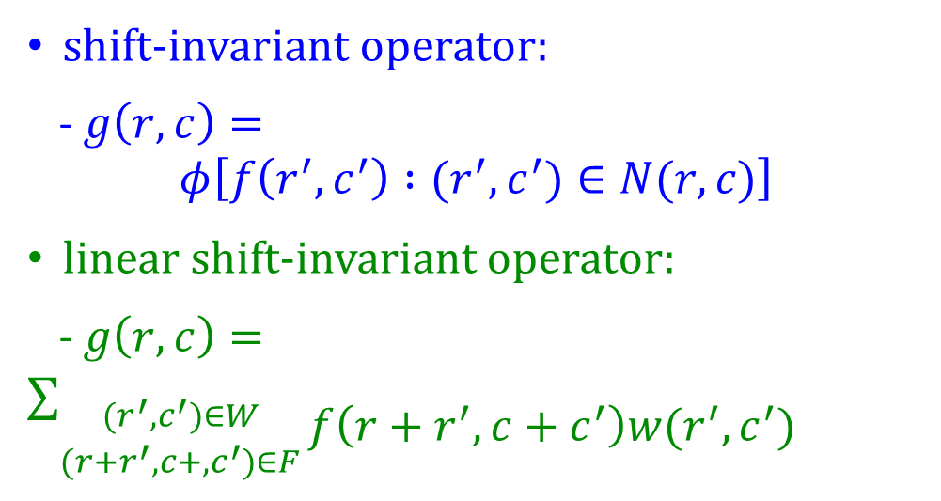
6.1.2 Non-Rec. Neighborhood Operator
Definitions:
given image(input): $f$, output image: $g$, n$eighborhood operator:φ ,$ neighborhood: $N(r,c)$
general operator:
- $g\left(r,c\right)=$
$$φ\left[r,c,f\left(r^{′},c^{′}\right) :(r^{′},c^{′})∈N(r,c)\right]$$
linear operator (position-dependent):
-$g\left(r,c\right)=\sum_{(r^{′},c^{′})∈N(r,c)}{f\left(r^{′},c^{′}\right)w(r^{′},c^{′},r,c)}$
shift-invariant operator:
- $g\left(r,c\right)=$
$$φ\left[f\left(r^{′},c^{′}\right) :(r^{′},c^{′})∈N(r,c)\right]$$
linear shift-invariant operator:
- $g\left(r,c\right)=\sum_{\begin{aligned}(r^{′},c^{′})∈W \\ ({r+r}^{′},c+,c^{′})∈F\end{aligned}}{\begin{aligned} \\ f\left(r+r^{′},c+c^{′}\right)w(r^{′},c^{′})\end{aligned}}$
$$g=f⨂w$$

Slide 9
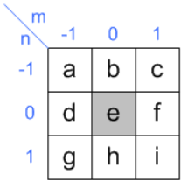



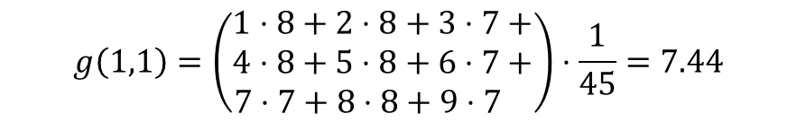

6.1.2 Non-Rec. Neighborhood Operator
Cross-correlation
$∈$Linear Shifted-Invariant Operator
The weight function $w$ is called the kernel or the mask of weights , $domain\left(w\right)=W$
$(f⨂{w)}\left(r,c\right)=\sum_{\begin{aligned}(r^{′},{ c}^{′})∈W \\ ({r+r}^{′}, c+c^{′})∈F\end{aligned}}{f\left(r+r^{′}, c+c^{′}\right)w(r^{′},c^{′})}$
$$mask$$
$$input image$$
Q&A
6.44 (B) 7.44 (C) 8.44
1 | 2 | 3
4 | 5 | 6
7 | 8 | 9
8 | 8 | 7 | 7 | 6 | 3
8 | 8 | 7 | 7 | 6 | 3
7 | 8 | 7 | 8 | 8 | 2
6 | 6 | 7 | 8 | 2 | 1
6 | 6 | 6 | 7 | 1 | 1
6 | 6 | 6 | 6 | 1 | 1
(B) 7.44
$$\frac{1}{45}$$
$$g\left(1,1\right)=\left(\begin{aligned}1⋅8+2⋅8+3⋅7+ \\ 4⋅8+5⋅8+6⋅7+ \\ 7⋅7+8⋅8+9⋅7 \end{aligned}\right)⋅\frac{1}{45}=7.44$$

Slide 10
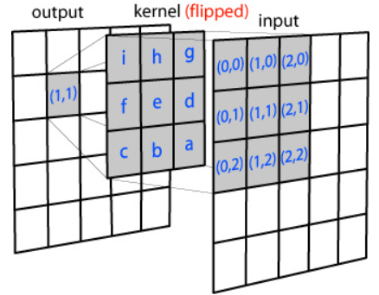

6.1.2 Non-Rec. Neighborhood Operator
Convolution 1/2
$∈$Linear Shifted-Invariant Operator
The weight function $w$ is called the kernel or the mask of weights , $domain\left(w\right)=W$
$(f∗w)\left(r,c\right)=\sum_{\begin{aligned}(r^{′}, c^{′})∈W \\ ({r−r}^{′}, c−c^{′})∈F\end{aligned}}{f\left(r−r^{′}, c−c^{′}\right)w(r^{′},c^{′})}$
http://www.songho.ca/dsp/convolution/convolution.html

Slide 11

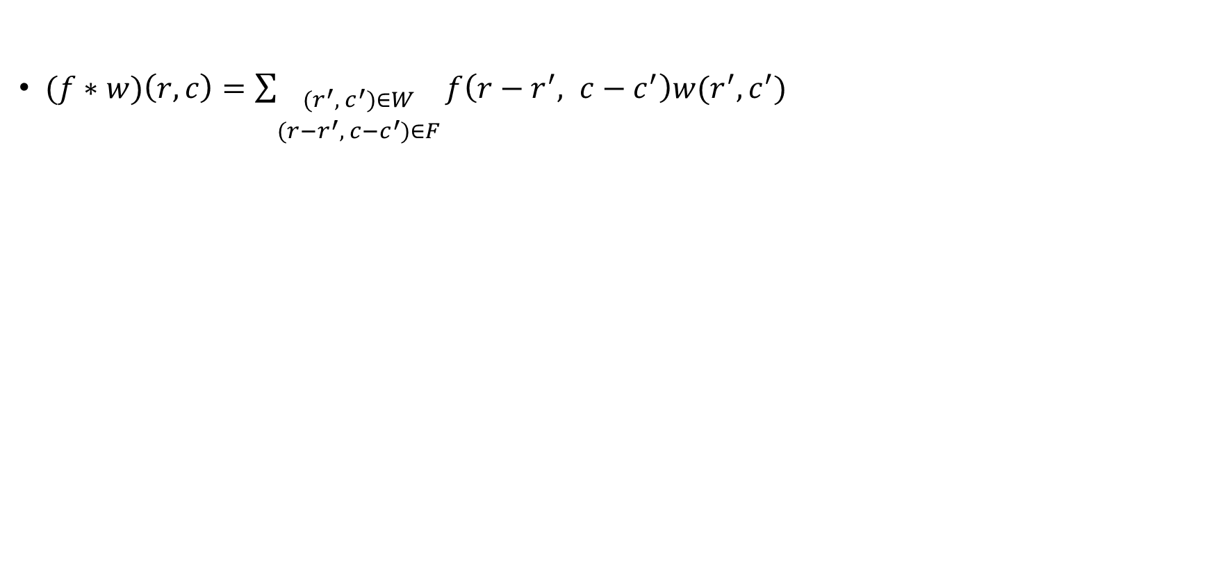

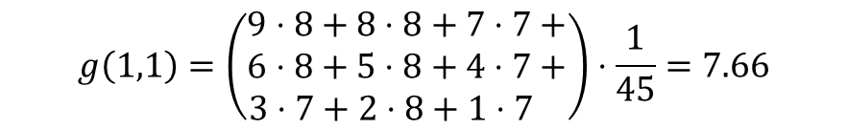

6.1.2 Non-Rec. Neighborhood Operator
Convolution 2/2
$(f∗w)\left(r,c\right)=\sum_{\begin{aligned}(r^{′}, c^{′})∈W \\ ({r−r}^{′}, c−c^{′})∈F\end{aligned}}{f\left(r−r^{′}, c−c^{′}\right)w(r^{′},c^{′})}$
$$mask$$
$$input image$$
Q&A
6.66 (B) 7.66 (C) 8.66
1 | 2 | 3
4 | 5 | 6
7 | 8 | 9
8 | 8 | 7 | 7 | 6 | 3
8 | 8 | 7 | 7 | 6 | 3
7 | 8 | 7 | 8 | 8 | 2
6 | 6 | 7 | 8 | 2 | 1
6 | 6 | 6 | 7 | 1 | 1
6 | 6 | 6 | 6 | 1 | 1
(B) 7.66
$$\frac{1}{45}$$
$$g\left(1,1\right)=\left(\begin{aligned}9⋅8+8⋅8+7⋅7+ \\ 6⋅8+5⋅8+4⋅7+ \\ 3⋅7+2⋅8+1⋅7 \end{aligned}\right)⋅\frac{1}{45}=7.66$$

Slide 12
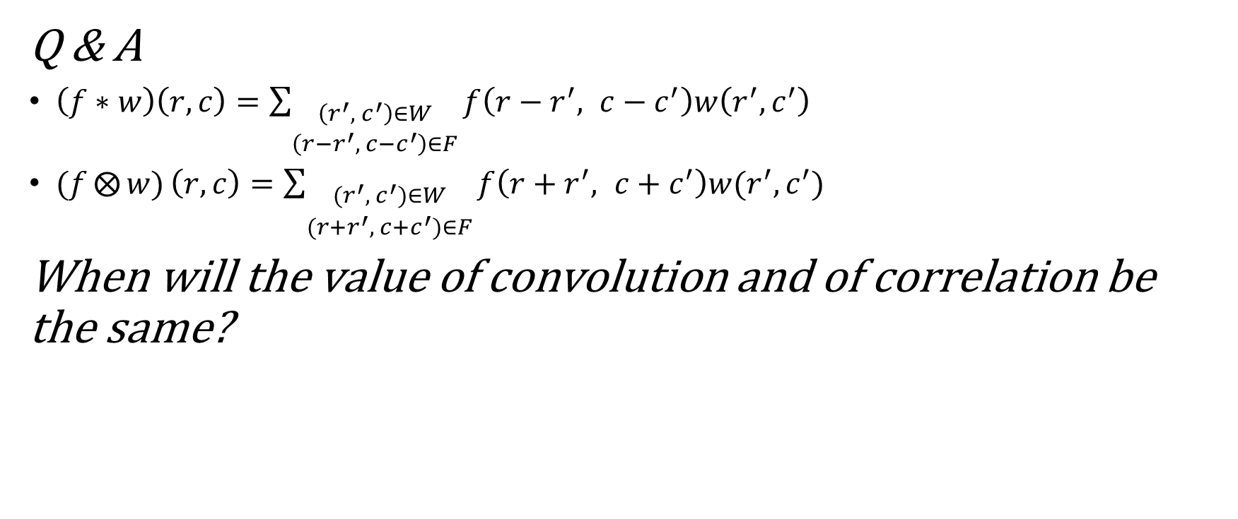
6.1.2 Non-Rec. Neighborhood Operator
Cross-correlation 2/2
Q & A
$\left(f∗w\right)\left(r,c\right)=\sum_{\begin{aligned}\left(r^{′}, c^{′}\right)∈W \\ \left({r−r}^{′}, c−c^{′}\right)∈F\end{aligned}}{f\left(r−r^{′}, c−c^{′}\right)w\left(r^{′},c^{′}\right)}$
$(f⨂{w)}\left(r,c\right)=\sum_{\begin{aligned}(r^{′},{ c}^{′})∈W \\ ({r+r}^{′}, c+c^{′})∈F\end{aligned}}{f\left(r+r^{′}, c+c^{′}\right)w(r^{′},c^{′})}$
When will the value of convolution and of correlation be the same?
Ans. When the mask is symmetric.

Slide 13
6.1 Introduction
6.2 Symbolic Neighborhood Operators
  6.2.1 Region-Growing Operator
  6.2.2 Nearest Neighbor Sets and Influence Zones
  6.2.3 Region-Shrinking Operator
  6.2.4 Mark-Interior/Border-Pixel Operator
  6.2.5 Connectivity Number Operator
    Yokoi Connectivity Number
    Rutovitz Connectivity Number
  6.2.6 Connected Shrink Operator
  6.2.7 Pair Relationship Operator
  6.2.8 Thinning Opertator
  6.2.9 Distance Transformation Operator
  6.2.10 Radius od Fusion
  6.2.11 Number of Shortest Paths
6.3 Extremum-Related Neighborhood Operators
  6.3.1 Non-Minima-Maxima Operator
  6.3.2 Relative Extrema Operator
  6.3.3 Reachability Operator
6.4 Linear Shift-invariant Neighborhood Operators
  6.4.1 Convolution and Correlation
  6.4.2 Sperability

Slide 14
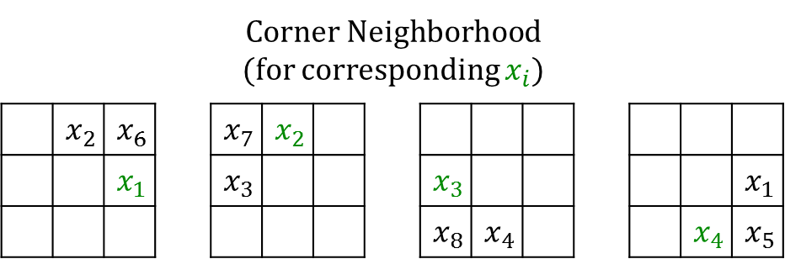
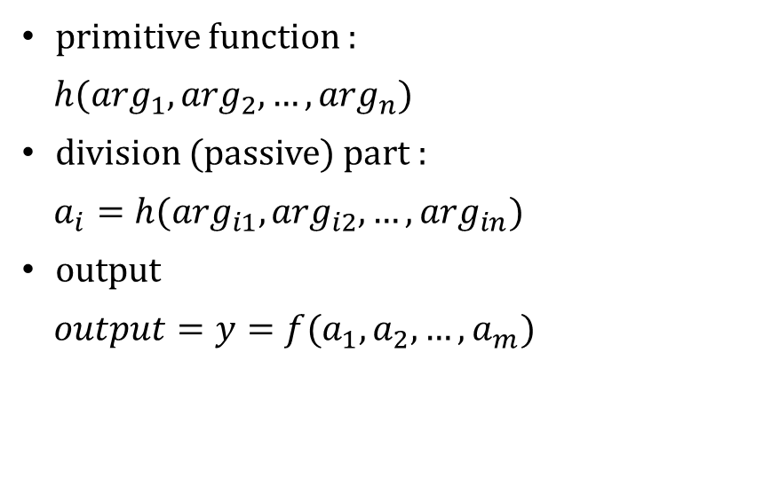



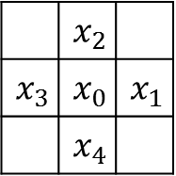
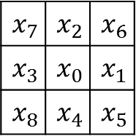
6.2.0 Definition
Indexing of 4-connected and 8-connected neighborhood of $x_{0}$
primitive function :
$h(\arg_{1},\arg_{2},…,\arg_{n})$
division (passive) part :
$a_{i}=h(\arg_{i1},\arg_{i2},…,\arg_{in})$
output
$output=y=f(a_{1},a_{2},…,a_{m})$
$4$-$connected$
$8$-$connected$
 | $$x_{2}$$
$$x_{3}$$ | $$x_{0}$$ | $$x_{1}$$
 | $$x_{4}$$
$$x_{7}$$ | $$x_{2}$$ | $$x_{6}$$
$$x_{3}$$ | $$x_{0}$$ | $$x_{1}$$
$$x_{8}$$ | $$x_{4}$$ | $$x_{5}$$
(clockwise numbering)

Slide 15

6.2.1 Region-Growing Operator

Slide 16
6.2.1 Region-Growing Operator
Function
  It change all pixels whose label is the background label to the non-background label of neighboring pixels
  a.k.a Dilation
Classification
  Non-Rec.
  Symbolic data domain (input/output : region-label)

Slide 17
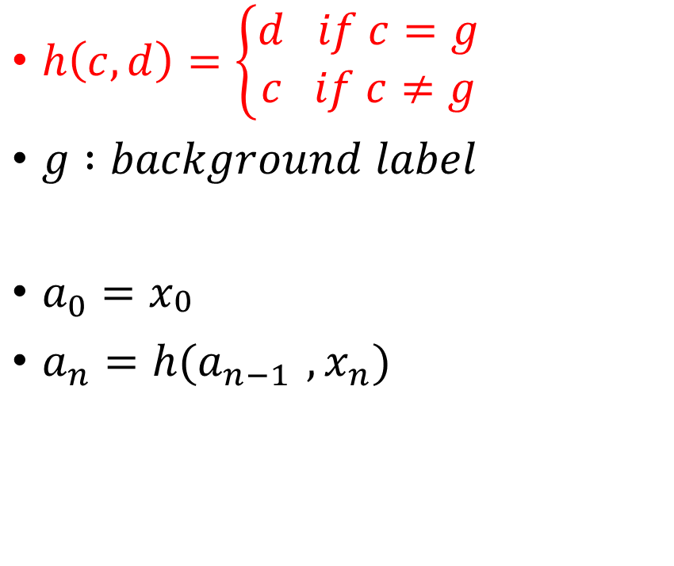
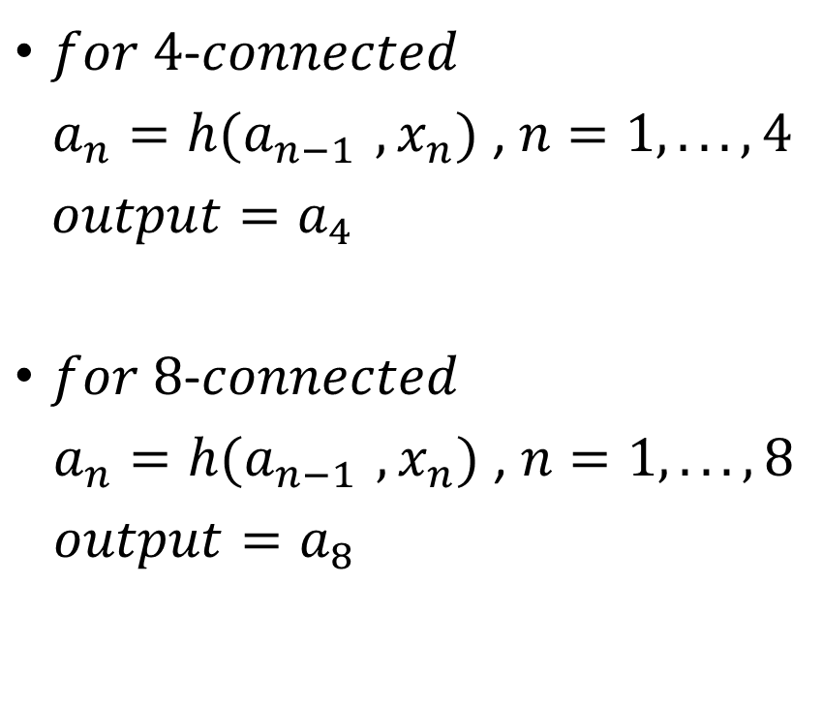
6.2.1 Region-Growing Operator
$h\left(c,d\right)=\left\{\begin{aligned}d if c=g \\ c if c≠g\end{aligned}\right.$
$g :background label$
$a_{0}=x_{\begin{aligned}0 \\ \end{aligned}}$
$a_{n}=h(a_{n−1 },x_{n})$
$for 4$-$connected$
$a_{n}=h(a_{n−1 },x_{n})$ , $n=1,... ,4$
${output=a}_{4}$
$for 8$-$connected$
$a_{n}=h(a_{n−1 },x_{n})$ , $n=1,... ,8$
${output=a}_{8}$

Slide 18
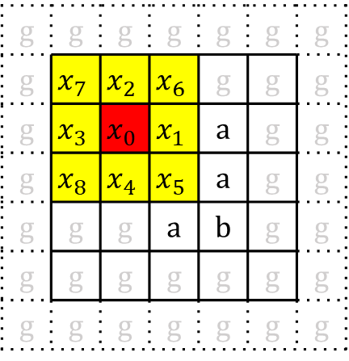

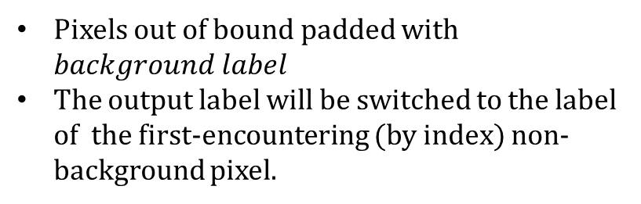
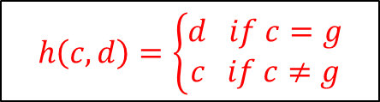
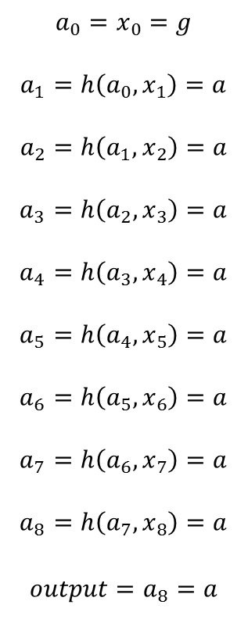
Case 1
Region-Growing
Operator
(at one point)
g | g | g | g | g | g | g
g | g | g | g | g | g | g
g | g | g | a | a | g | g
g | g | g | b | a | g | g
g | g | g | a | b | g | g
g | g | g | g | g | g | g
g | g | g | g | g | g | g
g | g | g | g | g | g | g
g | g | g | g | g | g | g
g | g | a | a | a | g | g
g | g | g | b | a | g | g
g | g | g | a | b | g | g
g | g | g | g | g | g | g
g | g | g | g | g | g | g
$$a_{0}=x_{0}=g$$
$$a_{1}=h\left({a_{0},x}_{1}\right)=a$$
$$a_{2}=h\left({a_{1},x}_{2}\right)=a$$
$$a_{3}=h\left({a_{2},x}_{3}\right)=a$$
$$a_{4}=h\left({a_{3},x}_{4}\right)=a$$
$$a_{5}=h\left({a_{4},x}_{5}\right)=a$$
$$a_{6}=h\left({a_{5},x}_{6}\right)=a$$
$$a_{7}=h\left({a_{6},x}_{7}\right)=a$$
$$a_{8}=h\left({a_{7},x}_{8}\right)=a$$
$$output=a_{8}=a$$
input
output
$$b$$
g | g | g | g | g | g | g
g | $$x_{7}$$ | $$x_{2}$$ | $$x_{6}$$ | g | g | g
g | $$x_{3}$$ | $$x_{0}$$ | $$x_{1}$$ | a | g | g
g | $$x_{8}$$ | $$x_{4}$$ | $$x_{5}$$ | a | g | g
g | g | g | a | b | g | g
g | g | g | g | g | g | g
g | g | g | g | g | g | g
$$h\left(c,d\right)=\left\{\begin{aligned}d if c=g \\ c if c≠g\end{aligned}\right.$$
Pixels out of bound padded with $background label$
The output label will be switched to the label of the first-encountering (by index) non-background pixel.
Index

Slide 19
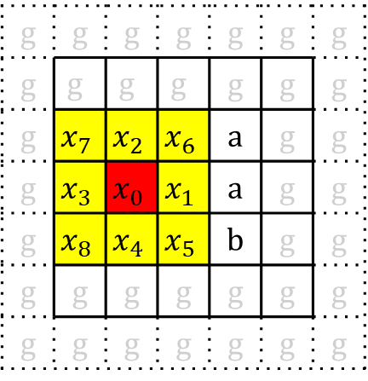

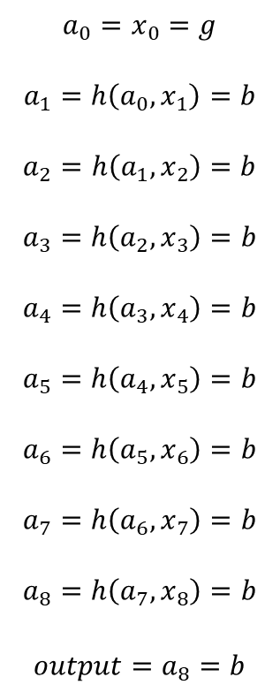
Case 2
Region-Growing
Operator
(at one point)
g | g | g | g | g | g | g
g | g | g | g | g | g | g
g | g | g | a | a | g | g
g | g | g | b | a | g | g
g | g | g | a | b | g | g
g | g | g | g | g | g | g
g | g | g | g | g | g | g
g | g | g | g | g | g | g
g | g | g | g | g | g | g
g | g | a | a | a | g | g
g | g | b | b | a | g | g
g | g | g | a | b | g | g
g | g | g | g | g | g | g
g | g | g | g | g | g | g
$$a_{0}=x_{0}=g$$
$$a_{1}=h\left({a_{0},x}_{1}\right)=b$$
$$a_{2}=h\left({a_{1},x}_{2}\right)=b$$
$$a_{3}=h\left({a_{2},x}_{3}\right)=b$$
$$a_{4}=h\left({a_{3},x}_{4}\right)=b$$
$$a_{5}=h\left({a_{4},x}_{5}\right)=b$$
$$a_{6}=h\left({a_{5},x}_{6}\right)=b$$
$$a_{7}=h\left({a_{6},x}_{7}\right)=b$$
$$a_{8}=h\left({a_{7},x}_{8}\right)=b$$
$$output=a_{8}=b$$
$$a$$
input
output
g | g | g | g | g | g | g
g | g | g | g | g | g | g
g | $$x_{7}$$ | $$x_{2}$$ | $$x_{6}$$ | a | g | g
g | $$x_{3}$$ | $$x_{0}$$ | $$x_{1}$$ | a | g | g
g | $$x_{8}$$ | $$x_{4}$$ | $$x_{5}$$ | b | g | g
g | g | g | g | g | g | g
g | g | g | g | g | g | g
$$h\left(c,d\right)=\left\{\begin{aligned}d if c=g \\ c if c≠g\end{aligned}\right.$$
Pixels out of bound padded with $background label$
The output label will be switched to the label of the first-encountering (by index) non-background pixel.
Index

Slide 20
g | g | g | g | g | g | g
g | g | g | g | g | g | g
g | g | g | a | a | g | g
g | g | g | a | a | g | g
g | g | g | b | b | g | g
g | g | g | g | g | g | g
g | g | g | g | g | g | g
g | g | g | g | g | g | g
g | g | a | a | a | a | g
g | g | a | a | a | a | g
g | g | a | a | a | a | g
g | g | b | b | b | b | g
g | g | b | b | b | b | g
g | g | g | g | g | g | g
Region-Growing
Operator
(for all points)
input
output

Slide 21
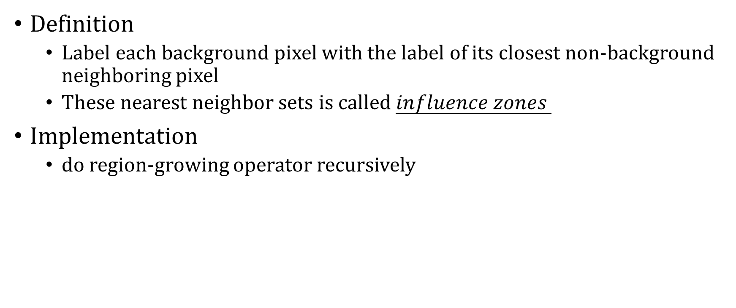
6.2.2 Nearest Neighbor Sets and
Influence Zones
Definition
  Label each background pixel with the label of its closest non-background neighboring pixel
  These nearest neighbor sets is called $influence zones$
Implementation
  do region-growing operator recursively

Slide 22
g | g | g | g | g | g | g
g | g | g | g | g | g | g
g | g | g | a | a | g | g
g | g | g | a | a | g | g
g | g | g | a | a | g | g
g | g | g | g | g | g | g
g | g | g | g | g | g | g
g | g | g | g | g | g | g
g | g | a | a | a | a | g
g | g | a | a | a | a | g
g | g | a | a | a | a | g
g | g | a | a | a | a | g
g | g | a | a | a | a | g
g | g | g | g | g | g | g
Region-Growing
Operator
(for all point)
input
output
(influence zones)

Slide 23

6.2.3 Region-Shrinking Operator

Slide 24
6.2.3 Region-Shrinking Operator
Function:
  It change the label on all border pixels to the background pixel
  may change the connectivity of a region and can even entirely delete a region upon repeated application
  a.k.a “Erosion”
Classification
  Non-Rec.
  Symbolic data domain (input/output : region-label)

Slide 25
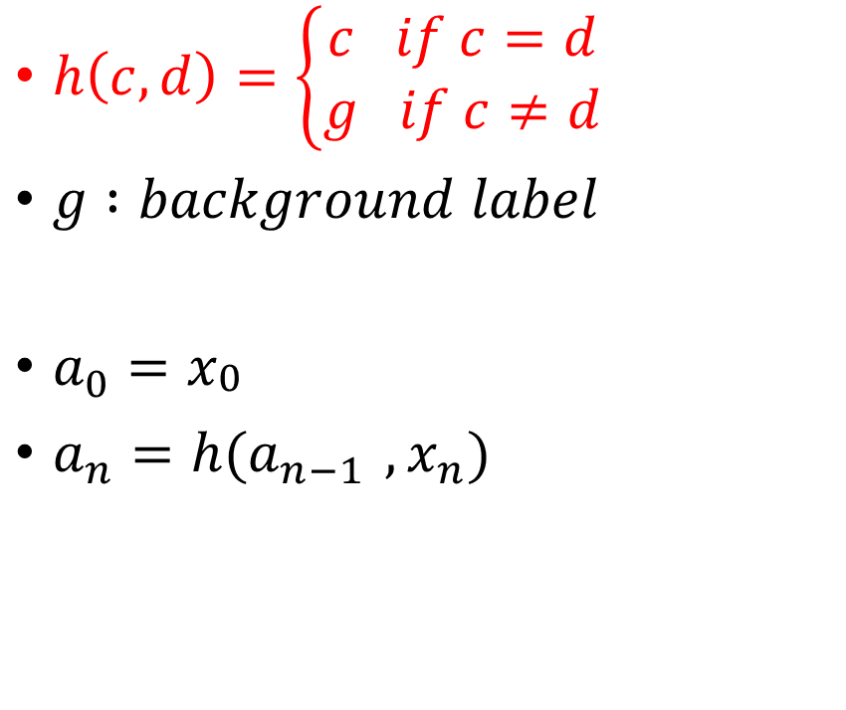
6.2.3 Region-Shrinking Operator
$h\left(c,d\right)=\left\{\begin{aligned}c if c=d \\ g if c≠d\end{aligned}\right.$
$g :background label$
$a_{0}=x_{\begin{aligned}0 \\ \end{aligned}}$
$a_{n}=h(a_{n−1 },x_{n})$
$for 4$-$connected$
$a_{n}=h(a_{n−1 },x_{n})$ , $n=1,... ,4$
${output=a}_{4}$
$for 8$-$connected$
$a_{n}=h(a_{n−1 },x_{n})$ , $n=1,... ,8$
${output=a}_{8}$

Slide 26
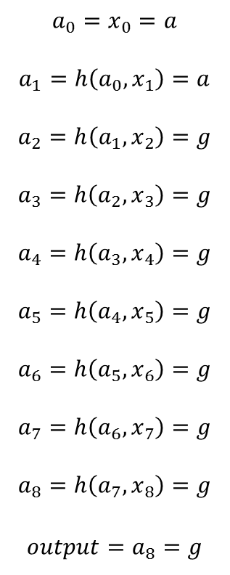


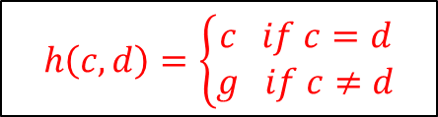
Region-Shrinking
Operator
(at one point)
g | g | g | g | g | g | g
g | g | g | g | g | g | g
g | g | a | a | a | g | g
g | g | a | a | a | g | g
g | g | a | a | a | g | g
g | g | g | g | g | g | g
g | g | g | g | g | g | g
g | g | g | g | g | g | g
g | g | g | g | g | g | g
g | g | g | a | a | g | g
g | g | a | a | a | g | g
g | g | a | a | a | g | g
g | g | g | g | g | g | g
g | g | g | g | g | g | g
$$a_{0}=x_{0}=a$$
$$a_{1}=h\left({a_{0},x}_{1}\right)=a$$
$$a_{2}=h\left({a_{1},x}_{2}\right)=g$$
$$a_{3}=h\left({a_{2},x}_{3}\right)=g$$
$$a_{4}=h\left({a_{3},x}_{4}\right)=g$$
$$a_{5}=h\left({a_{4},x}_{5}\right)=g$$
$$a_{6}=h\left({a_{5},x}_{6}\right)=g$$
$$a_{7}=h\left({a_{6},x}_{7}\right)=g$$
$$a_{8}=h\left({a_{7},x}_{8}\right)=g$$
$$output=a_{8}=g$$
input
output
g | g | g | g | g | g | g
g | $$x_{7}$$ | $$x_{2}$$ | $$x_{6}$$ | g | g | g
g | $$x_{3}$$ | $$x_{0}$$ | $$x_{1}$$ | a | g | g
g | $$x_{8}$$ | $$x_{4}$$ | $$x_{5}$$ | a | g | g
g | g | a | a | a | g | g
g | g | g | g | g | g | g
g | g | g | g | g | g | g
$$h\left(c,d\right)=\left\{\begin{aligned}c if c=d \\ g if c≠d\end{aligned}\right.$$
Pixels out of bound padded with $background label$
$when a_{i}=g , ∀i<8 , output=g$
Index(參考用)

Slide 27
g | g | g | g | g | g | g
g | g | g | g | g | g | g
g | g | a | a | a | g | g
g | g | a | a | a | g | g
g | g | a | a | a | g | g
g | g | g | g | g | g | g
g | g | g | g | g | g | g
g | g | g | g | g | g | g
g | g | g | g | g | g | g
g | g | g | g | g | g | g
g | g | g | a | g | g | g
g | g | g | g | g | g | g
g | g | g | g | g | g | g
g | g | g | g | g | g | g
Region-Shrinking
Operator
(for all points)
input
output

Slide 28
6.2.3.1 Approach Euclidean-distance
 |  |  | 0
 |  |  | 0
4-neighborhood
8-neighborhood

Slide 29
6.2.3.1 Approach Euclidean-distance
 |  |  | 1
 |  | 1 | 0 | 1
 |  |  | 1
 |  | 1 | 1 | 1
 |  | 1 | 0 | 1
 |  | 1 | 1 | 1
4-neighborhood
8-neighborhood

Slide 30
6.2.3.1 Approach Euclidean-distance
 |  |  | 2
 |  | 2 | 1 | 2
 |  | 1 | 0 | 1
 |  |  | 1
 | 2 | 2 | 2
 | 2 | 1 | 1 | 1
 | 2 | 1 | 0 | 1
 |  | 1 | 1 | 1
4-neighborhood
8-neighborhood

Slide 31
6.2.3.1 Approach Euclidean-distance
 |  |  | 2
 |  | 2 | 1 | 2
 | 2 | 1 | 0 | 1 | 2
 |  | 2 | 1 | 2
 |  |  | 2
 | 2 | 2 | 2 | 2 | 2
 | 2 | 1 | 1 | 1 | 2
 | 2 | 1 | 0 | 1 | 2
 | 2 | 1 | 1 | 1 | 2
 | 2 | 2 | 2 | 2 | 2
4-neighborhood
8-neighborhood

Slide 32




6.2.3.1 Approach Euclidean-distance
 |  |  | 3
 |  | 3 | 2 | 3
 | 3 | 2 | 1 | 2 | 3
3 | 2 | 1 | 0 | 1 | 2 | 3
 | 3 | 2 | 1 | 2 | 3
 |  | 3 | 2 | 3
 |  |  | 3
3 | 3 | 3 | 3 | 3 | 3 | 3
3 | 2 | 2 | 2 | 2 | 2 | 3
3 | 2 | 1 | 1 | 1 | 2 | 3
3 | 2 | 1 | 0 | 1 | 2 | 3
3 | 2 | 1 | 1 | 1 | 2 | 3
3 | 2 | 2 | 2 | 2 | 2 | 3
3 | 3 | 3 | 3 | 3 | 3 | 3
4-neighborhood: 3 ← $\left|Δx\right|+|Δy|$
8-neighborhood: 3 ← $max(\left|Δx\right|+\left|Δy\right|)$
Euclidean-distance: $\sqrt{5}$ ← $\sqrt{{(Δx)}^{2}+{(Δy)}^{2}}$
Euclidean-distance: $\sqrt{10} \text{← }\sqrt{{(Δx)}^{2}+{(Δy)}^{2}}$
4-neighborhood < Euclidean-distance < 8-neighborhood

Slide 33
6.2.3.1 Approach Euclidean-distance
 |  |  |  | 2 | 2 | 2
 |  |  |  | 2 | 1 | 2
 |  |  |  | 1 | 0 | 1
 |  |  |  |  | 1

Slide 34
6.2.3.1 Approach Euclidean-distance
 |  |  |  | 2 | 2 | 2
 |  |  | 2 | 2 | 1 | 2 | 2
 |  |  | 2 | 1 | 0 | 1 | 2
 |  |  | 2 | 2 | 1 | 2 | 2
 |  |  |  | 2 | 2 | 2

Slide 35
6.2.3.1 Approach Euclidean-distance
 |  |  |  | 3
 |  |  | 3 | 2 | 2 | 2
 |  |  | 2 | 2 | 1 | 2 | 2
 |  |  | 2 | 1 | 0 | 1 | 2
 |  |  | 2 | 2 | 1 | 2 | 2
 |  |  |  | 2 | 2 | 2

Slide 36
6.2.3.1 Approach Euclidean-distance
 |  |  |  | 3 | 3 | 3
 |  |  | 3 | 2 | 2 | 2 | 3
 |  | 3 | 2 | 2 | 1 | 2 | 2 | 3
 |  | 3 | 2 | 1 | 0 | 1 | 2 | 3
 |  | 3 | 2 | 2 | 1 | 2 | 2 | 3
 |  |  | 3 | 2 | 2 | 2 | 3
 |  |  |  | 3 | 3 | 3

Slide 37
6.2.3.1 Approach Euclidean-distance
 |  |  | 4 | 4 | 4
 |  |  | 4 | 3 | 3 | 3
 |  |  | 3 | 2 | 2 | 2 | 3
 |  | 3 | 2 | 2 | 1 | 2 | 2 | 3
 |  | 3 | 2 | 1 | 0 | 1 | 2 | 3
 |  | 3 | 2 | 2 | 1 | 2 | 2 | 3
 |  |  | 3 | 2 | 2 | 2 | 3
 |  |  |  | 3 | 3 | 3

Slide 38
6.2.3.1 Approach Euclidean-distance
 |  |  | 4 | 4 | 4 | 4 | 4
 |  | 4 | 4 | 3 | 3 | 3 | 4 | 4
 | 4 | 4 | 3 | 2 | 2 | 2 | 3 | 4 | 4
 | 4 | 3 | 2 | 2 | 1 | 2 | 2 | 3 | 4
 | 4 | 3 | 2 | 1 | 0 | 1 | 2 | 3 | 4
 | 4 | 3 | 2 | 2 | 1 | 2 | 2 | 3 | 4
 | 4 | 4 | 3 | 2 | 2 | 2 | 3 | 4 | 4
 |  | 4 | 4 | 3 | 3 | 3 | 4 | 4
 |  |  | 4 | 4 | 4 | 4 | 4

Slide 39
6.2.3.1 Approach Euclidean-distance
 |  |  | 5
 |  | 5 | 4 | 4 | 4 | 4 | 4
 |  | 4 | 4 | 3 | 3 | 3 | 4 | 4
 | 4 | 4 | 3 | 2 | 2 | 2 | 3 | 4 | 4
 | 4 | 3 | 2 | 2 | 1 | 2 | 2 | 3 | 4
 | 4 | 3 | 2 | 1 | 0 | 1 | 2 | 3 | 4
 | 4 | 3 | 2 | 2 | 1 | 2 | 2 | 3 | 4
 | 4 | 4 | 3 | 2 | 2 | 2 | 3 | 4 | 4
 |  | 4 | 4 | 3 | 3 | 3 | 4 | 4
 |  |  | 4 | 4 | 4 | 4 | 4

Slide 40
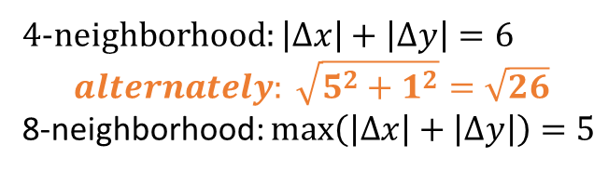
6.2.3.1 Approach Euclidean-distance
 |  |  | 5 | 5 | 5 | 5 | 5
 |  | 5 | 4 | 4 | 4 | 4 | 4 | 5
 | 5 | 4 | 4 | 3 | 3 | 3 | 4 | 4 | 5
5 | 4 | 4 | 3 | 2 | 2 | 2 | 3 | 4 | 4 | 5
5 | 4 | 3 | 2 | 2 | 1 | 2 | 2 | 3 | 4 | 5
5 | 4 | 3 | 2 | 1 | 0 | 1 | 2 | 3 | 4 | 5
5 | 4 | 3 | 2 | 2 | 1 | 2 | 2 | 3 | 4 | 5
5 | 4 | 4 | 3 | 2 | 2 | 2 | 3 | 4 | 4 | 5
 | 5 | 4 | 4 | 3 | 3 | 3 | 4 | 4 | 5
 |  | 5 | 4 | 4 | 4 | 4 | 4 | 5
 |  |  | 5 | 5 | 5 | 5 | 5
4-neighborhood: $\left|Δx\right|+\left|Δy\right|=6$
$$alternately: \sqrt{5^{2}+1^{2}}=\sqrt{26}$$
8-neighborhood: $max\left(\left|Δx\right|+\left|Δy\right|\right)=5$

Slide 41
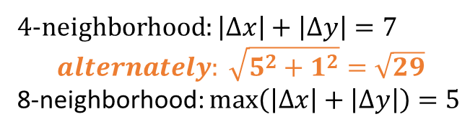
6.2.3.1 Approach Euclidean-distance
 |  |  | 5 | 5 | 5 | 5 | 5
 |  | 5 | 4 | 4 | 4 | 4 | 4 | 5
 | 5 | 4 | 4 | 3 | 3 | 3 | 4 | 4 | 5
5 | 4 | 4 | 3 | 2 | 2 | 2 | 3 | 4 | 4 | 5
5 | 4 | 3 | 2 | 2 | 1 | 2 | 2 | 3 | 4 | 5
5 | 4 | 3 | 2 | 1 | 0 | 1 | 2 | 3 | 4 | 5
5 | 4 | 3 | 2 | 2 | 1 | 2 | 2 | 3 | 4 | 5
5 | 4 | 4 | 3 | 2 | 2 | 2 | 3 | 4 | 4 | 5
 | 5 | 4 | 4 | 3 | 3 | 3 | 4 | 4 | 5
 |  | 5 | 4 | 4 | 4 | 4 | 4 | 5
 |  |  | 5 | 5 | 5 | 5 | 5
4-neighborhood: $\left|Δx\right|+\left|Δy\right|=7$
$$alternately: \sqrt{5^{2}+1^{2}}=\sqrt{29}$$
8-neighborhood: $max\left(\left|Δx\right|+\left|Δy\right|\right)=5$

Slide 42
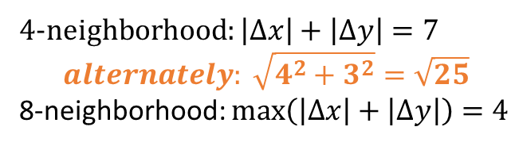
6.2.3.1 Approach Euclidean-distance
 |  |  | 5 | 5 | 5 | 5 | 5
 |  | 5 | 4 | 4 | 4 | 4 | 4 | 5
 | 5 | 4 | 4 | 3 | 3 | 3 | 4 | 4 | 5
5 | 4 | 4 | 3 | 2 | 2 | 2 | 3 | 4 | 4 | 5
5 | 4 | 3 | 2 | 2 | 1 | 2 | 2 | 3 | 4 | 5
5 | 4 | 3 | 2 | 1 | 0 | 1 | 2 | 3 | 4 | 5
5 | 4 | 3 | 2 | 2 | 1 | 2 | 2 | 3 | 4 | 5
5 | 4 | 4 | 3 | 2 | 2 | 2 | 3 | 4 | 4 | 5
 | 5 | 4 | 4 | 3 | 3 | 3 | 4 | 4 | 5
 |  | 5 | 4 | 4 | 4 | 4 | 4 | 5
 |  |  | 5 | 5 | 5 | 5 | 5
4-neighborhood: $\left|Δx\right|+\left|Δy\right|=7$
$$alternately: \sqrt{4^{2}+3^{2}}=\sqrt{25}$$
8-neighborhood: $max\left(\left|Δx\right|+\left|Δy\right|\right)=4$
This is the way how discrete pixels approach a continuous circle.

Slide 43
6.2.4 Mark-Interior/Border-Pixel Operator
Function
  It marks all interior pixels with the label i, and all border pixels with the label b
Classification
  Non-Rec.
  symbolic data domain(input : binary-label/output : number-label)

Slide 44
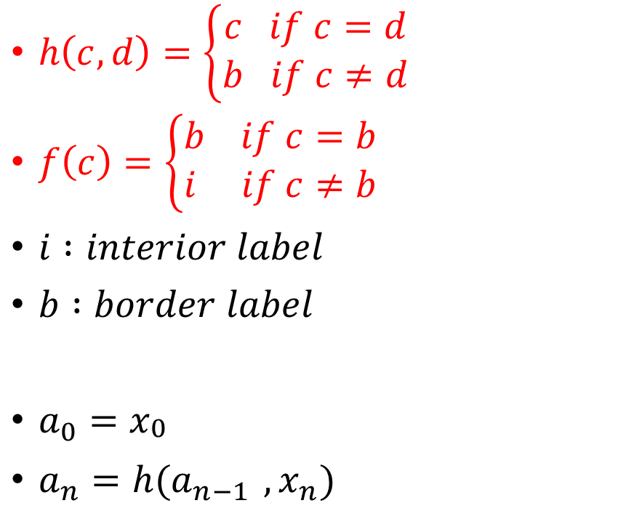
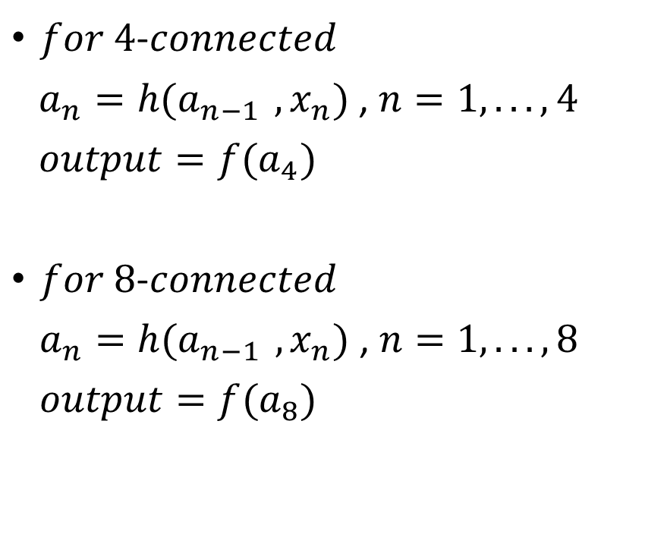
6.2.4 Mark-Interior/Border-Pixel Operator
$h\left(c,d\right)=\left\{\begin{aligned}c if c=d \\ b if c≠d\end{aligned}\right.$
$f\left(c\right)=\left\{\begin{aligned}b if c=b \\ i if c≠b\end{aligned}\right.$
$i :interior label$
$b :border label$
$a_{0}=x_{\begin{aligned}0 \\ \end{aligned}}$
$a_{n}=h(a_{n−1 },x_{n})$
$for 4$-$connected$
$a_{n}=h(a_{n−1 },x_{n})$ , $n=1,... ,4$
${output=f(a}_{4})$
$for 8$-$connected$
$a_{n}=h(a_{n−1 },x_{n})$ , $n=1,... ,8$
${output=f(a}_{8})$

Slide 45
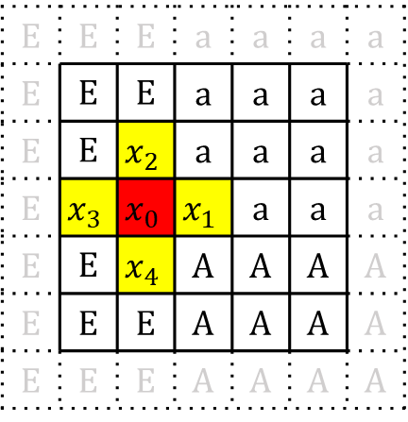
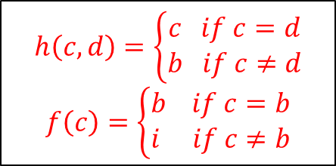
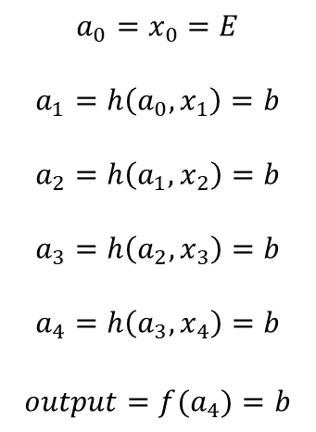
Case 1
Mark interior/border-Pixel Operator
(at one point)
E | E | E | a | a | a | a
E | E | E | a | a | a | a
E | E | E | a | a | a | a
E | E | E | a | a | a | a
E | E | E | A | A | A | A
E | E | E | A | A | A | A
E | E | E | A | A | A | A
E | E | E | a | a | a | a
E | E | E | a | a | a | a
E | E | E | a | a | a | a
E | E | E | a | a | a | a
E | E | E | A | A | A | A
E | E | E | A | A | A | A
E | E | E | A | A | A | A
$$a_{0}=x_{0}=E$$
$$a_{1}=h\left({a_{0},x}_{1}\right)=b$$
$$a_{2}=h\left({a_{1},x}_{2}\right)=b$$
$$a_{3}=h\left({a_{2},x}_{3}\right)=b$$
$$a_{4}=h\left({a_{3},x}_{4}\right)=b$$
$$output={f(a}_{4})=b$$
a
input
output
E | E | E | a | a | a | a
E | E | E | a | a | a | a
E | E | $$x_{2}$$ | a | a | a | a
E | $$x_{3}$$ | $$x_{0}$$ | $$x_{1}$$ | a | a | a
E | E | $$x_{4}$$ | A | A | A | A
E | E | E | A | A | A | A
E | E | E | A | A | A | A
$$h\left(c,d\right)=\left\{\begin{aligned}c if c=d \\ b if c≠d\end{aligned}\right.$$
$$f\left(c\right)=\left\{\begin{aligned}b if c=b \\ i if c≠b\end{aligned}\right.$$
for 4-connectivity
i: interior label
b: border label
Index

Slide 46
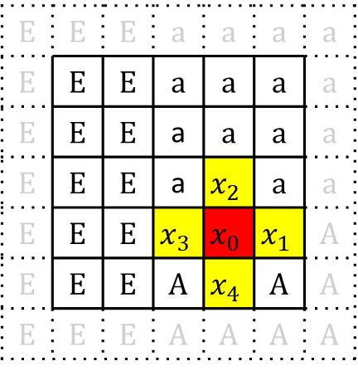
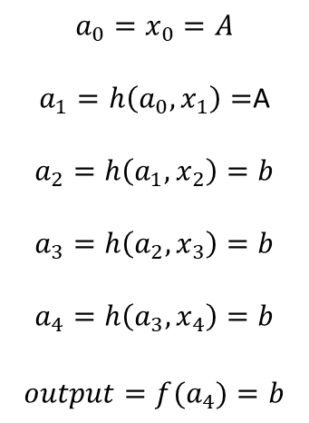
Case 2
Mark interior/border-Pixel Operator
(at one point)
E | E | E | a | a | a | a
E | E | E | a | a | a | a
E | E | E | a | a | a | a
E | E | E | a | a | a | a
E | E | E | A | A | A | A
E | E | E | A | A | A | A
E | E | E | A | A | A | A
E | E | E | a | a | a | a
E | E | E | a | a | a | a
E | E | E | a | a | a | a
E | E | E | a | a | a | a
E | E | E | A | A | A | A
E | E | E | A | A | A | A
E | E | E | A | A | A | A
$$a_{0}=x_{0}=A$$
$a_{1}=h\left({a_{0},x}_{1}\right)=$A
$$a_{2}=h\left({a_{1},x}_{2}\right)=b$$
$$a_{3}=h\left({a_{2},x}_{3}\right)=b$$
$$a_{4}=h\left({a_{3},x}_{4}\right)=b$$
$$output={f(a}_{4})=b$$
a
input
output
E | E | E | a | a | a | a
E | E | E | a | a | a | a
E | E | E | a | a | a | a
E | E | E | a | $$x_{2}$$ | a | a
E | E | E | $$x_{3}$$ | $$x_{0}$$ | $$x_{1}$$ | A
E | E | E | A | $$x_{4}$$ | A | A
E | E | E | A | A | A | A
$$h\left(c,d\right)=\left\{\begin{aligned}c if c=d \\ b if c≠d\end{aligned}\right.$$
$$f\left(c\right)=\left\{\begin{aligned}b if c=b \\ i if c≠b\end{aligned}\right.$$
for 4-connectivity
i: interior label
b: border label
Index

Slide 47
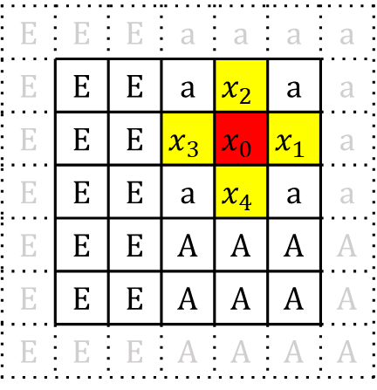
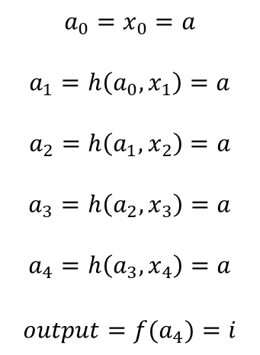
Case 3
Mark interior/border-Pixel Operator
(at one point)
E | E | E | a | a | a | a
E | E | E | a | a | a | a
E | E | E | a | a | a | a
E | E | E | a | a | a | a
E | E | E | A | A | A | A
E | E | E | A | A | A | A
E | E | E | A | A | A | A
E | E | E | a | a | a | a
E | E | E | a | a | a | a
E | E | E | a | a | a | a
E | E | E | a | a | a | a
E | E | E | A | A | A | A
E | E | E | A | A | A | A
E | E | E | A | A | A | A
$$a_{0}=x_{0}=a$$
$$a_{1}=h\left({a_{0},x}_{1}\right)=a$$
$$a_{2}=h\left({a_{1},x}_{2}\right)=a$$
$$a_{3}=h\left({a_{2},x}_{3}\right)=a$$
$$a_{4}=h\left({a_{3},x}_{4}\right)=a$$
$$output={f(a}_{4})=i$$
a
input
output
E | E | E | a | a | a | a
E | E | E | a | $$x_{2}$$ | a | a
E | E | E | $$x_{3}$$ | $$x_{0}$$ | $$x_{1}$$ | a
E | E | E | a | $$x_{4}$$ | a | a
E | E | E | A | A | A | A
E | E | E | A | A | A | A
E | E | E | A | A | A | A
$$h\left(c,d\right)=\left\{\begin{aligned}c if c=d \\ b if c≠d\end{aligned}\right.$$
$$f\left(c\right)=\left\{\begin{aligned}b if c=b \\ i if c≠b\end{aligned}\right.$$
for 4-connectivity
i: interior label
b: border label
Index

Slide 48
<Legend>
  i: interior label
  b: border label
E | E | E | a | a | a | a
E | E | E | a | a | a | a
E | E | E | a | a | a | a
E | E | E | a | a | a | a
E | E | E | A | A | A | A
E | E | E | A | A | A | A
E | E | E | A | A | A | A
E | E | E | a | a | a | a
E | i | b | b | i | i | a
E | i | b | b | i | i | a
E | i | b | b | b | b | a
E | i | b | b | b | b | A
E | i | b | b | i | i | A
E | E | E | A | A | A | A
Mark interior/border-Pixel Operator
(for all points)
input
output

Slide 49
6.2.5 Connectivity Number Operator
Function
  Its purpose is to classify the way a pixel is connected to its like neighbors
Classification
  Non-Rec.
  symbolic data domain(input : binary-label/output : number-label)
Types
  Yokoi Connectivity Number
  Rutovitz Connectivity Number

Slide 50

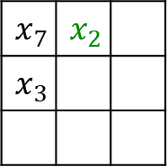
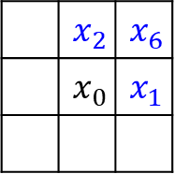
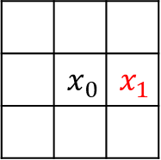
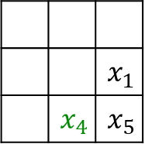
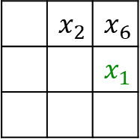
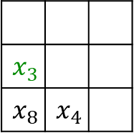
6.2.5.1 Yokoi Connectivity Number
(for 4-connectivity)
A pixel is an interior pixel if its value and that of each of its 4-connected neighbor are the same(Yokoi number of an interior pixel : 5)
The 4-connectivity of pixel is given by the number of times(條件達成次數)
Corner Neighborhood
(for corresponding $x_{i}$)
 | $$x_{2}$$ | $$x_{6}$$
 |  | $$x_{1}$$
$$x_{7}$$ | $$x_{2}$$
$$x_{3}$$
$$x_{3}$$
$$x_{8}$$ | $$x_{4}$$
 |  | $$x_{1}$$
 | $$x_{4}$$ | $$x_{5}$$
 | $$x_{0}$$ | $$x_{1}$$
 | $$x_{2}$$ | $$x_{6}$$
 | $$x_{0}$$ | $$x_{1}$$

Slide 51






$$Isolated label 0$$
$$Edge label 1$$
$$Connecting label 2$$
 | 1
1 | 1
1 | 1
1 | 1
1 | 1 | 1
 | 1 | 1
1 | 1 | 1
f(s,s,s,s) = 0
f(s,s,q,s) = 1
f(s,r,q,s) = 1
f(q,s,q,s) = 2
f(r,q,q,s) = 2
1 | 1 | 1
1 | 1 | 1
1 | 1
1 | 1 | 1
1 | 1 | 1
 | 1 | 1
1 | 1 | 1
1 | 1
 | 1
1 | 1 | 1
1 | 1 | 1
f(r,r,r,q) = 1
f(r,r,q,s) = 1
f(r,q,r,q) = 2
f(q,q,r,r) = 2
$$Branching label 3$$
$$Crossing label 4$$
$$Interior label 5$$
1 | 1 | 1
 | 1
 | 1 | 1
1 | 1 | 1
 | 1
 | 1
1 | 1 | 1
 | 1
1 | 1 | 1
1 | 1 | 1
1 | 1 | 1
f(q,s,q,q) = 3
f(r,q,q,q) = 3
f(q,q,q,q) = 4
f(r,r,r,r) = 5

Slide 52
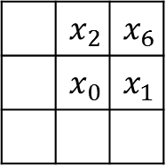


6.2.5.1 Yokoi Connectivity Number
for 4-connectivity
$h\left(b,c,d,e\right)=\left\{\begin{aligned}q if b=c and (d≠b ∨e≠b) \\ r if b=c and (d=b∧e=b) \\ s if b≠c and (d=b∧e=b)\end{aligned}\right.$
$$8\text{−}connected neighborhood$$
$$x_{7}$$ | $$x_{2}$$ | $$x_{6}$$
$$x_{3}$$ | $$x_{0}$$ | $$x_{1}$$
$$x_{8}$$ | $$x_{4}$$ | $$x_{5}$$
$$h(x_{0},x_{1},x_{6}{,x}_{2})=q$$
$$h(x_{0},x_{1},x_{6}{,x}_{2})=r$$
 | 1 | 1
 |  | 1
 | 1 | 1
 | 1
 | 1 | 1
 | 1 | 1
 | 1 | 1
 | $$x_{2}$$ | $$x_{6}$$
 | $$x_{0}$$ | $$x_{1}$$
$$h(x_{0},x_{1},x_{6}{,x}_{2})=s$$
 | 1
 |  | 1
 | 1
 | 1
 | 1
 | 1 | 1
 | 1

Slide 53


6.2.5.1 Yokoi Connectivity Number
for 4-connectivity
$h\left(b,c,d,e\right)=\left\{\begin{aligned}q if b=c and (d≠b ∨e≠b) \\ r if b=c and (d=b∧e=b) \\ s if b≠c and (d=b∧e=b)\end{aligned}\right.$
$$f(a_{1},a_{2},a_{3},a_{4})=\left\{\begin{aligned}5 if a_{1}=a_{2}=a_{3}=a_{4}=r \\ n where \#n\#=\#\#\#\#\#\#\#\#\#\#numberof\#\left\{a_{k} | a_{k}=q\right\}, otherwise\#\#\#\#\#\#\end{aligned}\right.$$
 | 1
1 | 1 | 1
 | 1
1 | 1 | 1
1 | 1 | 1
1 | 1 | 1
 | 1 | 1
1 | 1 | 1
 | 1
1 | 1 | 1
1 | 1 | 1
1 | 1
a₁ = q
a₁ = r
a₁ = r
a₁ = r
a₂ = q
a₂ = r
a₂ = q
a₂ = r
a₃ = q
a₃ = r
a₃ = q
a₃ = r
a₄ = q
a₄ = r
a₄ = q
a₄ = q
f(a₁, a₂, a₃, a₄) = 4
(crossing)
f(a₁, a₂, a₃, a₄) = 5
(interior)
f(a₁, a₂, a₃, a₄) = 3
(branching)
f(a₁, a₂, a₃, a₄) = 1
(edge)

Slide 54


6.2.5.1 Yokoi Connectivity Number (HW) due Nov. 21
<Hint>
Binarize the benchmark image Lena as in HW2 by 128
using 8x8 blocks as a unit, take the topmost-left pixel as the down-sampled data, Down-sample Lena from 512x512 to 64x64
Count the Yokoi connectivity number
Result of this assignment is a 64x64 matrix. Please align the matrix within 1 single A4 page (using 4-connected).

Slide 56







6.2.5.1 Yokoi Connectivity Number
(for 8-connectivity)
A pixel is an interior pixel if its value and that of each of its 8-connected neighbor are the same(Yokoi number of an interior pixel : 5)
The 8-connectivity of pixel is given by the number of times(條件達成次數)
Corner Neighborhood
(for corresponding $x_{i}$)
 | $$x_{2}$$ | $$x_{6}$$
 |  | $$x_{1}$$
$$x_{7}$$ | $$x_{2}$$
$$x_{3}$$
$$x_{3}$$
$$x_{8}$$ | $$x_{4}$$
 |  | $$x_{1}$$
 | $$x_{4}$$ | $$x_{5}$$
 | $$x_{0}$$ | $$x_{1}$$
 | $$x_{2}$$ | $$x_{6}$$
 | $$x_{0}$$ | $$x_{1}$$

Slide 57






$$Isolated (label 0)$$
$$Edge (label 1)$$
$$Connecting (label 2)$$
 | 1
1 | 1
 |  | 1
 | 1
1 | 1
1 | 1
1 | 1 | 1
1
 | 1 | 1
f(s,s,s,s) = 0
f(s,q,s,s) = 1
f(q,s,s,s) = 1
f(q,r,s,s) = 1
f(s,q,s,q) = 2
f(s,q,s,q) = 2
1 | 1
1 | 1 | 1
1 | 1 | 1
1 | 1 | 1
1 | 1 | 1
1 | 1 | 1
1 |  | 1
1 |  | 1
1 | 1 | 1
1 | 1 | 1
 | 1
1 | 1 | 1
f(s,r,s,q) = 1
f(r,r,s,q) = 1
f(r,r,s,q) = 1
f(s,q,s,q) = 2
f(q,s,q,s) = 2
$$Branching (label 3)$$
$$Crossing (label 4)$$
$$Interior (label 5)$$
 | 1
 | 1
1 |  | 1
1 |  | 1
 | 1
 |  | 1
1 |  | 1
 | 1
1 |  | 1
1 | 1 | 1
1 | 1 | 1
1 | 1 | 1
f(q,s,q,q) = 3
f(q,q,s,q) = 3
f(q,q,q,q) = 4
f(r,r,r,r) = 5

Slide 58


6.2.5.1 Yokoi Connectivity Number
Sample on textbook

Slide 59


6.2.5.1 Yokoi Connectivity Number
for 4-connectivity
$h\left(b,c,d,e\right)=\left\{\begin{aligned}q if b=c and (d≠b ∨e≠b) \\ r if b=c and (d=b∧e=b) \\ s if b≠c and (d=b∧e=b)\end{aligned}\right.$
for 8-connectivity
$h\left(b,c,d,e\right)=\left\{\begin{aligned}q if b≠c and (d=b∨e=b) \\ r if b=c and (d=b∧e=b) \\ s otherwisend (d=b∧e=b)\end{aligned}\right.$
$f\left(b,c,d,e\right)=\left\{\begin{aligned}5 if a_{1}=a_{2}=a_{3}=a_{4}=r \\ n where n=\#\#⋕\left\{a_{k}\left|a_{k}=q\right.\right\} , otherwise\end{aligned}\right.$
$a_{1}=h(x_{0},x_{1},x_{6}{,x}_{2})$
$a_{2}=h(x_{0},x_{2},x_{7}{,x}_{3})$
$a_{3}=h(x_{0},x_{3},x_{8}{,x}_{4})$
$a_{4}=h(x_{0},x_{4},x_{5}{,x}_{1})$
$output=f({a_{1},a_{2},a_{3},a}_{4})$

Slide 60

6.2.5.2 Rutovitz Connectivity Number
The Rutovitz connectivity number simply counts the number of transitions from symbols that are different from that of the center pixel to symbols that are the same as that of the center pixel as one travels around the 8-neighborhood of a pixel
 |  | $$x_{6}$$
 | $$x_{0}$$ | $$x_{1}$$
 |  | 0
 | 1 | 1
 |  | 1
 | 1 | 0
 |  | 1
 | 0 | 0
 |  | 0
 | 0 | 1
0: background label
1: image label

Slide 61





6.2.5.2 Rutovitz Connectivity Number
$h\left(a,b,c\right)=\left\{\begin{aligned}1 if(a=b ∧a≠c)∨(a≠b∧a=c) \\ 0 otherwise \end{aligned}\right.$
$$index$$
$$a_{1}=h(x_{0}{,x}_{1}{,x}_{6})$$
$$a_{2}=h\left(x_{0}{,x}_{6}{,x}_{2}\right)$$
$$a_{3}=h\left(x_{0}{,x}_{2}{,x}_{7}\right)$$
$$a_{4}=h\left(x_{0}{,x}_{7}{,x}_{3}\right)$$
$$a_{5}=h\left(x_{0}{,x}_{3}{,x}_{8}\right)$$
$$a_{6}=h\left(x_{0}{,x}_{8}{,x}_{4}\right)$$
$$a_{7}=h\left(x_{0}{,x}_{4}{,x}_{5}\right)$$
$$a_{8}=h\left(x_{0}{,x}_{5}{,x}_{1}\right)$$
$$output=\sum_{n=1}^{8}{a_{n}}$$
 |  | $$x_{6}$$
 | $$x_{0}$$ | $$x_{1}$$
$$h\left(x_{0}x_{1}x_{6}\right)=1$$
 | a | a
 |  | a
 | a

Slide 62
6.2.6 Connected Shrink Operator
Function
  The connected shrink operator labels only those border pixels that can be deleted from a connected region without disconnected the region
Classification
  Rec.
  symbolic data domain(input/output : binary image)

Slide 63






6.2.6 Connected Shrink Operator
Corner Neighborhood
(for corresponding $x_{i}$)
for 4-connectivity
$h\left(b,c,d,e\right)=\left\{\begin{aligned}1 if b=c∧(b≠d ∨ b≠e) \\ 0 otherwise \end{aligned}\right.$
for 8-connectivity
$h\left(b,c,d,e\right)=\left\{\begin{aligned}1 if b≠c∧(b=d ∨ b=e) \\ 0 otherwise \end{aligned}\right.$
$a_{1}=h(x_{0},x_{1},x_{6},x_{2})$
$a_{1}=h(x_{0},x_{2},x_{7},x_{3})$
$a_{1}=h(x_{0},x_{3},x_{8},x_{4})$
$a_{1}=h(x_{0},x_{4},x_{5},x_{1})$
$output=f\left(a_{1},a_{2},a_{3},a_{4},x_{0}\right)=\left\{\begin{aligned}g if exactly one of a_{1},a_{2},a_{3}{,a}_{4}=1 \\ x_{0} otherwise \end{aligned}\right.$
 | $$x_{2}$$ | $$x_{6}$$
 |  | $$x_{1}$$
$$x_{7}$$ | $$x_{2}$$
$$x_{3}$$
$$x_{3}$$
$$x_{8}$$ | $$x_{4}$$
 |  | $$x_{1}$$
 | $$x_{4}$$ | $$x_{5}$$
Yokoi Connectivity Number
:label 1(edge)
Scan: top-down left-right
Input: last-step output (not the original image)

Slide 64


Padded with
$$background label$$
 |  |  | * | *
 |  | * | * | * | *
 | * | * | * | * | * | *
 |  | * | * |  | * | *
 |  |  | * |  | * | *
 |  |  | * |  | * | *
 |  |  | * |  | * | *
 |  |  |  | *
 |  | * | * | * | *
 | * | * | * | * | * | *
 |  | * | * |  | * | *
 |  |  | * |  | * | *
 |  |  | * |  | * | *
 |  |  | * |  | * | *
 |  | * | * | * | *
 | * | * | * | * | * | *
 |  | * | * |  | * | *
 |  |  | * |  | * | *
 |  |  | * |  | * | *
 |  |  | * |  | * | *
$$delete, when r\left(yellow\right)=1$$
$$ref 6.2.5 Yokoi connectivity number$$

Slide 65
 |  |  | * | * | *
 | * | * | * | * | * | *
 |  | * | * |  | * | *
 |  |  | * |  | * | *
 |  |  | * |  | * | *
 |  |  | * |  | * | *
 |  |  |  | * | *
 | * | * | * | * | * | *
 |  | * | * |  | * | *
 |  |  | * |  | * | *
 |  |  | * |  | * | *
 |  |  | * |  | * | *
 |  |  |  |  | *
 | * | * | * | * | * | *
 |  | * | * |  | * | *
 |  |  | * |  | * | *
 |  |  | * |  | * | *
 |  |  | * |  | * | *
$$delete, when r\left(yellow\right)=1$$
$$ref 6.2.5 Yokoi connectivity number$$

Slide 66
 | * | * | * | * | * | *
 |  | * | * |  | * | *
 |  |  | * |  | * | *
 |  |  | * |  | * | *
 |  |  | * |  | * | *
 |  | * | * | * | * | *
 |  | * | * |  | * | *
 |  |  | * |  | * | *
 |  |  | * |  | * | *
 |  |  | * |  | * | *
 |  |  | * | * | * | *
 |  | * | * |  | * | *
 |  |  | * |  | * | *
 |  |  | * |  | * | *
 |  |  | * |  | * | *
$$delete, when r\left(yellow\right)=1$$
$$ref 6.2.5 Yokoi connectivity number$$

Slide 67
 |  |  | * | * | * | *
 |  | * | * |  | * | *
 |  |  | * |  | * | *
 |  |  | * |  | * | *
 |  |  | * |  | * | *
 |  |  | * | * | * | *
 |  | * | * |  | * | *
 |  |  | * |  | * | *
 |  |  | * |  | * | *
 |  |  | * |  | * | *
 |  |  | * | * | * | *
 |  | * | * |  | * | *
 |  |  | * |  | * | *
 |  |  | * |  | * | *
 |  |  | * |  | * | *
$$delete, when r\left(yellow\right)=1$$
$$ref 6.2.5 Yokoi connectivity number$$

Slide 68
 |  |  | * | * | *
 |  | * | * |  | * | *
 |  |  | * |  | * | *
 |  |  | * |  | * | *
 |  |  | * |  | * | *
 |  |  | * | * | *
 |  |  | * |  | * | *
 |  |  | * |  | * | *
 |  |  | * |  | * | *
 |  |  | * |  | * | *
 |  |  | * | * | *
 |  | * | * |  | * | *
 |  |  | * |  | * | *
 |  |  | * |  | * | *
 |  |  | * |  | * | *
$$delete, when r\left(yellow\right)=1$$
$$ref 6.2.5 Yokoi connectivity number$$

Slide 69
 |  |  | * | * | *
 |  |  | * |  | * | *
 |  |  | * |  | * | *
 |  |  | * |  | * | *
 |  |  | * |  | * | *
 |  |  | * | * | *
 |  |  | * |  | *
 |  |  | * |  | * | *
 |  |  | * |  | * | *
 |  |  | * |  | * | *
 |  |  | * | * | *
 |  |  | * |  | *
 |  |  | * |  | * | *
 |  |  | * |  | * | *
 |  |  | * |  | * | *
$$delete, when r\left(yellow\right)=1$$
$$ref 6.2.5 Yokoi connectivity number$$

Slide 70
 |  |  | * | * | *
 |  |  | * |  | *
 |  |  | * |  | * | *
 |  |  | * |  | * | *
 |  |  | * |  | * | *
 |  |  | * | * | *
 |  |  | * |  | *
 |  |  | * |  | *
 |  |  | * |  | * | *
 |  |  | * |  | * | *
 |  |  | * | * | *
 |  |  | * |  | *
 |  |  | * |  | *
 |  |  | * |  | * | *
 |  |  | * |  | * | *
$$delete, when r\left(yellow\right)=1$$
$$ref 6.2.5 Yokoi connectivity number$$

Slide 71
 |  |  | * | * | *
 |  |  | * |  | *
 |  |  | * |  | *
 |  |  | * |  | * | *
 |  |  | * |  | * | *
 |  |  | * | * | *
 |  |  | * |  | *
 |  |  | * |  | *
 |  |  | * |  | *
 |  |  | * |  | * | *
 |  |  | * | * | *
 |  |  | * |  | *
 |  |  | * |  | *
 |  |  | * |  | *
 |  |  |  |  | * | *
$$delete, when r\left(yellow\right)=1$$
$$ref 6.2.5 Yokoi connectivity number$$

Slide 72


$$output of$$
$$region−shrinking operator$$
$$for comparison$$
$$final output$$
 |  |  | * | * | *
 |  |  | * |  | *
 |  |  | * |  | *
 |  |  | * |  | *
 |  |  |  |  | * | *
 |  |  | * | * | *
 |  |  | * |  | *
 |  |  | * |  | *
 |  |  | * |  | *
 |  |  |  |  | *
 |  |  | * | *
 |  | * | * | * | *
 | * | * | * | * | * | *
 |  | * | * |  | * | *
 |  |  | * |  | * | *
 |  |  | * |  | * | *
 |  |  | * |  | * | *
$$delete, when r\left(yellow\right)=1$$
$$ref 6.2.5 Yokoi connectivity number$$
green region are those pixels deleted

Slide 73
6.2.7 Pair Relationship Operator
Function
  Relabels with a specified label all border pixels that are next to an interior pixel
Classification
  Non-Rec.
  symbolic data domain

Slide 74


 | b | b | b | b | b | b
 | b | i | i | i | i | b
 | b | b | b | i | i | b | b
 | b |  |  | b | b | i | b
 | b |  |  |  | b | b | b
 | b |  |  |  |  |  | b
 | q | p | p | p | p | q
 | p | q | q | q | q | p
 | q | p | p | q | q | p | q
 | q |  |  | p | p | q | p
 | q |  |  |  | q | p | q
 | q |  |  |  |  |  | q
for 4-connectivity
$$output=\left\{\begin{aligned}q if \sum_{n=1}^{4}{h\left(x_{n},i\right)<1∨ x_{0}≠b} \\ p if \sum_{n=1}^{4}{h\left(x_{n},i\right)≥1 ∧ x_{0}=b}\end{aligned}\right.$$
$$Let l =b , m=i , θ=1$$
$$h\left(a,i\right)=\left\{\begin{aligned}1 if a=i \\ 0 otherwise\end{aligned}\right.$$
Notes:
排除內部與無關

Slide 75



6.2.7 Pair Relationship Operator
for 4-connected
$$output=\left\{\begin{aligned}q if \sum_{n=1}^{4}{h\left(x_{n},m\right)<θ ∨ x_{0}≠l} \\ p if \sum_{n=1}^{4}{h\left(x_{n},m\right)≥θ ∧ x_{0}=l}\end{aligned}\right.$$
for 8-connected
$$output=\left\{\begin{aligned}q if \sum_{n=1}^{8}{h\left(x_{n},m\right)<θ ∨ x_{0}≠l} \\ p if \sum_{n=1}^{8}{h\left(x_{n},m\right)≥θ ∧ x_{0}=l}\end{aligned}\right.$$
$$h\left(a,m\right)=\left\{\begin{aligned}1 if a=m \\ 0 otherwise\end{aligned}\right.$$
Assign p to those pixels satisfy pixel value = l
and have more than $θ$ neighbors whose pixel value = m

Slide 76
6.2.8 Thinning Operator(HW) due Nov. 28
Composition of three operator
  6.2.4 mark-interior/border-pixel operator
  6.2.7 pair relationship operator
  6.2.6 marked-pixel connected shrink operator

Slide 77
6.2.8 Thinning Operator
Step1
  input : original symbolic image
  marked-interior/border-pixel operator
  output : interior/border image
Step2
  input : interior/border image
  pair relationship operator
  output : marked image
Step3
  input : original symbolic image +marked image
  marked-pixel connected shrink operator
    removable(by connected shrink operator on original symbolic image)
    marked(by marked image)
    delete those pixels satisfied the two conditions mentioned above
    output : thinned output image
use thinned output image as next original symbolic image
repeat step1, step2, step3 until the last output never changed

Slide 78





Step1 & Step2 : produce two input images for Step3
$$original symbolic image$$
$$Interior/border image$$
$$marked image$$
 | * | * | * | * | * | *
 | * | * | * | * | * | *
 | * | * | * | * | * | * | *
 | * |  |  | * | * | * | *
 | * |  |  |  | * | * | *
 | * |  |  |  |  |  | *
 | b | b | b | b | b | b
 | b | i | i | i | i | b
 | b | b | b | b | i | b | b
 | b |  |  | b | b | i | b
 | b |  |  |  | b | b | b
 | b |  |  |  |  |  | b
 | * | * | * | * | * | *
 | * | * | * | * | * | *
 | * | * | * | * | * | * | *
 | * |  |  | * | * | * | *
 | * |  |  |  | * | * | *
 | * |  |  |  |  |  | *
$$8\text{−}connected$$
$$8\text{−}connected$$

Slide 79







Step3 : marked-pixel connected shrink operator
$$original symbolic image$$
$$marked image for r_{1}$$
$$output after r_{1}$$
$$r_{1}$$ | * | * | * | * | * | *
$$r_{2}$$ | * | * | * | * | * | *
$$r_{3}$$ | * | * | * | * | * | * | *
$$r_{4}$$ | * |  |  | * | * | * | *
$$r_{5}$$ | * |  |  |  | * | * | *
$$r_{6}$$ | * |  |  |  |  |  | *
 | * | * | * | * | * | *
 | * | * | * | * | * | *
 | * | * | * | * | * | * | *
 | * |  |  | * | * | * | *
 | * |  |  |  | * | * | *
 | * |  |  |  |  |  | *
$$r_{1}$$
$$r_{2}$$ | * | * | * | * | * | *
$$r_{3}$$ | * | * | * | * | * | * | *
$$r_{4}$$ | * |  |  | * | * | * | *
$$r_{5}$$ | * |  |  |  | * | * | *
$$r_{6}$$ | * |  |  |  |  |  | *
$$removable$$
為求版面潔淨，若干步驟省略不顯示，
不可整$row$作完才與$marked$比對，每作完一個點就要決定是否$delete$
正式操作仍需要由 $left\text{−}right top\text{− }down scan$
$$ref 6.2.6 connected shrinking operator$$

Slide 80




$$original symbolic image$$
$$marked image for r_{2}$$
$$output after r_{2}$$
$$r_{1}$$
$$r_{2}$$ | * | * | * | * | * | *
$$r_{3}$$ | * | * | * | * | * | * | *
$$r_{4}$$ | * |  |  | * | * | * | *
$$r_{5}$$ | * |  |  |  | * | * | *
$$r_{6}$$ | * |  |  |  |  |  | *
 | * | * | * | * | * | *
 | * | * | * | * | * | *
 | * | * | * | * | * | * | *
 | * |  |  | * | * | * | *
 | * |  |  |  | * | * | *
 | * |  |  |  |  |  | *
$$r_{1}$$
$$r_{2}$$ |  | * | * | * | *
$$r_{3}$$ | * | * | * | * | * | * | *
$$r_{4}$$ | * |  |  | * | * | * | *
$$r_{5}$$ | * |  |  |  | * | * | *
$$r_{6}$$ | * |  |  |  |  |  | *
$$removable$$

Slide 81




$$original symbolic image$$
$$marked image for r_{3}$$
$$output after r_{3}$$
$$r_{1}$$
$$r_{2}$$ |  | * | * | * | *
$$r_{3}$$ | * | * | * | * | * | * | *
$$r_{4}$$ | * |  |  | * | * | * | *
$$r_{5}$$ | * |  |  |  | * | * | *
$$r_{6}$$ | * |  |  |  |  |  | *
 | * | * | * | * | * | *
 | * | * | * | * | * | *
 | * | * | * | * | * | * | *
 | * |  |  | * | * | * | *
 | * |  |  |  | * | * | *
 | * |  |  |  |  |  | *
$$r_{1}$$
$$r_{2}$$ |  | * | * | * | *
$$r_{3}$$ | * | * |  |  | *
$$r_{4}$$ | * |  |  | * | * | * | *
$$r_{5}$$ | * |  |  |  | * | * | *
$$r_{6}$$ | * |  |  |  |  |  | *
$$removable$$

Slide 82




$$original symbolic image$$
$$marked image for r_{4}$$
$$output after r_{4}$$
$$r_{1}$$
$$r_{2}$$ |  | * | * | * | *
$$r_{3}$$ | * | * |  |  | *
$$r_{4}$$ | * |  |  | * | * | * | *
$$r_{5}$$ | * |  |  |  | * | * | *
$$r_{6}$$ | * |  |  |  |  |  | *
 | * | * | * | * | * | *
 | * | * | * | * | * | *
 | * | * | * | * | * | * | *
 | * |  |  | * | * | * | *
 | * |  |  |  | * | * | *
 | * |  |  |  |  |  | *
$$r_{1}$$
$$r_{2}$$ |  | * | * | * | *
$$r_{3}$$ | * | * |  |  | *
$$r_{4}$$ | * |  |  |  | * | *
$$r_{5}$$ | * |  |  |  | * | * | *
$$r_{6}$$ | * |  |  |  |  |  | *
$$removable$$

Slide 83




$$original symbolic image$$
$$marked image for r_{5}$$
$$output after r_{5}$$
$$r_{1}$$
$$r_{2}$$ |  | * | * | * | *
$$r_{3}$$ | * | * |  |  | *
$$r_{4}$$ | * |  |  |  | * | *
$$r_{5}$$ | * |  |  |  | * | * | *
$$r_{6}$$ | * |  |  |  |  |  | *
 | * | * | * | * | * | *
 | * | * | * | * | * | *
 | * | * | * | * | * | * | *
 | * |  |  | * | * | * | *
 | * |  |  |  | * | * | *
 | * |  |  |  |  |  | *
$$r_{1}$$
$$r_{2}$$ |  | * | * | * | *
$$r_{3}$$ | * | * |  |  | *
$$r_{4}$$ | * |  |  |  | * | *
$$r_{5}$$ | * |  |  |  |  | * | *
$$r_{6}$$ | * |  |  |  |  |  | *
$$removable$$

Slide 84




$$original symbolic image$$
$$marked image for r_{6}$$
$$output after r_{6}$$
$$r_{1}$$
$$r_{2}$$ |  | * | * | * | *
$$r_{3}$$ | * | * |  |  | *
$$r_{4}$$ | * |  |  |  | * | *
$$r_{5}$$ | * |  |  |  |  | * | *
$$r_{6}$$ | * |  |  |  |  |  | *
 | * | * | * | * | * | *
 | * | * | * | * | * | *
 | * | * | * | * | * | * | *
 | * |  |  | * | * | * | *
 | * |  |  |  | * | * | *
 | * |  |  |  |  |  | *
$$r_{1}$$
$$r_{2}$$ |  | * | * | * | *
$$r_{3}$$ | * | * |  |  | *
$$r_{4}$$ | * |  |  |  | * | *
$$r_{5}$$ | * |  |  |  |  | * | *
$$r_{6}$$ | * |  |  |  |  |  | *
$$removable$$
$$check stop criterion…$$

Slide 85


$$original symbolic image$$
$$output$$
$$comparison$$
 | * | * | * | * | * | *
 | * | * | * | * | * | *
 | * | * | * | * | * | * | *
 | * |  |  | * | * | * | *
 | * |  |  |  | * | * | *
 | * |  |  |  |  |  | *
 |  | * | * | * | *
 | * | * |  |  | *
 | * |  |  |  | * | *
 | * |  |  |  |  | * | *
 | * |  |  |  |  |  | *
 | * | * | * | * | * | *
 | * | * | * | * | * | *
 | * | * | * | * | * | * | *
 | * |  |  | * | * | * | *
 | * |  |  |  | * | * | *
 | * |  |  |  |  |  | *

Slide 86

6.2.8 Thinning Operator
HW due: Nov. 21
lena.thin

Slide 87
Midterm
Covered: Chap 1. – Chap 6.2.8
Time :11/7 14:20~17:20
Place: R101

Slide 88
6.2.9 Distance Transformation Operator
Function
  The purpose of distance transformation operator is to produce a numeric image whose pixels are labeled with distance between each of them and their closet border pixel
Classification
  Rec.*1, Non-Rec.*2
  symbolic data domain (input : binary image/output : numeric image)

Slide 89

6.2.9 Distance Transformation Operator
(nonrecursive1)
Initialization : set all inner labels i ; otherwise 0.
Iteration : in n-th iteration
label with a n all pixels whose label is i and that are
next to a pixel whose label is n-1
( do region growing operator on $background$)
Stopping criterion : when no pixel with label i

Slide 90




 |  | $$i$$ | $$i$$ | $$i$$ | $$i$$
 |  | $$i$$ | $$i$$ | $$i$$ | $$i$$
 | $$i$$ | $$i$$ | $$i$$ | $$i$$ | $$i$$
 |  | $$i$$ | $$i$$ | $$i$$ | $$i$$
 |  | $$i$$ | $$i$$ | $$i$$ | $$i$$
 |  | $$1$$ | $$1$$ | $$1$$ | $$1$$
 |  | $$1$$ | $$i$$ | $$i$$ | $$1$$
 | $$1$$ | $$i$$ | $$i$$ | $$i$$ | $$1$$
 |  | $$1$$ | $$i$$ | $$i$$ | $$1$$
 |  | $$1$$ | $$1$$ | $$1$$ | $$1$$
 |  | $$1$$ | $$1$$ | $$1$$ | $$1$$
 |  | $$1$$ | $$2$$ | $$2$$ | $$1$$
 | $$1$$ | $$2$$ | $$i$$ | $$2$$ | $$1$$
 |  | $$1$$ | $$2$$ | $$2$$ | $$1$$
 |  | $$1$$ | $$1$$ | $$1$$ | $$1$$
 |  | $$1$$ | $$1$$ | $$1$$ | $$1$$
 |  | $$1$$ | $$2$$ | $$2$$ | $$1$$
 | $$1$$ | $$2$$ | $$3$$ | $$2$$ | $$1$$
 |  | $$1$$ | $$2$$ | $$2$$ | $$1$$
 |  | $$1$$ | $$1$$ | $$1$$ | $$1$$
1. See region out of i as a union region
2. Do region growing operator and label++ per run
4-connected

Slide 91

6.2.9 Distance Transformation Operator
(nonrecursive2)
$h\left(a_{0},…,a_{N}\right)=\left\{\begin{aligned}i if a_{n}=i,n=1,…,N \\ min\left\{b\left|for some\right. n≤N,a_{n}≠i,b=a_{n}+1\right\} \\ if a_{0}=i and there exists n such that a_{n}≠i \\ a_{0} if a_{0}≠i \end{aligned}\right.$
for 8-connectivity
$output=h(x_{0},x_{1},…,x_{8})$
for 4-connectivity
$output=h(x_{0},x_{1},…,x_{4})$
i | i | i
i | i | i
i | i | i
0 | 0 | 0
0 | i | i
i | i | i
3 | 3 | 3
3 | 3 | 3
3 | 3 | 3
i | i | i
i | i | i
i | i | i
0 | 0 | 0
0 | 1 | i
i | i | i
3 | 3 | 3
3 | 4 | 3
3 | 3 | 3

Slide 92







6.2.9 Distance Transformation Operator
(recursive)
 | $$x_{2}$$
$$x_{3}$$ | $$x_{0}$$
 | $$x_{0}$$ | $$x_{1}$$
 | $$x_{4}$$
$$h\left(a_{0},…,a_{N},d\right)=\left\{\begin{aligned}0 if a_{N}=0 \\ min\left\{a_{1},…,a_{n}\right\}+d otherwisw\end{aligned}\right.$$
$g$($a_{1}{,...,a}_{N},d$)=$min\left\{a_{1},...,a_{N}\right\}+d$
$$x_{7}$$ | $$x_{2}$$ | $$x_{6}$$
$$x_{3}$$ | $$x_{0}$$
 | $$x_{0}$$ | $$x_{1}$$
$$x_{8}$$ | $$x_{4}$$ | $$x_{5}$$
left-right top-bottom scan
$for 4\text{−}connected$
- $output=h{(x}_{2},x_{3},x_{0},1)$
$for \text{8}\text{−}connected$
- $output=h{(x_{2},x}_{6},x_{7},x_{3},x_{0},1)$
right-left bottom-top
$for 4\text{−}connected$
- $output=min\left\{x_{0},g\left(x_{1},x_{4},1\right)\right\}$
$for \text{8−}connected$
- $output=min\left\{x_{0},g\left(x_{1},x_{4},x_{5},x_{8},1\right)\right\}$
Notes:
為什麼八相臨要考慮X6, X8

Slide 93







$$left\text{−}right top\text{−}bottom$$
 |  | $$1$$ | $$1$$ | $$1$$ | $$1$$
 |  | $$1$$ | $$2$$ | $$2$$ | $$2$$
 | $$1$$ | $$2$$ | $$2$$ | $$2$$ | $$3$$
 |  | $$1$$ | $$2$$ | $$3$$ | $$4$$
 |  | $$1$$ | $$2$$ | $$3$$ | $$4$$
$$input image$$
$$intersection$$
 |  | $$1$$ | $$1$$ | $$1$$ | $$1$$
 |  | $$1$$ | $$1$$ | $$1$$ | $$1$$
 | $$1$$ | $$1$$ | $$1$$ | $$1$$ | $$1$$
 |  | $$1$$ | $$1$$ | $$1$$ | $$1$$
 |  | $$1$$ | $$1$$ | $$1$$ | $$1$$
 |  | $$1$$ | $$1$$ | $$1$$ | $$1$$
 |  | $$1$$ | $$2$$ | $$2$$ | $$1$$
 | $$1$$ | $$2$$ | $$3$$ | $$2$$ | $$1$$
 |  | $$1$$ | $$2$$ | $$2$$ | $$1$$
 |  | $$1$$ | $$1$$ | $$1$$ | $$1$$
$$Right\text{−}left bottom\text{−}top$$
 |  | 4 | 3 | 2 | 1
 |  | 4 | 3 | 2 | 1
 | 1 | 3 | 3 | 2 | 1
 |  | 2 | 2 | 2 | 1
 |  | 1 | 1 | 1 | 1

Slide 94


6.2.10 Radius of Fusion
Definition
  The radius of fusion for any connected component of I is the radius $ρ$ of a disk satisfying the condition that if the binary image I is morphologically closed with a disk of radius$ρ$ ,then the given connected region will fuse with some other connected region.

Slide 95



6.2.10 Radius of Fusion
Implementation
  region-growing operator *n
  region-shrinking operator *n+1
  “radius” == operation time “n”
$$original$$
$$region−growing operator$$
$$region−shrinking operator$$
 | * | * | * |  |  | * | *
 | * | * | * | * |  | * | *
 | * | * | *
* | * | * | * | * | * | * | * | *
* | * | * | * | * | * | * | * | *
* | * | * | * | * | * | * | * | *
* | * | * | * | * | * | * | * | *
* | * | * | * | *
 | * | * | * | * | * | * | *
 | * | * | * | * | * | * | *
 | * | * | * | *

Slide 96
6.2.11 Number of Shortest Paths
function
  count for each 0-pixel the number of shortest paths to the set that is represented as the binary-1 pixel on a binary image
Classification
  Rec.
  symbolic data domain(input : binary label /output : numeric label)

Slide 97

6.2.11 Number of Shortest Paths
$$p^{m}\left(r,c\right)=\left\{\begin{aligned}p^{m−1}\left(r,c\right) if p^{m−1}(r,c)≠0 \\ \sum_{(r^{′},c^{′})∈N}{p^{m−1}(r−r^{′},{c−c}^{′})} if p^{m−1}\left(r,c\right)=0\end{aligned}\right.$$
 | 1
 | 1 | 1
 | 1 | 2
 | 1 | 1

Slide 98






$$p^{0}$$
$$p^{1}$$
$$p^{2}$$
 |  | 1
 |  | 1
 |  | 1
 | 1 | 1 | 1
 | 1 | 1 | 1
 |  | 1
 |  | 1
 | 2 | 1 | 2
1 | 1 | 1 | 1 | 1
1 | 1 | 1 | 1 | 1
 | 2 | 1 | 2
 |  | 1
$$p^{3}$$
$$p^{4}$$
$$p^{5}$$
 | 3 | 1 | 3
3 | 2 | 1 | 2 | 3
1 | 1 | 1 | 1 | 1 | 1
1 | 1 | 1 | 1 | 1 | 1
3 | 2 | 1 | 2 | 3 | 1
 | 3 | 1 | 3
6 | 3 | 1 | 3 | 6
3 | 2 | 1 | 2 | 3
1 | 1 | 1 | 1 | 1 | 1
1 | 1 | 1 | 1 | 1 | 1
3 | 2 | 1 | 2 | 3 | 1
6 | 3 | 1 | 3 | 6
6 | 3 | 1 | 3 | 6 | 10
3 | 2 | 1 | 2 | 3 | 4
1 | 1 | 1 | 1 | 1 | 1
1 | 1 | 1 | 1 | 1 | 1
3 | 2 | 1 | 2 | 3 | 4
6 | 3 | 1 | 3 | 6 | 10

Slide 99
6.1 Introduction
6.2 Symbolic Neighborhood Operators
  6.2.1 Region-Growing Operator
  6.2.2 Nearest Neighbor Sets and Influence Zones
  6.2.3 Region-Shrinking Operator
  6.2.4 Mark-Interior/Border-Pixel Operator
  6.2.5 Connectivity Number Operator
    Yokoi Connectivity Number
    Rutovitz Connectivity Number
  6.2.6 Connected Shrink Operator
  6.2.7 Pair Relationship Operator
  6.2.8 Thinning Opertator
  6.2.9 Distance Transformation Operator
  6.2.10 Radius od Fusion
  6.2.11 Number of Shortest Paths
6.3 Extremum-Related Neighborhood Operators
  6.3.1 Non-Minima-Maxima Operator
  6.3.2 Relative Extrema Operator
  6.3.3 Reachability Operator
6.4 Linear Shift-invariant Neighborhood Operators
  6.4.1 Convolution and Correlation
  6.4.2 Saperability

Slide 100
6.3.0 Extremum-Related Neighborhood Operators
Finding pixels or regions that are relative minima and relative maxima can play an important role in the extraction of interesting points or region primitives for texture analysis or matching purposes.

Slide 101
6.3.1 Non-Minima-Maxima Operator
Function
  Pixel is labeled with an index 0,1,2 or 3 indicating whether the pixel is nonmaximum , nonminimum , interior to a connected set-of equal-valued pixels , or part of a transition region
Classification
  numeric to symbolic (input : numeric image/output : number image)

Slide 102

6.3.1 Nom-Minima-Maxima Operator
$a_{0}=b_{0}=x_{0}$
$a_{n}=min\left\{a_{n−1},x_{0}\right\} n=1,2,3,4$
$b_{n}=max\left\{b_{n−1},x_{0}\right\} n=1,2,3,4$
$output=\left\{\begin{aligned}0\left(flat\right) if a_{4}=x_{0}∧b_{4}=x_{0} \\ 1\left(nonmaximum\right) if a_{4}=x_{0}∧b_{4}>x_{0} \\ 2\left(nonminimum\right) if a_{4}<x_{0}∧b_{4}=x_{0} \\ 3\left(transition\right) if a_{4}<x_{0}∧b_{4}<x_{0}\end{aligned}\right.$
3 | 3 | 3
3 | 3 | 3
3 | 3 | 3
1 | 1 | 1
1 | 1 | 1
1 | 1 | 3
1 | 4 | 1
3 | 4 | 1
3 | 3 | 1
1 | 1 | 4
3 | 3 | 3
3 | 3 | 3
flat
nonmaximum
nonminimum
transition
Notes:
Bn 課本打成 min

Slide 103




6.3.2 Relative Extrema Operator
Each pixel on the output image contain the value of highest extrema that can reach it by monotonic path
Monotonic path :
-僅向二個以下方向行走,且彼此垂直
-前進方向之數值不得超過自身值(Max)
-前進方向之數值不得超過自身值(Min)
Consist of
-Relative Maxima Operator
-Relative Minima Operator
Classification
-recursive
-numeric data domain
left-right top-bottom scans
input
output
$$x_{3}$$ | $$x_{2}$$ | $$x_{4}$$
 | $$x_{1}$$ | $$x_{0}$$
$$l_{3}$$ | $$l_{2}$$ | $$l_{4}$$
 | $$l_{1}$$ | $$l_{0}$$
left-right top-bottom scans
input
output
 | $$x_{0}$$ | $$x_{1}$$
$$x_{4}$$ | $$x_{2}$$ | $$x_{3}$$
 | $$l_{0}$$ | $$l_{1}$$
$$l_{4}$$ | $$l_{2}$$ | $$l_{3}$$

Slide 104
6.3.2 Relative Extrema Operator
Monotonic Example(Relative Maxima)
2 | 3 | 5 | 4
9 | 1 | 6 | 2
6 | 5 | 1 | 2
4 | 5 | 3 | 1
2 | 3 | 5 | 4
9 | 1 | 6 | 2
6 | 5 | 1 | 2
4 | 5 | 3 | 1
2 | 3 | 5 | 4
9 | 1 | 6 | 2
6 | 5 | 1 | 2
4 | 5 | 3 | 1
2 | 3 | 5 | 4
9 | 1 | 6 | 2
6 | 5 | 1 | 2
4 | 5 | 3 | 1
2 | 3 | 5 | 4
9 | 1 | 6 | 2
6 | 5 | 1 | 2
4 | 5 | 3 | 1
2 | 3 | 5 | 4
9 | 1 | 6 | 2
6 | 5 | 1 | 2
4 | 5 | 3 | 1

Slide 105







6.3.2 Relative Extrema Operator
(Relative Maxima Operator)
$$h\left(b,c,d,e\right)=\left\{\begin{aligned}max\left\{d,e\right\} if c≥b \\ d if c<b\end{aligned}\right.$$
for 4-connectivity
$a_{n}=h\left(x_{0},x_{n},a_{n−1},l_{n}\right) , n=1,2$
$a_{0}=l_{0}$
$output=a_{4}$
for 8-connectivity
$a_{n}=h\left(x_{0},x_{n},a_{n−1},l_{n}\right) , n=1,2,3,4$
$a_{0}=l_{0}$
$output=a_{4}$
input
output
input
output
 | $$x_{2}$$
$$x_{1}$$ | $$x_{0}$$
 | $$l_{2}$$
$$l_{1}$$ | $$l_{0}$$
$$x_{3}$$ | $$x_{2}$$ | $$x_{4}$$
 | $$x_{1}$$ | $$x_{0}$$
$$l_{3}$$ | $$l_{2}$$ | $$l_{4}$$
 | $$l_{1}$$ | $$l_{0}$$

Slide 106







6.3.2 Relative Extrema Operator
(Relative Minima Operator)
$$h\left(b,c,d,e\right)=\left\{\begin{aligned}min\left\{d,e\right\} if c≤b \\ d if c>b\end{aligned}\right.$$
for 4-connectivity
$a_{n}=h\left(x_{0},x_{n},a_{n−1},l_{n}\right) , n=1,2$
$a_{0}=l_{0}$
$output=a_{4}$
for 8-connectivity
$a_{n}=h\left(x_{0},x_{n},a_{n−1},l_{n}\right) , n=1,2,3,4$
$a_{0}=l_{0}$
$output=a_{4}$
input
output
input
output
 | $$x_{0}$$ | $$x_{1}$$
 | $$x_{2}$$
 | $$l_{0}$$ | $$l_{1}$$
 | $$l_{2}$$
 | $$x_{0}$$ | $$x_{1}$$
$$x_{4}$$ | $$x_{2}$$ | $$x_{3}$$
 | $$l_{0}$$ | $$l_{1}$$
$$l_{4}$$ | $$l_{2}$$ | $$l_{3}$$

Slide 107






$$h\left(b,c,d,e\right)=\left\{\begin{aligned}max\left\{d,e\right\} if c≥b \\ d if c<b\end{aligned}\right.$$
對(2,3)作一次完整的Relative Maxima Operator
$$original(for ref)$$
$$last output$$
$$a_{0}=x_{0}=6$$
 | 2 | 3 | 5 | 4
2 | 2 | 3 | 5 | 4
9 | 9 | 1 | 6 | 2
6 | 6 | 5 | 1 | 2
4 | 4 | 5 | 3 | 1
 | 2 | 3 | 5 | 5
2 | 2 | 3 | 5 | 5
9 | 9 | 1 | 6 | 2
6 | 6 | 5 | 1 | 2
4 | 4 | 5 | 3 | 1
$$a_{1}=h\left(x_{0},x_{1},a_{0},l_{1}\right)$$
$$a_{1}=h\left(1,9,1,9\right)=9$$
$$∵1<9 \left(by original image\right)$$
$$∴9可與1連繫,表示1可藉由monotonic path 連接到9$$
$$final output$$
 | 2 | 3 | 5 | 4
2 | 2 | 3 | 5 | 4
9 | 9 | 1 | 6 | 2
6 | 6 | 5 | 1 | 2
4 | 4 | 5 | 3 | 1
 | 2 | 3 | 5 | 5
2 | 2 | 3 | 5 | 5
9 | 9 | 1 | 6 | 2
6 | 6 | 5 | 1 | 2
4 | 4 | 5 | 3 | 1
$$a_{2}=h\left(x_{0},x_{2},a_{1},l_{2}\right)$$
$$a_{1}=h\left(1,3,9,3\right)=9$$
$$∵1<3 \left(by original image\right)$$
$∴\text{3}可與1連繫$,但3並非可連繫極值之
最大值,故捨棄
 | 2 | 3 | 5 | 5
2 | 2 | 3 | 5 | 5
9 | 9 | 9

Slide 108





$$h\left(b,c,d,e\right)=\left\{\begin{aligned}max\left\{d,e\right\} if c≥b \\ d if c<b\end{aligned}\right.$$
$$a_{n}=h\left(x_{0},x_{n},a_{n−1},l_{n}\right) , n=1,2$$
對(2,3)作一次完整的Relative Maxima Operator
left-right top-bottom scan part
$$original$$
$$lastest output$$
 | 2 | 3 | 5 | 4
2 | 2 | 3 | 5 | 4
9 | 9 | 1 | 6 | 2
6 | 6 | 5 | 1 | 2
4 | 4 | 5 | 3 | 1
 | 2
2 | 2
$$a_{0}=x_{0}=2$$
$$a_{1}=h\left(2,2,2,2\right)=2$$
$$a_{2}=h\left(2,2,2,2\right)=2$$
 | 2 | 3 | 5 | 4
2 | 2 | 3 | 5 | 4
9 | 9 | 1 | 6 | 2
6 | 6 | 5 | 1 | 2
4 | 4 | 5 | 3 | 1
 | 2 | 3
2 | 2 | 3
$$a_{0}=x_{0}=3$$
$$a_{1}=h\left(3,2,3,3\right)=3$$
$$a_{2}=h\left(3,3,3,3\right)=3$$

Slide 109


$$h\left(b,c,d,e\right)=\left\{\begin{aligned}max\left\{d,e\right\} if c≥b \\ d if c<b\end{aligned}\right.$$
$$a_{n}=h\left(x_{0},x_{n},a_{n−1},l_{n}\right) , n=1,2$$
$$original$$
$$lastest output$$
 | 2 | 3 | 5 | 4
2 | 2 | 3 | 5 | 4
9 | 9 | 1 | 6 | 2
6 | 6 | 5 | 1 | 2
4 | 4 | 5 | 3 | 1
 | 2 | 3 | 5
2 | 2 | 3 | 5
$$a_{0}=x_{0}=5$$
$$a_{1}=h\left(5,3,5,3\right)=5$$
$$a_{2}=h\left(5,5,3,5\right)=5$$
 | 2 | 3 | 5 | 4
2 | 2 | 3 | 5 | 4
9 | 9 | 1 | 6 | 2
6 | 6 | 5 | 1 | 2
4 | 4 | 5 | 3 | 1
 | 2 | 3 | 5 | 4
2 | 2 | 3 | 5 | 5
$$a_{0}=x_{0}=4$$
$$a_{1}=h\left(4,5,4,5\right)=5$$
$$a_{2}=h\left(4,4,5,4\right)=5$$

Slide 110


$$h\left(b,c,d,e\right)=\left\{\begin{aligned}max\left\{d,e\right\} if c≥b \\ d if c<b\end{aligned}\right.$$
$$a_{n}=h\left(x_{0},x_{n},a_{n−1},l_{n}\right) , n=1,2$$
$$original$$
$$lastest output$$
 | 2 | 3 | 5 | 4
2 | 2 | 3 | 5 | 4
9 | 9 | 1 | 6 | 2
6 | 6 | 5 | 1 | 2
4 | 4 | 5 | 3 | 1
 | 2 | 3 | 5 | 4
2 | 2 | 3 | 5 | 5
9 | 9
$$a_{0}=x_{0}=9$$
$$a_{1}=h\left(9,9,9,9\right)=9$$
$$a_{2}=h\left(9,2,9,2\right)=9$$
 | 2 | 3 | 5 | 4
2 | 2 | 3 | 5 | 4
9 | 9 | 1 | 6 | 2
6 | 6 | 5 | 1 | 2
4 | 4 | 5 | 3 | 1
 | 2 | 3 | 5 | 4
2 | 2 | 3 | 5 | 5
9 | 9 | 9
$$a_{0}=x_{0}=1$$
$$a_{1}=h\left(1,9,1,9\right)=9$$
$$a_{2}=h\left(1,3,9,3\right)=9$$

Slide 111


$$h\left(b,c,d,e\right)=\left\{\begin{aligned}max\left\{d,e\right\} if c≥b \\ d if c<b\end{aligned}\right.$$
$$a_{n}=h\left(x_{0},x_{n},a_{n−1},l_{n}\right) , n=1,2$$
$$original$$
$$lastest output$$
 | 2 | 3 | 5 | 4
2 | 2 | 3 | 5 | 4
9 | 9 | 1 | 6 | 2
6 | 6 | 5 | 1 | 2
4 | 4 | 5 | 3 | 1
 | 2 | 3 | 5 | 4
2 | 2 | 3 | 5 | 5
9 | 9 | 9 | 6
$$a_{0}=x_{0}=6$$
$$a_{1}=h\left(6,1,6,9\right)=6$$
$$a_{2}=h\left(6,5,6,5\right)=6$$
 | 2 | 3 | 5 | 4
2 | 2 | 3 | 5 | 4
9 | 9 | 1 | 6 | 2
6 | 6 | 5 | 1 | 2
4 | 4 | 5 | 3 | 1
 | 2 | 3 | 5 | 4
2 | 2 | 3 | 5 | 5
9 | 9 | 9 | 6 | 6
$$a_{0}=x_{0}=2$$
$$a_{1}=h\left(2,6,2,6\right)=6$$
$$a_{2}=h\left(2,5,6,5\right)=6$$

Slide 112


$$h\left(b,c,d,e\right)=\left\{\begin{aligned}max\left\{d,e\right\} if c≥b \\ d if c<b\end{aligned}\right.$$
$$a_{n}=h\left(x_{0},x_{n},a_{n−1},l_{n}\right) , n=1,2$$
$$original$$
$$lastest output$$
 | 2 | 3 | 5 | 4
2 | 2 | 3 | 5 | 4
9 | 9 | 1 | 6 | 2
6 | 6 | 5 | 1 | 2
4 | 4 | 5 | 3 | 1
 | 2 | 3 | 5 | 4
2 | 2 | 3 | 5 | 5
9 | 9 | 9 | 6 | 6
6 | 9
$$a_{0}=x_{0}=6$$
$$a_{1}=h\left(6,6,6,6\right)=6$$
$$a_{2}=h\left(6,9,6,9\right)=9$$
 | 2 | 3 | 5 | 4
2 | 2 | 3 | 5 | 4
9 | 9 | 1 | 6 | 2
6 | 6 | 5 | 1 | 2
4 | 4 | 5 | 3 | 1
 | 2 | 3 | 5 | 4
2 | 2 | 3 | 5 | 5
9 | 9 | 9 | 6 | 6
6 | 9 | 9
$$a_{0}=x_{0}=5$$
$$a_{1}=h\left(5,6,6,9\right)=9$$
$$a_{2}=h\left(5,1,9,9\right)=9$$

Slide 113


$$h\left(b,c,d,e\right)=\left\{\begin{aligned}max\left\{d,e\right\} if c≥b \\ d if c<b\end{aligned}\right.$$
$$a_{n}=h\left(x_{0},x_{n},a_{n−1},l_{n}\right) , n=1,2$$
$$original$$
$$lastest output$$
 | 2 | 3 | 5 | 4
2 | 2 | 3 | 5 | 4
9 | 9 | 1 | 6 | 2
6 | 6 | 5 | 1 | 2
4 | 4 | 5 | 3 | 1
 | 2 | 3 | 5 | 4
2 | 2 | 3 | 5 | 5
9 | 9 | 9 | 6 | 6
6 | 9 | 9 | 9
$$a_{0}=x_{0}=1$$
$$a_{1}=h\left(1,5,1,9\right)=9$$
$$a_{2}=h\left(1,6,9,6\right)=9$$
 | 2 | 3 | 5 | 4
2 | 2 | 3 | 5 | 4
9 | 9 | 1 | 6 | 2
6 | 6 | 5 | 1 | 2
4 | 4 | 5 | 3 | 1
 | 2 | 3 | 5 | 4
2 | 2 | 3 | 5 | 5
9 | 9 | 9 | 6 | 6
6 | 9 | 9 | 9 | 6
$$a_{0}=x_{0}=2$$
$$a_{1}=h\left(2,1,2,9\right)=2$$
$$a_{2}=h\left(2,2,2,6\right)=6$$

Slide 114


第4列省略…
以下是作完第一輪left-right top-bottom之結果
$$original$$
$$lastest output$$
 | 2 | 3 | 5 | 4
2 | 2 | 3 | 5 | 4
9 | 9 | 1 | 6 | 2
6 | 6 | 5 | 1 | 2
4 | 4 | 5 | 3 | 1
 | 2 | 3 | 5 | 4
2 | 2 | 3 | 5 | 5
9 | 9 | 9 | 6 | 6
6 | 9 | 9 | 9 | 6
4 | 9 | 9 | 9 | 9

Slide 115
Then iterates down and up again until there are no more change
$$original$$
$$lastest output$$
 | 2 | 3 | 5 | 4
2 | 2 | 3 | 5 | 4
9 | 9 | 1 | 6 | 2
6 | 6 | 5 | 1 | 2
4 | 4 | 5 | 3 | 1
 | 2 | 3 | 5 | 4
2 | 9 | 6 | 6 | 6
9 | 9 | 9 | 6 | 6
6 | 9 | 9 | 9 | 6
4 | 9 | 9 | 9 | 9

Slide 116
6.3.3 Reachability Operator
Definition
  Ascending reachability (relative minima)
  and descending reachability (relative maxima)
classification
  Recursive
  In the very beginning: numeric input
  Later on: symbolic input & output
Function
  Label each pixel with the relative extrema that can reach it by a monotonic path

Slide 117


