Slide 1
Computer and Robot Vision I
Chapter 2
Binary Machine Vision:
Thresholding and Segmentation
Presented by: 傅楸善 & 蘇唯誠
0921679513
b96902050@ntu.edu.tw
指導教授: 傅楸善 博士

Slide 2
2.1 Introduction
binary value 1: considered part of object
binary value 0: background pixel
binary machine vision: generation and analysis of binary image

Slide 3
2.2 Thresholding
if
if
r: row, c: column
I: grayscale intensity, B: binary intensity
T: intensity threshold

Slide 4
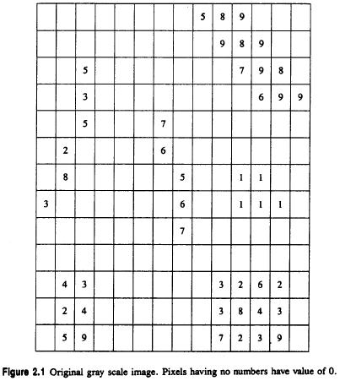
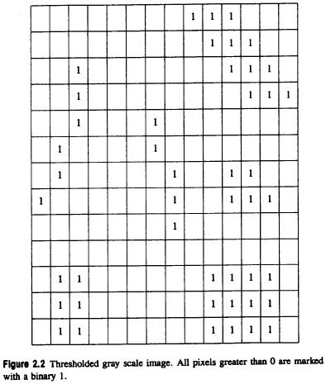
2.2 Thresholding

Slide 5
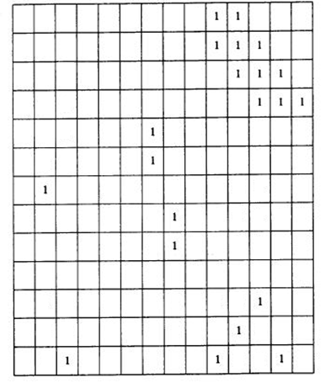
2.2 Thresholding

Slide 6
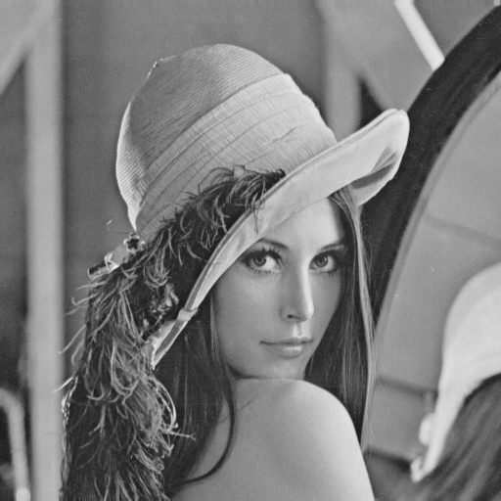
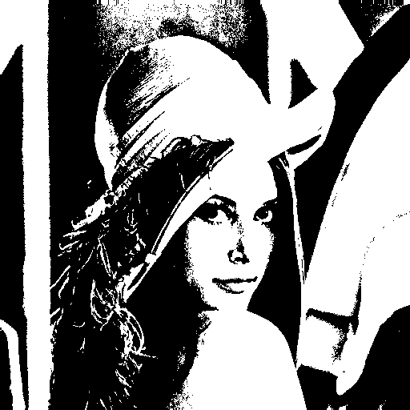
2.2 Thresholding

Slide 7
2.2 Thresholding
histogram
m spans each gray level value e.g. 0 - 255
#: operator counts the number of elements in a set

Slide 8
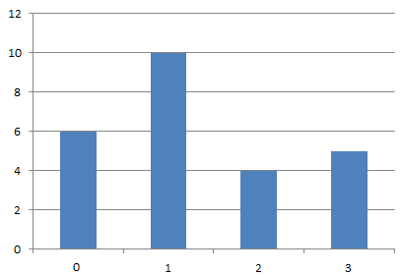
2.2 Thresholding
0 | 2 | 2 | 3 | 3
1 | 0 | 0 | 1 | 1
1 | 2 | 3 | 0 | 1
0 | 1 | 1 | 0 | 1
1 | 1 | 2 | 3 | 3
2-bits source image
histogram of left image

Slide 9
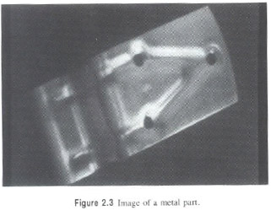
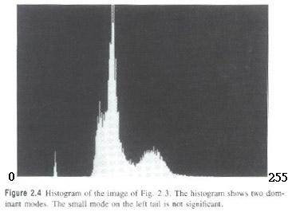
2.2 Thresholding

Slide 10
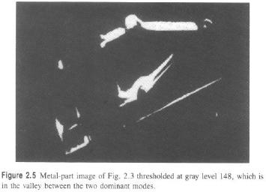
2.2 Thresholding

Slide 11
2.2 Thresholding

Slide 12
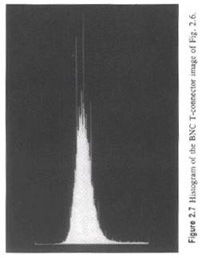
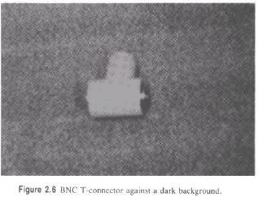
2.2 Thresholding
Notes:
Bayonet Neill Concelman Connector (BNC)
The standard connector used to connect IEEE 802.3 10Base2 coaxial cable to an MAU(媒體附著單元 (Media attachment unit))

Slide 13
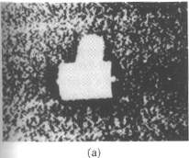
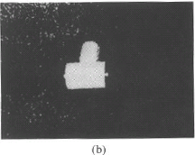
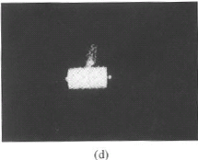
2.2 Thresholding

Slide 14
2.2.1 Minimizing Within-Group Variance
: histogram probabilities of
gray values
: the spatial domain of the image
Notes:
otsu

Slide 15
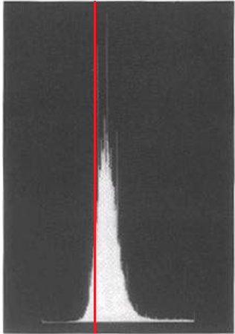
2.2.1 Minimizing Within-Group Variance
Given threshold t, divide histogram into two parts.
Part 1 is the left hand side of the histogram.
Part 2 is the right hand side of the histogram.

Slide 16
2.2.1 Minimizing Within-Group Variance
Within-group variance : weighted sum of group
variances
find which minimizes

Slide 17
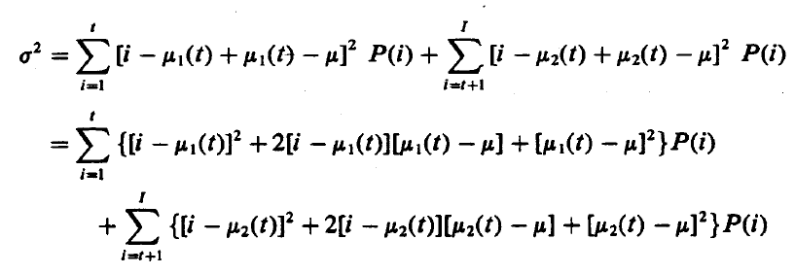
2.2.1 Minimizing Within-Group Variance

Slide 18
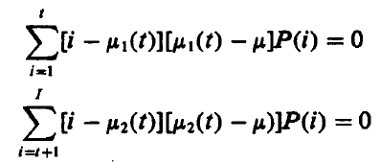
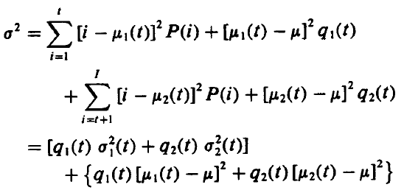
2.2.1 Minimizing Within-Group Variance

Slide 19
2.2.1 Minimizing Within-Group Variance
constant
find which maximizes

Slide 20
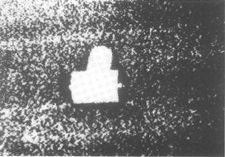
2.2.1 Minimizing Within-Group Variance

Slide 21
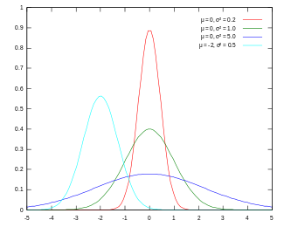
2.2.2 Minimizing Kullback Information Distance
Gaussian distribution

Slide 22
2.2.2 Minimizing Kullback Information Distance
minimize the Kullback directed divergence
mixture distribution of the two Gaussians in histogram:
Notes:
最小化Kullback直接分岐

Slide 23
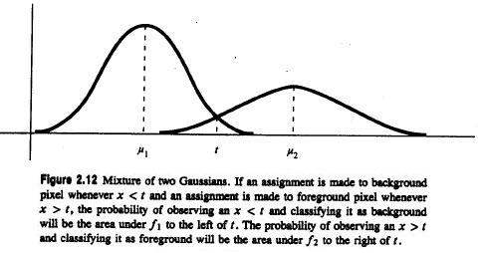
2.2.2 Minimizing Kullback Information Distance
: mean of distribution

Slide 24
2.2.2 Minimizing Kullback Information Distance

Slide 25
2.2.2 Minimizing Kullback Information Distance

Slide 26
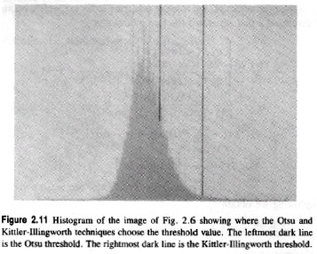
2.2.2 Minimizing Kullback Information Distance
Left dark line:
Otsu
Right dark line:
Kittler-Illingworth

Slide 27
2.3 Connected Components Labeling
Connected Components labeling is a grouping operation.
Connected Component labeling is one image-processing technique that can make a unit change from pixel to region.
Notes:
Definition

Slide 28
2.3.1 Connected Components Operators
Notes:
To explain what neighborhood is

Slide 29
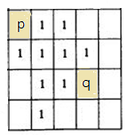
2.3.1 Connected Components Operators
Two 1-pixels and belong to the same
connected component if there is a sequence of
1-pixels of where
and is a neighbor of for
Notes:
definition

Slide 30
􀀀 2.3.1 Connected Components Operators
0 | 0 | 1 | 0 | 0
1 | 1 | 1 | 0 | 1
0 | 0 | 0 | 1 | 1
1 | 0 | 0 | 1 | 0
1 | 1 | 0 | 1 | 0
source binary image
0 | 0 | 1 | 0 | 0
1 | 1 | 1 | 0 | 2
0 | 0 | 0 | 2 | 2
3 | 0 | 0 | 2 | 0
3 | 3 | 0 | 2 | 0
0 | 0 | 1 | 0 | 0
1 | 1 | 1 | 0 | 1
0 | 0 | 0 | 1 | 1
2 | 0 | 0 | 1 | 0
2 | 2 | 0 | 1 | 0
Connected components labeling with 4-adjacency
Connected components labeling with 8-adjacency
Notes:
example

Slide 31
2.3.2 Connected Components Algorithms
All the algorithms process a row of the image at a time
All the algorithms assign new labels to the first pixel of each component and attempt to propagate the label of a pixel to right or below neighbors
Notes:
Principle & stop condition

Slide 32
2.3.2 Connected Components Algorithms
What label should be assigned to pixel A?
How to keep track of the equivalence of two or more labels?
How to use the equivalence information to complete processing?
Notes:
Issue
A應該放什麼標籤
怎麼保持追蹤等價的標籤
怎麼使用等價訊息去完成處理

Slide 33
2.3.3 An Iterative Algorithm
Step 1. initialization of each pixel to a unique label
Step 2. iteration of top-down followed by bottom-up passes
Step3. repeat step 2 until no change
Notes:
Algorithm’s flow
Top-down left-right followed by bottom-up right-left

Slide 34
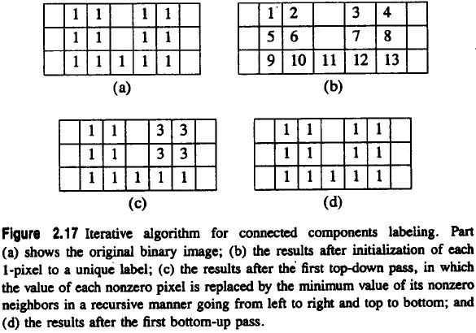
2.3.3 An Iterative Algorithm
Notes:
Why can’t just one iterative
Jump to 35(ori) 36(after top-down)=>12與7的交界處

Slide 35
2.3.4 The Classical Algorithm
performs label propagation as above
when two different labels propagate to the same pixel, the
smaller label propagates and equivalence entered into
table
resolve equivalence classes by DFS (Depth-First Search)
second pass performs a translation
Notes:
Two top-down phase
First phase: assign label and establish equ_table
mid-phase: find equivalence classes
Second phase: chx label according to equ_label

Slide 36
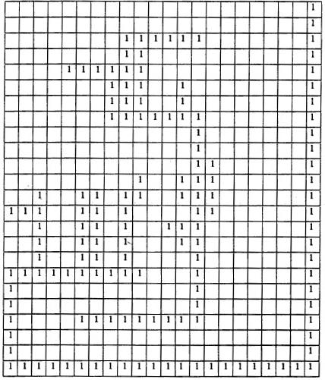
2.3.4 The Classical Algorithm

Slide 37
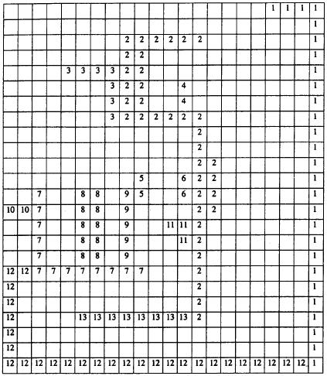

Slide 38
2.3.4 The Classical Algorithm
main problem: global equivalence table may be
too large for memory
Notes:
problem

Slide 39
2.3.5 A Space-Efficient Two-Pass Algorithm That Uses a Local Equivalence Table
Small table stores only equivalences from current and preceding lines
Relabel each line with equivalence labels when equivalence detected
Notes:
Point2. alternation

Slide 40
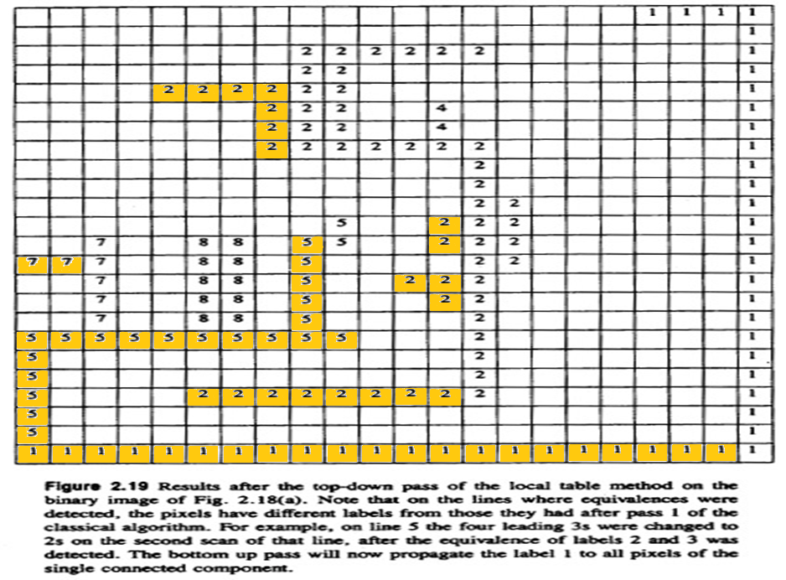
2.3.5 A Space-Efficient Two-Pass Algorithm That Uses a Local Equivalence Table

Slide 41
2.3.6 An Efficient Run-Length Implementation of the Local Table Method
A run-length encoding of a binary image is a list of contiguous typically horizontal runs of 1-pixels.
Notes:
一個有效率的局部表格中連接長度的實作方法
二元影像的連續長度編碼通常是1的連續水平連接的清單

Slide 42
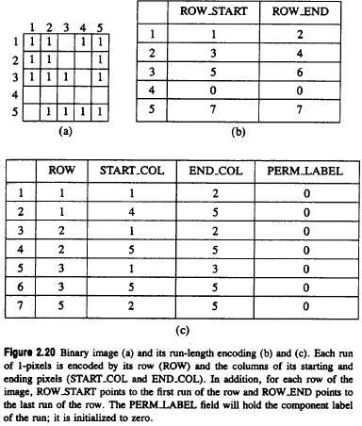
run 1
run 2
run 7
run number
Notes:
Original picture
Label number start and end

Slide 43
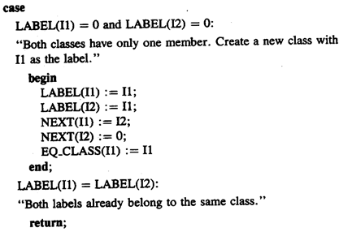
2.3.6 An Efficient Run-Length Implementation of the Local Table Method

Slide 44
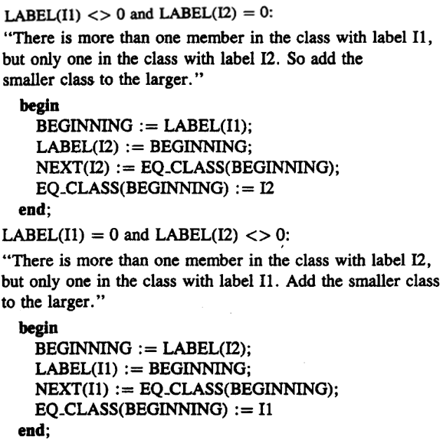

Slide 45
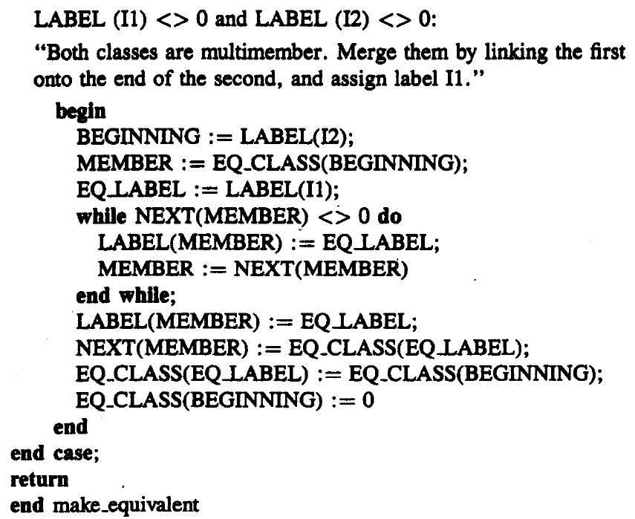
2.3.6 An Efficient Run-Length Implementation of the Local Table Method

Slide 46
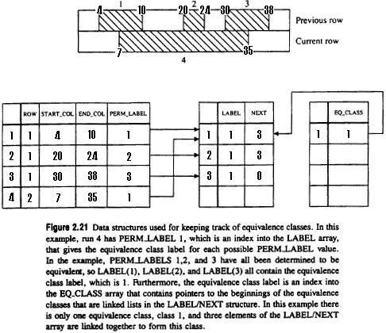
Notes:
Mid-table: label/next array
Left-table: EQ_CLASS array

Slide 47
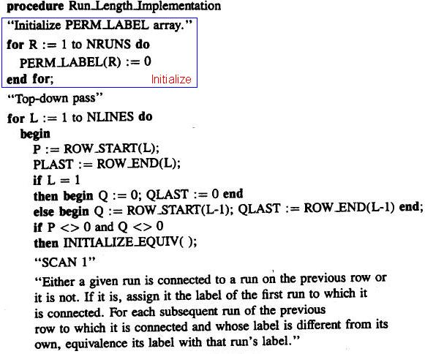
2.3.6 An Efficient Run-Length Implementation of the Local Table Method

Slide 48
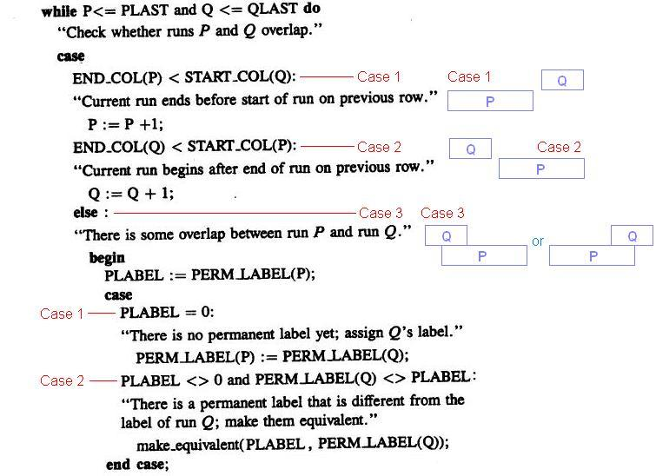

Slide 49
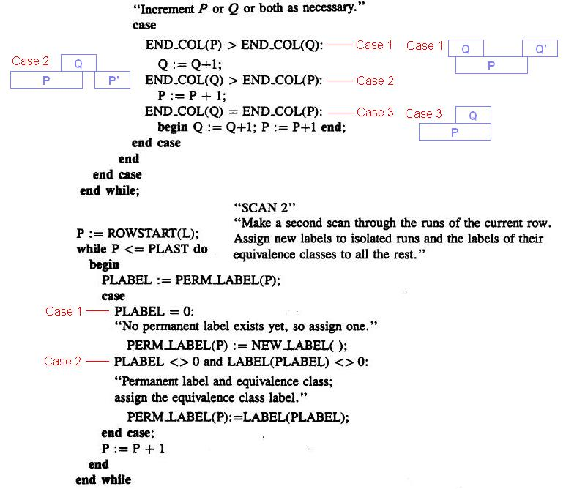

Slide 50
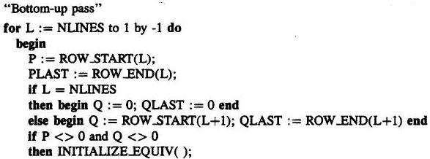
2.3.6 An Efficient Run-Length Implementation of the Local Table Method

Slide 51
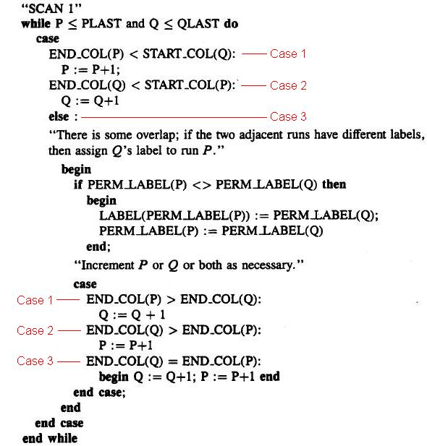

Slide 52
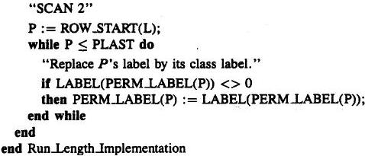
2.3.6 An Efficient Run-Length Implementation of the Local Table Method

Slide 53
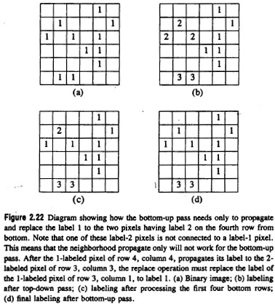

Slide 54
2.4 Signature Segmentation and Analysis
signature: histogram of the nonzero pixels of the resulting masked image
signature: a projection
projections can be vertical, horizontal, diagonal, circular…

Slide 55
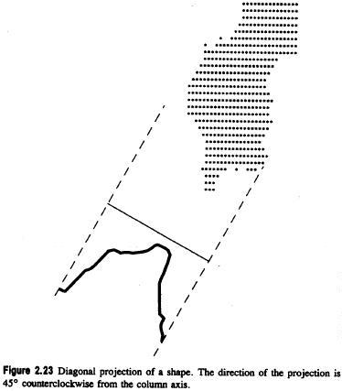

Slide 56
2.4 Signature Segmentation and Analysis
vertical projection of a segment:
column between
horizontal projection: row between
vertical and horizontal projection define a rectangle
and

Slide 57
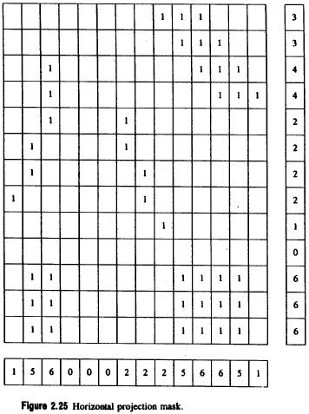
2.4 Signature Segmentation and Analysis

Slide 58
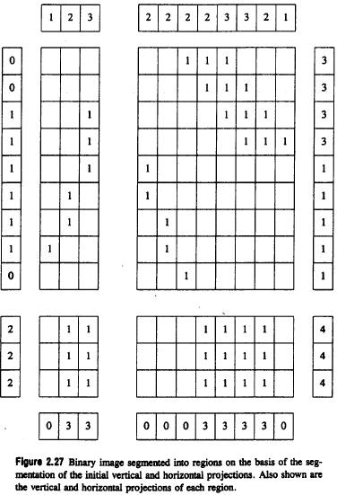

Slide 59
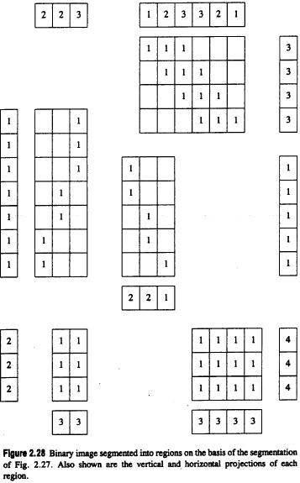

Slide 60
2.4 Signature Segmentation and Analysis
segment the vertical and horizontal projections
treat each rectangular subimage as the image

Slide 61
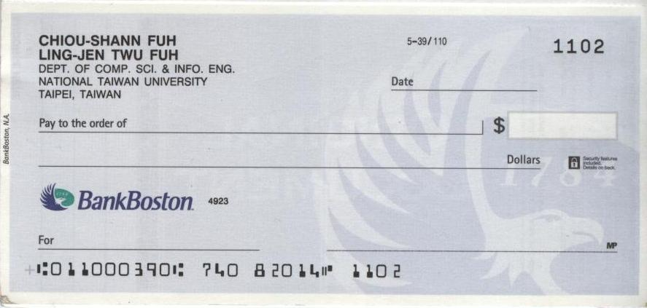
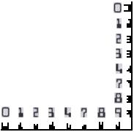
2.4 Signature Segmentation and Analysis
OCR: Optical Character Recognition
MICR: Magnetic Ink Character Recognition
Notes:
Magnetic ink character recognition
光學字母辨識
磁性墨水辨識

Slide 62
2.4 Signature Segmentation and Analysis
Diagonal projections:
: from upper left to lower right
: from upper right to lower left
object area: sum of all the projections values in the segment

Slide 63
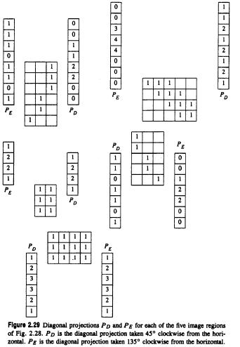

Slide 64
2.5 Summary
Create binary image by thresholding.
Find out connected component on binary image.
Generate signature segmentation by projection.

Slide 65
Project due Oct. 7
Write a program to generate:
a binary image (threshold at 128)
a histogram
connected components (regions with +
at centroid, bounding box)

