Slide 1
Computer Vision Chapter 10 Image Segmentation
Presented by: 傅楸善 & 吳立夫
0934400450
Tstuo25103@gmail.com
指導教授: 傅楸善 博士

Slide 2
Outline
直接在原圖上面分群
10.1 Introduction
10.2 Measurement-Space-Guided Spatial Clustering
10.2.1 Thresholding
10.2.2 Multidimensional Measurement-Space Clustering
10.3 Region Growing
10.3.1 Single-Linkage Region Growing
10.3.2 Hybrid-Linkage Region Growing
10.3.3 Centroid-Linkage Region Growing
在其他的地方分群之後，轉回原圖
10.4 Hybrid-Linkage Combinations
10.5 Spatial Clustering
10.6 Split and Merge
10.7 Rule-Based Segmentation
10.8 Motion-Based Segmentation
10.9 Summary

Slide 3
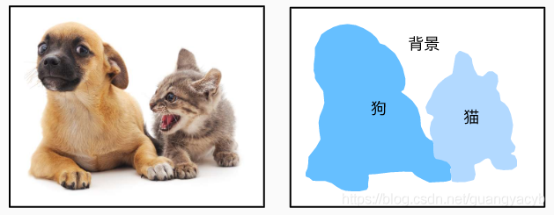
10.1 Introduction
What’s image segmentation?
partition of image
set of non-overlapping regions
Union of segmented regions is the entire image
Segmentation purpose
Decompose image into meaningful parts to application

Slide 4
10.1 Introduction
It’s very difficult to tell a computer program
What's the constitutes of a “meaningful” segmentation.
Guidelines:
Regions of an image segmentation
Uniform and homogeneous with respect to some characteristic.
Gray level or texture.
被分在同一個區塊的像素要有均勻且相似的某個特性。
Adjacent regions of a segmentation
Significantly different values with respect to the characteristic on which they are uniform.
相鄰的區塊對於第1點的特性應該要有顯著差異。
Region interiors should be simple and without many small holes.
一個區塊內部應該要簡單，而且沒有很多小洞。
Boundaries of each segment should be simple, not ragged, and must be spatially accurate.
分割區塊的邊界應該要簡單，沒有鋸齒，在空間上精準。

Slide 5
10.1 Introduction
For exp
holes
ragged
Notes:
統計出圖 (a) 的 Histogram後，如 (b) 所示
我們可以在山谷處下手，切割出四大區塊，結果圖如 (c) 所示
可以看出圖(c)當中的顏色變為 白，淺灰，深灰，黑

Slide 6
10.1 Introduction
Clustering:
Partitioning a set of pattern vectors into subsets.
將一組特徵向量(Pattern vectors)分割出來並加進分割的集合的過程
對於影像分割，pattern vectors可以是指像素的
亮度(Intensity)
質地(texture)
相似的地方：都是把有相近特性的資料分群在一起。
相異的地方：影像分割的分群是在空間域(spatial domain)。
Notes:
將一組模式向量劃分為子集

Slide 7
10.1 Introduction
Mainly discus about segmenting an image based on gray level intensity.
主要討論針對灰度值(gray-level intensity)的影像分割。
對於其他特性的影像分割(例如texture)
先把按照那個特性(characteristic)轉成特性值(feature value)
no full theory of clustering & image segmentation
Image segmentation is an ad hoc problem.
不同技術依據著不同的強調(emphasis)與犧牲(compromise)
Notes:
對於如何做Clustering與影像切割的做法
沒有一套經典且完備的理論

Slide 8
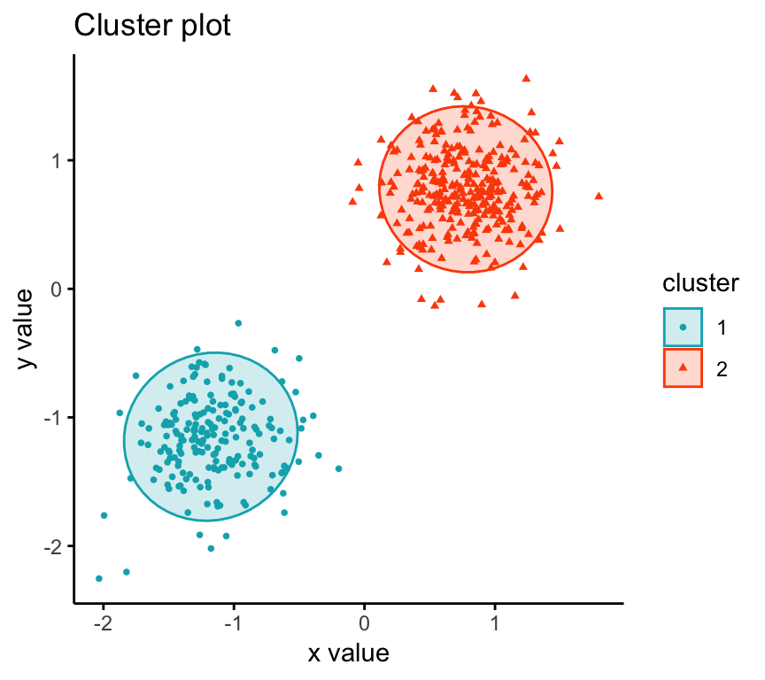
10.2 Measurement-Space-Guided Spatial Clustering
測度空間(Measure space)
The pattern of measurement data to be classified is represented as a measurement vector
要分類的測量數據的模式被表示為測量向量
空間群聚(Spatial Clustering)
A bounded group of occurrences and concentration to be unlikely to have occurred by chance.
有界的、不太可能偶然發生的、具有足夠規模和集中度的事件組

Slide 9
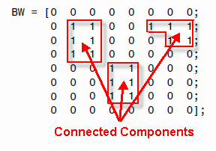
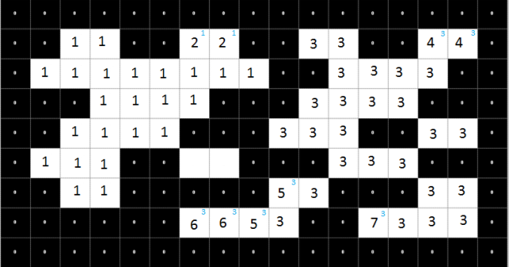
10.2 Measurement-Space-Guided Spatial Clustering
measurement-space-guided的過程:
Define a partition in measurement space.
我們會去定義每個在該 “測度空間”上的分割區域
Each pixel is assigned the label of the cell in the measurement-space partition to which it belongs.
每個像素都被分配了它所屬的測量空間分群中的標籤。
The image segments are defined as the connected components of the pixels having the same label.
影像片段被定義為具有相同標籤的像素的連通分量。
Notes:
測量空間引導的過程：使用測量空間聚類過程在測量空間中定義一個分區。
每個像素都被分配了它所屬的測量空間分區中單元格的標籤。
圖像片段被定義為具有相同標籤的像素的連通分量。

Slide 10
10.2 Measurement-Space-Guided Spatial Clustering
Where does it work well?
A few kinds of distinct objects having widely different gray-level intensities.
Appear on a nearly uniform background.
Pros:
Clustering requires only one pass through the data.
Notes:
它在哪里工作得很好？
幾種明顯的對象具有廣泛不同的灰度強度。
出現在幾乎統一的背景上。
優點：聚類只需要一次通過數據。

Slide 11
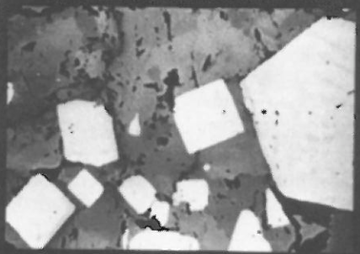
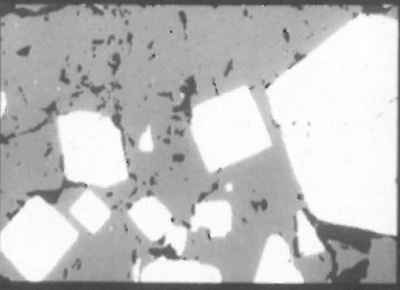
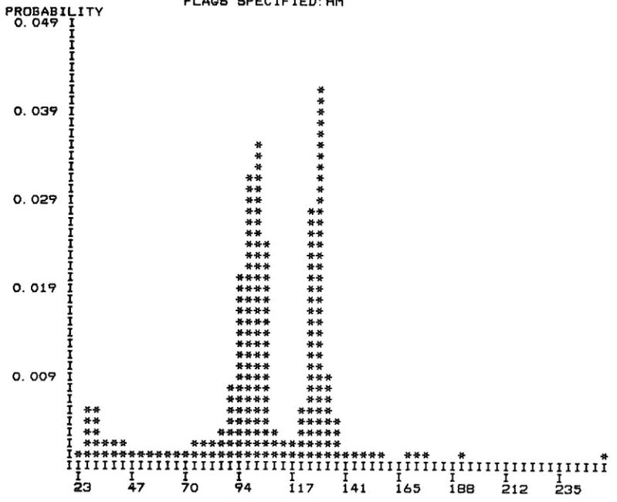
10.2 Measurement-Space-Guided Spatial Clustering
Good segmentation
3 nonoverlapping modes:
black holes
Pyrorhotite (磁黃鐵礦)
Pyrite (黃鐵礦 )
深灰
(磁黃鐵礦)
黑
淺灰(黃鐵礦)

Slide 12
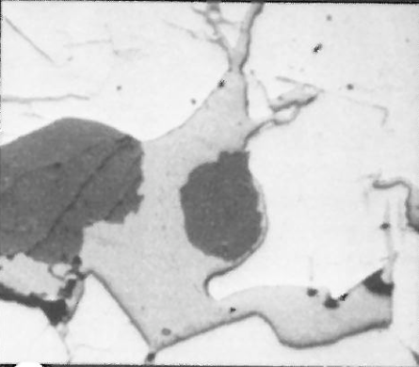
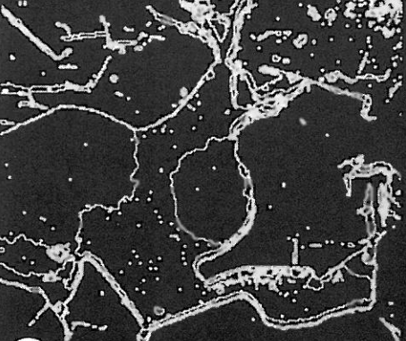
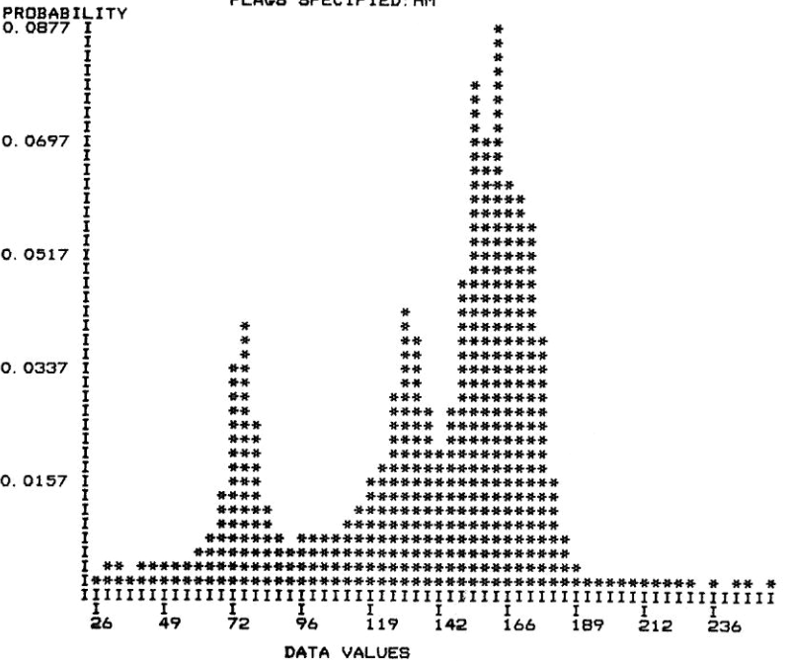
10.2 Measurement-Space-Guided Spatial Clustering
Bad segmentation
灰色們太相近了

Slide 13
10.2 Measurement-Space-Guided Spatial Clustering
Bad segmentation

Slide 14
10.2 Measurement-Space-Guided Spatial Clustering
結論：
segmentation into homogeneous regions:
not necessarily good solution
在measurement space上做clustering就算可以把某樣性質分成很明確的群聚
但轉換回原圖時卻常常會有holes跟boundary ragged的狀況
Notes:
分割成同質區域：不一定是好的解決方案在測量空間上做聚類可以把某樣性質看很明顯的群聚但轉換回原圖時卻常常有洞和邊界參差不齊的狀況

Slide 15
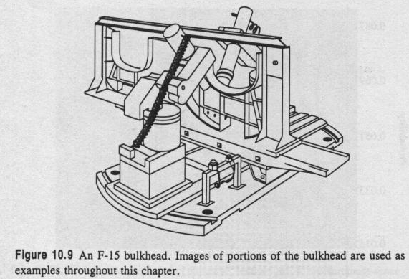
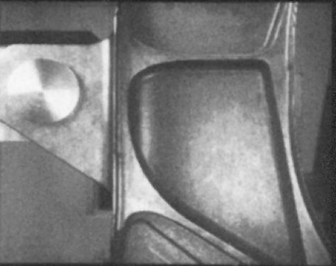
10.2 Measurement-Space-Guided Spatial Clustering
那如果真的遇到那種histogram分群很不明顯的圖要怎麼辦?

Slide 16
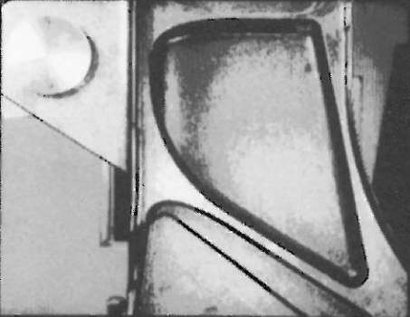
10.2 Measurement-Space-Guided Spatial Clustering
Five clusters: bad spatial continuation, boundaries noisy and busy
Notes:
五類：空間延續性差，邊界雜訊多且繁忙

Slide 17
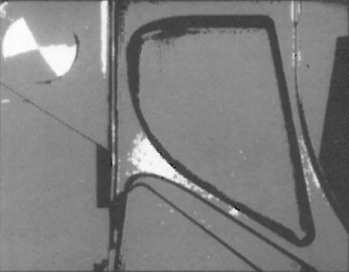
10.2 Measurement-Space-Guided Spatial Clustering
Three clusters: less boundary noise, but much less detail
Notes:
三組：邊界雜訊少，但細節少得多

Slide 18
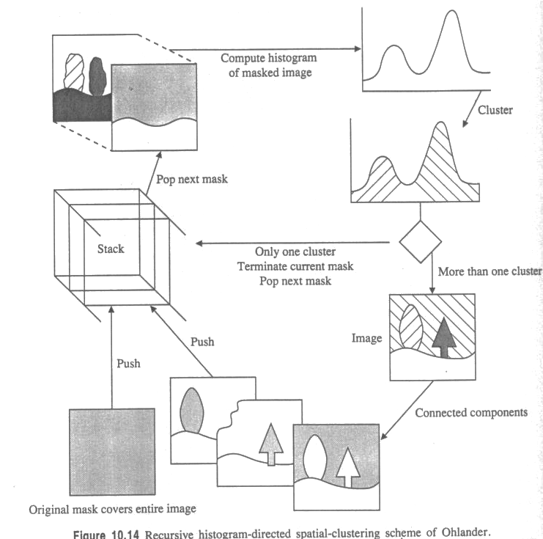
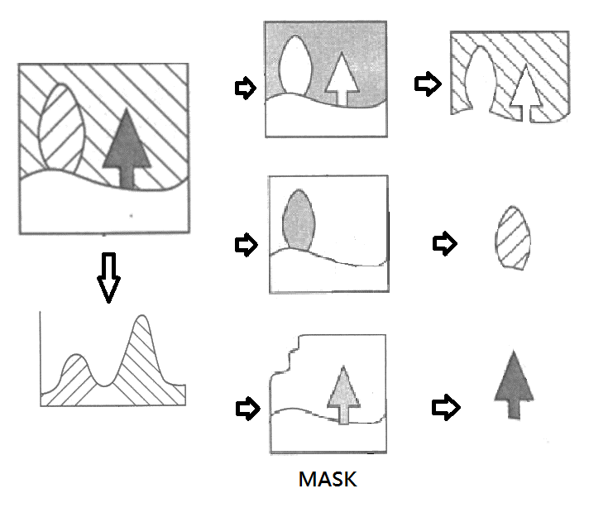
10.2 Measurement-Space-Guided Spatial Clustering
Recursive Histogram-Directed Spatial Clustering
遞歸直方圖定向空間群聚
Notes:
本方法的起始，如左下角，將整張圖當成一個mask，Push進Stack當中，程式會從Stack中pop出mask來加以運算
很明顯地，一開始，我們先Pop出整張原圖當成一個mask去計算Histogram，
假設計算的結果如右上角，我們獲得了兩個山峰
我們以山峰作為 Cluster 的依據，將兩個山峰分成兩群
如果分出來的結果，Cluster 數量大於一群的話 (本例)
將Cluster同群內的Pixels再做Connected Component，得出來的結果就是本Cluster求得的mask
將不同Cluster做出來的結果 mask 分別 push 到一個stack中
下一次的遞迴時，可以再利用stack中的mask，計算出該mask的Histogram，
如果這次只得到一個山峰，只分出一個Cluster，則找到我們要的區域，停止本次mask之計算。
再pop出另一個mask計算。

Slide 19
10.2 Measurement-Space-Guided Spatial Clustering
Recursive Histogram-Directed Spatial Clustering
遞歸直方圖定向空間群聚
取得算是漂亮，
雖然有點分太細，
導致region一堆
shrink and ﬁll operations on the segmentation
去除微小區域
但幾長薄區域丟失

Slide 20
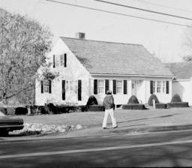
10.2 Measurement-Space-Guided Spatial Clustering
Recursive Histogram-Directed Spatial Clustering
遞歸直方圖定向空間群聚

Slide 21
10.2 Measurement-Space-Guided Spatial Clustering
Recursive Histogram-Directed Spatial Clustering
遞歸直方圖定向空間群聚
R, G, B bands
Karhunen-Loeve transform
(R+G+B)/3, (R-B)/2, (2G-R-B)/4

Slide 22
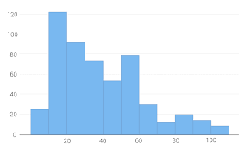
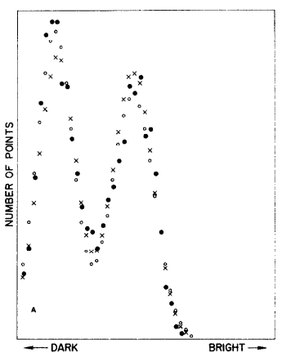
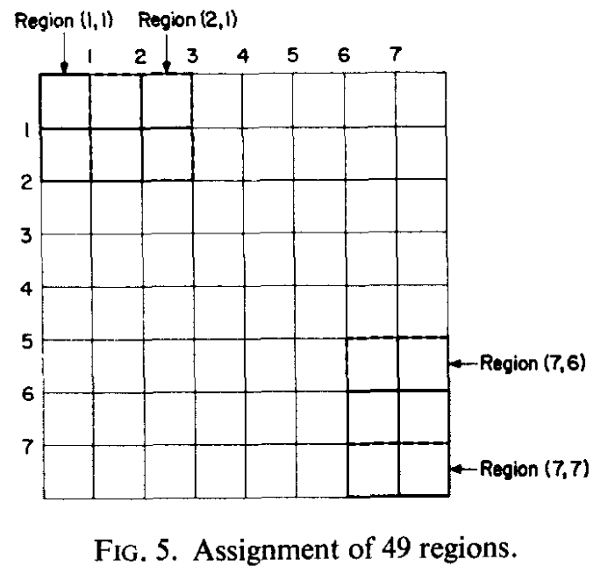
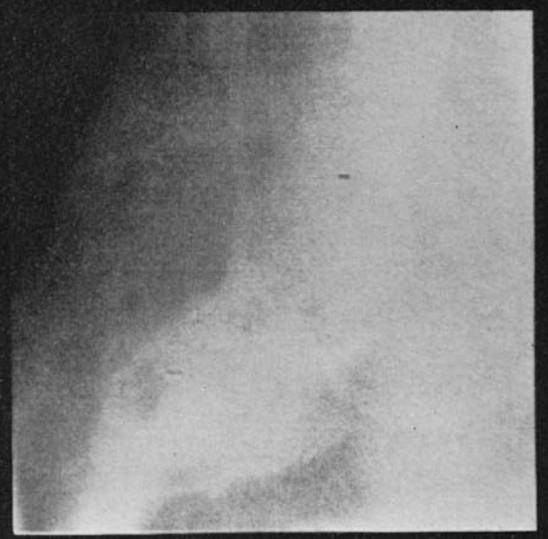
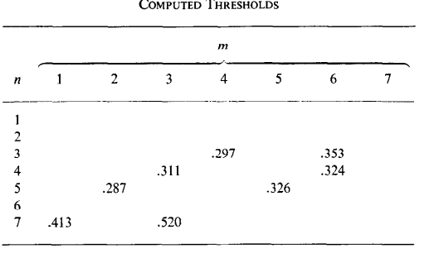
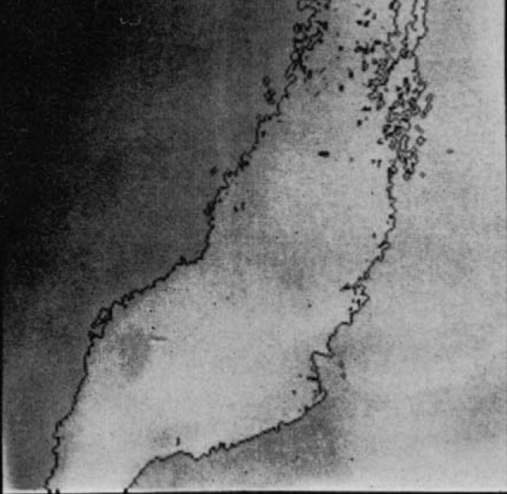
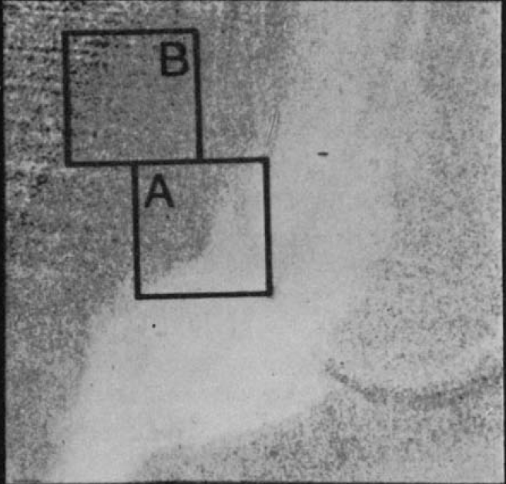
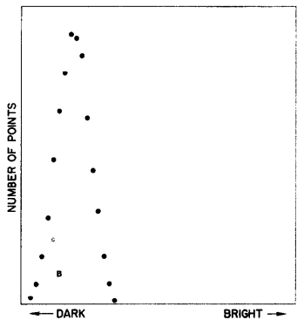
10.2.1 Thresholding
Q: What if the histogram is not nicely bimodal?
Some thoughts from researchers in the field…
Local Histogram
Chow and Kaneko 1972
Review: Measurement-space-clustering doesn’t require good spatial continuation.
(1) Divide image into mutually exclusive blocks.
(2) Compute histogram and determine threshold.
(3) Interpolate threshold value.
Notes:
評論：測量空間聚類不需要良好的空間連續性。(1) 將圖像劃分為互斥的塊。(2) 計算直方圖並確定閾值。(3) 內插閾值。

Slide 23
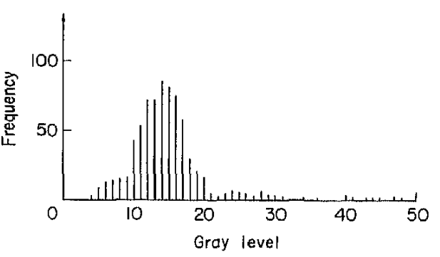
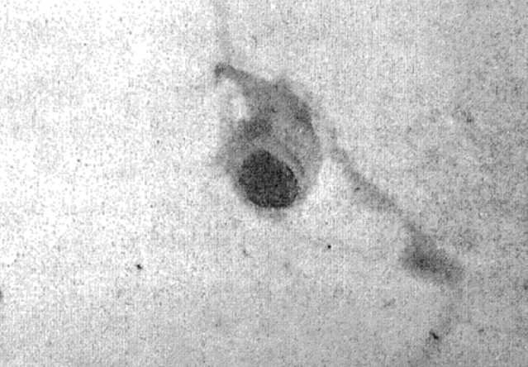
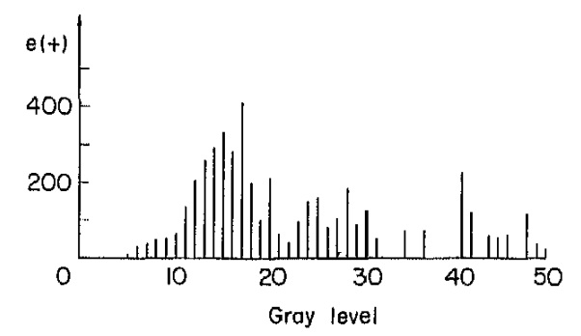
10.2.1 Thresholding
Some thoughts from researchers in the field…
2. High Laplacian Magnitude
Weszka, Nagel, and Rosenfeld 1974
Only determine histogram for high Laplacian magnitude pixels.
Those pixels are the shoulders
Don’t involve pixels between regions that help make the histogram valley shallow.

Slide 24
10.2.1 Thresholding
Some thoughts from researchers in the field…
3. Minimized Busyness
Weszka and Rosenfeld 1978
Busyness: the percentage of pixels having a neighbor whose threshold value is different from their own threshold value.
相鄰像素的百分比具有與其自身閾值不同的閾值。
Notes:
相鄰像素的百分比具有與其自身閾值不同的閾值。

Slide 25
10.2.1 Thresholding
Kohler 1981
Define:
set E(T): edges detected by a threshold T
$E\left(T\right)=\{[\left(i,j\right),(k,l)|$
$1. pixels \left(i,j\right) and \left(k,l\right) are neighbors$
$2.\min{\{I(i,j),I\left(k,l\right)\}}≤T<max\left\{I\left(i,j\right),I\left(k,l\right)\right\}\}.$
$C\left(T\right)=\sum_{\left[I\left(ⅈ,j\right),\left(k,l\right)\right]∈E(T)}{min⁡\{\left|I\left(i,j\right)−T\right|,|I\left(k,l\right)−T|\}}$
The average contrast is $C(T)/\#E(T)$
The best threshold $T_{b}$ is the value that
maximizes $C(T)/\#E(T)$

Slide 26
10.2.1 Thresholding
T₁ = 50
[45, 110] -> [5, 60]
[33, 88] -> [17, 38]
[15, 65] -> [35, 15]
[45, 115] -> [5, 65]
[0, 225] -> [50, 175]
The average contrast of all edges
(5+17+15+5+50) / 5 = 18.4

Slide 27
10.2.1 Thresholding
T₁ = 60
[45, 110] -> [15, 50]
[33, 88] -> [27, 28]
[15, 65] -> [45, 5]
[45, 115] -> [15, 55]
[0, 225] -> [60, 165]
The average contrast of all edges
(15+27+5+15+60) / 5 = 24.4
The best threshold T_{b} is determined by the maximizes

Slide 28
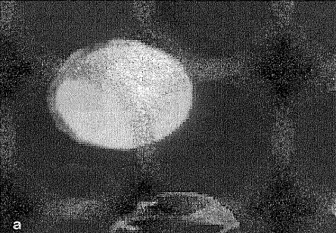
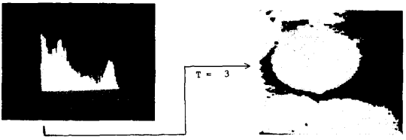
10.2.1 Thresholding
Kohler 1981
White blood cell

Slide 29
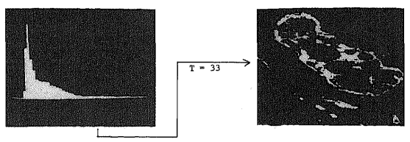
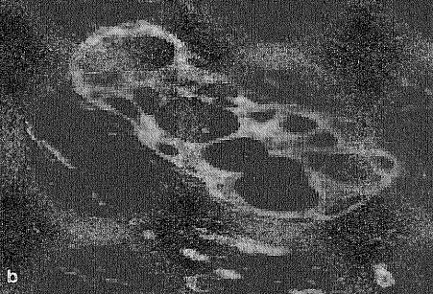
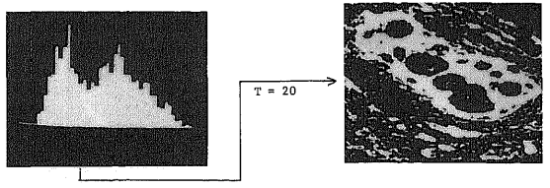
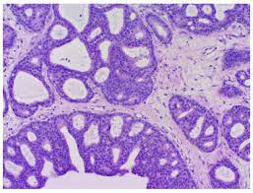
10.2.1 Thresholding
Kohler 1981
cribriform breast duct
Notes:
篩狀乳腺導管

Slide 30
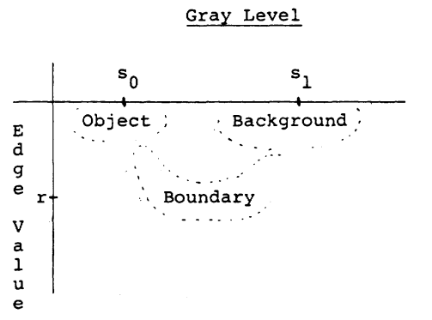
10.2.1 Thresholding
Panda and Rosenfeld 1978
Approach for segmenting white blob against dark background
Assumption (edge):
Low gradient?
Not likely to be an edge → Either dark background or bright blob pixel.
Histogram: bimodal
Good threshold: valley
High gradient?
Likely to be an edge. → Bimodal.
Histogram: unimodal
Good threshold: mean
2 threshold values
one for low-gradient pixels
one for high-gradient pixels.

Slide 31
10.2.1 Thresholding
FLIR (Forward Looking Infra-Red) image
from NATO (North Atlantic Treaty Organization) database
戰車引擎位置
真正引擎的位置
Thresholded at 190
引擎附近的熱氣
Thresholded at 159

Slide 32
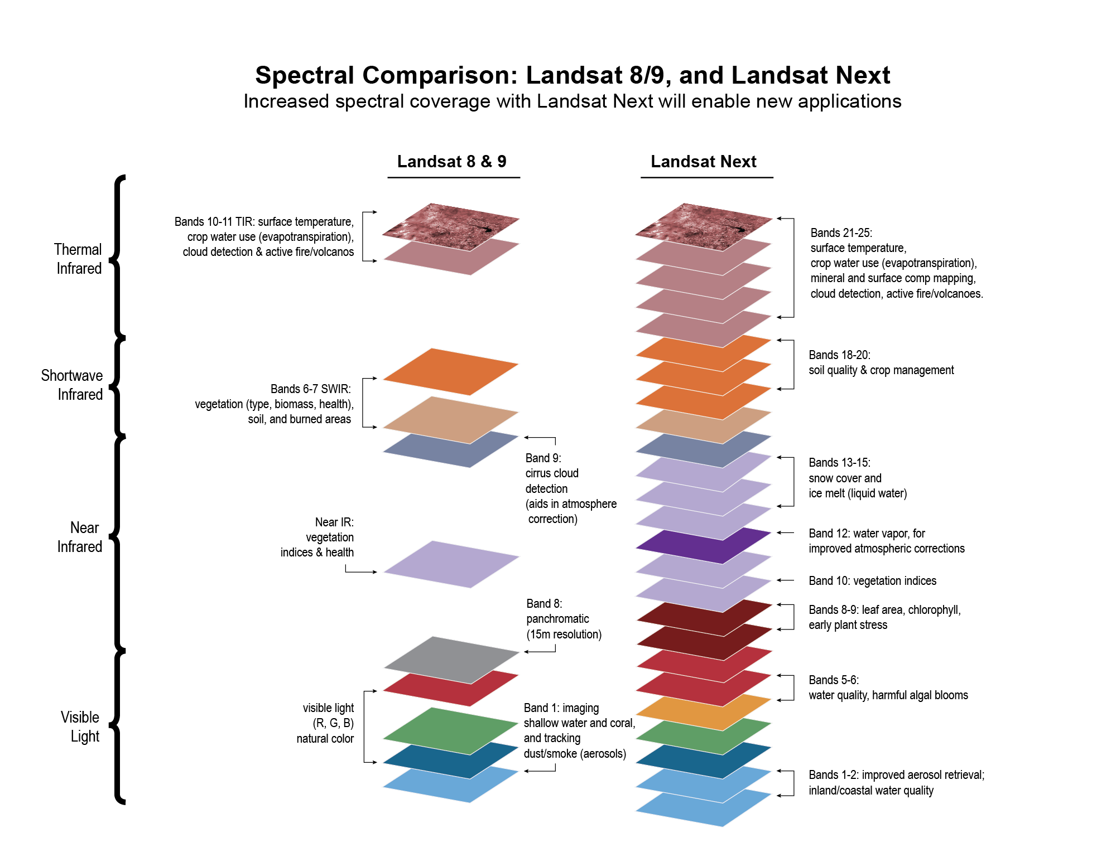
10.2.2 Multidimensional Measurement-Space Clustering
LANDSAT image: consists of seven separate images called bands
Constraints of reality
high correlation between band-to-band pixel values
帶間像素值之間的高相關性
large amount of spatial redundancy in image data
影像數據中存在大量冗餘空間

Slide 33
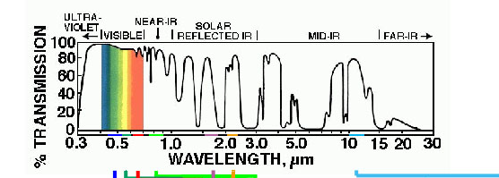
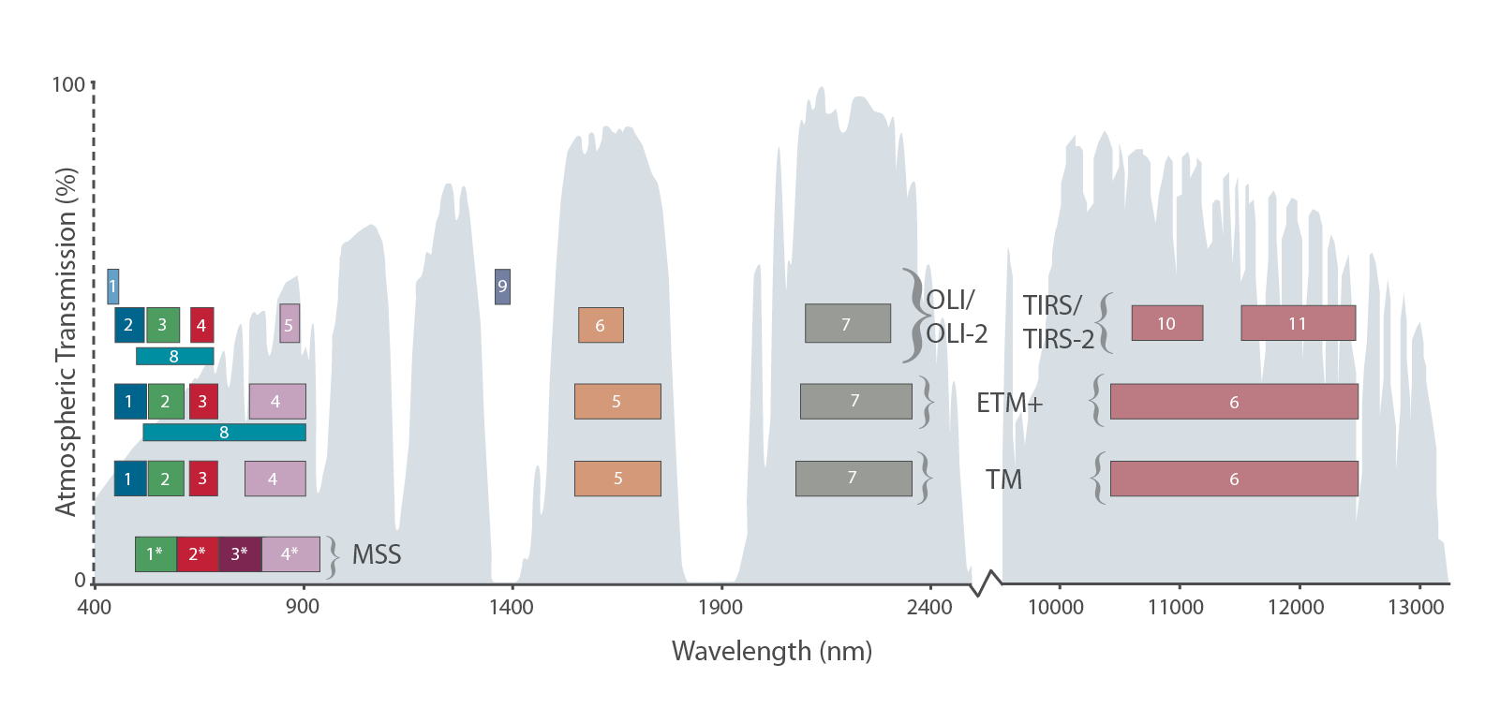
10.2.2 Multidimensional Measurement-Space Clustering
Spectral sensitivity of LANDSAT 7 Bands
0.45-0.52 µm Blue-Green
0.52-0.60 µm Green
0.63-0.69 µm Red
0.76-0.90 µm Near-IR
1.55-1.75 µm Shortwave-IR
10.40-12.50 µm Thermal-IR
2.08-2.35 µm Mid-IR
Notes:
http://www.chromoscope.net/

Slide 34
10.2.2 Multidimensional Measurement-Space Clustering
Spectral sensitivity of LANDSAT 7 Bands
Notes:
http://www.chromoscope.net/

Slide 35
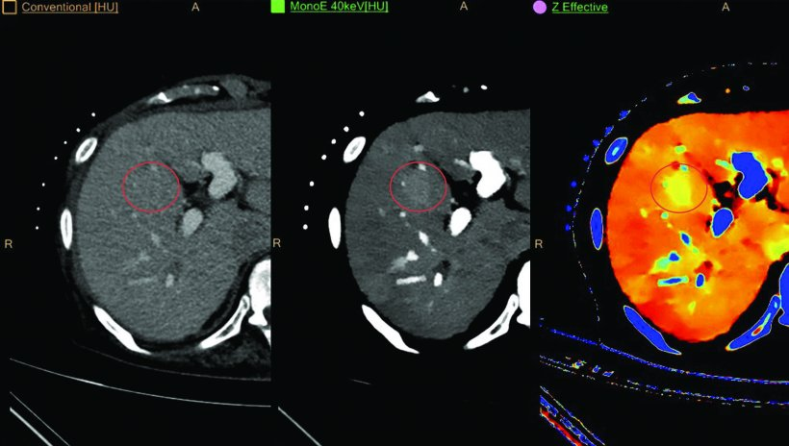
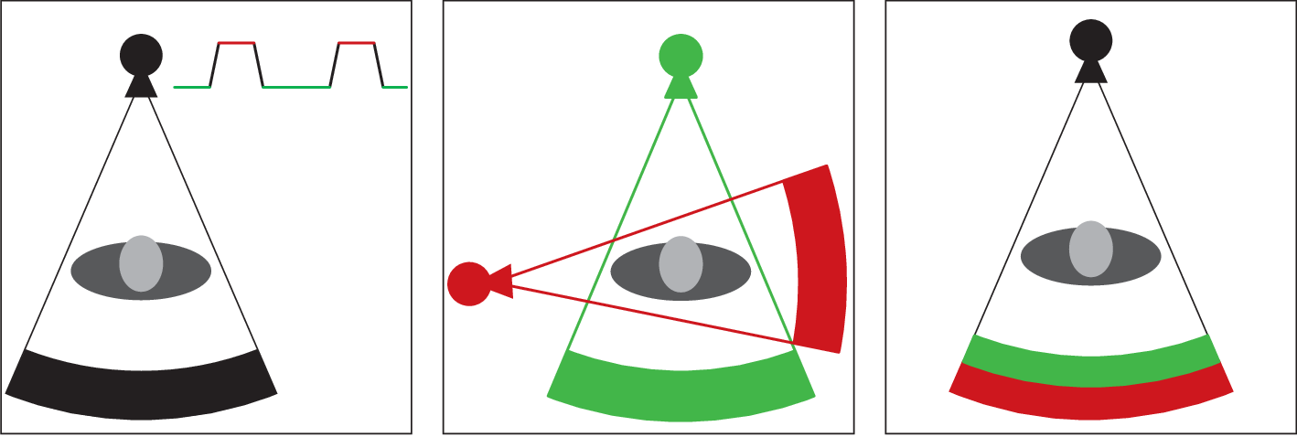
10.2.2 Multidimensional Measurement-Space Clustering
Dual-energy Computed Tomography (CT)
Two different energy x-ray
Notes:
http://www.chromoscope.net/

Slide 36
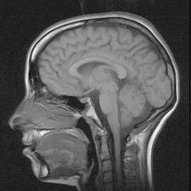
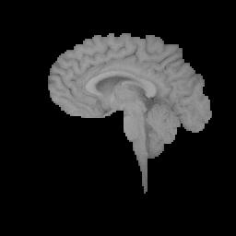
10.3 Region Growing
A segmentation technique based on the similarity of adjacent pixels.
Predefined seed pixels
Growing criteria
Stop conditions
Notes:
基於相鄰像素相似度的分割技術。
預定義的種子像素
成長標準
停止條件

Slide 37
10.3.1 Single-Linkage Region Growing
The SLRG just like the biological low-level visual system
Detect image regions characterized by a gentle intensity gradient
Maximal sets of pixels belonging to same connected component
Simple image and the corresponding graph
Two pixels connected by edge: if 4-neighbor and values differ 5
Notes:
SLRG 就像生物低級視覺系統檢測
以溫和強度梯度為特徵的圖像區域
屬於同一連通分量的最大像素集
簡單的圖像和對應的圖形
由邊連接的兩個像素：如果 4-neighbor 和值不同 5

Slide 38
10.3.2 Hybrid-Linkage Region Growing
hybrid-linkage techniques:
Each pixel is assigned a property vector
depends on K x K neighborhood of the pixel
Those pixels are similar with neighborhoods
Edge detection operators
Comparing textures
Can segment more complex images
But it is computationally more expensive
Notes:
混合連接區域增長
混合連接技術：
每個像素被分配一個屬性向量
取決於像素的 K x K 鄰域
這些像素與鄰域相似
邊緣檢測算子
比較紋理
可以分割更複雜的圖像
但它在計算上更昂貴

Slide 39
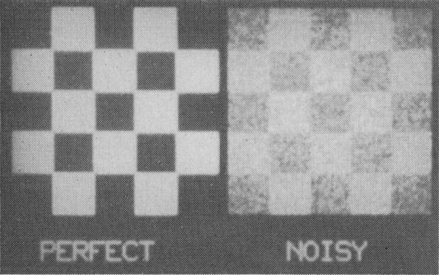
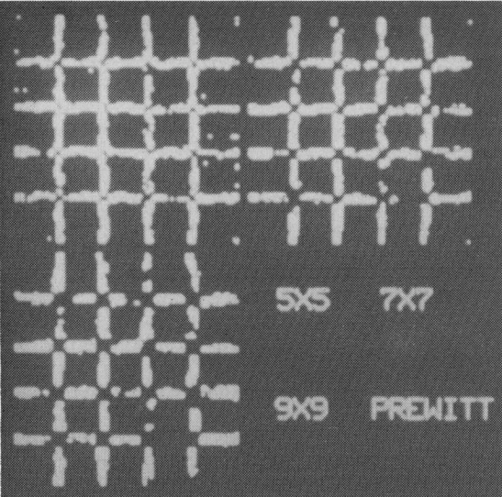
10.3.2 Hybrid-Linkage Region Growing
Haralick (1984), Zero Crossing (details in Ch. 8)
Notes:
混合連接區域增長

Slide 40
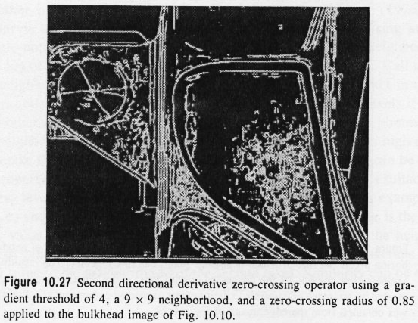
10.3.2 Hybrid-Linkage Region Growing
Haralick (1984), Zero Crossing (details in Ch. 8)
Edge detection
after region-filling
Notes:
混合連接區域增長

Slide 41
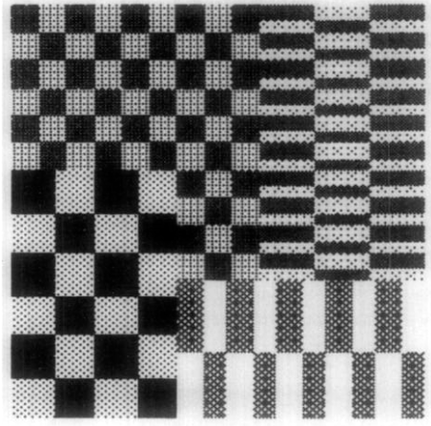
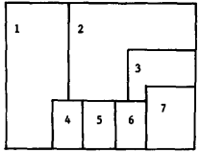
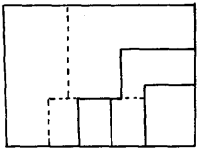
10.3.2 Hybrid-Linkage Region Growing
Pong (1984) facet model 小平面模型
Steps:
Segment the image into small regions.
Calculate the property vector of each segment.
Merge close enough regions
Next iteration: repeat from Step 2.
Notes:
混合連接區域增長

Slide 42
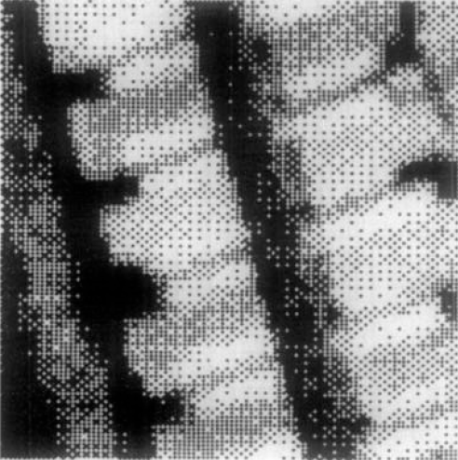
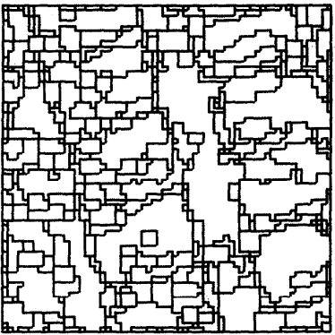
10.3.2 Hybrid-Linkage Region Growing
Pong (1984) facet model 小平面模型
Original image
1304 regions
350 regions
29 regions
80 regions
110 regions
Notes:
混合連接區域增長

Slide 43
10.3.2 Hybrid-Linkage Region Growing
Pong (1984) facet model 小平面模型
Notes:
混合連接區域增長

Slide 44
10.3.3 Centroid-Linkage Region Growing
Difference:
Pairs of neighboring pixels are not compared for similarity
Steps:
The image is scanned in some predetermined manner
left-right, top-bottom.
A pixel’s value is compared with the mean of an already existing region
If its value and the segment’s mean value are close enough
the pixel is added to the segment
the segment’s mean is updated
Notes:
質心連接區域增長
區別：不比較相鄰像素對的相似性
步驟：
1.圖像以某種預定的方式掃描，例如左右、上下。
2.一個像素的值與一個已經存在
但不一定完成的相鄰段的平均值進行比較。
3.如果它的值和段的平均值足夠接近，則將像素添加到段並更新段的平均值。

Slide 45
10.3.3 Centroid-Linkage Region Growing
Difference:
Pairs of neighboring pixels are not compared for similarity
Steps:
If the means of the two competing regions are close enough
the two regions are merged
the pixel is added to the merged region
If no neighboring region has a close-enough mean
Create a new segment
Notes:
質心連接區域增長
區別：不比較相鄰像素對的相似性
4.如果兩個競爭區域的均值足夠接近，則將兩個區域合併，並將像素添加到合併區域中。
5.如果沒有相鄰區域具有足夠接近的均值，則建立一個新段。

Slide 46
10.3.3 Centroid-Linkage Region Growing
Fatih (2002) Automatic threshold determination
Notes:
質心連接區域增長

Slide 47
10.4 Hybrid-Linkage Combinations
Review (strength and weakness):
Single-Linkage
Strength: Spatially accurate
Weakness: Excessive merging
Centroid-Linkage
Strength: Ability to place boundaries in weak gradient areas
Notes:
質心連接區域增長
回顧（強弱）：
單連接
強度：空間準確
弱點：過度合併
質心連接
強度：能夠在弱梯度區域放置邊界

Slide 48
10.4 Hybrid-Linkage Combinations
Combined Centroid-Hybrid Linkage
Centroid-linkage for only non-edge pixels
Region growing is not permitted across edge pixels
Notes:
組合質心-混合連接
僅用於非邊緣像素的質心鏈接
不允許跨邊緣像素進行區域增長

Slide 49
10.5 Spatial Clustering
Spatial-clustering:
clustering
spatial region growing
histogram-mode-seeking
region growing
spatial-linkage technique
Example: Haralick and Kelly (1969)
Find the peaks of the histogram
Find the pixels in the peaks, they are the initial segments
Perform region growing
Notes:
空間聚類：
聚類
空間區域生長
直方圖模式搜索
區域增長
空間聯繫技術
示例：Haralick 和 Kelly (1969) 找到
直方圖的峰值
找到峰值中的像素，它們是初始段
執行區域生長

Slide 50
10.6 Split and Merge
Steps:
if the segment is not homogeneous enough
Split into quarters
if the segment is similar enough
merge regions
Notes:
步驟：
如果該段不夠均勻
分成四等份
如果該段足夠相似
合併區域

Slide 51
10.6 Split and Merge
Notes:
步驟：
如果該段不夠均勻
分成四等份
如果該段足夠相似
合併區域

Slide 52
10.6 Split and Merge
Downside:
Boundaries tend to be squarish and artificial.
Large memory usage
Miss-merging
Horowitz and Pavlidis (1976)
Data structure: Quad tree
Notes:
缺點：
邊界往往是方形的和人為的。
內存佔用大
誤合併
解決方案：霍洛維茨和帕夫利迪斯 (1976)
數據結構：四叉樹

Slide 53
10.6 Split and Merge

Slide 54
10.7 Rule-Based Segmentation
Introduction:
It is not easy to try different concepts without complete reprogramming
The Nazif and Levine system (1984)
Rule-based expert system for segmentation
Not application domain specific
general-purpose
scene-independent knowledge and grouping criteria
Notes:
介紹：
不完全重新編程就不容易嘗試不同的概念
納齊夫和萊文系統 (1984)
基於規則的分割專家系統
不是特定於應用程序域的
一般用途
獨立於場景的知識和分組標準

Slide 55
10.7 Rule-Based Segmentation
The Nazif and Levine system (1984)
Composition:
set of processes
The initializer (初始化)
The line analyzer(線性分析)
The region analyzer (區域分析)
The area analyzer(面積分析)
The focus of attention(關注焦點)
the scheduler(排程)
two associate memories
the short-term memory (STM)
the long-term memory (LTM)
Notes:
介紹：
不完全重新編程就不容易嘗試不同的概念
納齊夫和萊文系統 (1984)
基於規則的分割專家系統
不是特定於應用程序域的
一般用途
獨立於場景的知識和分組標準

Slide 56
10.7 Rule-Based Segmentation
The Nazif and Levine system (1984)
The short-term memory :
holds the input image, the segmentation data, and the output.
The long-term memory:
system knowledge about low-level segmentation and control strategies.
Match rules in the LTM against the data stored in the STM
Rule fires
Action
Data modification
Notes:
短期記憶：保存輸入圖像、分割數據和輸出。
長期記憶：包含代表有關低級分割和控制策略的系統知識的模型。
將 LTM 中的規則與存儲在 STM 中的數據進行匹配
規則觸發
行動
數據修改

Slide 57
10.7 Rule-Based Segmentation
The Nazif and Levine system (1984)
LTM has three levels of rules
level 1 are knowledge rules that encode information
Properties of regions, lines, and areas in the form of situation-action pairs.
splitting a region
merging two regions;
adding, deleting, or extending a line
merging two lines
creating or modifying a focus-of-attention area
Notes:
級別 1 是對信息進行編碼的知識規則
以情境-動作對形式表示的區域、線和區域的屬性。
分割區域
合併兩個區域；
添加、刪除或延長一行
合併兩條線
創建或修改關注焦點區域

Slide 58
10.7 Rule-Based Segmentation
The Nazif and Levine system (1984)
LTM has three levels of rules
level 1 are knowledge rules that encode information
Properties of regions, lines, and areas in the form of situation-action pairs.
splitting a region
merging two regions;
adding, deleting, or extending a line
merging two lines
creating or modifying a focus-of-attention area
Notes:
級別 1 是對信息進行編碼的知識規則
以情境-動作對形式表示的區域、線和區域的屬性。
分割區域
合併兩個區域；
添加、刪除或延長一行
合併兩條線
創建或修改關注焦點區域

Slide 59
10.7 Rule-Based Segmentation
The Nazif and Levine system (1984)
LTM has three levels of rules
level 2 are the control rules
Focus-of-attention rules
Find the next data entry to be considered:
a region, a line, or an entire area
Inference rules
Their actions do not modify the data in the STM
Modify the matching order of different knowledge rule sets
Control which process will be activated next.
Notes:
2 級是控制規則
注意力集中規則
找到下一個要考慮的數據條目：
一個區域、一條線或整個區域
推理規則
他們的動作不會修改STM中的數據
修改不同知識規則集的匹配順序
控制接下來將激活哪個進程。

Slide 60
10.7 Rule-Based Segmentation
The Nazif and Levine system (1984)
LTM has three levels of rules
Level 3 is the highest rule level
Strategy rules
Select the set of control rules
Executes the most proper control strategy for a given set of data.
Notes:
級別 3 是最高規則級別
策略規則
選擇控制規則集
對給定的數據集執行最合適的控制策略。

Slide 61
10.7 Rule-Based Segmentation
The Nazif and Levine system (1984)
Notes:
輸入資料類型

Slide 62
10.7 Rule-Based Segmentation
The Nazif and Levine system (1984)
Notes:
數值化描述特徵

Slide 63
10.7 Rule-Based Segmentation
The Nazif and Levine system (1984)
Notes:
數值化空間特徵

Slide 64
10.7 Rule-Based Segmentation
The Nazif and Levine system (1984)
Notes:
邏輯特徵

Slide 65
10.7 Rule-Based Segmentation
The Nazif and Levine system (1984)
Notes:
活動

Slide 66
10.7 Rule-Based Segmentation
The Nazif and Levine system (1984)
Notes:
注意力集中動作
監督動作

Slide 67
10.7 Rule-Based Segmentation
Example: CLARKLABS

Slide 68
10.8 Motion-Based Segmentation
The motion of the objects creates a change in the images that can be used to help locate the moving objects.
In time-varying image analysis
sequence of images
the moving objects appear in different positions of the image
Notes:
物體的運動會在圖像中產生變化，可用於幫助定位運動物體。
在時變圖像分析中
圖像序列
運動物體出現在圖像的不同位置

Slide 69
10.8 Motion-Based Segmentation

Slide 70
10.9 Summary
Single-Linkage
Simplest and most prone to unwanted merge.
Hybrid and centroid region growing
Split-and-merge
Not subject to unwanted merge
Large memory usage and blocky boundaries
Measurement-space-guided spatial clustering
Regions not smoothly bounded, many holes
Spatial-clustering
Not well-enough tested
Hybrid-Linkage
Best compromise between smooth boundaries and few unwanted regions
Notes:
單聯動
最簡單也最容易發生不需要的合併。
混合和質心區域增長
拆分-合併
不受不需要的合併大量內存使用和塊狀邊界
測量空間引導的空間聚類區
域邊界不平滑，有很多洞
空間聚類
沒有經過充分的測試
混合聯動
平滑邊界和少數不需要的區域之間的最佳折衷

