Slide 1
Computer and Robot Vision I
Chapter 10. Image Segmentation
Presented by: 李志洸
r09945040@ntu.edu.tw
指導教授: 傅楸善 博士

Slide 2
10.1 Introduction
Technology from 30+ years ago. Why should we learn it?
Digital imaging is primarily used for industrial, scientific and medical applications back then, and it is still a major field today.
We will focus on basic methods, using techniques such as histogram mode seeking and region growing. These are the fundamentals of image segmentation.
Let’s take a quick view at the applications of image segmentation.

Slide 3
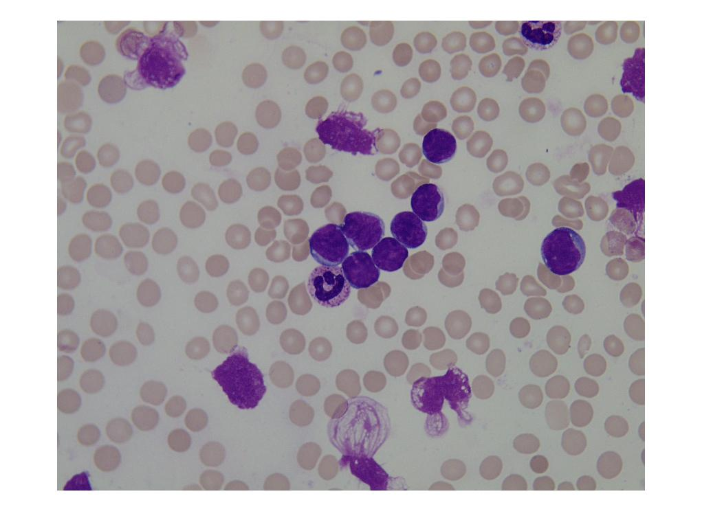
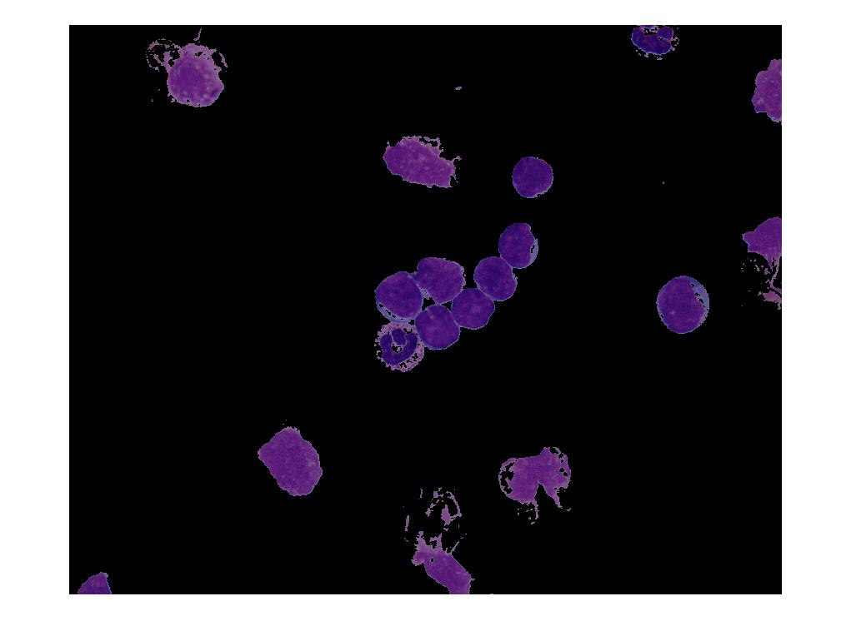
10.1 Introduction
Medical Applications
Src: ADNAN KHASHMAN and ESAM AL-ZGOUL,
Image Segmentation of Blood Cells in Leukemia Patients
Src: https://dsp.stackexchange.com/questions/16710

Slide 4
10.1 Introduction
LED: Light-Emitting Diode
NI: National Instruments
Industrial
Src: Yong-zhi MIN, Biao YUE, Hong-feng MA, Ben-yu XIAO
Research on Methods of Segmentation for Rail Surface Defects in Image-based Rail Inspection System

Slide 5
10.1
Continuous Images
Source:
Nir Friedman and Stuart Russell,
Image Segmentation in Video Sequences:
A Probabilistic Approach

Slide 6
10.1 Introduction
What is image segmentation?
partition of image into set of non-overlapping regions
union of segmented regions is the entire image
Guidelines:
Regions of an image segmentation should be uniform and homogeneous with respect to some characteristic, such as gray level or texture.
被分在同一個區塊的像素要有相同或相似的某個特性。
2. Region interiors should be simple and without many small holes.
一個區塊內部應該要簡單，而且沒有很多小洞。

Slide 7
10.1 Introduction
Guidelines:
3. Adjacent regions of a segmentation should have significantly different values with respect to the characteristic on which they are uniform.
相鄰的區塊對於第1點的特性應該要有顯著差異。
4. Boundaries of each segment should be simple, not ragged, and must be spatially accurate.
分割區塊的邊界應該要簡單，沒有鋸齒，在空間上精準。

Slide 8
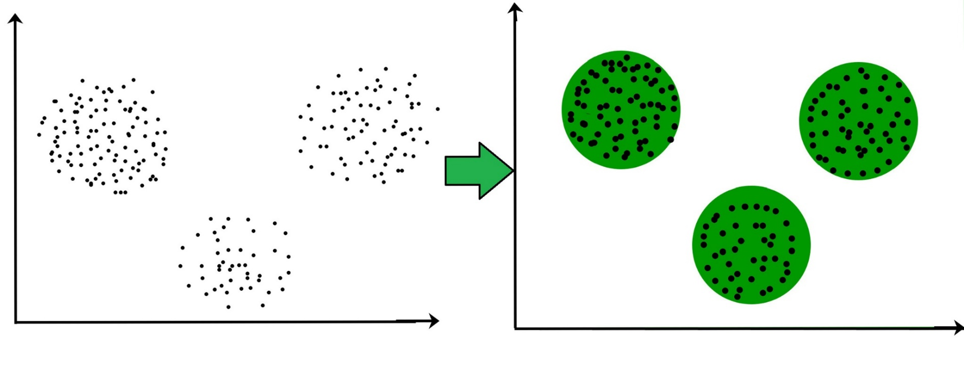
10.1 Introduction
Clustering: a close friend of image segmentation
Partitioning a set of pattern vectors into subsets called clusters.
對於影像分割，pattern vectors可以是指像素的intensity、texture等等。
相似的地方：都是把有相近特性的資料分群在一起。
相異的地方：影像分割的分群是在空間域(spatial domain)。
Question: 如果用Intensity當作每個像素的pattern vector，我們是幾個維度的空間上做Clustering? 1D? 2D? 3D?

Slide 9
10.1 Introduction
This chapter:
Mainly discus about segmenting an image based on gray level intensity.
主要討論針對灰度值(gray-level intensity)的影像分割。
For segmenting other features, using feature’s characteristic can extract its feature value. Then same technique can apply.
對於其他特性的影像分割(例如texture)，可以先把按照那個特性(characteristic)轉成特性值(feature value)，然後用一樣的方法來做分割。
Image segmentation is an ad hoc problem.
不同的技術根據強調與犧牲的不同

Slide 10
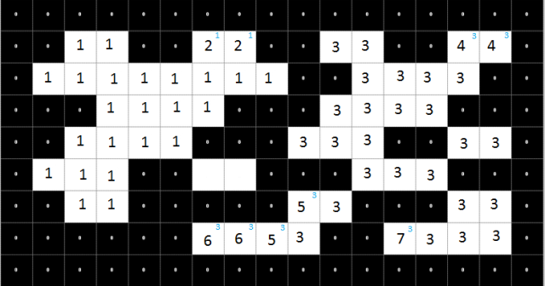
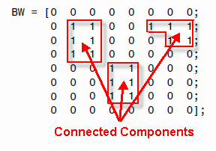
10.2 Measurement-Space-Guided Spatial Clustering
名詞解釋: Measurement-Space, Spatial Clustering
Process:
Uses the measurement-space-clustering process to define a partition in measurement space.
Each pixel is assigned the label of the cell in the measurement-space partition to which it belongs.
The image segments are defined as the connected components of the pixels having the same label.

Slide 11
10.2 Measurement-Space-Guided Spatial Clustering
Where does it work well?
Where there are a few kinds of distinct objects having widely different gray-level intensities.
Where these objects appear on a nearly uniform background.
Pros:
Clustering requires only one pass through the data.

Slide 12
10.2 Measurement-Space-Guided Spatial Clustering
Process in more detail
Assumption: Homogeneous objects on the image manifest themselves as the clusters in measurement space.
Image segmentation is accomplished by mapping the clusters in measurement space back to the image domain where the maximal connected components of the mapped back clusters constitute the image segments.

Slide 13
10.2 Measurement-Space-Guided Spatial Clustering
Clustering分群：The measurement space clustering can be accomplished by determining the valleys in this histogram and declaring the clusters to be the intervals of values between valleys. (More on this later.)
Label標記：A pixel whose value is in the ith interval is labeled with index i.
Connected Component連通元件：The segment the pixel belongs to is one of the connected components of all pixels whose label is i.

Slide 14
10.2 Measurement-Space-Guided Spatial Clustering
Good segmentation

Slide 15
10.2 Measurement-Space-Guided Spatial Clustering
Bad segmentation

Slide 16
10.2 Measurement-Space-Guided Spatial Clustering
Review: Guidelines:
Regions of an image segmentation should be uniform and homogeneous with respect to some characteristic, such as gray level or texture.
被分在同一個區塊的像素要有相同或相似的某個特性。
2. Region interiors should be simple and without many small holes.
一個區塊內部應該要簡單，而且沒有很多小洞。
3. Adjacent regions of a segmentation should have significantly different values with respect to the characteristic on which they are uniform.
相鄰的區塊對於第1點的特性應該要有顯著差異。
4. Boundaries of each segment should be simple, not ragged, and must be spatially accurate.
分割區塊的邊界應該要簡單，沒有鋸齒，在空間上精準。

Slide 17
10.2 Measurement-Space-Guided Spatial Clustering
Unimodal

Slide 18
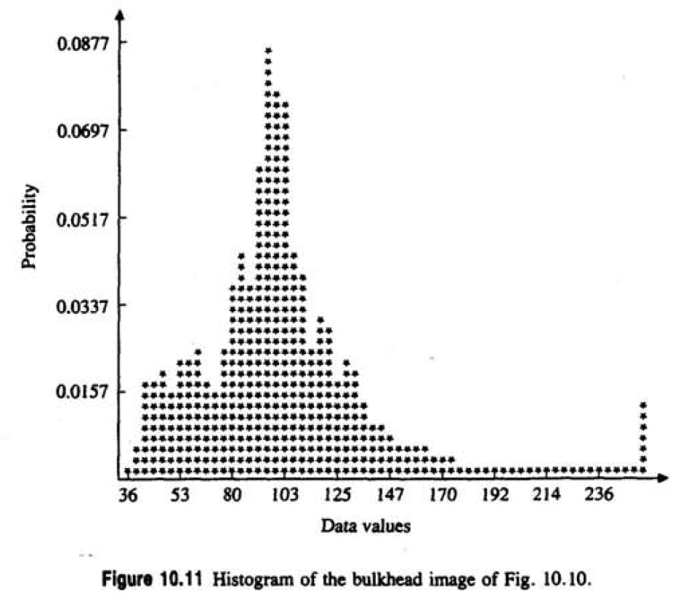
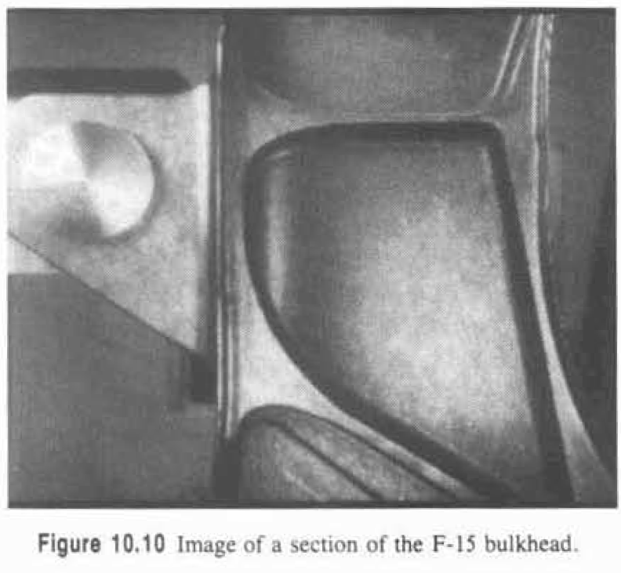
Notes:
谷底到最低谷側的高度差做為谷深，選出五組或三組(淘汰兩個谷深較淺的)

Slide 19
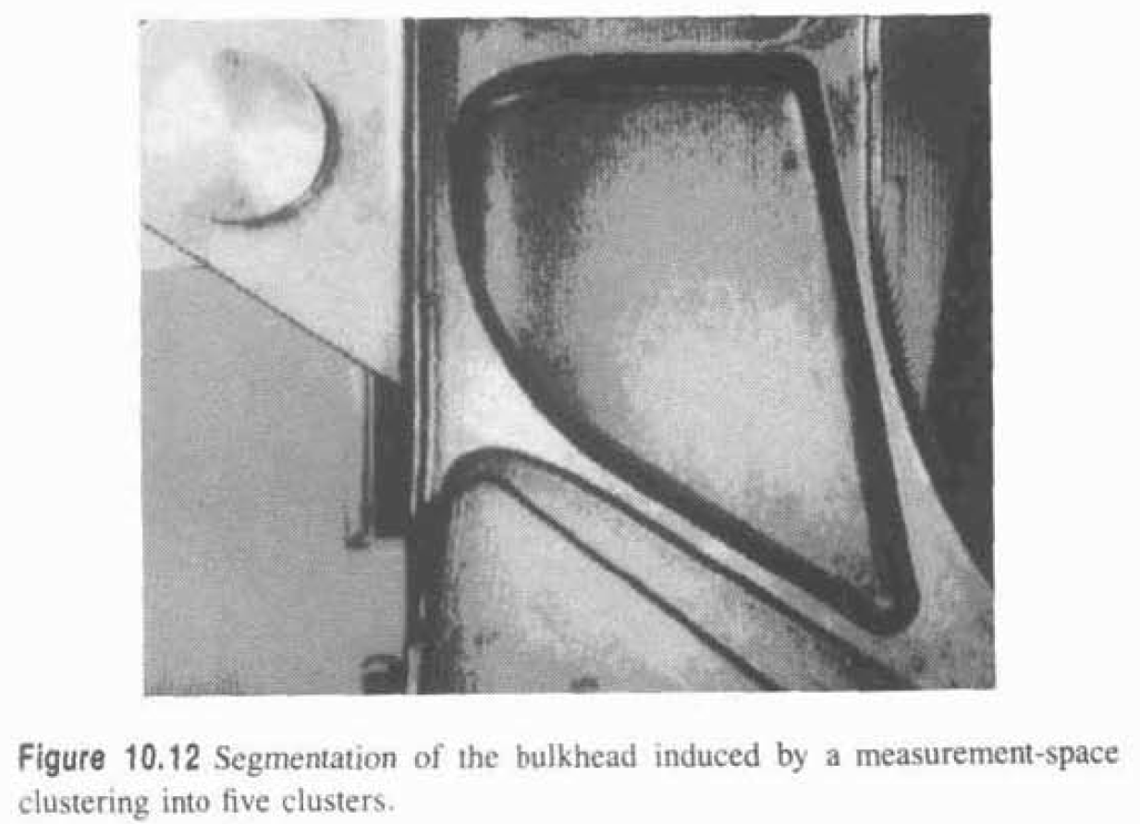

Slide 20
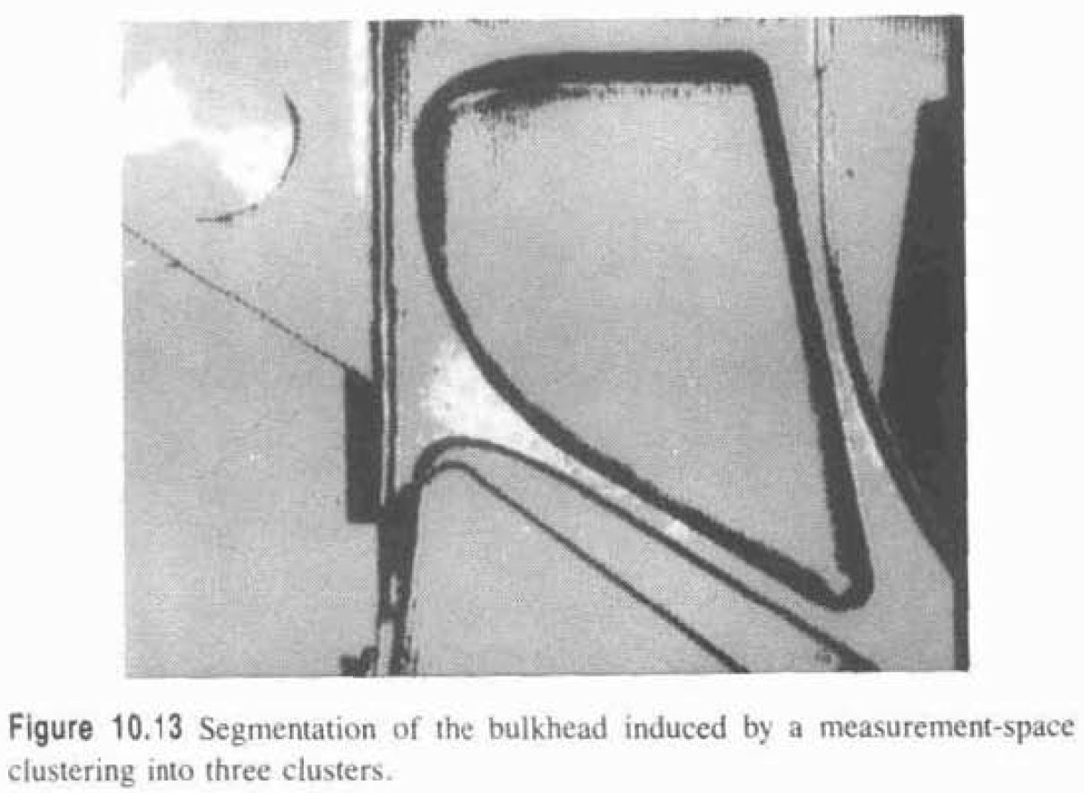

Slide 21
10.2 Measurement-Space-Guided Spatial Clustering
Problem with measurement-space-clustering
There is no requirement for good spatial continuation.
Resulting boundaries are very noisy and busy.

Slide 22
10.2 Measurement-Space-Guided Spatial Clustering
Recursive Histogram Mode Seeking
Ohlander, Price, and Reddy 1978
1. Begin by defining a mask selecting all pixels on the image.
2. A histogram of the masked image is computed.
3. Separation of one mode of the histogram set from another mode.
Notes:
Use the Laser Pen Tool to show where we are at on the illustration.
初始化是涵蓋整張圖的遮罩(什麼都沒遮)

Slide 23
10.2 Measurement-Space-Guided Spatial Clustering
Recursive Histogram Mode Seeking
4(1). If there is only one measurement-space cluster then the mask is terminated.
4(2). If there is more than one cluster, then each connected component of all pixels with the same cluster is, in turn, used to generate a mask that is placed on a mask stack.
5. Clustering is repeated for each new mask until the stack is empty.
Notes:
Use the Laser Pen Tool to show where we are at on the illustration.

Slide 24
10.2 Measurement-Space-Guided Spatial Clustering
Result
Opening
with
3x3 square

Slide 25
tiny regions removed, but several long, thin regions lost

Slide 26
10.2.2 Measurement-Space-Guided Spatial Clustering
Color Image

Slide 27
recursive histogram-directed spatial clustering
R, G, B bands (left)
Karhunen-Loeve transform (right)
(R+G+B)/3, (R-B)/2, (2G-R-B)/4

Slide 28
10.2.1 K-means Clustering
Given data, cluster in into k clusters
K is given by the user
Find the best cluster center u_{i} for every x_{j}
$J=\sum_{i=1}^{k}{\sum_{xj∈St}{(xj−ui)^{2}}}$

Slide 29
10.2.1 K-means Clustering
Algorithm
Randomly initialize cluster centers U₁….U_{K}
Determine points in each cluster:
For each point x, find the closest U_{i}; put x into cluster i
Given points in each cluster, solve for U_{i}:
Set U_{i} to be the mean of points in cluster i
If any U_{i} has changed, repeat Step 2.

Slide 30
10.2.1 K-means Clustering

Slide 31
10.2.1 K-means Clustering
Pros:
Simple
Cons:
Memory-intensive
Need to pick K
Initialization sensitive
Outlier sensitive
Only finds “spherical” clusters

Slide 32
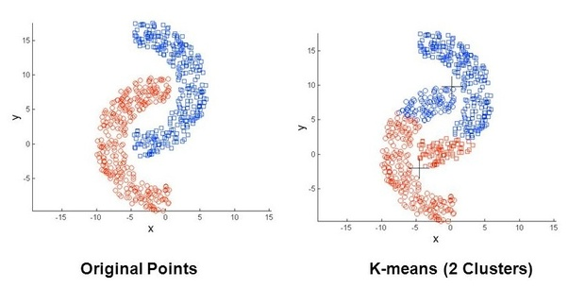
10.2.1 K-means Clustering
Cons:
Only finds “spherical” clusters

Slide 33
10.2.1 K-means Clustering
Otsu & K-means????
They are both based on the same criterion that minimizes the within-class variance.
K-means does not require computing a gray-level histogram before running, but Otsu method needs to compute a gray-level histogram first.
Otsu method and K-means, DongjuLiu, JianYu, 2009, Ninth International Conference on Hybrid Intelligent Systems.
Notes:
IEEE Xplore Full-Text PDF:

Slide 34
10.2.2 Measurement-Space-Guided Spatial Clustering

Slide 35
10.2.3 Thresholding
Q: What if the histogram is not nicely bimodal?
Some thoughts from researchers in the field…
Local Histogram
Chow and Kaneko 1972
Review: Measurement-space-clustering does not require good spatial continuation.
(1) Divide image into mutually exclusive blocks. (2) Compute histogram and determine threshold. (3) Interpolate threshold value.

Slide 36
10.2.3 Thresholding
Some thoughts from researchers in the field…
2. High Laplacian Magnitude
Weszka, Nagel, and Rosenfeld 1974
Only determine histogram for high Laplacian magnitude pixels.
Those pixels are the shoulders, which do not involve pixels between regions that help make the histogram valley shallow.
Notes:
Laplacian Magnitude邊緣強度

Slide 37
10.2.3 Thresholding
Some thoughts from researchers in the field…
3. Minimized Busyness
Weszka and Rosenfeld 1978
Busyness: the percentage of pixels having a neighbor whose threshold value is different from their own threshold value.

Slide 38
10.2.3 Thresholding
Kohler 1981
Define:
set E(T): edges detected by a threshold T
$E\left(T\right)=\{[\left(i,j\right),(k,l)|$
$1. pixels \left(i,j\right) and \left(k,l\right) are neighbors$
$2.\min{\{I(i,j),I\left(k,l\right)\}}≤T<max\left\{I\left(i,j\right),I\left(k,l\right)\right\}\}.$
$C\left(T\right)=\sum_{\left[I\left(ⅈ,j\right),\left(k,l\right)\right]∈E(T)}{min⁡\{\left|I\left(i,j\right)−T\right|,|I\left(k,l\right)−T|\}}$
The average contrast is $C(T)/\#E(T)$
The best threshold $T_{b}$ is the value that
maximizes $C(T)/\#E(T)$

Slide 39
10.2.3 Thresholding – example
T = 50
[45, 110]
[33, 88]
[15, 65]
[45, 115]
[0, 225]

Slide 40
10.2.3 Thresholding – example
T₁ = 50
[45, 110] -> [5, 60]
[33, 88] -> [17, 38]
[15, 65] -> [35, 15]
[45, 115] -> [5, 65]
[0, 225] -> [50, 175]

Slide 41
10.2.3 Thresholding – example
Example
T₁ = 50
[5, 60]
[17, 38]
[35, 15]
[5, 65]
[50, 175]
The average contrast of all edges
(5+17+15+5+50) / 5 = 18.4
Notes:
第三步驟：把取出來的小的加總起來
除以邊緣上有幾個Pixel → 本例是五個
算出來是 18.4

Slide 42
10.2.3 Thresholding (cont’)
Example
T₂ = 60
[45, 110] -> [15, 50]
[33, 88] -> [27, 28]
[15, 65] -> [45, 5]
[45, 115] -> [15, 55]
[0, 225] -> [60, 165]

Slide 43
10.2.3 Thresholding (cont’)
Example
T₂ = 60
[15, 50]
[27, 28]
[45, 5]
[15, 55]
[60, 165]
The average contrast of all edges
(15+27+5+15+60) / 5 = 24.4
The best threshold T_{b} is determined by the maximizes

Slide 44
10.2.3 Thresholding
Panda and Rosenfeld 1978
Approach for segmenting white blob against dark background
Assumption (edge):
Low gradient?
Not likely to be an edge → Either dark background or bright blob pixel.
High gradient?
Likely to be an edge. → Bimodal.

Slide 45
10.2.3 Thresholding
Panda and Rosenfeld 1978
Low-gradient pixels
Histogram: bimodal
Good threshold: valley
High-gradient pixels
Histogram: unimodal
Good threshold: mean
2 threshold values, one for low-gradient pixels and one for high-gradient pixels.
Notes:
雙峰的

Slide 46
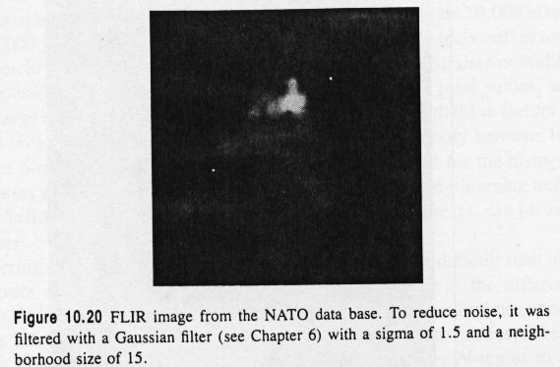
10.2.3 Thresholding
FLIR (Forward Looking Infra-Red) image from NATO (North Atlantic Treaty Organization) database
紅外線偵測戰車引擎位置
Notes:
Atlantic 大西洋
Treaty 條約(公約)

Slide 47
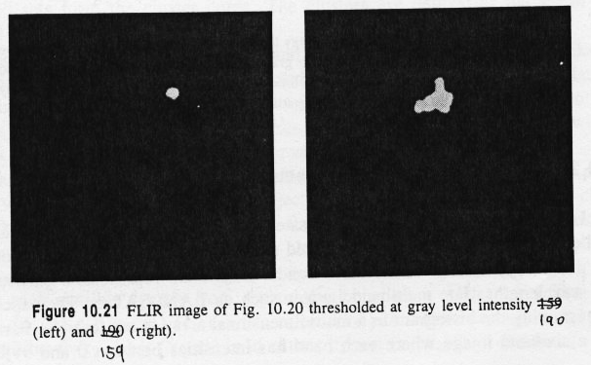
10.2.3 Thresholding
Thresholded at gray level intensity 190 and 159
引擎附近的熱氣
真正引擎的位置

Slide 48
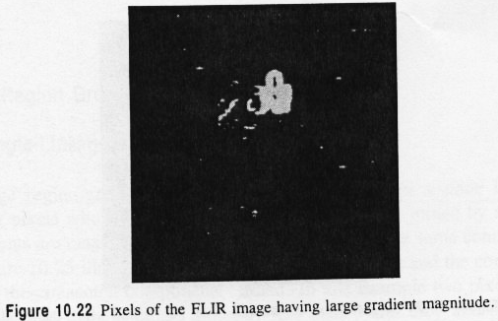
10.2.3 Thresholding
pixels having large gradient magnitude
戰車引擎位置

Slide 49
10.2.3 Thresholding
2D gray level intensity-gradient space

Slide 50
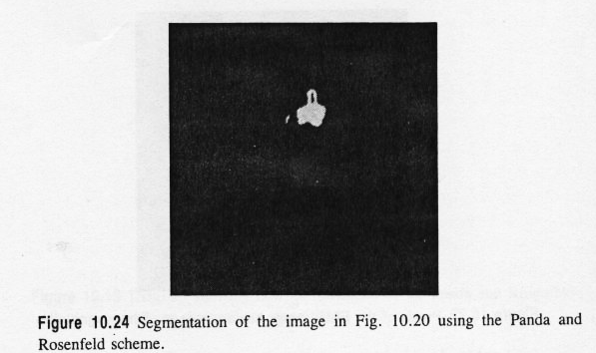
10.2.3 Thresholding
resulting segmentation: bright object with slightly darker appendage on top
戰車引擎位置

Slide 51
10.2.4 Multidimensional Measurement-Space Clustering
LANDSAT image: consists of seven separate images called bands
Constraints of reality
high correlation between band-to-band pixel values
large amount of spatial redundancy in image data
Notes:
LAND SATILITE 大地衛星影像
Band 頻帶
spatial redundancy 空間重複性

Slide 52
10.2.4 Multidimensional Measurement-Space Clustering
IR: Infra-Red
Spectral sensitivity of LANDSAT 7 Bands.
Band Number Wavelength Interval Spectral Response.
1. 0.45-0.52 µm Blue-Green
2. 0.52-0.60 µm Green
3. 0.63-0.69 µm Red
4. 0.76-0.90 µm Near-IR
5. 1.55-1.75 µm Shortwave-IR
6. 10.40-12.50 µm Thermal-IR
7. 2.08-2.35 µm Mid-IR

Slide 53
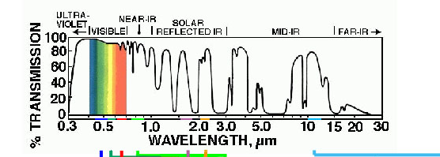
10.2.3 Multidimensional Measurement-Space Clustering

Slide 54
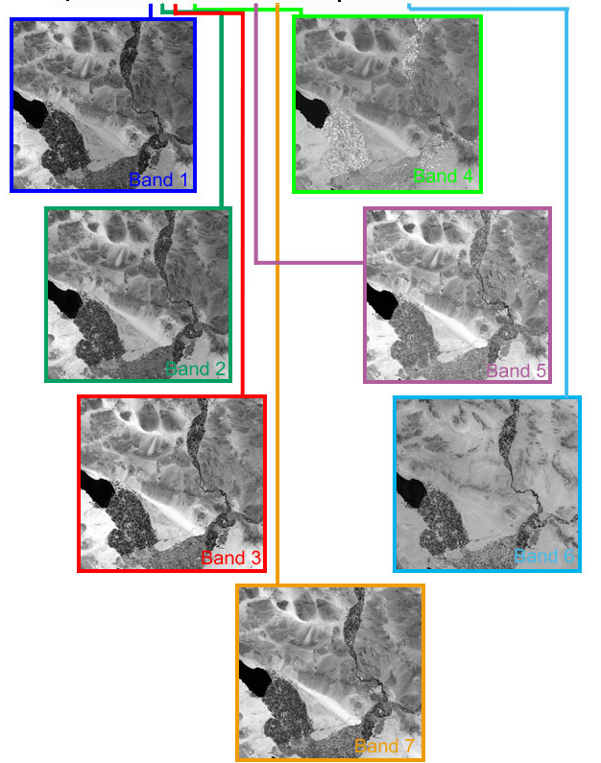

Slide 55
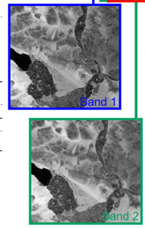
Band1: c1,c2,c3 三個clusters
Band2: c4,c5 兩個clusters
Band1 + Band2 的cluster 就可能是{(c1,c4),(c1,c5) ,(c2,c4) ,(c2,c5) ,(c3,c4) ,(c3,c5)}

Slide 56
10.2.4 Multidimensional Measurement-Space Clustering
What and purpose.

Slide 57
10.3.1 Single-Linkage Region Growing
Neighboring pixels whose properties are similar enough are joined by an arc.
Problem:
Chaining: Only takes on arc leaking from one region to a neighborhood one to cause the regions to merge.

Slide 58
Two pixels connected by edge: if 4-neighbor and values differ ≤ 5

Slide 59
10.3.2 Hybrid-Linkage Region Growing
The hybrid techniques seek to assign a property vector to each pixel where the property vector depends on the K x K neighborhood of the pixel.
Pixels that are similar are so because their neighborhoods in some special sense are similar.
Similarity is thus established as a function of neighboring pixel values, and this makes the technique better behaved on noisy data.

Slide 60
10.3.2 Hybrid-Linkage Region Growing
Hybrid-linkage region growing with edge operator
Steps:
Use an edge operator to label each pixel
edge or non-edge.
Neighboring pixels, neither of which is an edge, are joined by an arc.
Quality: highly dependent on the edge operator used.
Using simple operators (such as Roberts and Sobel operators) may provide too much region linkage. Why?
Notes:
Edge operator is the key

Slide 61
10.3.2 Hybrid-Linkage Region Growing

Slide 62
10.3.2 Hybrid-Linkage Region Growing
Haralick, Zero Crossing (details in Ch. 8)
Steps:
Each neighborhood is least-square fitted with cubic polynomial in two variables.
The first and second partial derivatives are easily determined.
Notes:
最小平方擬和

Slide 63
10.3.2 Hybrid-Linkage Region Growing
Haralick, Zero Crossing (details in Ch. 8)
Steps:
3. The first partial derivatives at the center pixel determine the gradient direction.
4. The second partials determine the second directional derivative.
5. If the gradient is high enough and if, in the gradient direction, the second directional derivative has a negatively sloped zero crossing inside the pixel’s area, then an edge is declared in the neighborhood area.

Slide 64
10.3.2
Haralick, Zero Crossing (details in Ch. 8)
Source: https://mipav.cit.nih.gov/pubwiki/index.php/Edge_Detection:_Zero_X_Laplacian

Slide 65
10.3.2 Hybrid-Linkage Region Growing
Haralick, Zero Crossing: Result

Slide 66
10.3.2 Hybrid-Linkage Region Growing
Pong (1984) facet model 小平面模型
Steps:
Segment the image into small regions.
Calculate the property vector of each segment.
Merge close enough regions, and replace property vectors with functions of neighboring regions.
Next iteration: repeat from Step 2.

Slide 67
10.3.2 Hybrid-Linkage Region Growing
Pong (1984) facet model
First iteration of the Pong algorithm

Slide 68
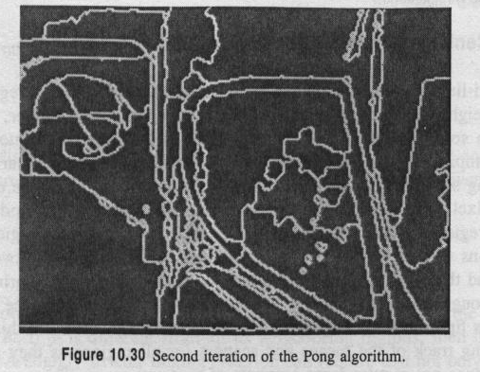
10.3.2 Hybrid-Linkage Region Growing
Pong (1984) facet model
Second iteration of the Pong algorithm

Slide 69
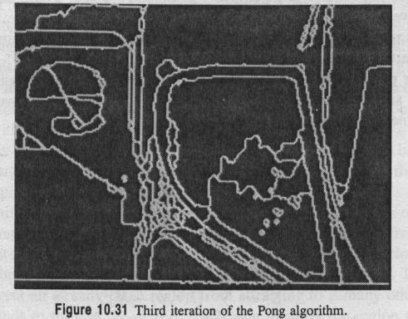
10.3.2 Hybrid-Linkage Region Growing
Pong (1984) facet model
Third iteration of the Pong algorithm

Slide 70
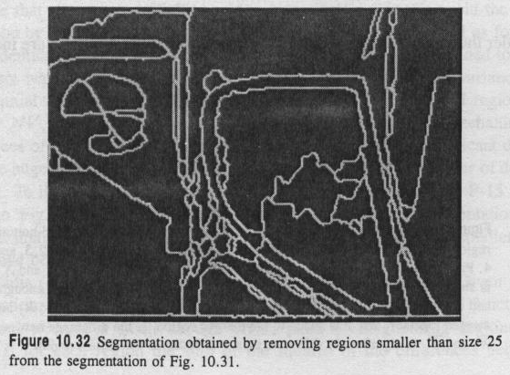
10.3.2 Hybrid-Linkage Region Growing
Pong (1984) facet model
after removing regions smaller than size 25

Slide 72
10.3.2 Hybrid-Linkage Region Growing
Jarvis and Patrick (1973) Shared-nearest-neighbor
Steps:
For every pixel:
examine its K*K neighborhood
By certain similarity, create a similar-neighbor list of the N pixels that similar with it.
Pixel A, with L(a)
Pixel B, with L(b)
If L(a) and L(b) have n pixels in common, and n is high enough, A joins with B.

Slide 73
10.3.2 Hybrid-Linkage Region Growing
Jarvis and Patrick (1973) Shared-nearest-neighbor
Better version:
Assign every pixel with a vector
consist of its own gray value and the mean of the gray level intensities of its K*K neighborhood pixels.

Slide 74
10.3.2 Hybrid-Linkage Region Growing
Jarvis and Patrick (1973) Shared-nearest-neighbor
Better version:
X(x, a), Y(y, b) are two neighbor pixels.
S = w₁(x-y)² + w₂(x-b)² + w₃(y-a)²
The similarity is determined by whether S is small enough.
w₁,w₂ ,w₃ : nonnegative weights learned from similar class training data.

Slide 75
10.3.3 Centroid-Linkage Region Growing
Difference: Pairs of neighboring pixels are not compared for similarity. Why is this useful?
Steps:
The image is scanned in some predetermined manner, such as left-right, top-bottom.
A pixel’s value is compared with the mean of an already existing but not necessarily completed neighboring segment.
If its value and the segment’s mean value are close enough, then the pixel is added to the segment and the segment’s mean is updated.

Slide 76
10.3.3 Centroid-Linkage Region Growing
Difference: Pairs of neighboring pixels are not compared for similarity. Why is this useful?
Steps:
If the means of the two competing regions are close enough, the two regions are merged and the pixel is added to the merged region.
If no neighboring region has a close-enough mean, then a new segment is established.

Slide 77
10.3.3 Centroid-Linkage Region Growing
Memory
Large or small?
Hash table for small multiple of pixels in a row.
Short Coming: V-shaped background regions
Solution: Two passes
Scanning direction has an impact on the result.

Slide 78
10.3.3 Centroid-Linkage Region Growing
Results
Notes:
One-pass centroid-linkage segmentation
Two-pass centroid segmentation of the bulkhead image

Slide 79
10.4 Hybrid-Linkage Combinations
Review (strength and weakness):
Single-Linkage
Strength: Spatially accurate
Weakness: Excessive merging
Centroid-Linkage
Strength: Ability to place boundaries in weak gradient areas
Combine the strengths?
Combined Centroid-Hybrid Linkage
Centroid-linkage for only non-edge pixels
Region growing is not permitted across edge pixels.

Slide 80
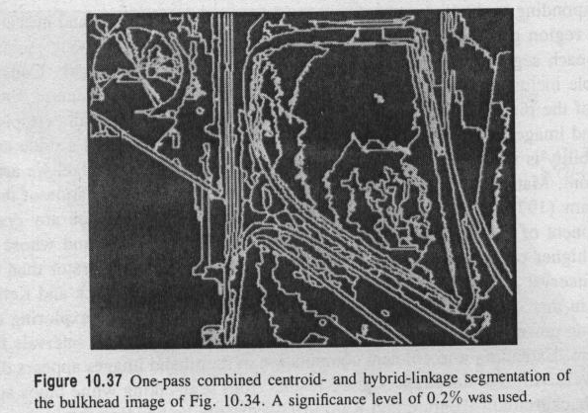
10.4 Hybrid-Linkage Combinations
One-pass combined centroid and hybrid-linkage segmentation

Slide 81
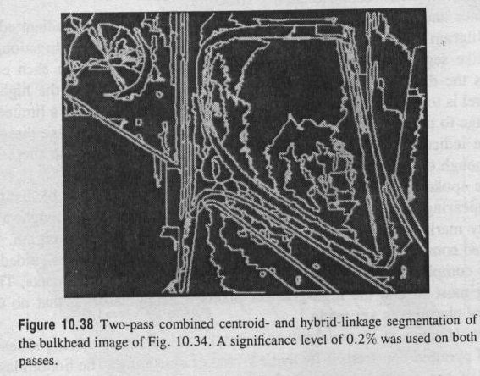
10.4 Hybrid-Linkage Combinations
Two-pass combined centroid and hybrid-linkage segmentation

Slide 82
10.5 Spatial Clustering
Introduction: Simultaneously combining clustering in measurement space with a spatial region growing.
Example: Haralick and Kelly (1969)
Find the peaks of the histogram
Find the pixels in the peaks, they are the initial segments
Perform region growing

Slide 83
10.6 Split and Merge
Steps:
Begins with the entire image as the initial segment
Successively splits each of its current segments into quarters if the segment is not homogeneous enough.
A merging method starts with an initial segmentation and successively merges regions that are similar enough.
homogeneous enough:
Max – min
Variance
Efficiency of the split-and-merge method can be increased by arbitrarily partitioning the image into square regions of a user-selected size and then splitting these further, if they are not homogeneous

Slide 84
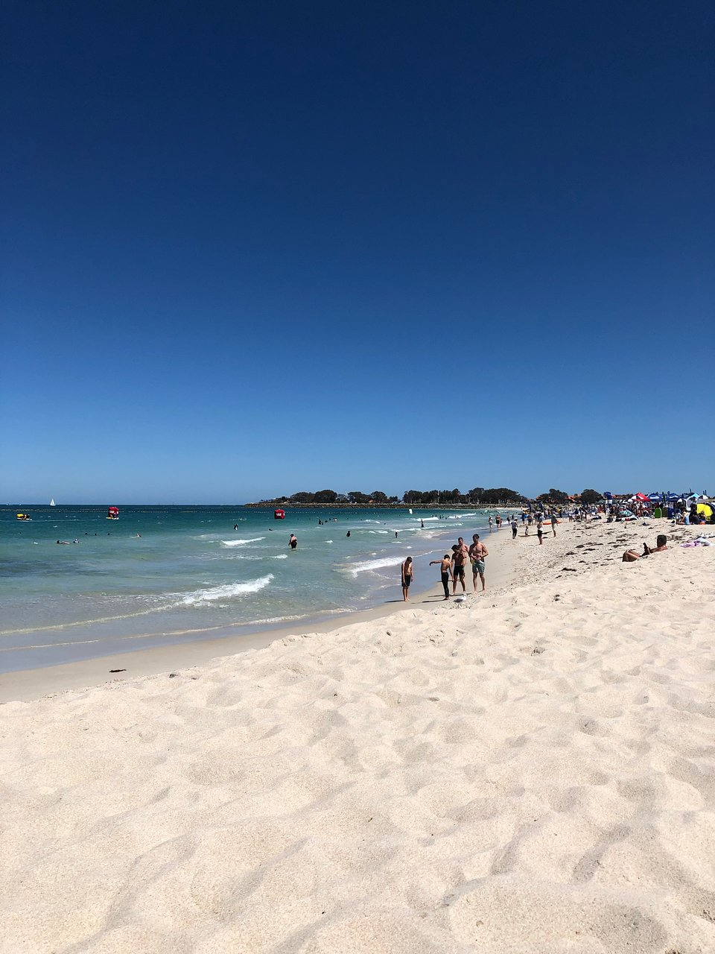
10.6 Split and Merge

Slide 85
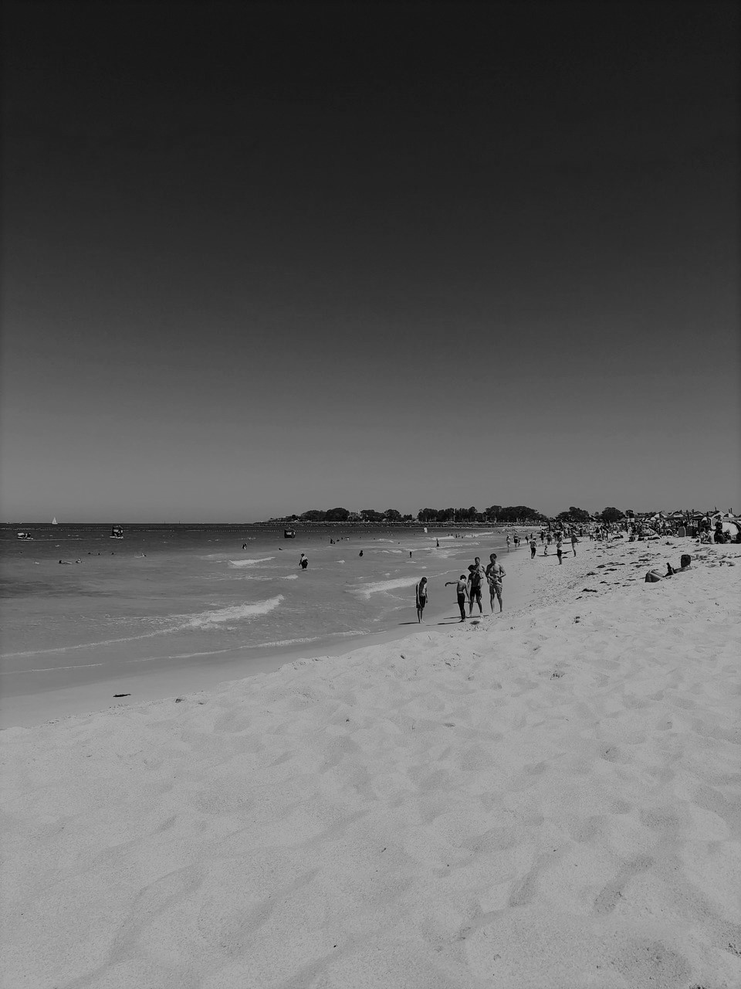
10.6 Split and Merge

Slide 86
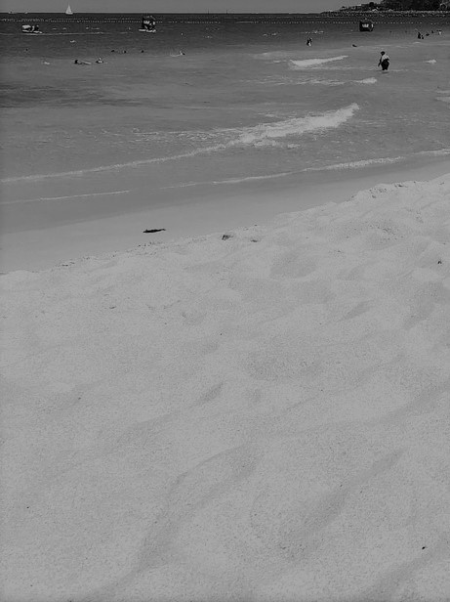
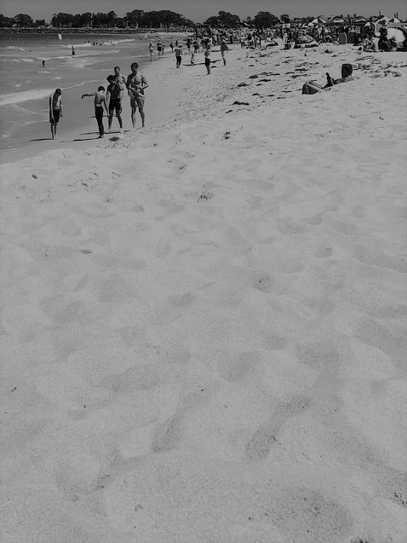
10.6 Split and Merge

Slide 87
10.6 Split and Merge

Slide 88
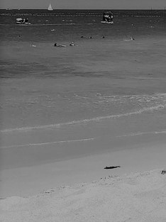
10.6 Split and Merge

Slide 89
10.6 Split and Merge
Downside:
Boundaries tend to be squarish and artificial.
Large memory usage
Miss-merging
Solution:
Horowitz and Pavlidis (1976)
Data structure: Quadtree

Slide 90
10.6 Split and Merge
Horowitz and Pavlidis (1976) Data structure: Quadtree
The entire image is represented by the root node.
The children of the root are the regions obtained by splitting the root into four equal pieces, and so on.
A segmentation is represent by a cutset, a minimal set of nodes separating the root from all of the leaves.

Slide 91
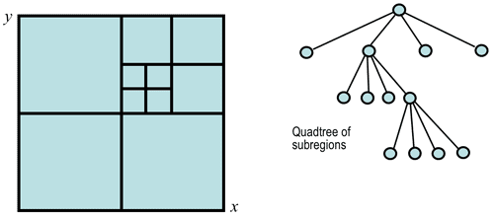
10.6 Split and Merge
Horowitz and Pavlidis (1976) Data structure: Quadtree
A segmentation is represent by a cutset, a minimal set of nodes separating the root from all of the leaves.

Slide 92
10.6 Split and Merge
Horowitz and Pavlidis (1976) Data structure: Quadtree
In the tree structure
the merging process consists of removing four nodes from the cutset and replacing them with their parent.
Splitting consists of removing a node from the cutset and replacing it with its four children
The two processes are mutually exclusive

Slide 93
10.6 Split and Merge
Horowitz and Pavlidis (1976) Data structure: Quadtree
All the merging operations are followed by all the splitting operation.
The splitting and merging in the tree structure is followed by a final grouping procedure that can merge adjacent unrelated blocks found in the final cutset.

Slide 94
10.6 Split and Merge
Figure 10.40 illustrates the result of a Horowitz and Pavlidis type split-and-merge segmentation of the bulkhead image.

Slide 95
10.7 Rule-Based Segmentation
Introduction: It is not easy to try different concepts without complete reprogramming, thus the rule-based system is born.
The Nazif and Levine system (1984)
Rule-based expert system for segmentation
Not application domain specific but include general-purpose, scene-independent knowledge about images and grouping criteria.
Allows more specific strategies to be incorporated without changing the code
Chapter 19 has details of this system.

Slide 96
10.7 Rule-Based Segmentation
The Nazif and Levine system (1984)
Composition:
set of processes
The initializer
The line analyzer
The region analyzer
The area analyzer
The focus of attention
the scheduler
two associate memories
the short-term memory (STM)
the long-term memory (LTM)

Slide 97
10.7 Rule-Based Segmentation
The Nazif and Levine system (1984)
The short-term memory :
holds the input image, the segmentation data, and the output.
The long-term memory:
contains the model representing the system knowledge about low-level segmentation and control strategies.
When a system process matches rules in the LTM against the data stored in the STM. the rule fires, and an action, usually involving data modification, is performed.

Slide 98
10.7 Rule-Based Segmentation
The Nazif and Levine system (1984)
LTM has three levels of rules.
Levels 1 to 3 (from lowest to highest)
level 1 are knowledge rules that encode information about the properties of regions, lines, and areas in the form of situation-action pairs.
The specific actions include splitting a region; merging two regions; adding, deleting, or extending a line; merging two lines; and creating or modifying a focus-of-attention area.
Knowledge rules are classified by their actions.

Slide 99
10.7 Rule-Based Segmentation
The Nazif and Levine system (1984)
LTM has three levels of rules.
level 2 are the control rules, which are divided into two categories:
focus-of-attention rules and inference rules.
Focus-of-attention rules find the next data entry to be considered: a region, a line, or an entire area. These rules control the focus-of-attention strategy.
Inference rules are meta-rules in that their actions do not modify the data in the STM. Instead, they alter the matching order of different knowledge rule sets. Thus they control which process will be activated next.

Slide 100
10.7 Rule-Based Segmentation
The Nazif and Levine system (1984)
LTM has three levels of rules.
Level 3 is the highest rule level, are strategy rules that select the set of control rules that executes the most appropriate control strategy for a given set of data.

Slide 101
10.7 Rule-Based Segmentation
The Nazif and Levine system (1984)
The conditions of the rules are made up of
(1) a symbolic qualifier depicting a logical operation to be performed on the data
(2) a symbol denoting the data entry on which the condition is to be matched
(3) a feature of this data entry
(4) an optional NOT qualifier
(5) an optional DIFFERENCE qualifier that applies the operation to differences in feature values.

Slide 102
10.7 Rule-Based Segmentation
Different data entry types allowed

Slide 103
10.7 Rule-Based Segmentation
Numerical descriptive features that can be associated with condition

Slide 104
10.7 Rule-Based Segmentation
Numerical spatial features that can be associated with condition

Slide 105
10.7 Rule-Based Segmentation
Logical features that can be associated with the condition part of a rule (True/False)

Slide 106
10.7 Rule-Based Segmentation
Area, region, and line analyzer actions that can be associated with a rule

Slide 107
10.7 Rule-Based Segmentation
Focus-of-attention and supervisor actions that can be associated with a rule.

Slide 108
10.7 Rule-Based Segmentation
Example rules

Slide 109
10.7 Rule-Based Segmentation
Example: Segmentation of Aerial Imagery
Source: McKEOWN et al.: RULE-BASED INTERPRETATION OF AERIAL IMAGERY

Slide 110
10.7 Rule-Based Segmentation
Example: Segmentation of Aerial Imagery
Source: McKEOWN et al.: RULE-BASED INTERPRETATION OF AERIAL IMAGERY

Slide 111
10.7 Rule-Based Segmentation
Example: Segmentation of Aerial Imagery
Source: McKEOWN et al.: RULE-BASED INTERPRETATION OF AERIAL IMAGERY

Slide 112
10.8 Motion-Based Segmentation
In time-varying image analysis, the data are a sequence of images instead of a single image.
The motion of the objects creates a change in the images that can be used to help locate the moving objects.
Stationary camera: Thompson
Non-stationary camera: Jain
Chapter 15

Slide 113
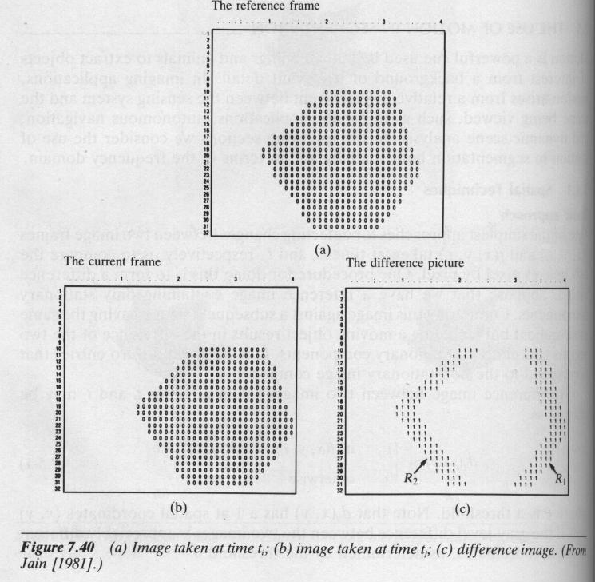
10.8 Motion-Based Segmentation (cont’)

Slide 114
10.8 Motion-Based Segmentation
Stationary camera: Thompson
A stationary camera viewing a scene containing moving objects.
Partitioning a scene into regions corresponding to surfaces with distinct velocities.
In each frame of the sequence after the first frame the moving objects appear in different positions of the image from those in the previous frame.

Slide 115
10.8 Motion-Based Segmentation
Stationary camera: Thompson
first computed velocity estimates for each point of the scene (see Chapter 15)
and then performed the segmentation by a region-merging procedure that combined regions based on similarities in both intensity and motion.

Slide 116
10.8 Motion-Based Segmentation
Non-stationary camera: Jain
A non-stationary camera viewing a scene containing moving objects.
Ego-Motion Polar Transform (EMP)!!!!!
The Ego-Motion Polar Transform used the known location of the focus of expansion (see Chapter 15) to transform the original frame sequence into another camera-centered sequence
Transform then judge
Notes:
擴張焦點
強調最後這句

Slide 117
10.8 Motion-Based Segmentation
Non-stationary camera: Jain
A (x, y, z)
Camera (x₀, y₀, z₀)
During the time interval between frames:
A undergoes displacement (dx, dy, dz)
camera undergoes displacement (dx₀, dy₀, dz₀)

Slide 118
10.8 Motion-Based Segmentation
Non-stationary camera: Jain
When the projection plane is at z = 1, the focus of expansion is at (dx₀ /dz₀ dy₀ /dz₀).
The projection A‘ of point A after the displacements is at (X, Y) in the image plane, where
$X=\frac{(x+dx−x_{0}−dx_{0})}{(z+dz−z_{0}−dz_{0})}$ $Y=\frac{(y+dy−y_{0}−dy_{0})}{(z+dz−z_{0}−dz_{0})}$

Slide 119
10.8 Motion-Based Segmentation
Non-stationary camera: Jain
The point A' is converted into its polar coordinates (r, $θ$), with the focus of expansion being the origin in the image plane. The polar coordinates are given by
$θ= \tan^{−1}{[\frac{dz_{0}\left(y+dy−y_{0}\right)−dy_{0}\left(z+dz−z_{0}\right)}{dz_{0}\left(x+dx−x_{0}\right)−dx_{0}\left(z+dz−z_{0}\right)}}]$
$r=[(X−dx_{0})^{2}+(Y−dy_{0})^{2}]^{\frac{1}{2}}$

Slide 120
10.8 Motion-Based Segmentation
Non-stationary camera: Jain
If the camera continues its motion in the same direction, then the focus of expansion remains the same, and $θ$ remains constant.
Thus the radial motion of the stationary point A‘ in the image plane due to the motion of the camera is converted to horizontal motion in (r, $θ$) space.

Slide 121
10.8 Motion-Based Segmentation
Non-stationary camera: Jain
If the camera has only a translational component to its motion, then:
The regions that show only horizontal velocity in the (r, $θ$) space can be classified as due to stationary surfaces.
The regions having a vertical velocity component are due to nonstationary surfaces.
Notes:
相對運動
追焦時的物體 相對於 相機只會有垂直方向的速度
背景則 相對於 相機只會有水平方向的速度

Slide 122
10.9 Summary
Single-Linkage
Simplest and most prone to unwanted merge.
Hybrid and centroid region growing
Split-and-merge
Not subject to unwanted merge
Large memory usage and blocky boundaries
Measurement-space-guided spatial clustering
Regions not smoothly bounded, many holes
Spatial-clustering
Not well-enough tested
Hybrid-Linkage
Best compromise between smooth boundaries and few unwanted regions

Slide 123
10.9 Summary
Algorithms | Pros | Cons
Single Linkage Region Growing | Simple | Region merge errors
Hybrid/Centroid Linkage Region Growing | Avoid region merge errors | complex
Split and Merge | Avoid region merge errors | Large memory usage, Blocky region boundary
MS Clustering | Avoid region merge errors, blocky boundary | Ragged bound regions, Salt and Pepper noise

Slide 124
Thank you ☺

