Slide 1
Vehicle License Plate Image Restoration
Presenter: 康家豪
E-mail: jack.kang0808@gmail.com
Phone: 0967085045

Slide 2
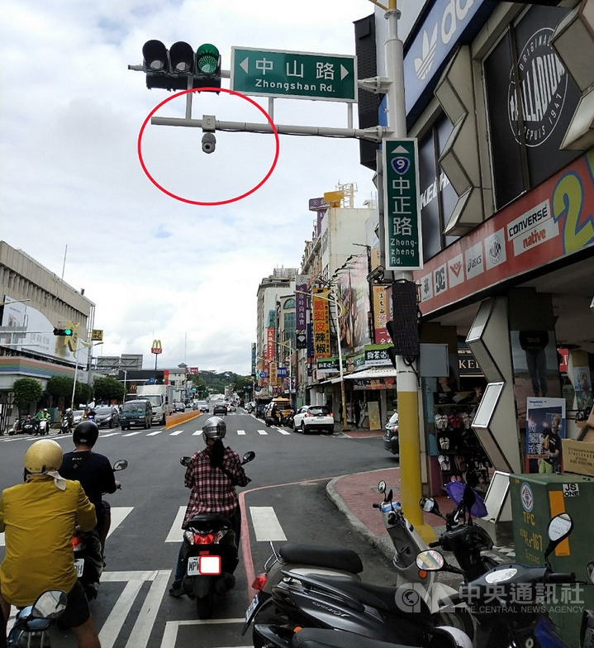
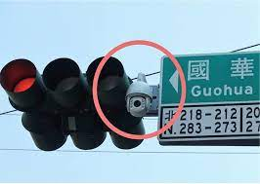
Technology Law Enforcement

Slide 3
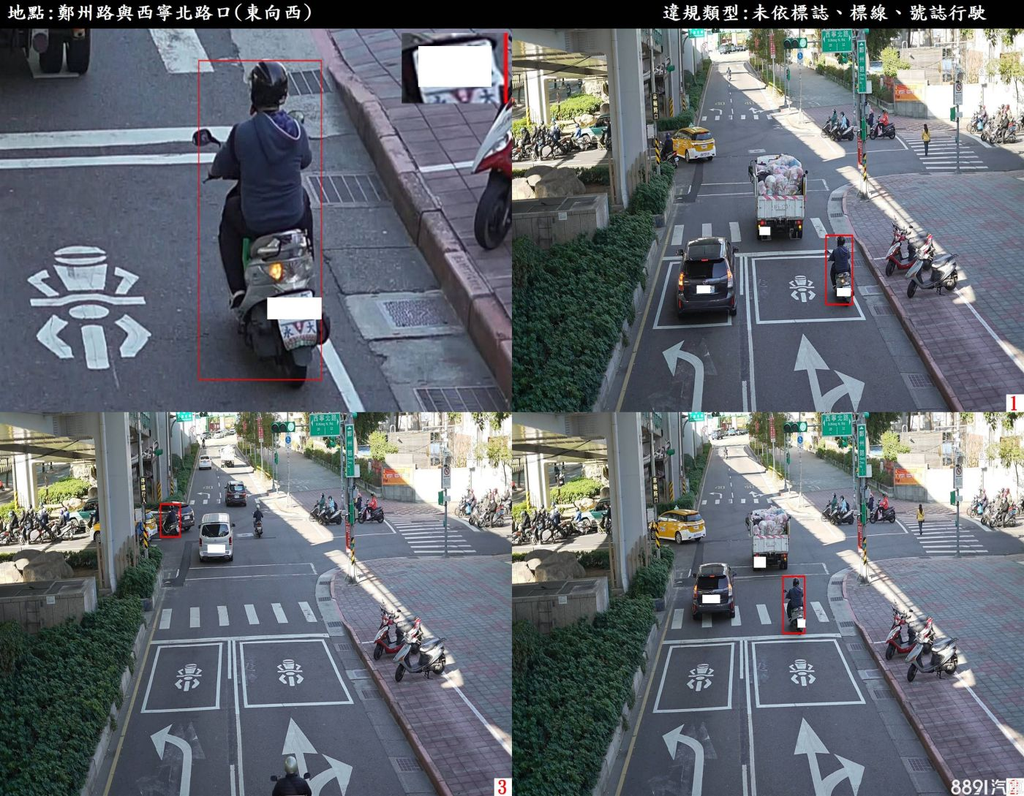

Slide 4
Clear License Plate

Slide 5
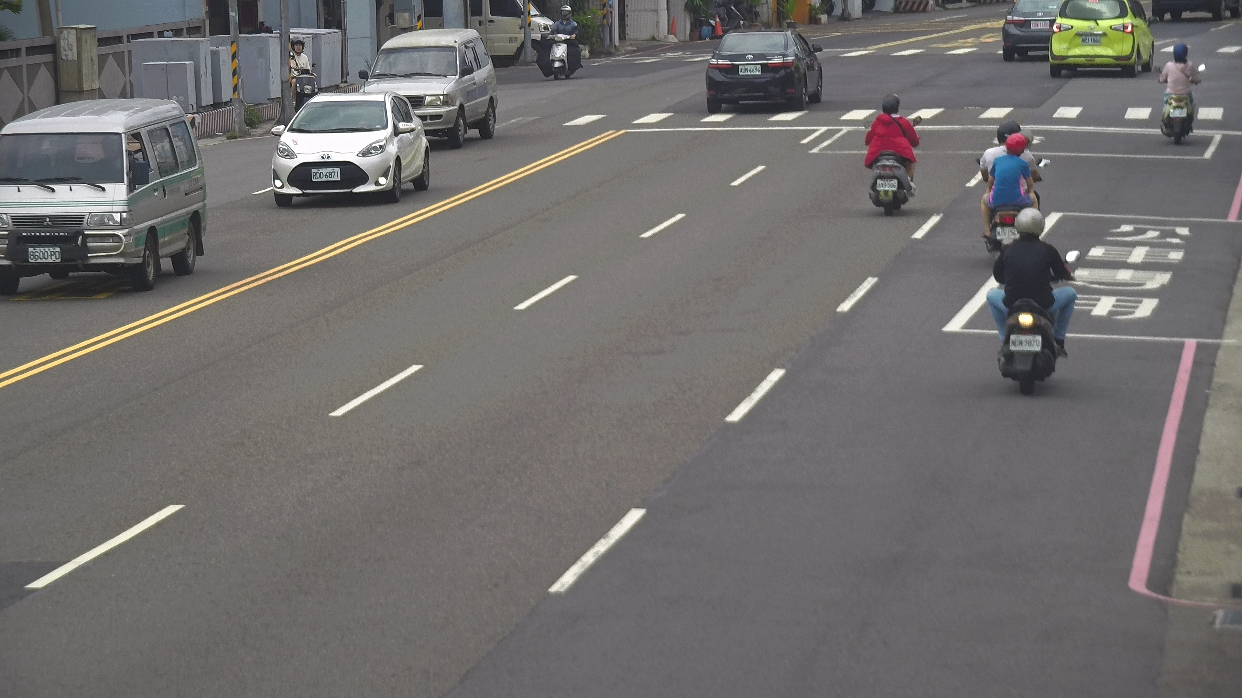
Blur License Plate

Slide 6
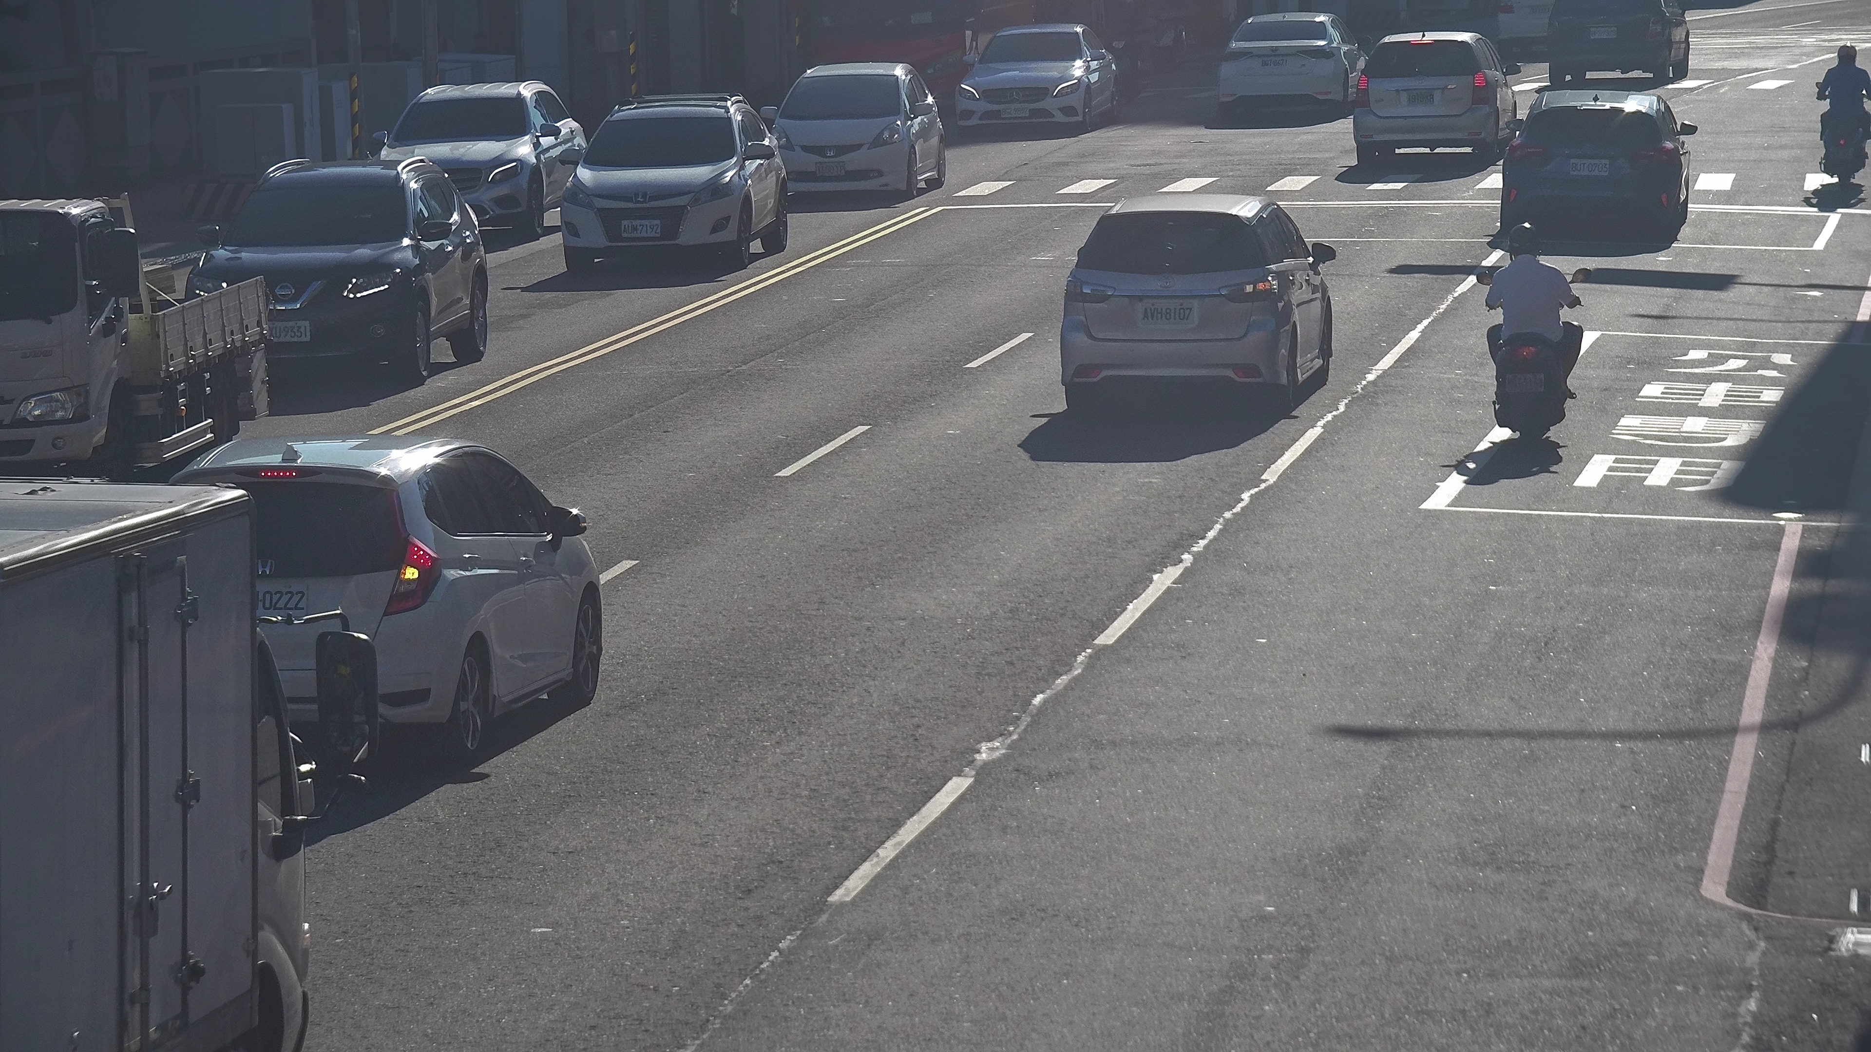

Slide 7
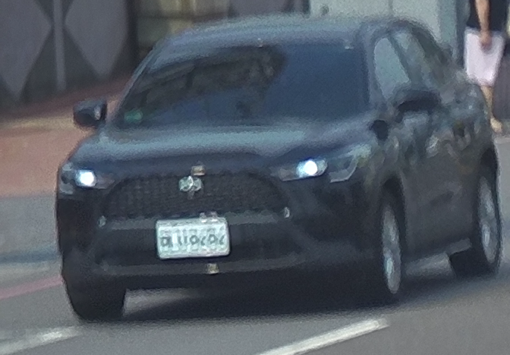
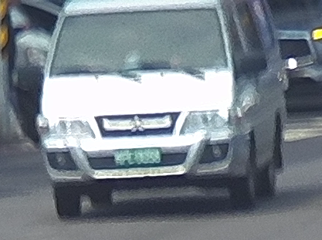
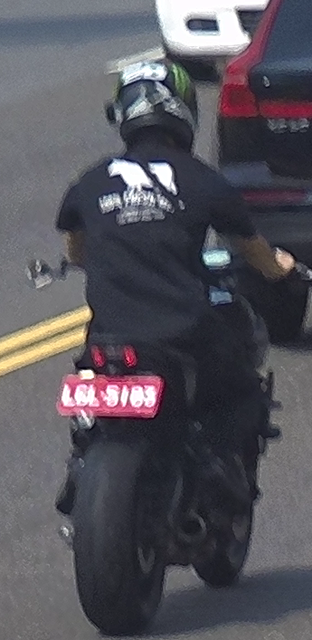
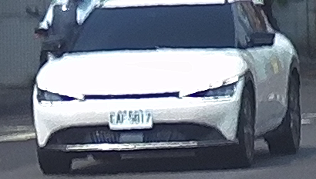
Real-world Blur Image

Slide 8
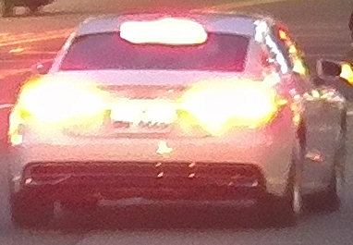
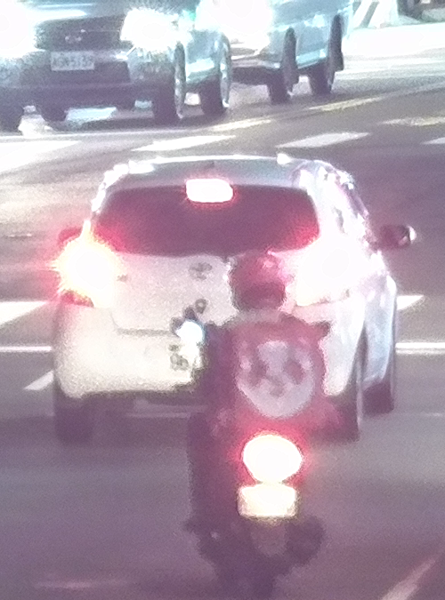
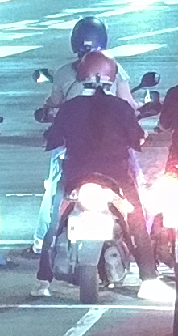
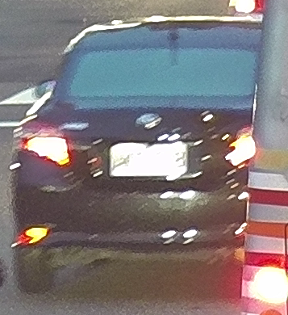
Real-world Blur Image

Slide 9
Motion Blur
When a camera captures a moving subject or is in motion while capturing an image, it results in motion blur. This occurs because the position of objects changes, leaving a trail or multiple trails of blurred pixels on the light-sensitive sensor.
In digital image processing, motion blur can be artificially applied to an image using filters or algorithms to recreate this effect. By doing so, it imparts a sense of movement or dynamic action to static images.

Slide 10
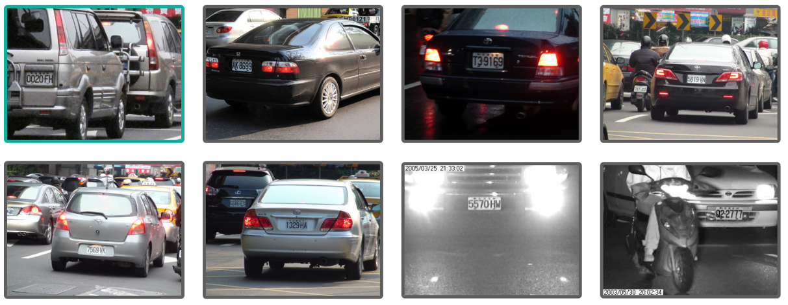
Dataset- AOLP (Application-Oriented License Plate)
The application-oriented license plate (AOLP) benchmark database has 2049 images of Taiwan license plates, with various locations, time, tracffic, and weather conditions.
We used the subset of the dataset which is refers to traffic law enforcement. 757 images were collected for this application category.

Slide 11
Generate Blurred Images – Motion Blur
We randomly blur the images using a random blur length and angle for the point-spread function responsible for motion-deblurring of an image.
The Point-Spread Function (PSF) is a mathematical description or model that represents how a point source of light is spread out or blurred in an image due to the characteristics of the imaging system or optical system.
The range of blur length is 5-10 pixels and angle is 0-360 degrees.

Slide 12
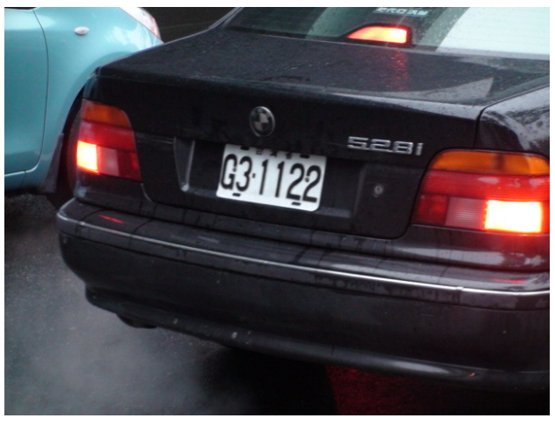
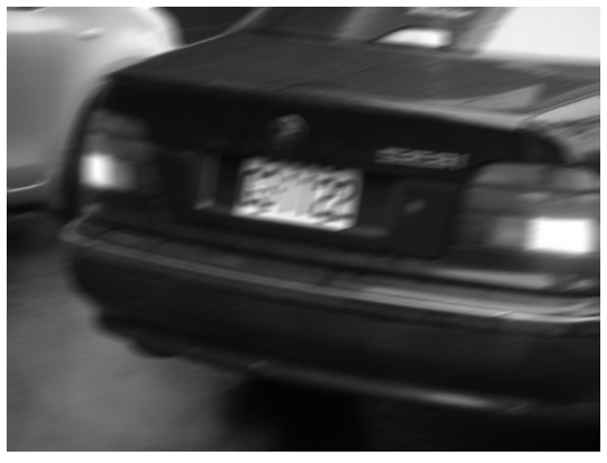
Generate Blurred Images
Original Image
(length, angle) | (20, 15) | (40, 15) | (40,45)
Kernel
Blurred Image

Slide 13
Generate Blurred Images – Gaussian kernels
Isotropic and anisotropic Gaussian filters are the common choices for blur kernels. We show several Gaussian kernels and their corresponding blurry images
Isotropic Gaussian Filter(各向同性高斯濾波器):
An isotropic Gaussian filter is a uniform filter whose blur effect is the same in all directions. In other words, it blurs all parts of the image to the same degree.
Anisotropic Gaussian Filter (各向異性高斯濾波器)
The anisotropic Gaussian filter is a non-uniform filter that affects the image differently in different directions. This means it can simulate a blur effect in a specific direction.

Slide 14
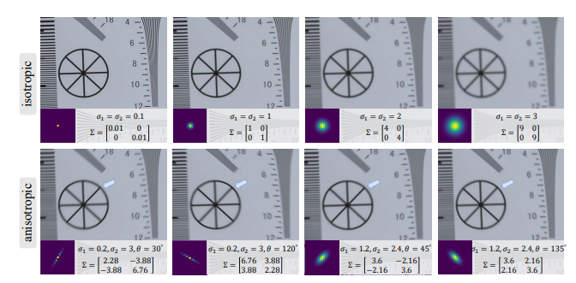
Generate Blurred Images – Gaussian kernels

Slide 15
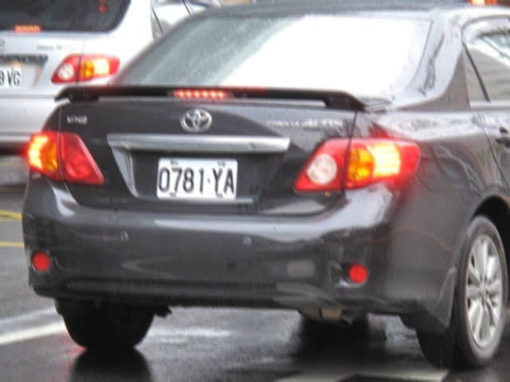
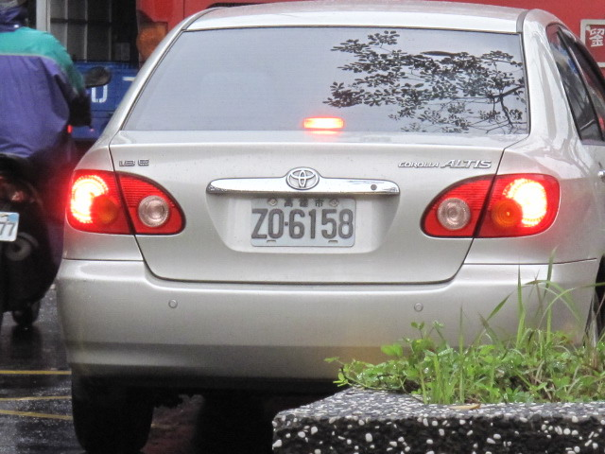
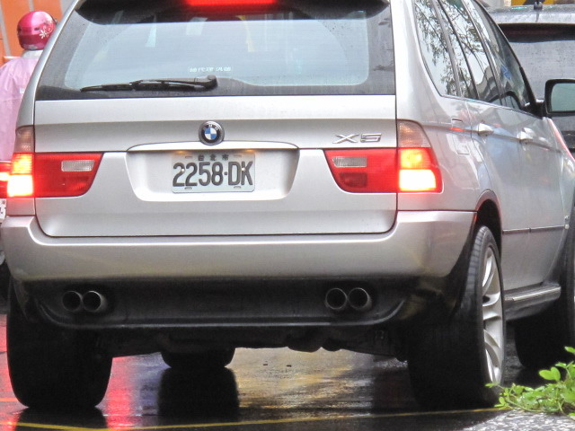
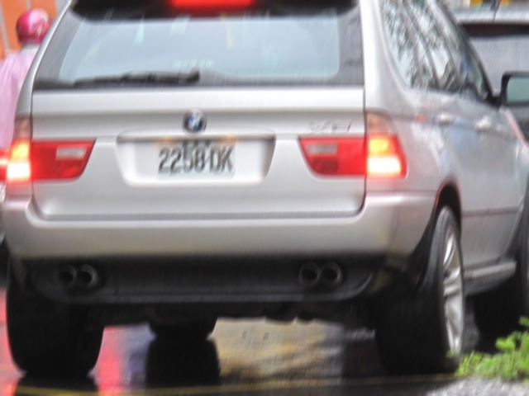
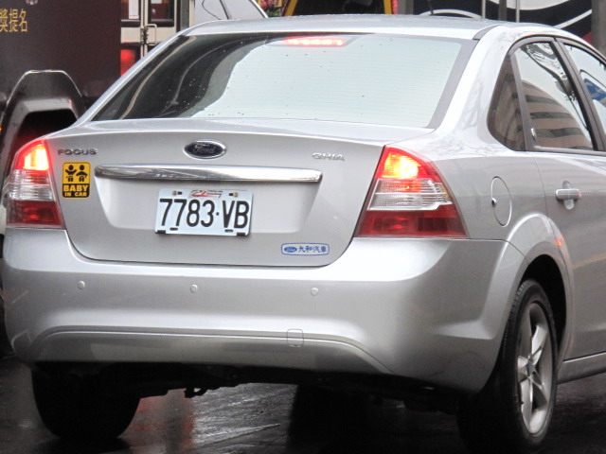
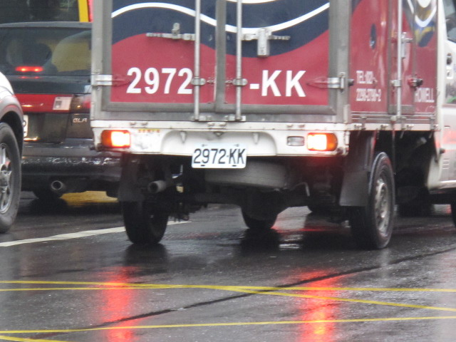
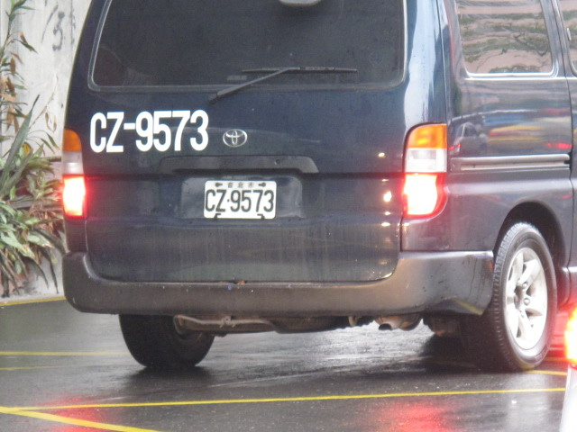
Generated Blurred Images Dataset

Slide 16
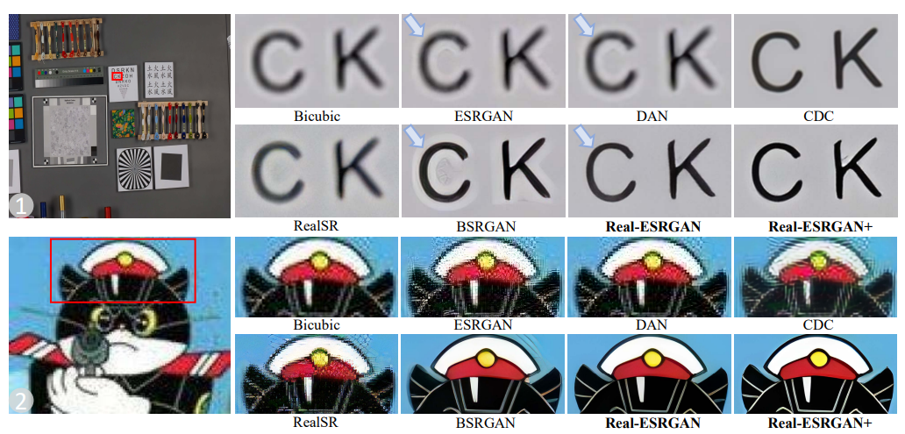
Real-ESRGAN
Real-ESRGAN: Real Enhanced Super-Resolution Generative Adversarial Networks
Though many attempts have been made in blind super resolution to restore low-resolution images with unknown and complex degradations, they are still far from addressing general real-world degraded images.
Real-ESRGAN extends the powerful ESRGAN to a practical restoration application.

Slide 17
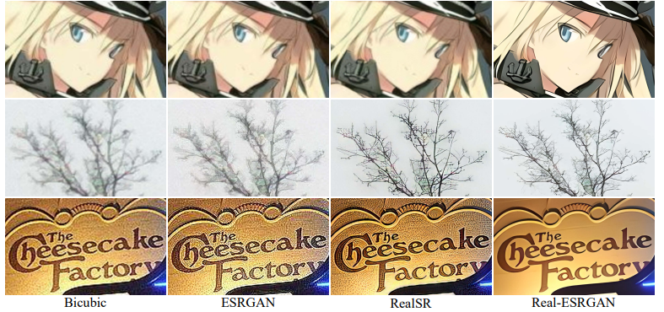

Slide 18
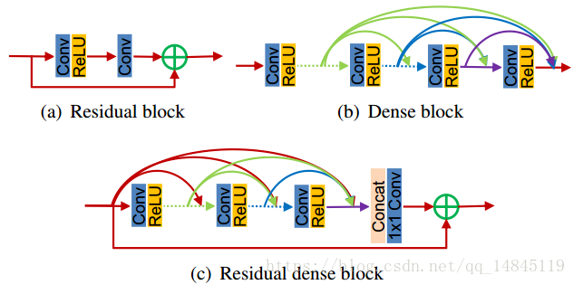
Real-ESRGAN Generator
Real-ESRGAN adopts the same generator as ESRGAN.
Notes:
Residual Block
解決梯度消失問題：深度神經網絡中的主要問題之一是梯度消失，即在反向傳播過程中，梯度逐漸減小，使得深層網絡難以訓練。殘差塊通過引入跳躍連接（shortcut connection）或者稱為快捷連接，可以有效地解決這個問題。這個跳躍連接允許梯度在網絡中更容易地傳播，因為梯度可以通過跳躍連接直接傳遞到更早的層次。
支持訓練非常深的網絡：殘差塊的引入使得訓練非常深的網絡成為可能。由於梯度能夠更自由地傳播，因此可以構建數百層的深度卷積神經網絡，而不會遇到梯度消失或梯度爆炸的問題。
Dense Block
特征重用：Dense Block中的每个层都连接到前面的所有层，使得每个层都可以接收来自之前所有层的特征图作为输入。这意味着在Dense Block内部，特征可以被充分重复使用和传递。这有助于网络更好地捕捉和利用输入图像中的各种信息和特征。
梯度流：Dense Block内部的密集连接可以有效地解决梯度消失问题。因为每个层都有跨层的梯度流，所以即使在非常深的网络中，梯度仍然可以有效地传播。这使得可以构建非常深的神经网络，而不会遇到训练困难的问题。

Slide 19
Real-ESRGAN Discriminator
Real-ESRGAN improves the VGG-style discriminator in ESRGAN to an U-Net design with skip connections. The U-Net outputs realness values for each pixel, and can provide detailed per-pixel feedback to the generator.

Slide 20
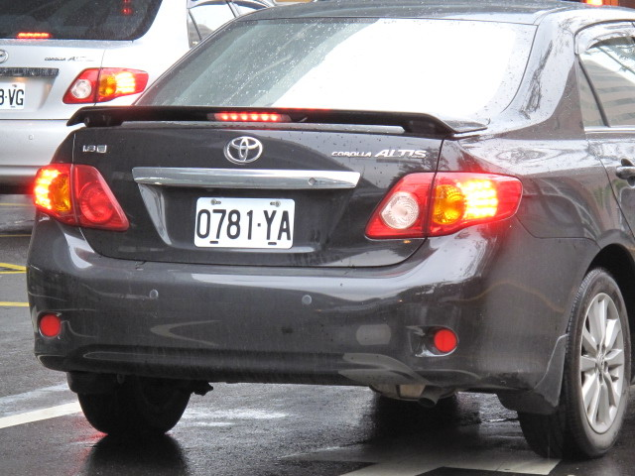
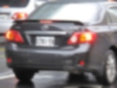
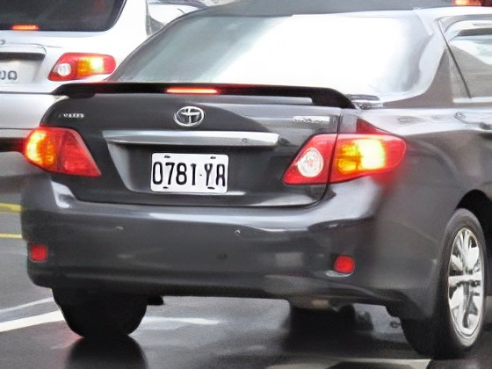
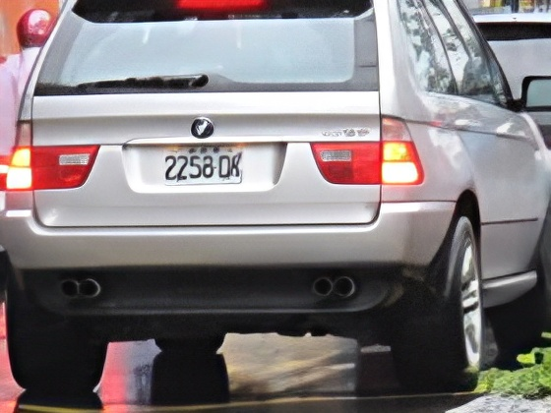
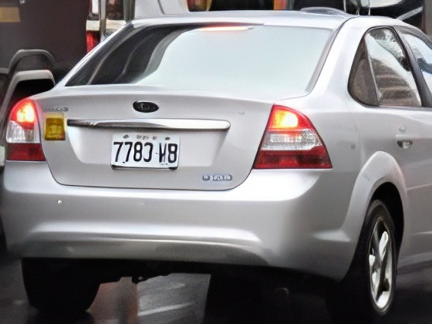
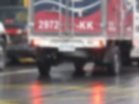
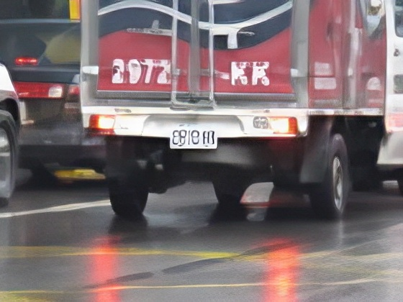
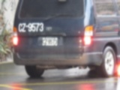
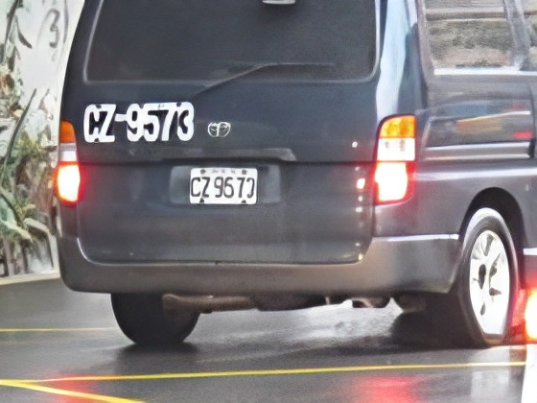
Experiment Result
Ground truth | Blur image | Deblur result | Ground truth | Blur image | Deblur result

Slide 21
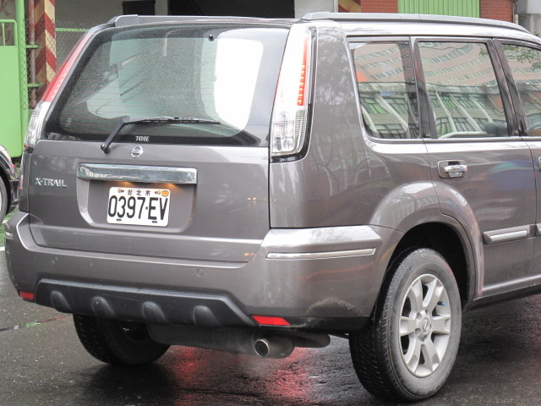
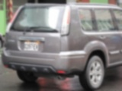
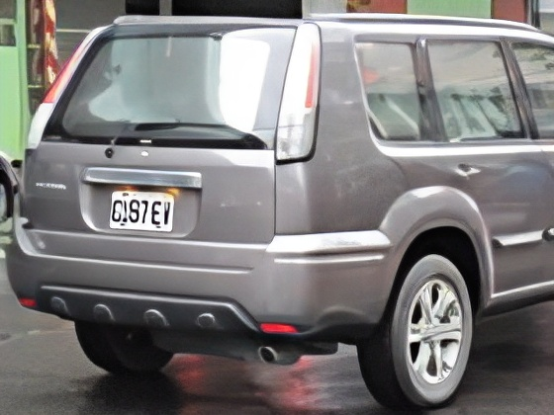
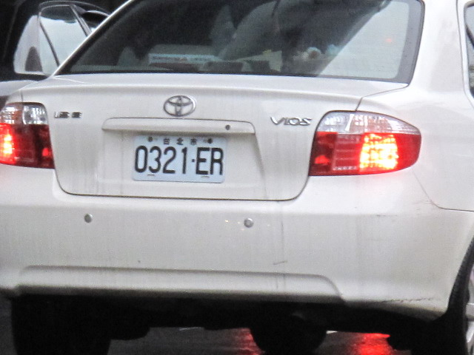
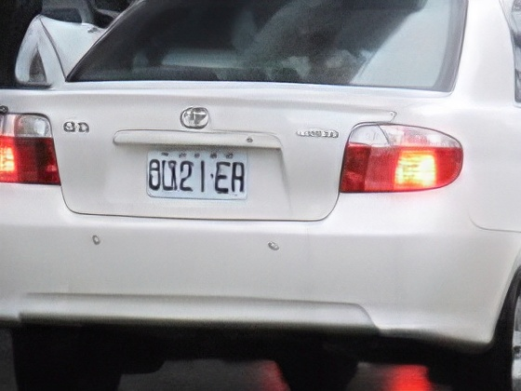
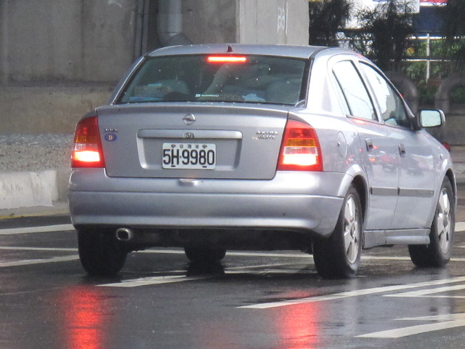
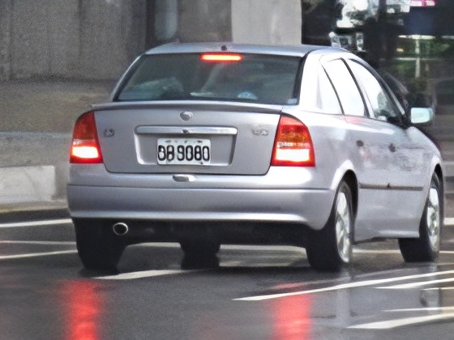
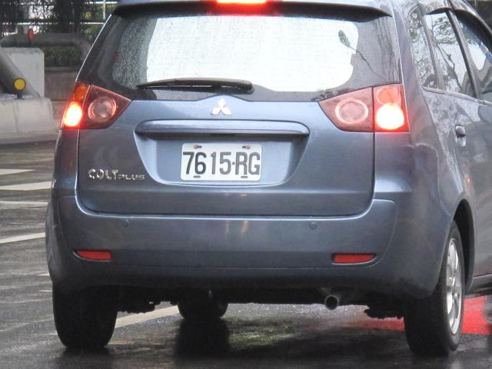
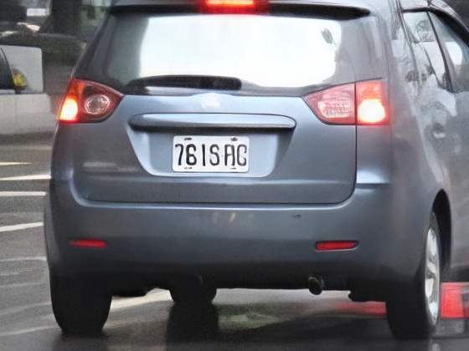
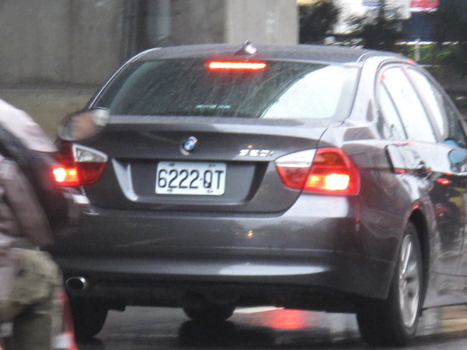
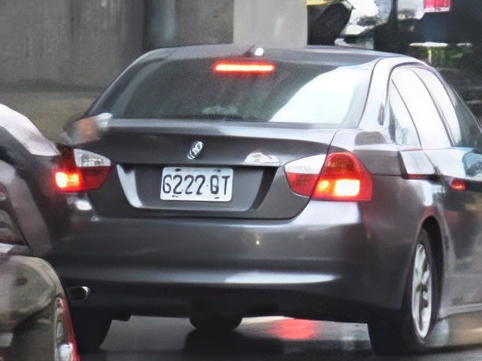
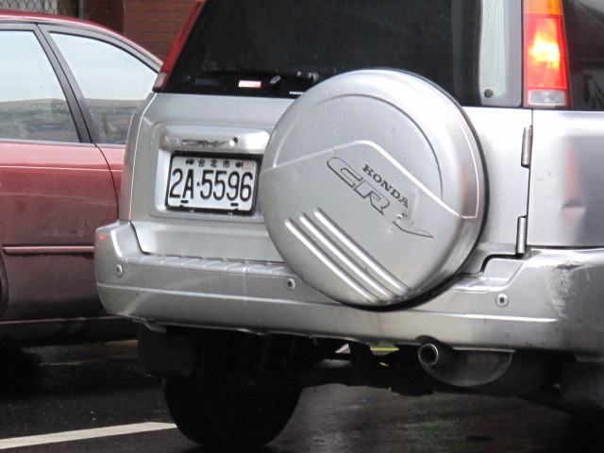
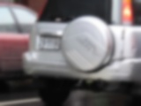
Experiment Result
Ground truth | Blur image | Deblur result | Ground truth | Blur image | Deblur result

Slide 22
Test
Method: Using Real-ESRGAN to restore blur license plate
Step: Generate blur image -> training Real-ESRGAN model ->restore blur license plate successfully
Result: Make the blur license plate number can be recognize

Slide 23
References
G. -S. Hsu, J. -C. Chen and Y. -Z. Chung, "Application-Oriented License Plate Recognition," in IEEE Transactions on Vehicular Technology, vol. 62, no. 2, pp. 552-561, Feb. 2013
https://github.com/xinntao/Real-ESRGAN

