Slide 1
Super Resolution
Presenter: Ting Chen 陳 婷
E-mail: tiffany970216@gmail.com
Phone: 0906334568

Slide 2
Introduction (1/7)
01
HR: High-Resolution
LR: Low-Resolution
Super-Resolution (SR)
Super-resolution (SR) refers to the reconstruction of corresponding high-resolution (HR) images from observed low-resolution (LR) images.
Most of current research is on single image super-resolution (SISR).
SR is often used in fields such as surveillance equipment, satellite imagery, and medical imaging.
W. Yang, X. Zhang, Y. Tian, W. Wang, J. Xue and Q. Liao, “Deep Learning for Single Image Super-Resolution: A Brief Review,” in IEEE Transactions on Multimedia, vol. 21, no. 12, pp. 3106-3121, Dec. 2019, doi: 10.1109/TMM.2019.2919431.
01
Notes:
超解析（SR）是指從觀察到的低解析度圖像重建相應的高解析度圖像。
當前的大多數研究都是關於單圖像超解析（SISR）。
SR常用於監控設備、衛星圖像、醫學成像等領域。

Slide 3
Introduction (2/7)
01
PCB: Printed Circuit Board
LR: Low-Resolution
HR: High-Resolution
Research Direction
Use traditional image processing methods to perform super resolution on the solder ball of the printed circuit board (PCB board) image.
The solder ball image is subjected to 4x down-sampling through bicubic interpolation to generate a low-resolution (LR) image, and then reconstructed back to a high-resolution (HR) image through an image processing algorithm.
The goal is to make the two images as close as possible.
02
Notes:
利用傳統的影像處理方法對印刷電路板（PCB板）影像的錫球進行超解析。
焊球影像透過雙三次插值進行 4 倍下採樣，生成低解析度 (LR) 影像，然後透過影像處理演算法重建回高解析度 (HR) 影像。
目標是使兩個影像盡可能接近。

Slide 4
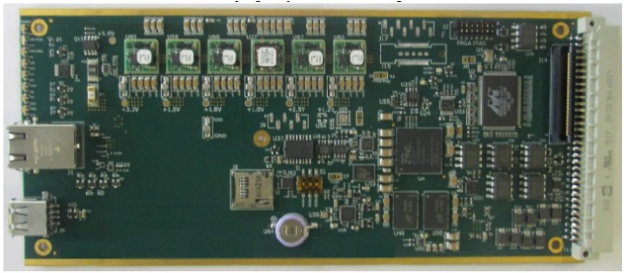
Introduction (3/7)
01
PCB: Printed Circuit Board
PCB Inspection
PCB inspection is an essential part of the electronic industry to find out the defects, such as voids, short circuits, and so on.
In the current PCB inspection, the common methods are Automated Optical Inspection (AOI), Solder Paste Inspection (SPI), and Automated X-ray Inspection (AXI).
Void
A kind of PCB [1].
03
Notes:
PCB檢測是電子行業的重要組成部分，用於找出缺陷，例如空洞、短路等。
在目前的PCB檢測中，常見的方法有自動光學檢測（AOI）、焊膏檢測（SPI）和自動X射線檢測（AXI）。

Slide 5
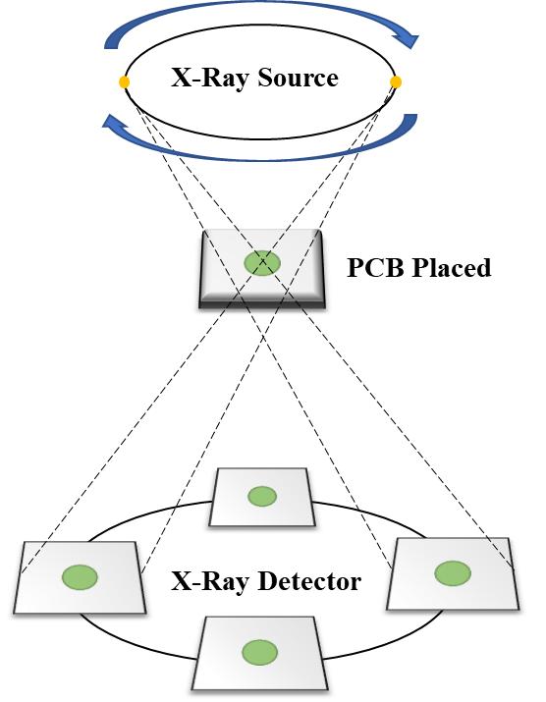
Introduction (4/7)
01
PCB: Printed Circuit Board
PCB X-Ray Image
The X-Ray machine to capture images of the PCB board to be inspected surrounding 360°. If a PCB is captured every 11.25°, then 32 X-Ray images can be obtained.
04
Notes:
X光機對待檢PCB板進行360°全方位拍攝圖像。 如果每 11.25° 捕獲一次 PCB，則可以獲得 32 張 X 射線圖像。

Slide 6
Introduction (5/7)
01
Defect Inspection Process
The defect inspection process of our collaborative company, Test Research, Inc.
For efficiency, they reduce the size of the images and perform 3D image reconstruction before enlarging them back to their original size.
Current Down-Scaling and Up-Scaling Methods: Bicubic.
Therefore, the quality of X-ray images is crucial. If the image quality is distorted, or details are lost after enlargement, the defect inspection system may make errors.
05
Notes:
我們的合作公司 Test Research, Inc. 的缺陷檢查流程。
為了提高效率，他們會縮小圖像的尺寸並執行 3D 圖像重建，然後再將其放大回原始尺寸。
當前的縮小和放大方法：雙三次。
因此，X 射線圖像的質量至關重要。 如果圖像質量失真，或者放大後細節丟失，缺陷檢測系統可能會出錯。

Slide 7
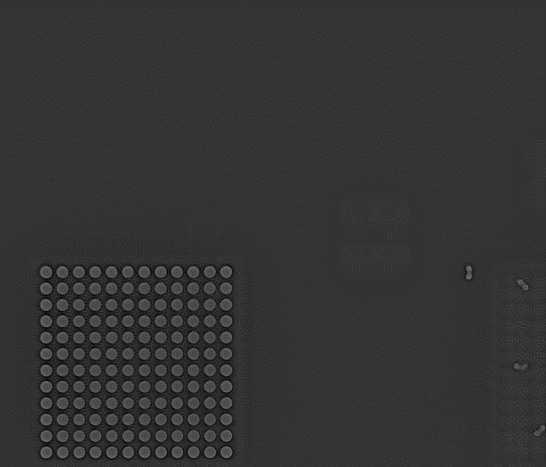
Introduction (6/7)
01
PCB: Printed Circuit Board
The size of the PCB X-Ray image is usually very large because defect inspection aims to detect even the slightest defects.
Although deep-learning super-resolution methods can obtain very good image quality, the resources, time, and computational complexity required are very high.
There are too many types of PCB X-Ray images in the industry. It is impossible to retrain the entire model every time a new PCB is received to improve the super-resolution accuracy of this board.
2,228 $×$ 1,904 = 4,242,112 pixels
06
Notes:
PCB X 射線圖像的尺寸通常非常大，因為缺陷檢查的目的是檢測哪怕是最輕微的缺陷。
雖然深度學習超解析方法可以獲得非常好的圖像質量，但所需的資源、時間和計算複雜度都非常高。
行業內PCB X-Ray圖像的類型太多。 不可能每次收到新的 PCB 時都重新訓練整個模型以提高該板的超解析精度。

Slide 8
Introduction (7/7)
01
In traditional super-resolution methods, although the image quality of the results is inferior to that of deep learning, the computational complexity is usually relatively simple, fewer computer resources are used, and the execution time is shorter.
In 2017, Google proposed the Rapid and Accurate Image Super-Resolution (RAISR) method.
This method uses Bilinear interpolation for upscaling and then uses Hash-Table to find the pre-trained filters corresponding to the interpolated pixels to adjust the image details and improve the image quality.
We proposed a traditional super-resolution algorithm for enlarging 4x resolution: HsuSR.
07
Notes:
傳統的超解析方法中，雖然結果的圖像質量不如深度學習，但計算複雜度通常相對簡單，使用的計算機資源較少，執行時間較短。
2017年，谷歌提出了快速準確的圖像超分辨率（RAISR）方法。
該方法使用雙線性插值進行放大，然後使用哈希表找到與插值像素對應的預訓練濾波器來調整圖像細節並提高圖像質量。
我們提出了一種用於放大 4 倍解析度的傳統超解析演算法：HsuSR。

Slide 9
Methodology (1/6)
02
LR: Low Resolution
SR: Super Resolution
We expect to enlarge 4x images as similar to the original image.
Divide into two parts:
Interpolation Process
Improve Execution Speed
LR image
Bilinear Interpolation
Select Filter from Hash Table
Use Filter to Fine-Tune the Image
SR Image
The Flowchart of HsuSR.
08

Slide 10
Methodology (2/6)
02
Interpolation Process
Hash Table
Buckets
Pixel-Type
Angle
Strength
Coherence
ID
Filter
Keys
1
Filter 1
Hash
Function
2
Filter 2
… … …
N
Filter N
09

Slide 11
Methodology (3/6)
02
Interpolation Process
Filter Training
In the training step, the first step involves determining which category of filter each patch belongs to. The second step is to take all the patches of this category and input them into Equation to find the most suitable filter.
Boundary values of Strength and Coherence:
Strength: Strong ≥ 55.2366 > Medium ≥ 22.9531 > Weak
Coherence: Strong ≥ 0.639152 > Medium ≥ 0.392087 > Weak
10
Notes:
在訓練步驟中，第一步涉及確定每個補丁屬於哪個類別的過濾器。 第二步是獲取該類別的所有補丁並將它們輸入方程以找到最合適的過濾器。

Slide 12
Methodology (4/6)
02
GPU: Graphics Processing Unit
CPU: Central Processing Unit
ALU: Arithmetic Logic Unit
DRAM: Dynamic Random-Access Memory
Improve Execution Speed
GPU vs. CPU
GPU has simpler control unit, ALU unit, and cache designs. Otherwise, they come in larger quantities. This makes GPUs proficient at handling large volumes of simple tasks.
About speed, GPUs offer a significant advantage over CPUs, typically ranging from 10 to 100 times faster.
11
Notes:
GPU 與 CPU
GPU具有更簡單的控制單元、ALU單元和緩存設計。 否則，它們的數量會更大。 這使得 GPU 能夠熟練地處理大量簡單任務。
在速度方面，GPU 比 CPU 具有顯著優勢，通常快 10 到 100 倍。

Slide 13
Methodology (5/6)
02
GPU: Graphics Processing Unit
CPU: Central Processing Unit
ALU: Arithmetic Logic Unit
DRAM: Dynamic Random-Access Memory
Improve Execution Speed
GPU vs. CPU
Control Unit
ALU Unit
ALU Unit
Control
ALU
ALU
ALU
ALU
ALU
ALU
ALU
ALU Unit
ALU Unit
Cache
Control
ALU
ALU
ALU
ALU
ALU
ALU
ALU
Cache
Cache
Control
ALU
ALU
ALU
ALU
ALU
ALU
ALU
Cache
Control
ALU
ALU
ALU
ALU
ALU
ALU
ALU
Cache
DRAM
DRAM
CPU
GPU
https://www.gigabyte.com/tw/Article/cpu-vs-gpu-which-processor-is-right-for-you
12

Slide 14
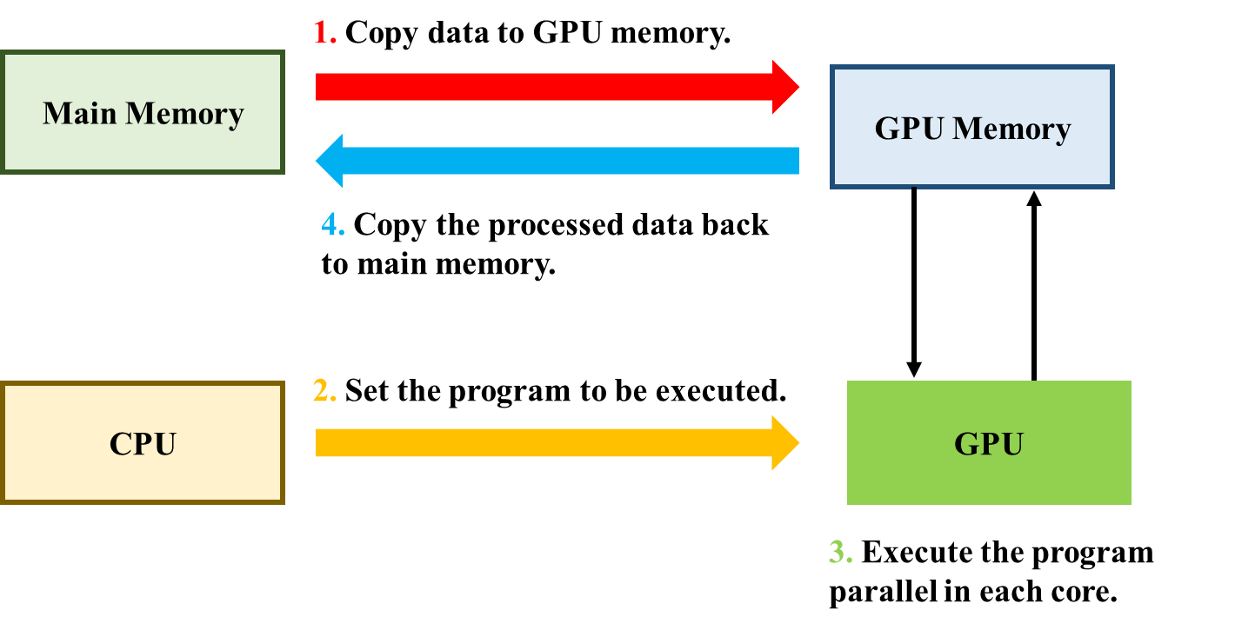
Methodology (6/6)
02
CUDA: Compute Unified Device Architecture
Improve Execution Speed
CUDA
CUDA is a parallel computing architecture proposed by Nvidia.
The compiler of CUDA program is NVCC (NVidia CUDA Compiler).
CUDA processing flowchart.
13
Notes:
CUDA
CUDA是Nvidia提出的並行計算架構。
CUDA程序的編譯器是NVCC（NVidia CUDA Compiler）。

Slide 15
Experimental Results
03
System Environment
Operating System | Windows 10
CPU (Central Processing Unit) | AMD Ryzen 9 5900X 12-Core Processor (24 Threads)
RAM (Random Access Memory) | 32.0 GB
GPU (Graphics Processing Unit) | Nvidia GeForce RTX 3090
Programming Development Tool | Visual Studio 2022
OpenCV | OpenCV 4.6.0
CUDA Version (Compute Unified Device Architecture) | CUDA 11.7
14

Slide 16
Experimental Results
03
PSNR (Peak Signal-to-Noise Ratio)
Peak Signal-to-Noise Ratio (PSNR) is an objective criterion for evaluating images.
It takes the ratio of the maximum value of the image signal to the noise in the image as the evaluation standard.
The unit of PSNR is decibel (dB).
15
Notes:
PSNR（峰值信噪比）
峰值信噪比（PSNR）是評價圖像的客觀標準。
它以圖像信號的最大值與圖像中噪聲的比值作為評價標準。
PSNR 的單位是分貝（dB）。

Slide 17
Experimental Results
03
SSIM index (Structural Similarity index)
SSIM is an indicator used to measure the similarity between two digital images.
The range of the SSIM index is between 0 and 1.
The higher the value, the better.
μ: mean intensity of images
${\text{σ}}^{2}$: variance of image intensity
$σ_{xy}$: Covariance of predicted and actual image intensity
$C_{1}$, $C_{2}$: constant (typically 0.01, 0.03)
16
Notes:
SSIM指數（結構相似性指數）
SSIM是用來衡量兩個數字圖像之間相似度的指標。
SSIM索引的範圍在0到1之間。
值越高越好。

Slide 18
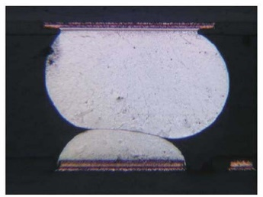
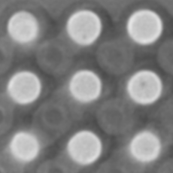
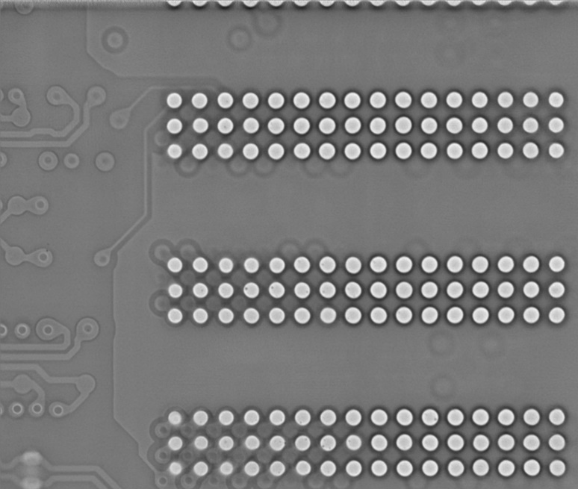
Experimental Results
03
HIP: Head In Pillow
Testing Image 1 (Void): Image Size = 2,228 × 1,904 pixels
Testing Image 4 (HIP): Image Size = 1,820 × 1,540 pixels
xy-direction
xy-direction
xz-direction
xz-direction
yz-direction
yz-direction
17

Slide 19
Experimental Results
03
Scale: 4, Size: 2,228 × 1,904 pixels (Nvidia 3090, No Input/Output, Computation Only)
↑the higher, the better; ↓the lower, the better; Red bold: the best; Blue bold: the second.
Our HsuSR ranks the second in all metrics and also gets good image quality.
The most important point is that HsuSR can achieve our goal of processing an image in less than 0.03 seconds.
Method | PSNR (↑) | Rank (↓) of PSNR | SSIM (↑) | Rank (↓) of SSIM | Time (↓) (Second) | Rank (↓) of Time
Bicubic | 46.218 | 5 | 0.9896 | 4 | CPU 0.00296 | 1
ICBI [5] | 48.126 | 3 | 0.9917 | 3 | CPU 3.53010 | 4
A+ [23] | 49.837 | 1 | 0.9935 | 1 | CPU 6.22936 GPU ??? | 5
RAISR [19] | 46.757 | 4 | 0.9881 | 5 | CPU 2.03094 | 3
HsuSR | 48.970 | 2 | 0.9926 | 2 | GPU 0.02299 | 2
18

Slide 20
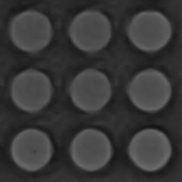
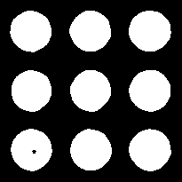
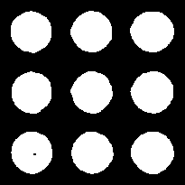
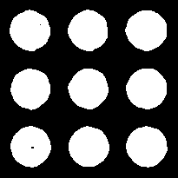
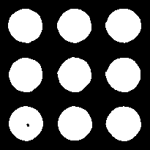
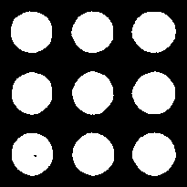
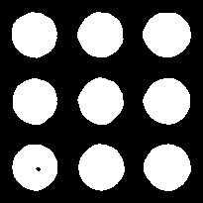
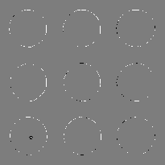
Diff (xy-direction)
Target
Bicubic
ICBI [5]
A+ [23]
RAISR [19]
HsuSR
17

Slide 21
Diff (xz-direction)
Target
Bicubic
ICBI [5]
A+ [23]
RAISR [19]
HsuSR
Target
Bicubic
ICBI [5]
A+ [23]
RAISR [19]
HsuSR
20

Slide 22
Experimental Results
03
Scale: 4, Size: 2,228 × 1,904 pixels (Nvidia 3090, No Input/Output, Computation Only)
↓the lower, the better; Red bold: the best; Blue bold: the second.
It is evident that A+ produces better image quality compared with our HsuSR.
However, our HsuSR also performs well, with differences of less than 20 pixels compared with A+.
xy-direction
xz-direction
yz-direction
Method | Diff Value (↓) | Rank (↓) of Diff
Bicubic | 364 | 5
ICBI [5] | 215 | 3
A+ [23] | 190 | 1
RAISR [19] | 326 | 4
HsuSR | 209 | 2
Method | Diff Value (↓) | Rank (↓) of Diff
Bicubic | 348 | 4
ICBI [5] | 406 | 5
A+ [23] | 270 | 2
RAISR [19] | 342 | 3
HsuSR | 266 | 1
Method | Diff Value (↓) | Rank (↓) of Diff
Bicubic | 512 | 5
ICBI [5] | 511 | 4
A+ [23] | 378 | 1
RAISR [19] | 472 | 3
HsuSR | 394 | 2
21

Slide 23
Experimental Results
03
Scale: 4, Size: 1,820 × 1,540 pixels (Nvidia 3090, No Input/Output, Computation Only)
↑the higher, the better; ↓the lower, the better; Red bold: the best; Blue bold: the second.
Comparing our HsuSR with A+, the difference in SSIM is only 0.003 and the difference in PSNR is around 0.45.
This indicates that the difference between the two methods is very small.
Method | PSNR (↑) | Rank (↓) of PSNR | SSIM (↑) | Rank (↓) of SSIM | Time (↓) (Second) | Rank (↓) of Time
Bicubic | 41.002 | 5 | 0.9836 | 4 | CPU 0.00212 | 1
ICBI [5] | 42.478 | 3 | 0.9866 | 3 | CPU 3.2085 | 4
A+ [23] | 43.807 | 1 | 0.9884 | 1 | CPU 3.98449 GPU ??? | 5
RAISR [19] | 41.834 | 4 | 0.9832 | 5 | CPU 1.39004 | 3
HsuSR | 43.362 | 2 | 0.9881 | 2 | GPU 0.02191 | 2
22

Slide 24
Diff (xy-direction)
Target
Bicubic
ICBI [5]
A+ [23]
RAISR [19]
HsuSR
23

Slide 25
Diff (xz-direction)
Target
Bicubic
ICBI [5]
A+ [23]
RAISR [19]
HsuSR
Target
Bicubic
ICBI [5]
A+ [23]
RAISR [19]
HsuSR
24

Slide 26
Experimental Results
03
Scale: 4, Size: 1,820 × 1,540 pixels (Nvidia 3090, No Input/Output, Computation Only)
↓the lower, the better; Red bold: the best; Blue bold: the second.
ICBI is based on directional interpolation, and the solder ball shapes in the xz-directions and yz-directions have clear orientations, resulting in better overall interpolation results.
xy-direction
xz-direction
yz-direction
Method | Diff Value (↓) | Rank (↓) of Diff
Bicubic | 274 | 5
ICBI [5] | 145 | 2
A+ [23] | 173 | 3
RAISR [19] | 192 | 4
HsuSR | 130 | 1
Method | Diff Value (↓) | Rank (↓) of Diff
Bicubic | 167 | 4
ICBI [5] | 104 | 1
A+ [23] | 133 | 3
RAISR [19] | 303 | 5
HsuSR | 127 | 2
Method | Diff Value (↓) | Rank (↓) of Diff
Bicubic | 66 | 4
ICBI [5] | 39 | 1
A+ [23] | 51 | 3
RAISR [19] | 102 | 5
HsuSR | 50 | 2
25

Slide 27
Test
04
Method: Generate high-resolution images using traditional image processing method HsuSR
Steps: Input LR image and parameters => HsuSR => Generate reconstructed HR images
Results: Make the reconstructed HR image as similar as possible to the original HR image
26

Slide 28
Thanks for listening !
Presenter: Ting Chen 陳 婷
E-mail: tiffany970216@gmail.com
Phone: 0906334568

Slide 29
References
05
N. F. Bate, C. J. Fluke, B. R. Barsdell, H. Garsden, and G. F. Lewis, “Computational Advances in Gravitational Microlensing: A Comparison of CPU, GPU, and Parallel, Large Data Codes,” New Astronomy, vol. 15, no. 8, pp. 726-734, 2010.
Y. Romano, J. Isidoro, and P. Milanfar, “RAISR: Rapid and Accurate Image Super Resolution,” IEEE Transactions on Computational Imaging, vol. 3, no. 1, pp. 110-125, doi: 10.1109/TCI.2016.2629284, 2017.
Test Research, Inc., “TRI Innovation,” https://www.tri.com.tw/tw/index.html, 2023.

