Slide 1
Computer Vision Chapter 10 Image Segmentation
Presented by: 傅楸善 & 賴彥廷
Phone: 0909415101
Email: d09943020@ntu.edu.tw
指導教授: 傅楸善 博士

Slide 2
Outline
10.1 Introduction
10.2 Measurement-Space-Guided Spatial Clustering
10.2.1 Thresholding
10.2.2 Multidimensional Measurement-Space Clustering
10.3 Region Growing
10.3.1 Single-Linkage Region Growing
10.3.2 Hybrid-Linkage Region Growing
10.3.3 Centroid-Linkage Region Growing
10.4 Hybrid-Linkage Combinations
10.5 Spatial Clustering
10.6 Split and Merge
10.7 Rule-Based Segmentation
10.8 Motion-Based Segmentation
10.9 Summary

Slide 3
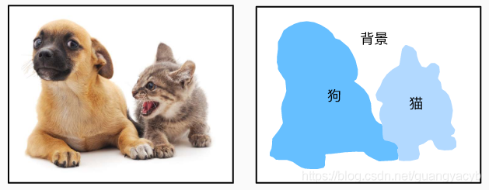
10.1 Introduction
What’s image segmentation?
partition of image into set of non-overlapping regions
Union of segmented regions is the entire image
Segmentation purpose
Decompose image into meaningful parts to application
Background
Dog
Cat

Slide 4
10.1 Introduction
It’s very difficult to tell a computer program
What constitutes a “meaningful” segmentation?
Guidelines:
Regions of an image segmentation
Uniform and homogeneous with respect to some characteristic.
Gray level or texture.
Adjacent regions of a segmentation
Significantly different values with respect to the characteristic on which they are uniform.
Region interiors should be simple and without many small holes.
Boundaries of each segment should be simple, not ragged, and must be spatially accurate.

Slide 5
10.1 Introduction
For example
holes
ragged

Slide 6
10.1 Introduction
Clustering:
Partitioning a set of pattern vectors into subsets called clusters.
Pattern vectors could be
Intensity
texture
Similar : Grouping data together with similar characteristics.
Different : In image segmentation, the grouping is done on spatial domain

Slide 7
10.1 Introduction
Mainly discuss about segmenting an image based on gray-level intensity.
For segmenting other features, using feature’s characteristic can extract its feature value. Then same technique can apply.
Image segmentation is an ad hoc problem.
Different techniques rely on different emphasis and compromise

Slide 8
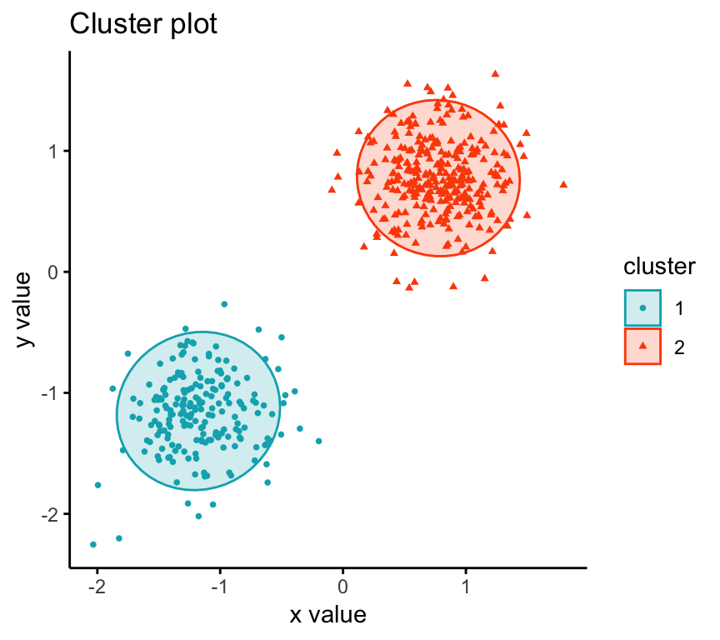
10.2 Measurement-Space-Guided Spatial Clustering
Measurement space
The pattern of measurement data to be classified is represented as a measurement vector
Spatial Clustering
A bounded group of occurrences and concentration to be unlikely to have occurred by chance.

Slide 9
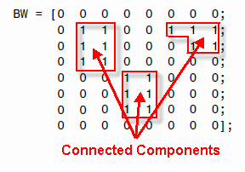
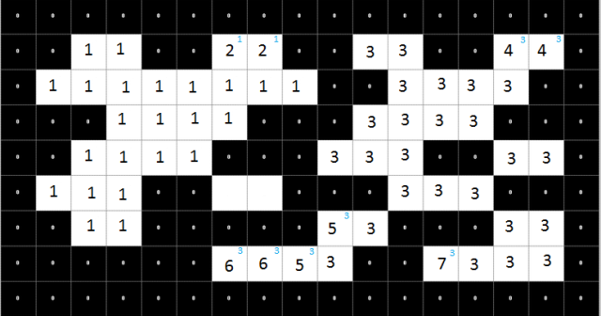
10.2 Measurement-Space-Guided Spatial Clustering
The process of measurement-space-guided spatial clustering:
Uses the measurement-space-clustering process to define a partition in measurement space
Each pixel is assigned the label of the cell in the measurement-space partition to which it belongs.
The image segments are defined as the connected components of the pixels having the same label.

Slide 10
10.2 Measurement-Space-Guided Spatial Clustering
Where does it work well?
A few kinds of distinct objects having widely different gray-level intensities.
Appear on a nearly uniform background.
Pros:
Clustering requires only one pass through the data.

Slide 11
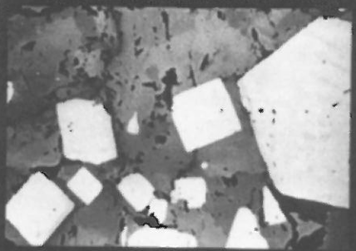
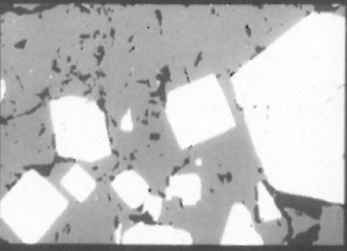
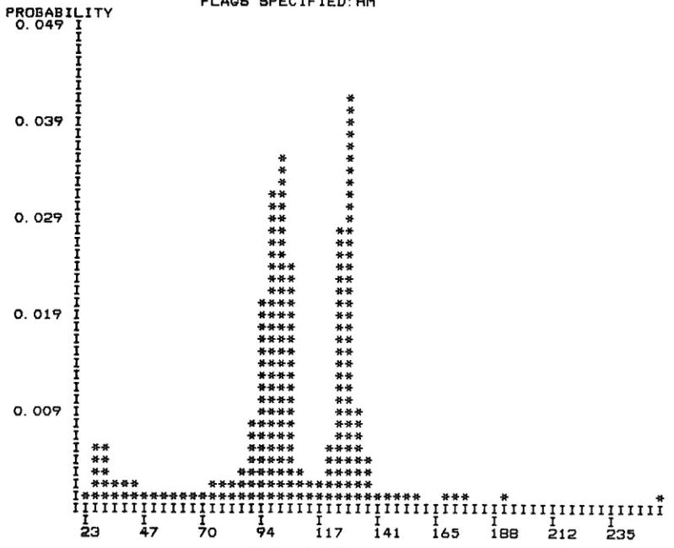
10.2 Measurement-Space-Guided Spatial Clustering
Good segmentation
3 nonoverlapping modes:
Pyrite
Pyrrhotite
black holes
Black: blue
Pyrrohotite: green
Pyrite : yellow

Slide 12
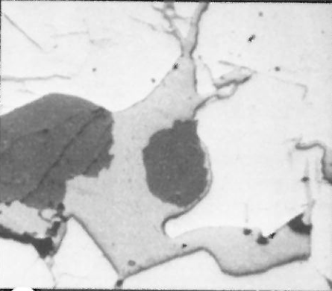
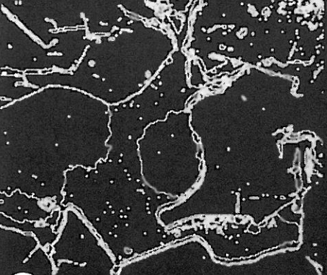
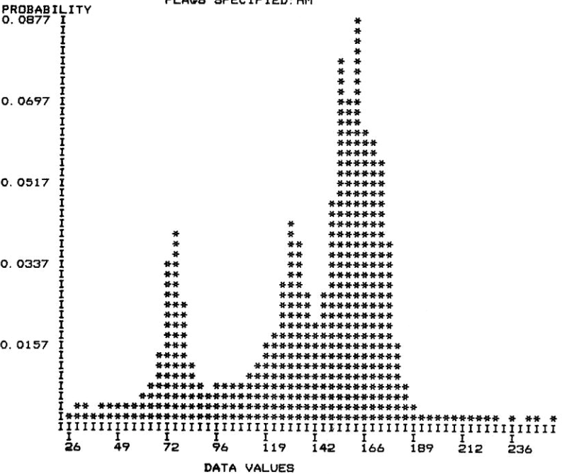
10.2 Measurement-Space-Guided Spatial Clustering
Bad segmentation

Slide 13
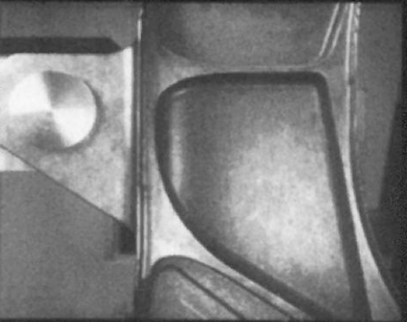
10.2 Measurement-Space-Guided Spatial Clustering
So what should I do if I really encounter that kind of graph whose histogram grouping is not obvious?

Slide 14
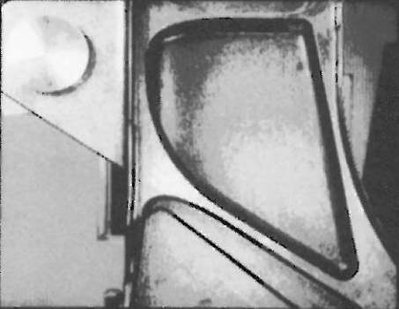
10.2 Measurement-Space-Guided Spatial Clustering
Five clusters: bad spatial continuation, boundaries noisy and busy

Slide 15
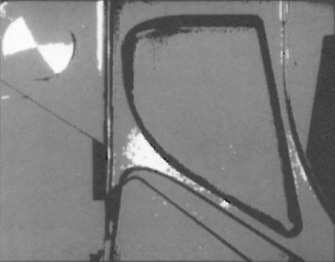
10.2 Measurement-Space-Guided Spatial Clustering
Three clusters: less boundary noise, but much less detail

Slide 16
10.2 Measurement-Space-Guided Spatial Clustering
Problem with measurement-space-clustering
There is no requirement for good spatial continuation.
Resulting boundaries are very noisy and busy.

Slide 17
10.2 Measurement-Space-Guided Spatial Clustering
Recursive Histogram-Directed Spatial Clustering
Ohlander, Price, and Reddy 1978

Slide 18
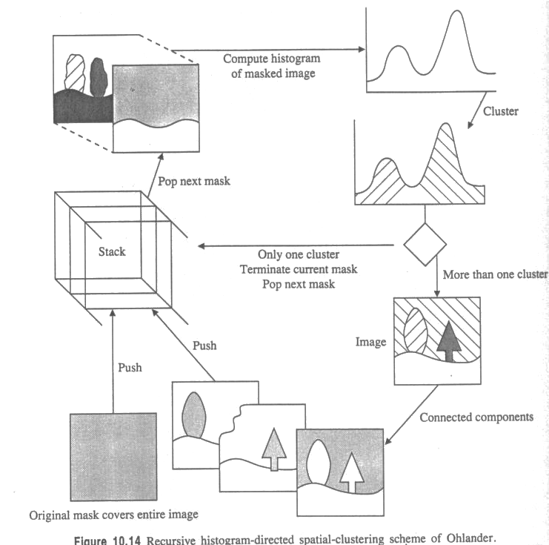
10.2 Measurement-Space-Guided Spatial Clustering
Recursive Histogram-Directed Spatial Clustering
Loop
Start here

Slide 19
10.2 Measurement-Space-Guided Spatial Clustering
Recursive Histogram-Directed Spatial Clustering
Opening
with
3x3 square

Slide 20
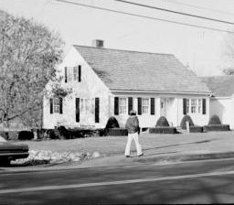
10.2 Measurement-Space-Guided Spatial Clustering
Recursive Histogram-Directed Spatial Clustering:
Color Image

Slide 21
10.2 Measurement-Space-Guided Spatial Clustering
Recursive Histogram-Directed Spatial Clustering
R, G, B bands
Karhunen-Loeve transform
(R+G+B)/3, (R-B)/2, (2G-R-B)/4

Slide 22
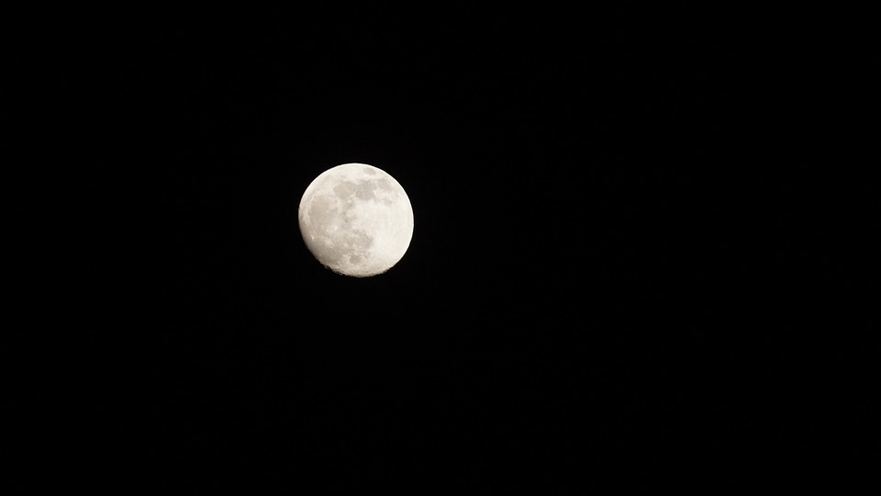
10.2.1 Thresholding
Q: What if the histogram is not nicely bimodal?
Some thoughts from researchers in the field…
Local Histogram
Chow and Kaneko 1972
Review: Measurement-space-clustering doesn’t require good spatial continuation.
(1) Divide image into mutually exclusive blocks. (eg. Neighborhood size 33x33)
(2) Compute histogram and determine threshold.
threshold value can be considered to apply to the center of each block
(3) Interpolate threshold value.

Slide 23
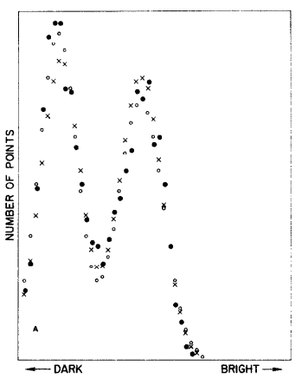
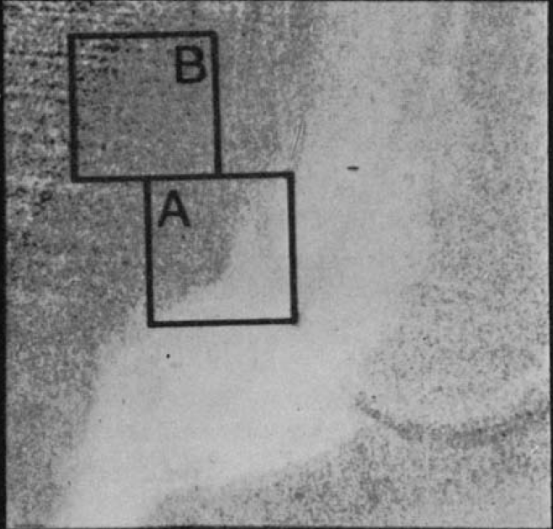
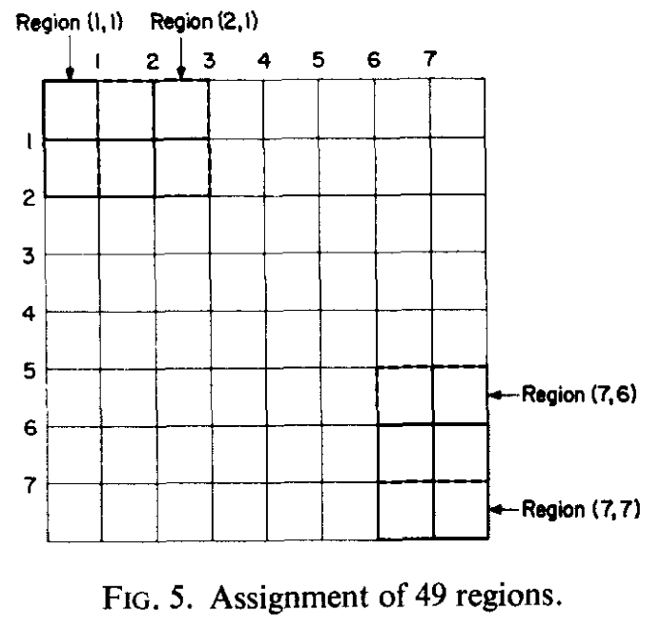
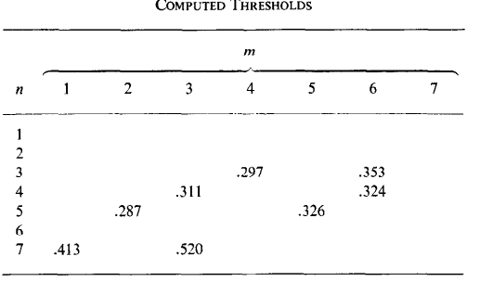
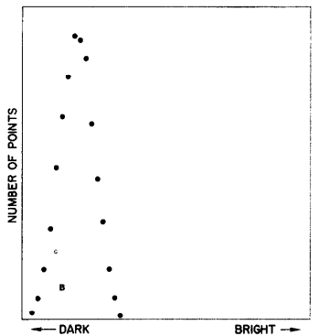
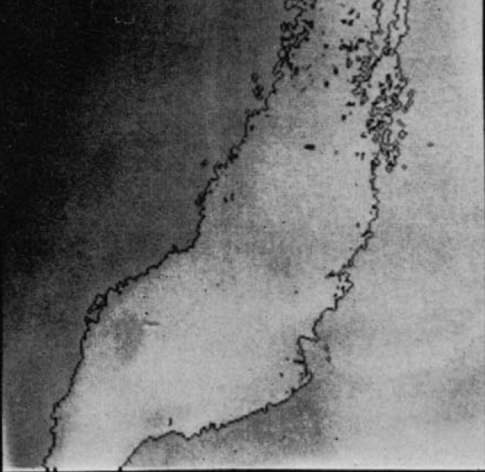
10.2.1 Thresholding
A
B

Slide 24
10.2.1 Thresholding
Some thoughts from researchers in the field…
High Laplacian Magnitude
Weszka, Nagel, and Rosenfeld 1974
Only determine histogram for high Laplacian magnitude pixels (see ch6).
Those pixels are the shoulders
Don’t involve pixels between regions that help make the histogram valley shallow.
Remember that high Laplacian magnitude pixels are those with greater changes in slope (the second derivative)

Slide 25
10.2.1 Thresholding
Some thoughts from researchers in the field…
Minimized Busyness
Weszka and Rosenfeld 1978
Select threshold based on busyness.
Busyness: the percentage of pixels having a neighbor whose threshold value is different from their own threshold value.
A good threshold is the point near the histogram valley between two peaks that minimizes the busyness.

Slide 26
10.2.1 Thresholding
Kohler (1981) suggests choosing the threshold that detects more high-contrast edges and fewer lower-contrast edges.
Define:
set E(T): edges detected by a threshold T
$C\left(T\right):$contrast of given edge
$E\left(T\right)=\{[\left(i,j\right),(k,l)|$
$1. pixels \left(i,j\right) and \left(k,l\right) are neighbors$
$2.\min{\{I(i,j),I\left(k,l\right)\}}≤T<max\left\{I\left(i,j\right),I\left(k,l\right)\right\}\}.$
$C\left(T\right)=\sum_{\left[\left(ⅈ,j\right),\left(k,l\right)\right]∈E(T)}{min⁡\{\left|I\left(i,j\right)−T\right|,|I\left(k,l\right)−T|\}}$
The average contrast is $C(T)/\#E(T)$ #: number of
The best threshold $T_{b}$ is the value that
maximizes $C(T)/\#E(T)$

Slide 27
10.2.1 Thresholding
when T₁ = 50 and
[45, 110] -> [5, 60]
[33, 88] -> [17, 38]
[15, 65] -> [35, 15]
[45, 115] -> [5, 65]
[0, 225] -> [50, 175]
A = [$I\left(i,j\right),I(k,l)$],
$B= [|I\left(i,j\right)−T|,|I\left(k,l\right)−T|$],
The average contrast of all edges is:
A
B
(5+17+15+5+50) / 5 = 18.4
min value is labelled in red
Notes:
這邊我們就用一個例子來描述。假設門檻值是 50，

Slide 28
10.2.1 Thresholding
T₂ = 60
[45, 110] -> [15, 50]
[33, 88] -> [27, 28]
[15, 65] -> [45, 5]
[45, 115] -> [15, 55]
[0, 225] -> [60, 165]
A = [$I\left(i,j\right),I(k,l)$],
$B= [|I\left(i,j\right)−T|,|I\left(k,l\right)−T|$],
The average contrast of all edges
A
B
(15+27+5+15+60) / 5 = 24.4
The best threshold T_{b} is determined by maximizing

Slide 29
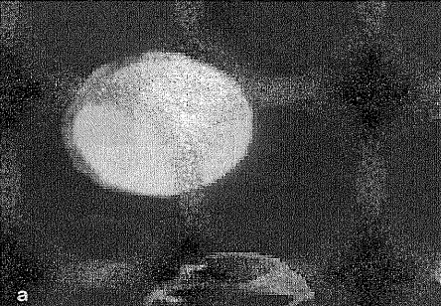
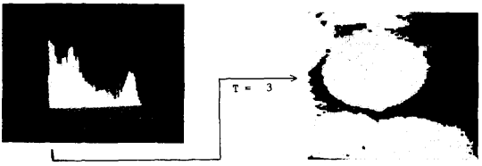
10.2.1 Thresholding
Kohler 1981
White blood cell

Slide 30
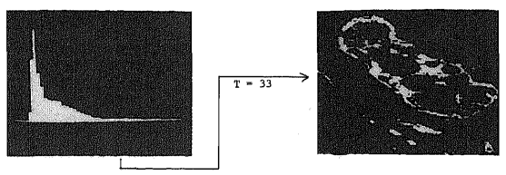
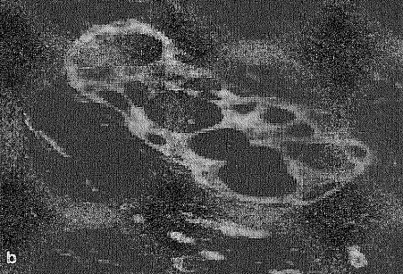
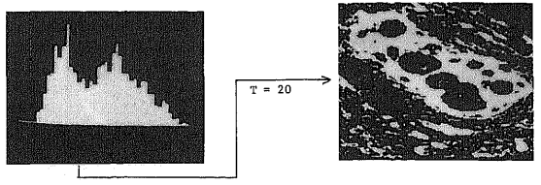
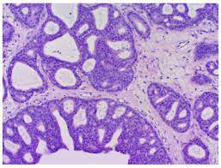
10.2.1 Thresholding
Kohler 1981
cribriform breast duct
Notes:
篩狀乳腺導管

Slide 31
10.2.1 Thresholding
Panda and Rosenfeld 1978
Approach for segmenting white blob against dark background
Assumption (edge):
Low gradient?
Not likely to be an edge → Either dark background or bright blob pixel.
Histogram: bimodal
Good threshold: valley
High gradient?
Likely to be an edge. → Bimodal.
Histogram: unimodal
Good threshold: mean
2 threshold values
one for low-gradient pixels
one for high-gradient pixels.
Notes:
Histogram: 直方圖
Bimodal: 雙峰
Unimodal: 單峰

Slide 32
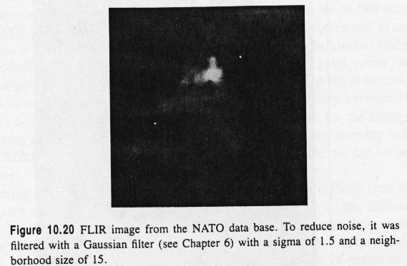
10.2.1 Thresholding
FLIR (Forward Looking Infra-Red) image
from NATO (North Atlantic Treaty Organization) database

Slide 33
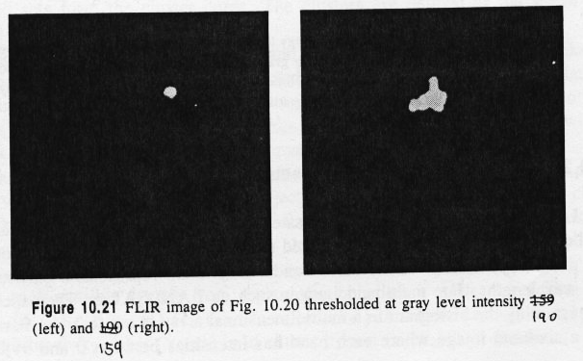
10.2.1 Thresholding
Thresholded at 190
Thresholded at 159

Slide 34
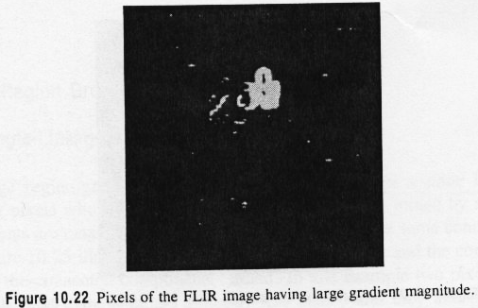
10.2.1 Thresholding
pixels having large gradient magnitude

Slide 35
10.2.1 Thresholding
2D gray level intensity-gradient space

Slide 36
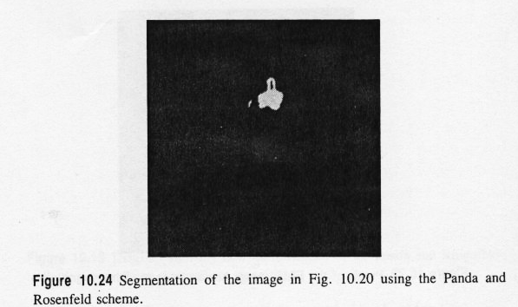
10.2.1 Thresholding
resulting segmentation: bright object with slightly darker appendage on top

Slide 37
10.2.2 Multidimensional Measurement-Space Clustering
LANDSAT image: consists of seven separate images called bands
Constraints of reality
high correlation between band-to-band pixel values
large amount of spatial redundancy in image data

Slide 38
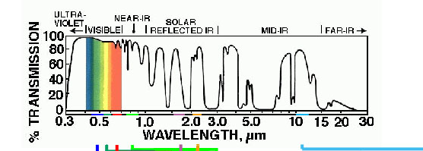
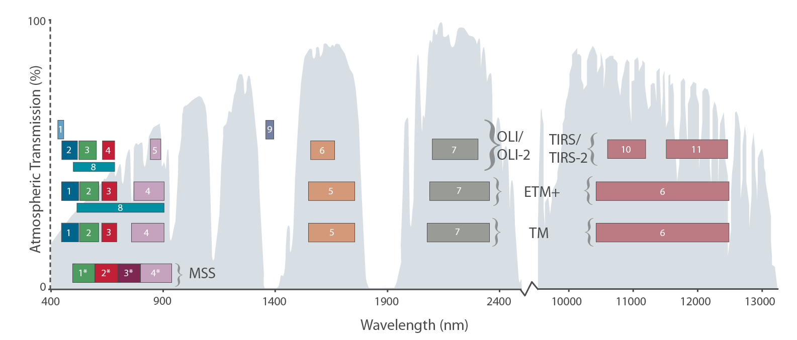
10.2.2 Multidimensional Measurement-Space Clustering
Spectral sensitivity of LANDSAT 7 Bands
0.45-0.52 µm Blue-Green
0.52-0.60 µm Green
0.63-0.69 µm Red
0.76-0.90 µm Near-IR
1.55-1.75 µm Shortwave-IR
10.40-12.50 µm Thermal-IR
2.08-2.35 µm Mid-IR
MSS: Multispectral Scanner System
OLI: Operational Land Imager
TIRS: Thermal Infrared Sensor
ETM: Enhanced Thematic Mapper
TM: Thematic Mapper

Slide 39
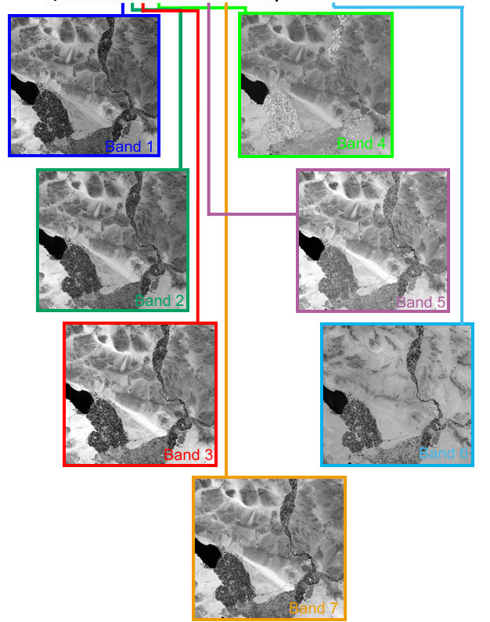

Slide 40
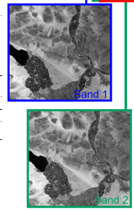
Band1: c1,c2,c3 3 clusters
Band2: c4,c5 2 clusters
Clusters could be {(c1,c4),(c1,c5) ,(c2,c4) ,(c2,c5) ,(c3,c4) ,(c3,c5)}
in Band1 + Band2

Slide 41
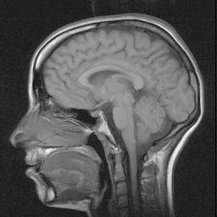
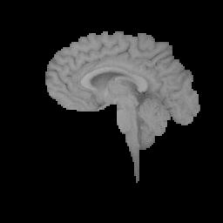
10.3 Region Growing
A segmentation technique based on the similarity of adjacent pixels.
Predefined seed pixels
Growing criteria
Stop conditions
MRI: Magnetic Resonance Image
Notes:
根據相鄰位元的相似信

Slide 42
10.3.1 Single-Linkage Region Growing
Neighboring pixels whose properties are similar enough are joined by an arc.
Two pixels connected by edge: if 4-neighbor and gray levels differ by less than 5
Problem:
Chaining: Only takes one arc leaking from one region to a neighborhood one to cause the regions to merge.
Notes:
4-neighbor: 四個相鄰值
Chaining: 鏈結

Slide 43
10.3.2 Hybrid-Linkage Region Growing
Hybrid-linkage techniques:
Each pixel is assigned a property vector
Depends on K x K neighborhood of the pixel
Edge operator is applied to image, labeling each pixel as
edge or nonedged.
Neighboring pixels, neither of which is an edge, are joined by an arc.
The edge pixels can be left assigned as edges and considered as background.
Notes:
property vector: 特性向量
Arc: 弧度

Slide 44
10.3.2 Hybrid-Linkage Region Growing
Problem: the quality is highly dependent on the edge operator used.
Using simple operators (such as Roberts and Sobel operators) may provide too much region linkage.
Region cannot be declared a segment unless it is completely surrounded by edge pixel.

Slide 45
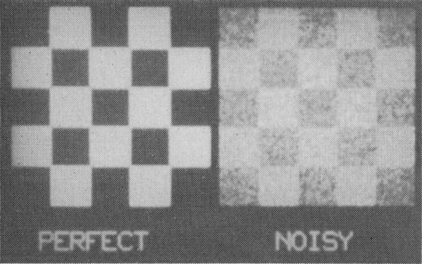
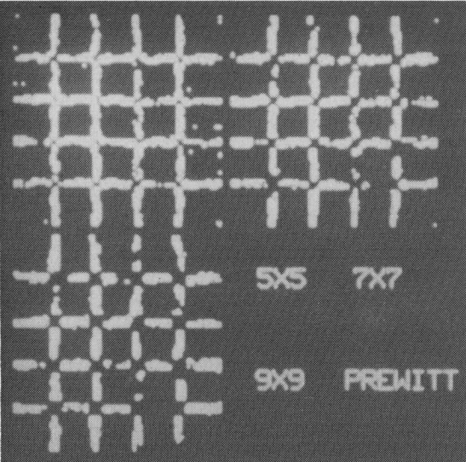
10.3.2 Hybrid-Linkage Region Growing
Edge operator : Haralick (1984), Zero Crossing (details in Ch. 8)

Slide 46
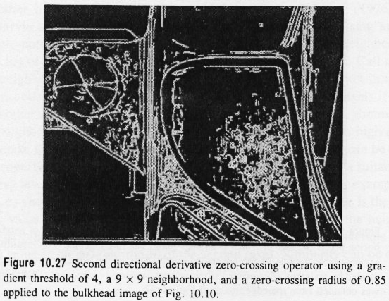
10.3.2 Hybrid-Linkage Region Growing
Haralick (1984), Zero Crossing (details in Ch. 8)
Edge detection
after region-filling

Slide 47
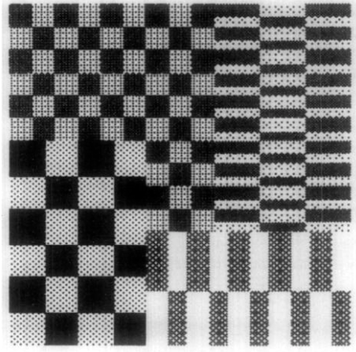
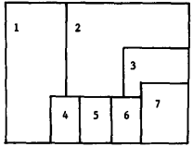
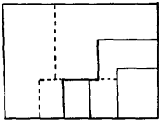
10.3.2 Hybrid-Linkage Region Growing
Pong (1984) facet model
Steps:
Segment the image into small regions.
Calculate the property vector of each segment.
Merge close enough regions
Next iteration: repeat from Step 2.
Notes:
Facet: 面相

Slide 48
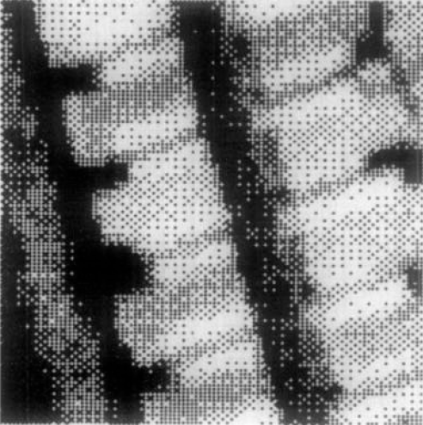
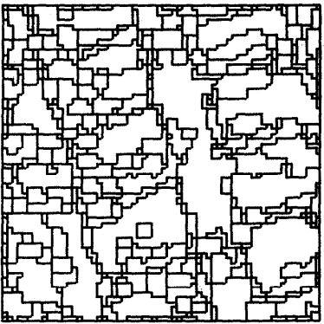
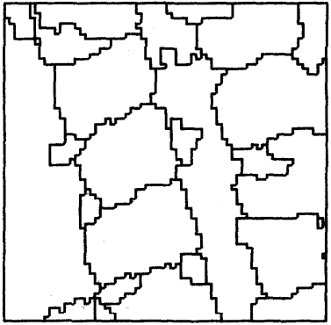
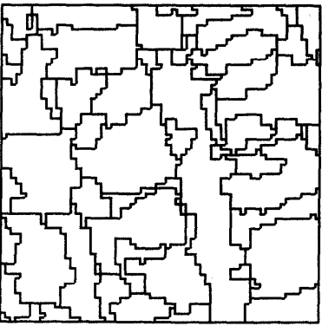
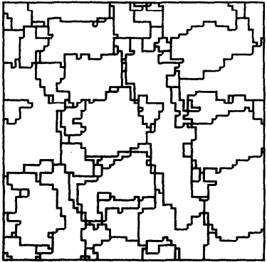
10.3.2 Hybrid-Linkage Region Growing
Pong (1984) facet model
Original image
1304 regions
350 regions
29 regions
80 regions
110 regions

Slide 49
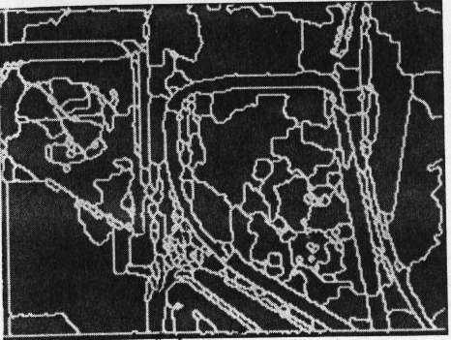
10.3.2 Hybrid-Linkage Region Growing
Pong (1984) facet model
after removing regions smaller than size 25

Slide 50
10.3.3 Centroid-Linkage Region Growing
Difference:
Pairs of neighboring pixels are not compared for similarity
Steps:
The image is scanned in some predetermined manner
left-right, top-bottom.
A pixel’s value is compared with the mean of an already existing region
If its value and the segment’s mean value are close enough
The pixel is added to the segment
The segment’s mean is updated
If more than one region is close enough:
The pixel is added to closest region

Slide 51
10.3.3 Centroid-Linkage Region Growing
Steps:
If the means of the two competing regions are close enough
The two regions are merged
The pixel is added to the merged region
If no neighboring region has a close-enough mean
Create a new segment

Slide 52
10.3.3 Centroid-Linkage Region Growing
Memory
Large or small? small
Hash table for small multiple of pixels in a row.
Scanning direction has an impact on the result.
Notes:
Requires small amounts of memory
Hash table: 雜湊表

Slide 53
10.3.3 Centroid-Linkage Region Growing
Results

Slide 54
10.4 Hybrid-Linkage Combinations
Review (strength and weakness):
Single-Linkage
Strength: Spatially accurate
Weakness: Excessive merging
Centroid-Linkage
Strength: Ability to place boundaries in weak gradient areas

Slide 55
10.4 Hybrid-Linkage Combinations
Combined Centroid-Hybrid Linkage
Centroid-linkage for only non-edge pixels
Region growing is not permitted across edge pixels

Slide 56
10.5 Spatial Clustering
Spatial-clustering:
Introduction: Simultaneously combining clustering in measurement space with a spatial region growing.
Example: Haralick and Kelly (1969)
Find the peaks of the measurement space histogram
Find the pixels in the peaks, they are the initial segments
Perform region growing

Slide 57
10.6 Split and Merge
Steps:
Begins with the entire image as the initial segment
Successively splits each of its current segments into quarters if the segment is not homogeneous enough.
A merging method starts with an initial segmentation and successively merges regions that are similar enough.
homogeneous enough:
Max – min
Variance
Efficiency of the split-and-merge method can be increased by arbitrarily partitioning the image into square regions of a user-selected size and then splitting these further, if they are not homogeneous

Slide 59
10.6 Split and Merge
Downside:
Boundaries tend to be squarish and artificial.
Large memory usage
Miss-merging
Solution:
Horowitz and Pavlidis (1976)
Data structure: Quad tree

Slide 60
10.6 Split and Merge
Horowitz and Pavlidis (1976) Data structure: Quadtree
The entire image is represented by the root node.
The children of the root are the regions obtained by splitting the root into four equal pieces, and so on.
A segmentation is represented by a cutset, a minimal set of nodes separating the root from all of the leaves.

Slide 61
10.6 Split and Merge
In the tree structure
the merging process consists of removing four nodes from the cutset and replacing them with their parent.
Splitting consists of removing a node from the cutset and replacing it with its four children
The two processes are mutually exclusive
Notes:
mutually exclusive: 互斥

Slide 62
10.6 Split and Merge
All the merging operations are followed by all the splitting operation.
The splitting and merging in the tree structure is followed by a final grouping procedure that can merge adjacent unrelated blocks found in the final cutset.

Slide 63
10.6 Split and Merge

Slide 64
10.7 Rule-Based Segmentation
Introduction:
It is not easy to try different concepts without complete reprogramming
The Nazif and Levine system (1984)
Rule-based expert system for segmentation
Not application domain specific
general-purpose
scene-independent knowledge and grouping criteria
Chapter 19 has details of this system.

Slide 65
10.7 Rule-Based Segmentation
The Nazif and Levine system (1984)
Composition:
set of processes
The initializer
The line analyzer
The region analyzer
The area analyzer
The focus of attention
the scheduler
two associate memories
the short-term memory (STM)
the long-term memory (LTM)

Slide 66
10.7 Rule-Based Segmentation
The Nazif and Levine system (1984)
The short-term memory :
holds the input image, the segmentation data, and the output.
The long-term memory:
system knowledge about low-level segmentation and control strategies.
Match rules in the LTM against the data stored in the STM
Rule fires
Action
Data modification

Slide 67
10.7 Rule-Based Segmentation
The Nazif and Levine system (1984)
LTM has three levels of rules
Levels 1 to 3 (from lowest to highest)
level 1 are knowledge rules that encode information properties of regions, lines, and areas in the form of situation-action pairs.
splitting a region
merging two regions
adding, deleting, or extending a line
merging two lines
creating or modifying a focus-of-attention area

Slide 68
10.7 Rule-Based Segmentation
The Nazif and Levine system (1984)
LTM has three levels of rules
level 2 contains the control rules
Focus-of-attention rules
Find the next data entry to be considered:
a region, a line, or an entire area
Inference rules
Their actions do not modify the data in the STM
Modify the matching order of different knowledge rule sets
Control which process will be activated next.

Slide 69
10.7 Rule-Based Segmentation
The Nazif and Levine system (1984)
LTM has three levels of rules
Level 3 is the highest rule level
Strategy rules
Select the set of control rules (level 2)
Executes the most proper control strategy for a given set of data.

Slide 70
10.7 Rule-Based Segmentation
Data entry types:
Table 10.1
Different kind of feature:
Table 10.2~10.4
Possible actions that can be associated with a rule:
Table 10.5~10.6
Rules:
Table 10.7

Slide 71
10.7 Rule-Based Segmentation
Different data entry types allowed

Slide 72
10.7 Rule-Based Segmentation
Numerical descriptive features

Slide 73
10.7 Rule-Based Segmentation
Numerical spatial features

Slide 74
10.7 Rule-Based Segmentation
Logical features

Slide 75
10.7 Rule-Based Segmentation

Slide 76
10.7 Rule-Based Segmentation
The Nazif and Levine system (1984)

Slide 77
10.7 Rule-Based Segmentation

Slide 78
Data type (table 10.1)
Next data type (table 10.6)
Focus-of-attention rules
Data feature (table 10.2 ~ 10.4)
level 1
Match !
Actions (table 10.5)
Rules (table 10.7)
Level 3

Slide 79
10.8 Motion-Based Segmentation
In time-varying image analysis, the data are a sequence of images instead of a single image.
The motion of the objects creates a change in the images that can be used to help locate the moving objects.
Stationary camera: Thompson
Non-stationary camera: Jain
Details in Chapter 15

Slide 80
10.8 Motion-Based Segmentation

Slide 81
10.8 Motion-Based Segmentation
Stationary camera: Thompson
A stationary camera viewing a scene containing moving objects.
Partitioning a scene into regions corresponding to surfaces with distinct velocities.

Slide 82
10.8 Motion-Based Segmentation
Stationary camera: Thompson
first computed velocity estimates for each point of the scene (see Chapter 15)
and then performed the segmentation by a region-merging procedure that combined regions based on similarities in both intensity and motion.

Slide 83
10.8 Motion-Based Segmentation
Non-stationary camera: Jain
A non-stationary camera viewing a scene containing moving objects.
Ego-Motion Polar Transform (EMP)!!!!!
The Ego-Motion Polar Transform used the known location of the focus of expansion (see Chapter 15) to transform the original frame sequence into another camera-centered sequence

Slide 84
10.9 Summary
Single-Linkage
Simplest and most prone to unwanted merges.
Hybrid and centroid region growing
Split-and-merge
Not subject to unwanted merges
Large memory usage and blocky boundaries
Measurement-space-guided spatial clustering
Regions not smoothly bounded, many holes
Spatial-clustering
Not well tested enough
Hybrid-Linkage
Best compromise between smooth boundaries and few unwanted regions

Slide 85
Bad Jokes
Funny cats
https://www.youtube.com/watch?v=5LrG333wKy8
https://www.youtube.com/watch?v=zgytnHd9GIo
Funny humans
https://www.Instagram.com/reel/CwPhTPCq_5r/?igshid=MzRlODBiNWFlZA==
Pink panther
https://youtu.be/15GHnR2X8dA?si=5S56lYC1COEvVCEq

Slide 86
Thank you for listening

