Slide 1
Chapter 9
Texture
Presenter: Pei-Jing Yu (郁霈靖)
Phone: 0953235733
E-Mail: jesseyu222@gmail.com
Advisor: Prof. Chiou-Shann Fuh

Slide 2
Outline
Introduction
  9.1
Statistical Texture Feature Approach
  9.2 ~ 9.10
Model-based Technique
  9.11 ~ 9.13
Application
  9.16 ~ 9.18
Notes:
章節介紹
1. 介紹什麼是Texture
2. Texture的統計特徵
3. 簡單來講就是如何定義一個model去造出我們想要的texture
4. 如何應用texture的技術

Slide 3
Introduction
Statistical Texture Feature Approach
Model-based Technique
Application

Slide 4
What is “texture” ?

Slide 5
Introduction
What does texture mean?
  Formal approach or precise definition of texture does not exist.
Texture discrimination techniques are for the most part ad hoc.
created for a particular purpose only
Notes:
找不到比較正規或精確定義texture的方法
為什麼呢，如果我們要對texture做鑑別或分類，會是以ad hoc的方式，什麼是ad hoc，就是 created for a particular purpose only
我們會為了要得到某個結果，而去產生某些方法，去隊為裏做分析，所以並沒有一個通用的方法可以針對每個紋理作分析。
雖然廣義的紋理辨識技術不存在，但可以對特定目的制定出特定的辨識方式，然而分析紋理的技術仍受限於紋理類別
Ex:”辨識地貌紋理的方法(何種大自然環境，森林、沙漠、雪地)”用在”辨識普通照片中的紋理(人的性別、年紀、胖瘦)”效果也許就非常差
辨認每一種texture 都是一個不一樣的model 稱為ad hoc
Formal 正規的
Approach 方法
Precise 精準的
Ad hoc.特別的 (專門)
For the most part 主要的

Slide 6
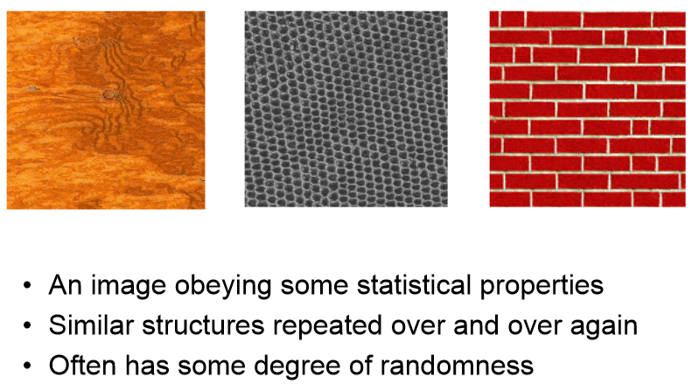
What is Texture?
An image obeying some statistical properties
Similar structure repeated over and over again
Often has some degree of randomness
Notes:
既然沒有定義，那該怎麼”描述”紋理??
他會服從一些屬性。(影像的各式各樣統計數值 (ex. local的variation大致相同等等) )
類似的結構不斷重複(ex.一個黑點被其他六個黑點圍起來、兩層磚頭交錯排列，位差半個磚頭)
可能含有一點隨機性(ex.木頭紋路並不是整塊都一至、磚頭大小不一)
Obey 服從 一些屬性
(某些區塊一職重複)
Degree 程度 (左一)

Slide 7
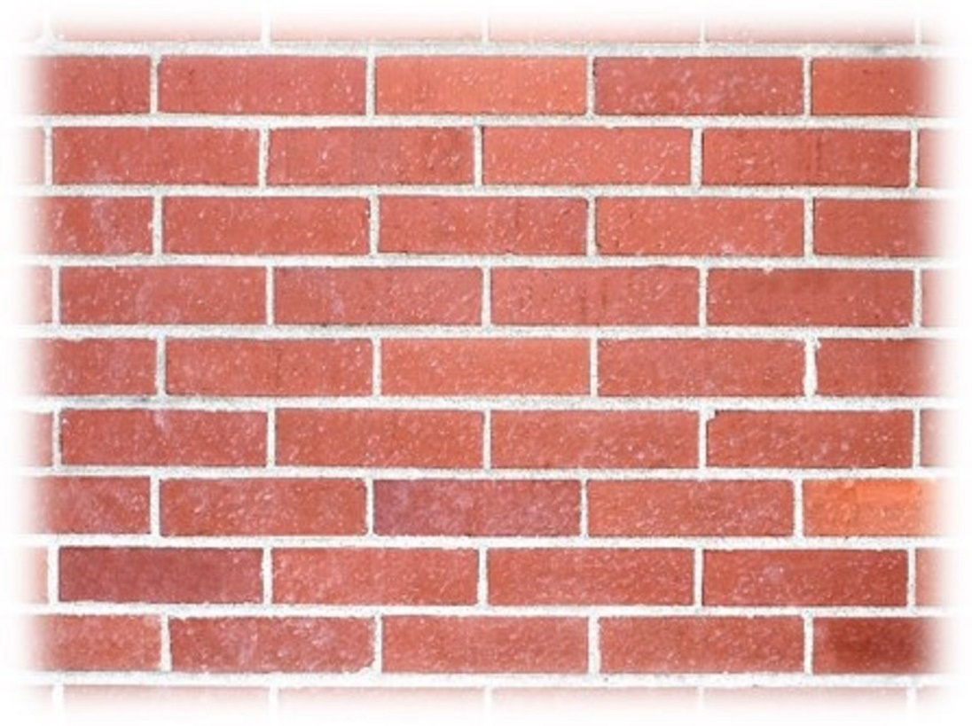
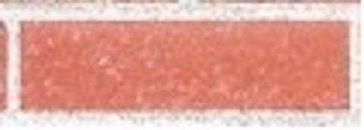

What is Texture?
Texture is a non-local property.
  Repeating patterns of local variations in image intensity which are too fine to be distinguished as separated object at the observed resolution.
Notes:
Texture是一種Non-local (非區域性的)特性，只有一小塊是無法辨識的，必須觀察大範圍空間才可展現紋理的特性
一再重複的的結構應該視為相同的材質，而非不同的

Slide 8
“Texel” and “Texture Primitive”
Notes:
在做影像處理的時候image裡面有pixel 那每一個pixel組成可以得到一個image
那texture也有一個叫做texel的東西
跟texel很像的東西叫做Texture Primitive
待會會做介紹
Primitive 元件
如果要了解一個texture需要了解他的基本組成

Slide 9
Texel
Texture element: basic textural unit of some defining spatial relationships.
Texture: A set texels occurring in some regular or repeated pattern.
Elements | Construct | Array
Pixels |  | Image
Texels |  | Texture
Notes:
Texel(紋素)
Texel = texture element 紋理元素
是Texture組成的最小單位
描述紋理的基本單位
紋理(texture)是紋素(texel)以某種固定或重複的方式排列所產生的

Slide 10
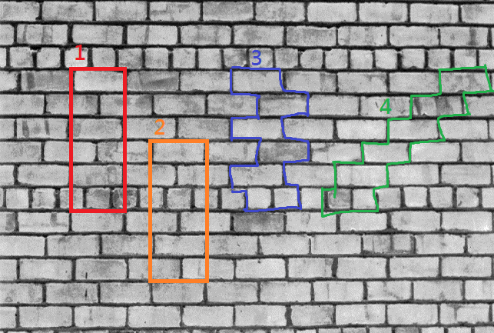
Texel
Notes:
1,2,3,4是texel
經過重新排列組合可以組成texture
紅框的不是texel

Slide 11
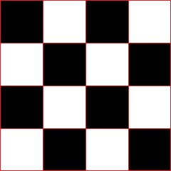
Texture Primitive
Connected set of pixels characterized by attribute set.
Simplest primitive: pixel with gray level attribute
More complicated primitive: connected set of pixels homogeneous in level, characterized by size, elongation, orientation, and average gray level
Notes:
以屬性集為特徵的連接的像素集。
他會把相同屬性的歸類為同一類
最簡單的圖元：具有灰階屬性的像素
更複雜的圖元：在像素級別相同，相連的像素集下，其特徵在於尺寸，伸長率，方向和平均灰階
Primitive 相同性質，越大塊越好
Attribute 屬性
Complicated 複雜
Elongation 拉長
Orientation 方向

Slide 12
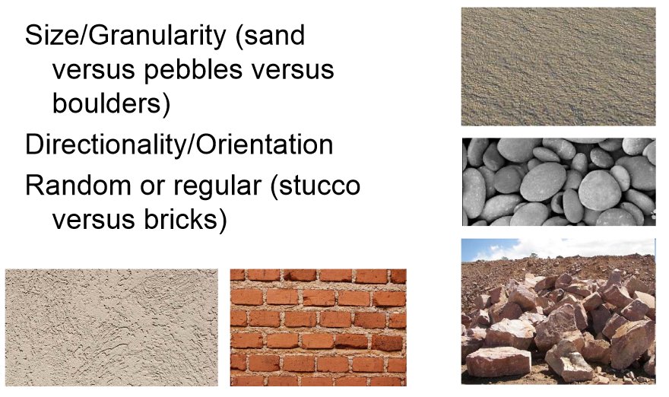
Characterizing Texture
An image texture is described by
  types of its primitives
  number of its primitives
  their spatial organization or layout.
Image texture can be qualitatively evaluated as some properties.
Notes:
紋理特徵
對電腦而言，紋理可以由 primitive (圖原) 的數量、類型以及他們的空間關係來描述
沙子 石頭 岩石 都是primitive
可以將圖像紋理定性為某些屬性，就像是我們平常口頭上描述的形容詞 (e.g. 沙子很平滑)
type不一樣，數量也不一樣
Characterizing 特性化
Layout 配置

Slide 13
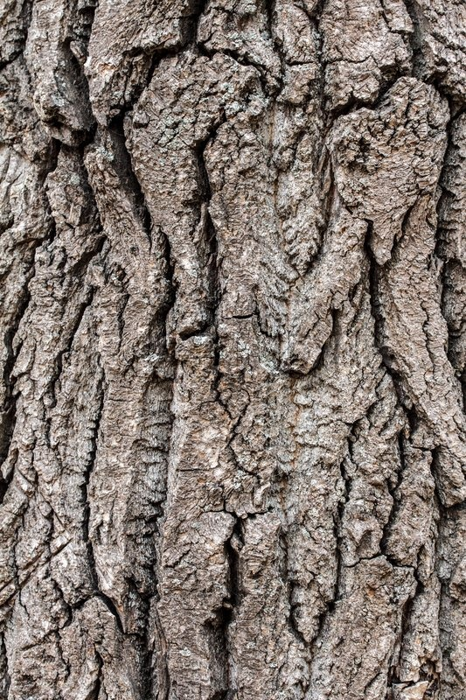
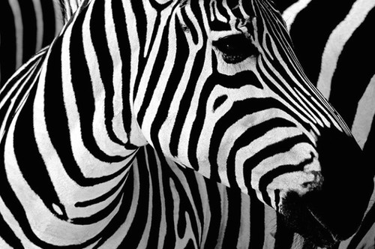
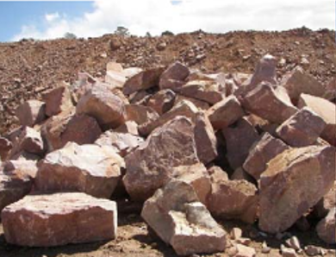
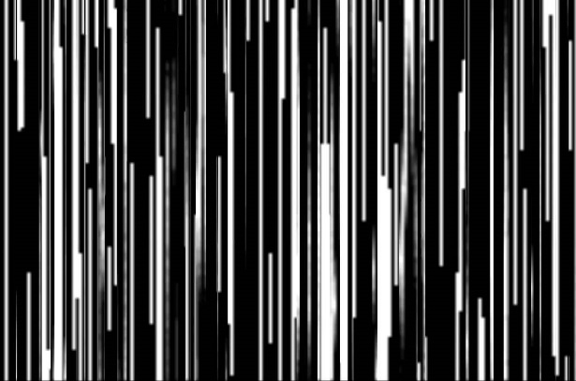
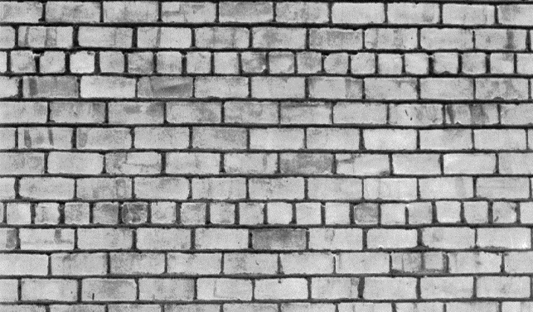
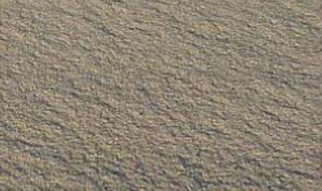
Some Texture Properties
Fineness
Coarseness
Contrast
Directionality
Roughness
Regularity
Smoothness
Notes:
細緻
粗糙
對比高
有方向性的
樹皮粗糙
排列整齊
平滑

Slide 14
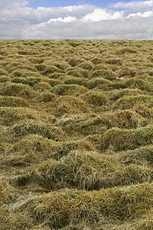
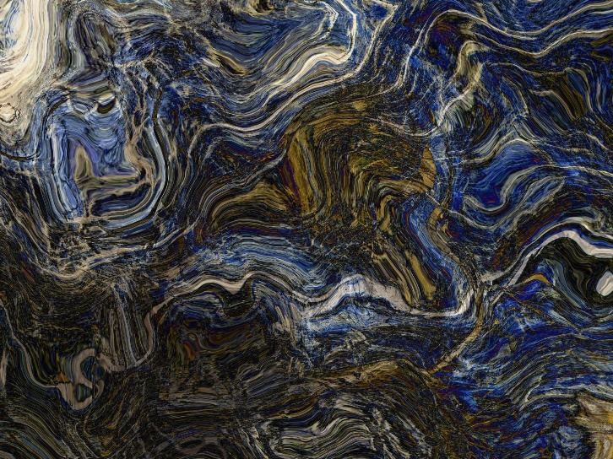
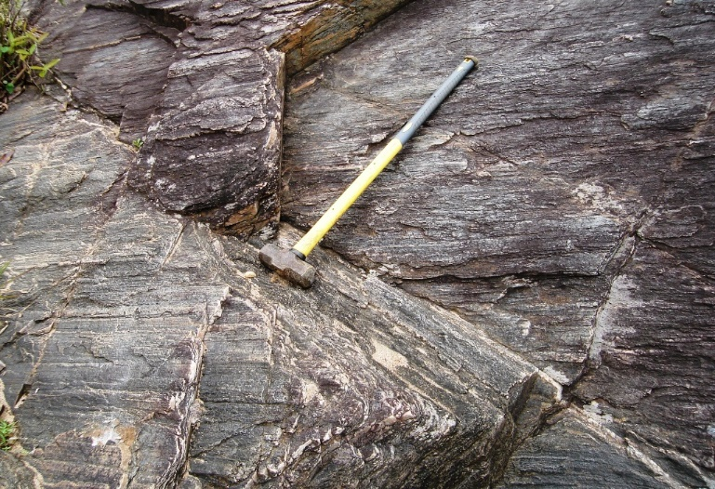
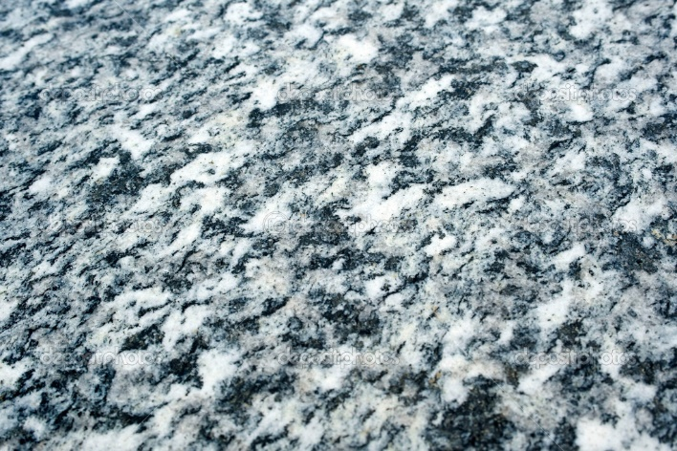
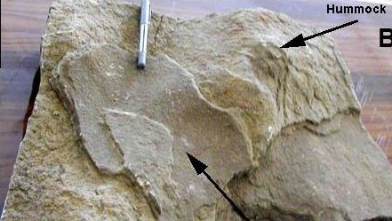
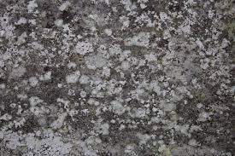
Some Texture Properties
Granularity
Randomness
Lineation
Mottled
Irregular
Hummocky
Notes:
顆粒度
隨機性
線型
斑駁
不規則
圓丘
這些就是課本上有提到的一些紋理的屬性

Slide 15
Characterizing Texture
Each of these qualities translates into some property of the gray level primitives and the spatial interaction between them.
Open issue:
  Map semantic meaning into precise properties.
  Texture discrimination techniques are for the most part
  ad hoc.
created for a particular purpose only
Notes:
上述的紋理特徵可轉化為灰階primitives (圖元) 的某些屬性以及它們之間的空間交互作用。
公開問題：
我們如果可以定義每一個primitive，那可不可以有很精確的屬性去了解他的語意？
答案還是沒有辦法，Texture discrimination techniques還是ad hoc的方式，也就是沒有辦法用formal的方法去得到texture的property

Slide 16
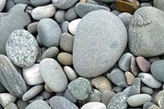
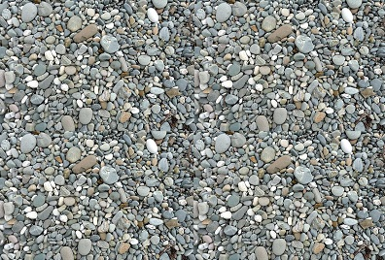
Texture and Scale
Which one is coarse/fine?
Notes:
比較哪張圖是粗糙或細緻
可能乍看之下是左邊粗糙，右邊細緻
其實兩張是影像是同一張圖，只是一張近拍，一張遠拍
先看影片

Slide 17
Texture and Scale
For any textural surface, there exists a scale at which, it appears smooth and “textureless”. (see from infinite distance)
As resolution increases, the surfaces appears as a fine texture and then a coarse one, and for multiple-scale textural surface the cycle of smooth, fine, and coarse may repeat.
https://www.youtube.com/watch?v=0vnA_KIojLg
Notes:
對於任何紋理表面，都有一個刻度，若以無限遠的距離來觀測東西表面，看到的表面將會非常平順、”看起來沒紋理特性”
隨著分辨率的提高，就算是精緻的表面其實都會有很粗糙的紋理存在的。然後這些很粗糙的紋理可能又是由很多重複循環的其他不同紋理所構成的。

Slide 18
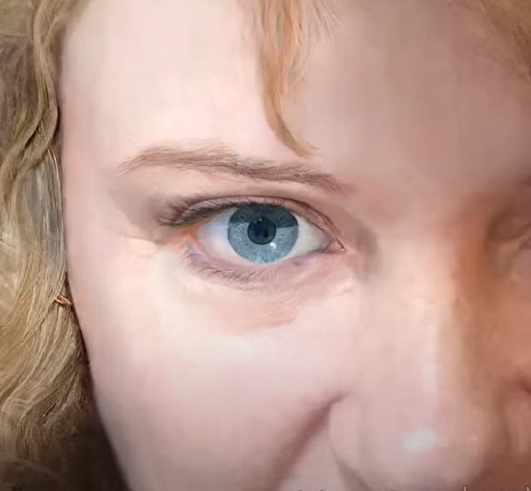
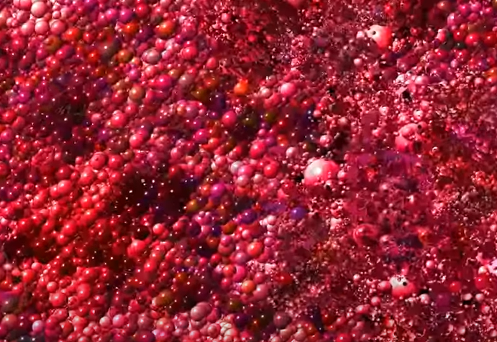
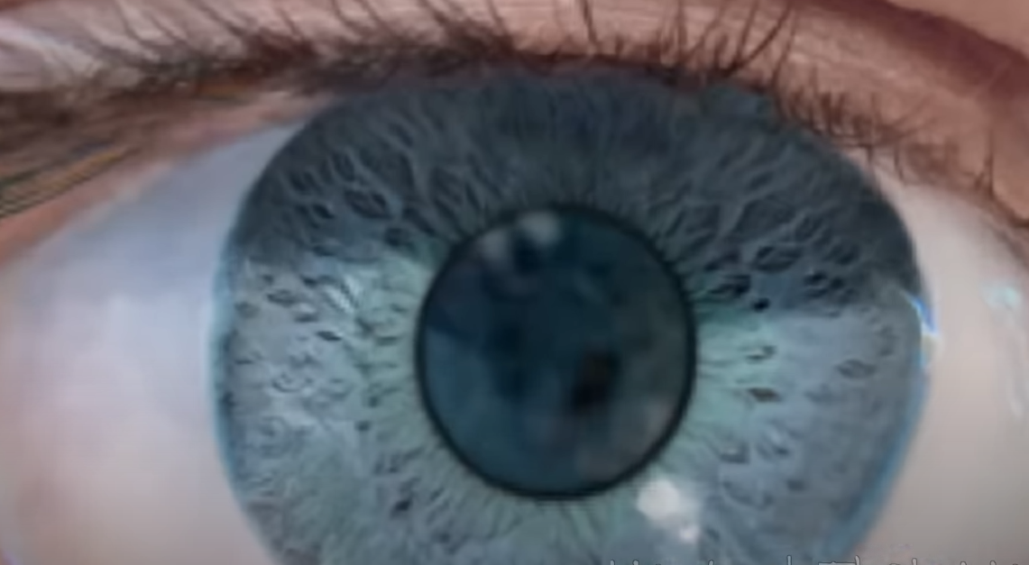
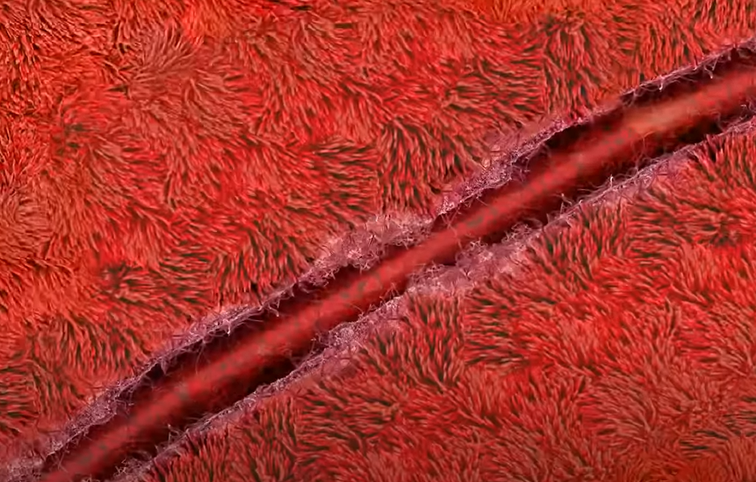
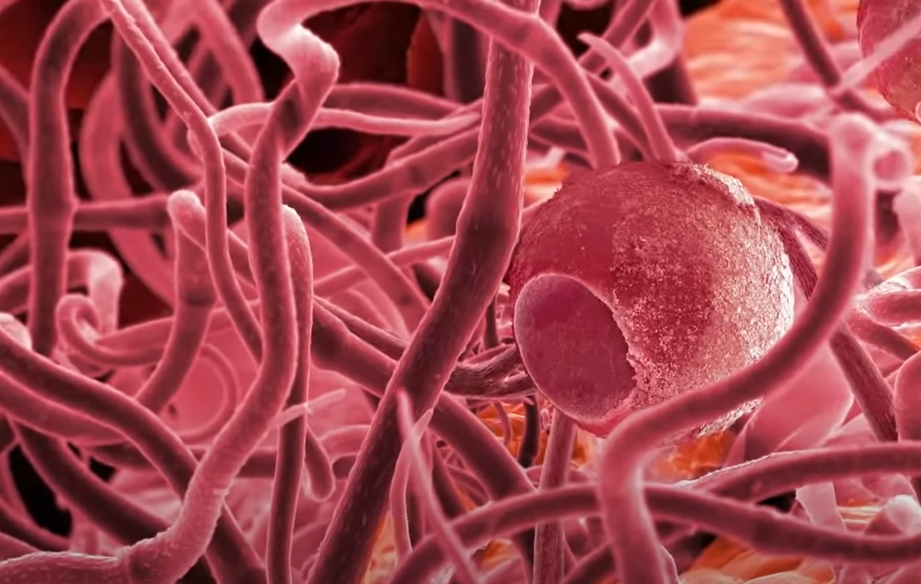
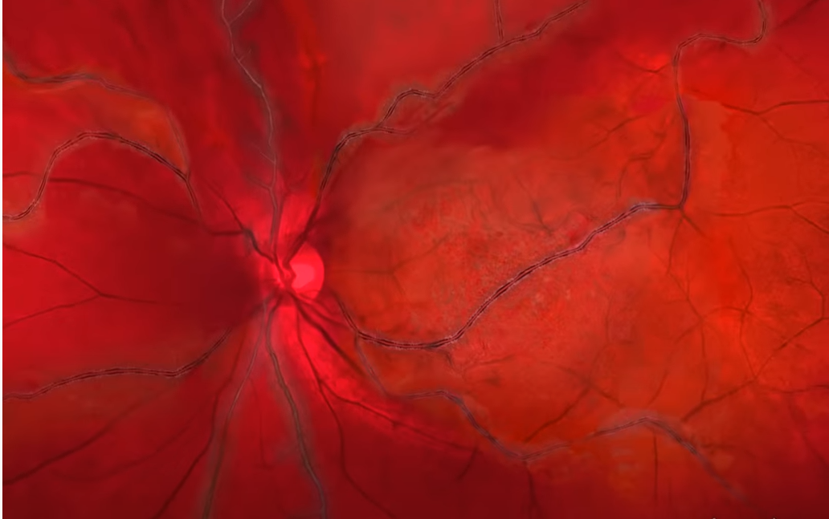
Texture and Scale
Notes:
表面上看起來很平滑的紋理可能是由很多很小的單位組成的。

Slide 19
Texture and Scale
Texture cannot be analyzed without frame of reference on scale or resolution.
Texture is a scale-dependent phenomenon.
Notes:
因此，沒有scale(尺度)或resolution(分辨率)的參照就無法分析紋理。
紋理是與比例有關的現象。

Slide 20
Fun Time

Slide 21
How to Analyze Texture ?

Slide 22
Texture Analysis Issues (Test)
Pattern recognition:
  Given textured region, determine the class the region belongs to.
Generative model:
  Given textured region, determine a description or model for it.
Texture segmentation:
  Given image having many textured areas, determine boundaries.
Notes:
考試的小重點
圖形識別
產生模型
紋理分段
這三個是針對紋理分析的較重要的部分

Slide 23
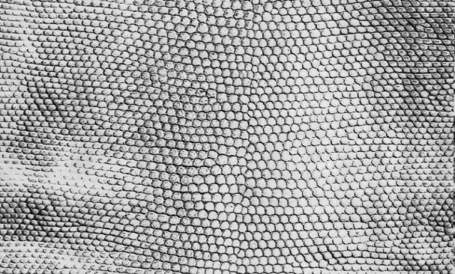
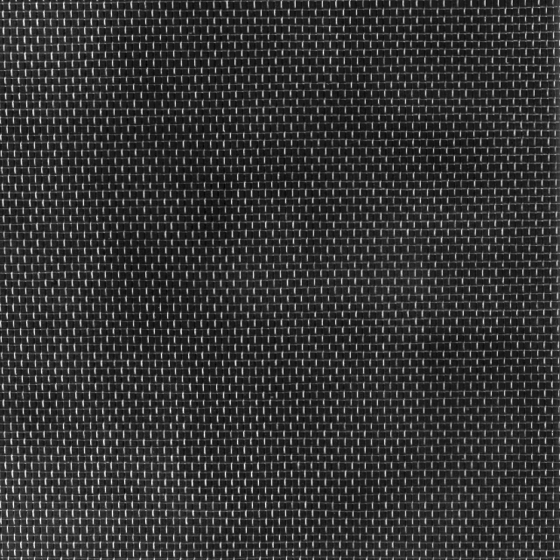

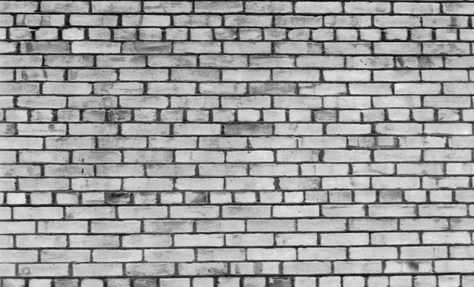
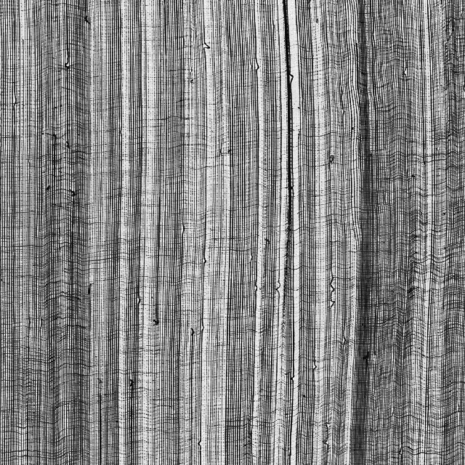
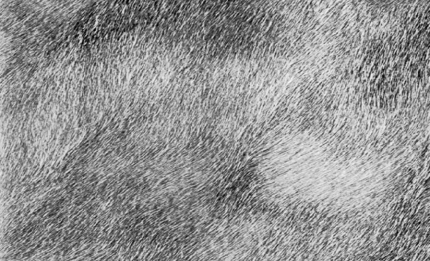
Pattern Recognition
Scales
Linen
Nylon
Bricks
Gauze
Fur
Notes:
圖形識別
給圖片要辨識出是什麼東西
鱗片
麻布
尼龍布
磚牆
紗布
毛皮

Slide 24
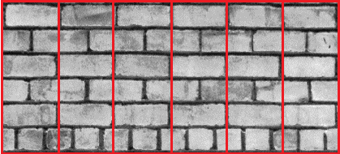
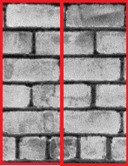
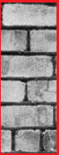
Generative Model
Notes:
產生模型
給定一個紋理區域為model，重複排列組合這個model可以產生原本的image

Slide 25
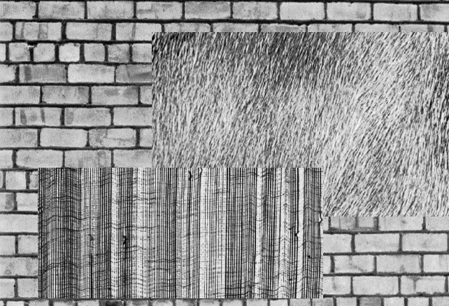
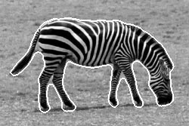
Texture Segmentation
Notes:
紋理分段
要如何針對image作分割
可以針對pixel做分類，可以把斑馬很標準的畫出來

Slide 26
Texture Analysis
Statistical Approach
Model Based Technique

Slide 27
Statistical Texture Feature Approaches
Spatial gray level co-occurrence probabilities
Autocorrelation function
Edgeness per unit area
Relative extrema distributions
Mathematical morphology
Spectral power density function
Gray-level run-length distributions
Notes:
關於”以統計來描述紋理”這種方式，課本列舉了幾種
空間灰階共生機率
自相關函數
單位面積邊界密度
相對極值分布
數學型態學
光譜功率密度函數
灰階行程長度分布
Spatial 空間的
Co-occurrence 共同發生
Probability 機率
Autocorrelation 自相關函數 f(x) time domain vs. spatial domain
Cross-correlation 交互相關函數 f(x) vs. g(x)
Extrema 極值
Distribution 分布
Morphology 形態學
Spectral power density function 頻譜功率密度函數
0001111011100000 run-length encoding 串列長度編碼

Slide 28
Model Based Technique
Auto-regression
Markov random fields
Random Mosaic models
Moving-average
Time-series models (extended to 2D)
Notes:
關於建構模型的方式，課本列出以下幾種
– 自回歸
– 馬卡夫隨機場
– 隨機馬賽克
– 移動平均
– 時間序列
Auto-regression 自回歸
Fields場
Mosaic model 馬賽克模型
Extend 延伸

Slide 29
Fun Time

Slide 30
Statistical Texture Feature Approach

Slide 31
Introduction
Gray Level Statistics
Statistical Texture Feature Approach
Model-based Technique
Application

Slide 32
First-Order Gray-Level Statistics
Statistics of single pixels
E.g. Histogram, mean, median, variance
Notes:
Statistical Texture Feature Approach 會分三個階段
首先是一階灰階統計量，也就是單個pixel的灰階拿來做統計
ex. 直方圖、平均、中位數、變異數、標準差
但只看單一個pixel沒辦法做到全觀的分析

Slide 33
Second-Order Gray-Level Statistics
The combined statistics of gray levels of pairs of pixels in which each two pixels in a pair have a fixed relative position
E.g. co-occurrence
Gray level spatial dependence: characterize texture by co-occurrence
Notes:
二階灰階統計量
針對兩個pixel間的相關性，pixel會去看他鄰近的pixel對於他的相關性
兩個固定相對位置的pixel，他們聯合的灰階所做的統計
E.g. 第三章，灰階共生矩陣
由共生灰階空間相關性: 由pixel灰階共生所產生的紋理特徵

Slide 34
Co-Occurrence Matrix
The gray level co-occurrence can be specified in a matrix of relative frequencies Pij with which two neighboring pixels separated by distance d occur on the image, one with gray level i and the other with gray level j
Symmetric matrix
Function of angle and distance between pixels
Notes:
與第三章的 Co-Occurrence Matrix 相同
灰階共生矩陣可以分析相鄰兩個pixel之間的關聯：
要運算灰階共生矩陣需先在影像中給定一個距離d，並給予比較的角度，因為他有0度、45度、90度、135度
先given d
2個pixel距離多遠
還要給角度

Slide 35


Co-Occurrence Matrix
(1,1) | (1,2) | (1,3) | (1,4)
(2,1) | (2,2) | (2,3) | (2,4)
(3,1) | (3,2) | (3,3) | (3,4)
(4,1) | (4,2) | (4,3) | (4,4)
D=1
Angle = 0$°$
$$L_{x}=\left\{1,2,3,4\right\}$$
$$L_{y}=\left\{1,2,3,4\right\}$$
$$R_{H}=\left\{\left(\left(k,l\right),\left(m,n\right)\right)∈\left(L_{y}×L_{x}\right) \right| k−m=0,\left|l−n\right|=1\}$$
$$=\{ \left(\left(1,1\right),\left(1,2\right)\right),\left(\left(1,2\right),\left(1,1\right)\right),\left(\left(1,2\right),\left(1,3\right)\right),\left(\left(1,3\right),\left(1,2\right)\right),$$
$\left(\left(1,3\right),\left(1,4\right)\right),\left(\left(1,4\right),\left(1,3\right)\right),\left(\left(2,1\right),\left(2,2\right)\right),\left(\left(2,2\right),\left(2,1\right)\right),$
$\left(\left(2,2\right),\left(2,3\right)\right),\left(\left(2,3\right),\left(2,2\right)\right),\left(\left(2,3\right),\left(2,4\right)\right),\left(\left(2,4\right),\left(2,3\right)\right),$
$\left(\left(3,1\right),\left(3,2\right)\right),\left(\left(3,2\right),\left(3,1\right)\right),\left(\left(3,2\right),\left(3,3\right)\right),\left(\left(3,3\right),\left(3,2\right)\right),$
$\left(\left(3,3\right),\left(3,4\right)\right),\left(\left(3,4\right),\left(3,3\right)\right),\left(\left(4,1\right),\left(4,2\right)\right),\left(\left(4,2\right),\left(4,1\right)\right),$
$\left(\left(4,2\right),\left(4,3\right)\right),\left(\left(4,3\right),\left(4,2\right)\right),\left(\left(4,3\right),\left(4,4\right)\right),\left(\left(4,4\right),\left(4,3\right)\right) \}$
The set of all distance-1 horizontal neighbor resolution cells on a 4x4 image.
Notes:
最簡單的例子:
空間上距離是1 然後是水平的 然後圖上的每個(k(x1) l(y1) 和 m(x2) n(y2) 就有這些關係) 。
也就是這張圖上的是x y 座標 而不是最後的矩陣，只是為了解釋一下你要統計這些pixel之間的關係
就是過去和回來都要去算。最上面的圖是我們的image，每一個格子代表著一個pixel，所以這個是一個4*4 pixel的image
Relationship horizontal
x y 各是1~4
(d=1)

Slide 36
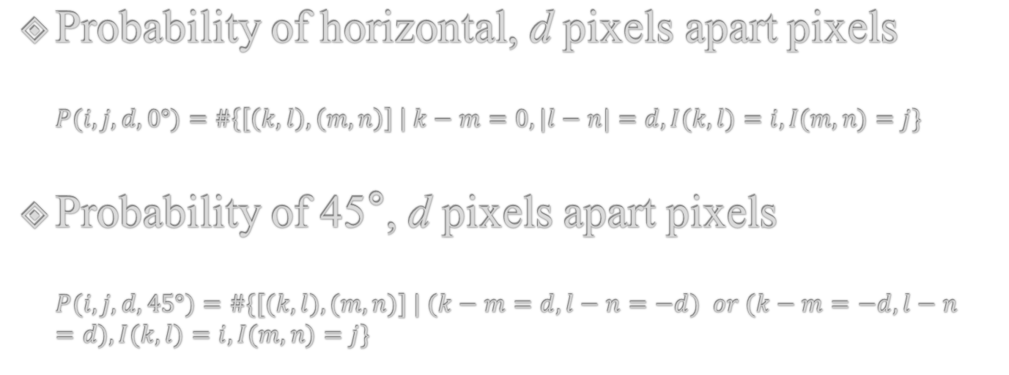


Co-Occurrence Matrix
(1,1) | (1,2) | (1,3) | (1,4)
(2,1) | (2,2) | (2,3) | (2,4)
(3,1) | (3,2) | (3,3) | (3,4)
(4,1) | (4,2) | (4,3) | (4,4)
$$L_{x}=\left\{1,2,3,4\right\}$$
$$L_{y}=\left\{1,2,3,4\right\}$$
Probability of horizontal, d pixels apart pixels
$$P(i,j,d, 0°)=\#\left\{\left[\left(k, l\right),\left(m, n\right)\right] \right| k−m=0, |l−n|=d, I(k, l)=i, I(m,n)=j\}$$
Probability of 45°, d pixels apart pixels
$$P(i, j, d, 45°)=\#\{[(k, l), (m, n)] | (k−m=d, l−n=−d) or (k−m=−d, l−n=d), I(k, l)=i, I(m,n)=j\}$$
Notes:
Function 表示 0度 & 45度

Slide 37
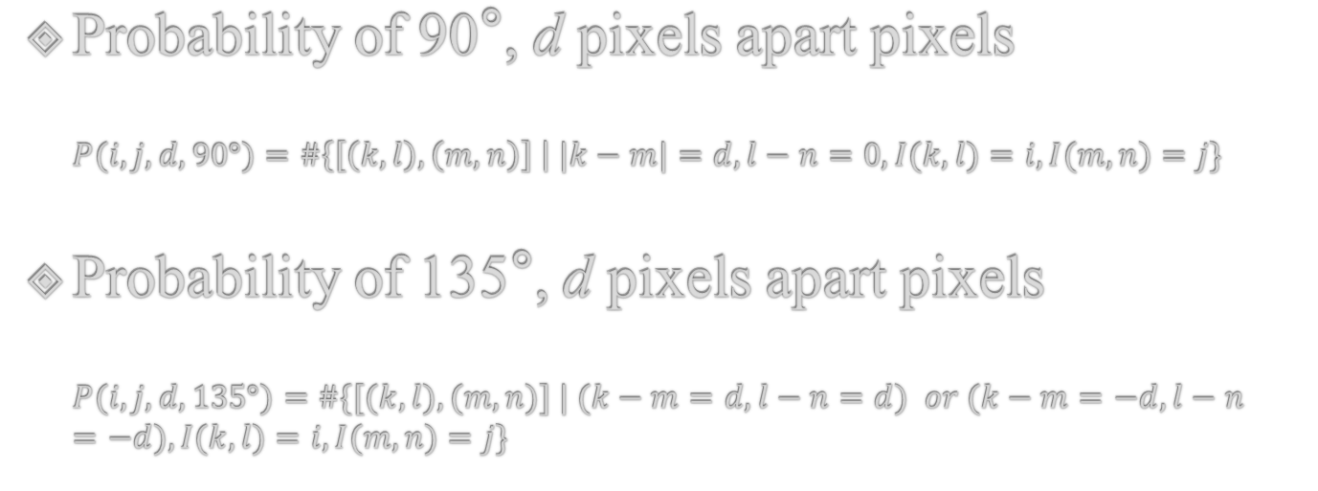
Co-Occurrence Matrix
(1,1) | (1,2) | (1,3) | (1,4)
(2,1) | (2,2) | (2,3) | (2,4)
(3,1) | (3,2) | (3,3) | (3,4)
(4,1) | (4,2) | (4,3) | (4,4)
$$L_{x}=\left\{1,2,3,4\right\}$$
$$L_{y}=\left\{1,2,3,4\right\}$$
Probability of 90°, d pixels apart pixels
$$P(i,j,d, 90°)=\#\left\{\left[\left(k, l\right),\left(m, n\right)\right] \right| |k−m|=d, l−n=0, I(k, l)=i, I(m,n)=j\}$$
Probability of 135°, d pixels apart pixels
$$P(i, j, d, 135°)=\#\{[(k, l), (m, n)] | (k−m=d, l−n=d) or (k−m=−d, l−n=−d), I(k, l)=i, I(m,n)=j\}$$
Notes:
Function 表示 90度 & 135度

Slide 38




Co-Occurrence Matrix
 |  | Gray level
Gray Level |  | 0 | 1 | 2 | 3
 | 0 | #(0,0) | #(0,1) | #(0,2) | #(0,3)
 | 1 | #(1,0) | #(1,1) | #(1,2) | #(1,3)
 | 2 | #(2,0) | #(2,1) | #(2,2) | #(2,3)
 | 3 | #(3,0) | #(3,1) | #(3,2) | #(3,3)
0 | 0 | 1 | 1
0 | 0 | 1 | 1
0 | 2 | 2 | 2
2 | 2 | 3 | 3
$$0° P_{H}=\left(\begin{matrix}4 & 2 & 1 & 0 \\ 2 & 4 & 0 & 0 \\ 1 & 0 & 6 & 1 \\ 0 & 0 & 1 & 2\end{matrix}\right)$$
$$90° P_{V}=\left(\begin{matrix}6 & 0 & 2 & 0 \\ 0 & 4 & 2 & 0 \\ 2 & 2 & 2 & 2 \\ 0 & 0 & 2 & 0\end{matrix}\right)$$
$$135° P_{LD}=\left(\begin{matrix}2 & 1 & 3 & 0 \\ 1 & 2 & 1 & 0 \\ 3 & 1 & 0 & 2 \\ 0 & 0 & 2 & 0\end{matrix}\right)$$
$$45° P_{SD}=\left(\begin{matrix}4 & 1 & 0 & 0 \\ 1 & 2 & 2 & 0 \\ 0 & 2 & 4 & 1 \\ 0 & 0 & 1 & 0\end{matrix}\right)$$
Notes:
舉例建立四個角度 d=1 的 Co-Occurrence Matrix

Slide 39

Variant of Co-Occurrence Matrix
Gray level difference probability:
$$P\left(d\right)=\sum_{i}{\sum_{j}{P(i,j)}}$$
$$\left|i−j\right|=d$$
Notes:
Co-Occurrence Matrix的差異
灰度差異概率
一張圖上所有intensity 相差為d的這些pixel pair做co-occurrence後再累加的結果
If d=2
i=2 j=0
i=3 j=1

Slide 40
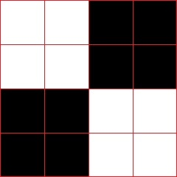







$$0° P_{H}=\left(\begin{matrix}8 & 4 \\ 4 & 8\end{matrix}\right)$$
$$0° P_{H}=\left(\begin{matrix}0 & 12 \\ 12 & 0\end{matrix}\right)$$
$$P\left(d\right)=\sum_{i}{\sum_{j}{P(i,j)}}$$
$$\left|i−j\right|=d$$
$P_{H}(0)=$ 8+8=16
$P_{H}(0)=$ 0+0=0
$P_{H}(1)=$ 4+4=8
$P_{H}(1)=$ 12+12=24
Notes:
左邊顆粒大 d小時 p(d)大
反之 相反
0是黑 1是白

Slide 41





coarse
fine
$$P\left(d\right)=\sum_{i}{\sum_{j}{P(i,j)}}$$
$$\left|i−j\right|=d$$
$P_{H}(0)=$ 8+8=16
$P_{H}(0)=$ 0+0=0
$P_{H}(1)=$ 4+4=8
$P_{H}(1)=$ 12+12=24
The probability of small contrast d for a coarse texture will be much higher than for a fine texture.
Notes:
粗糙紋理的小對比度d的可能性比精細紋理的大得多。
左邊顆粒大: d小時 p(d)大
右邊顆粒小: d大時 p(d)大
0是黑 1是白

Slide 42
Summary of Gray-level Co-Occurrence
Advantages
  Use spatial interrelationship of the gray levels to characterize a texture.
  Be able to do so by gray-level transformation, which is an invariant way.
Weakness
  Not capture the shape aspects of the gray level primitives.
  Not likely to work well for textures composed of large-area primitives.
  Cannot capture the spatial relationships between primitives that are regions larger than a pixel.
Notes:
好處
是固定的，不用因為不同texture改變算法
使用灰階的空間相互關係來描述紋理。
弱點
無法利用灰階 primitive (圖元) 的形狀方面去做分析。
對於由大面積 primitive (圖元) 組成的紋理或是primitive不是單一pixel的類型不太可能很好地工作。

Slide 43
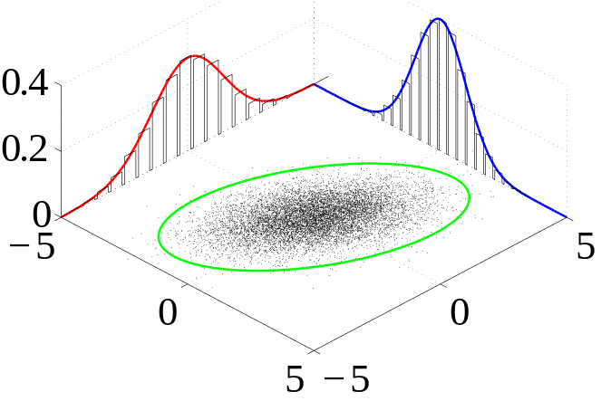
Generalized Gray Level Spatial Dependence Models for Texture
Simple generalization: consider more than two pixels at a time
Given a specific kind of spatial neighborhood and a sub-image, one can parametrically estimate the joint probability distribution of the gray levels over the neighborhoods in the sub-image.
Notes:
廣義灰階空間相關模型
前面所提的是考慮兩個pixel的關係，這邊是一次看更多pixel
接著利用聯合機率分布納入更多pixels間的資訊
右下角這個就是一個描述5*5的機率分布的圖

Slide 44
Strong Texture Measures and Generalized Co-occurrence
Gray Level Co-occurrence
Statistical Texture Feature Approach
Model-based Technique
Application

Slide 45
Strong Texture Measures and Generalized Co-occurrence
Strong texture measure takes into account the co-occurrence between texture primitives rather than pixels.
It is useful to work with primitives that are maximally connected sets of pixels having particular properties.
聯集
Notes:
前面是pixel與pixel的關係
此處分析 primitive 跟 primitive之間的關係
使用primitives是具有特定屬性的pixels最大聯集組成。
若比較primitive之間的關聯會增加分析的完整性

Slide 46
Strong Texture Measures and Generalized Co-occurrence
Other attributes include measures of shape, or with the variance of its local property.
  Connected components
  Ascending\descending components
  Saddle components
  Relative maxima\minima components
  Central Axis components
Examples of primitives property
Notes:
第一步需要建立完善的primitive
其他屬性包括形狀的度量，或其局部屬性的變化。
連接的組件
升序/降序組件
鞍座組件
相對最大\最小分量
中心軸組件
都可以作為primitive的選取方式

Slide 47
Spatial Relationship
After constructing the primitives, we have
  a list of primitives
  their center coordinates
  their attributes
Notes:
選完primitive之後會得到primitive的一些性質
會得到 a list of primitives 還有中心座標跟屬性

Slide 48
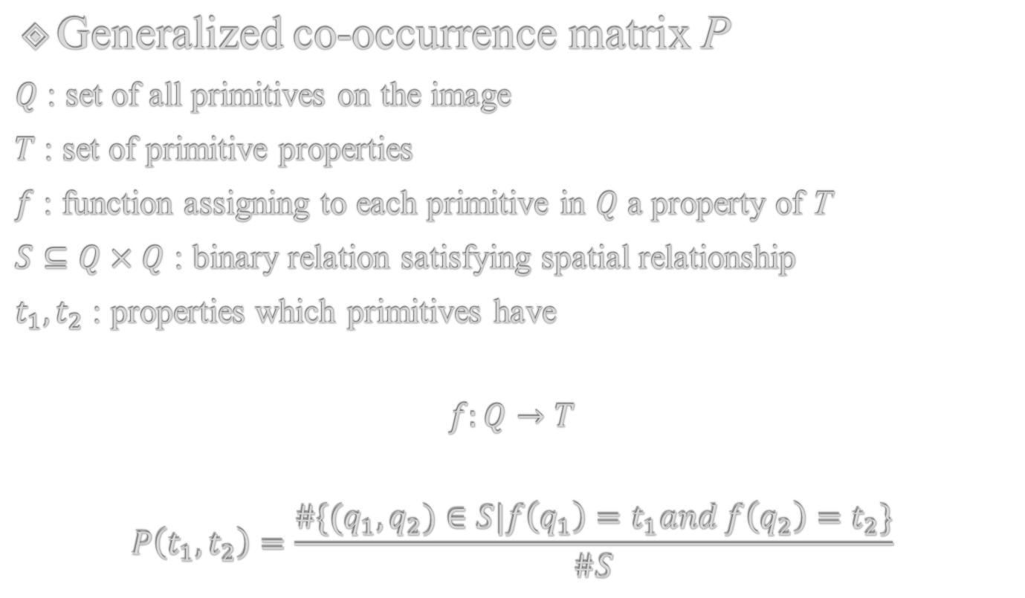
Spatial Relationship
Generalized co-occurrence matrix P
$Q$ : set of all primitives on the image
$T$ : set of primitive properties
$f$ : function assigning to each primitive in $Q$ a property of T
$S⊆Q×Q$ : binary relation satisfying spatial relationship
$t_{1},t_{2}$ : properties which primitives have
$$f:Q→T$$
$$P\left(t_{1},t_{2}\right)=\frac{\#\{(q_{1},q_{2})∈S|f\left(q_{1}\right)=t_{1}and f\left(q_{2}\right)=t_{2}\}}{\#S}$$
Notes:
把primitive跟屬性都分析好之後，接下來要做運算
先定義參數
Q set {primitive1, primmitive2, ….} (Q是primitiv的set)
T set {f(Q(1))=properties, f(Q(2))properties, ….}
f(Q(1))=properties=t1
F function →針對Q做統一處理 (計算平均亮度)
S 空間中的關係 (primitive1的中心距離 與 primmitive2的中心距離差異) primitive1, primmitive2可以表示為兩種不同的石頭
# number of
比較P(t1, t2) = q1與q2屬於某空間距離後滿足f(q1)=t1且f(q2)=t2/空間中的距離
t1 t2 在S空間中，滿足條件的比率有多少

Slide 49
Fun Time

Slide 50
Strong Texture Measures and Generalized Co-occurrence
Autocorrelation Function
Statistical Texture Feature Approach
Model-based Technique
Application

Slide 51
Autocorrelation Function
Texture relates to the spatial size of the gray level primitives on an image
Gray level primitives of larger size are indicative of coarser texture
Gray level primitives of smaller size are indicative of finer texture
Autocorrelation function is a feature that describes the size of gray level primitives
Notes:
自相關 autocorrelation
每個primitive會自己跟自己做比較
先找出primitive 大小(Corase or fine)
紋理與圖像上灰度的空間大小有關
較大size 的gray level primitives表示較粗糙的紋理
較小size 的gray level primitives表示較精細的紋理
自相關函數是描述、判斷 gray level primitives 的大小

Slide 52
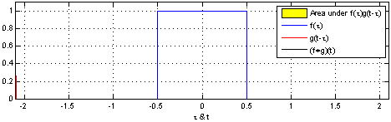




Autocorrelation Function
Area under $f(τ)⋆f(t)$
$$f(τ)$$
$$f(t)$$
($f+f)(t)$
Notes:
以1D來比較的話
自己跟自己的相關程度比較

Slide 53
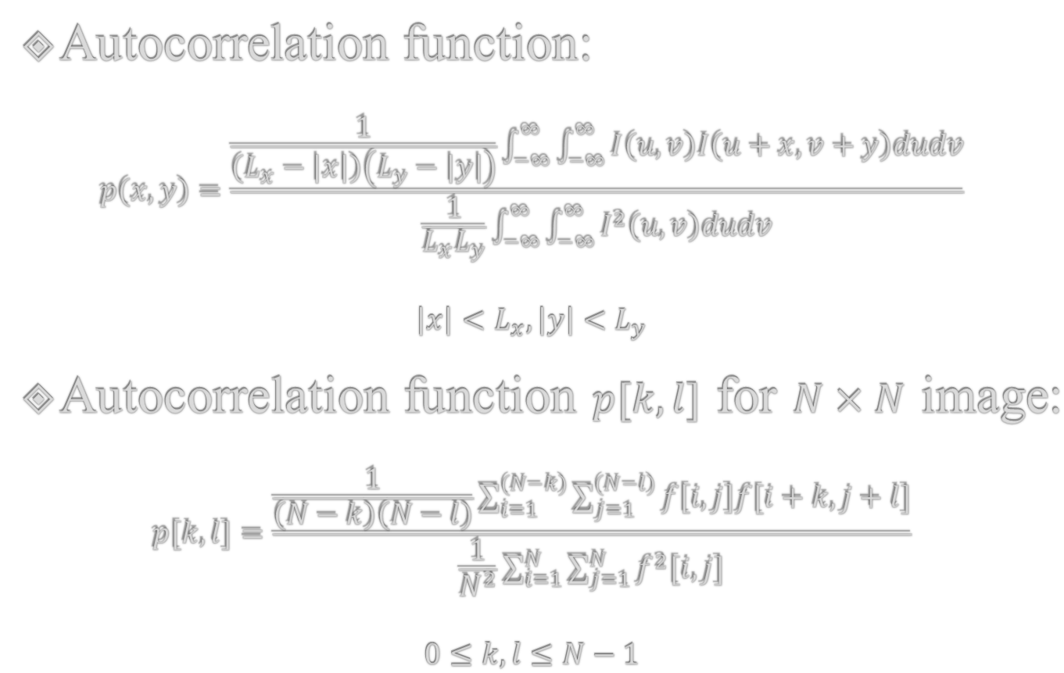
Autocorrelation Function
Autocorrelation function:
$$p\left(x,y\right)=\frac{\frac{1}{\left(L_{x}−\left|x\right|\right)\left(L_{y}−\left|y\right|\right)}\int_{−∞}^{∞}{\int_{−∞}^{∞}{I\left(u,v\right)I\left(u+x,v+y\right)dudv}}}{\frac{1}{L_{x}L_{y}}\int_{−∞}^{∞}{\int_{−∞}^{∞}{I^{2}\left(u,v\right)dudv}}}$$
$$\left|x\right|<L_{x},\left|y\right|<L_{y}$$
Autocorrelation function $p[k,l]$ for $N×N$ image:
$$p[k,l]=\frac{\frac{1}{\left(N−k\right)\left(N−l\right)}\sum_{i=1}^{(N−k)}{\sum_{j=1}^{(N−l)}{f\left[i,j\right]f[i+k,j+l]}}}{\frac{1}{N^{2}}\sum_{i=1}^{N}{\sum_{j=1}^{N}{f^{2}[i,j]}}}$$
$$0≤k,l≤N−1$$
Notes:
他的算式就會像這個樣子
那為什麼這邊會有積分是連續的，因為這個 Autocorrelation ，不只有針對image做處理，在signal也可以做處理
所以他會有連續跟離散的算法，我們主要是用下面這一個公式去做運算。

Slide 54
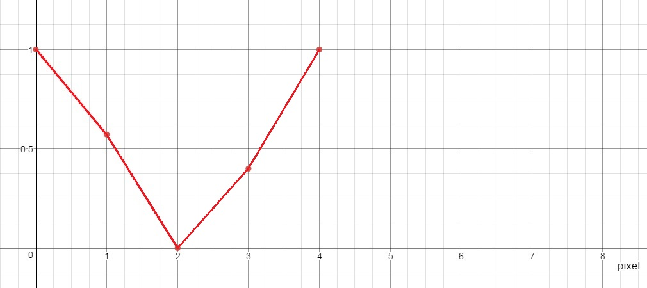
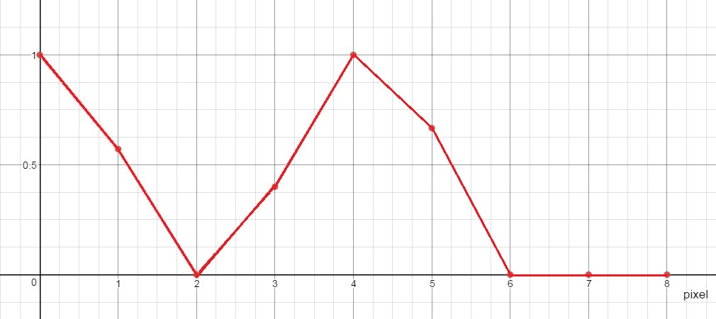
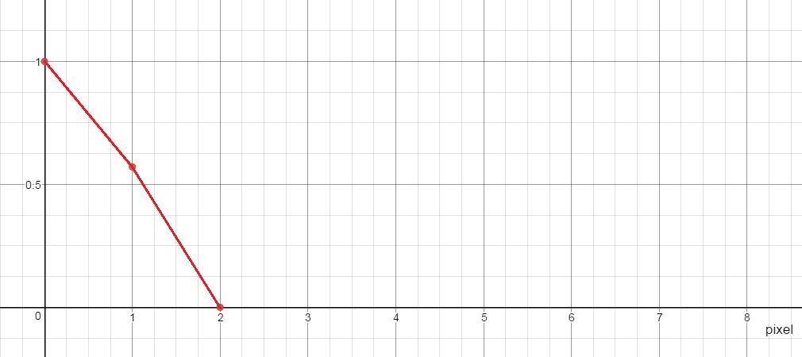
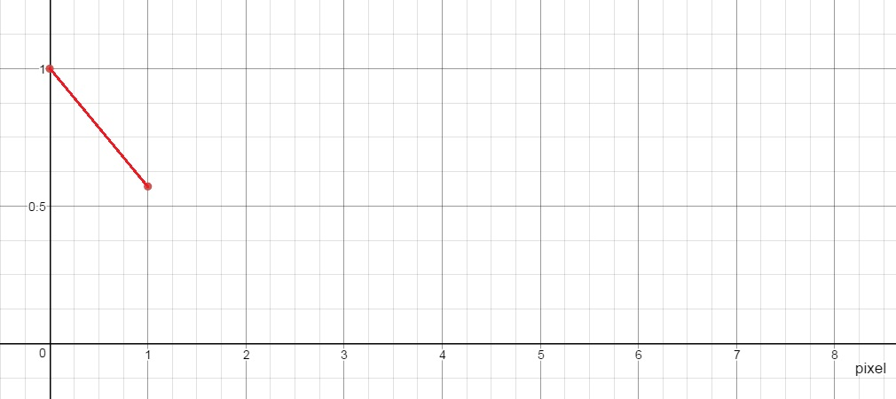
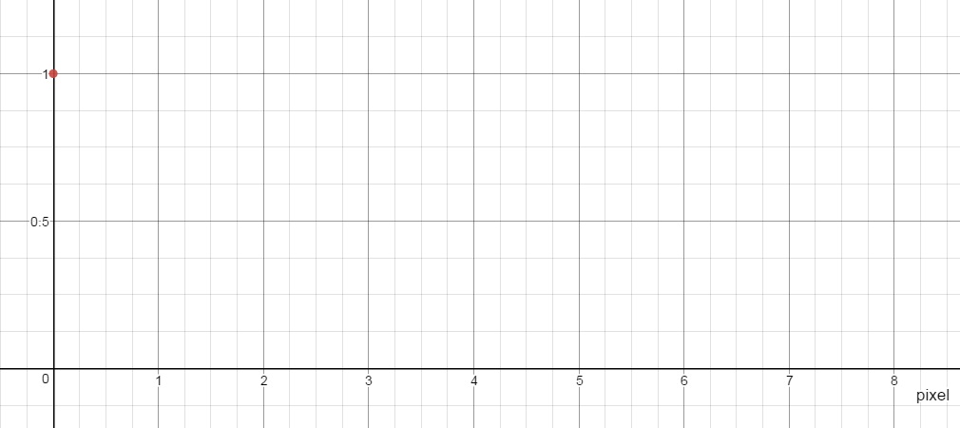







$$p[k]=\frac{\frac{1}{\left(N−k\right)}\sum_{i=1}^{(N−k)}{f\left[i\right]f[i+k]}}{\frac{1}{N}\sum_{i=1}^{N}{f^{2}[i]}}$$
$k=0$
$$\frac{\frac{1}{8}×4}{\frac{1}{8}×4}=1$$
$k=4$
$$\frac{\frac{1}{4}×2}{\frac{1}{8}×4}=1$$
$k=1$
$$\frac{\frac{1}{7}×2}{\frac{1}{8}×4}=\frac{4}{7}$$
$k=5$
$$\frac{\frac{1}{3}×1}{\frac{1}{8}×4}=\frac{2}{3}$$
$k=3$
$$\frac{\frac{1}{5}×1}{\frac{1}{8}×4}=\frac{2}{5}$$
$k=2$
$$\frac{\frac{1}{6}×0}{\frac{1}{8}×4}=0$$
Notes:
N 棋盤上多少塊(8塊)
K stride(位移量)
F intensity(黑0 白1)

Slide 55








$$p[k]=\frac{\frac{1}{\left(N−k\right)}\sum_{i=1}^{(N−k)}{f\left[i\right]f[i+k]}}{\frac{1}{N}\sum_{i=1}^{N}{f^{2}[i]}}$$
$k=0$
$$\frac{\frac{1}{8}×4}{\frac{1}{8}×4}=1$$
$k=2$
$$\frac{\frac{1}{6}×3}{\frac{1}{8}×4}=1$$
$k=1$
$$\frac{\frac{1}{7}×0}{\frac{1}{8}×4}=0$$
Notes:
0是黑 1是白

Slide 56

Coarse texture → function drops off slowly
Fine texture → function drops off rapidly
Notes:
上面coarse
下面 fine

Slide 57
Autocorrelation Function
Regular and Random:
  Regular texture → function will have peaks and valleys
  Random texture → only peak at [0,0]; breadth of peak gives the size of the texture
Coarse and Fine:
  Coarse texture → function drops off slowly
  Fine texture → function drops off rapidly
Notes:
用Autocorrelation分析出的結果會呈現
有規律和隨機：
有規律的紋理→有明顯且規律的高峰、低谷
隨機的紋理→僅在[0,0]達到峰值；峰寬給出了紋理的大小
粗和細：
粗紋理→緩慢下降，高峰變到低谷時間長
系紋理 →迅速下降，高峰變到低谷時間短

Slide 58
Autocorrelation Function
Digital Transform Method
Statistical Texture Feature Approach
Model-based Technique
Application

Slide 59
Digital Transform Methods and Texture
In the digital transform method of texture analysis, the digital image is typically divided into a set of non-overlapping small square sub-images.
The vectors are re-expressed in a new coordinate system.
Fourier transform uses the complex sinusoid basic set. Hadamard transform uses the Walsh function basic set, …..
Notes:
以往在分析texture可能都會是針對空間域的處理方式
這小節講解不一樣的方式，如：傅立葉轉換 Spatial domain → frequency domain
在紋理分析的數字變換方法中，frequency比較可以凸顯紋理的方向性或是fine跟coarse的程度，Digital Transform Methods通常將圖像劃分為不重疊的小正方形子圖像。 (達到更好的結果，每一塊都會得到不同的property)
將不同向量在新的坐標系中重新表達。
傅立葉變換使用複數正弦基本集，哈達瑪變換使用Walsh函數基本集，…..

Slide 60






Digital Transform Methods and Texture
Notes:
Gray level的圖片轉換到Frequency domain的圖
亮點的分布方向會與原圖紋理的分布方向垂直，如圖(1)
Fine texture 距離原點越遠
反之 距離越近

Slide 61






Digital Transform Methods and Texture
Fine Texture
Coarse Texture
Notes:
亮點會與原圖紋理垂直，如圖(1)
Fine texture 距離原點越遠
反之 距離越近

Slide 62
Digital Transform Methods and Texture
Key points:
  The basis vectors of the new coordinate system have an interpretation that relates to spatial frequency or sequence.
  Since frequency is a close relative of texture, such transformations can be useful.
Notes:
關鍵點：
新坐標系的基向量具有與空間頻率或序列有關的特性。
由於頻率與紋理密切相關，所以做這些轉換對於紋理的分析是有幫助的。

Slide 63
Digital Transform Methods and Texture
High frequency power → fine texture
Directionality → directional texture
Notes:
透過digital transform method 可以知道
Fine or coarse
方向性

Slide 64
Fun Time

Slide 65
Digital Transform Method
Textural Energy
Statistical Texture Feature Approach
Model-based Technique
Application

Slide 66

Texture Energy
The image is first convolved with a variety of kernels.
Then each convolved image is processed with a nonlinear operator to determine the total textural energy in each pixel’s neighborhood.
$$S_{n}\left(r,c\right)= \frac{1}{49}\sum_{i=−3}^{3}{\sum_{j=−3}^{3}{| J_{n}\left(r+i,c+j\right)|}}$$
$J_{n}$: Input image convolved with the n-th kernel.
Notes:
Convolve (v.)
Convolution (n.)
Texture Energy 跟digital Transform 有點類似，都是將texture上的pixel給予新的定義，藉由新的定義分析他是什麼樣類型的紋理。
第一步：
首先將映像與各種內核進行卷積(convolve)。
第二步：
然後使用非線性算子(non-linear operator)對每個卷積過的圖像進行處理，針對每個pixel的鄰近區域計算得到他的texture energy。

Slide 67
Texture Energy
The textural energy approach is very much in the spirit of the transform approach.
But it uses smaller windows or neighborhood supports.
Notes:
用一個新的kernel去分析每一個區域給予一個新的定義
紋理能量方法非常符合前面提到的Fourier transform method的精神 。
→對每一個pixel都以另一種形式去描述他們
→spatial domain to frequency domain
→先convolve再none-linear operator 計算出pixel的texture energy
但它使用的window size較小，而且還有用上鄰居。

Slide 68

Texture Energy
Laws’ Technique (Laws, 1980)
  Filter the input image using texture filters.
  Compute texture energy by summing the absolute value of filtering results in local neighborhoods around each pixel.
$$S_{n}\left(r,c\right)= \frac{1}{49}\sum_{i=−3}^{3}{\sum_{j=−3}^{3}{| J_{n}\left(r+i,c+j\right)|}}$$
$J_{n}$: Input image convolved with the n-th kernel.
Notes:
Non-lineare的operator算法會是這樣子
先對pixel value取絕對值後針對neighborhood做相加再取平均
DL方式中，kernel的數值是針對每一次訓練，loss function跟operator進行運算得到的
此處的kernel如何運算？

Slide 69
Texture Energy — Law’s texture
L5 | (Level) | = [ -1 -4 -6 -4 -1 ]
E5 | (Edge) | = [ -1 -2 -0 -2 -1 ]
S5 | (Spot) | = [ -1 -0 -2 -0 -1 ]
R5 | (Ripple) | = [ -1 -4 -6 -4 -1 ]
L5 (Gaussian) gives a center-weighted local average
E5 (Gradient) responds to row or col step edges
S5 (LoG) detects spots
R5 (Gabor) detects ripples
Notes:
舉例: Law’s自己定義了一kernel
是針對某些特性會有比較好的結果的一些kernel
Gaussian → 1 4 6 4 1
Spot 點(高點)
Ripple 漣漪
Gabor (ㄍㄚˇ ㄅㄡˋ)
這幾個kernel比較容易activate這些屬性
如果看課本，也會有L3 L7這種3或7個element的陣列

Slide 70

Texture Energy — Law’s texture
Creation of 2D Kernel
  1D kernels are “multiplied” to construct 2D kernels, for example, kernel E5L5 is the “product” of E5 and L5
$$\left[\begin{matrix}−1 \\ −2 \\ 0 \\ 2 \\ 1\end{matrix}\right]×\left[\begin{matrix}1 & 4 & 6 & 4 & 1\end{matrix}\right]=\left[\begin{matrix}−1 & −4 & −6 & −4 & −1 \\ −2 & −8 & −12 & −8 & −2 \\ 0 & 0 & 0 & 0 & 0 \\ 2 & 8 & 12 & 8 & 2 \\ 1 & 4 & 6 & 4 & 1\end{matrix}\right]$$
E5
L5
E5L5
Notes:
1D 如何到 2D？
ELSR取排列組合
第一個transpose後與第二個相乘 可以得到 2D kernel

Slide 71
Texture Energy — Law’s texture
Filter the neighborhood with 16 5x5 kernels
Compute energy at each pixel by summing absolute value of filter output across neighborhood around pixel
Define 9 features:
L5E5 / E5L5
L5R5 / R5L5
E5S5 / S5E5
S5S5
R5R5
L5S5 / S5L5
E5E5
E5R5 / R5E5
S5R5 / R5S5
Notes:
共有16個5x5 kernels，但有些重複，有些只有方向上的差異，不需要重複運算，最後剩下9個kenels
s
通過求和像素周圍附近的濾波器輸出的絕對值的總和來計算每個像素的能量
定義9個功能 kernel

Slide 72
Texture Energy — Law’s texture
Water
Fence
Small
Flower
Flag
Big
Flower
Border
Tiger
Grass
Region | E5E5 | S5S5 | R5R5 | E5L5 | S5L5 | R5L5 | S5E5 | R5E5 | R5S5
Tiger | 168.1 | 84.0 | 807.7 | 553.7 | 354.4 | 910.6 | 116.3 | 339.2 | 257.4
Water | 68.5 | 36.9 | 366.8 | 218.7 | 149.3 | 459.4 | 49.6 | 159.1 | 117.3
Flag | 258.1 | 113.0 | 787.7 | 1057.6 | 702.2 | 2056.3 | 192.4 | 611.5 | 350.8
Fence | 189.5 | 80.7 | 624.3 | 701.7 | 377.5 | 803.1 | 120.6 | 297.5 | 215.0
Grass | 206.5 | 103.6 | 1031.7 | 625.2 | 428.3 | 1153.6 | 146.0 | 427.5 | 323.6
Small flower | 114.9 | 48.6 | 289.1 | 402.6 | 241.3 | 484.3 | 73.6 | 158.2 | 109.3
Big flower | 75.7 | 28.8 | 177.1 | 301.5 | 158.4 | 270.0 | 45.6 | 89.7 | 62.9
Borders | 15.3 | 6.4 | 64.4 | 92.3 | 36.3 | 74.5 | 9.3 | 26.1 | 19.5
Notes:
三張圖我們大致上可以分辨出這些物件
Ex：tiger R5R5，S5L5數值偏大，可以以此來分類
Grass 在R5R5會有最大的數值

Slide 73
Texture Energy — Law’s texture
Water
Fence
Small
Flower
Flag
Big
Flower
Border
Tiger
Grass
Segmentation into 4 cluster
Segmentation into 4 cluster
Segmentation into 3 cluster
Notes:
可以大致將物體做區分，但我覺得比DL差很多，但在以前這是還不錯的結果
不過課本提到，此一方法與Co-Occurrence matrix相比效果好很多
( Law’s有做一個實驗，他8種texture做比較，結果發現用這種方式的結果準確率達到94% 而co-occurrence matrix只有72% )

Slide 74
Textural Energy
Textural Edgeness
Statistical Texture Feature Approach
Model-based Technique
Application

Slide 75
Texture Edgeness
Some researchers conceive of texture not in terms of spatial frequency but in terms of edgeness per unit area.
Notes:
剛剛都是以空間、頻率的方式來判別紋理，現在試著根據每單位面積的邊緣度來判斷紋理(邊緣密度、邊緣方向)。
也就是可以根據一個image edge的特定，來推出image的property

Slide 76
Texture Edgeness
Edge Density and Direction
  Use an edge detector as the first step in texture analysis.
  The number of edge pixels in a fixed-size region tells us how busy that region is.
  The direction of the edges also help characterize the texture.
Notes:
第七章提到的edge detector方式
Edge detector 可以得到edge的size(density)或方向等
邊緣密度和方向 將邊緣檢測器用作紋理分析的第一步。
固定大小區域中邊緣像素的數量告訴我們該區域有密集。
邊緣的方向也有助於表示紋理。

Slide 77

Texture Edgeness
Edge per unit area:
  $$F_{edgeness}=\frac{\left|\left\{p|gradient_magnitude\left(p\right)≥threshold\right\}\right|}{N}$$
  Where $N$ is the size of the image region being analyzed
Histogram of edge magnitude and direction for a region R:
  $$F_{magdir}=\left(H_{magnitude}\left(R\right), H_{direction}\left(R\right)\right)$$
  Where these are the normalized histograms of gradient magnitudes and gradient directions, respectively.
Notes:
課本舉了這兩個例子
1.給定一個有N pixel的Region，p占多少$, P屬於 gradient_magnitude(傾斜大小) (計算$梯度強度，可以得到物體的骨架)，滿足某個數值的門檻
2. 對於一個Region R來說，可以直接畫出他的magnitude與direction的X,Y圖 (邊緣強度直方圖和邊緣方向直方圖)，可以此分析出region的特性

Slide 78


Texture Edgeness
Threshold Edge Image
Original Image
Different $F_{edgeness}$ for different region
Notes:
對這張圖做邊緣偵測，用剛剛講的去做分析，框框中密度差很多，可能就會分析說是不同的物體

Slide 79
Fun Time

Slide 80
Vector Dispersion
Textural Edgeness
Statistical Texture Feature Approach
Model-based Technique
Application

Slide 81

Vector Dispersion
Divide the texture into mutually exclusive neighborhoods
A sloped plane fit to the gray levels is performed for each neighborhood
Graphical representation of the dispersion of a group of unit surface normal vectors for a patch of gray level intensity surface.
Notes:
第八章學到的小平面方法
這部分
主要處理image是平坦還是崎嶇的
如果針對image的x,y,z軸表示的話，Z可以是intensity
將紋理劃分為互斥的鄰域 (每個平面最像，相互之間error最小的區域)
為每個鄰域執行適合灰階的傾斜平面 (利用第八章提到的小平面方式去fit每個剛剛切出來的小區塊)

Slide 82

Vector Dispersion
Using relative coordinate system whose origin is the center of the neighborhood, one can model the gray level in the neighbor with:
$$I\left(r,c\right)=αr+βc+γ$$
$$\left(\begin{matrix}l_{i} \\ m_{i} \\ n_{i}\end{matrix}\right)=\frac{1}{\sqrt{{α_{i}}^{2}+{β_{i}}^{2}+1}}\left(\begin{matrix}α_{i} \\ β_{i} \\ −1\end{matrix}\right)$$
Graphical representation of the dispersion of a group of unit surface normal vectors for a patch of gray level intensity surface.
Notes:
平面方程式：
Z=alpha*X+beta*Y+gamma
移項
alpha*X+beta*Y-Z+gamma=0
Vector=(alpha, beta, -1) →法向量
此處是單位法向量：還要計算平方相加開根號
L m n就是每一個小平面的法向量 (i)指第i個

Slide 83
Vector Dispersion
For smooth texture, the coefficients are close
For rough texture, the coefficients are quite apart
Graphical representation of the dispersion of a group of unit surface normal vectors for a patch of gray level intensity surface.
Notes:
根據係數去建立每個小區塊的單位法向量
越是平滑的表面，這些單位法向量方向就會越一致
越是粗糙的表面，這些單位法向量方向就會越分散

Slide 84
Vector Dispersion
Relative Extrema Density
Statistical Texture Feature Approach
Model-based Technique
Application

Slide 85
Relative Extrema Density
Count the number of relative extrema per unit area for a texture measure
Relative extrema:
  Relative minimum
  Relative maximum
Notes:
計算每單位面積的相對極值以進行紋理測量
一個texture中有多少個max 跟 min
Relative extrema 可以分為相對最小值跟最大值

Slide 86

Relative Extrema Density
Relative minimum:
$$g\left(i\right)≤g\left(i+1\right) and g\left(i\right)≤g(i−1)$$
Relative maximum:
$$g\left(i\right)≥g\left(i+1\right) and g\left(i\right)≥g(i−1)$$
Pixels in a constant run: both minimum and maximum
Notes:
若要偵測pixel i則比較前後的數值
g是指一個function(偵測intensity)之類的
比較若較小min 若較大 max

Slide 87
Relative Extrema Density
M
M
m
M
m
m
Coarse
Fine
M
M
M
M
M
M
M
M
M
M
m
m
m
m
m
m
m
m
m
m
Notes:
coarse的紋理，相對極值出現的頻率較低
fine的紋理，相對極值出現的頻率較高

Slide 88






Coarse texture
Fine texture
$$\frac{max}{N}=\frac{8}{56}$$
$$\frac{max}{N}≈\frac{1}{2}$$
$$\frac{min}{N}=\frac{20}{56}$$
$$\frac{min}{N}≈\frac{1}{2}$$
Notes:
0是黑 1是白
比較後可以得知 fine texture 的相對最大值跟相對最小值的數量會比coarse texture來的多

Slide 89
Mathematical Morphology
Relative Extrema Density
Statistical Texture Feature Approach
Model-based Technique
Application
Notes:
第五章
Dilation erosion opening closing
Morphology 形態學

Slide 90
Mathematical Morphology
Granularity
Fractal
Notes:
Mathematical Morphology (數學形態學)
Granularity 顆粒度: 分析他是fine還是coarse，顆粒度大還是小
Fractal 碎形: 後面會說明

Slide 91

Mathematical Morphology
Granularity of a binary image F:
$$G\left(d\right)=1−\frac{\#(F∘H_{d})}{\#F}$$
  $∘$ : Opening operator
  $\#$ : number of elements
  $H_{d}$: disk structuring element of diameter $d$
$G(d)$ measures the proportion of pixel participating in grains of size smaller than $d$
Notes:
一張binary image F 透過
直徑為d的structure element opening 後佔整體的比例為多少
(Opening: 要比這個d的顆粒度大的要保留)
Image 經過直徑為d的structure element Opening 後
表示會留下顆粒度比d還要大的部分
再用1去扣掉，表示比d還小的部分
顆粒度小的(fine) →曲線比較快達到100% (畫圖)
反之(coarse) →曲線比較平緩達到100%

Slide 92

Mathematical Morphology
Use gray level erosion and dilation to determine the fractal surface of the gray level intensity surface of the texture scene:
recursive and self-similar
Notes:
什麼是 Fractal (碎形)
遞迴劃出相同的圖案
這一類recursive的動作畫出的pattern我們稱為fractal

Slide 93


Mathematical Morphology
A fractal is a natural phenomenon or a mathematical set that exhibits a repeating pattern that displays at every scale.
Notes:
這邊用比較動態的方式來解釋
放大來看會看到重複的圖形
表現出在每個尺度上都顯示的重複模式。

Slide 94

Notes:
這是針對一條線的操作
對每一個線段再做一樣的操作
會得到向第四條的樣子

Slide 95

Mathematical Morphology
Scale-$k$ volume of the blanket around a gray level intensity surface $I$:
$$V\left(k\right)=\sum_{(r,c)}{\left(I⊕_{k}H\right)\left(r,c\right)−\left(I⊖_{k}H\right)\left(r,c\right)}$$
$⊕_{k}$: k-fold dilation
$⊖_{k}$: k-fold erosion
The fractal surface area A at scale k is defined by:
$$A\left(k\right)=\frac{V\left(k\right)−V(k−1)}{2}$$
Notes:
此種分析方式可適用於各式的texture上
此處定義一個體積為k且灰階強度為I的blanket
這個式子表示針對影像做k次的dilation - k次的erosion (opening - closing)
外包線與內包線的差異再做加總，可以得到面積的總和
A表示k與k-1增長多少

Slide 96

Mathematical Morphology
The fractal signature S at scale k is defined by:
$$S\left(k\right)=\frac{d}{d\log{k}}\log{A\left(k\right)=\frac{kA′(k)}{A(k)}}$$
Compare the similarity between textures by weighted distance D between their fractal signature:
$$D=\sum_{k}{{[S_{1}\left(k\right)−S_{2}\left(k\right)]}^{2}\log\left(\frac{k+\frac{1}{2}}{k−\frac{1}{2}}\right)}$$
Notes:
Fractal signature
定義在 scale k 時的碎形特徵 S
主要是求最後的difference，用最後這個算式做計算
這樣就可以比較兩個texture的相似度
計算碎形特徵的距離差(D)來分辨紋理是否相似

Slide 97
Fun Time

Slide 98
Model-based Technique

Slide 99
Model Based Technique
Estimation:
  Estimate values of model parameters based on observed sample examples of model-based techniques.
Verification:
  Verify given image texture sample is consistent with or fits the model.
Notes:
Model Based Technique會分兩部分，類似DL中的訓練(training) 跟測試(testing)
估算：
基於觀察到的基於模型的技術的樣本示例，估計模型參數的值。
(對一個rigion作分析)
驗證：
驗證給定的圖像紋理樣本與模型一致或適合模型。
(分析完之後去驗證這個model是不是符合後續的使用)

Slide 100
Mathematical Morphology
Auto-regression Model
Statistical Texture Feature Approach
Model-based Technique
Application

Slide 101
Auto-regression Models
Doing linear estimates of a pixel’s gray level with the gray levels in the neighborhood
For coarse texture, coefficient will be similar
For fine texture, coefficient will vary widely
Notes:
Auto-regression表示透過該位置前面幾個pixel的值來求得結果
粗糙的紋理，線性係數會比較相近
細緻的紋理，線性係數差異會較大

Slide 102

Auto-regression Models
One-dimensional auto-regression model:
  Next gray value $a_{N+1}$: linear combination of synthesized data and noise value
$$a_{N+1}=\sum_{k=0}^{K−1}{α_{k}a_{N−k}+\sum_{l=0}^{L−1}{β_{l}b_{N−l}}}$$
  $a_{k}$: given starting sequence
  $b_{k}$: randomly generated noise image
Auto-regression Terms
Moving Average Terms
Notes:
1D範例，每一個pixel的灰階都是由前面的pixel的灰階 + noise所產生的

Slide 103



Auto-regression Models
$$a_{N+1}=\sum_{k=0}^{K−1}{α_{k}a_{N−k}+\sum_{l=0}^{L−1}{β_{l}b_{N−l}}}$$
  $a_{k}$: given starting sequence
  $b_{k}$: randomly generated noise image
$$a_{1}$$ | $$a_{2}$$ | $$a_{3}$$ | $$a_{4}$$ | .. | ..
.. | .. | .. | .. | .. | ..
.. | .. | .. | .. | .. | ..
.. | .. | $$a_{n}$$
$$b_{1}$$ | $$b_{2}$$ | $$b_{3}$$ | $$b_{4}$$ | .. | ..
.. | .. | .. | .. | .. | ..
.. | .. | .. | .. | .. | ..
.. | .. | $$b_{n}$$
Auto-regression Terms
Moving Average Terms
Notes:
針對每一個a1 a2 a3…an都有一個屬於他的計算方式
描述pixel的方式
b是隨機產生的pattern，a是原本的序列
根據該pixel的前幾個pixel決定(有幾個需要由k決定) if 兩個位置k=2
對應到生成的noise(randomly generated ) 的數量(不一定是k個)可以是l個 if l=3 →b1 b2 b3
A4=a3*alpha3+a2*alpha2 (if k=2)

Slide 104

Auto-regression Models
Two-dimensional auto-regression model:
$$a\left(i,j\right)=\sum_{\left(k,l\right)∈N\left(i,j\right)}{α\left(i−k,j−l\right)a\left(k,l\right)}+\sum_{\left(k,l\right)∈N\left(i,j\right)}{β\left(i−k,j−l\right)b(k,l)}$$
$$N\left(i,j\right)=\left\{\left(k,l\right)\right| \left(i−D≤k<i and j−D≤l≤j+D\right)$$
$$or (k=i and j−D≤l<j)\}$$
Auto-regression Terms
Moving Average Terms
Notes:
2D的算法也是一樣由前面的鄰居pixel們的灰階算出新pixel的灰階
其中“鄰居”定義與1D相仿

Slide 105



Auto-regression Models
D Pixels
D Pixels
$$a\left(i,j\right)=\sum_{\left(k,l\right)∈N\left(i,j\right)}{α\left(i−k,j−l\right)a\left(k,l\right)}+\sum_{\left(k,l\right)∈N\left(i,j\right)}{β\left(i−k,j−l\right)b(k,l)}$$
$$N\left(i,j\right)=\left\{\left(k,l\right)\right| \left(i−D≤k<i and j−D≤l≤j+D\right)$$
$$or (k=i and j−D≤l<j)\}$$
D Pixels
 |  | $$a\left(i,j\right)$$
 |  | $$b\left(i,j\right)$$
Auto-regression Terms
Moving Average Terms
Notes:
在1D的世界中，我們是根據該pixel之前位置的數值
在2D的世界中，我們會針對該位置左邊D位置以及以上D位置的左右各D的位置

Slide 106

Auto-regression Models
Estimate gray value for pixel $(i,j)$ by using the differences between the actual values and the estimated value
$$\hat{a}\left(i,j\right)=\sum_{\left(k,l\right)∈N\left(i,j\right)}{α\left(i−k,j−l\right)a\left(k,l\right)}+ \sum_{\left(k,l\right)∈N\left(i,j\right)}{β\left(i−k,j−l\right)\left[a\left(k,l\right)−\hat{a}(k,l)\right]}$$
For texture category c, define the estimated gray value for pixel $(i,j)$:
$${\hat{a}}_{c}\left(i,j\right)=\sum_{\left(k,l\right)∈N\left(i,j\right)}{α_{c}\left(i−k,j−l\right)a_{c}\left(k,l\right)}+\sum_{\left(k,l\right)∈N\left(i,j\right)}{β_{c}\left(i−k,j−l\right)\left[a_{c}\left(k,l\right)−{\hat{a}}_{c}(k,l)\right]}$$
$\{α_{c}\left(m,n\right),β_{c}(m,n)\}$ are the coefficients for texture category c.
Notes:
這邊表示原本是需要random產生一個beta的數值
這邊會透過前面計算過的數值去計算
我們可以知道ground truth (a) –估計值(a hat) 就是之前的b
之前有講到，Model based 就是建立一個描述texture region
對於紋理類別c，如果要用一個model去定義Pixel(𝑖，𝑗)的估計灰階值：
就是求出一這一個model 的coefficient → alpha beta
不同紋理，自回歸的參數也就不同，下面例子為利用 c紋理自回歸係數來做新pixel的灰階估算

Slide 107

Auto-regression Models
Pixel $(i,j)$ has texture category c if
  $\left|a\left(i,j\right)−{\hat{a}}_{c}(i,j)\right|≤\left|a\left(i,j\right)−{\hat{a}}_{d}(i,j)\right|$ for every texture category d, and $\left|a\left(i,j\right)−{\hat{a}}_{c}(i,j)\right|≤θ$
$θ:$ threshold
$(i,j)$ is a boundary pixel if $\left|a\left(i,j\right)−{\hat{a}}_{c}(i,j)\right|>θ$
Can be employed in texture segmentation applications as well as texture synthesis applications.
Notes:
如果要判對pixel (i,j)是不是屬於 texture c
原始數據(a(i,j))與C類別的model來分析a(i,j)的數值 (a hat c) 誤差要比較D類別的model來分析a(i,j)的數值 (a hat d)小
原始數據(a(i,j))與C類別的model來分析a(i,j)的數值 (a hat c) 誤差要小於門檻值
(對於已知的所有紋理，若 c紋理自回歸係數所估算的差值最小，且這差值小於設定的門檻值)
那麼就認定這個pixel屬於 c紋理
若差值最小但是卻不符合門檻值 -> 這個pixel是 c紋理的邊緣
這個方式可以在紋理分割以及紋理合成中應用。

Slide 108
Discrete Markov Random Field
Auto-regression Model
Statistical Texture Feature Approach
Model-based Technique
Application

Slide 109
Discrete Markov Random Fields
C
(r, c)
j
i
R
Notes:
在離散馬可夫隨機場裡，定義影像(r, c)座標，每個pixel (r,c) 的灰階都是用其鄰居來推估，鄰居位置皆以pixel (r, c)為(0,0)所建立的(i, j)座標描述
與auto regression model方式很像 只不過不是只根據前面的數值，是根據周圍(fields)的數值
所以，Markov Random Fields可以做到pattern recognition但無法做到pattern generation，因為他不會根據前面已知去推測後面的
對於超出影像的狀況，可以想像將影像綑在圓柱體上，超過的部分將會從到影像另一頭跑出來；因為(r, c)方向都適用，所以可以想像將影像弄成圓柱體 (甜甜圈) 形狀

Slide 110

Discrete Markov Random Fields
Each pixel’s value is a linear combination of the values in its neighborhood plus a correlated noise term:
$$I\left(r,c\right)=\sum_{\left(i,j\right)∈N}{I\left(r−i,c−j\right)h\left(i,j\right)+u\left(r,c\right)}$$
$h$: coefficients, computed from texture image with least-square method
$u$: joint set of possible correlated Gaussian random variables
Notes:
根據前頁所講的想法建構出的數學式
跟剛剛的autoregression一樣，原始的去加上一個noise的線性組合
(h(i,j) 為鄰居(i,j)的係數，用最小平方法求出)
每個像素的值是其附近值與noise的線性組合：

Slide 111

Discrete Markov Random Fields
To determine the coefficients $h\left(i,j\right)$ for $\left(i,j\right)∈N$, we can proceed by least squares:
$$ε^{2}=\sum_{(r,c)}{{\left[I\left(r,c\right)−\sum_{\left(i,j\right)∈N}{I\left(r−i,c−j\right)h\left(i,j\right)}\right]}^{2}}$$
Texture classification can be done by comparing a computed set of coefficients
Notes:
如何求出coefficient
就是用最小平方法(Mean Square Error)去做評估方式
真實的值-估計的值再取平方
利用最小平方法求出鄰居們的係數後
根據係數 h 就可以將紋理進行分類

Slide 112
Fun Time

Slide 113
Discrete Markov Random Field
Random Mosaic Model
Statistical Texture Feature Approach
Model-based Technique
Application

Slide 114
Random Mosaic Models
Constructing steps:
  Provide a means of tessellating a plane into cells
  Assign a property value to each cell
Notes:
隨機馬賽克模型可以分成兩個部分
1. 提供一種將平面細分為單元的方法 (也就是要如何針對image去切割 (馬賽克) )
2. 為每個單元分配一個屬性值，切割完後也是透過前面所教的的方式進行分析
第二個部分課本只有提到哪些人用了哪些方式，基本上就是把每個切出來的”塊”，當作是一個pixel，然後利用前面提過的方式用傳統統計分析；或是套用其他模型，例如自回歸。

Slide 115
How to partition
Poisson Line Model
Occupancy Model
Delaunay Model
Notes:
所以這個章節會著墨的只有第一個部分：怎麼切?

Slide 116

Random Mosaic Models
Poisson Line Model
  Use a Poisson process of intensity $λ/π$ determine ordered pairs $\left(θ,p\right)∈\left[0,π\right]×\left(−∞,∞\right)$.
  Each pair $\left(θ,p\right)$ is associated with a line $x\cos{θ}+y\sin{θ}=p$.
Notes:
使用Poisson distribution (普瓦松分布) 產生一堆參數組($θ,p$) (theta, p的pair) 用於定義$x\cos{θ}+y\sin{θ}=p$的線
再利用這些參數產生直線，用這些線來切塊

Slide 117

Random Mosaic Models
Occupancy Model
  Tessellation is produced by a Poisson process of intensity $λ$, which plants points in the plane.
  Each point determines a cell that consists of all points in the plane closest to the given planted point. (Voronoi Diagram)
Notes:
將透過Poisson distribution 產生很多點，並以此為畫分依據。(每個點將離他最近的pixels都納入自己的多邊型塊裡面。(沃羅諾伊圖))
要找出實線部分，可透過每個點相連的虛線部分與之垂直的部分即可區分出不同的區塊

Slide 118
Random Mosaic Models
Delaunay Model
  A line segmentation is drawn between each pair of planted points whose corresponding cells in the occupancy model share a common border segment.
Notes:
Delaunay Model (德勞內模型)
剛剛的部分是將每一個點虛線連接，Delaunay model則是化成實線做分割
在占用模型中使用同邊的兩個點中間畫分出割線。
德勞內三角化 - 平面上的點集合 P三角形化，使的點P中沒有點處於三角形化後任一三角形外接圓的內部。盡量避免出現極瘦(鈍角)三角形

Slide 119
Structural Approach to Texture Model
Random Mosaic Model
Statistical Texture Feature Approach
Model-based Technique
Application

Slide 120

Structural Approaches to Texture Models
Pure structural models:
  primitive in regular repetitive spatial arrangements.
To describe the texture, describe the primitive and the placement rules
Notes:
純結構模型：
最單純的結構模型，Primitive (原質) 在空間中規律的排列
如果根據上述設定，描述了 Primitive 的排列方式，也就描述了Texture (紋理)
就這個image來說，要如何生成這個image
分析他重複排列組合的primitive

Slide 121
Structural Approaches to Texture Models
Notes:
如果要生成這個image，可以從這個model去重複排列產生這個texture，就是Structural Approaches to Texture Models

Slide 122
Summary of Texture Analysis
9.2 & 9.3 co-occurrence → 顆粒大小
9.4 autocorrelation → 顆粒、隨機性
9.5 digital transform methods → 方向、顆粒
9.6 texture energy (convolution) → segmentation
9.7 texture edgeness → Edge的粗細、方向
9.8 vector dispersion → 粗糙、平坦
9.9 relative extrema density → 顆粒
9.10 mathematical morphology → 顆粒、碎形
9.11 ~ 9.13 autoregression, Markov random field, random mosaic models → 係數推測

Slide 123
Application

Slide 124
Structural Approach to Texture Model
Texture Segmentation
Statistical Texture Feature Approach
Model-based Technique
Application

Slide 125
Texture Segmentation
Each region has homogeneous texture, and each pair of adjacent region is differently textured
Notes:
每個區域具有均勻的紋理，並且每對相鄰區域具有不同的紋理
針對每一個pixel算出各自的texture energy
這邊沒有多講是因為前面已經講到滿多segmentation的方法

Slide 126
Synthetic Texture Image Generation
Texture Segmentation
Statistical Texture Feature Approach
Model-based Technique
Application

Slide 127


Synthetic Texture Image Generation
Notes:
如何將兩張影像融合在一起 (拼圖的結果)
這個在深度學習應該很多人會做，就是要把A影像跟B影像結合起來得到C影像，但C影像是屬於A影像的結構、B的風格
A《戴珍珠耳環的少女》約翰尼斯·維梅爾 + B浮雕石膏板
A大笨鐘 + B倫敦花樣素材

Slide 128


Synthetic Texture Image Generation
Notes:
A安潔莉娜裘莉 + B煙
A德國 + B刀畫
要來說明這樣的影是怎麼產生的

Slide 129


Synthetic Texture Image Generation
Step0 : Input sample texture
Notes:
input

Slide 130
Synthetic Texture Image Generation
Step1: Choose a region from the original texture sample image as the initial region.
Notes:
從原始紋理樣本圖像中選擇一個區域作為初始區域，放進去要生成的影像裡面

Slide 131
Synthetic Texture Image Generation
Step2: Find the region with the similar edges in the original image.
Notes:
在原始圖像中找到邊緣相似的區域。
根據第一個放入的pattern最右邊的特性，回到原本pattern做比較，他屬於哪個部分，再抓出屬於他的部分，再拉回來。
重複這個步驟

Slide 132
Synthetic Texture Image Generation
Step3: Paste it on the result image.
Notes:
貼上的部分是與原來區域很相似的
除了接上去無違和以外
還需要注重原始的輪廓，才不會最後有走鐘的可能

Slide 133

Synthetic Texture Image Generation
Step4: Back to Step2 and repeat.
Notes:
重複步驟2~4

Slide 134

Synthetic Texture Image Generation
Boundary optimization
Notes:
有點違和的部分
可以做post processing (Blur)之類的處理

Slide 135

Synthetic Texture Image Generation
More result
Increase window size
Notes:
用越大塊來拼貼會越smooth

Slide 136

Synthetic Texture Image Generation
More result

Slide 137
Synthetic Texture Image Generation
Shape from Texture
Statistical Texture Feature Approach
Model-based Technique
Application

Slide 138
Shape from Texture
Using image texture gradients to estimate surface orientation of the observation 3D object
Assumption: the observed texture area no depth changes and no texture changes in observed texture area, and no sub-textures
Notes:
使用圖像紋理的改變來估計觀察3D對象的表面方向
要怎麼在2D的影像中了解他在3D長什麼樣子
假設：觀察到的紋理區域沒有深度變化，觀察到的紋理區域沒有紋理變化，並且沒有子紋理

Slide 139

Shape from Texture
Notes:
用一個2D的image怎麼去辨識3D的方向
可以分析這些圓形的長軸短軸的法向量
其垂直的平面可以得到其方向

Slide 140


Shape from Texture
Notes:
怎麼從左邊這個影像去回推右邊這樣的結果，就是透過這樣的方式去分析的

Slide 141

Shape from Texture
Notes:
走向是怎麼樣呢
向日葵 – 因為前面顆粒比較大，後面顆粒比較小，可以知道前面比較近，越來越遠
看電影的人 – 從前往後延伸
樹皮 – 左邊顆粒比較大，右邊顆粒比較小，可以知道由左往右延伸
這些是 Shape from Texture 的應用

Slide 142
Shape from Texture
Summary
Statistical Texture Feature Approach
Model-based Technique
Application

Slide 143
Fun Time

Slide 144
Summary
Texture: in terms of primitives (or texels) and their spatial relationships
We reviewed a number of different textural feature extraction techniques
Qualitatively, texture analysis works
Quantitatively, the techniques are generally not dependable
Notes:
- 紋理：可以探討Primitive (原質) (or texel (紋素) )跟Prrmitive在空間中的關係
- 我們回顧了許多不同的紋理特徵提取技術，前面為統計，後面為模型
主要是後面兩點
- 定性來說，紋理分析是有用的 (分辨不同紋理可行、建立紋理模型可行、依紋理切塊可行、合成紋理可行)
定量來說，目前的分析技術尚不可靠: 紋理種類不同分析容易失效、前設條件多，容易不滿足
(ad hoc方式: 只會為了某種特定的方法而產生某種特定的分析結果，並不能說一個分析結果就能代表所有)

Slide 145
Reference
Computer and Robot Vision Volume I: Ch.9 Texture
NTU Computer Vision I, ch9_2006_PPT, ch9_2013_PPT, ch9_2014_PPT, ch9_2019_PPT, ch9_2020_PPT, ch9_2021_PPT
University of Washington
  https://courses.cs.washington.edu/courses/cse455/09wi/Lects/lect12.pdf
Wiki
  https://en.wikipedia.org/wiki/Joint_probability_distribution
  https://en.wikipedia.org/wiki/Autocorrelation
  https://en.wikipedia.org/wiki/Convolution
  https://en.wikipedia.org/wiki/Fractal
  https://en.wikipedia.org/wiki/Fractal_landscape
  https://en.wikipedia.org/wiki/Voronoi_diagram
  https://en.wikipedia.org/wiki/Delaunay_triangulation
Fractal Foundation
  http://fractalfoundation.org/resources/what-are-fractals/
Deviant Art
    http://www.deviantart.com/digitalart/fractals/rawfractal/
  London Bricks
    http://www.londonbricks-uk.co.uk/
  HIPR2
    http://homepages.inf.ed.ac.uk/rbf/HIPR2/fourier.htm

