Slide 1
Computer and Robot Vision I
Chapter 8
The Facet Model
Presenter: 李詠億
Phone: 0975032973
E-mail: r11944059@ntu.edu.tw
指導教授：傅楸善 博士
2022/11/8
Notes:
Facet model: 小平面模型

Slide 2
8.0 Outline
8.1 Introduction
8.2 Relative Maxima
8.3 Sloped Facet Parameter and Error Estimation
8.4 Facet-Based Peak Noise Removal
8.5 Iterated Facet Model
8.6 Gradient-Based Facet Edge Detection
8.7 Bayesian Approach to Gradient Edge Detection
8.8 Zero-Crossing Edge Detector
8.9 Integrated Directional Derivative Gradient Operator
8.10 Corner Detection
8.11 Isotropic Derivative Magnitudes
8.12 Ridges and Ravines on Digital Images
8.13 Topographic Primal Sketch
Notes:
8.1到8.5會介紹相對極大值的原理應用、斜小平面的一些參數預估及誤差估計
還有峰值雜訊的移除等等
再來會介紹迭代小平面模型，主要是將亮度灰階影像表面分為片狀連續區域
那8.6到8.10基本上是利用小平面模型來做邊緣檢測或是角落偵測，還有就是利用梯度來做邊緣的檢測器
到了8.11~8.13會用前面學的小平面模型來辨識山脊或是溝壑，還有地形的輪廓
8.1 用local給的資訊推擬合最接近觀測到的影象灰階亮度的連續數學模型(算式 函數 之類的東西)出來
8.2 介紹小平面模型定義一維觀測序列相對極大值的原理應用
8.3 對斜小平面參數預估及誤差估計
8.4 對傾斜的小平面模型雜訊的移除處理
8.5 介紹迭代小平面模型，用來將亮度灰階影像表面分為片狀連續區域
8.6 介紹使用古典梯度邊界偵測應用
8.7 討論使用貝式法去決定觀測的梯度強度統計
8.8討論zero crossing 在二階導數的邊界偵測
8.9討論集成方向導數梯度
8.10 討論小平面方法去做corner detection邊角偵測
8.11討論了使用小平面的方法來計算高階等向性(各向同性)
8.12討論山脊和溝壑
8.13提出了每個像素的各種地形類別的標籤轉化

Slide 3
Outline
8.1 Introduction
8.2 Relative Maxima
8.3 Sloped Facet Parameter and Error Estimation
8.4 Facet-Based Peak Noise Removal
8.5 Iterated Facet Model
8.6 Gradient-Based Facet Edge Detection
8.7 Bayesian Approach to Gradient Edge Detection
8.8 Zero-Crossing Edge Detector
8.9 Integrated Directional Derivative Gradient Operator
8.10 Corner Detection
8.11 Isotropic Derivative Magnitudes
8.12 Ridges and Ravines on Digital Images
8.13 Topographic Primal Sketch

Slide 4
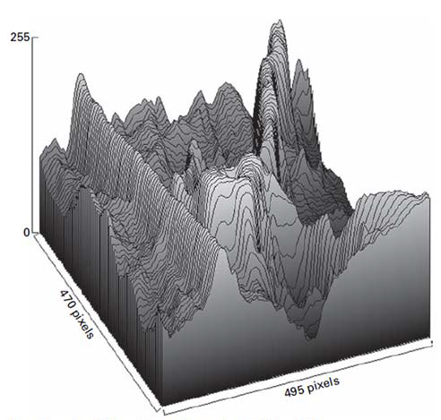
8.1 Introduction
The facet model principle states that the image can be thought of as an underlying continuum or piecewise continuous gray level intensity surface.
observed digital image: noisy discretized sampling of distorted version of this surface
Notes:
我們的圖片可以被認為是一個底層連續或分段連續的灰階亮度表面。
數位影像可以視為是扭曲或是失真版本的帶有雜訊的離散採樣。
下面這張圖呢是一張470*495的影像，其中越高的地方代表他的強度越高，也就越亮
因為是以8bit 來表示，所以最亮的數值就是255，最暗的地方是0
那這樣的亮度差別造成了地形的高低起伏

Slide 5
8.1 Introduction
To actually carry out the processing with the observed digital image requires a model describes what the general form of the surface would be in the neighborhood of any pixel.
https://all3dp.com/what-is-stl-file-format-extension-3d-printing/
Notes:
我們需要一個模型來描述像素附近的表面。
以鄰域的來看，最左邊的圖就是用比較大的平面來組成
那越往右邊三角形的鄰域就越小，整個模型就越光滑

Slide 6
8.1 Introduction
Example: Imagine an image (size=1*N)
https://all3dp.com/what-is-stl-file-format-extension-3d-printing/
Notes:
這邊以一維數列當作例子。(可以把它想像成一張數位影像中的一個row。)

Slide 7
8.1 Introduction
Example:
https://all3dp.com/what-is-stl-file-format-extension-3d-printing/
Notes:
鎖定一個pixel作為中心點。

Slide 8
8.1 Introduction
Example:
https://all3dp.com/what-is-stl-file-format-extension-3d-printing/
Notes:
然後去擬合出一條曲線。這就是所謂的小平面模型

Slide 9
8.1 Introduction
Example:
https://all3dp.com/what-is-stl-file-format-extension-3d-printing/
Notes:
那如果你鎖定不同的pixel就會產生不同的曲線。

Slide 10
8.1 Introduction
There are many kinds of facet model 1. piecewise constant (flat facet model)
2. piecewise linear (sloped facet model)
3. piecewise quadratic
4. piecewise cubic
Notes:
那這種小平面模型有幾種形式
像是求出來的都是常數值，那他就是一個平面
第二種是傾斜的平面
再來是用二次方程式來表示，那他就是一條曲線
最後是三次方來表示，就會是一個立體的表面
一般式：一些數學方程式
分段常數（平的小平面模型）理想區間：常數灰階值
分段線性（斜的小平面模型）理想區間：斜的平面灰階值
分段二次方程式（灰階表面）理想區間：二元二次方程式 (圓形等)
分段三次方程式，灰階表面 理想區間：立方表面

Slide 11
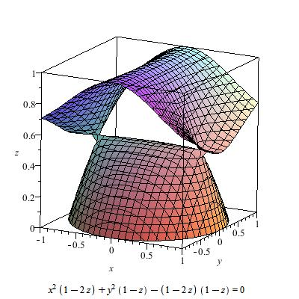
8.1 Introduction
Cubic surfaces
https://en.wikipedia.org/wiki/Cubic_surface
Notes:
舉例來說
這張圖就是一個立體的，三度空間的平面模型

Slide 12
Outline
8.1 Introduction
8.2 Relative Maxima
8.3 Sloped Facet Parameter and Error Estimation
8.4 Facet-Based Peak Noise Removal
8.5 Iterated Facet Model
8.6 Gradient-Based Facet Edge Detection
8.7 Bayesian Approach to Gradient Edge Detection
8.8 Zero-Crossing Edge Detector
8.9 Integrated Directional Derivative Gradient Operator
8.10 Corner Detection
8.11 Isotropic Derivative Magnitudes
8.12 Ridges and Ravines on Digital Images
8.13 Topographic Primal Sketch
Notes:
8.2 介紹小平面模型相對極大值的原理應用

Slide 13
8.2 Relative Maxima
relative maxima:
first derivative zero
second derivative negative
Notes:
我們來看一個找出相對極大值的例子
那在看例子之前
先幫大家複習一下小時候求相對極大值的方法
求相對極大值的方法
要滿足兩點
第一點就是 一階導數為零
第二點就是 二階導數是負的

Slide 14
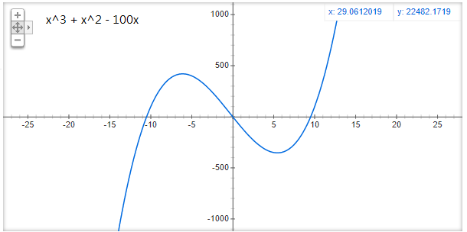
8.2 Relative Maxima
Notes:
來看一個找出相對極大值的例子
這是一個一元三次的方程式，他有兩個極值，一個相對極大值和一個相對極小值

Slide 15
8.2 Relative Maxima
Notes:
上面這張圖是把剛剛的方程式做微分
就會發現他有兩個解，這就是剛剛那條曲線的極值的位置
怎麼知道他是相對極大還是相對極小值呢？
我們看下面這張圖，如果二階導數是負的那他就是相對極大值，正的就是相對極小值

Slide 16
8.2 Relative Maxima
One-dimensional observation sequence
$f_{1 },f_{2 },f_{3 }$,……$f_{N }$
To find the relative maxima, we can least-squares fit a quadratic function
$\hat{c}m^{2}+\hat{b}m+\hat{a}$ ,
where $−k≤m≤k$ , to each group of 2k+1 successive observations
Notes:
假設我們觀察到一個一維數列，來看看怎麼求出相對極大值
給定數列f1~fn，可想像成 長=1、寬=n 的數位影像。
每次取2k+1個連續的fi，並以最中間作為$f_{0}$，因此最左邊為$f_{−k}$, 最右邊為$f_{k}$。
根據這些點，用最小平方法來擬合(fit)它們。

Slide 17
8.2 Relative Maxima
$f_{1},f_{2}$, $f_{3}$, $f_{4}$, $f_{5}$, $f_{6}$ = (3, 4, 5, 2, 7, 8), $k=1$
Notes:
下面直接來看一個例子
這邊有六個點，觀察到的值分別是3,4,5,2,7,8
這個值就可以想成是灰階的亮度值
也就是我們8.1那張有高低起伏的圖取一小段出來
K=1代表往左右各看一個數

Slide 18
8.2 Relative Maxima
$f_{1},f_{2}$, $f_{3}$, $f_{4}$, $f_{5}$, $f_{6}$ = (3, 4, 5, 2, 7, 8), $k=1$
(-1, 3), (0, 4), (1, 5)
$\hat{c_{1}}m^{2}+\hat{b_{1}}m+\hat{a_{1}}$
Notes:
以4為中心點，左右各看一個數

Slide 19
8.2 Relative Maxima
$f_{1},f_{2}$, $f_{3}$, $f_{4}$, $f_{5}$, $f_{6}$ = (3, 4, 5, 2, 7, 8), $k=1$
(-1, 3), (0, 4), (1, 5)
(-1, 4), (0, 5), (1, 2)
$\hat{c_{1}}m^{2}+\hat{b_{1}}m+\hat{a_{1}}$
$\hat{c_{2}}m^{2}+\hat{b_{2}}m+\hat{a_{2}}$
Notes:
以此類推

Slide 20
8.2 Relative Maxima
$f_{1},f_{2}$, $f_{3}$, $f_{4}$, $f_{5}$, $f_{6}$ = (3, 4, 5, 2, 7, 8), $k=1$
(-1, 3), (0, 4), (1, 5)
(-1, 5), (0, 2), (1, 7)
(-1, 4), (0, 5), (1, 2)
(-1, 2), (0, 7), (1, 8)
$\hat{c_{1}}m^{2}+\hat{b_{1}}m+\hat{a_{1}}$
$\hat{c_{3}}m^{2}+\hat{b_{3}}m+\hat{a_{3}}$
$\hat{c_{2}}m^{2}+\hat{b_{2}}m+\hat{a_{2}}$
$\hat{c_{4}}m^{2}+\hat{b_{4}}m+\hat{a_{4}}$
Notes:
以此類推
請大家記好現在的推理邏輯 我們等等在算的時候會用到

Slide 21
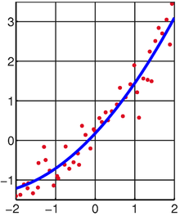
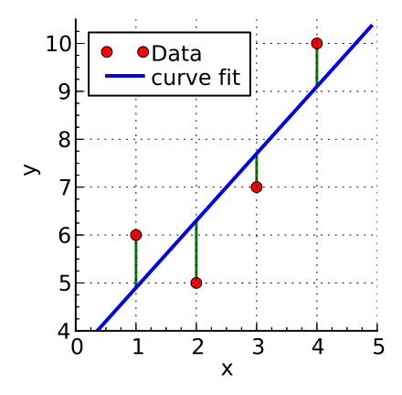
8.2 Relative Maxima
The squared fitting error $ε_{n}^{2}$ for the $n_{th}$ group of 2k+1 can be expressed by
$$ε_{n}^{2}= \sum_{m=−k}^{k}{{(\hat{c}m^{2}+\hat{b}m+\hat{a} −f_{n+m})}^{2}}$$
https://en.wikipedia.org/wiki/Least_squares
Notes:
接下來我們要做擬合
我們用的是最小平方法
左邊的圖是我們利用linear regression，也就是線性回歸來做
我們觀察到四個點，想要找到最接近、符合這四個點的方程式
前面有提到說觀測值是帶有雜訊的離散取樣，這邊紅點到藍線的誤差，也就是綠色的部分，就是所謂的雜訊
右邊就是我們實際去試著擬合一條二次曲線
那所以怎麼求呢？
$\hat{c}m^{2}+\hat{b}m+\hat{a}$為預測的小平面模型方程式，帶有三個參數，我們把它扣掉$觀測值f_{n+m}$，就會是誤差error，m的範圍是從-k到k
我們希望誤差的平方達到最小。
*/計算誤差最小的平方和的算式
一般式可以表示為 $ε_{n}^{2}= \sum_{m=−k}^{k}{{(\hat{c}m^{2}+\hat{b}m+\hat{a} −f_{n+m})}^{2}}$
$\hat{c}m^{2}+\hat{b}m+\hat{a}$為預測式子，會使
最小平方法求得的數據與實際數據之間誤差的平方和為最小
我們擬合出來的數學式和觀測值的誤差的平方和就是這個式子
我們的觀測值一共有大N個，每次取2k+1個點，假設可以取小n組
最小平方法要求我們求出來的a-hat, b-hat, c-hat使得這個誤差的平方和最小/*

Slide 22
8.2 Relative Maxima
Ex. $f$ = (3, 4, 5, 2, 7, 8), $k$ = 1
When n=2, we get (-1, 3), (0, 4), (1, 5)
$ε_{2}^{2}=$ ${(\hat{c}∗{\left(−1\right)}^{2}+\hat{b}∗(−1)+\hat{a} −3)}^{2}$
+ ${(\hat{c}∗{\left(0\right)}^{2}+\hat{b}∗(0)+\hat{a} −4)}^{2}$ + ${(\hat{c}∗{\left(1\right)}^{2}+\hat{b}∗(1)+\hat{a} −5)}^{2}$
= …
When n=3, we get (-1, 4), (0, 5), (1, 2)
$ε_{3}^{2}=$ ${(\hat{c}∗{\left(−1\right)}^{2}+\hat{b}∗(−1)+\hat{a} −4)}^{2}$
+ ${(\hat{c}∗{\left(0\right)}^{2}+\hat{b}∗(0)+\hat{a} −5)}^{2}$ + ${(\hat{c}∗{\left(1\right)}^{2}+\hat{b}∗(1)+\hat{a} −2)}^{2}$
= …
https://en.wikipedia.org/wiki/Least_squares
Notes:
舉例
剛剛前面有請大家把座標點的邏輯搞清楚，這邊我們就要用到了
我們把(-1,3)也就是m=-1時的觀測值3代入剛剛的最小平方法公式，
把(0,4)也就是m=0時的觀測值4代入剛剛的最小平方法公式，
(1,5)也就是m=1時的觀測值5代入剛剛的最小平方法公式，
然後我們把這些式子加起來
下面是n=3的時候，所以中心點是(0,5)
用同樣的方法來做運算

Slide 23
8.2 Relative Maxima
Taking partial derivatives of $ε_{n}^{2}$ with respect to the free parameter $\hat{a}$ , $\hat{b}$, $\hat{c}$ results in the following
Notes:
我們希望$ε_{n}^{2}$最小，可以把式子寫成這樣的形式
然後分別對a-hat b-hat c-hat做偏微分
/* 用$ε_{n}^{2}$的相對於自由參數$\hat{a}$ , $\hat{b}$, $\hat{c}$偏導數如下矩陣表示
偏導數為 0 的時候，誤差會最小
我們對ahat bhat chat 求偏導數(偏微分)
(連鎖律: 微分一次 * 本身微分) */

Slide 24
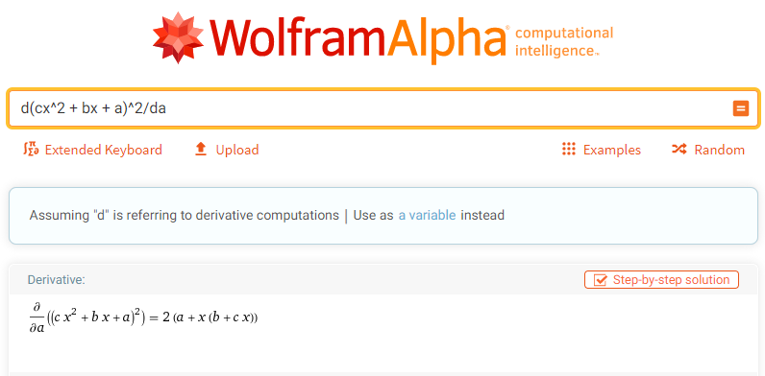
8.2 Relative Maxima
Partial Derivatives
https://www.wolframalpha.com/
Notes:
微積分的問題可以參考這個網站
一些簡單的計算可以直接得到答案
當然我們考試的時候不會要你做偏微
這點請大家放心

Slide 25
8.2 Relative Maxima
Assume k = 1, setting these partial derivatives to zero and simplifying yields the matrix equation from
Notes:
我們再回來看這個式子

Slide 26
8.2 Relative Maxima
Assume k = 1, setting these partial derivatives to zero and simplifying yields the matrix equation from
m = -1: $\hat{c}$ – $\hat{b}$ + $\hat{a}$ –$f_{n−1}$= 0 $\hat{c}$ - $\hat{b}$ + $\hat{a}$ = $f_{n−1}$
m = 0: $\hat{a}$ – $f_{n}$ = 0 $\hat{a}$ = $f_{n}$
m = 1: $\hat{c}$ + $\hat{b}$ + $\hat{a}$ – $f_{n+1}$ = 0 $\hat{c}$ + $\hat{b}$ + $\hat{a}$ = $f_{n+1}$
Notes:
假設k=1，(只取三個點)
M = -1, M = 0, M = 1 代入解聯立

Slide 27
8.2 Relative Maxima
$$\hat{a}=f_{n}$$
$$\hat{b}=\frac{1}{2}{ (f}_{n+1}−f_{n−1})$$
$$\hat{c}=\frac{1}{2}(f_{n−1}−2f_{n}+f_{n+1})$$
Notes:
我們移項然後去解聯立方程式之後得到的結果是右邊這樣

Slide 28
8.2 Relative Maxima
$\hat{a}=f_{n}, \hat{b}=\frac{1}{2}{ (f}_{n+1}−f_{n−1}), \hat{c}=\frac{1}{2}(f_{n−1}−2f_{n}+f_{n+1})$
$f$ = (3, 4, 5, 2, 7, 8), $k$ = 1
When n=2, we get (-1, 3), (0, 4), (1, 5)
$$\hat{a}=4$$
$$\hat{b}=1$$
$$\hat{c}=0$$
$$y=x+4$$
$f_{2}=4$is not a maximum.
https://en.wikipedia.org/wiki/Least_squares
Notes:
回到主題relative maxima，以剛剛舉例的數列來實作
得到y=x+4
那這很明顯的就不是相對極大值

Slide 29
8.2 Relative Maxima
$\hat{a}=f_{n}, \hat{b}=\frac{1}{2}{ (f}_{n+1}−f_{n−1}), \hat{c}=\frac{1}{2}(f_{n−1}−2f_{n}+f_{n+1})$
$f$ = (3, 4, 5, 2, 7, 8), $k$ = 1
When n=3, we get (-1, 4), (0, 5), (1, 2)
(-0.25, 5.125)
$$\hat{a}=5$$
$$\hat{b}=−1$$
$$\hat{c}=−2$$
$$y=−2x^{2}−x+5$$
$f_{3}=5$is a maximum?
https://en.wikipedia.org/wiki/Least_squares
Notes:
同樣的方法我們看n=3的時候
求出下面的式子
那這邊的問題是說這個方程式的最大值是在x=-0.25的位置
那我們的(0,5)是不是極大值？
針對這種極小的誤差我們有一個判斷的依據
下一頁跟大家介紹

Slide 30
8.2 Relative Maxima
To test if $f_{n}$ is a relative Maximum:
The quadratic $y= \hat{c}m^{2}+\hat{b}m+\hat{a}$ has relative extrema at $x_{0}=−\frac{\hat{b}}{2\hat{c}}$
$\hat{c}<0$.
$\left|x_{0}\right|<1/2$.
Notes:
接下來觀察一個二次曲線
我們在小時候有學過，在$x_{0}=−\frac{\hat{b}}{2\hat{c}}$的時候會有一個相對極值
然後需要符合 $\hat{c}<0$ 才會有相對極大值，二次函數的二次方係數為負表示開口向下，開口向下就會有極大值
第二個條件是絕對值 x0 $要小於1/2$ ，代表$x_{0}$距離原點夠近。

Slide 31
8.2 Relative Maxima
$\hat{a}=f_{n}, \hat{b}=\frac{1}{2}{ (f}_{n+1}−f_{n−1}), \hat{c}=\frac{1}{2}(f_{n−1}−2f_{n}+f_{n+1})$
$f$ = (3, 4, 5, 2, 7, 8), $k$ = 1
When n=3, we get (-1, 4), (0, 5), (1, 2)
(-0.25, 5.125)
$$\hat{a}=5$$
$$\hat{b}=−1$$
$$\hat{c}=−2$$
$$y=−2x^{2}−x+5$$
$f_{3}=5$is a maximum.
https://en.wikipedia.org/wiki/Least_squares
Notes:
回來看這個例子，根據剛剛所知，這個0.25跟0只差0.25，絕對值是小於1/2的，所以他是一個相對極大值
結論：$f_{3}=5 為$相對極大值。

Slide 32
8.2 Relative Maxima
$\hat{a}=f_{n}, \hat{b}=\frac{1}{2}{ (f}_{n+1}−f_{n−1}), \hat{c}=\frac{1}{2}(f_{n−1}−2f_{n}+f_{n+1})$
$f$ = (3, 4, 5, 2, 7, 8), $k$ = 1
When n=4, we get (-1, 5), (0, 2), (1, 7)
$$\hat{a}=2$$
$$\hat{b}=1$$
$$\hat{c}=4$$
$$y=4x^{2}+x+2$$
$f_{4}=2$is not a maximum.
https://en.wikipedia.org/wiki/Least_squares
Notes:
下一個例子
當n=4的時候，我們用剛剛講的方法算出結果
得到$\hat{c}>$0，因此$f_{4}=2$並非相對極大值。

Slide 33
8.2 Relative Maxima
$\hat{a}=f_{n}, \hat{b}=\frac{1}{2}{ (f}_{n+1}−f_{n−1}), \hat{c}=\frac{1}{2}(f_{n−1}−2f_{n}+f_{n+1})$
$f$ = (3, 4, 5, 2, 7, 8), $k$ = 1
When n=5, we get (-1, 2), (0, 7), (1, 8)
$$\hat{a}=7$$
$$\hat{b}=3$$
$$\hat{c}=−2$$
$$y=−2x^{2}+3x+7$$
$$(−\frac{\hat{b}}{2\hat{c}}=0.75)$$
$f_{5}=7$is not a maximum.
https://en.wikipedia.org/wiki/Least_squares
Notes:
再來是n=5的時候，得到
$|−\frac{\hat{b}}{2\hat{c}}|=0.75>0$.5，因此$f_{5}=7$並非相對極大值。

Slide 34
Break

Slide 35
Outline
8.1 Introduction
8.2 Relative Maxima
8.3 Sloped Facet Parameter and Error Estimation
8.4 Facet-Based Peak Noise Removal
8.5 Iterated Facet Model
8.6 Gradient-Based Facet Edge Detection
8.7 Bayesian Approach to Gradient Edge Detection
8.8 Zero-Crossing Edge Detector
8.9 Integrated Directional Derivative Gradient Operator
8.10 Corner Detection
8.11 Isotropic Derivative Magnitudes
8.12 Ridges and Ravines on Digital Images
8.13 Topographic Primal Sketch
Notes:
8.3 斜的小平面參數預估

Slide 36
8.3 Sloped Facet Parameter and Error Estimation
Similar to 8.2, we employ a least-squares procedure both to estimate the parameters of the sloped facet model.
Given two-dimensional rectangular neighborhood, the row index set is R and the column index set is C
Notes:
剛才是一元二次，現在看二元一次的小平面模型。
我們用R作為row的索引值，C作為column的索引值

Slide 37
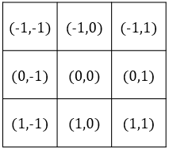
8.3 Sloped Facet Parameter and Error Estimation
Assume the coordinate of the given pixel are (0,0) in its central neighborhood, and assume each (r,c) ∈ R X C
Image function g is modeled by
Where $η$ is a random variable indexed on $R×C$ , which represents noise.
We assume that $η\sim N(0,σ^{2})$ is noise having mean 0 and variance $σ^{2}$ and that the noise for any two pixels is independent.
$$g\left(r,c\right)=αr+βc+γ+η(r,c)$$
observed
truth
noise
Notes:
二維的斜面小平面模型的方程式如上
數位影像=真實影像+noise。
Noise為隨機分布，且擁有常態分布的特性，平均值=0、變異數=$σ^{2}$ 。
且任兩個pixel之間的noise是互相獨立的

Slide 38
8.3 Sloped Facet Parameter and Error Estimation
The least-squares procedure determine parameters $\hat{a}$ , $\hat{b}$, $\hat{c}$ that minimize the sum of the squared differences between the fitted surface and the observed one
Taking the partial derivatives of $ε_{n}^{2}$ and setting them to zero
$$ε^{2}=\sum_{r∈R}{\sum_{c∈C}{{[\hat{α}r+\hat{β}c+\hat{γ}−g(r,c)]}^{2}}}$$
estimated
observed
Notes:
同樣的，我們用最小平方法求參數αhat βhat γhat，使得誤差(noise)的平方和最小
跟前面是一樣的操作，一階偏微分等於0

Slide 39
8.3 Sloped Facet Parameter and Error Estimation
We choose our coordinate RxC so that the center of the neighborhood RxC has coordinates (0, 0)
The symmetry in the chosen coordinate system leads to
Hence
$$\sum_{r∈R}{r}=0$$
$$\sum_{c∈C}{c}=0$$
and
$$\sum_{r∈R}{\sum_{c∈C}{rc}}=\sum_{r∈R}{r\sum_{c∈C}{c}}=0$$
Notes:
不失一般性(證明不是特例，而是普遍情況)，我們選擇中心點ＲＸＣ做為座標的原點
選擇的座標系統具有對稱性會使得 summation r = 0 而且 summation c = 0
summation r乘上c 會等於 summation r 乘上 summation c 還是等於0

Slide 40
8.3 Sloped Facet Parameter and Error Estimation
$$\frac{∂ε^{2}}{∂\hat{a}}$$
$$r$$
$$c$$
$$1$$
$$= 2\sum_{r∈R}{\sum_{c∈C}{\left[\hat{α}r+\hat{β}c+\hat{γ} −g\left(r, c\right)\right] =0}}$$
$$\frac{∂ε^{2}}{∂\hat{b}}$$
$$\frac{∂ε^{2}}{∂\hat{c}}$$
$$\sum_{r∈R}{r}=0 ，\sum_{c∈C}{c}=0 ，\sum_{r∈R}{\sum_{c∈C}{rc}}=0$$
Notes:
那我們把重點統整一下，放在這張投影片，接著開始計算

Slide 41
8.3 Sloped Facet Parameter and Error Estimation
$$2\sum_{r∈R}{\sum_{c∈C}{\left[\hat{α}r+\hat{β}c+\hat{γ} −g\left(r, c\right)\right]r=0}}$$
$$\sum_{r∈R}{\sum_{c∈C}{\left[\hat{α}r+\hat{β}c+\hat{γ} −g\left(r, c\right)\right]r=0}}$$
$$\sum_{r∈R}{\sum_{c∈C}{\left[\hat{α}r^{2}+\hat{β}cr+\hat{γ}r −rg\left(r, c\right)\right]=0}}$$
Notes:
我們以偏微分 α hat 做舉例
做化簡的動作
這邊簡單的把2除掉，並且把r乘進去

Slide 42
8.3 Sloped Facet Parameter and Error Estimation
$$\sum_{r∈R}{\sum_{c∈C}{\hat{α}r^{2}}}+\sum_{r∈R}{\sum_{c∈C}{\hat{β}cr }}+\sum_{r∈R}{\sum_{c∈C}{\hat{γ}r }}−\sum_{r∈R}{\sum_{c∈C}{rg\left(r, c\right) }}=0$$
0
0
$$\sum_{r∈R}{\sum_{c∈C}{\hat{α}r^{2}}}−\sum_{r∈R}{\sum_{c∈C}{rg\left(r, c\right) }}=0$$
$$\hat{α}\sum_{r∈R}{\sum_{c∈C}{r^{2}}}=\sum_{r∈R}{\sum_{c∈C}{rg\left(r, c\right) }}$$
Notes:
接著我們把summation裡的每一項拆開

Slide 43
8.3 Sloped Facet Parameter and Error Estimation
$$\sum_{r∈R}{\sum_{c∈C}{\hat{α}r^{2}}}+\sum_{r∈R}{\sum_{c∈C}{\hat{β}cr }}+\sum_{r∈R}{\sum_{c∈C}{\hat{γ}r }}−\sum_{r∈R}{\sum_{c∈C}{rg\left(r, c\right) }}=0$$
0
0
$$\sum_{r∈R}{\sum_{c∈C}{\hat{α}r^{2}}}−\sum_{r∈R}{\sum_{c∈C}{rg\left(r, c\right) }}=0$$
$$\hat{α}\sum_{r∈R}{\sum_{c∈C}{r^{2}}}=\sum_{r∈R}{\sum_{c∈C}{rg\left(r, c\right) }}$$
Notes:
前面已經知道summation r = 0 而且 summation c = 0
所以中間兩項直接消去

Slide 44
8.3 Sloped Facet Parameter and Error Estimation
$$\sum_{r∈R}{\sum_{c∈C}{\hat{α}r^{2}}}+\sum_{r∈R}{\sum_{c∈C}{\hat{β}cr }}+\sum_{r∈R}{\sum_{c∈C}{\hat{γ}r }}−\sum_{r∈R}{\sum_{c∈C}{rg\left(r, c\right) }}=0$$
0
0
$$\sum_{r∈R}{\sum_{c∈C}{\hat{α}r^{2}}}−\sum_{r∈R}{\sum_{c∈C}{rg\left(r, c\right) }}=0$$
$$\hat{α}\sum_{r∈R}{\sum_{c∈C}{r^{2}}}=\sum_{r∈R}{\sum_{c∈C}{rg\left(r, c\right) }}$$
Notes:
這邊做移項

Slide 45
8.3 Sloped Facet Parameter and Error Estimation
$$\sum_{r∈R}{\sum_{c∈C}{\hat{α}r^{2}}}+\sum_{r∈R}{\sum_{c∈C}{\hat{β}cr }}+\sum_{r∈R}{\sum_{c∈C}{\hat{γ}r }}−\sum_{r∈R}{\sum_{c∈C}{rg\left(r, c\right) }}=0$$
0
0
$$\sum_{r∈R}{\sum_{c∈C}{\hat{α}r^{2}}}−\sum_{r∈R}{\sum_{c∈C}{rg\left(r, c\right) }}=0$$
$$\hat{α}\sum_{r∈R}{\sum_{c∈C}{r^{2}}}=\sum_{r∈R}{\sum_{c∈C}{rg\left(r, c\right) }}$$
$$\hat{α}=\frac{\sum_{r∈R}{\sum_{c∈C}{rg\left(r, c\right) }}}{\sum_{r∈R}{\sum_{c∈C}{r^{2}}}}$$
Notes:
左邊留下 α hat

Slide 46
8.3 Sloped Facet Parameter and Error Estimation
Solving for $\hat{α}$, $\hat{β}$, and $\hat{γ}$ , we obtain
$$\hat{α}=\frac{\sum_{r∈R}{\sum_{c∈C}{rg\left(r, c\right) }}}{\sum_{r∈R}{\sum_{c∈C}{r^{2}}}}$$
$$\hat{β}=\frac{\sum_{r∈R}{\sum_{c∈C}{cg\left(r, c\right) }}}{\sum_{r∈R}{\sum_{c∈C}{c^{2}}}}$$
$$\hat{γ}=\frac{\sum_{r∈R}{\sum_{c∈C}{g\left(r, c\right) }}}{\sum_{r∈R}{\sum_{c∈C}{1}}}$$
Notes:
同樣的方法我們就可以求得估計值α β γ了

Slide 47
8.3 Sloped Facet Parameter and Error Estimation
Example: consider the following 3*3 region
3 | 5 | 9
4 | 7 | 7
0 | 3 | 7
Notes:
這邊我們來看個例子，考慮一個3 by 3的region

Slide 48
8.3 Sloped Facet Parameter and Error Estimation
Example:
3 | 5 | 9
4 | 7 | 7
0 | 3 | 7
$$\hat{α}=\frac{\sum_{r∈R}{\sum_{c∈C}{rg\left(r, c\right) }}}{\sum_{r∈R}{\sum_{c∈C}{r^{2}}}}$$
$$\hat{α}=\frac{−1×\left(3+5+9\right)+0∗\left(4+7+7\right)+1∗(0+3+7)}{{(−1)}^{2}∗3+{(0)}^{2}∗3+1^{2}∗3}=−1.17$$
Notes:
-1 乘上 Raw負 1 整列的和
0 乘上 Raw0 整列的和
1 乘上 Raw1 整列的和
再把他們加起來
分母的部分
因為column=3嘛
所以 r 平方加 r 平方加 r 平方也就會變成 r 平方乘3
那三個 r 都要加，就變成下面這樣
(-17 + 10) / 6 = $−1.17$

Slide 49
8.3 Sloped Facet Parameter and Error Estimation
Example:
3 | 5 | 9
4 | 7 | 7
0 | 3 | 7
$$\hat{β}=\frac{\sum_{r∈R}{\sum_{c∈C}{cg\left(r, c\right) }}}{\sum_{r∈R}{\sum_{c∈C}{c^{2}}}}$$
$$\hat{β}=\frac{−1×\left(3+4+0\right)+0∗\left(5+7+3\right)+1∗(9+7+7)}{{(−1)}^{2}∗3+{(0)}^{2}∗3+1^{2}∗3}=2.67$$
Notes:
再來是$\hat{β}，$用一樣的方式做計算

Slide 50
8.3 Sloped Facet Parameter and Error Estimation
Example:
3 | 5 | 9
4 | 7 | 7
0 | 3 | 7
$$\hat{γ}=\frac{\sum_{r∈R}{\sum_{c∈C}{g\left(r, c\right) }}}{\sum_{r∈R}{\sum_{c∈C}{1}}}$$
$$\hat{γ}=\frac{\left(3+5+9\right)+\left(4+7+7\right)+(0+3+7)}{9}=5$$
Notes:
再來是$\hat{γ}$，分子是帶入各個點，分母就是九個1相加

Slide 51
8.3 Sloped Facet Parameter and Error Estimation
Example:
$$\hat{α}r+\hat{β}c+\hat{γ}=\text{−1.17 }r+2.67 c \text{+5}$$
c
-1
0
1
r
-1
0
1
estimated
Notes:
我們知道了$\hat{α}$ $\hat{β}$ $\hat{γ}$之後，就可以利用這個擬合的方程式求出各個區域的擬合灰階值

Slide 52
8.3 Sloped Facet Parameter and Error Estimation
Example:
$$\hat{α}r+\hat{β}c+\hat{γ}=\text{−1.17 }r+2.67 c \text{+5}$$
3.5
(-1) $×$-1.17 + (-1) $×$2.67 $+$5 = 3.5
estimated

Slide 53
8.3 Sloped Facet Parameter and Error Estimation
Example:
$$\hat{α}r+\hat{β}c+\hat{γ}=\text{−1.17 }r+2.67 c \text{+5}$$
3.5 | 6.17
(-1) $×$-1.17 + (0) $×$2.67 $+$5 = 6.17
estimated

Slide 54
8.3 Sloped Facet Parameter and Error Estimation
Example:
$$\hat{α}r+\hat{β}c+\hat{γ}=\text{−1.17 }r+2.67 c \text{+5}$$
3.5 | 6.17 | 8.84
(-1) $×$-1.17 + (1) $×$2.67 $+$5 = 8.84
estimated

Slide 55
8.3 Sloped Facet Parameter and Error Estimation
Example:
$$\hat{α}r+\hat{β}c+\hat{γ}=\text{−1.17 }r+2.67 c \text{+5}$$
3.5 | 6.17 | 8.84
2.33 | 5 | 7.67
1.17 | 3.83 | 6.5
estimated
Notes:
這是估計值最後的結果

Slide 56
Notes:
圖例
剛剛的九宮格我們用軟體來模擬他的斜平面模型
就會長這個樣子

Slide 57
8.3 Sloped Facet Parameter and Error Estimation
Example:
Calculate the error:
3.5 | 6.17 | 8.84
2.33 | 5 | 7.67
1.17 | 3.83 | 6.5
3 | 5 | 9
4 | 7 | 7
0 | 3 | 7
0.5 | 1.17 | -0.17
-1.67 | -2 | 0.67
1.17 | 0.83 | -0.5
- =
estimated
observed
error
Notes:
求出擬合矩陣之後，扣掉觀察值，就能算出誤差

Slide 58
8.3 Sloped Facet Parameter and Error Estimation
Example:
$$ε^{2}=\sum_{r∈R}{\sum_{c∈C}{{(ε\left(r,c\right))}^{2}}}=$$
$$0.25 +1.3689+0.0289+$$
$$2.7889+ 4+0.4489+$$
$$1.3689+0.6889+ 0.25$$
$$=11.1934$$
c
-1
0
1
r
0.5 | 1.17 | -0.17
-1.67 | -2 | 0.67
1.17 | 0.83 | -0.5
-1
0
1
$$ε^{2}≅11.19$$
Notes:
然後我們就可以算出誤差的平方和

Slide 59
8.3 Sloped Facet Parameter and Error Estimation
According to the theory of Chi-square Distribution, the variance of the noise $η$ can be estimated as:
$$σ^{2}= \frac{ε^{2}}{\sum_{r}{\sum_{c}{1}}−3}$$
Notes:
根據卡方分配，我們令noise的變異數如下
其中分子為前面計算的error，也就是$ε^{2}$
分母是把所有的row跟column相加，也就是我們觀察的九個點
那再去扣掉三個參數alpha, beta, gamma
這邊是屬於統計學的領域，我們的重點會放在剛剛所講的課程，考試也是，請各位不用擔心

Slide 60
8.3 Sloped Facet Parameter and Error Estimation
Example:
Calculating the variance of $η$:
3 | 5 | 9
4 | 7 | 7
0 | 3 | 7
$$ε^{2}≅11.19$$
$$σ^{2}= \frac{ε^{2}}{\sum_{r}{\sum_{c}{1}}−3}$$
$σ^{2}= \frac{{(11.19)}^{2}}{9−3}≅20.87$
observed
Notes:
那我們用誤差的平方和，還有卡方分配
進而求出變異數為20.87

Slide 61
Break

Slide 62
Outline
8.1 Introduction
8.2 Relative Maxima
8.3 Sloped Facet Parameter and Error Estimation
8.4 Facet-Based Peak Noise Removal
8.5 Iterated Facet Model
8.6 Gradient-Based Facet Edge Detection
8.7 Bayesian Approach to Gradient Edge Detection
8.8 Zero-Crossing Edge Detector
8.9 Integrated Directional Derivative Gradient Operator
8.10 Corner Detection
8.11 Isotropic Derivative Magnitudes
8.12 Ridges and Ravines on Digital Images
8.13 Topographic Primal Sketch
Notes:
8.4 用小平面模型來做尖端雜訊的移除

Slide 63
8.4 Facet-Based Peak Noise Removal
Peak noise pixel: a pixel whose gray level intensity significantly differs from neighborhood pixels.
It is difficult to judge that the center pixel in part (b) is peak noise, whereas it is easier in part (a)
Notes:
尖端雜訊像素，灰階值意義上和鄰居不一樣(有點突兀的感覺)
圖a明顯有雜訊，那個尖端值十分突兀，
但圖b就比較難判斷，因為可能原本就是尖端
那所以我們需要一套基準來判斷它是不是雜訊。

Slide 64
8.4 Facet-Based Peak Noise Removal
Let N be a set of neighborhood pixels that does not contain the center pixel
(-1,-1) | (-1,0) | (-1,1)
(0,-1) | (0,0) | (0,1)
(1,-1) | (1,0) | (1,1)
$$N=R ×C −\{(0, 0)\}$$
observed
truth
noise
$$g\left(r, c\right)= N=αr+ βc+ γ+η\left(r, c\right) for (r,c)∈N$$
Where $η(r,c)$ is assumed to be independent additive Gaussian noise having mean 0 and variance $σ^{2}$
Notes:
我們用和上一章節一樣的做法，只是去除掉center pixel
因為我們是要看中間這點是否為雜訊
=> 所以先排除掉中間這點來看，看模型預估的值應該是多少，如果預估值和觀測值相差太大，我們就判斷此觀測值為Peak Noise.

Slide 65
8.4 Facet-Based Peak Noise Removal
The least-squares procedure determines $\hat{α}$, $\hat{β}$, and $\hat{γ}$ which minimize the sum of the squared difference between the fitted surface are given by the observed one:
The minimizing $\hat{α}$, $\hat{β}$, and $\hat{γ}$ are given by
$$ε^{2}=\sum_{(r, c)∈N}{{[\hat{α}r+\hat{β}c+\hat{γ}−g(r,c)]}^{2}}$$
$$\hat{α}=\frac{\sum_{(r, c)∈N}{rg(r,c)}}{\sum_{(r, c)∈N}{r^{2}}}$$
$$\hat{β}=\frac{\sum_{(r, c)∈N}{cg(r,c)}}{\sum_{(r, c)∈N}{c^{2}}}$$
$$\hat{γ}=\frac{\sum_{(r, c)∈N}{g(r,c)}}{\#N}$$
Notes:
跟前面的章節類似，使用最小平方法求得alpha_hat、beta_hat、gamma_hat。
這邊要特別注意的是我們排除了中心點，所以這邊的Ｎ是8

Slide 66
8.4 Facet-Based Peak Noise Removal
According to the theories of Chi-square Distribution and t-distribution,
we let $t= \frac{g\left(0,0\right)−\hat{γ}}{\sqrt{(1+\frac{1}{\#N})ε^{2}}}$ ,
and let $T_{\#N−3, p}$ be the threshold.
(Value for p is usually .05~.01)
Notes:
根據卡方分配和Ｔ分佈，我們令 t 等於下面的式子
並讓$T_{\#N−3, p}$作為一個臨界值
這邊的Ｎ-3是8-3=5
1)樣本數不多, 2)單一觀測值和預測值的差異, 3)標準差為估計值。

Slide 67
8.4 Facet-Based Peak Noise Removal
t-distribution table:
p
degree
of
freedom
Notes:
T值需要查表，自由度為8-3=5

Slide 68
8.4 Facet-Based Peak Noise Removal
If $t>T_{\#N−3, p}$, we assume that center pixel is a noise pixel, the output value of the center pixel will be $\hat{γ}$ .
If $t≤T_{\#N−3, p}$, we assume that center pixel is not a noise pixel, the output value of the center pixel will be $g\left(0,0\right)$.
Output of center pixel = $(t>T_{\#N−3, p}) ? \hat{γ} : g\left(0,0\right)$
Notes:
若 t > 臨界值$T_{\#N−3, p}$，我們將此中心點視為peak noise，用model的預測值 $\hat{γ}$來取代。
反之，如果 t < 臨界值$T_{\#N−3, p}$ ，則不是peak noise，我們什麼都不做。
下面是寫成判斷式的表示方式

Slide 69
8.4 Facet-Based Peak Noise Removal
Example: consider the following 3*3 region
3 | 5 | 3
4 | 9 | 3
0 | 3 | 3
Set p = 0.05, $T_{\#N−3, p}=2.015$
Notes:
舉例
這邊假設 p 是 0.05，那臨界值就會是2.015

Slide 70
8.4 Facet-Based Peak Noise Removal
Example:
3 | 5 | 3
4 | 9 | 3
0 | 3 | 3
$$\hat{α}=−0.83$$
$$\hat{β}=0.33$$
$$\hat{γ}=3.0$$
Set p = 0.05, $T_{\#N−3, p}=2.015$
Notes:
用前一章節的方法算出三個參數值

Slide 71
8.4 Facet-Based Peak Noise Removal
Example:
$$−0.83r+0.33c+3.0$$
3 | 5 | 3
4 | 9 | 3
0 | 3 | 3
0.25 | 1.36 | 1.36
1.78 |  | 0.11
3.36 | 0.69 | 0.25
error
Set p = 0.05, $T_{\#N−3, p}=2.015$
$$ε^{2}=9.16$$
Notes:
一樣帶回九宮格並算出error
這邊的$ε^{2}=9.16$

Slide 72
8.4 Facet-Based Peak Noise Removal
Example:
3 | 5 | 3
4 | 9 | 3
0 | 3 | 3
$$t=\frac{g\left(0, 0\right)−\hat{γ}}{\sqrt{\left(1+1/{\#N}\right)∗ε^{2}}}$$
$= \frac{9−3}{\sqrt{{(9}/{8)∗}9.16}}$
$=1.86$
Set p = 0.05, $T_{\#N−3, p}=2.015$
Notes:
再帶到公式裡面，計算小 t = 1.86

Slide 73
8.4 Facet-Based Peak Noise Removal
Example:
3 | 5 | 3
4 | 9 | 3
0 | 3 | 3
Since $t=1.86<2.015$,
the center pixel 9 is not considered to be a peak noise.
Set p = 0.05, $T_{\#N−3, p}=2.015$
Notes:
因為$1.86<2.015$，中心點這個pixel不會被當成noise

Slide 74
8.4 Facet-Based Peak Noise Removal
Example:
3 | 5 | 3
4 | 9.5 | 3
0 | 3 | 3
Change the center pixel to 9.5:
then $t=2.02>2.015$,
the center pixel is considered to be a peak noise.
Set p = 0.05, $T_{\#N−3, p}=2.015$
Notes:
那我們再看如果中心點的數值是9.5的時候，計算出來的 t = $2.02>2.015$，這個中心點就會被當成noise

Slide 75
8.4 Facet-Based Peak Noise Removal
Example:
3 | 5 | 3
4 | 3 | 3
0 | 3 | 3
$$Thus, center pixel= \hat{γ}=3.0$$
Set p = 0.05, $T_{\#N−3, p}=2.015$
Notes:
所以我們用$\hat{γ}$來取代原本的數值

Slide 76
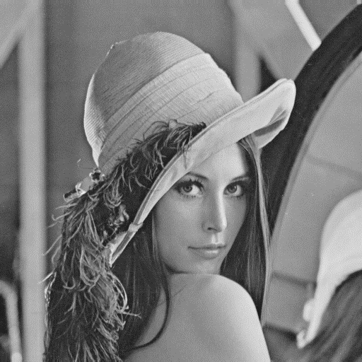
8.4 Facet-Based Peak Noise Removal
Ex: Lena.bmp
Notes:
接下來看看這樣的方法產生的效果，這是lena

Slide 77
8.4 Facet-Based Peak Noise Removal
Ex: Lena.bmp
Notes:
這是lena加入白胡椒鹽雜訊之後的圖

Slide 78
8.4 Facet-Based Peak Noise Removal
Ex: Lena.bmp
Neighborhood = 5*5, threshold = 0.5
Notes:
我們鄰域用 5*5, 並把臨界值設為 0.5
那就可以消除不少雜訊

Slide 79
8.4 Facet-Based Peak Noise Removal
Ex: Lena.bmp
Neighborhood = 5*5, threshold = 0.25
Notes:
那如果把臨界值設為 0.25，加上去的雜訊幾乎都被移除了

Slide 80
8.4 Facet-Based Peak Noise Removal
Ex: shiba.png
Notes:
再看一個例子

Slide 81
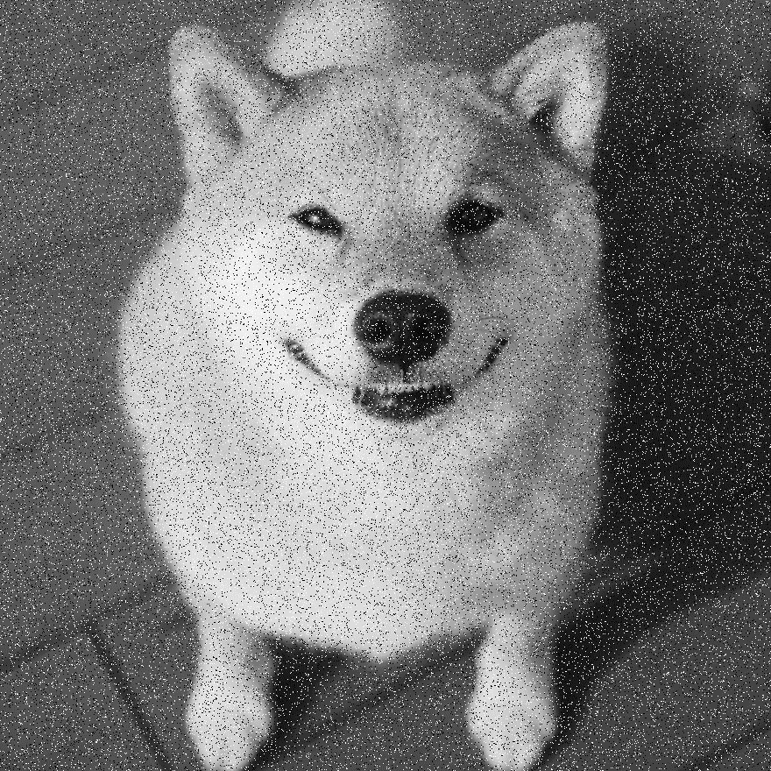
8.4 Facet-Based Peak Noise Removal
Ex: shiba.png

Slide 82
8.4 Facet-Based Peak Noise Removal
Ex: shiba.png
Neighborhood = 5*5, threshold = 0.25
Notes:
Neighborhood = 5*5, threshold = 0.25

Slide 83
Break

Slide 84
Outline
8.1 Introduction
8.2 Relative Maxima
8.3 Sloped Facet Parameter and Error Estimation
8.4 Facet-Based Peak Noise Removal
8.5 Iterated Facet Model
8.6 Gradient-Based Facet Edge Detection
8.7 Bayesian Approach to Gradient Edge Detection
8.8 Zero-Crossing Edge Detector
8.9 Integrated Directional Derivative Gradient Operator
8.10 Corner Detection
8.11 Isotropic Derivative Magnitudes
8.12 Ridges and Ravines on Digital Images
8.13 Topographic Primal Sketch
Notes:
8.5 重複模型或是迭代的小平面模型
facet model -> partition image to regions

Slide 85
8.5 Iterated Facet Model
The iterated model for ideal image
The spatial of the image can be partitioned into connected regions called facets.
Each of which satisfies certain gray level and shape constraints.
Notes:
重複模型對理想影像做了兩個假設:
1. 圖片可以被分割成許多相連的區域，這些區域就是我們的小平面
2. 每一個小平面都需要符合特定的灰階和形狀限制

Slide 86
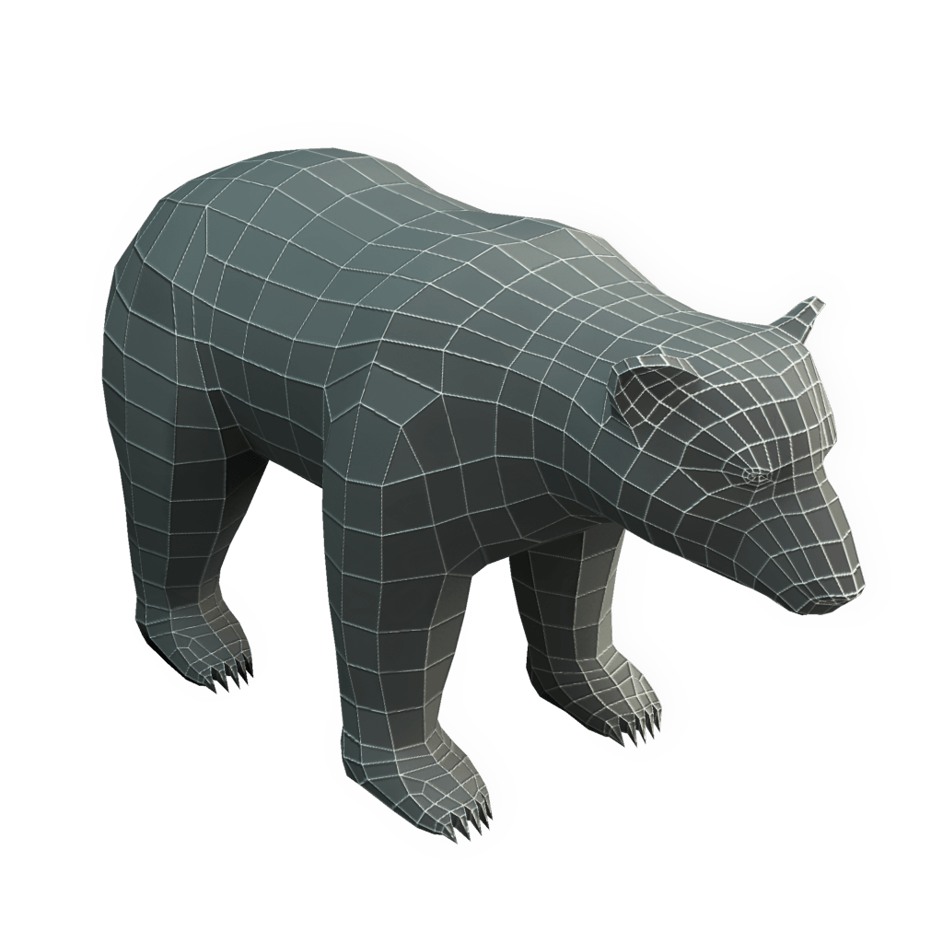
8.5 Iterated Facet Model
The iterated model for ideal image
https://www.pinterest.com/pin/296674694187240243/
Notes:
Ex: 這個3D熊由多個不同的四面體構成

Slide 87
8.5 Iterated Facet Model
Shape region constraint:
Each facet must be sufficiently smooth in shape.
To be precise, each region can be represented as the union of $K×K$ blocks of pixels.
Region gray level constraint:
Gray levels in each facet must be a polynomial function of row-column coordinates.
Replace the pixel value with the output of the model, which has the smallest residual error.
Notes:
剛剛提到它需要符合特定的灰階和形狀限制
先看一下形狀限制
--每一個小平面必須是平滑的形狀
也就是說，每個區域都可以表示為 k*k 個pixels
灰階限制
--每個小平面的灰階值必須是行列座標的多項式函數
那我們會把pixel的灰階值換成error最小的模型輸出

Slide 88
8.5 Iterated Facet Model
Resolution cell:
$B\left(r,c\right)$ be the $K×K$ blocks of resolution cells centered around resolution cell $\left(r,c\right)$ .
Gray value output:
One of the $K^{2}$ blocks has the smallest error of fit.
Set the output gray value to be that gray value fitted by the block having the smallest error of fit.
Notes:
Resolution cell ，解析單元
我們把Ｂ想成是Ｋ*Ｋ的resolution cell組成的，並以（r,c）這個座標為中心
其中一個K*K blocks會有最小的擬合誤差
我們就把它設為 output 的 gray value

Slide 89
8.5 Iterated Facet Model
$$B(0,0)$$
Resolution cell
3 | 5 | 9
4 | 7 | 7
0 | 3 | 7
Assume$ε_{smallest}^{2}$=1
$$J\left(r,c\right)$$
Observed image
$$\hat{J}\left(r,c\right)$$
Estimated image
$ε_{smallest}^{2}$: smallest error of fit for the $K×K$ blocks
Notes:
那這邊不看例子有點模糊
我們來看一張圖
觀察這個3 by 3的block，其中中心點被8個resolution cell所包圍
那這8個resolution cell之中一定有一個跟中間的block有著最小的擬合誤差
我們就把中間的cell換成那個最小的cell

Slide 90
8.5 Iterated Facet Model
Example:
Notes:
這是lena，resolution cell 比較小的狀況

Slide 91
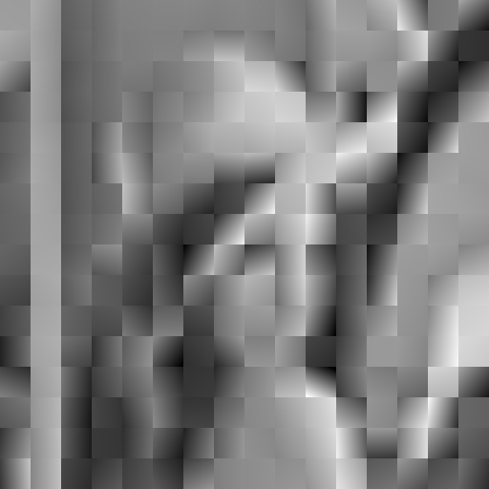
8.5 Iterated Facet Model
Example:
Notes:
這是lena，resolution cell 比較大的狀況，就會有一個馬賽克的效果

Slide 92
8.5 Iterated Facet Model
Example:
Notes:
這是另一個例子

Slide 93
8.5 Iterated Facet Model
Example:
Notes:
注意他的手

Slide 94
8.5 Iterated Facet Model
Example:
Notes:
一樣有馬賽克的效果

Slide 95
Break

Slide 96
Outline
8.1 Introduction
8.2 Relative Maxima
8.3 Sloped Facet Parameter and Error Estimation
8.4 Facet-Based Peak Noise Removal
8.5 Iterated Facet Model
8.6 Gradient-Based Facet Edge Detection
8.7 Bayesian Approach to Gradient Edge Detection
8.8 Zero-Crossing Edge Detector
8.9 Integrated Directional Derivative Gradient Operator
8.10 Corner Detection
8.11 Isotropic Derivative
8.12 Ridges and Ravines on Digital Images
8.13 Topographic Primal Sketch
Notes:
8.6 使用梯度來做邊界偵測的應用
gradient edge detector

Slide 97
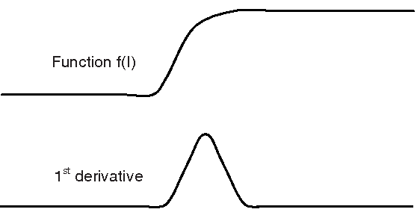
8.6 Gradient-Based Facet Edge Detection
gradient-based edge detection: high values in first partial derivative (sharp discontinuities)
https://www.semanticscholar.org/paper/Gradient-Based-Edge-Detection-of-Songket-Motifs-Jamil-Sembok/eea31d166c062a3dddccb212474a6b8
565ae6eee/figure/2
Notes:
邊界就是它的一邊暗，另一邊亮
所以梯度邊界偵測就是找一階偏微分的值很大的地方（明顯的不連續）
那很大是多大呢？
我們接下來會介紹判斷的標準

Slide 98
8.6 Gradient-Based Facet Edge Detection
When a neighborhood is fitted with the sloped facet model , $\hat{α}r+\hat{β}c+\hat{γ}$, a gradient magnitude of $\sqrt{{\hat{α}}^{2}+{\hat{β}}^{2}}$ will result.
Use ${\hat{α}}^{2}+{\hat{β}}^{2}$ as the basis for edge detection.
Notes:
以斜面的小平面模型為例
梯度的大小可以由alpha_hat平方加beta_hat平方再開根號來得到
所以我們就以${\hat{α}}^{2}+{\hat{β}}^{2}$ 當作一個判斷的基準

Slide 99
8.6 Gradient-Based Facet Edge Detection
For example:
$$\hat{α}r+\hat{β}c+\hat{γ}$$
= $\text{−1.17 }r+2.67 c \text{+5}$
3.5 | 6.17 | 8.84
2.33 | 5 | 7.67
1.17 | 3.83 | 6.5
$$\sqrt{{\hat{α}}^{2}+{\hat{β}}^{2}}$$
$$=\sqrt{{(−1.17)}^{2}+{2.67}^{2}}$$
Notes:
拿之前 8.3 的九宮格舉例
計算${\hat{α}}^{2}+{\hat{β}}^{2}$ 開根號

Slide 100
8.6 Gradient-Based Facet Edge Detection
Review: According to the theory of Chi-square Distribution, the variance of the noise $η$ can be estimated as:
$$σ^{2}= \frac{ε^{2}}{\sum_{r}{\sum_{c}{1}}−3}$$
Notes:
複習一下8.3最後的結論
分子是計算誤差
分母是自由度，也就是行列的個數相加再扣掉3
這個3是alpha beta gamma 三個參數

Slide 101
8.6 Gradient-Based Facet Edge Detection
If $ε_{n}^{2}$ represents the squared residual fitting error from the n-th neighborhood and the images has N neighborhoods, then we may use $\hat{σ^{2}}= \frac{ε^{2}}{\sum_{r}{\sum_{c}{1}}−3}=\frac{\frac{1}{N}\sum_{n=1}^{N}{ε_{n}^{2}}}{\sum_{r}{\sum_{c}{1}}−3}$ in place of $σ^{2}$.
Notes:
整張影像可以區分為n個neighborhood，那我們要計算出整張影像的標準差，
一張image會根據自己的neighborhood而算出不同的error。
全部加總就會是整張影像的error。
為了計算整張影像的變異數，我們把分子改成全部的 error 相加再除以Ｎ個neighborhoods。
分母一樣是自由度
所以我們用sigma平方head取代sigma平方

Slide 102
8.6 Gradient-Based Facet Edge Detection
How large must the gradient be in order to be considered significantly different from zero?
$G$ has essentially a chi-squared distribution with two degrees of freedom. $G=\frac{{\hat{α}}^{2}\sum_{r}{\sum_{c}{r^{2}}}+{\hat{β}}^{2}\sum_{r}{\sum_{c}{c^{2}}}}{\hat{σ^{2}}}$
(Null Hypothesis:$α=β=0)$ i.e., there is no edge
Notes:
剛剛我們有提到要判斷edge需要一個夠高的數值，那到底高是高到多少？
假設今天是一條水平線，那他平的就不會被當作是edge
如果是斜直線，我們就可以考慮一下
那到底要多斜？我們就可以用梯度來判斷
這邊我們會求出一個統計量Ｇ
分母是剛剛算的sigma平方hat
分子是alpha_hat平方乘上 row 做平方然後summation 再加上beta_hat平方乘上 column 做平方然後summation
這邊有一個虛無假設，如果alpha 和 beta = 0 那就沒有edge 因為他是平的

Slide 103
8.6 Gradient-Based Facet Edge Detection
Since we usually choose our neighborhood to be a square (Ex: 3*3, 5*5), we get: $\sum_{r}{\sum_{c}{r^{2}}}=\sum_{r}{\sum_{c}{c^{2}}}$
Then, $G=\frac{\sum_{r}{\sum_{c}{r^{2}}}}{\hat{σ^{2}}}({\hat{α}}^{2}+{\hat{β}}^{2})$
Notes:
通常neighborhood會找長方形，所以$\sum_{r}{\sum_{c}{r^{2}}} \sum_{r}{\sum_{c}{c^{2}}}$這兩項會相等。
因此可以把G轉成下面這個形式。
於是我們可以用${\hat{α}}^{2}+{\hat{β}}^{2}$ 當作Ｇ的大小，因為他們跟Ｇ是成正比的

Slide 104
8.6 Gradient-Based Facet Edge Detection
We set a threshold t such that if $G≥t$, we assume that the center pixel is an edge pixel.
$$IsEdge=\left(G≥t\right) ?True :False$$
Notes:
設一個threshold來做比較，和前面peak noise removal 類似。
當Ｇ大於 t 的時候，那我們就判定他是一條邊

Slide 105
8.6 Gradient-Based Facet Edge Detection
$$backgroung pixel=0$$
$$disk pixel=200$$
$$σ^{2}=40$$
$$σ^{2}=50$$
$$σ^{2}=75$$
Notes:
這是課本的圖例，他中間是一個圓盤，
我們加入不同的gaussian noise
在sigma平方等於40, 50, 75的時候所對應的影像

Slide 106
8.6 Gradient-Based Facet Edge Detection
$$t=120$$
$$t=4$$
$$t=8$$
$$t=11$$
upper right
Notes:
然後再應用剛剛所學的邊緣檢測的結果
剛剛noise越多的圖，這邊相對應的 t 就要越大
才會檢測的出來

Slide 107
8.6 Gradient-Based Facet Edge Detection
Example: lena.bmp

Slide 108
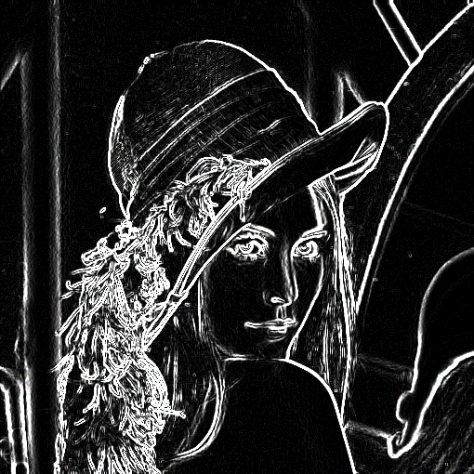
8.6 Gradient-Based Facet Edge Detection
Example:
Set neighborhood size to 3*3
Original
Slope image

Slide 109
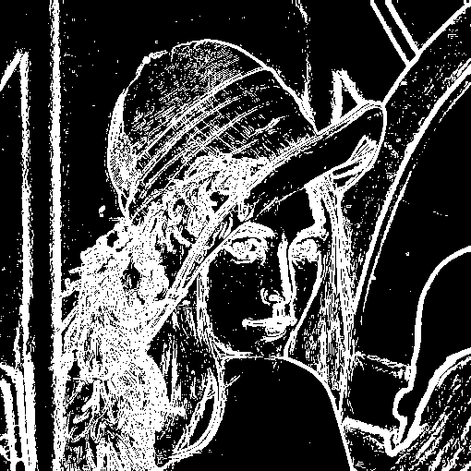
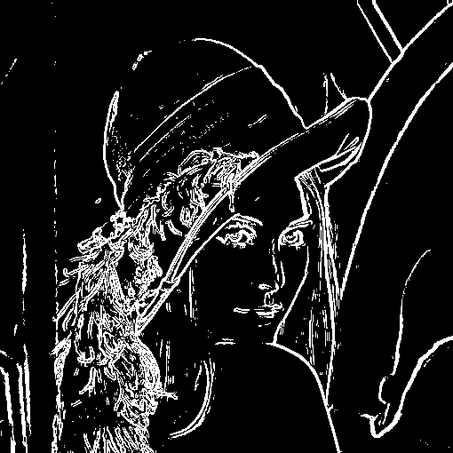
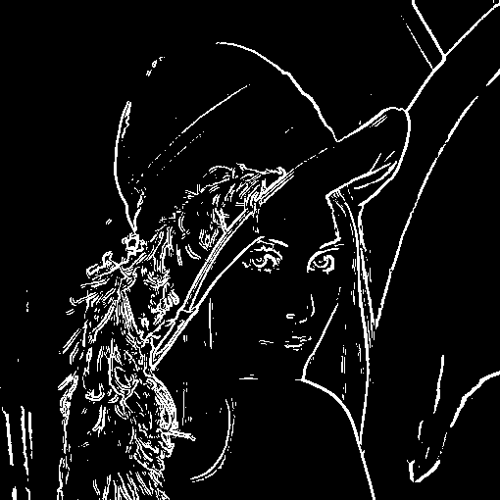
8.6 Gradient-Based Facet Edge Detection
Example:
Set neighborhood size to 3*3, threshold to 10, 60, 120, respectively.
Notes:
越小的threshold，他就會定義越多的edge，就會比較密集

Slide 110
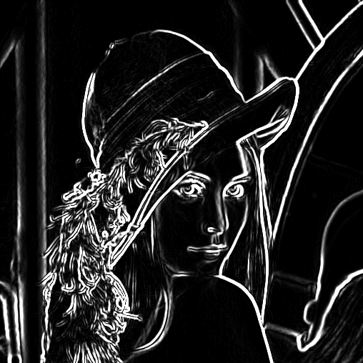
8.6 Gradient-Based Facet Edge Detection
Example:
Set neighborhood size to 5*5
Original
Slope image

Slide 111
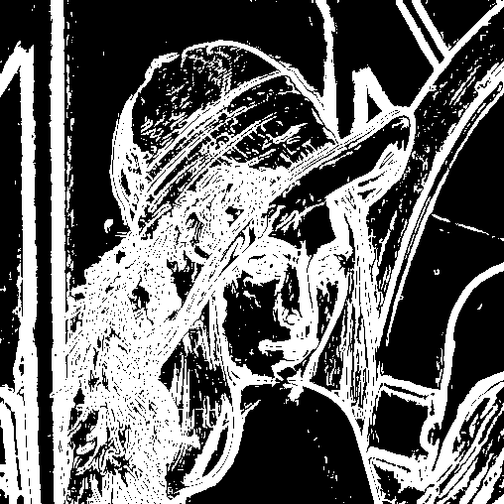
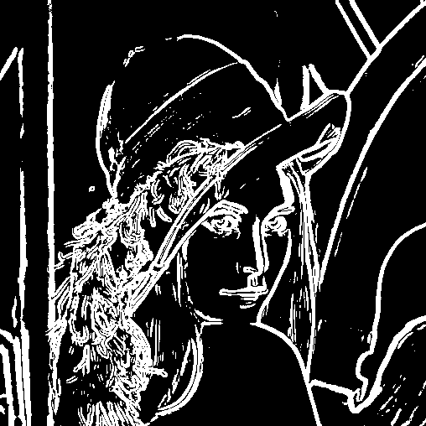
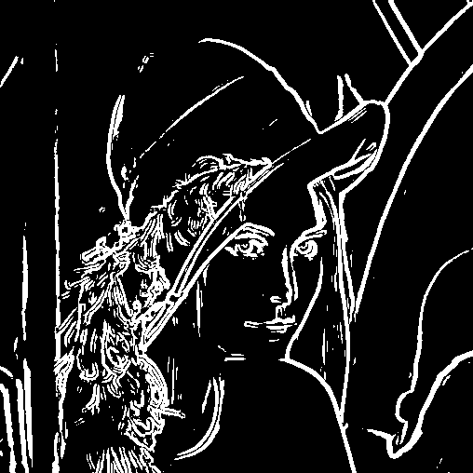
8.6 Gradient-Based Facet Edge Detection
Example:
Set neighborhood size to 5*5, threshold to 10, 60, 120, respectively.

Slide 112
8.6 Gradient-Based Facet Edge Detection
Example:
Set neighborhood size to 3*3, threshold to 10, 60, 120, respectively.
Notes:
跟剛剛的5*5比起來，這邊用3*3的小鄰域會比較細緻

Slide 113
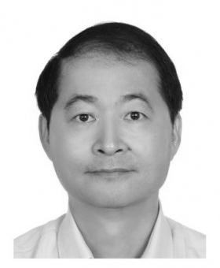
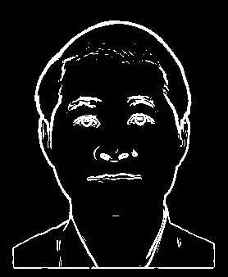
8.6 Gradient-Based Facet Edge Detection
Example:
Handsome young man
Notes:
這是對老師的照片做邊緣檢測的結果
Neighborhood = 3*3, threshold = 120

Slide 114
Outline
8.1 Introduction
8.2 Relative Maxima
8.3 Sloped Facet Parameter and Error Estimation
8.4 Facet-Based Peak Noise Removal
8.5 Iterated Facet Model
8.6 Gradient-Based Facet Edge Detection
8.7 Bayesian Approach to Gradient Edge Detection
8.8 Zero-Crossing Edge Detector
8.9 Integrated Directional Derivative Gradient Operator
8.10 Corner Detection
8.11 Isotropic Derivative Magnitudes
8.12 Ridges and Ravines on Digital Images
8.13 Topographic Primal Sketch
Notes:
8.7 使用貝式定理去決定觀測的梯度強度是否為Edge

Slide 115
8.7 Bayesian Approach to Gradient Edge Detection
The Bayesian approach is to decide there is an edge (statistically significant gradient) when,
$$P\left(edge | G\right)>P\left(nonedge|G\right)$$
$P\left(edge | G\right) :$ given gradient magnitude conditional probability of edge.
$P\left(nonedge|G\right) :$ given gradient magnitude conditional probability of nonedge.
Notes:
上一節我們介紹了用計算估計值並且設定閥值的方式來判斷是否為edge
這一節我們會用貝式定理去決定觀測的梯度強度是否為Edge
這邊講的是說 在統計值為Ｇ的情況下，edge的機率要大於nonegde的機率

Slide 116
8.7 Bayesian Approach to Gradient Edge Detection
$$P\left(edge | G\right)=\frac{P\left(G | edge\right)P\left(edge\right)}{P\left(G\right)}$$
$$P\left(nonedge | G\right)=\frac{P\left(G | nonedge\right)P\left(nonedge\right)}{P\left(G\right)}$$
$$P\left(edge | G\right)>P\left(nonedge|G\right)$$
Hence, a decision for edge is made whenever
$$P\left(G | edge\right)P\left(edge\right)>P\left(G | nonedge\right)P\left(nonedge\right)$$
Notes:
我們希望可以把Ｇ放到前面，所以透過貝氏定理的一些轉換，並且把這三個式子做結合，我們得到下面的結果

Slide 117
8.7 Bayesian Approach to Gradient Edge Detection
$$P\left(G | edge\right)P\left(edge\right)>P\left(G | nonedge\right)P\left(nonedge\right)$$
$P(G|nonedge)$ can be known according to the theory of chi-square distribution,
$P\left(nonedge\right)$ is a user-specified prior probability of non-edge, 0.9 to 0.95 are reasonable.
$P\left(edge\right)$ = 1 - $P\left(nonedge\right)$
Notes:
那我們其實是知道$P(G|nonedge)$ 的值的
Ｇ是根據卡方分配，那我們是在alpha = beta = 0的時候做一個虛無假設，所以這個Ｇ其實是在虛無假設之下求出來的一個值
那下面的$P\left(nonedge\right)$ 我們是不知道的，但這邊通常我們可以給一個先驗機率，在0.9~0.95之間是比較合理的
然後$P\left(edge\right)$ = 1 - $P\left(nonedge\right)$這個應該是蠻直覺的沒有問題

Slide 118
8.7 Bayesian Approach to Gradient Edge Detection
Infer $P\left(G | edge\right)$ from $P(G)$
$P\left(G\right)=P\left(G | edge\right)P\left(edge\right)+P\left(G | nonedge\right)P\left(nonedge\right)$
$P\left(G | edge\right)=\frac{P\left(G\right)−P\left(G | nonedge\right)P\left(nonedge\right)}{P\left(edge\right)}$
$=\frac{P\left(G\right)−P\left(G | nonedge\right)P\left(nonedge\right)}{1−P\left(nonedge\right)}$
Notes:
P(G) density function of the histogram of observed gradient magnitude
從 P(G) 可推出 P(給定是邊 ，G的機率)
這個影像要不就是edge，要不就是nonedge，所以加起來就可以得到這個等式
然後我們做一些移項，就可以得到下面的$P\left(G | edge\right)$的值

Slide 119
8.7 Bayesian Approach to Gradient Edge Detection
The threshold t for G is determined as that value t for which
$$P\left(t | edge\right)P\left(edge\right)=P\left(t | nonedge\right)P\left(nonedge\right)$$
$$P\left(G\right)=P\left(G | edge\right)P\left(edge\right)+P\left(G | nonedge\right)P\left(nonedge\right)$$
Implies that the threshold t must satisfy that
$P\left(t\right)=2P\left(t | nonedge\right)P\left(nonedge\right)$
Notes:
G 的門檻值 t
透過前一頁式子的移項和轉換，我們得到上面這兩條式子，把這兩條式子合併可以得到 $P\left(t\right)=2P\left(t | nonedge\right)P\left(nonedge\right)$
這告訴我們說threshold t 的設定必須滿足這條式子
（
因$為P\left(t\right)=P\left(t | edge\right)P\left(edge\right)+P\left(t | nonedge\right)P\left(nonedge\right)$,
而且$P\left(t | edge\right)P\left(edge\right)=P\left(t | nonedge\right)P\left(nonedge\right)$,
所以$P\left(t\right)=2P\left(t | nonedge\right)P\left(nonedge\right)$
）

Slide 120
Outline
8.1 Introduction
8.2 Relative Maxima
8.3 Sloped Facet Parameter and Error Estimation
8.4 Facet-Based Peak Noise Removal
8.5 Iterated Facet Model
8.6 Gradient-Based Facet Edge Detection
8.7 Bayesian Approach to Gradient Edge Detection
8.8 Zero-Crossing Edge Detector
8.9 Integrated Directional Derivative Gradient Operator
8.10 Corner Detection
8.11 Isotropic Derivative Magnitudes
8.12 Ridges and Ravines on Digital Images
8.13 Topographic Primal Sketch
Notes:
8.8
zero crossing detector 是另一種邊緣檢測器

Slide 121
8.8 Zero-Crossing Edge Detector
Comparison
gradient edge detector: looks for high values of first derivatives
zero-crossing edge detector: looks for relative maxima in first derivative
In what follows we assume that in each neighborhood of the images, the underlying gray-level intensity function f takes the general form
Notes:
跟前面的gradient edge detector比較一下
gradient edge detector會設定一個閥值來做判斷，去找出一階導數中比較高的值
Zero-crossing edge detector 會找一階導數的相對極大值
這是他們不一樣的地方
接下來，我們假設在圖像的每個鄰域中的小平面模型為一個三次方程式，

Slide 122
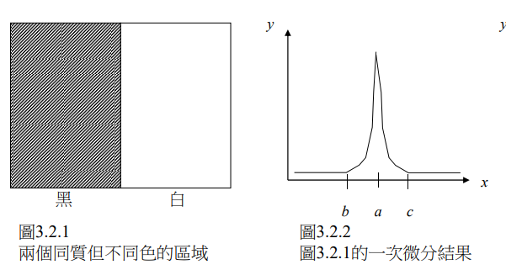
8.8 Zero-Crossing Edge Detector
http://140.117.156.238/course/CSSV/2011/%E7%9B%A3%E6%8E%A7%E8%A6%96%E8%A8%8A_ch3.pdf
Notes:
那右邊這是左邊這張圖做完一次微分之後的結果，可以看到在a點有著相對極大值
引用
http://140.117.156.238/course/CSSV/2011/%E7%9B%A3%E6%8E%A7%E8%A6%96%E8%A8%8A_ch3.pdf

Slide 123
8.8.1 Discrete Orthogonal Polynomials
A discrete orthogonal polynomial consists of Index Set R and Polynomial Set P.
A discrete orthogonal polynomial of size N has polynomials from degree 0~N-1.
The index set R must be symmetric. If $r∈R, then −r∈R.$
Ex.
Index Set
Discrete Orthogonal Polynomial Set
$$\{1, r, r^{2}−\frac{2}{3}\}$$
$$\{−1, 0, 1\}$$
Notes:
那我們要先介紹一個多項式
Discrete Orthogonal Polynomials
他是由一組index set和polynomial set所組成的
如果這個index set的size是n，那對應的多項式的degree就會從0到N-1
比方說下面這個例子的index set是-1,0,1，那對應的就是零次方到二次方的多項式
此外這個index set必須是對稱的，有-1就會有1，有-2就會有2等等

Slide 124
8.8.1 Discrete Orthogonal Polynomials
Suppose $P=\{P_{0}\left(r\right), …,P_{n−1}\left(r\right)\}$, $P_{i}\left(r\right)$ must be orthogonal to $P_{j}\left(r\right)$, where $0≤i,j≤n−1, i≠j$.
Hence, we must have the equations, $\sum_{r∈R}{P_{i}\left(r\right)P_{j}\left(r\right)=0,} 0≤i<j≤n−1.$
Ex. Let $R=\left\{−1, 0, 1\right\},$ $P=\{1, r, r^{2}−\frac{2}{3}\}$
Notes:
再來是他的名字，Orthogonal，正交
意思是說Ｐ裡面的任一項，去和另一項相乘，再把r都帶進去做summation出來的結果會等於零

Slide 125
8.8.1 Discrete Orthogonal Polynomials
Ex. Let $R=\left\{−1, 0, 1\right\},$ $P=\{1, r, r^{2}−\frac{2}{3}\}$
$$\sum_{r∈R}{P_{0}\left(r\right)P_{1}\left(r\right)=}\sum_{r∈R}{r=}\left(−1+0 +1\right)=0$$
$$\sum_{r∈R}{P_{0}\left(r\right)P_{2}\left(r\right)=}\sum_{r∈R}{(r^{2}−\frac{2}{3})=}\left(\frac{1}{3}+\left(−\frac{2}{3}\right)+\frac{1}{3}\right)=0$$
$$\sum_{r∈R}{P_{1}\left(r\right)P_{2}\left(r\right)=}\sum_{r∈R}{(r^{3}−\frac{2}{3}r)=}\left((−\frac{1}{3})+0+\frac{1}{3}\right)=0$$
Notes:
舉個例子比較清楚
這是 P0(r) 乘上P1(r)……

Slide 126
8.8.1 Discrete Orthogonal Polynomials
Ex. Let $R=\left\{−1, 0, 1\right\},$ $P=\{1, r, r^{2}−\frac{2}{3}\}$
$$\sum_{r∈R}{P_{0}\left(r\right)P_{1}\left(r\right)=}\sum_{r∈R}{r=}\left(−1+0 +1\right)=0$$
$$\sum_{r∈R}{P_{0}\left(r\right)P_{2}\left(r\right)=}\sum_{r∈R}{(r^{2}−\frac{2}{3})=}\left(\frac{1}{3}+\left(−\frac{2}{3}\right)+\frac{1}{3}\right)=0$$
$$\sum_{r∈R}{P_{1}\left(r\right)P_{2}\left(r\right)=}\sum_{r∈R}{(r^{3}−\frac{2}{3}r)=}\left((−\frac{1}{3})+0+\frac{1}{3}\right)=0$$

Slide 127
8.8.1 Discrete Orthogonal Polynomials
Ex. Let $R=\left\{−1, 0, 1\right\},$ $P=\{1, r, r^{2}−\frac{2}{3}\}$
$$\sum_{r∈R}{P_{0}\left(r\right)P_{1}\left(r\right)=}\sum_{r∈R}{r=}\left(−1+0 +1\right)=0$$
$$\sum_{r∈R}{P_{0}\left(r\right)P_{2}\left(r\right)=}\sum_{r∈R}{(r^{2}−\frac{2}{3})=}\left(\frac{1}{3}+\left(−\frac{2}{3}\right)+\frac{1}{3}\right)=0$$
$$\sum_{r∈R}{P_{1}\left(r\right)P_{2}\left(r\right)=}\sum_{r∈R}{(r^{3}−\frac{2}{3}r)=}\left((−\frac{1}{3})+0+\frac{1}{3}\right)=0$$

Slide 128
8.8.1 Discrete Orthogonal Polynomials
Discrete orthogonal polynomials can be recursively generated:
$P_{i+1}\left(r\right)=rP_{i}(r)－β_{i}P_{i−1}\left(r\right)$
$$P_{0 }\left(r\right)=1,P_{1 }\left(r\right)=r$$
$β_{i}=\frac{\sum_{r∈R}{rP_{i}\left(r\right)P_{i−1}\left(r\right)}}{\sum_{r∈R}{P_{i−1}^{2}\left(r\right)}}$
Notes:
這個Discrete orthogonal polynomial可以用遞迴的方式來定義
那定義如下，他可以產生polynomial的每一項

Slide 129
8.8.1 Discrete Orthogonal Polynomials
The first 4 polynomial function formulas are:
$$P_{0}\left(r\right)=1$$
$P_{1}\left(r\right)=r$
$${ P}_{2}\left(r\right)=r^{2}−\frac{μ_{2}}{μ_{0}}$$
$${ P}_{3}\left(r\right)=r^{3}−\frac{μ_{4}}{μ_{2}}r$$
$$, where μ_{k}=\sum_{s∈R}{s^{k}}$$
Notes:
那我們只focus前四項，透過剛剛的遞迴定義可以得到前四項長這個樣子
那我們來看例子 看看這些 $μ$怎麼算

Slide 130
8.8.1 Discrete Orthogonal Polynomials
Ex.
Index Set
Discrete Orthogonal Polynomial Set
$$\{1, r, r^{2}−\frac{2}{3}\}$$
$$\{−1, 0, 1\}$$
$${ P}_{2}\left(r\right)=r^{2}−\frac{μ_{2}}{μ_{0}}, μ_{k}=\sum_{s∈R}{s^{k}}$$
${ P}_{2}\left(r\right)= r^{2}−\frac{μ_{2}}{μ_{0}} = r^{2}−\frac{\sum_{s∈R}{s^{2}}}{\sum_{s∈R}{s^{0}}} =$ $r^{2}−\frac{1+0+1}{1+1+1} = r^{2}−\frac{2}{3}$
Notes:
以P2為例

Slide 131
8.8.1 Discrete Orthogonal Polynomials
The polynomial function can be expressed as:
$$f\left(r\right)=\sum_{n=0}^{N−1}{{a_{n}P}_{n}\left(r\right)}, where a_{i} are the coefficents.$$
Notes:
最後我們可以將任何的多項式利用我們的正交多項式來表示，因為他是正交的，所以可以用不同的線性組合表示
只要給定不同的係數a_i就可以了

Slide 132
8.8.2 Two-Dimensional Discrete Orthogonal Polynomials
2-D discrete orthogonal polynomials creatable from tensor products of 1D from above equations
Index Set
{-1,0,1}$×${-1,0,1}
Discrete Orthogonal Polynomial Set
$$\{1,r,r^{2}−\frac{2}{3}\}×\left\{1,c,c^{2}−\frac{2}{3}\right\}$$
$$=\{1,r,r^{2}−\frac{2}{3},c,{rc, c\left(r^{2}−\frac{2}{3}\right),c}^{2}−\frac{2}{3}, r\left(c^{2}−\frac{2}{3}\right),(r^{2}−\frac{2}{3})(c^{2}−\frac{2}{3})\}$$
Notes:
剛剛是一維的，那8.8.2我們要看的是二維的
我們把兩個 set 直接乘開

Slide 133
8.8.2 Two-Dimensional Discrete Orthogonal Polynomials
2-D discrete orthogonal polynomials creatable from tensor products of 1D from above equations
Index Set
{-1,0,1}$×${-1,0,1}
Discrete Orthogonal Polynomial Set
$$\{1,r,r^{2}−\frac{2}{3}\}×\left\{1,c,c^{2}−\frac{2}{3}\right\}$$
$$=\{1,r,r^{2}−\frac{2}{3},c,{rc, c\left(r^{2}−\frac{2}{3}\right),c}^{2}−\frac{2}{3}, r\left(c^{2}−\frac{2}{3}\right),(r^{2}−\frac{2}{3})(c^{2}−\frac{2}{3})\}$$

Slide 134
8.8.2 Two-Dimensional Discrete Orthogonal Polynomials
2-D discrete orthogonal polynomials creatable from tensor products of 1D from above equations
Index Set
{-1,0,1}$×${-1,0,1}
Discrete Orthogonal Polynomial Set
$$\{1,r,r^{2}−\frac{2}{3}\}×\left\{1,c,c^{2}−\frac{2}{3}\right\}$$
$$=\{1,r,r^{2}−\frac{2}{3},c,{rc, c\left(r^{2}−\frac{2}{3}\right),c}^{2}−\frac{2}{3}, r\left(c^{2}−\frac{2}{3}\right),(r^{2}−\frac{2}{3})(c^{2}−\frac{2}{3})\}$$

Slide 135
8.8.2 Two-Dimensional Discrete Orthogonal Polynomials
2-D discrete orthogonal polynomials creatable from tensor products of 1D from above equations
Index Set
{-1,0,1}$×${-1,0,1}
Discrete Orthogonal Polynomial Set
$$\{1,r,r^{2}−\frac{2}{3}\}×\left\{1,c,c^{2}−\frac{2}{3}\right\}$$
$$=\{1,r,r^{2}−\frac{2}{3},c,{rc, c\left(r^{2}−\frac{2}{3}\right),c}^{2}−\frac{2}{3}, r\left(c^{2}−\frac{2}{3}\right),(r^{2}−\frac{2}{3})(c^{2}−\frac{2}{3})\}$$

Slide 136
8.8.2 Two-Dimensional Discrete Orthogonal Polynomials
The polynomial function can be expressed as:
$$f\left(r, c\right)=\sum_{n=0}^{R∗C−1}{{a_{n}P}_{n}\left(r, c\right)}, where a_{i} are the coefficents.$$
Notes:
同理，我們可以將多項式表示成不同的線性組合，只是現在是二維的

Slide 137
8.8.3 Equal-Weighted Least-Squares Fitting Problem
The approximate fitting problem is to determine coefficients a₀,…,a_{K}, $K≤N−1$, such that
$$e^{2}=\sum_{r∈R}{{\left[d\left(r\right)−\sum_{n=0}^{K}{a_{n}P_{n}\left(r\right)}\right]}^{2}is minimized.}$$
$$the result is a_{m}=\frac{\sum_{r∈R}{P_{m}\left(r\right)d(r)}}{\sum_{s∈R}{P_{m}^{2}\left(s\right)}}.$$
Notes:
這邊跟前面計算誤差的公式非常類似，d(r) 代表觀測值，一樣用這是 least-square error fitting，我們扣掉預測值然後平方
我們希望他是最小的
(am 代表可將每一項係數，直接由 data values 的線性組合產生)
公式是這個樣子，那我們直接看例子比較清楚

Slide 138
8.8.3 Equal-Weighted Least-Squares Fitting Problem
$Let f\left(r, c\right)=a_{0}+a_{1}r+a_{2}c+a_{3}\left(r^{2}−2\right)+a_{4}rc+$
$$a_{5}\left(c^{2}−2\right)+a_{6}\left(r^{3}−3.4r\right)+a_{7}\left(r^{2}−2\right)c+a_{8}r\left(c^{2}−2\right)+$$
$$a_{9}\left(c^{3}−3.4c\right)$$
$Let d=$
1 | 1 | 1 | 1 | 5
1 | 1 | 1 | 5 | 6
1 | 1 | 5 | 6 | 6
1 | 5 | 6 | 6 | 6
1 | 5 | 6 | 6 | 6
Notes:
給定我們前面學的正交多項式
他有十個係數要去找
再給定觀測值 d 為5*5的矩陣

Slide 139
8.8.3 Equal-Weighted Least-Squares Fitting Problem
$Let f\left(r, c\right)=a_{0}+a_{1}r+a_{2}c+a_{3}\left(r^{2}−2\right)+a_{4}rc+$
$$a_{5}\left(c^{2}−2\right)+a_{6}\left(r^{3}−3.4r\right)+a_{7}\left(r^{2}−2\right)c+a_{8}r\left(c^{2}−2\right)+$$
$$a_{9}\left(c^{3}−3.4c\right)$$
$Let d=$
c
r
-2
-1
0
1
2
1 | 1 | 1 | 1 | 5
1 | 1 | 1 | 5 | 6
1 | 1 | 5 | 6 | 6
1 | 5 | 6 | 6 | 6
1 | 5 | 6 | 6 | 6
-2
-2 | -2 | -2 | -2 | -2
-1 | -1 | -1 | -1 | -1
0 | 0 | 0 | 0 | 0
1 | 1 | 1 | 1 | 1
2 | 2 | 2 | 2 | 2
-1
0
1
2
$$r$$
Notes:
假設現在要算a1
a1取決於 r ，所以右邊的表格就是填上 r 的數值

Slide 140
8.8.3 Equal-Weighted Least-Squares Fitting Problem
$a_{1}=\frac{\sum_{(r,c)∈R×C}{P_{1}\left(r, c\right)d(r,c)}}{\sum_{(r,c)∈R×C}{P_{1}^{2}\left(r,c\right)}}$
1*(-2) | 1*(-2) | 1*(-2) | 1*(-2) | 5*(-2)
1*(-1) | 1*(-1) | 1*(-1) | 5*(-1) | 6*(-1)
1*0 | 1*0 | 5*0 | 6*0 | 6*0
1*1 | 5*1 | 6*1 | 6*1 | 6*1
1*2 | 5*2 | 6*2 | 6*2 | 6*2
sum up
$$40$$
Notes:
分子就是對應位置相乘

Slide 141
8.8.3 Equal-Weighted Least-Squares Fitting Problem
$a_{1}=\frac{\sum_{(r,c)∈R×C}{P_{1}\left(r, c\right)d(r,c)}}{\sum_{(r,c)∈R×C}{P_{1}^{2}\left(r,c\right)}}$
-2 | -2 | -2 | -2 | -2
-1 | -1 | -1 | -1 | -1
0 | 0 | 0 | 0 | 0
1 | 1 | 1 | 1 | 1
2 | 2 | 2 | 2 | 2
4 | 4 | 4 | 4 | 4
1 | 1 | 1 | 1 | 1
0 | 0 | 0 | 0 | 0
1 | 1 | 1 | 1 | 1
4 | 4 | 4 | 4 | 4
square
sum up
$$50$$
$$r$$
Notes:
分母就是剛剛右邊的表格平方和

Slide 142
8.8.3 Equal-Weighted Least-Squares Fitting Problem
$Let f\left(r, c\right)=a_{0}+a_{1}r+a_{2}c+a_{3}\left(r^{2}−2\right)+a_{4}rc+$
$$a_{5}\left(c^{2}−2\right)+a_{6}\left(r^{3}−3.4r\right)+a_{7}\left(r^{2}−2\right)c+a_{8}r\left(c^{2}−2\right)+$$
$$a_{9}\left(c^{3}−3.4c\right)$$
$Let d=$
$$a_{1}=\frac{\sum_{(r,c)∈R×C}{P_{1}\left(r, c\right)d(r,c)}}{\sum_{(r,c)∈R×C}{P_{1}^{2}\left(r,c\right)}}$$
$$=\frac{40}{50}$$
$$=0.8$$
1 | 1 | 1 | 1 | 5
1 | 1 | 1 | 5 | 6
1 | 1 | 5 | 6 | 6
1 | 5 | 6 | 6 | 6
1 | 5 | 6 | 6 | 6
Notes:
我們得到0.8

Slide 143
8.8.3 Equal-Weighted Least-Squares Fitting Problem
$Let f\left(r, c\right)=a_{0}+a_{1}r+a_{2}c+a_{3}\left(r^{2}−2\right)+a_{4}rc+$
$$a_{5}\left(c^{2}−2\right)+a_{6}\left(r^{3}−3.4r\right)+a_{7}\left(r^{2}−2\right)c+a_{8}r\left(c^{2}−2\right)+$$
$$a_{9}\left(c^{3}−3.4c\right)$$
$Let d=$
1 | 1 | 1 | 1 | 5
1 | 1 | 1 | 5 | 6
1 | 1 | 5 | 6 | 6
1 | 5 | 6 | 6 | 6
1 | 5 | 6 | 6 | 6
4 | 2 | 0 | -2 | -4
2 | 1 | 0 | -1 | -2
0 | 0 | 0 | 0 | 0
-2 | -1 | 0 | 1 | 2
-4 | -2 | 0 | 2 | 4
$$rc$$
Notes:
再試試 a4，a4取決於 rc ，所以右邊的表格就是 r 乘上 c 填進去

Slide 144
8.8.3 Equal-Weighted Least-Squares Fitting Problem
$a_{4}=\frac{\sum_{(r,c)∈R×C}{P_{4}\left(r, c\right)d(r,c)}}{\sum_{(r,c)∈R×C}{P_{4}^{2}\left(r,c\right)}}$
1*4 | 1*2 | 1*0 | 1*(-2) | 5*(-4)
1*2 | 1*1 | 1*0 | 5*(-1) | 6*(-2)
1*0 | 1*0 | 5*0 | 6*0 | 6*0
1*(-2) | 5*(-1) | 6*0 | 6*1 | 6*2
1*(-4) | 5*(-2) | 6*0 | 6*2 | 6*4
sum up
$$3$$
Notes:
一樣的算法 分子是對應位置相乘

Slide 145
8.8.3 Equal-Weighted Least-Squares Fitting Problem
$a_{4}=\frac{\sum_{(r,c)∈R×C}{P_{4}\left(r, c\right)d(r,c)}}{\sum_{(r,c)∈R×C}{P_{4}^{2}\left(r,c\right)}}$
4 | 2 | 0 | -2 | 4
2 | 1 | 0 | -1 | 2
0 | 0 | 0 | 0 | 0
-2 | -1 | 0 | 1 | 2
-4 | -2 | 0 | 2 | 4
16 | 4 | 0 | 4 | 16
4 | 1 | 0 | 1 | 4
0 | 0 | 0 | 0 | 0
4 | 1 | 0 | 1 | 4
16 | 4 | 0 | 4 | 16
square
sum up
$$100$$
$$r$$
Notes:
分母是右邊的表格平方和

Slide 146
8.8.3 Equal-Weighted Least-Squares Fitting Problem
$Let f\left(r, c\right)=a_{0}+a_{1}r+a_{2}c+a_{3}\left(r^{2}−2\right)+a_{4}rc+$
$$a_{5}\left(c^{2}−2\right)+a_{6}\left(r^{3}−3.4r\right)+a_{7}\left(r^{2}−2\right)c+a_{8}r\left(c^{2}−2\right)+$$
$$a_{9}\left(c^{3}−3.4c\right)$$
$Let d=$
$$a_{4}=\frac{\sum_{(r,c)∈R×C}{P_{4}\left(r, c\right)d(r,c)}}{\sum_{(r,c)∈R×C}{P_{4}^{2}\left(r,c\right)}}$$
$$=\frac{3}{100}$$
$$=0.03$$
1 | 1 | 1 | 1 | 5
1 | 1 | 1 | 5 | 6
1 | 1 | 5 | 6 | 6
1 | 5 | 6 | 6 | 6
1 | 5 | 6 | 6 | 6
Notes:
得到0.03

Slide 147
8.8.4 Directional Derivative Edge Finder
Review:
z$\text{ero}\text{−}\text{crossing} \text{edge} \text{detector}\text{: }\text{looks} \text{for} \text{relative} \text{maxima} \text{in} \text{first} \text{derivative}$
Notes:
我們定義方向導數邊界尋檢器視為一運算。
一個邊的所有pixel 的二階方向導數在具有方向梯度上有負斜率過零點
ρ(rho), alpha

Slide 148
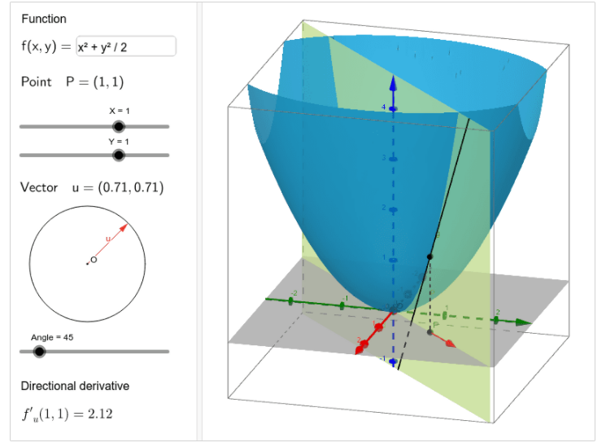
8.8.4 Directional Derivative Edge Finder
Directional Derivative:
To cut the surface $f(r,c)$ with a plane that is oriented in the desired direction.
The intersection results in a curve. The derivative of the curve is the direction derivative.
Source: Directional Derivative – GeoGebra
Notes:
方向導數可以比方為，將三維表面，順著某一方向，用平面來切
所得到的結果會是一個曲線，而此曲線的導數即為方向導數

Slide 149
8.8.4 Directional Derivative Edge Finder
We transfer the $f\left(r, c\right)$ into polar coordinate system.
$$f\left(r, c\right)→ f_{α}(ρ)$$
$r$: row
$c$: column
$ρ$: radius in polar coordinate
$α$ : angle in polar coordinate, clockwise from column axis
Notes:
現在我們想要把它轉成極座標，原本是用row跟column，現在是用角度跟半徑去算座標的位置
ρ(rho)

Slide 150
8.8.4 Directional Derivative Edge Finder
We can easily replace $r, c$ with $ρsinα, ρcosα,$ respectively.
$$r=ρsinα, c=ρcosα$$
We define $α$ with
$$sinα=\frac{k_{2}}{\sqrt{k_{2}^{2}+k_{3}^{2}}}, cosα=\frac{k_{3}}{\sqrt{k_{2}^{2}+k_{3}^{2}}}$$
where $k_{2}$represents the sum of weight that involves $r$,
and $k_{3}$represents the sum of weight that involves $c$.
Notes:
這邊做座標的轉換，$r=ρsinα, c=ρcosα$
那因為我們還不知道alpha，我們定義$sinα=\frac{k_{2}}{\sqrt{k_{2}^{2}+k_{3}^{2}}}, cosα=\frac{k_{3}}{\sqrt{k_{2}^{2}+k_{3}^{2}}}$
其中k2是原本r的係數總和
k3是原本c的係數總和

Slide 151
8.8.4 Directional Derivative Edge Finder
$Let f\left(r, c\right)=a_{0}+a_{1}r+a_{2}c+a_{3}\left(r^{2}−2\right)+a_{4}rc+a_{5}\left(c^{2}−2\right)+a_{6}\left(r^{3}−3.4r\right)+a_{7}\left(r^{2}−2\right)c+a_{8}r\left(c^{2}−2\right)+$ $a_{9}\left(c^{3}−3.4c\right)$
$$k_{2}=1−3.4−2=−4.4$$
$$k_{3}=1−2−3.4=−4.4$$
where $k_{2}$represents the sum of weight that involves $r$,
and $k_{3}$represents the sum of weight that involves $c$.

Slide 152
8.8.4 Directional Derivative Edge Finder
Relative Maximum
For some $\left|ρ\right|<ρ_{0},$where $ρ_{0}$is slightly smaller than the length of the side of a pixel. (Ex. $ρ_{0}=1.0$)
$f_{α}^{′′′}\left(ρ\right)<0$
$f_{α}^{′′}\left(ρ\right)=0$
$f_{α}^{′}\left(ρ\right)≠0$
The pixel is marked as edge candidate
Notes:
那我們通常會限制它在某個範圍內，比方說1.0，那要找一階導數的相對極大值，要滿足一階導數不等於零，二階導數等於零，三階導數小於零
滿足的話這個pixel就會被當成是邊緣的候選者

Slide 153
8.8.4 Directional Derivative Edge Finder
Analyzing
Transfer $f_{α}(ρ)$ to $g_{α}(ρ)$ so that the inflection point is at the origin, and the essence hasn’t changed.
$f_{α}\left(ρ\right)= c_{0}+c_{1}ρ+c_{2}ρ^{2}+c_{3}ρ^{3}$
$g_{α}\left(ρ\right)=C(Sρ−S^{3}ρ^{3})$
$where, C=\frac{{(c_{2}^{2}−3c_{1}c_{3})}^{1.5}}{3^{1.5}c_{3}^{2}}, S=\sqrt{\frac{3c_{3}^{2}}{(c_{2}^{2}−3c_{1}c_{3})}}$
Notes:
原本是上面這個形式，我們轉為下面這個形式
主要是把反曲點移到原點的位置，其他東西都不變
轉換的過程比較複雜，但結果就是像下面這樣

Slide 154
8.8.4 Directional Derivative Edge Finder
Analyzing (Continue.)
$g_{α}\left(ρ\right)=C\left(Sρ−S^{3}ρ^{3}\right)$
$g_{α}^{′}\left(ρ\right)=C\left(S−{3S}^{3}ρ^{2}\right)$
$g_{α}^{′′}\left(ρ\right)=−6CS^{3}ρ$
The locations of the relative maximum depend only on$S.$
They are located at $±1/S\sqrt{3}$. (Obtained by solving $g_{α}^{′}\left(ρ\right)$=0)
Notes:
那這樣做的好處是我們在觀察相對極大值的location時，就可以完全依賴 S 來做判斷
解右下角的等式可以得到他會固定在$±1/S\sqrt{3}$的位置

Slide 155
8.8.4 Directional Derivative Edge Finder
Analyzing (Continue.)
$g_{α}\left(ρ\right)=C\left(Sρ−S^{3}ρ^{3}\right)$
$g_{α}^{′}\left(ρ\right)=C\left(S−{3S}^{3}ρ^{2}\right)$
$g_{α}^{′′}\left(ρ\right)=−6CS^{3}ρ$
The height of the relative maximum depends only on$C.$
Their heights are $±2C/\sqrt{3}$. (Obtained by computing $g_{α}\left(±1/S\sqrt{3}\right)$)
Notes:
那他的高度就會完全依賴 C，解右下角的式子就可以得到他是$±2C/\sqrt{3}$

Slide 156
8.8.4 Directional Derivative Edge Finder
Use the ideal step edge as experiments, we obtain: ($N$ = size of neighborhood)
-1 | -1 | 0 | 1 | 1
-1 | -1 | 0 | 1 | 1
-1 | -1 | 0 | 1 | 1
-1 | -1 | 0 | 1 | 1
-1 | -1 | 0 | 1 | 1
$$C=3.16257$$
$$S=\frac{1.793157}{N}$$
ideal step edge
Notes:
現在利用理想的邊界去做實驗的話
會取得Ｃ = 3.16275 S = 1.793257 除以Ｎ
Ｎ代表的是 neighborhood
那用這兩個最完美的數字當作基準
我們之後再去做測量的時候會測出跟這兩個不一樣的Ｃ跟Ｓ
差別越大的話我們越不會認定他是一個 edge

Slide 157
8.8.4 Directional Derivative Edge Finder
We use this as our standard for edge detection, we let:
$$Edge contrast=\frac{2C}{3.16257}, Edge scale=\frac{S×N}{1.793157}$$
For an edge, $Edge contrast$ is bigger than $p$ times the image’s dynamic range (Highest pixel value – lowest pixel value).
Also, $Edge scale$ is restricted between $lb$~$ub$
(Usually, $p=0.05, lb=0.4, ub=1.1$)
Notes:
所以最後我們用這兩個標準來去檢測邊緣，Ｃ這邊多給一個 2 是因為課本認為根據實驗結果這樣比較好
下面講的是說如果你的 $Edge contrast$ 大於Ｐ倍的 dynamic range 的話，那就算是一個 edge
dynamic range 就是把整張影像最高最亮的數值去減掉最低最暗的數值
同時 edge scale 必須限制在每一個區間
那課本給了一個推薦值，通常 $p=0.05, lb=0.4, ub=1.1$做出來的比較好

Slide 158
8.8.4 Directional Derivative Edge Finder
Ex: Lena.bmp

Slide 159
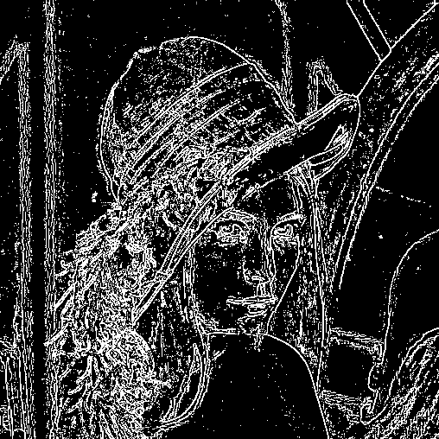
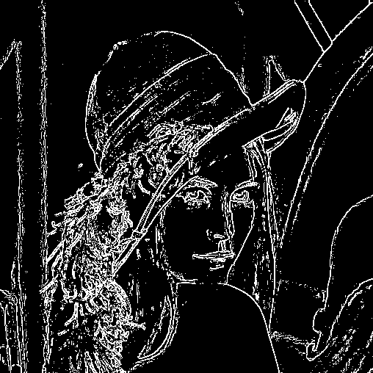
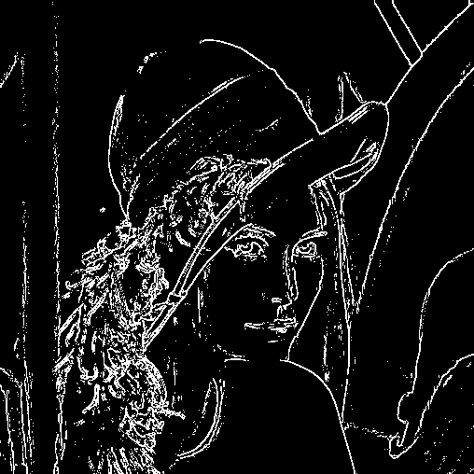
8.8.4 Directional Derivative Edge Finder
Ex:
$$p=0.05, lb=0.4, ub=1.1$$
$$p=0.1, lb=0.4, ub=1.1$$
$$p=0.15, lb=0.4, ub=1.1$$
Notes:
p 設越小會有越多的 pixel 通過門檻，看起來會比較密

Slide 160
8.8.4 Directional Derivative Edge Finder
(Gradient-based)
Notes:
跟前面的 gradient-based 比較一下，gradient-based 線條比較粗一點
Zero-cross 線條比較細一點

Slide 161
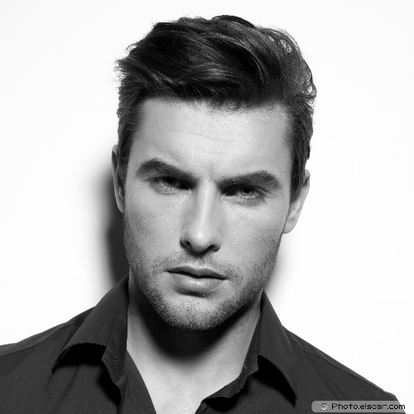
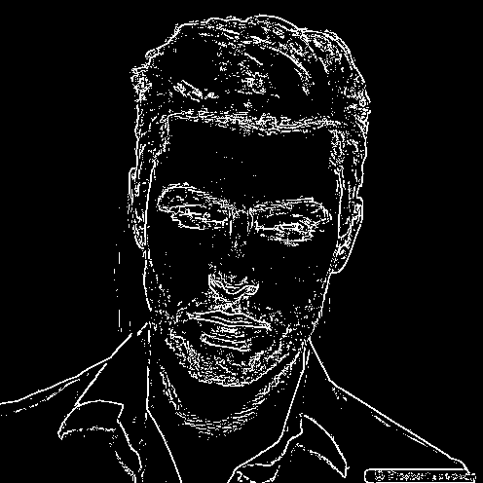
8.8.4 Directional Derivative Edge Finder
Ex:
Handsome young man
$$p=0.1, lb=0.4, ub=1.1$$

Slide 162
8.8.4 Directional Derivative Edge Finder
Ex: gradient-based
Handsome young man

Slide 163
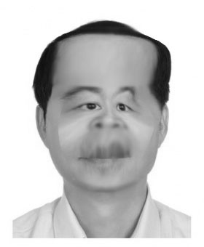
8.8.4 Directional Derivative Edge Finder
Ex: zero-cross
Ugly old man.jpg
$$p=0.1, lb=0.4, ub=1.1$$

Slide 164
Outline
8.1 Introduction
8.2 Relative Maxima
8.3 Sloped Facet Parameter and Error Estimation
8.4 Facet-Based Peak Noise Removal
8.5 Iterated Facet Model
8.6 Gradient-Based Facet Edge Detection
8.7 Bayesian Approach to Gradient Edge Detection
8.8 Zero-Crossing Edge Detector
8.9 Integrated Directional Derivative Gradient Operator
8.10 Corner Detection
8.11 Isotropic Derivative Magnitudes
8.12 Ridges and Ravines on Digital Images
8.13 Topographic Primal Sketch
Notes:
8.9 討論集成方向導數梯度

Slide 165
Break

Slide 166
8.9 Integrated Directional Derivative Gradient Operator
integrated directional derivative gradient operator
an operator that measures the integrated directional derivative strength as the integral of first directional derivative taken over a square area
more accurate step edge direction
Journals
Notes:
那他的意思是說前面看的gradient都是針對一個點去做討論他的大小，這邊看的是一整個面積
課本用的詞叫做 square area，一個方形的面積
他所參考的方式會比前面只參考一個點來的精準很多
公式附在下方
更詳細可以看課本 8.9.1 、 8.9.2 有 demo
或是右下角有附上作者發在 IEEE journals 的連結
後面比較偏向複雜理論，這邊就不會再往下講

Slide 167
Outline
8.1 Introduction
8.2 Relative Maxima
8.3 Sloped Facet Parameter and Error Estimation
8.4 Facet-Based Peak Noise Removal
8.5 Iterated Facet Model
8.6 Gradient-Based Facet Edge Detection
8.7 Bayesian Approach to Gradient Edge Detection
8.8 Zero-Crossing Edge Detector
8.9 Integrated Directional Derivative Gradient Operator
8.10 Corner Detection
8.11 Isotropic Derivative Magnitudes
8.12 Ridges and Ravines on Digital Images
8.13 Topographic Primal Sketch
Notes:
8.10 我們要討論的是corner detection

Slide 168
8.10 Corner Detection
purpose
corners: to detect buildings in aerial images
corner points: to determine displacement vectors from image pair
corners with two conditions
the occurrence of an edge
significant changes in edge direction
Edge direction: is defined as the direction that is orthogonal to the estimated gradient direction and in which, if one walked along the edge, the higher-valued area would be to the right
Notes:
主要有兩個目的
第一是 偵測空拍圖中的建築物
第二是 求出一對圖片中物體的位移量
Corner出現有兩個條件
它一定會出現在edge上
而且edge direction會出現明顯的變化

Slide 169
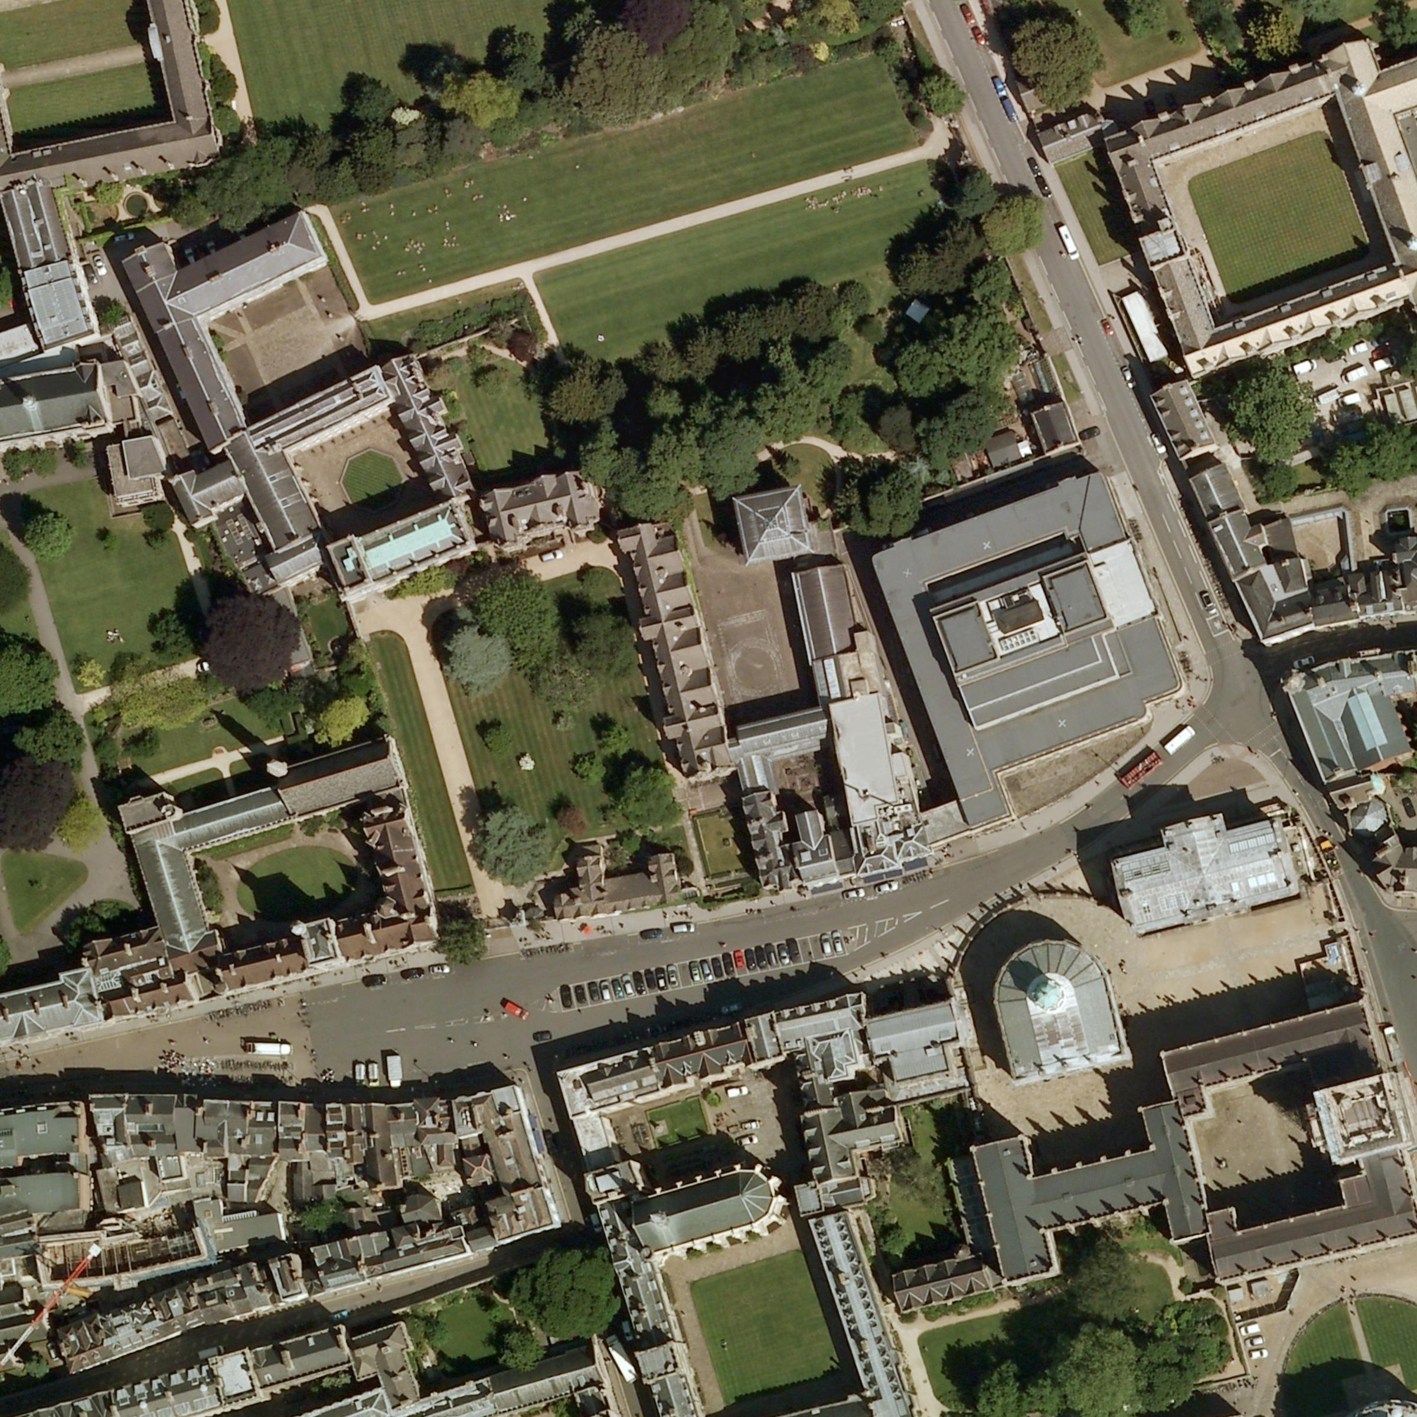
Aerial Images
Blackwell’s |
Book store‎
Notes:
像這樣的空拍圖，我們希望可以抓出他的位置

Slide 170
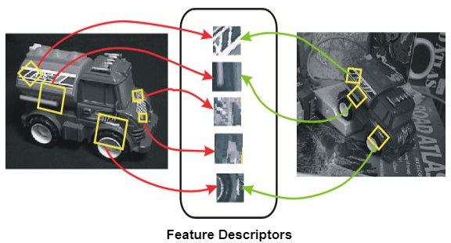
8.10 Corner Detection
corner points: to determine displacement vectors from image pair
Digital Image Processing, 4/e
Notes:
我們人眼可以判斷出這是同個物體在不同的角度
那透過corner detection去抓出一些feature，電腦也能判斷出他是同一個物體然後大概轉了多少角度

Slide 171
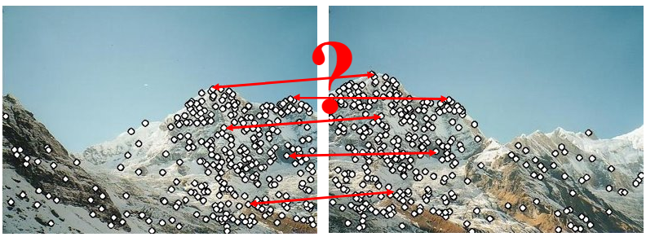
8.10 Corner Detection
corner points: to determine displacement vectors from image pair
Digital Image Processing, 4/e
Notes:
這兩張基本上是同一張圖，它們的位置稍微不一樣，我們如果能抓出他的 corner 的話，就可以很容易地把他們拼再一起

Slide 172
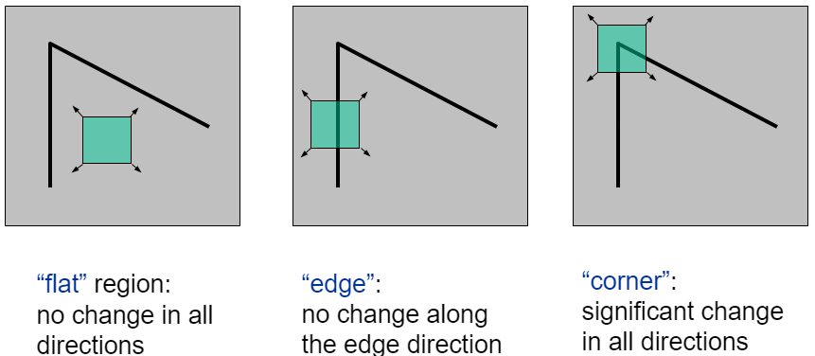
8.10 Corner Detection
corners with two conditions
the occurrence of an edge
significant changes in edge direction
Digital Image Processing, 4/e
Notes:
左: 不管什麼方向移動，都沒有感覺到邊，那這可能就是平面
中: 只有上下移動沒有改變，但左右移動會感覺到邊不見，那我們現在可能在edge上
右: 不管哪個方向移動都會感覺到邊不見，那可能就是在 corner 上

Slide 173
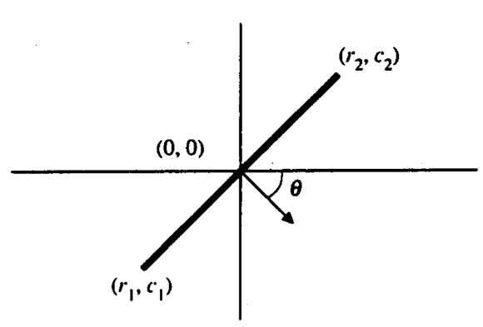
8.10 Corner Detection
Detection Method:
Given 3 points, $\left(0 ,0\right), \left(r_{1}, c_{1}\right), \left(r_{2}, c_{2}\right)$
$\left(r_{1}, c_{1}\right), \left(r_{2}, c_{2}\right)$ equidistant to the origin
Given a threshold $Ω$.
$|θ\left(r_{1}, c_{1}\right)−θ\left(r_{2}, c_{2}\right)|>Ω$.
$IsCorner= \left|θ\left(r_{1}, c_{1}\right)−θ\left(r_{2}, c_{2}\right)\right|>Ω ?True:False$
Notes:
那怎麼判斷是不是 Corner？
課本這邊的方法是
給三個點，$\left(0 ,0\right), \left(r_{1}, c_{1}\right), \left(r_{2}, c_{2}\right)$ 其中$\left(r_{1}, c_{1}\right), \left(r_{2}, c_{2}\right)$會跟原點等距離
再給一個 threshold $omega$，如果這兩個點的角度差大於 omega，那就會被視為是 corner

Slide 174
Outline
8.1 Introduction
8.2 Relative Maxima
8.3 Sloped Facet Parameter and Error Estimation
8.4 Facet-Based Peak Noise Removal
8.5 Iterated Facet Model
8.6 Gradient-Based Facet Edge Detection
8.7 Bayesian Approach to Gradient Edge Detection
8.8 Zero-Crossing Edge Detector
8.9 Integrated Directional Derivative Gradient Operator
8.10 Corner Detection
8.11 Isotropic Derivative Magnitudes
8.12 Ridges and Ravines on Digital Images
8.13 Topographic Primal Sketch
Notes:
8.11使用小平面的方法來說明各方向同性微分大小
Isotropic:等向的、各向同性。不同角度所測得的數值是相同的

Slide 175
8.11 Isotropic Derivative Magnitudes
A gradient edge can be understood as arising from a first-order isotropic derivative magnitude
Consider the two-dimensional function.
$$f(r,c)=k_{1}+k_{2}r+k_{3}c$$
rotate the coordinate system by$θ$and call the resulting function g in the new (r’, c’) coordinate
Notes:
梯度邊緣可以被理解為從一階各向同性導數量值而產生，我們需要理解的是，經過座標軸旋轉後，所求出的梯度大小會不會改變。
今天去 consider 一個二維 function 的 model，然後把他旋轉$θ角後得到$新的 model 跟新的座標 function

Slide 176
8.11 Isotropic Derivative Magnitudes
(Continue. ) rotate the coordinate system by$θ$and call the resulting function g in the new (r’,c’) coordinate
$$r^{′}=rcosθ+csinθ, c^{′}=−rsinθ+ccosθ$$
$$g\left(r^{′},c^{′}\right)=k_{1}+k_{2}r^{′}+k_{3}c^{′}$$
=$k_{1}+\left(k_{2}cosθ−k_{3}sinθ\right)r+\left(k_{2}sinθ+k_{3}cosθ\right)c$
Notes:
移項一下可以用 r, c 表示 r’, c’

Slide 177
8.11 Isotropic Derivative Magnitudes
(Continue. ) rotate the coordinate system by$θ$and call the resulting function g in the new (r’,c’) coordinate
$$r^{′}=rcosθ+csinθ, c^{′}=−rsinθ+ccosθ$$
$$g\left(r^{′},c^{′}\right)=k_{1}+k_{2}r^{′}+k_{3}c^{′}$$
=$k_{1}+\left(k_{2}cosθ−k_{3}sinθ\right)r+\left(k_{2}sinθ+k_{3}cosθ\right)c$
Notes:
那我們要把它轉成 g，這邊用到的是旋轉矩陣，轉完之後再把 r’和 g’帶進去

Slide 178
8.11 Isotropic Derivative Magnitudes
$g\left(r^{′},c^{′}\right) = k_{1}+\left(k_{2}cosθ−k_{3}sinθ\right)r+\left(k_{2}sinθ+k_{3}cosθ\right)c$
${[\frac{∂g\left(r^{′}, c^{′}\right)}{∂r}]}^{2}+{[\frac{∂g\left(r^{′}, c^{′}\right)}{∂c}]}^{2}$
=(k₂cos$θ$-k₃sin$θ$)² + (k₂sin$θ$+ k₃cos$θ$)²
=$k_{2}^{2}+k_{3}^{2}={[\frac{∂f\left(r, c\right)}{∂r}]}^{2}+{[\frac{∂f\left(r, c\right)}{∂c}]}^{2}$
The sum of the squares of the first partials is the same constant $k_{2}^{2}+k_{3}^{2}$, the squared gradient magnitude, for the original function or for the rotated function.
$$f(r,c)=k_{1}+k_{2}r+k_{3}c$$
Notes:
這邊分別對 r 跟 c 做偏微分
然後取他們的平方代表強度
結果跟原本的 f 函數的梯度強度相同
那就證明說梯度強度不會因為方向改變而改變

Slide 179
Outline
8.1 Introduction
8.2 Relative Maxima
8.3 Sloped Facet Parameter and Error Estimation
8.4 Facet-Based Peak Noise Removal
8.5 Iterated Facet Model
8.6 Gradient-Based Facet Edge Detection
8.7 Bayesian Approach to Gradient Edge Detection
8.8 Zero-Crossing Edge Detector
8.9 Integrated Directional Derivative Gradient Operator
8.10 Corner Detection
8.11 Isotropic Derivative
8.12 Ridges and Ravines on Digital Images
8.13 Topographic Primal Sketch
Notes:
8.12 討論山脊和溝壑

Slide 180
8.12 Ridges and Ravines on Digital Images

Slide 181
8.12 Ridges and Ravines on Digital Images
A digital ridge (ravine) occurs on a digital image when there is a simply connected sequence of pixels with gray level intensity values that are significantly higher (lower) in the sequence than those neighboring the sequence.
The facet model can be used to help accomplish ridge and ravine identification.
Notes:
在數位影像上的山脊或溝壑，是一連串的灰階值序列，它的灰階值明顯高於或是低於鄰近的序列值
山脊發生在灰階值比鄰域高，溝壑發生在灰階值比鄰居低的地方
那 Facet model 可以用來做這個判定
細節可以參考課本 8.12.2

Slide 182
Outline
8.1 Introduction
8.2 Relative Maxima
8.3 Sloped Facet Parameter and Error Estimation
8.4 Facet-Based Peak Noise Removal
8.5 Iterated Facet Model
8.6 Gradient-Based Facet Edge Detection
8.7 Bayesian Approach to Gradient Edge Detection
8.8 Zero-Crossing Edge Detector
8.9 Integrated Directional Derivative Gradient Operator
8.10 Corner Detection
8.11 Isotropic Derivative Magnitudes
8.12 Ridges and Ravines on Digital Images
8.13 Topographic Primal Sketch
Notes:
8.13 地形的基本描繪，透過一些判斷可以大概分出來說這張圖的哪個位置是什麼地形

Slide 183
8.13 Topographic Primal Sketch 8.13.1 Introduction
We can categorize topography using functions.
Categories:
These categories have required invariance
Peak
Pit
Ridge
Ravine
Saddle
Flat
Hillside
Notes:
我們將地形分成幾類，並進行標記和分類，就構成了地形的基本草圖
Peak:山峰 pit:凹坑 ridge:山脊 ravine:溝壑 saddle:鞍狀 flat:平面 hillside:山坡

Slide 184
8.13.2 Mathematical Classification of Topographic Structure
We will use the following notation to describe the mathematical properties of our topographic categories for continuous surfaces
Notes:
第一個是梯度向量
第二個是梯度強度
第三個omega (1)是二階方向導數具有最大強度的單位方向向量
第四個omega (2)是跟第三個omega (1)正交的向量
第五個是二階方向導數在omega(1)方向的值
第六個是二階方向導數在omega(2)方向的值

Slide 185
8.13.2 Peak
Peak (knob): occurs where there is a local maximum in all directions
curvature downward in all directions
gradient zero & second directional derivative negative in all directions
point classified as peak if
$λ_{1}$ is second directional derivative in $ω^{\left(1\right)}$ direction.
$λ_{2}$ is second directional derivative in $ω^{\left(2\right)}$ direction.
: gradient magnitude
Notes:
首先介紹peak
發生在所有方向的局部最大值
所有方向的曲率皆向下
在峰點的梯度為0
且在所有方向的二階方向導數皆為負
我們用剛剛的符號來標示它，就是$λ_{1}$ 跟$λ_{2}$ 都是負的，因為所有方向的二階方向導數都是負的
然後梯度為0，因為最頂端是平坦的

Slide 186
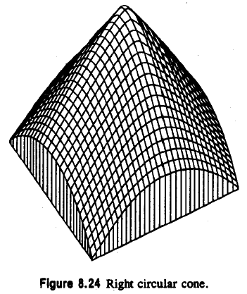
8.13.2 Peak
: second directional derivative in direction
: second directional derivative in direction
Notes:
梯度各方項都是負的

Slide 187
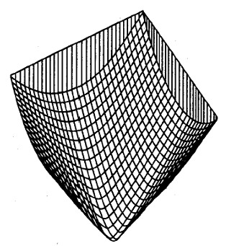
8.13.2 Pit
pit (sink: bowl): local minimum in all directions
pit: gradient zero, second directional derivative positive
Notes:
Pit 跟 peak 相反，所有方向的二階方向導數皆為正的
所以這邊這兩個是大於 0

Slide 188
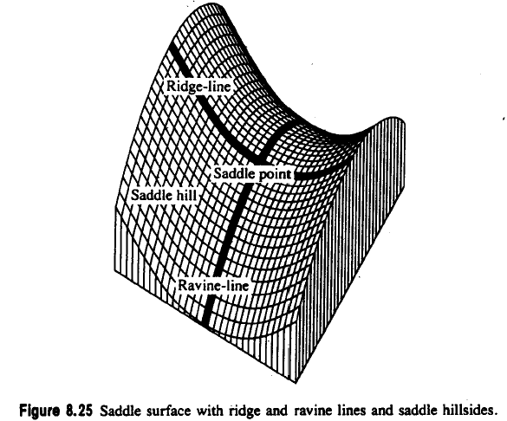
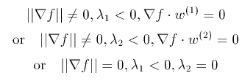
8.13.2 Ridge
A ridge occurs on ridge line, a curve consisting of a series of ridge points and along ridge line, the points to the right and left are lower
ridge line: may be flat, sloped upward, sloped downward, curved upward…
ridge: local maximum in one direction
Notes:
Ridge (山脊)
如果走在這條線上左右兩邊都會比較低
所以他就是 local maximum in one direction
下面這邊是他的判斷條件，有三種，畢竟他是一條線，有不同的區段，只要滿足其中一段就能判斷說他是 ridge 的一部分

Slide 189
8.13.2 Ravine
A ravine (valley): is identical to a ridge except that it is a local minimum in one direction
walk along ravine line: points to the right and left are higher
Notes:
Ravine(峽谷)
跟剛剛相反，如果走在這條線上左右兩邊都會比較高
所以他是 local minimum in one direction

Slide 190
8.13.2 Saddle
local maximum in one direction, local minimum in perpendicular dir.
positive curvature in one direction, negative in perpendicular dir.
gradient magnitude zero
extrema of second
directional derivative
have opposite signs
Notes:
Saddle point (鞍點)
他剛好在山脊跟溝壑的交界處，所以他的梯度會是 0
而且在一個方向有局部最大值，另一個方向有局部最小值
所以他的二階方向導數應該是異號，乘起來會小於零

Slide 191
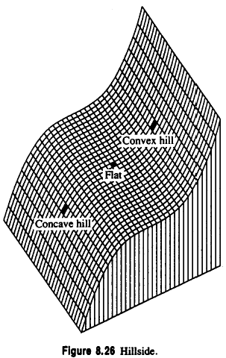
8.13.2 Flat
A flat (plain) is a simple, horizontal surface, must have zero gradient and no curvature.
It satisfies the following conditions
Notes:
Flat (平的)
這個就很簡單，他沒有任何的起伏變化，三個值都是 0

Slide 192
8.13.2 Hillside
A hillside point is anything not covered by previous categories.
hillside: nonzero gradient, no strict extrema
Slope: tilted flat (constant gradient)
convex hill: curvature positive (upward)
concave hill: curvature negative
(downward)
Notes:
Hillside(山坡)
前面六個都沒有歸類到的話就會被分類為山坡
它的梯度不為 0、沒有極值
如果要再去細分的話可以分成四種
hillside：非零梯度，無嚴格極大值
slope：傾斜的平面（常數梯度）
Convex hill：曲率為正（向上）
Concave hill：曲率為負 （向下）
不是 convex hull(凸包)

Slide 193
8.13.2 Hillside
saddle hill: up in one direction, down in perpendicular direction
inflection point: zero
crossing of second
directional derivative
Notes:
＠凹的坡：曲率為負（向下）(往內凹)
＠鞍狀坡：一方向向上，另一垂直方向向下
＠拐點、反區點：第二個方向導數的過零點

Slide 194
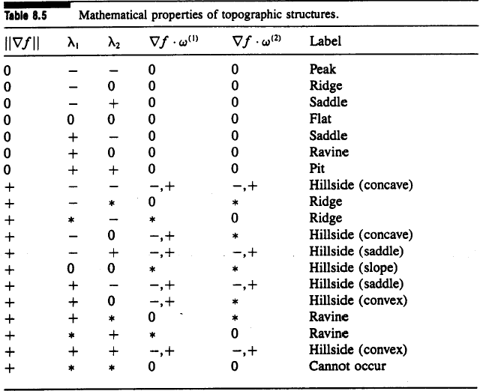
8.13.2 Summary of the Topographic Categories
Mathematical properties of topographic structures on continuous surfaces
Notes:
總結的表格，在做地形圖的時候直接用這個表格判斷比較快速

Slide 195
8.13.3 Topographic Classification Algorithm
peak, pit, ridge, ravine, saddle: likely not to occur precisely at a pixel’s center
peak, pit, ridge, ravine, saddle: if within pixel area, carry the label
We search zero crossing of the first directional derivative, then decide the label of the pixel.
Notes:
這幾種不太可能剛好出現在 pixel 的正中間
可能出現在好幾個 pixel 的交界點，包含好幾個pixel，所以接下來要講的就是如果出現這種情況的話要怎麼做最後的歸類

Slide 196
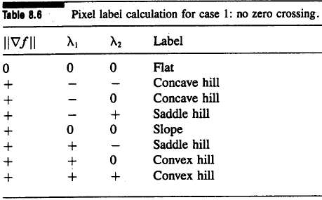
8.13.3 Case One: No Zero Crossing
No zero crossing along either of two directions: flat or hillside
If gradient zero, then flat
If gradient nonzero, then hillside
Hillside: possibly inflection point, slope, convex hill, concave hill,…
Notes:
如果在兩個一階方向導數沒有 zero crossing 則有可能是 flat or hillside
一樣也是看表格就好

Slide 197
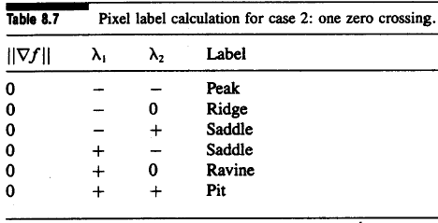
8.13.3 Case Two: One Zero Crossing
one zero crossing: peak, pit, ridge, ravine, or saddle
Notes:
如果在一階方向導數有zero crossing 則給定的標籤一定是(peak, pit, ridge, ravine, or saddle)

Slide 198
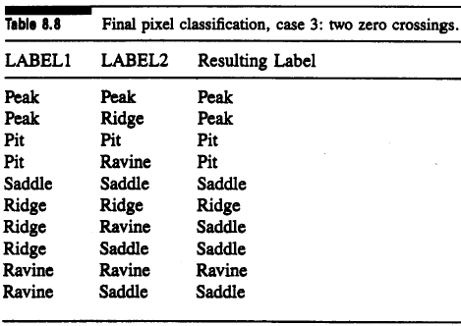
8.13.3 Case Three: Two Zero Crossings
LABEL1, LABEL2: assign label to each zero crossing
Notes:
如果有兩個 zero-crossing 就依照前面的方式做 label，再照這個表格做分類

Slide 199
8.13.3 Case Four: More Than Two Zero Crossings
More than two zero crossings:
Choose the one closest to pixel center
After ignoring the other, same as case 3
Notes:
那如果超過兩個的話，會選位置上最接近的兩個，並忽略掉其他部分，這兩個再回到前一頁的表格去做判定

Slide 200
8.13.4 Summary of Topographic Classification Scheme
One pass through the image, at each pixel
Calculate fitting coefficients, $k_{1}$ through $k_{10}$ of cubic polynomial
Use above coefficients to find gradient, gradient magnitude, and the eigenvalues and eigenvector of Hessian
Search in eigenvector direction for zero crossing of first derivative
Recompute gradient, gradient magnitude, second derivative at each zero crossing of the first directional derivative, then classify
Notes:
該方案是對每個像素進行地形分類的並行過程，可以一次通過圖像來完成。

Slide 201
END

